Slide 1
Monetary Bulletin 2014/2
Powerpoint charts from Table appendix

Slide 2
Chart 1

Slide 3
Chart 2

Slide 4
Chart 3

Slide 5
Chart 4

Slide 6
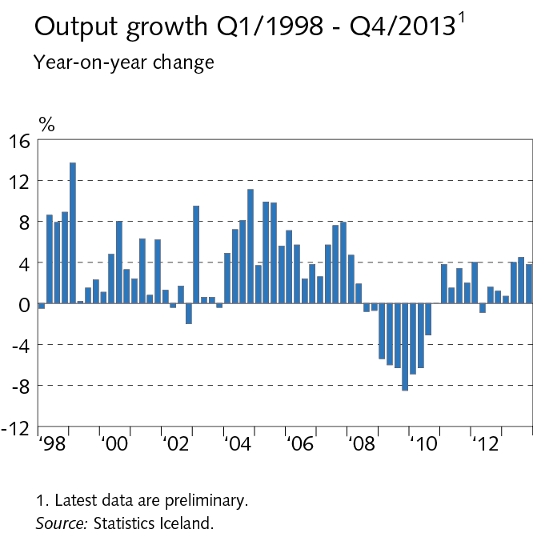
Chart 5

Slide 7
Chart 6

Slide 8
Chart 7

Slide 9
Chart 8

Slide 10
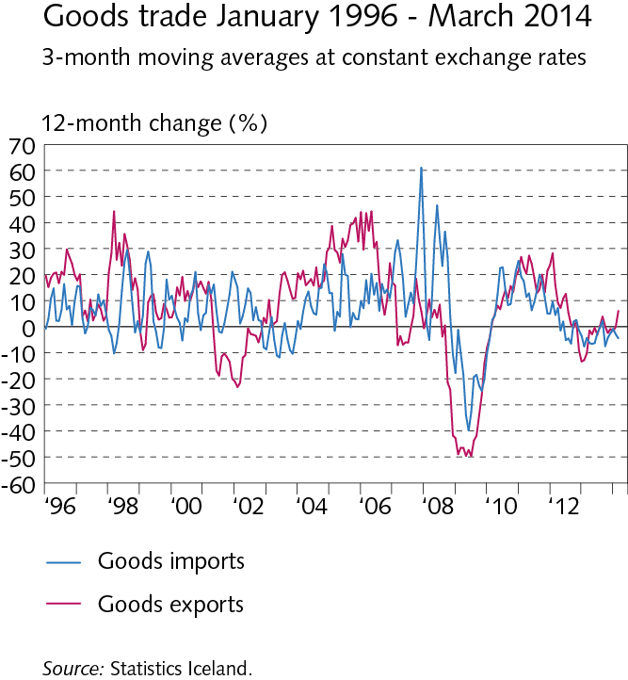
Chart 9

Slide 11
Chart 10

Slide 12
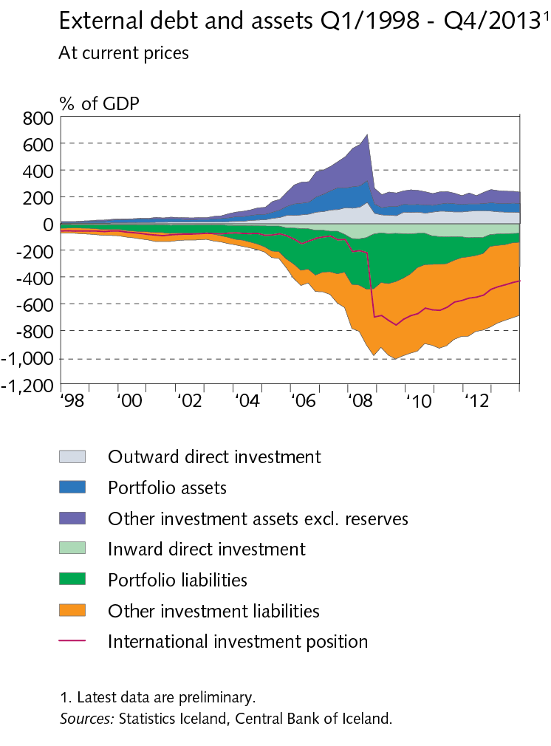
Chart 11

Slide 13
Chart 12

Slide 14
Chart 13

Slide 15
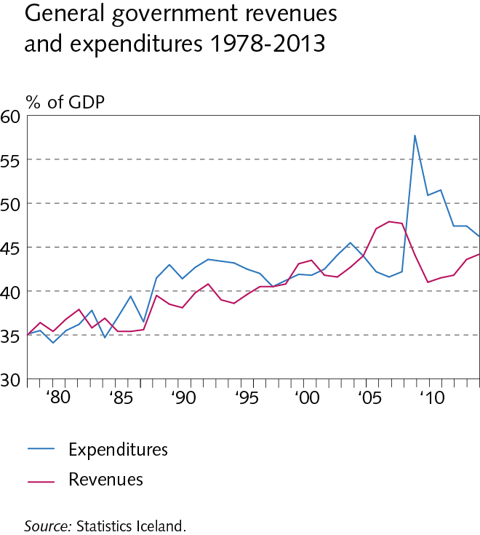
Chart 14

Slide 16
Chart 15

Slide 17
Chart 16

Slide 18
Chart 17

Slide 19
Chart 18

Slide 20
Chart 19

Slide 21
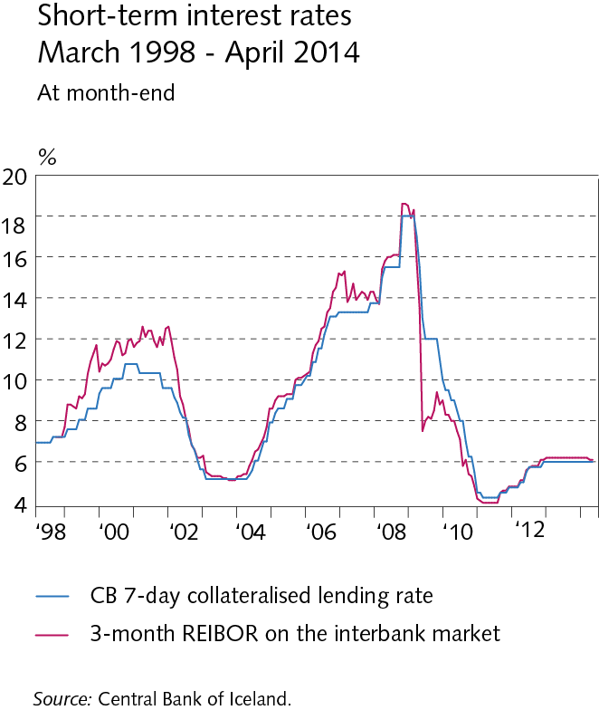
Chart 20

Slide 22
Chart 21

Slide 23
Chart 22

Slide 24
Chart 23

Slide 25
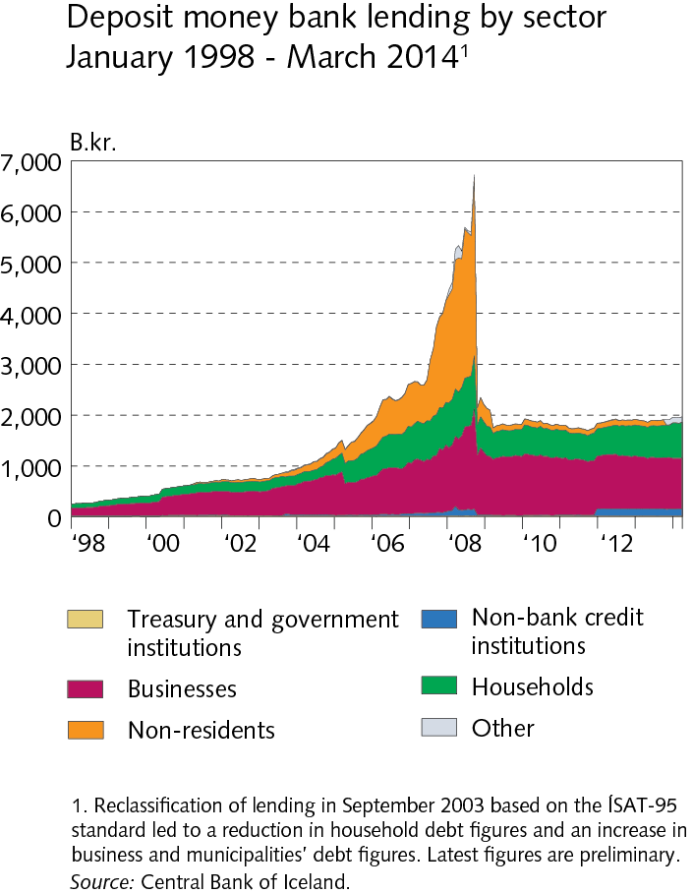
Chart 24

Slide 26
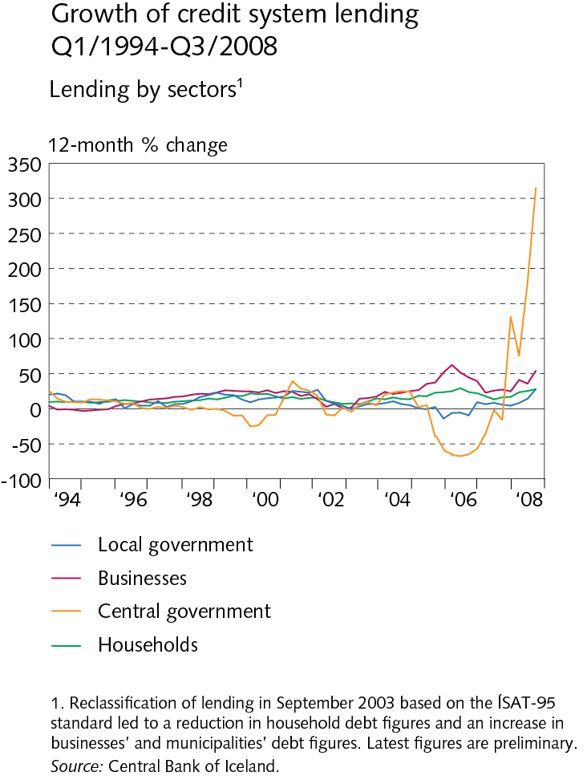
Chart 25

Slide 27
Chart 26

Slide 28
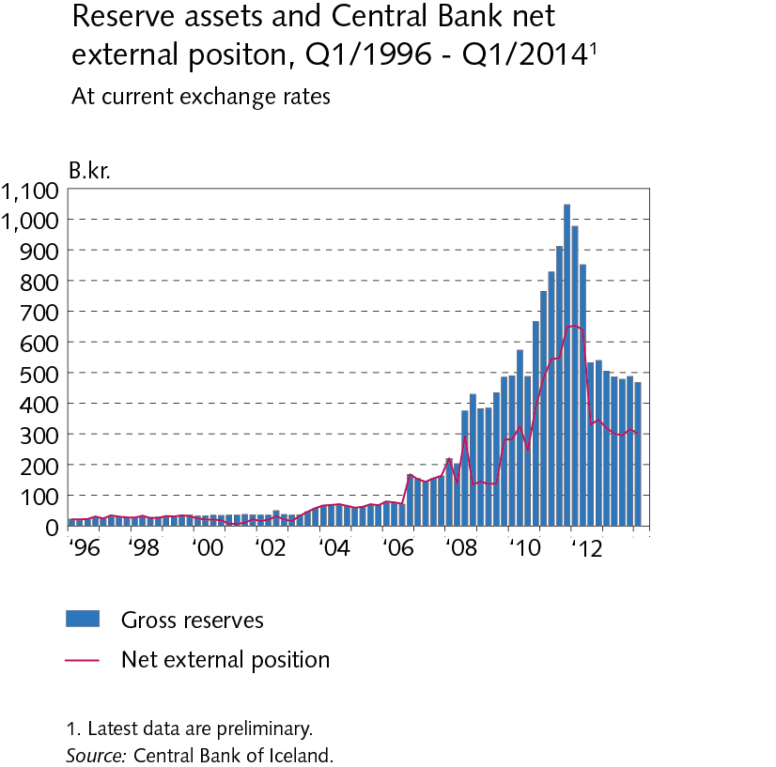
Chart 27

