Slide 1
Central Bank of Iceland
Financial stability 2012/1
Charts

Slide 2
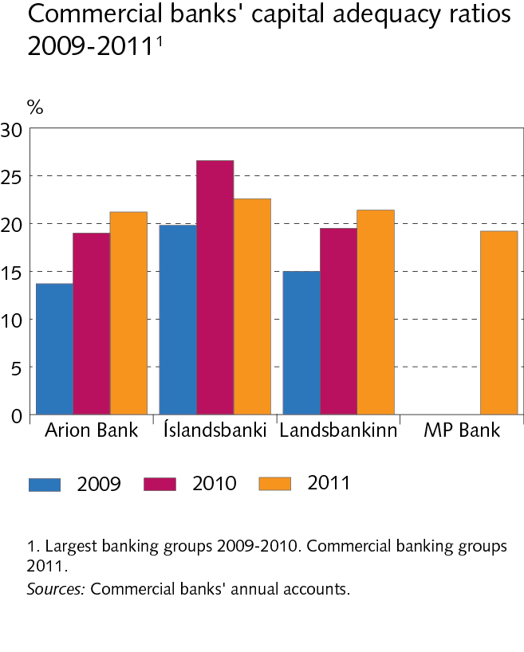
The financial system: outlook and major risks

Slide 3
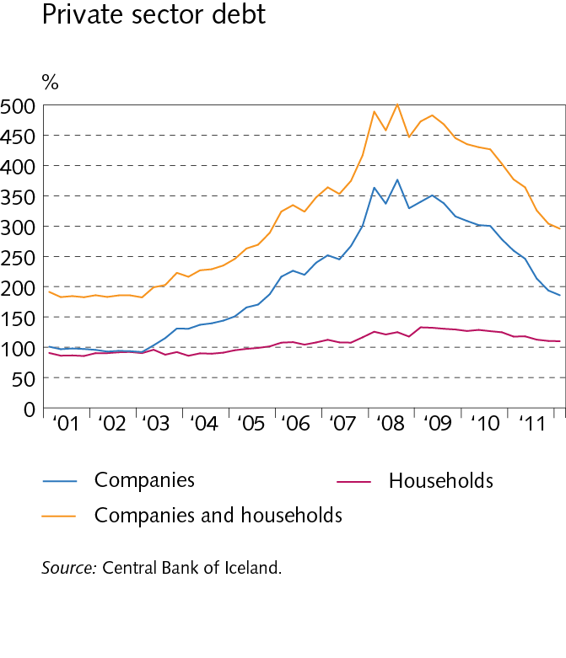
The financial system: outlook and major risks

Slide 4
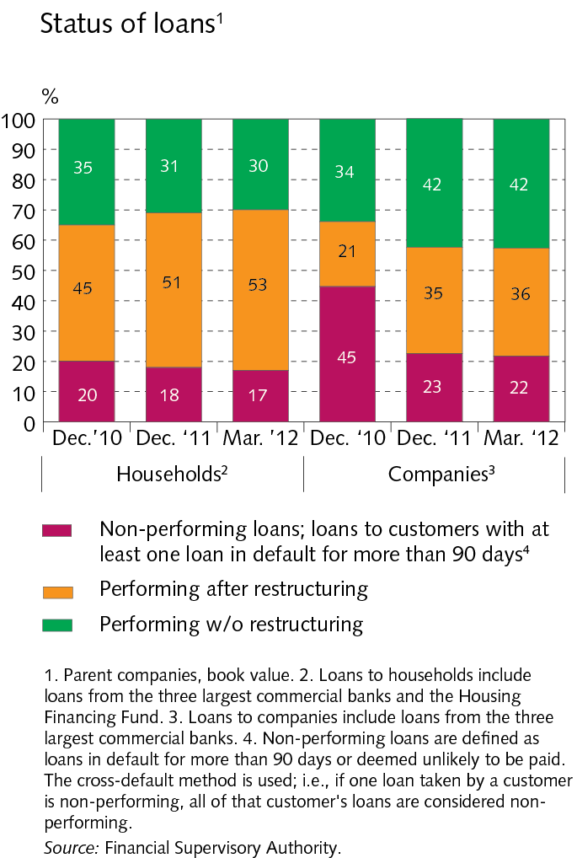
The financial system: outlook and major risks

Slide 5
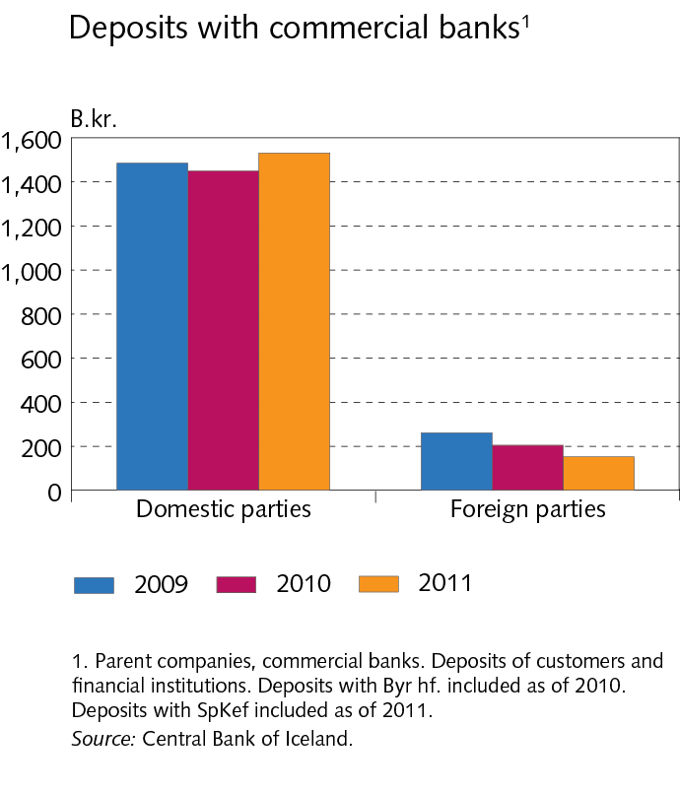
The financial system: outlook and major risks

Slide 6
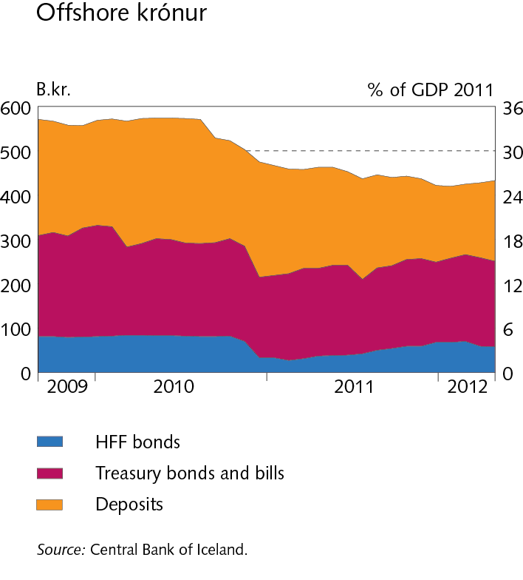
The financial system: outlook and major risks

Slide 7
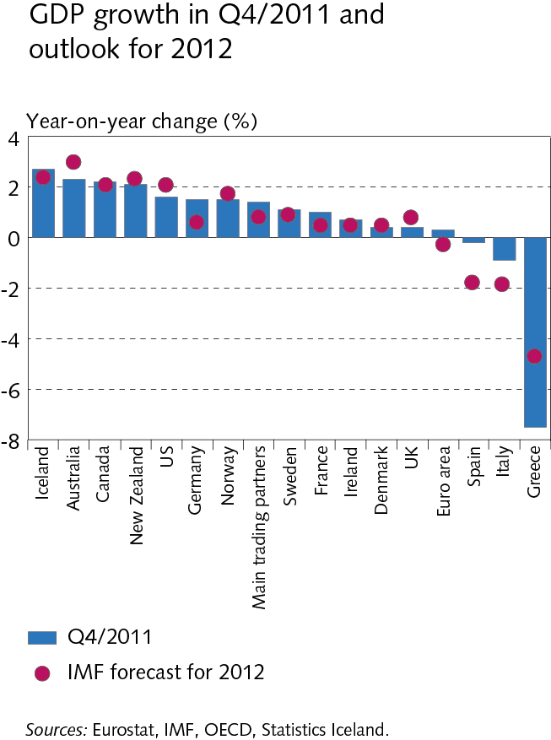
I Macroeconomic environment and financial markets

Slide 8
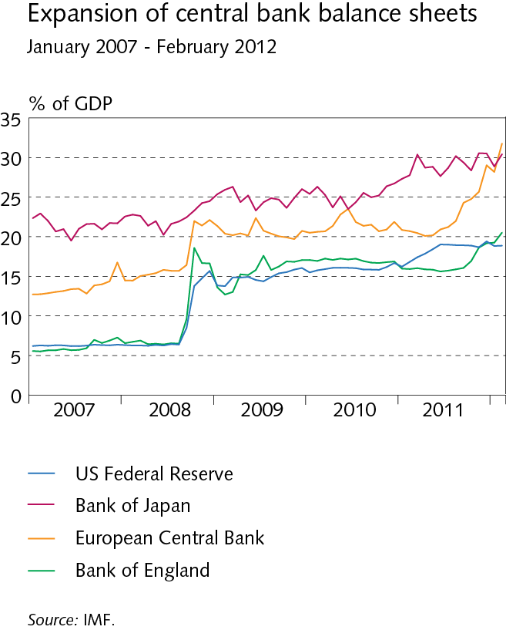
I Macroeconomic environment and financial markets

Slide 9
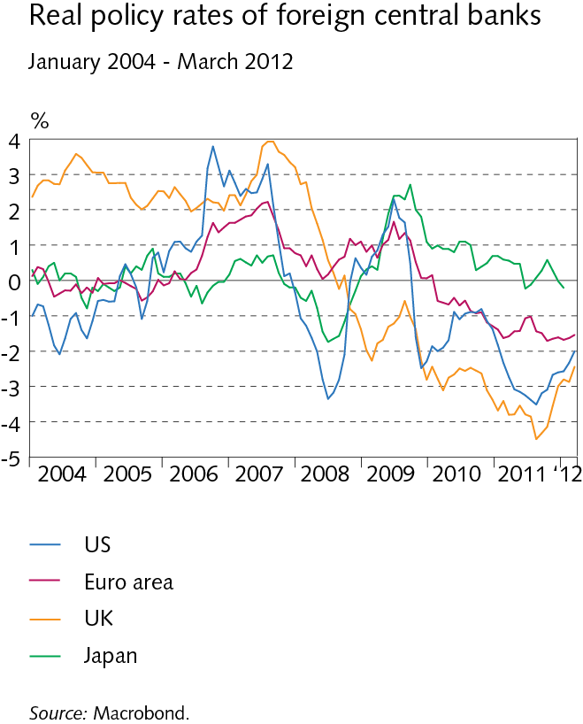
I Macroeconomic environment and financial markets

Slide 10
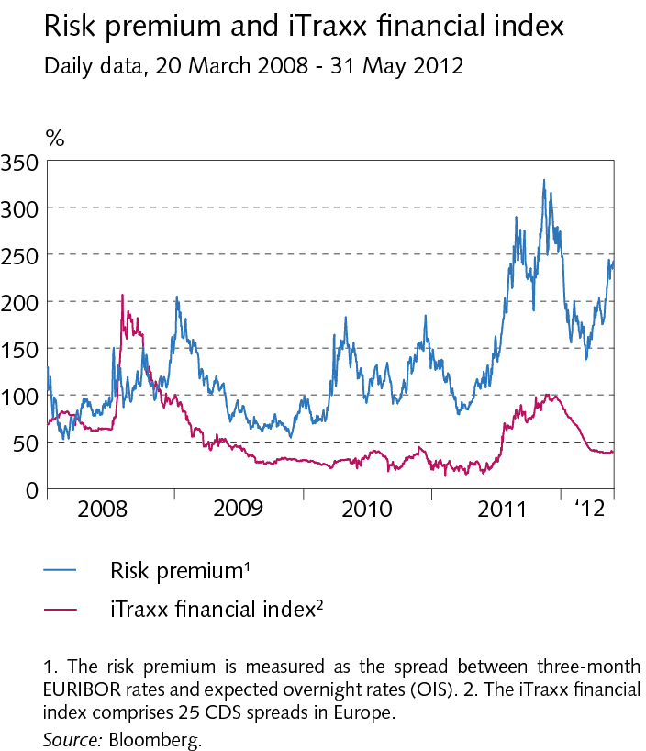
I Macroeconomic environment and financial markets

Slide 11
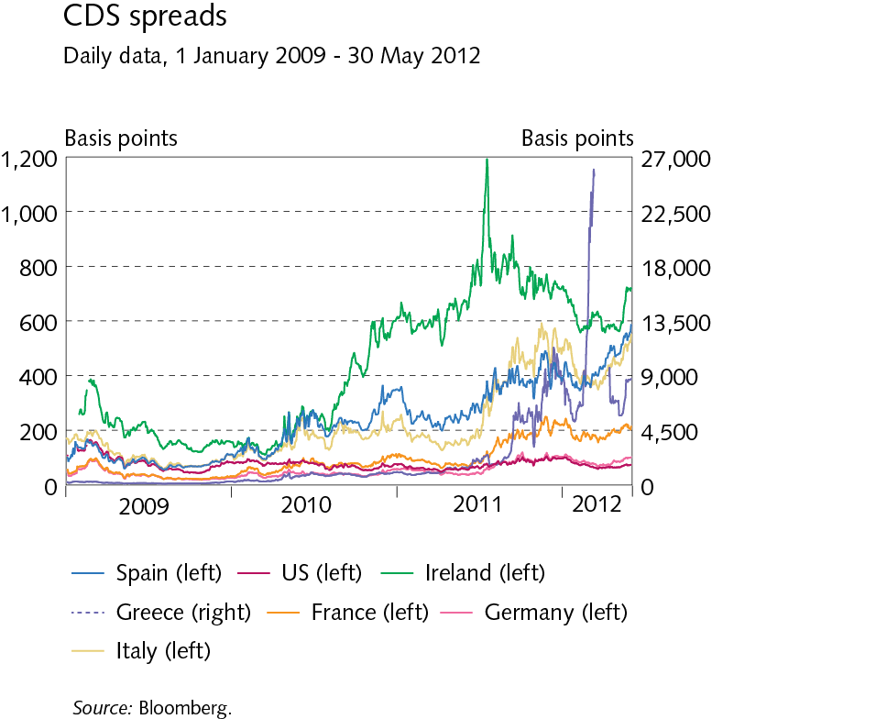
Box I-1 The euro area debt crisis

Slide 12
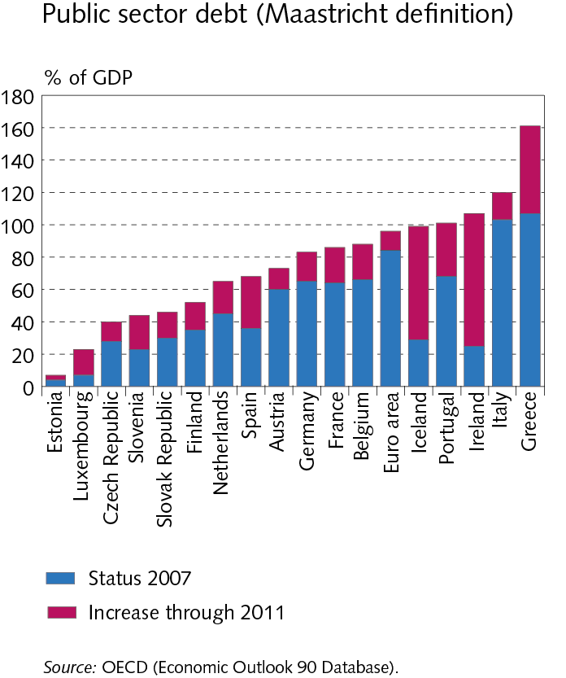
Box I-1 The euro area debt crisis

Slide 13
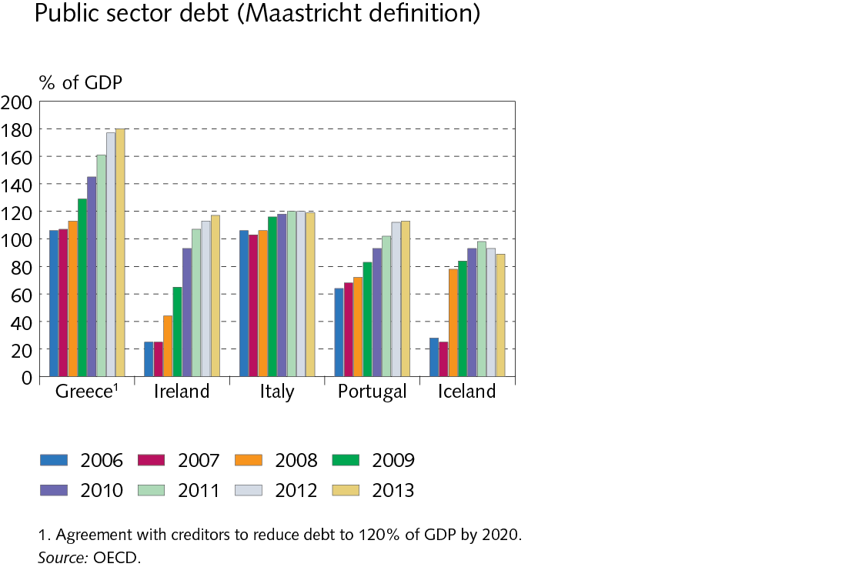
Box I-1 The euro area debt crisis

Slide 14
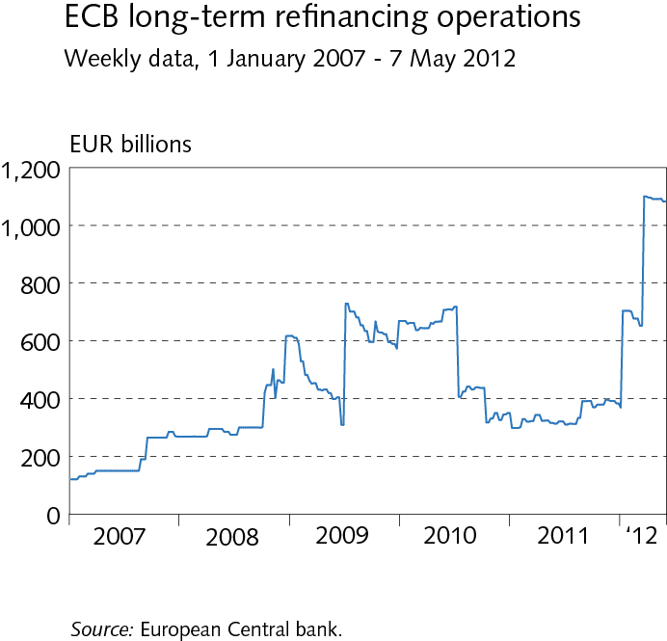
Box I-1 The euro area debt crisis

Slide 15
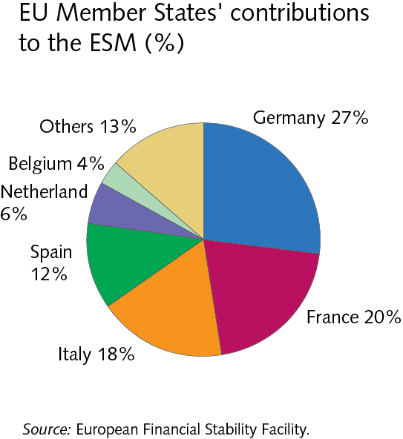
Box I-1 The euro area debt crisis

Slide 16
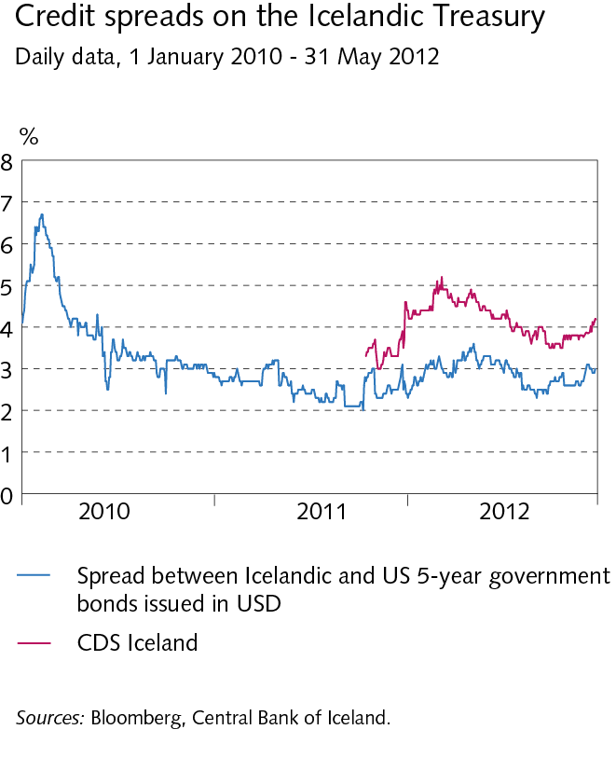
I Macroeconomic environment and financial markets

Slide 17
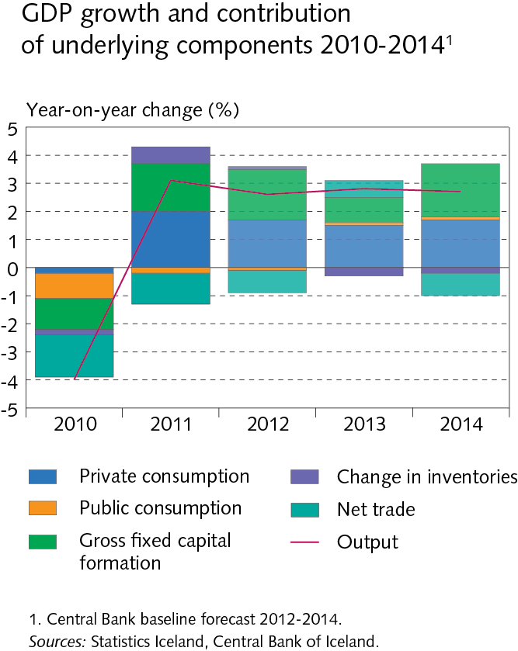
I Macroeconomic environment and financial markets

Slide 18
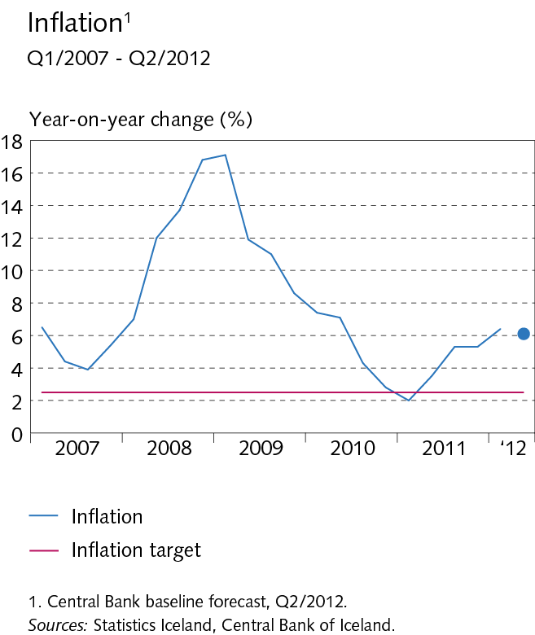
I Macroeconomic environment and financial markets

Slide 19
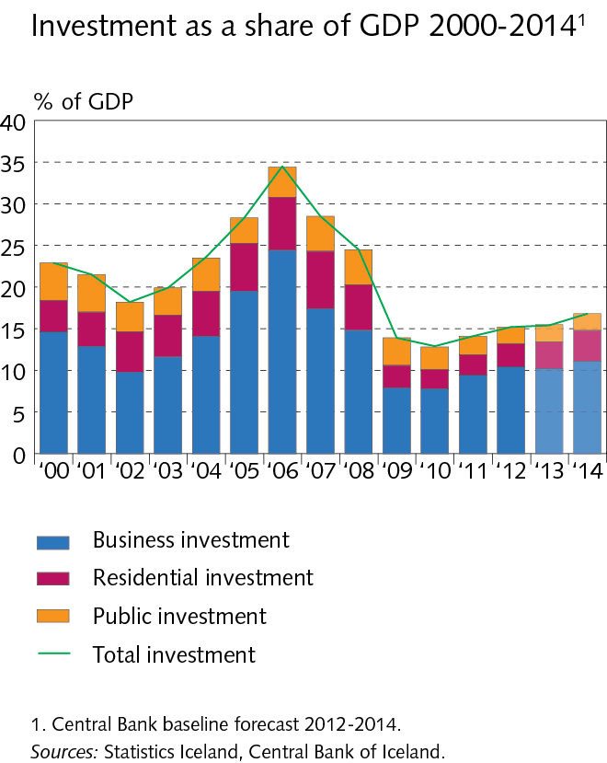
I Macroeconomic environment and financial markets

Slide 20
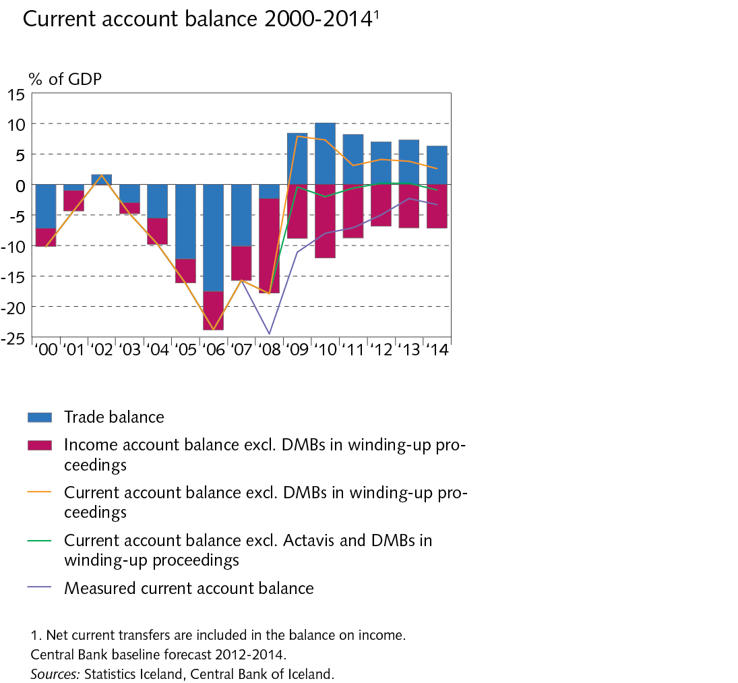
I Macroeconomic environment and financial markets

Slide 21
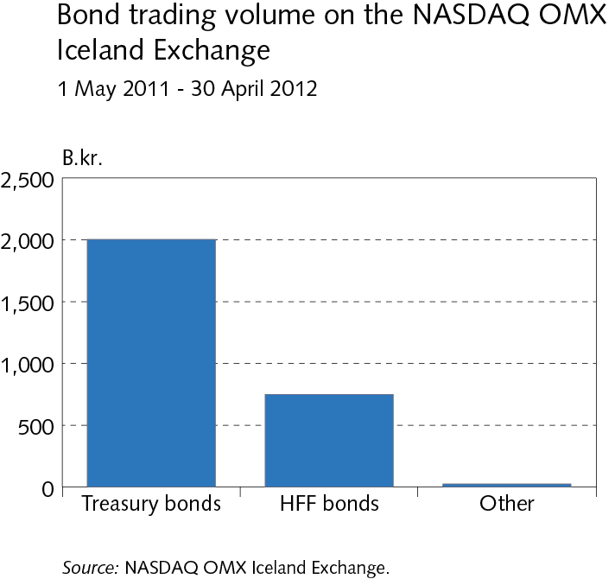
I Macroeconomic environment and financial markets

Slide 22
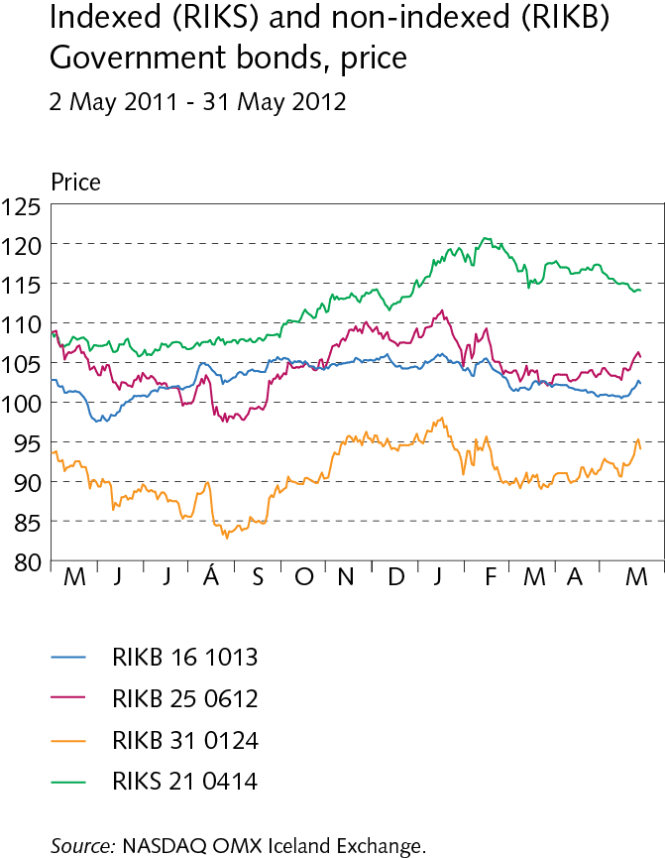
I Macroeconomic environment and financial markets

Slide 23
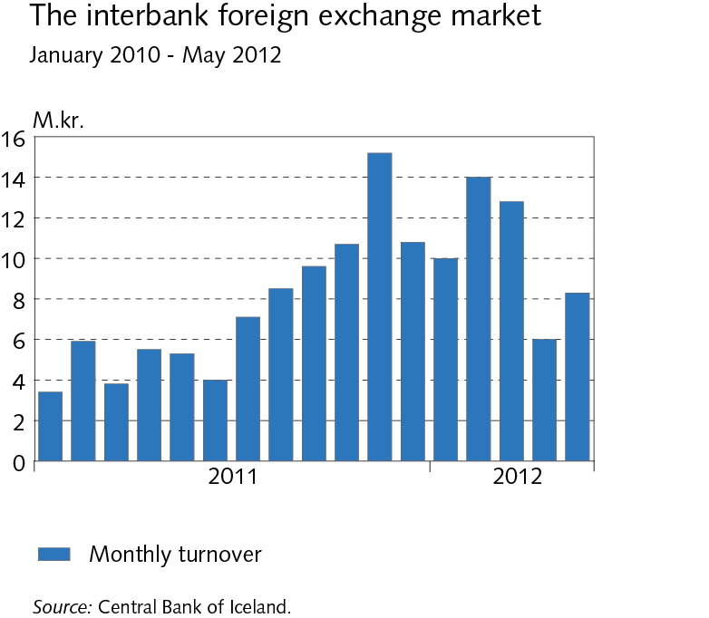
I Macroeconomic environment and financial markets

Slide 24
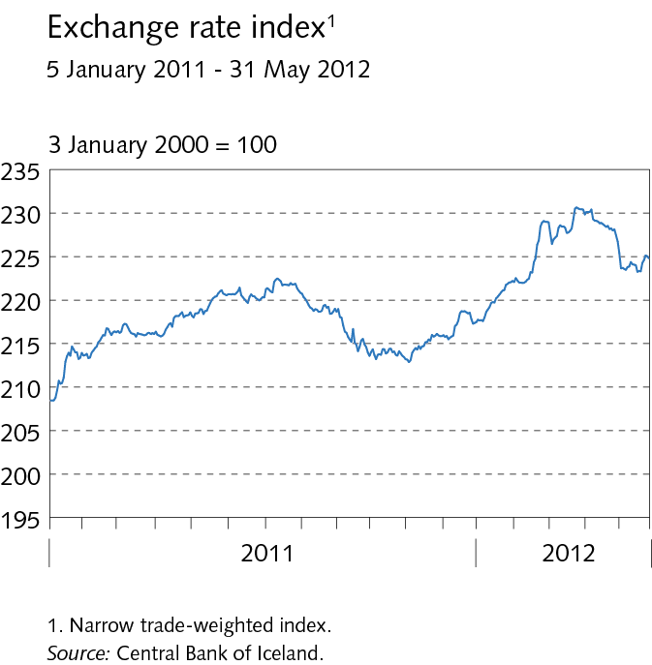
I Macroeconomic environment and financial markets

Slide 25
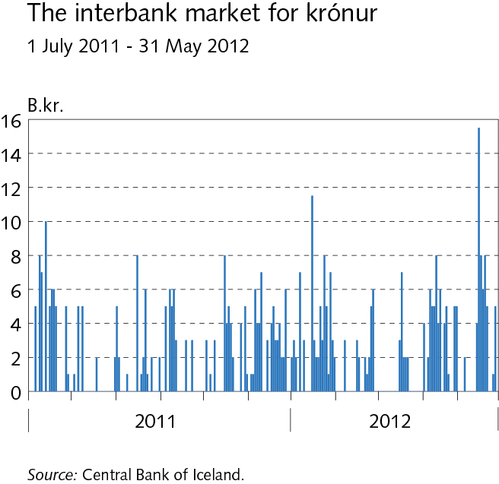
I Macroeconomic environment and financial markets

Slide 26
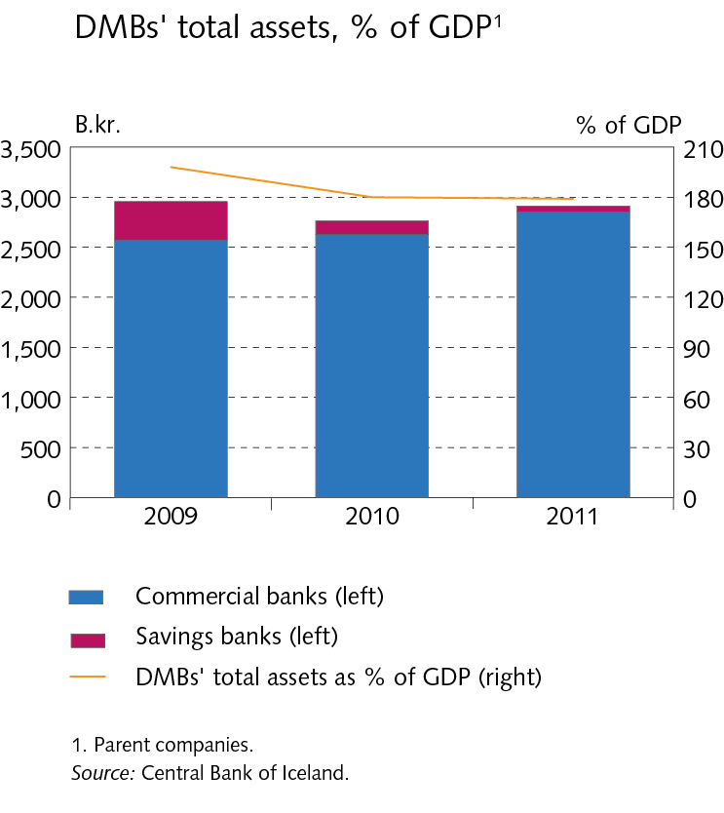
II The scope of financial institutions‘ operations

Slide 27
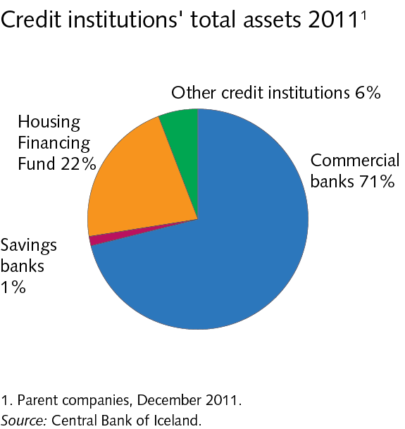
II The scope of financial institutions‘ operations

Slide 28
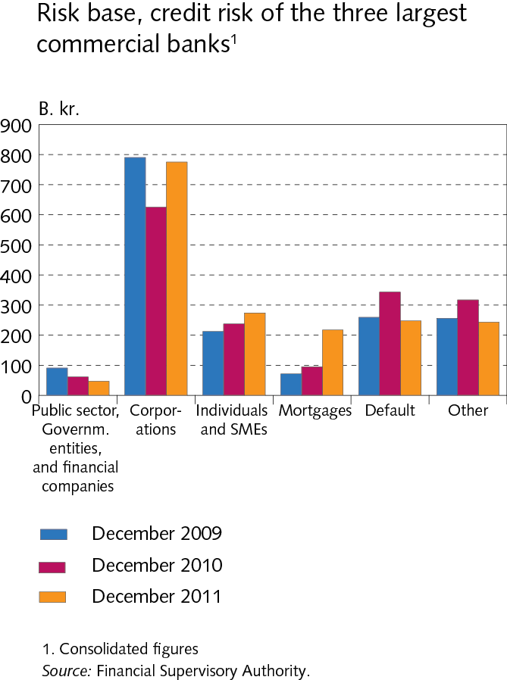
II The scope of financial institutions‘ operations

Slide 29
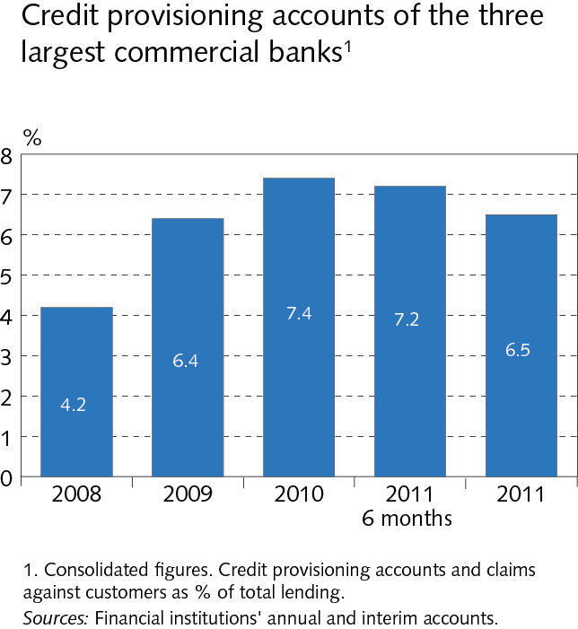
II The scope of financial institutions‘ operations

Slide 30
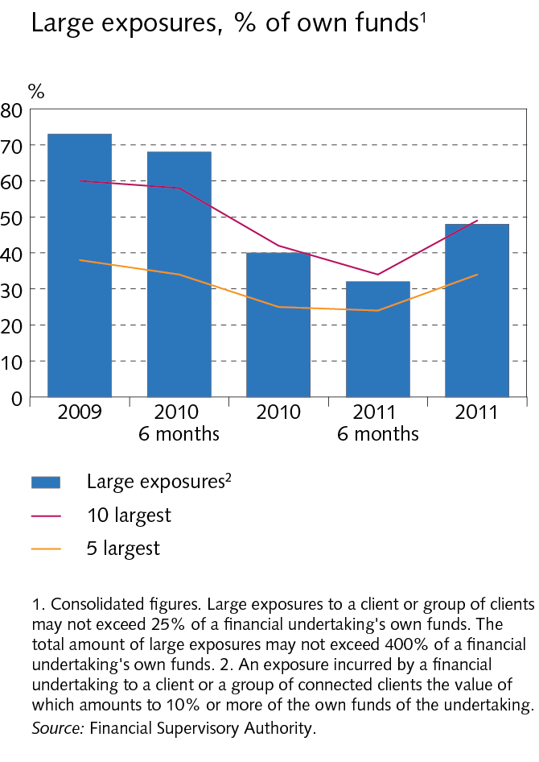
II The scope of financial institutions‘ operations

Slide 31
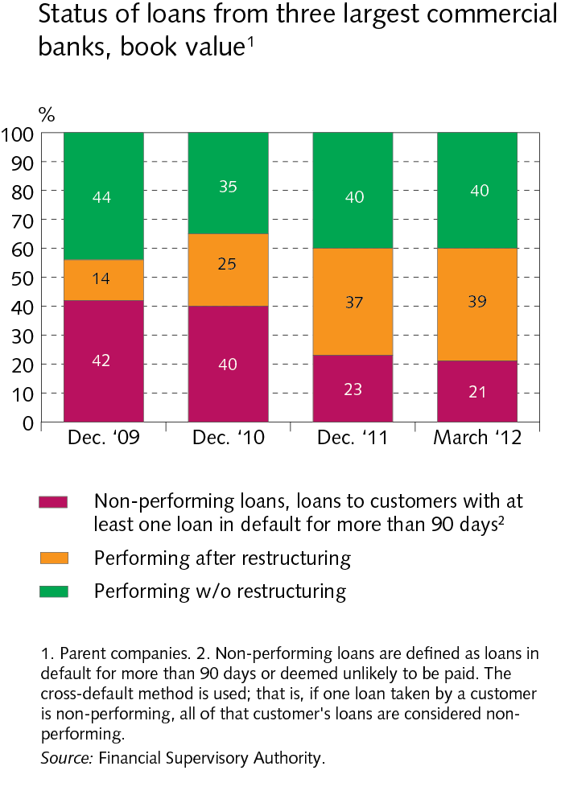
II The scope of financial institutions‘ operations

Slide 32
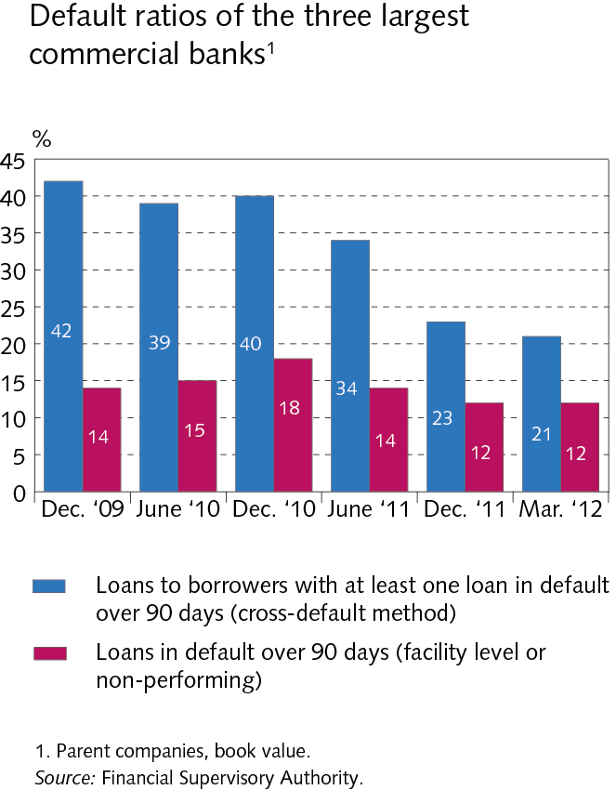
II The scope of financial institutions‘ operations

Slide 33
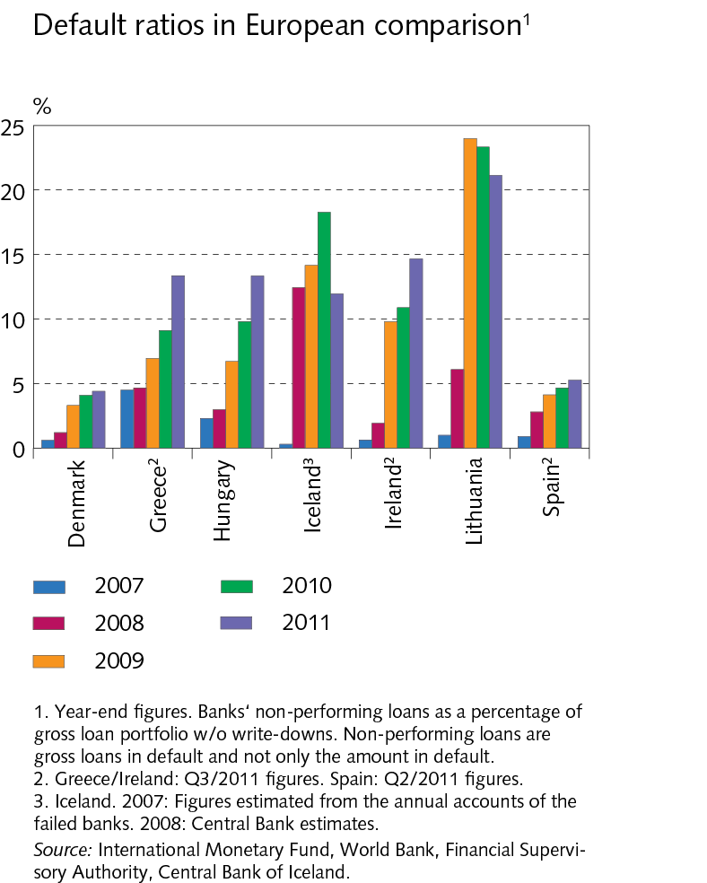
II The scope of financial institutions‘ operations

Slide 34
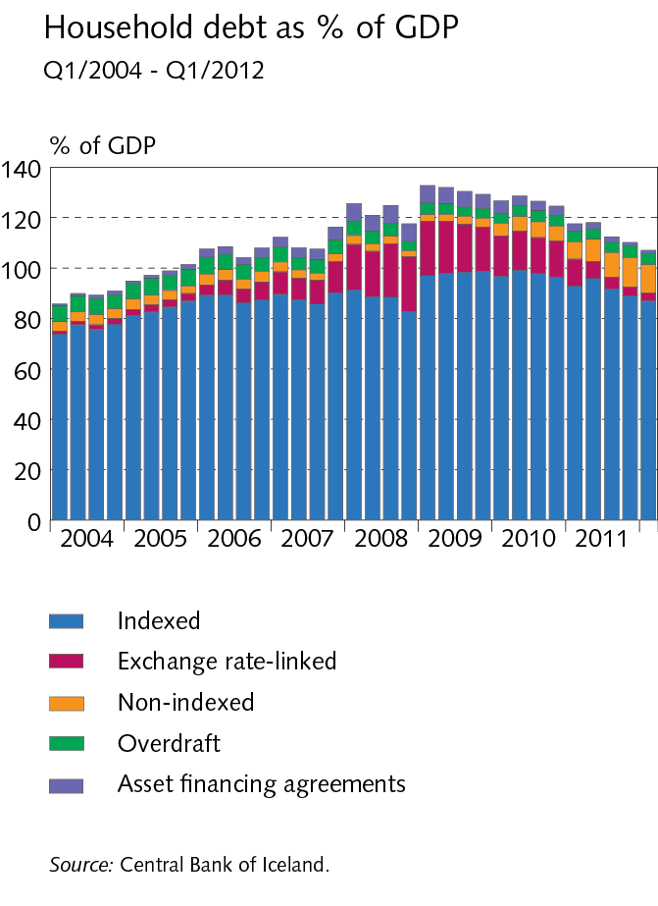
III Borrowers: Households and firms

Slide 35
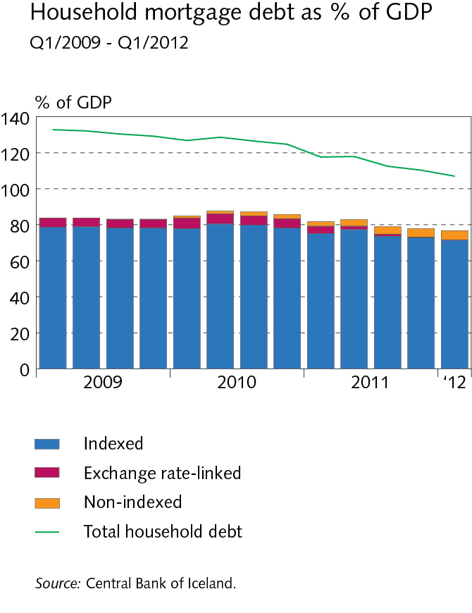
III Borrowers: Households and firms

Slide 36
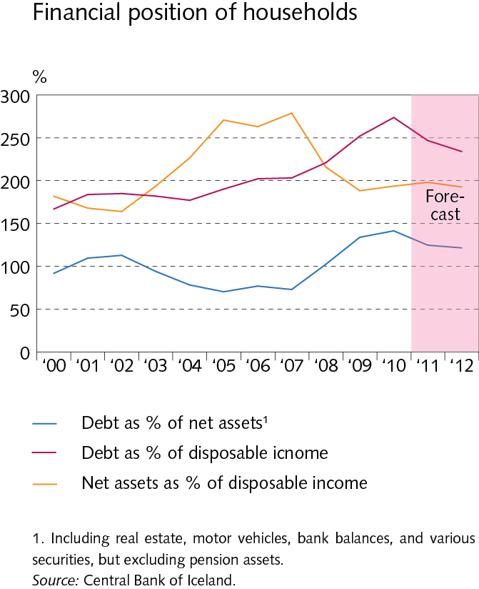
III Borrowers: Households and firms

Slide 37
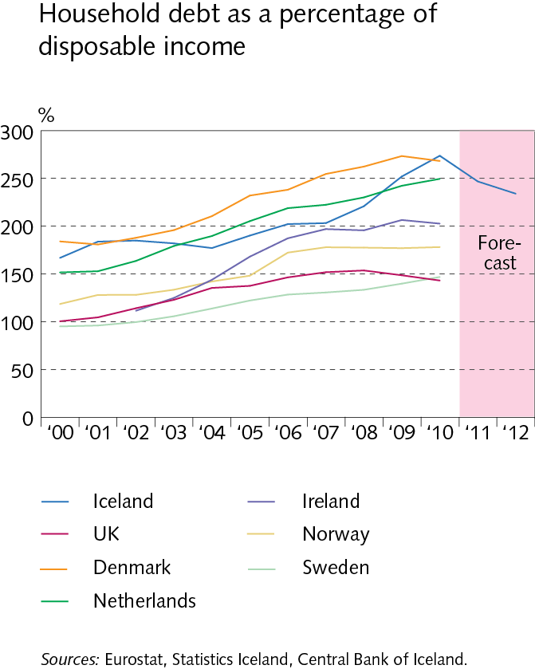
III Borrowers: Households and firms

Slide 38
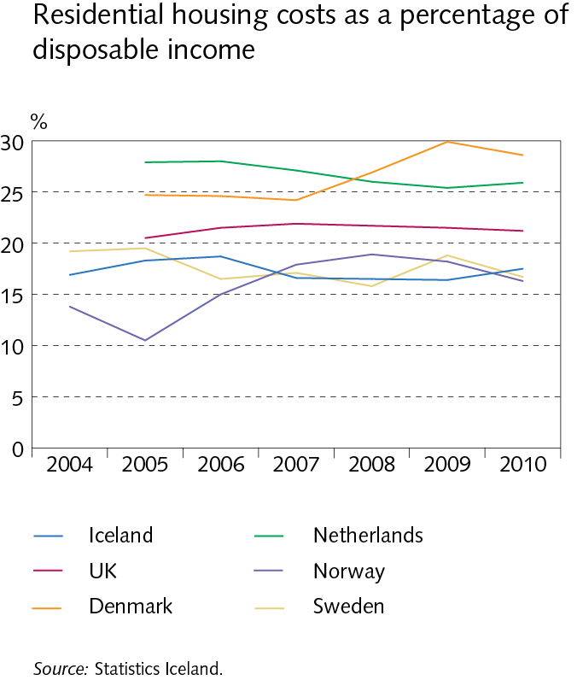
III Borrowers: Households and firms

Slide 39
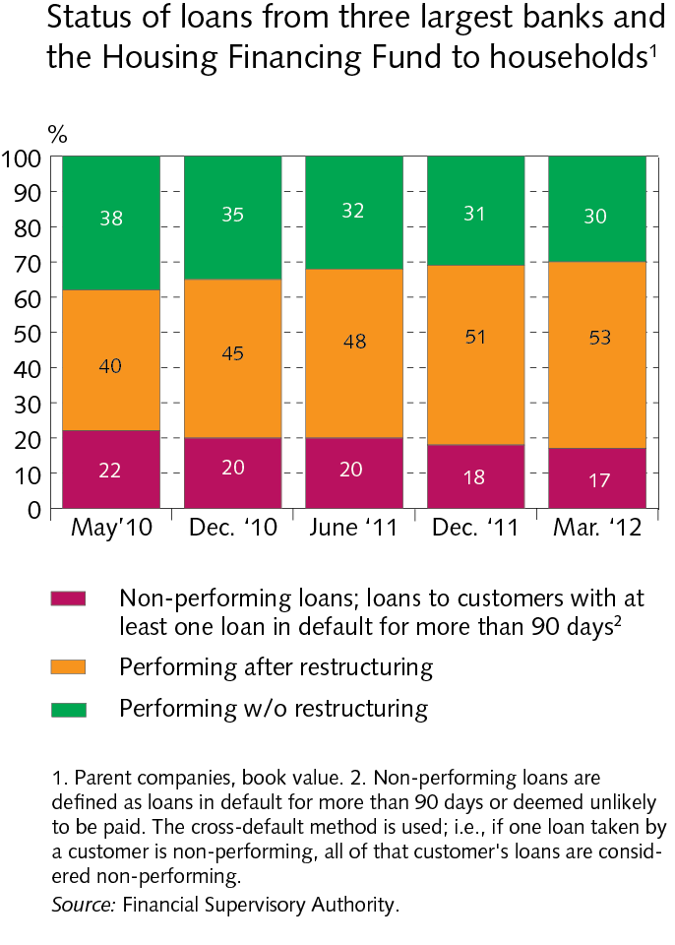
III Borrowers: Households and firms

Slide 40
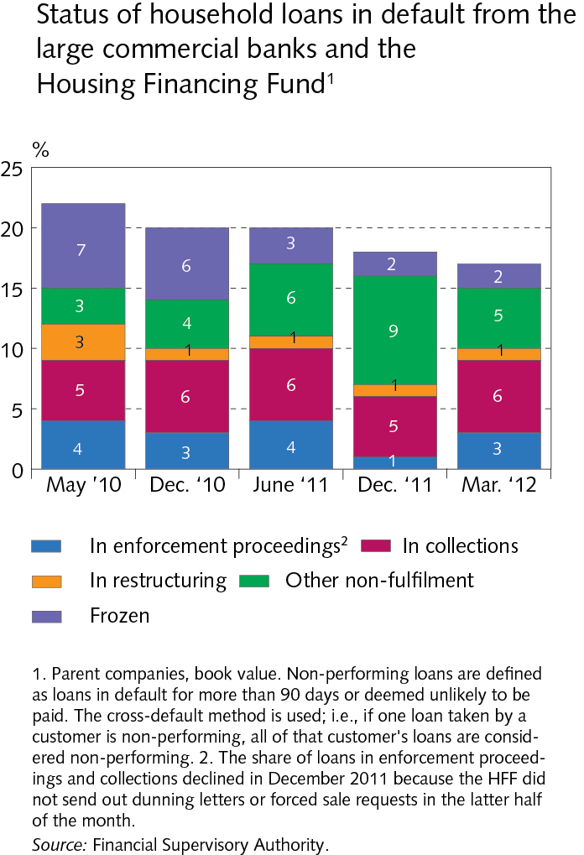
III Borrowers: Households and firms

Slide 41
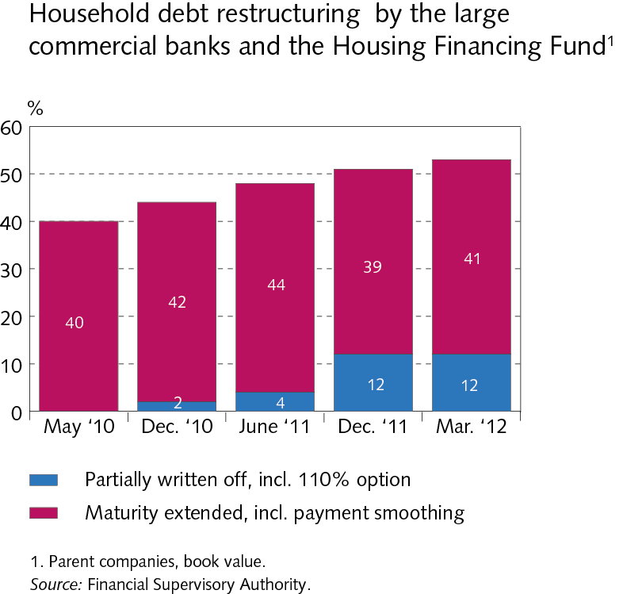
III Borrowers: Households and firms

Slide 42
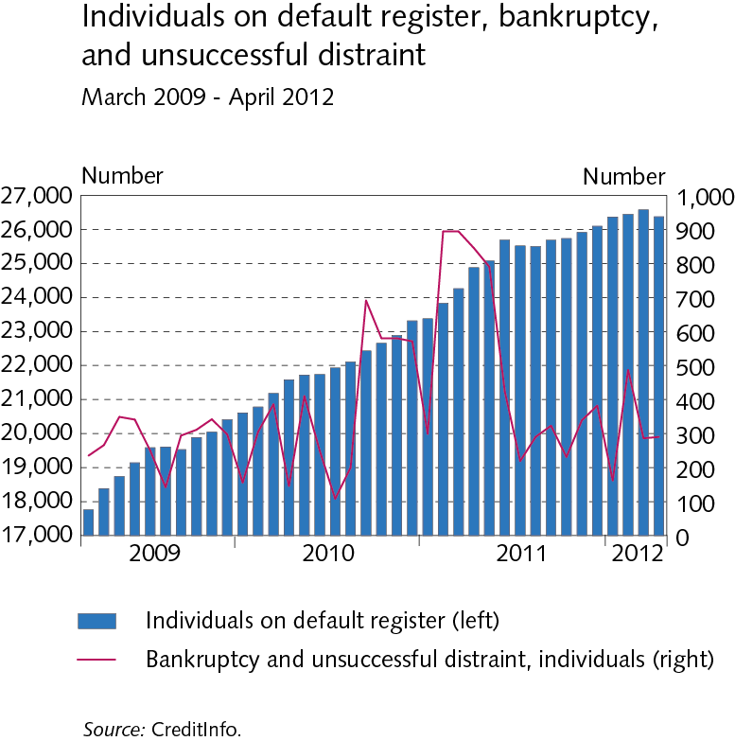
III Borrowers: Households and firms

Slide 43
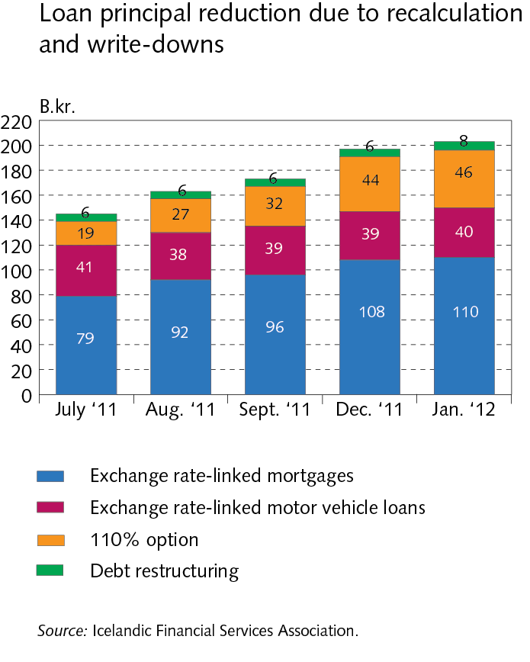
III Borrowers: Households and firms

Slide 44
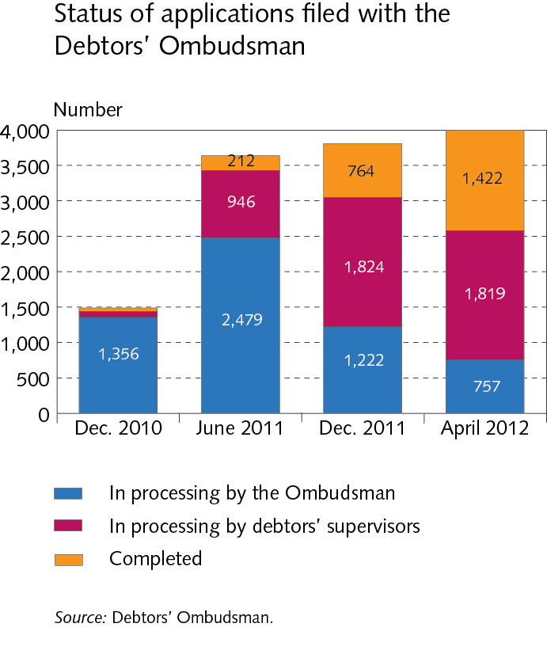
III Borrowers: Households and firms

Slide 45
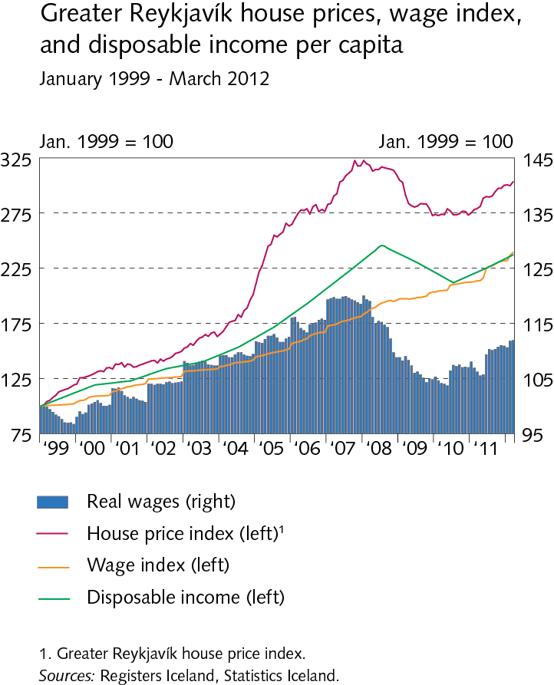
III Borrowers: Households and firms

Slide 46
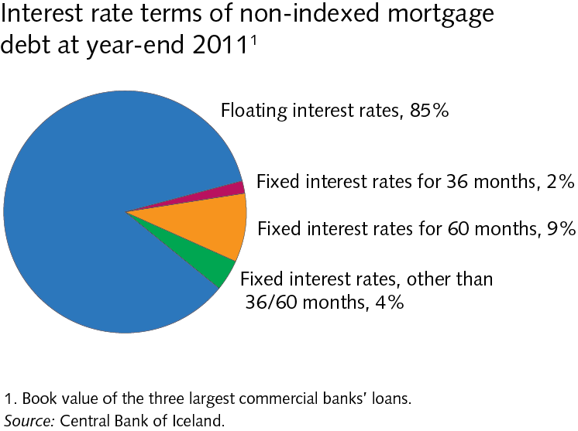
Box III-1 Review of interest rates on private sector loans

Slide 47
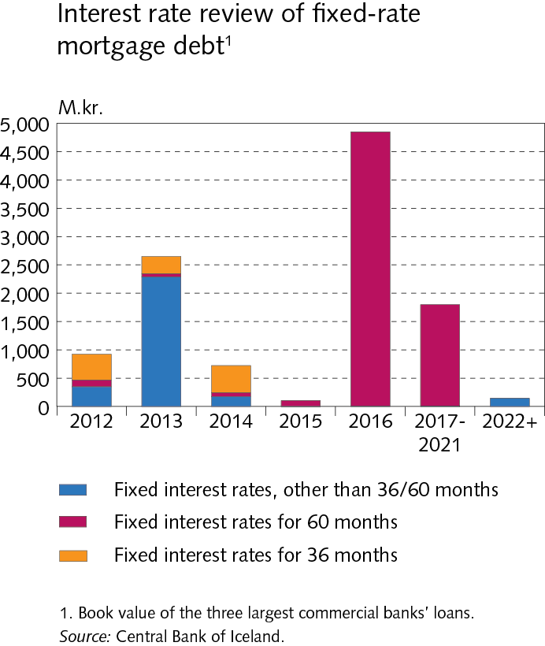
Box III-1 Review of interest rates on private sector loans

Slide 48
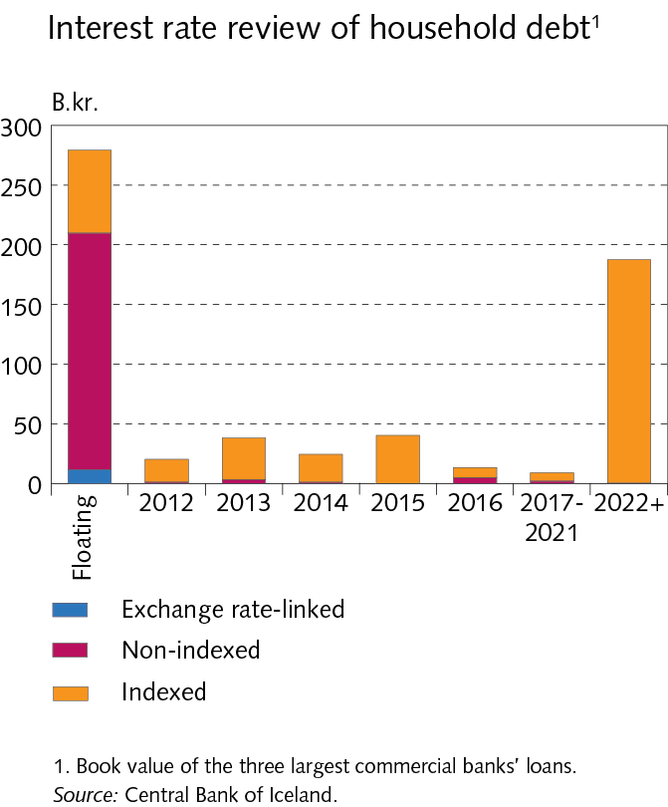
Box III-1 Review of interest rates on private sector loans

Slide 49
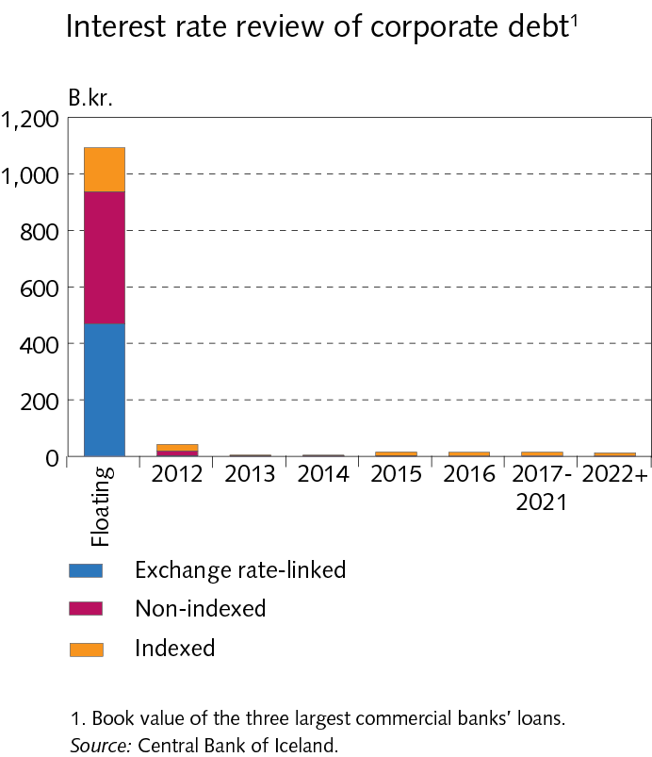
Box III-1 Review of interest rates on private sector loans

Slide 50
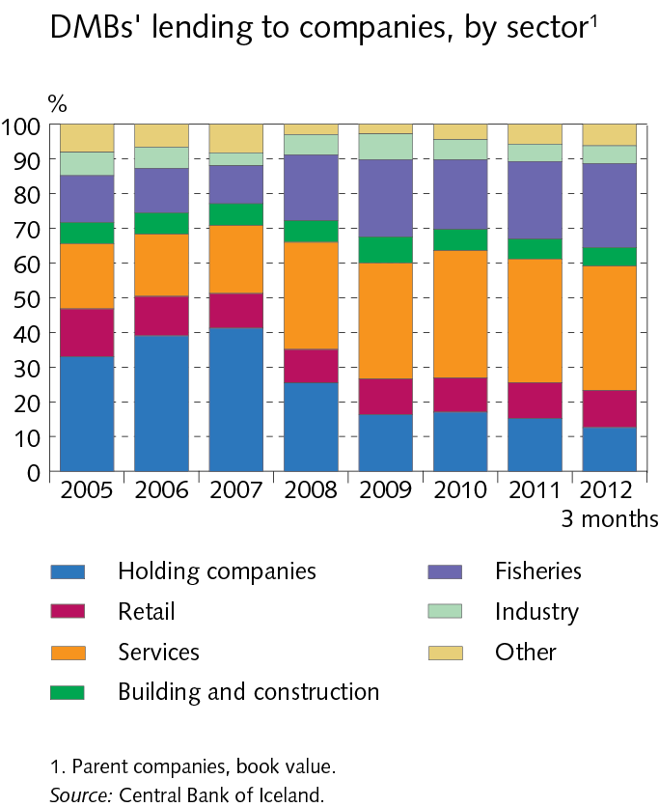
III Borrowers: Households and firms

Slide 51
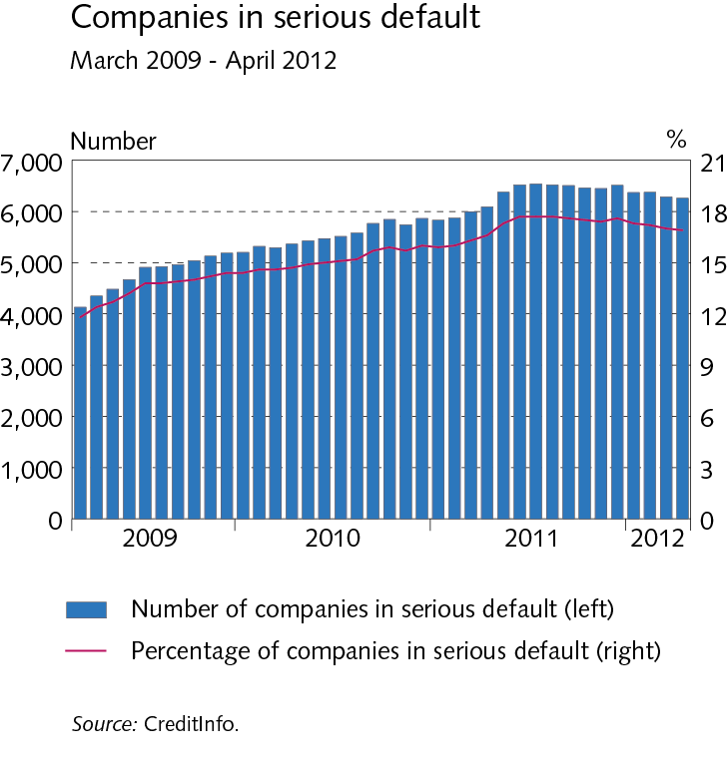
III Borrowers: Households and firms

Slide 52
III Borrowers: Households and firms

Slide 53
III Borrowers: Households and firms

Slide 54
III Borrowers: Households and firms

Slide 55
III Borrowers: Households and firms

Slide 56
III Borrowers: Households and firms

Slide 57
III Borrowers: Households and firms

Slide 58
III Borrowers: Households and firms

Slide 59
III Borrowers: Households and firms

Slide 60
III Borrowers: Households and firms

Slide 61
III Borrowers: Households and firms

Slide 62
III Borrowers: Households and firms

Slide 63
Box III-2 Household debt according to income tax returns

Slide 64
Box III-2 Household debt according to income tax returns

Slide 65
Box III-2 Household debt according to income tax returns

Slide 66
Box III-2 Household debt according to income tax returns

Slide 67
Box III-2 Household debt according to income tax returns

Slide 68
Box III-2 Household debt according to income tax returns

Slide 69
IV Funding

Slide 70
IV Funding

Slide 71
IV Funding

Slide 72
IV Funding

Slide 73
IV Funding

Slide 74
IV Funding

Slide 75
IV Funding

Slide 76
Box IV-1 Covered bonds

Slide 77
Box IV-1 Covered bonds

Slide 78
V Operations and equity

Slide 79
V Operations and equity

Slide 80
V Operations and equity

Slide 81
V Operations and equity

Slide 82
V Operations and equity

Slide 83
V Operations and equity

Slide 84
V Operations and equity

Slide 85
V Operations and equity

Slide 86
V Operations and equity

Slide 87
V Operations and equity

Slide 88
V Operations and equity

Slide 89
V Operations and equity

Slide 90
Box V-2 Exchange rate-linked loans: Court decisions and impact on financial institutions

Slide 91
VI Capital controls and financial stability

Slide 92
VI Capital controls and financial stability

Slide 93
VI Capital controls and financial stability

Slide 94
VI Capital controls and financial stability

Slide 95
VI Capital controls and financial stability

Slide 96
Box VI-2 Capital controls: the impact on asset prices

Slide 97
Box VI-2 Capital controls: the impact on asset prices

Slide 98
Box VI-2 Capital controls: the impact on asset prices

Slide 99
Box VI-2 Capital controls: the impact on asset prices

Slide 100
Box VI-2 Capital controls: the impact on asset prices

Slide 101
Box VI-2 Capital controls: the impact on asset prices

Slide 102
Box VI-2 Capital controls: the impact on asset prices

Slide 103
Box VI-2 Capital controls: the impact on asset prices

Slide 104
VII Payment and settlement systems

Slide 105
VII Payment and settlement systems

Slide 106
VII Payment and settlement systems

Slide 107
VII Payment and settlement systems

Slide 108
VII Payment and settlement systems

Slide 109
Appendix I New Payment Services Act and proposed legislation on issuance and handling of electronic money

Slide 110
Appendix II Nordic comparison

Slide 111
Appendix II Nordic comparison

Slide 112
Appendix II Nordic comparison

Slide 113
Appendix II Nordic comparison

Slide 114
Appendix II Nordic comparison

Slide 115
Appendix II Nordic comparison

