Slide 1
Financial Stability 2023/1
Charts
15 March 2022

Slide 2
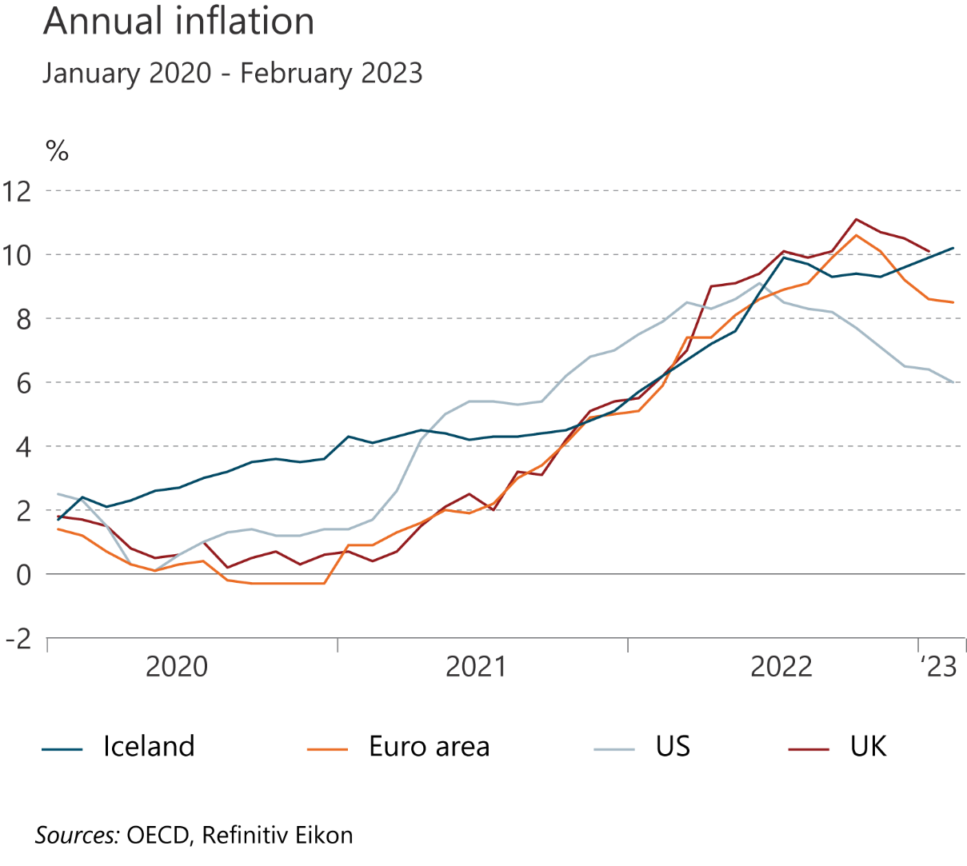
I Financial Stability: Developments and prospects

Slide 3
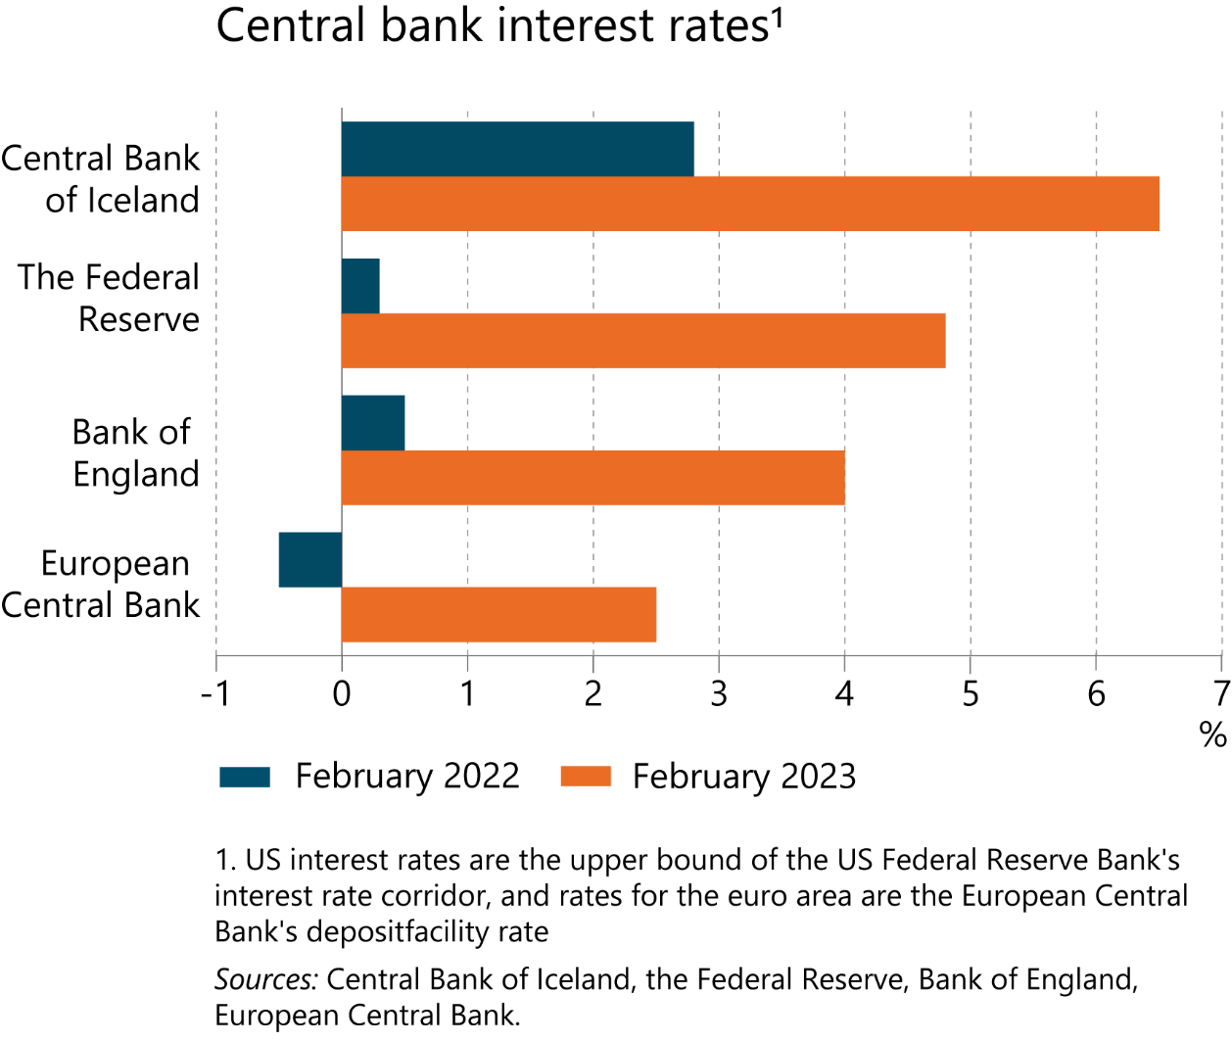
I Financial Stability: Developments and prospects

Slide 4
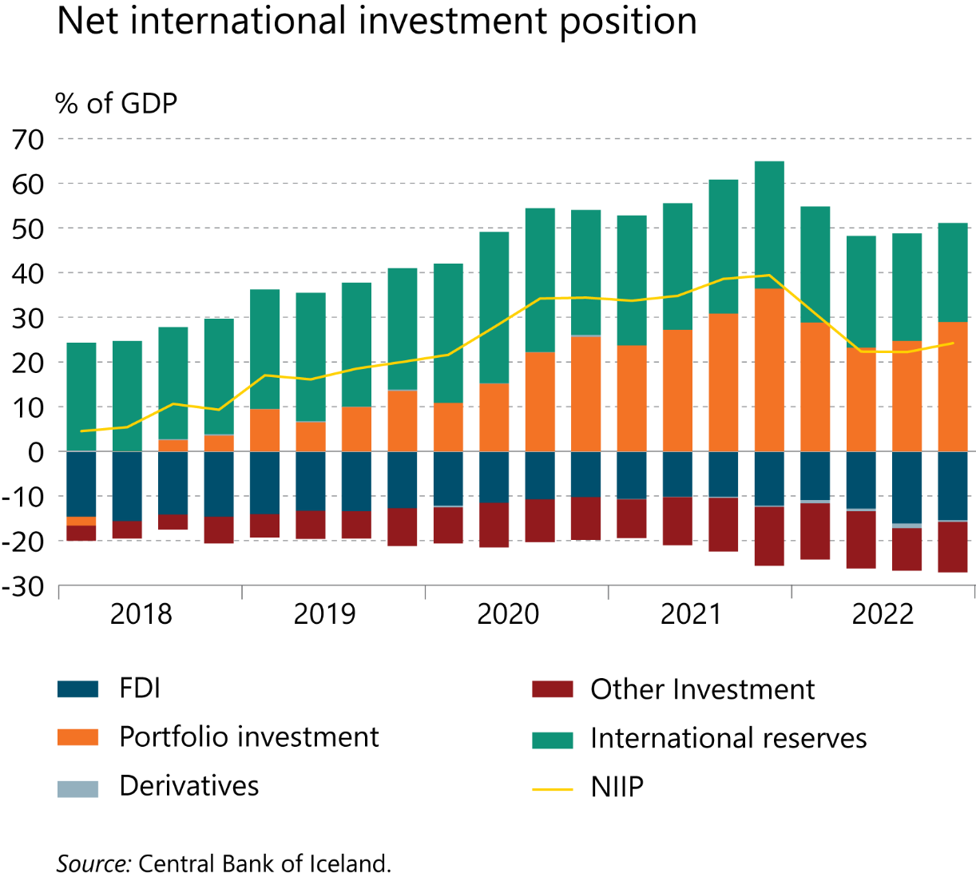
I Financial Stability: Developments and prospects

Slide 5
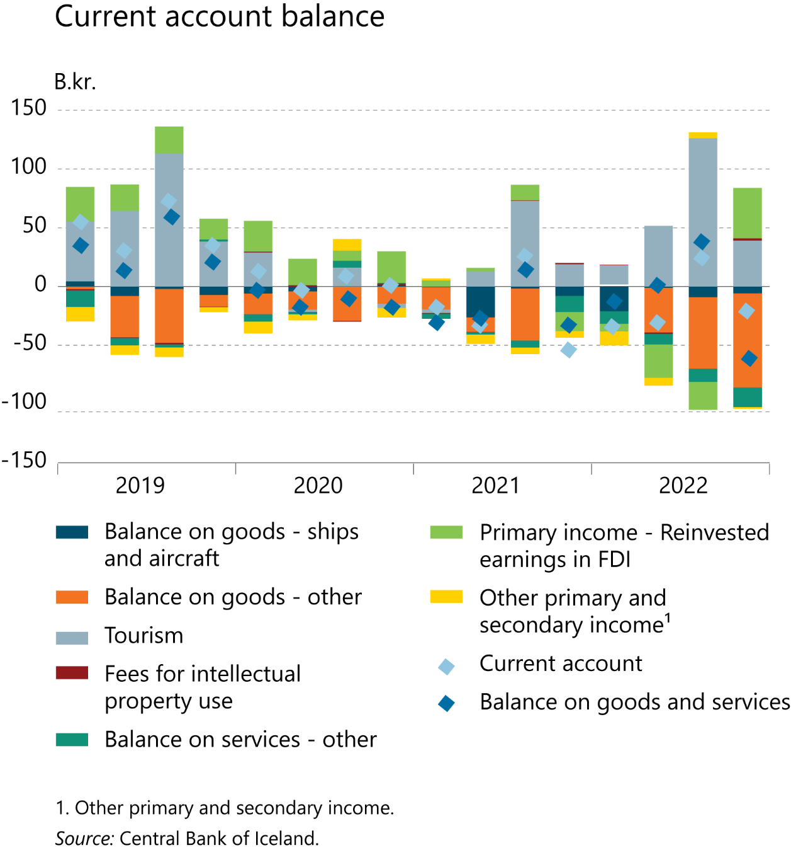
I Financial Stability: Developments and prospects

Slide 6
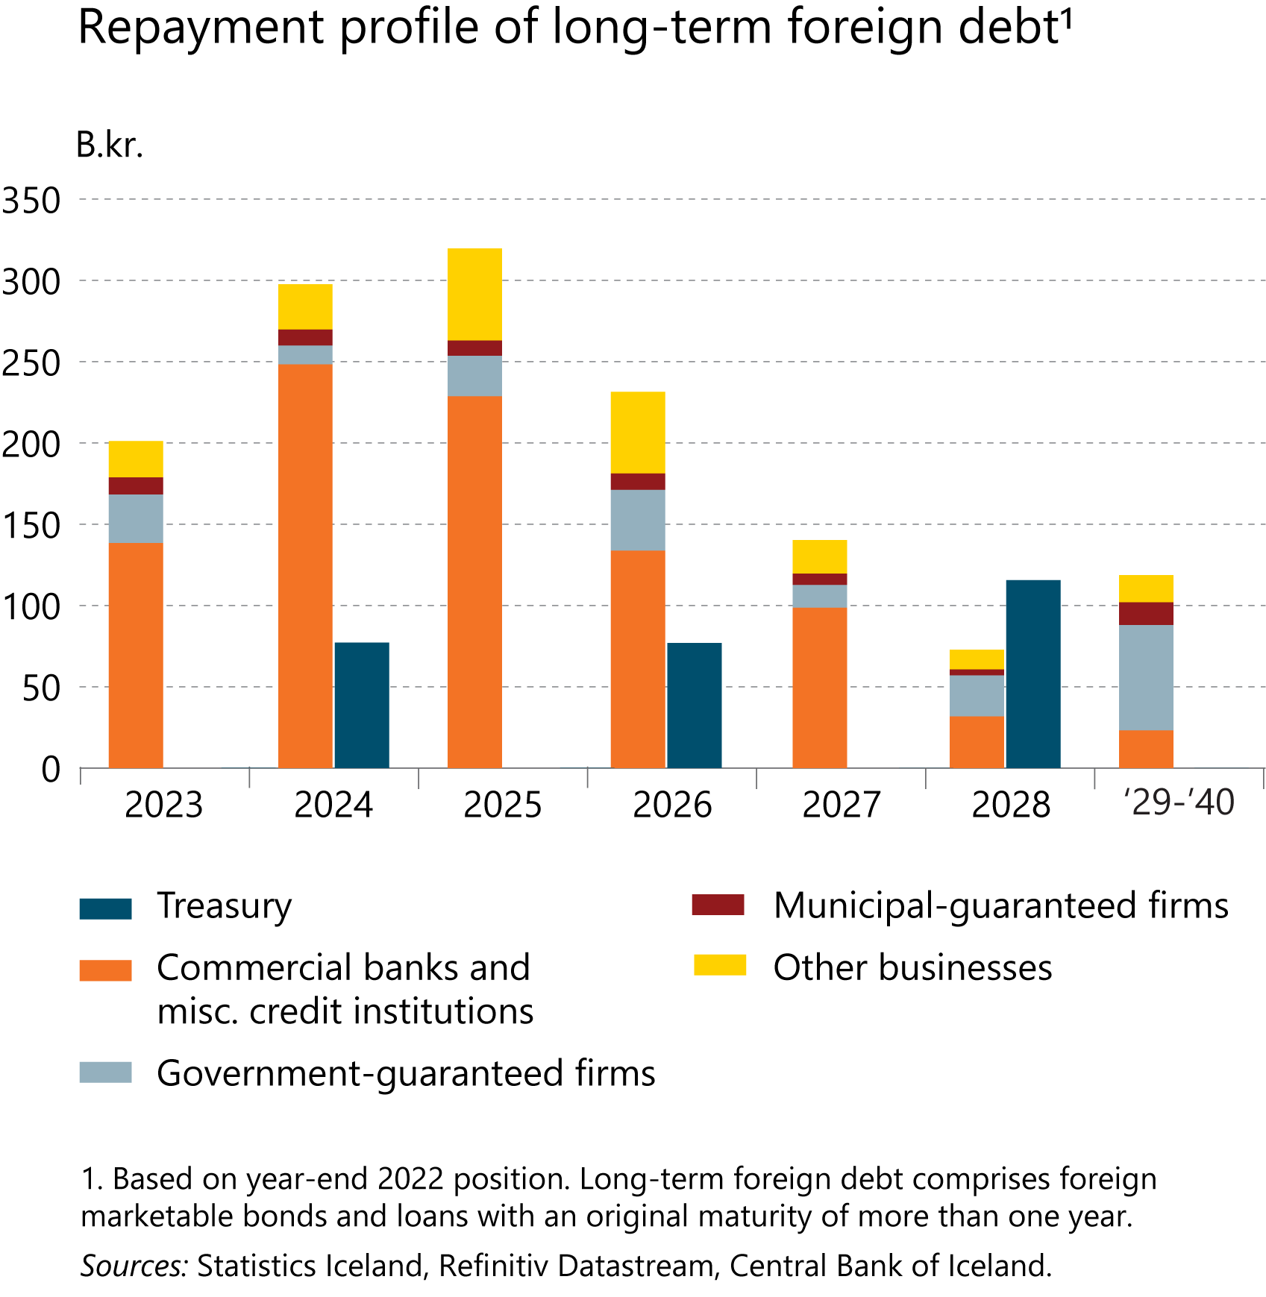
I Financial Stability: Developments and prospects

Slide 7
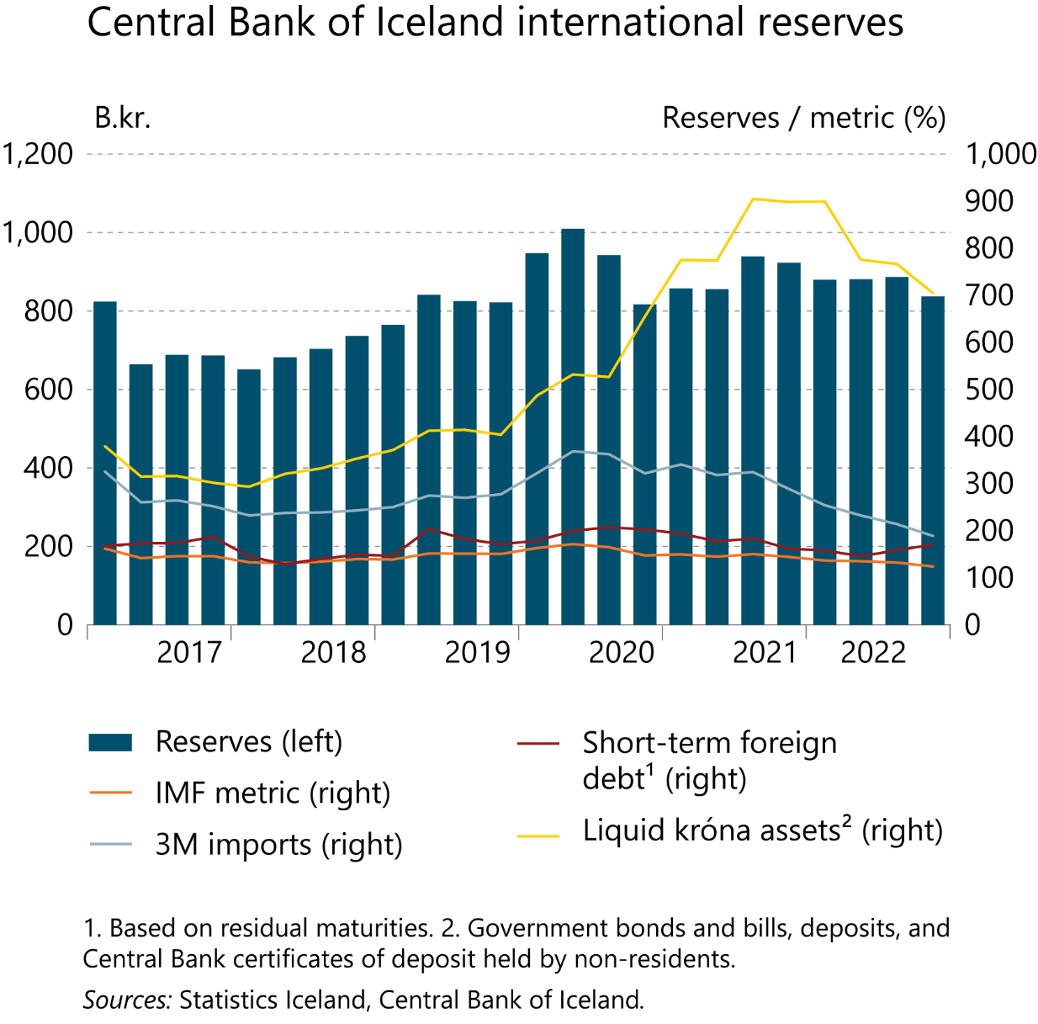
I Financial Stability: Developments and prospects

Slide 8
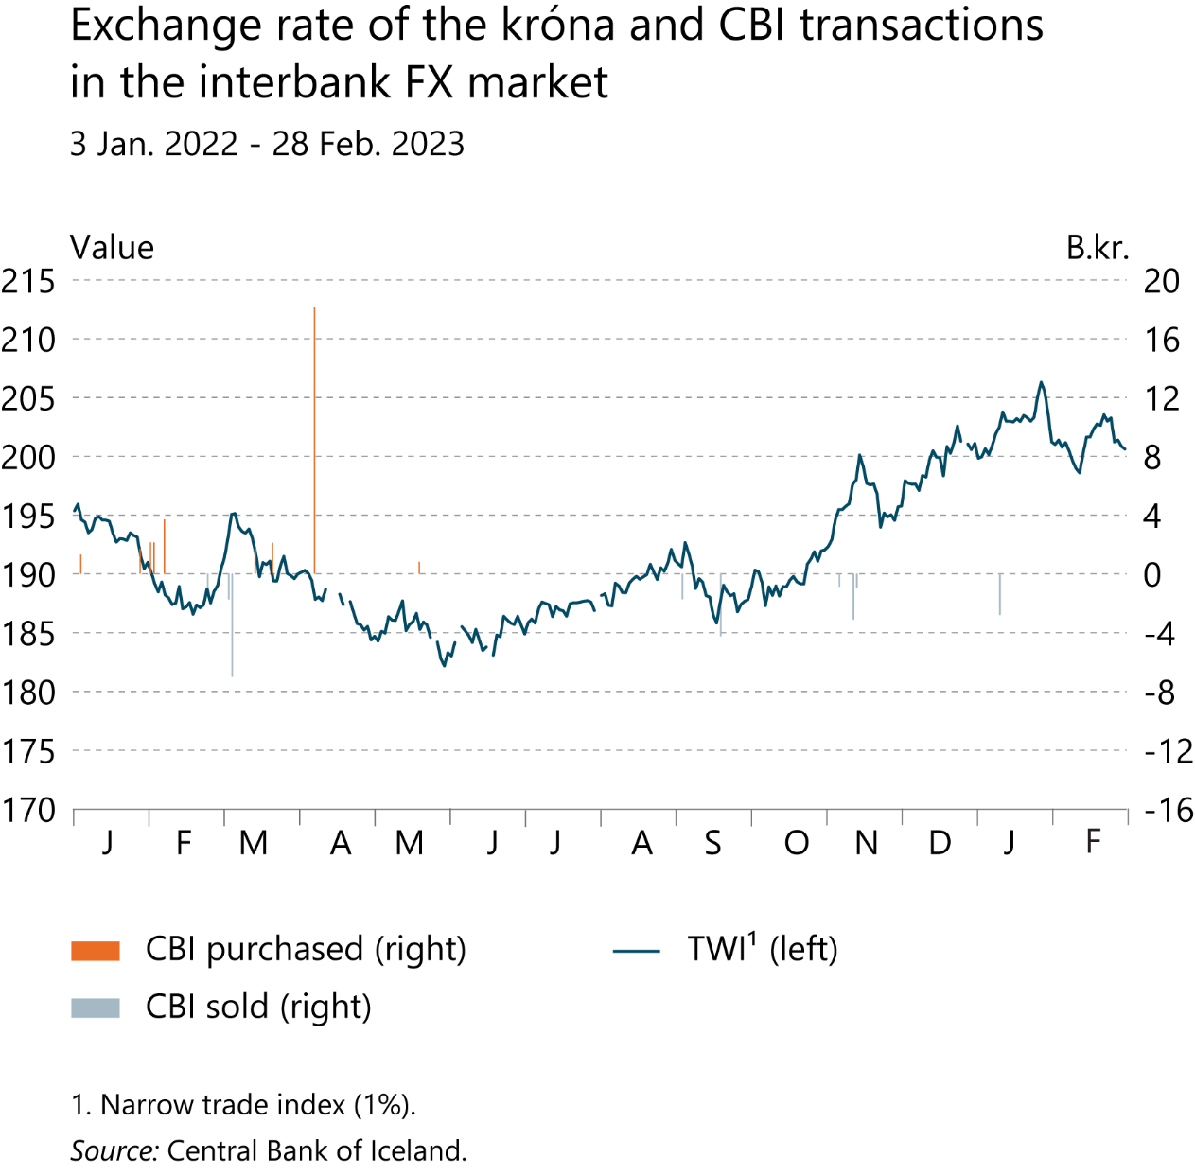
I Financial Stability: Developments and prospects

Slide 9
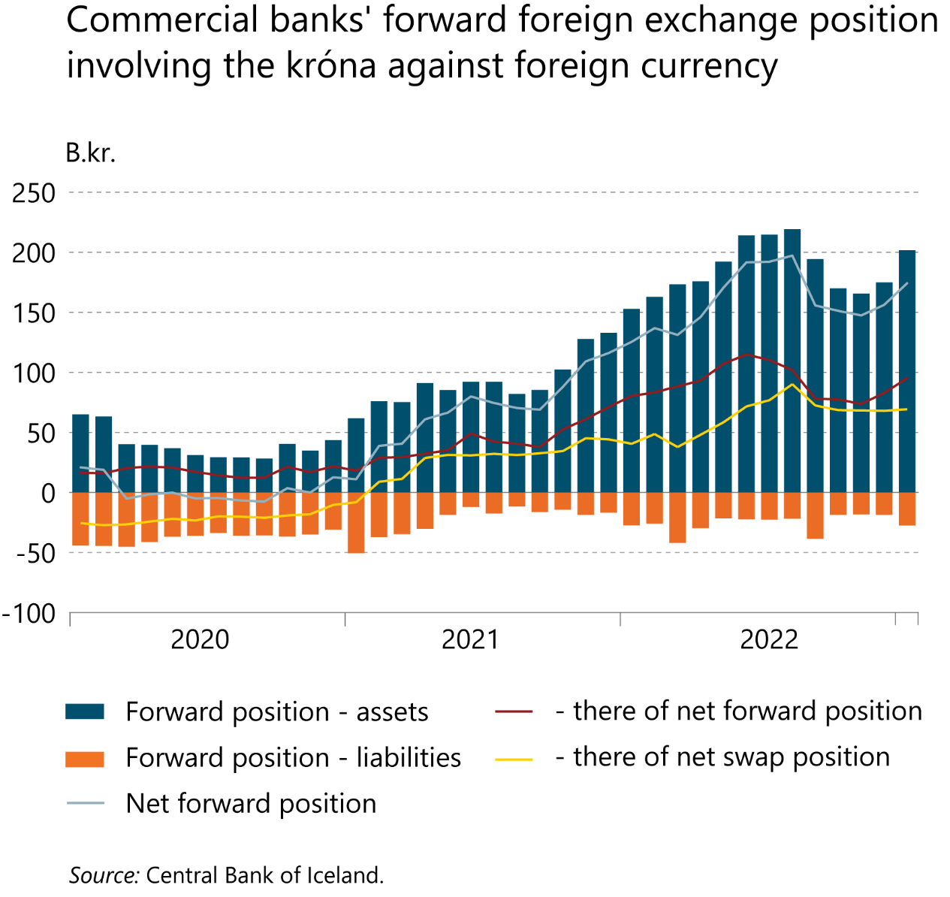
I Financial Stability: Developments and prospects

Slide 10
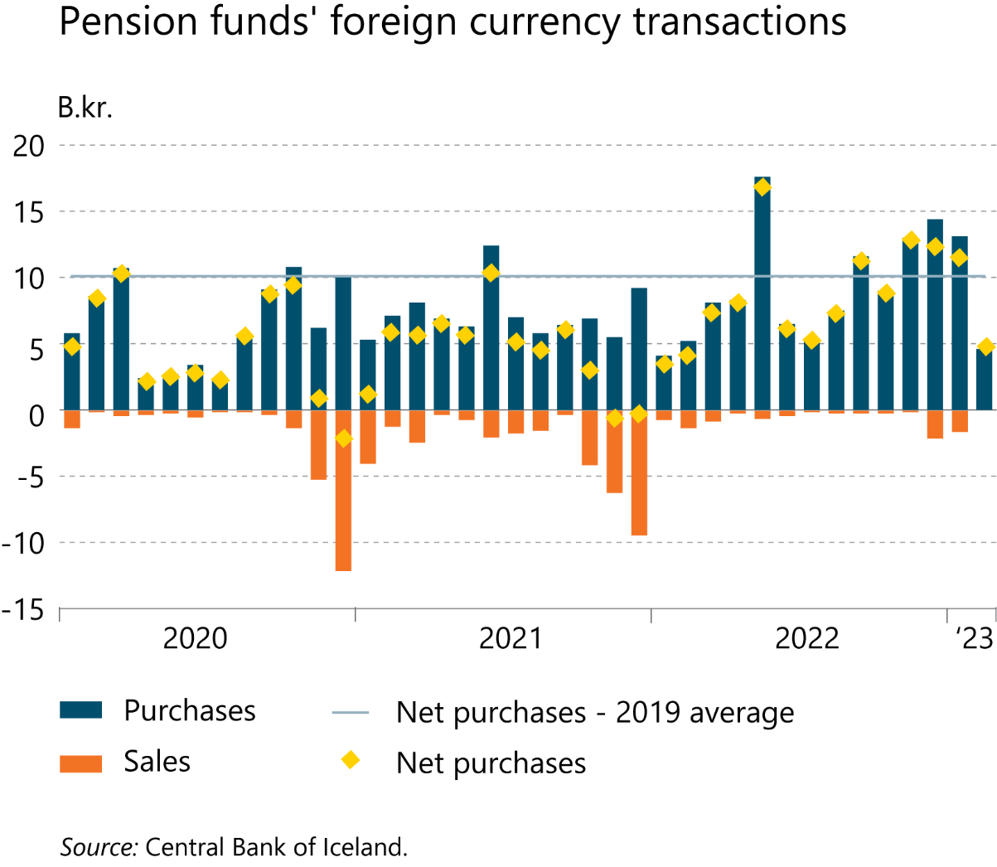
I Financial Stability: Developments and prospects

Slide 11
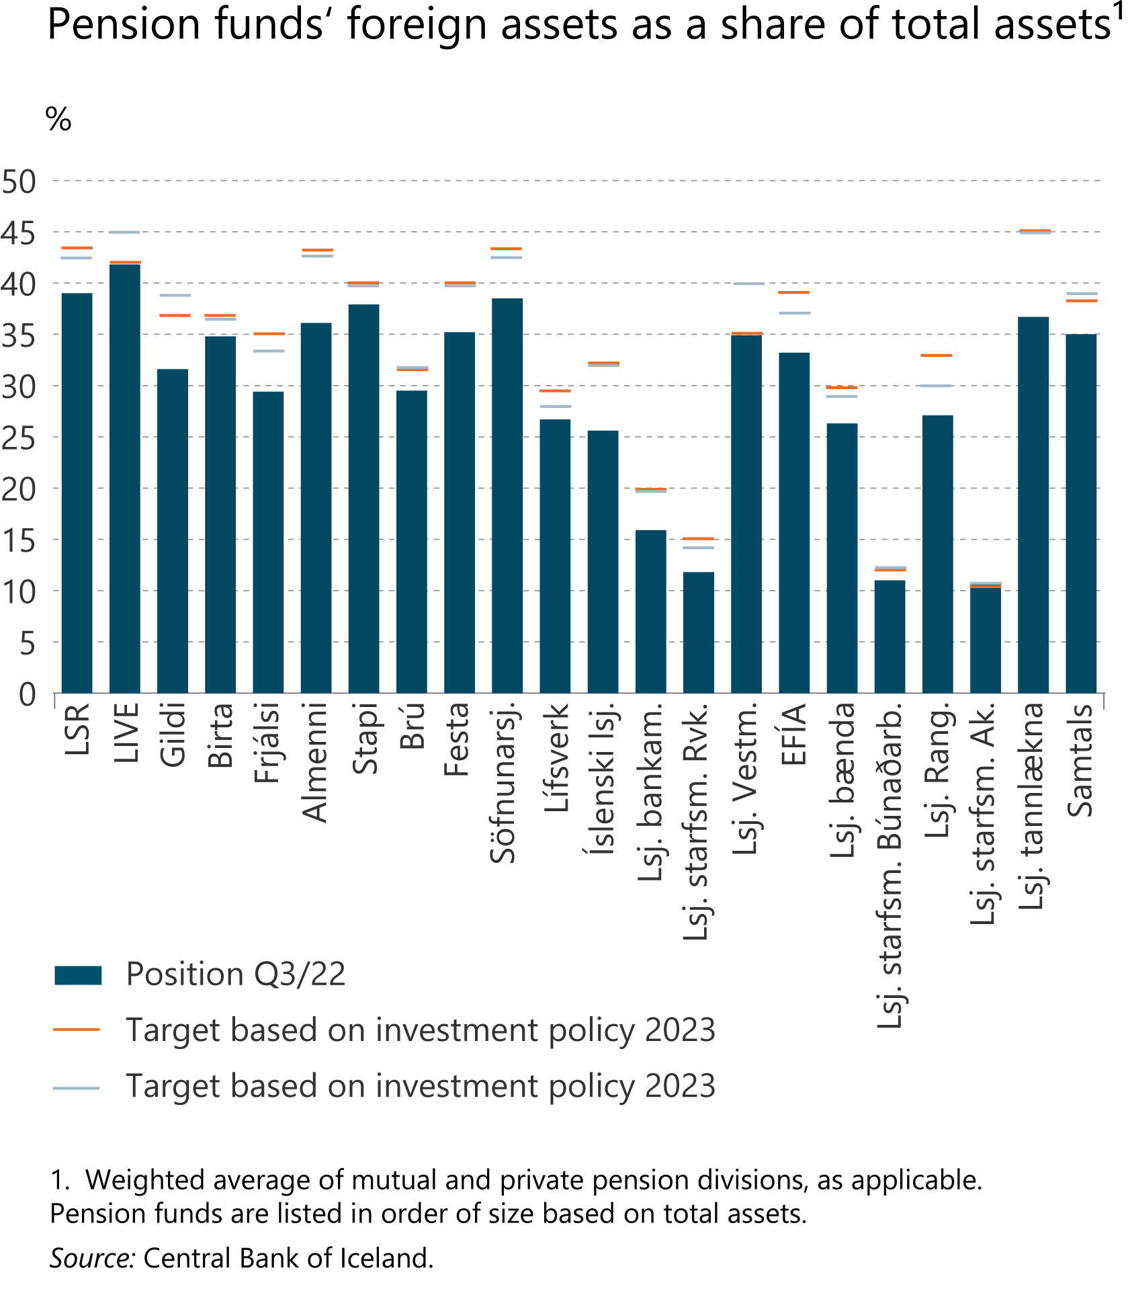
I Financial Stability: Developments and prospects

Slide 12
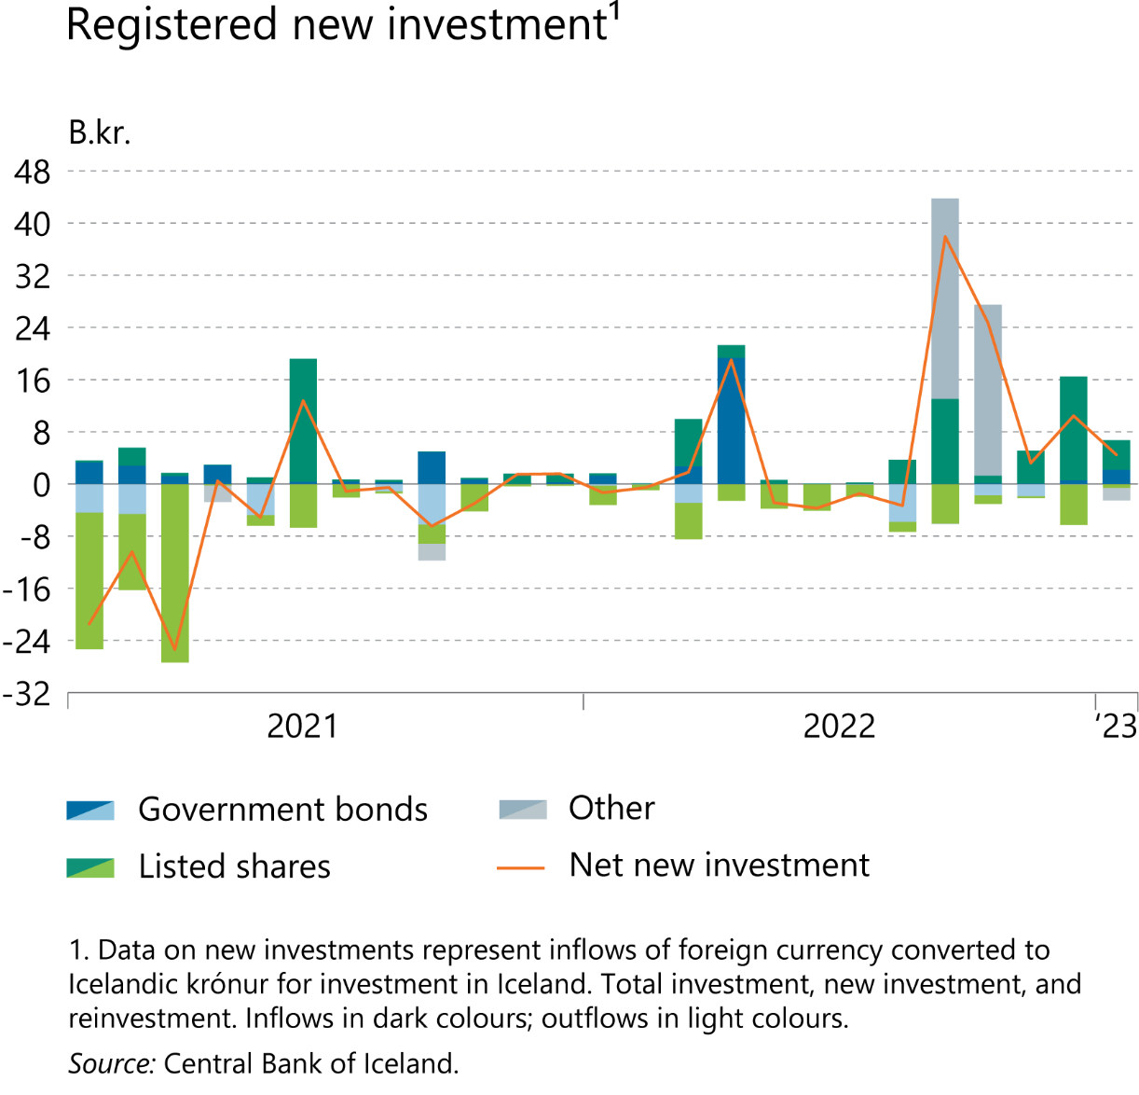
I Financial Stability: Developments and prospects

Slide 13
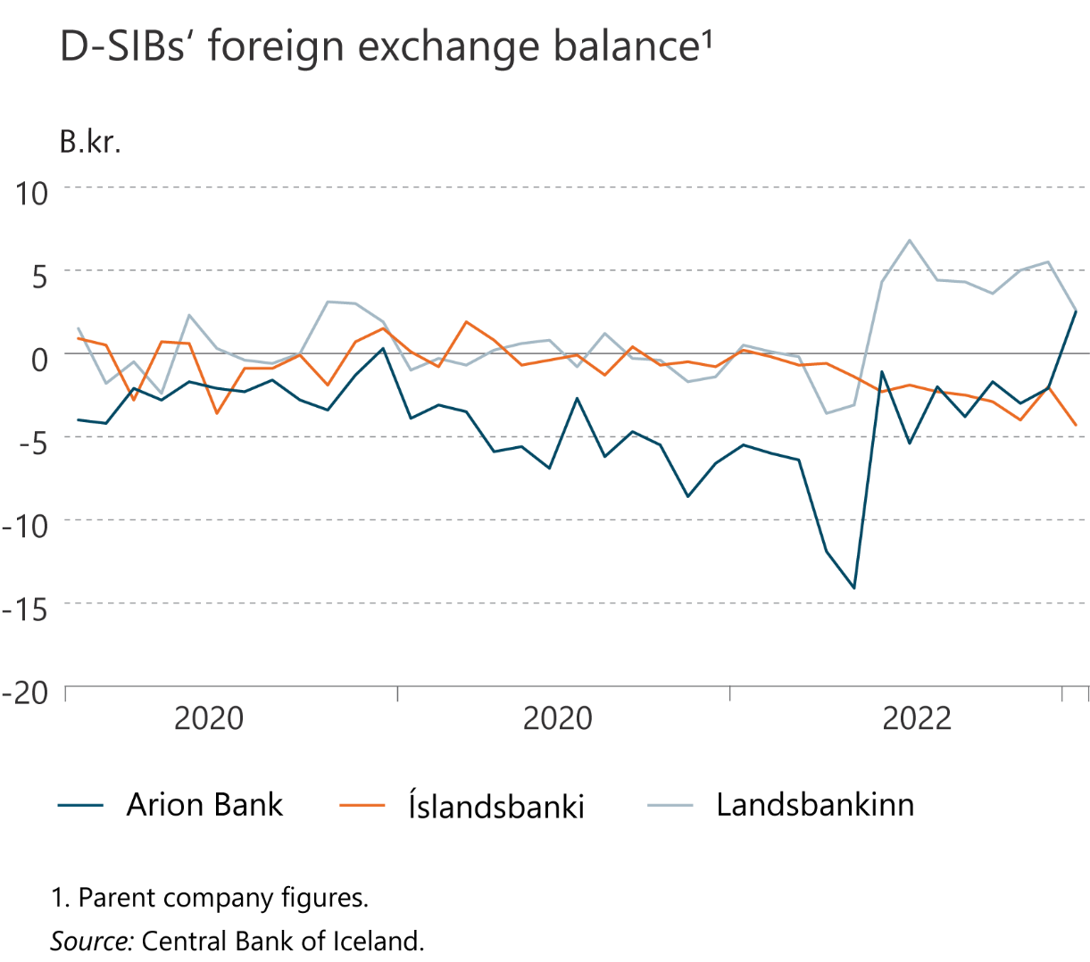
I Financial Stability: Developments and prospects

Slide 14
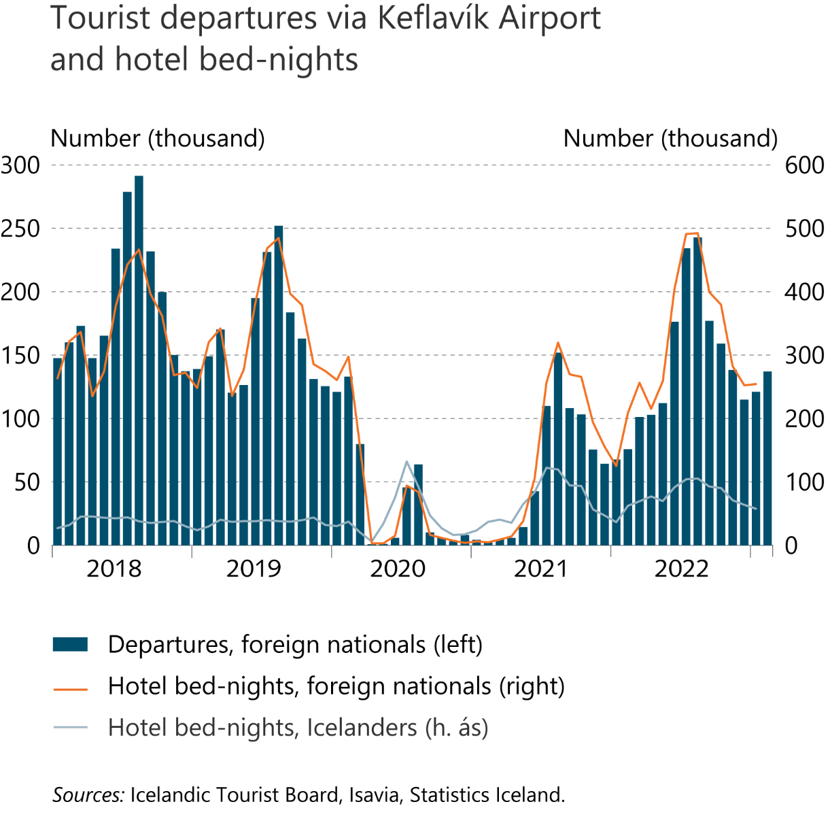
I Financial Stability: Developments and prospects

Slide 15
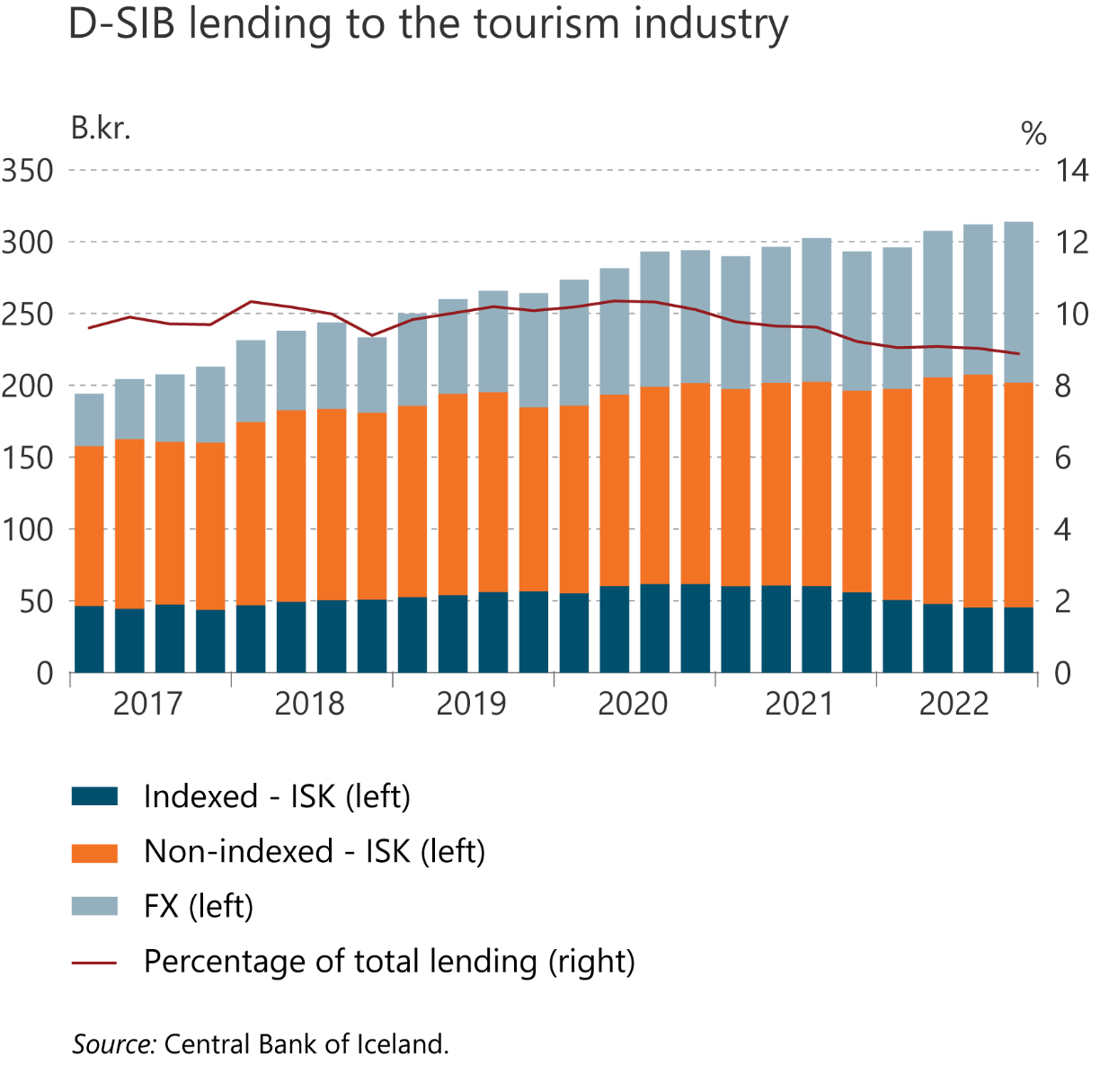
I Financial Stability: Developments and prospects

Slide 16
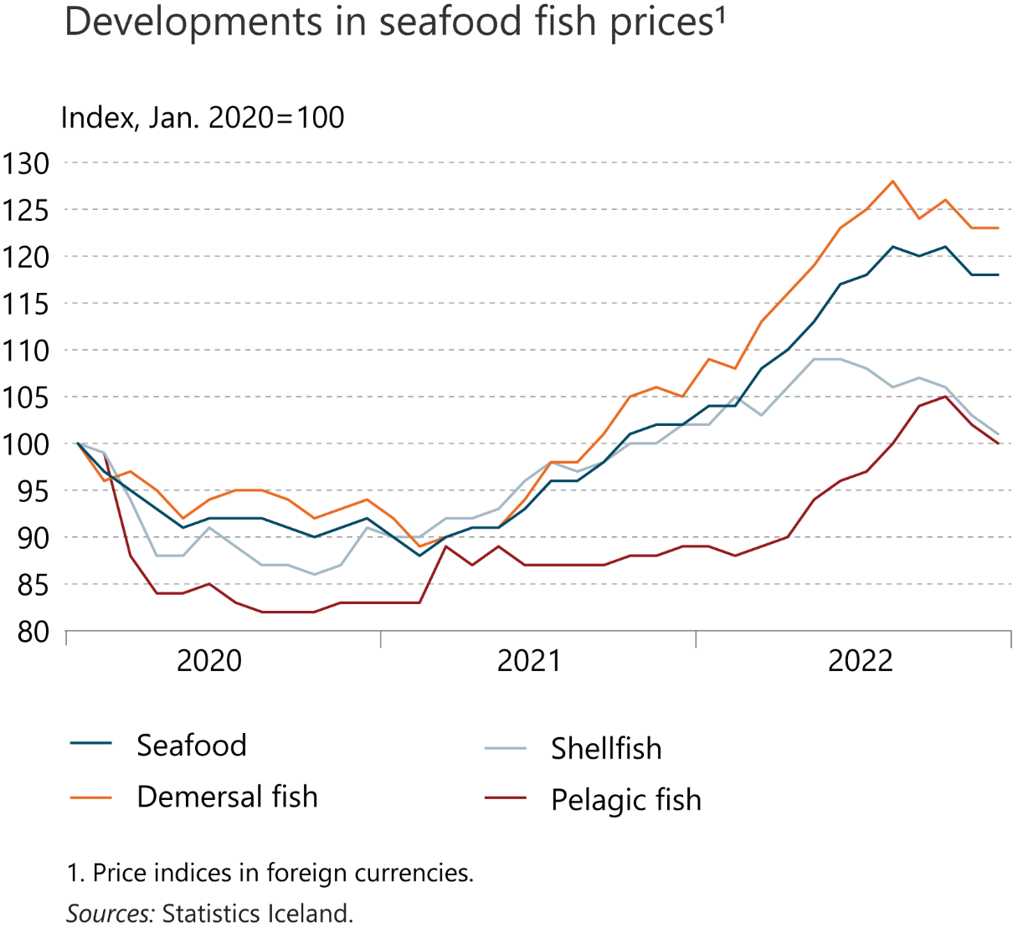
I Financial Stability: Developments and prospects

Slide 17
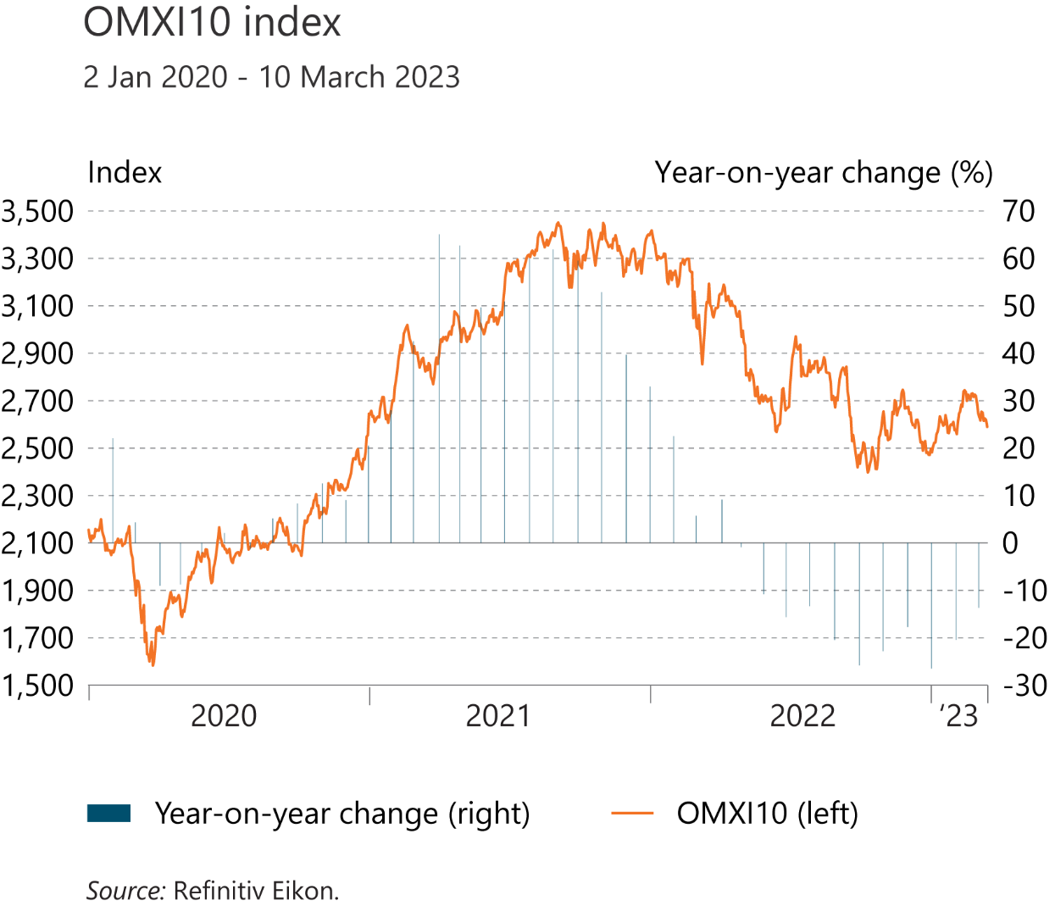
I Financial Stability: Developments and prospects

Slide 18
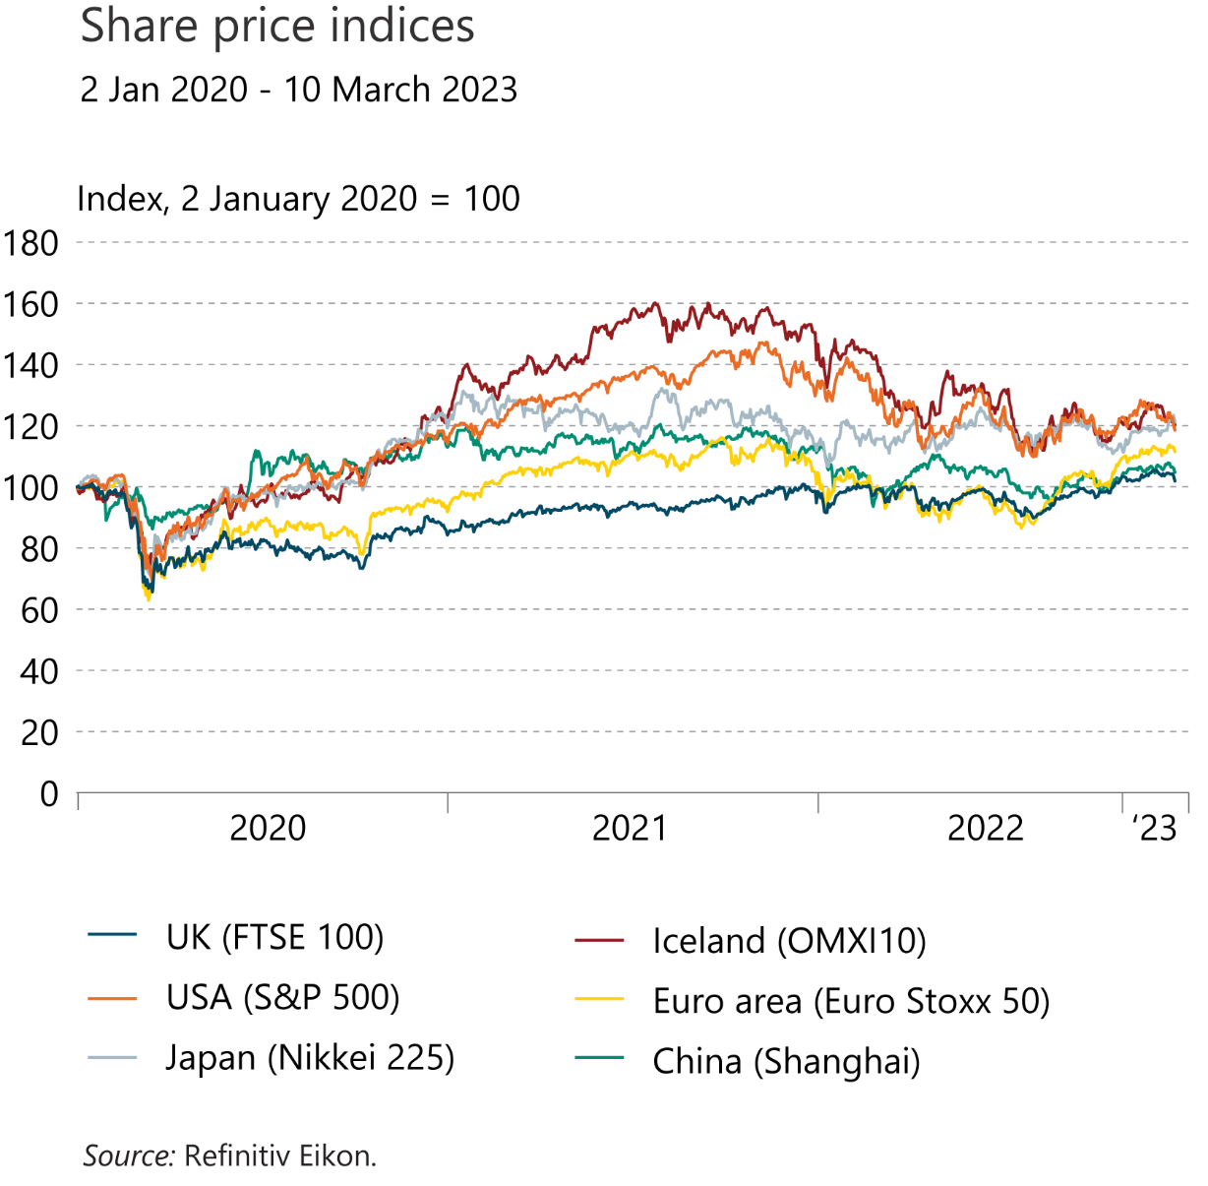
I Financial Stability: Developments and prospects

Slide 19
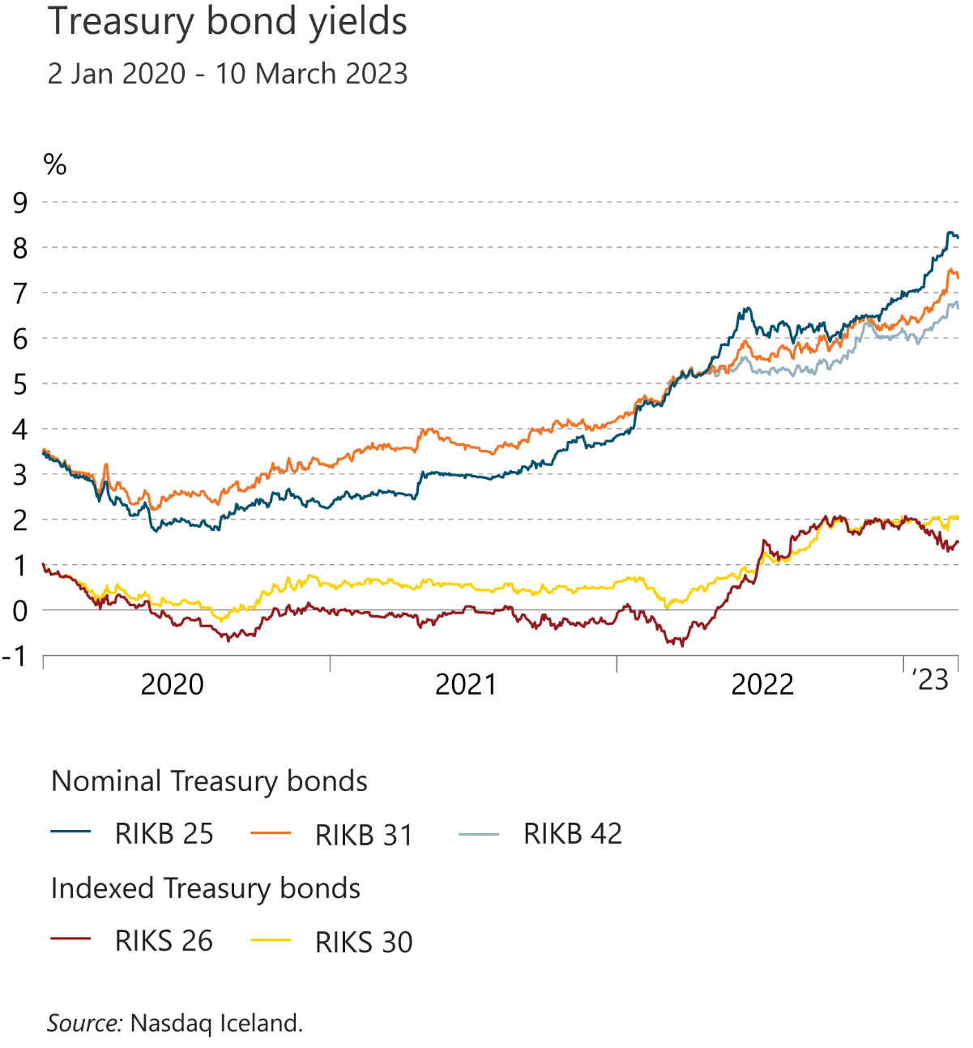
I Financial Stability: Developments and prospects

Slide 20
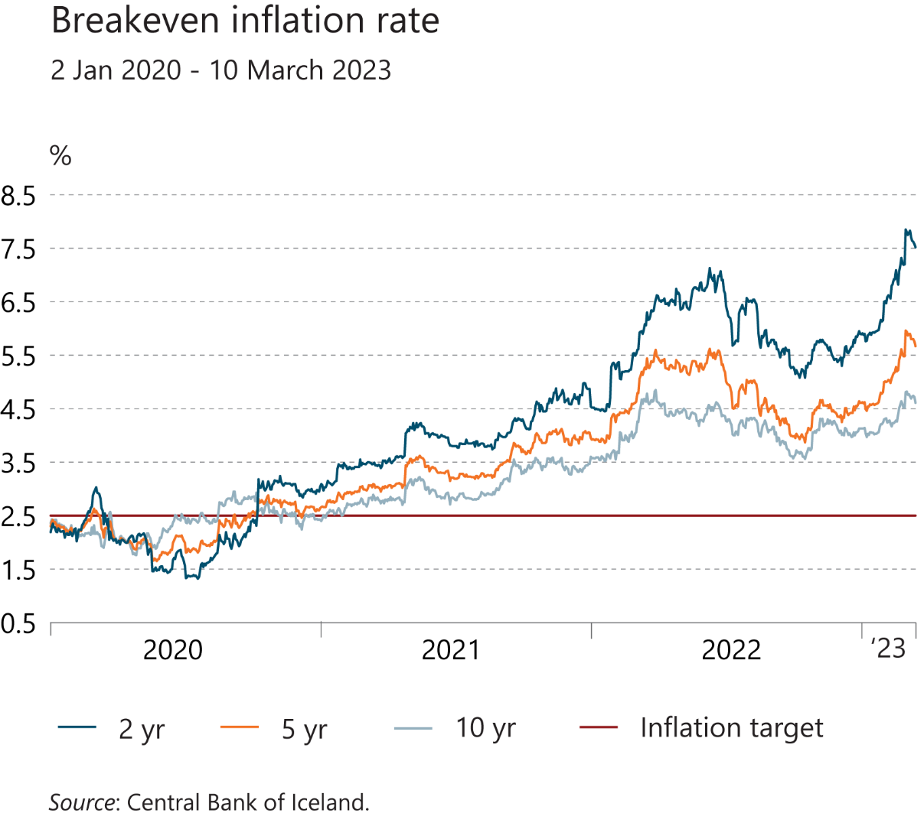
I Financial Stability: Developments and prospects

Slide 21
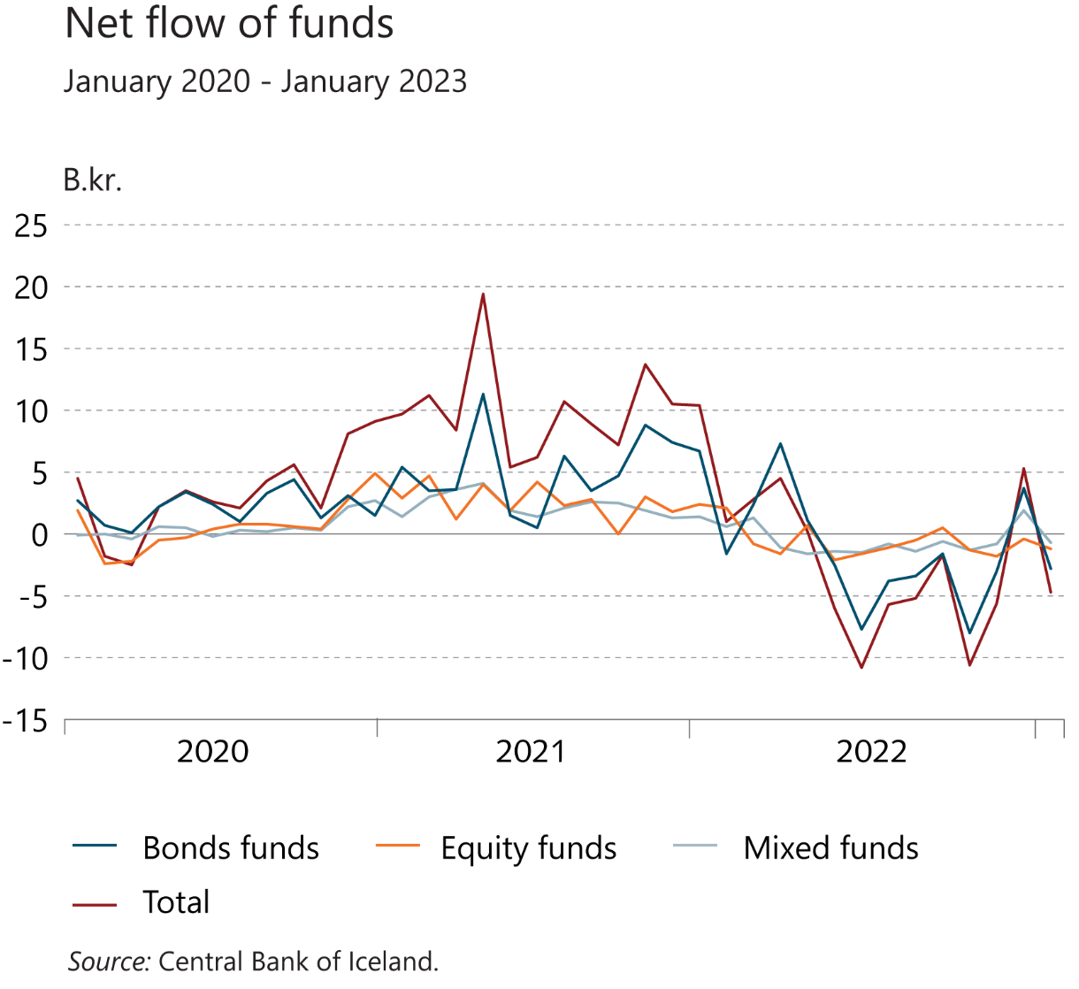
I Financial Stability: Developments and prospects

Slide 22
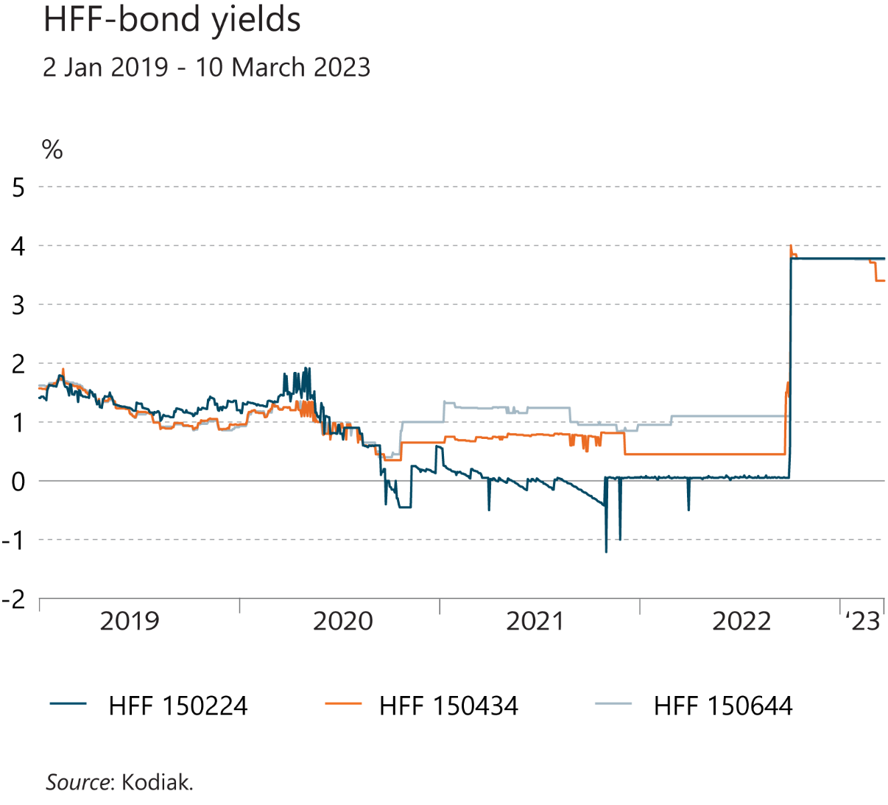
I Financial Stability: Developments and prospects

Slide 23
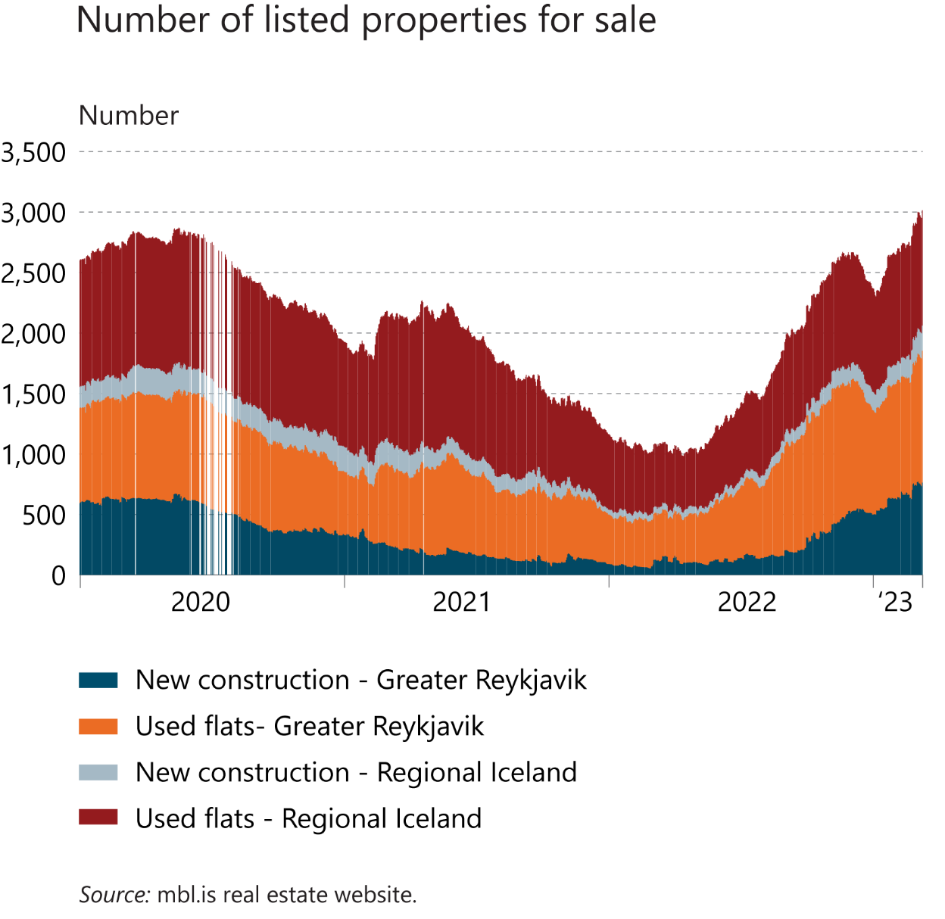
I Financial Stability: Developments and prospects

Slide 24
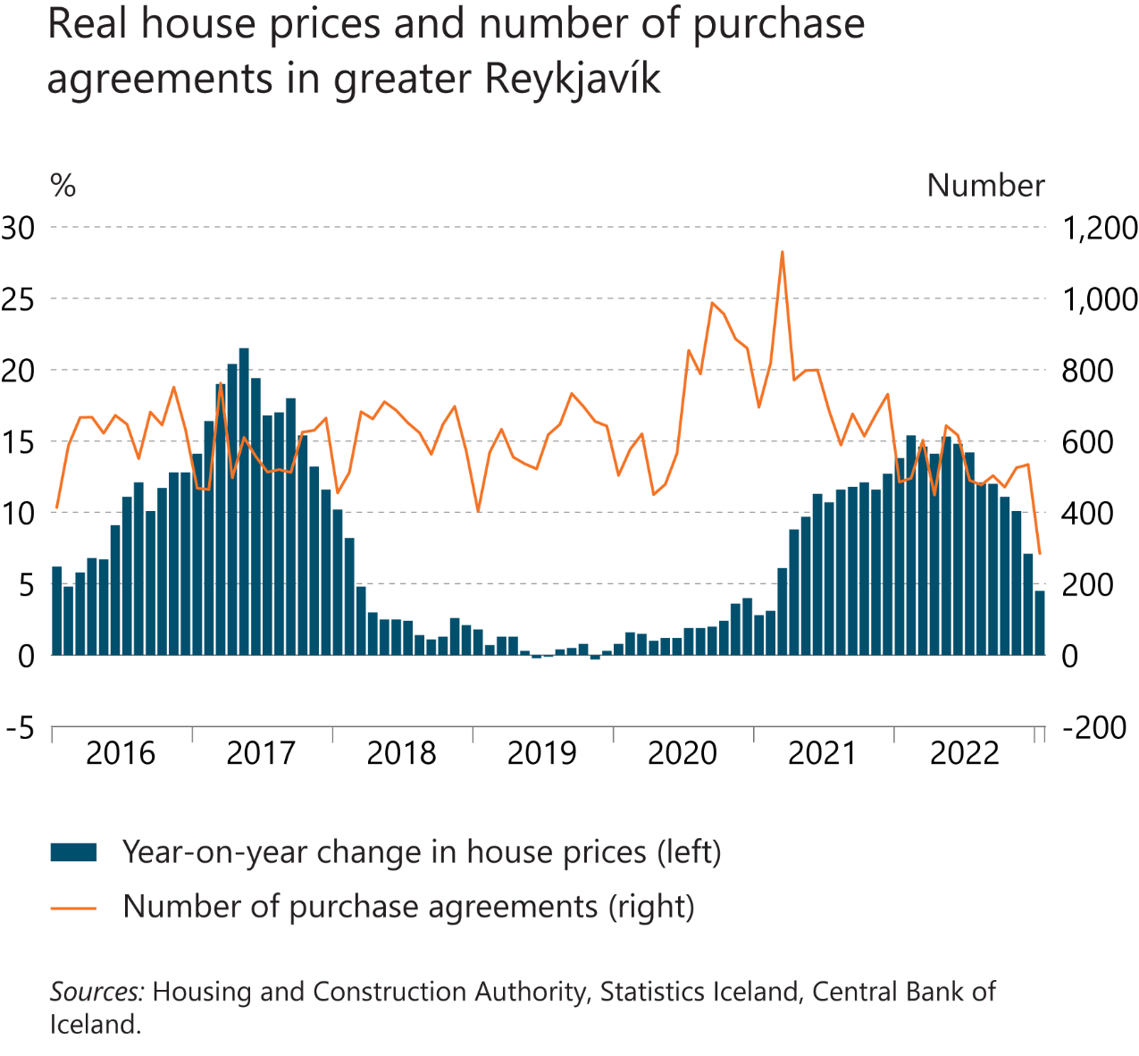
I Financial Stability: Developments and prospects

Slide 25
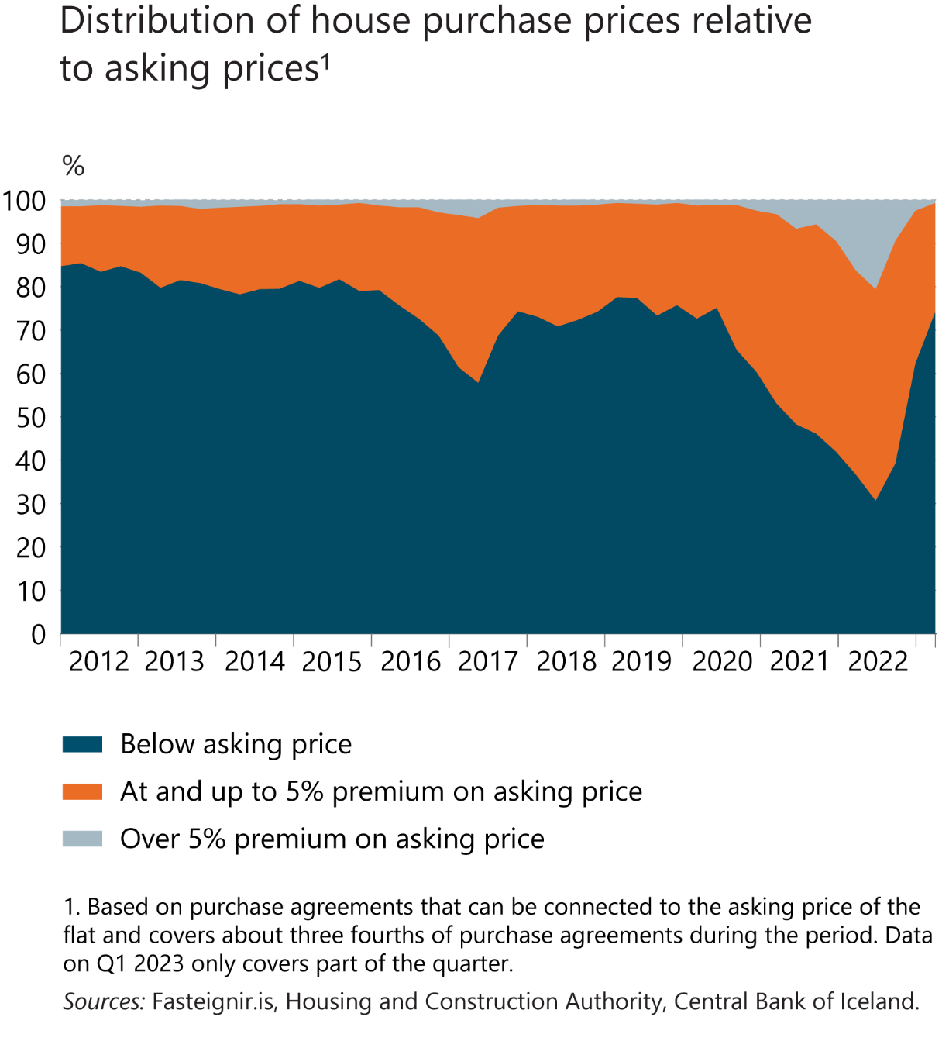
I Financial Stability: Developments and prospects

Slide 26
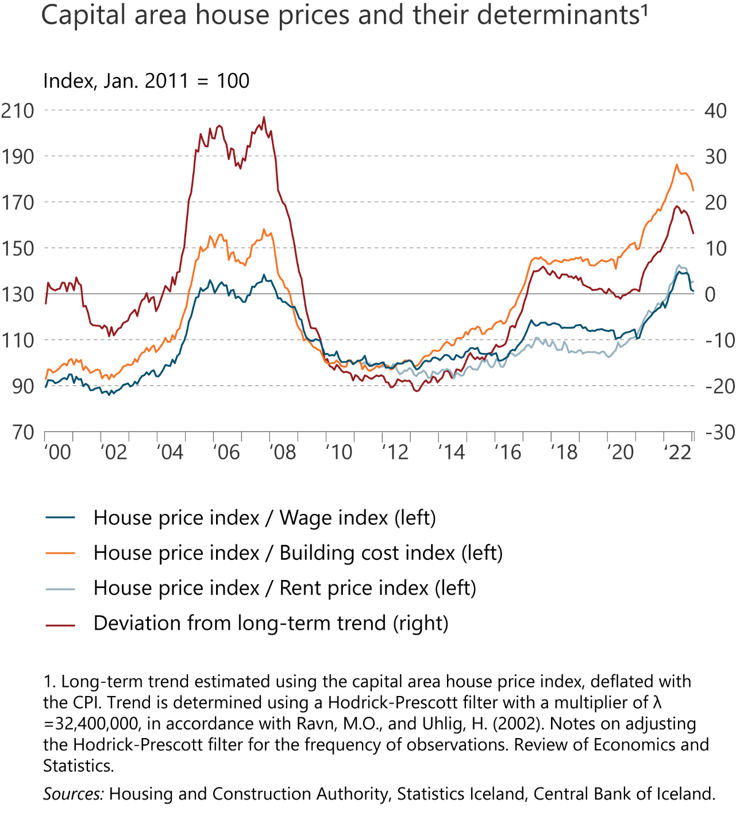
I Financial Stability: Developments and prospects

Slide 27
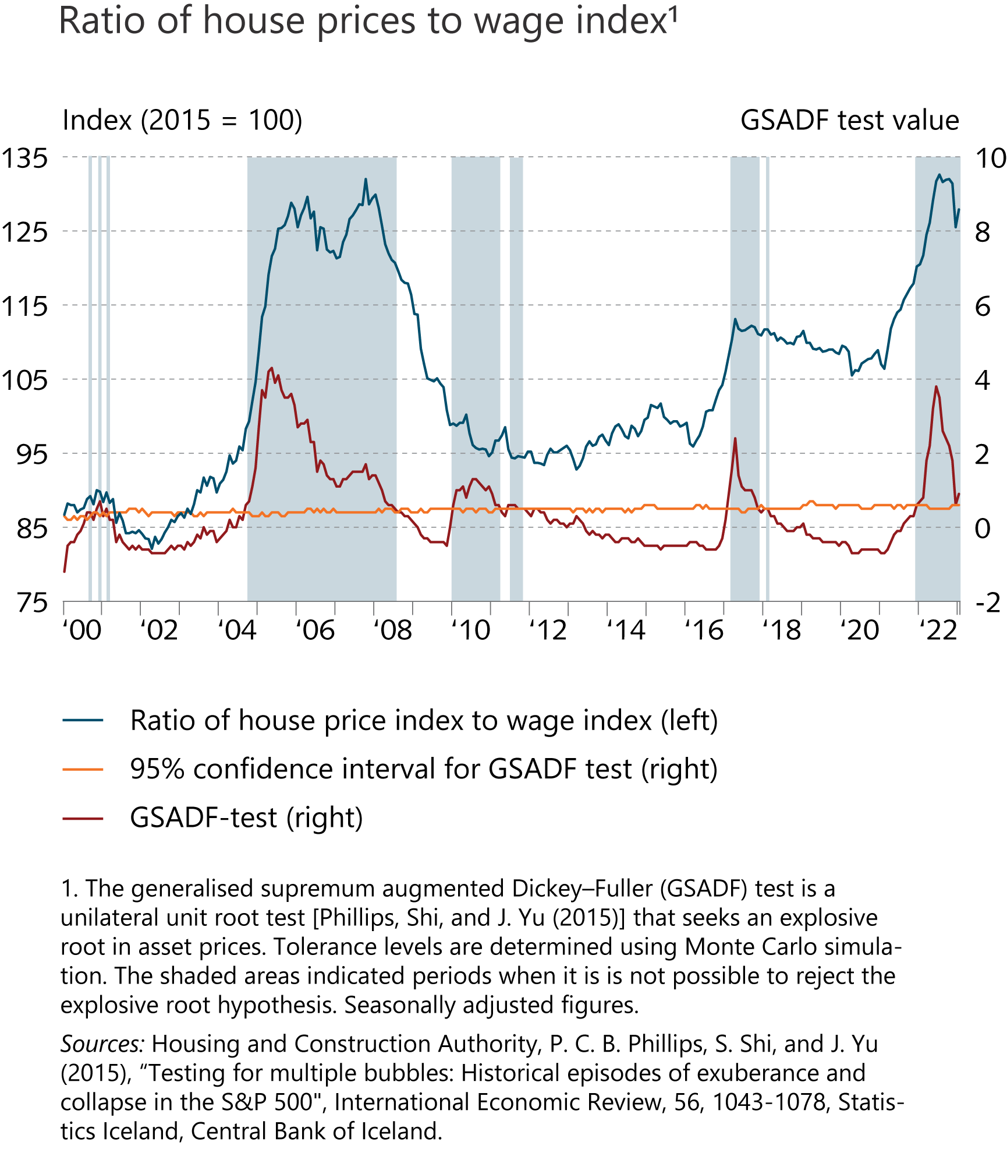
I Financial Stability: Developments and prospects

Slide 28
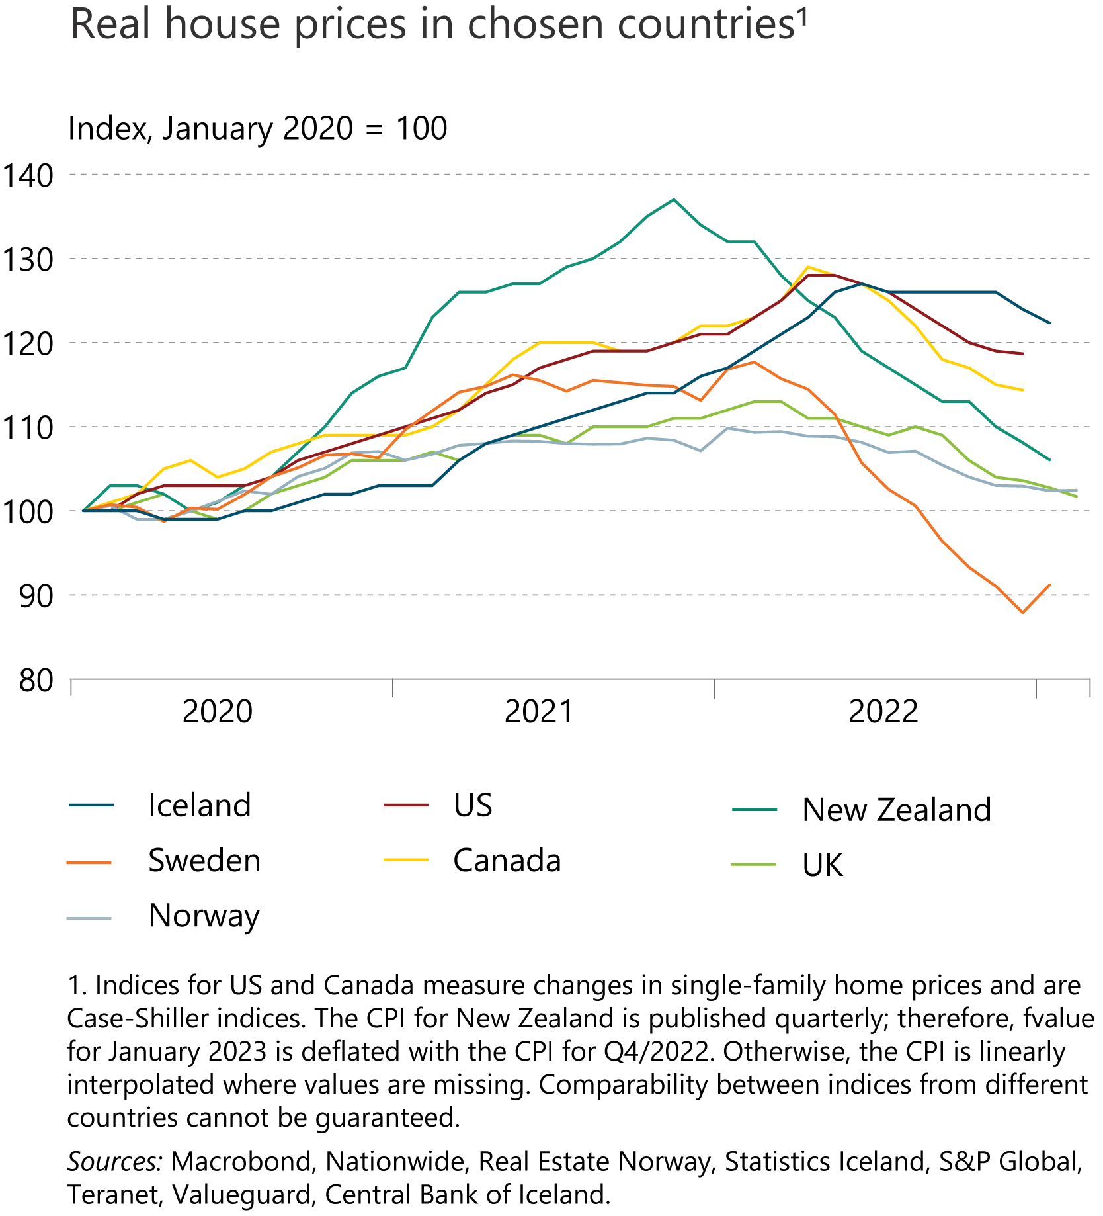
I Financial Stability: Developments and prospects

Slide 29
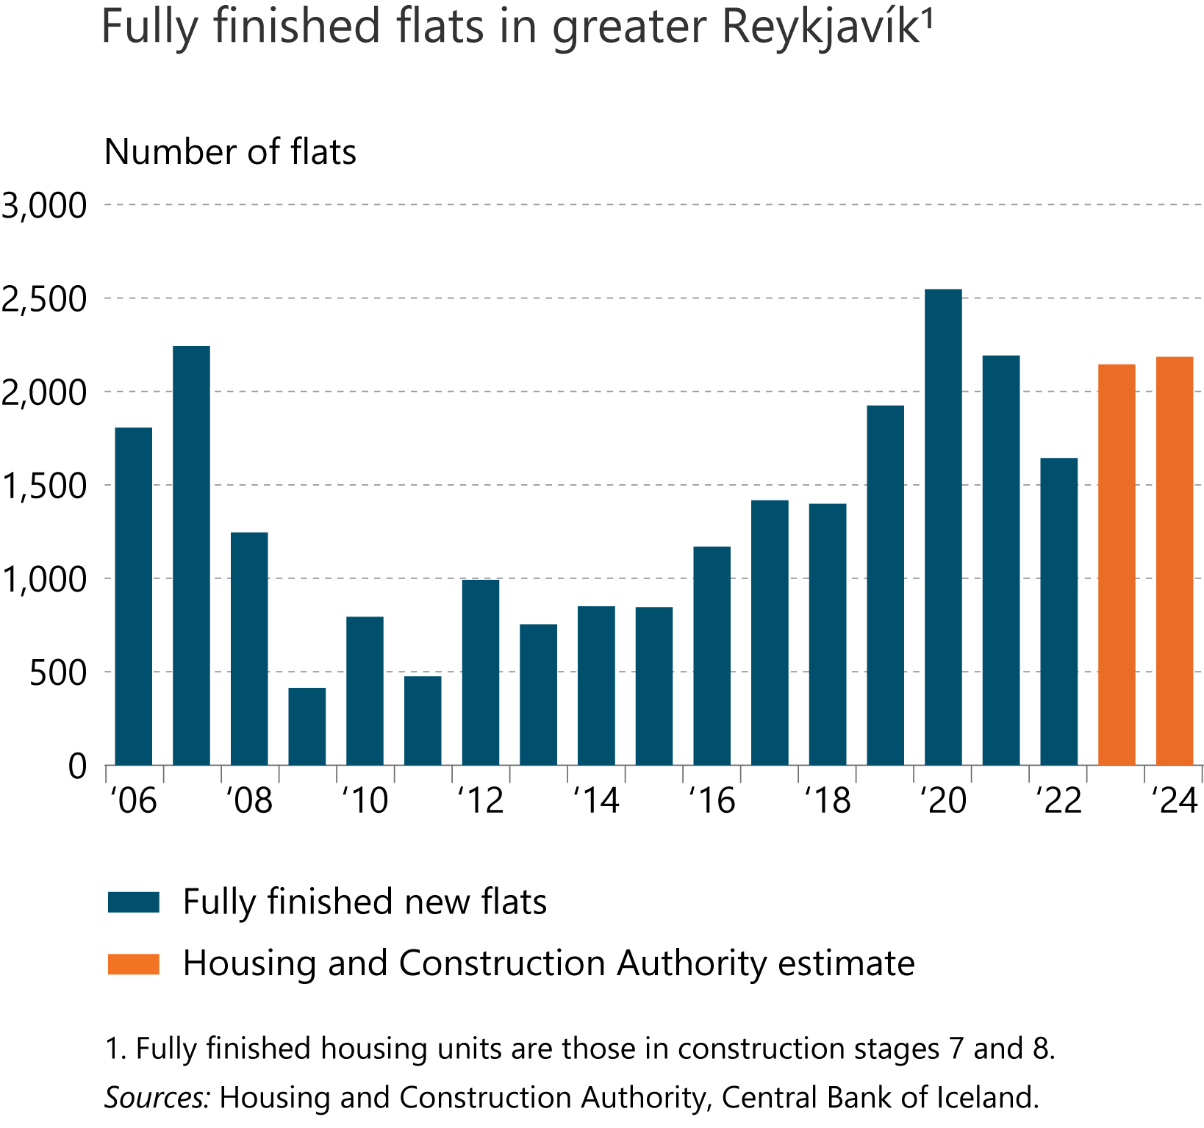
I Financial Stability: Developments and prospects

Slide 30
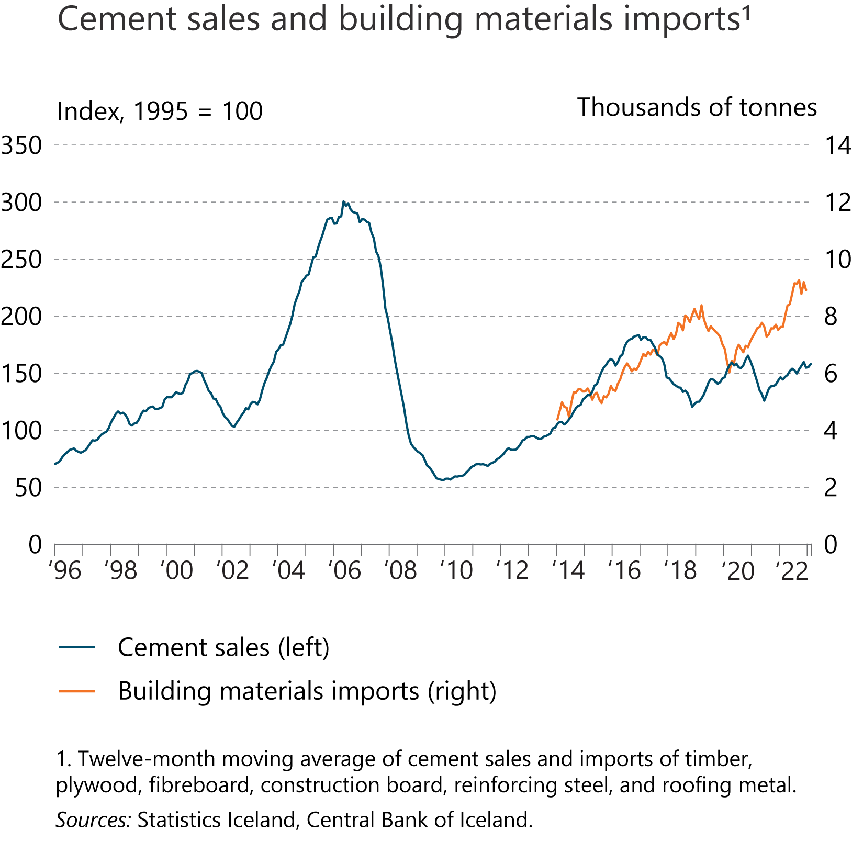
I Financial Stability: Developments and prospects

Slide 31
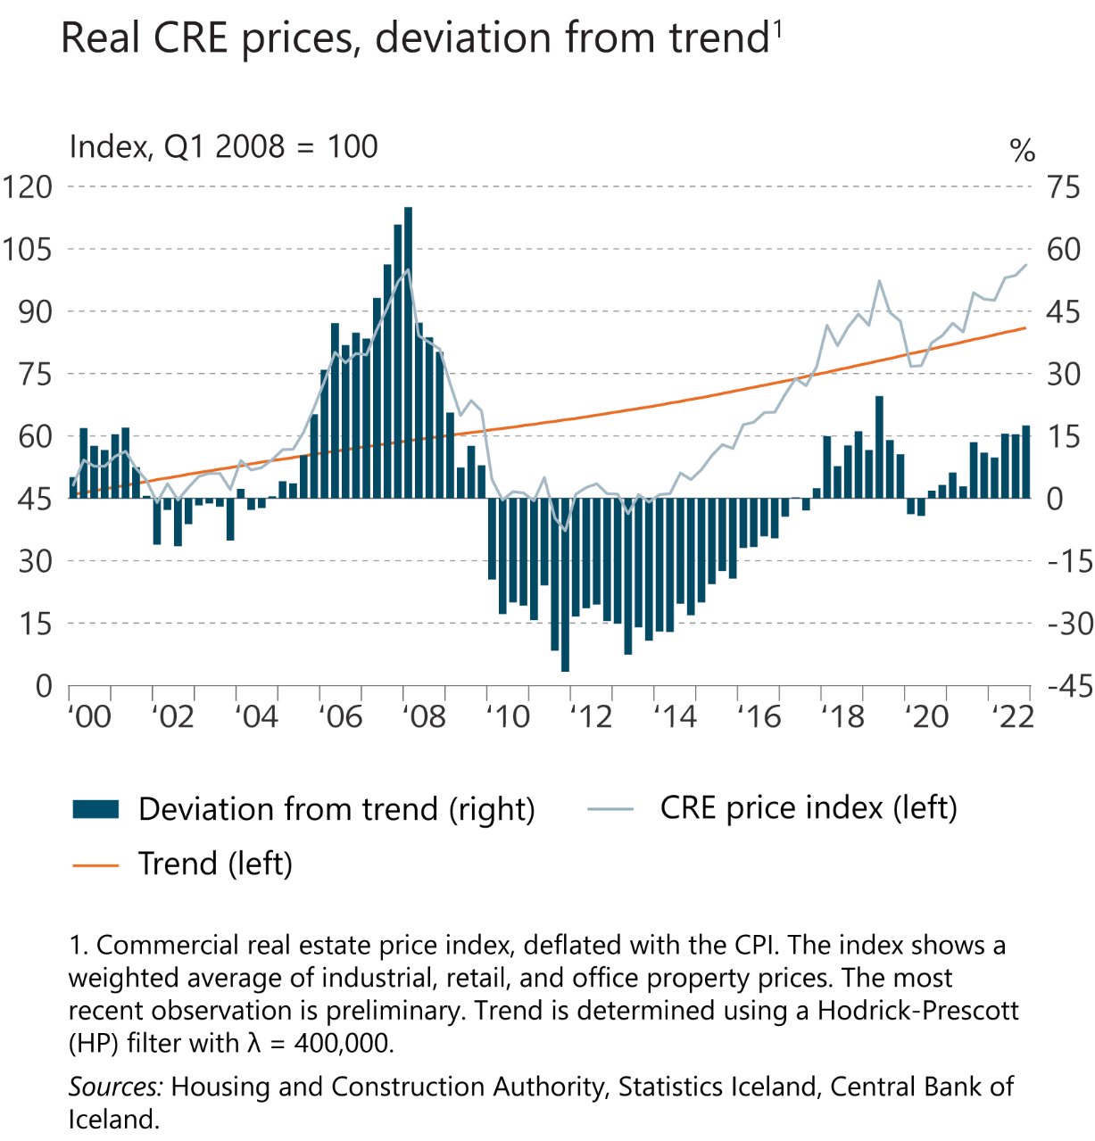
I Financial Stability: Developments and prospects

Slide 32
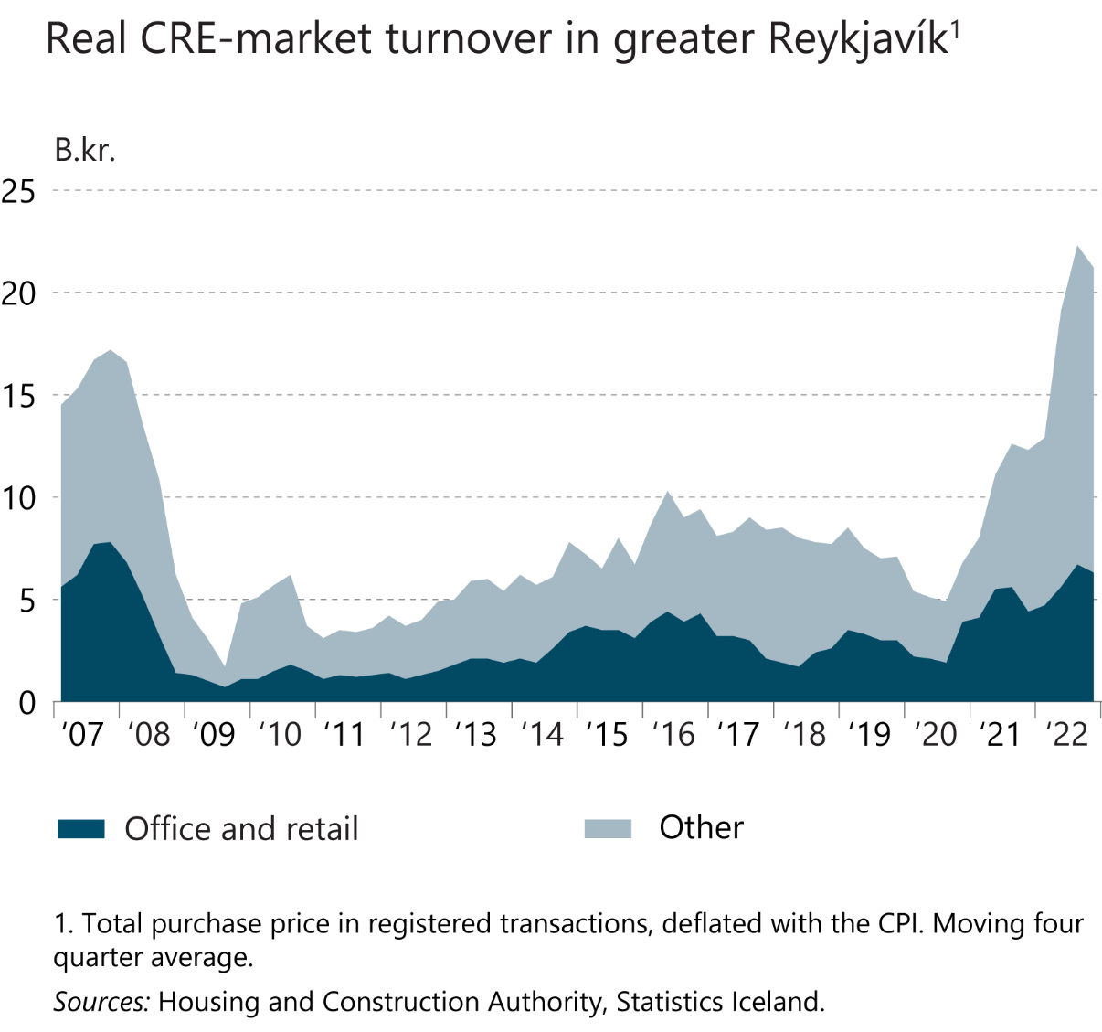
I Financial Stability: Developments and prospects

Slide 33
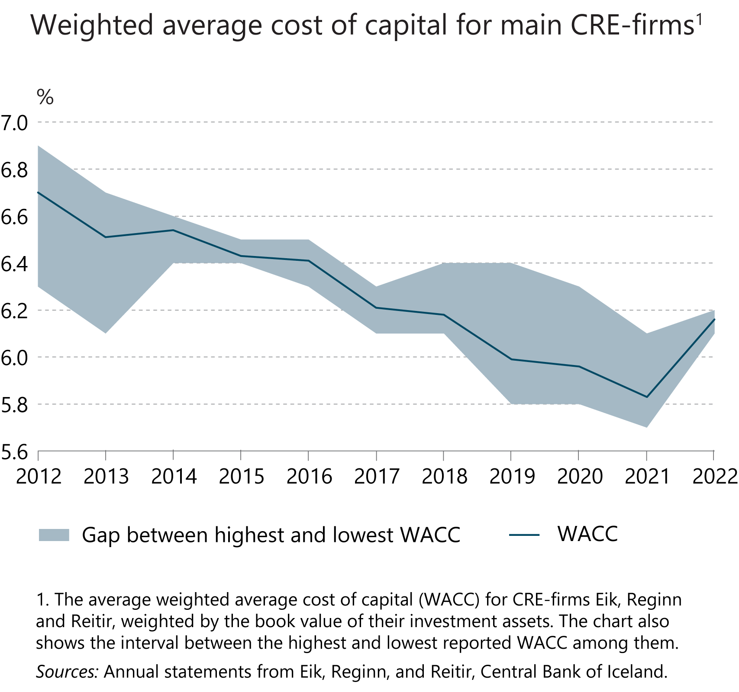
I Financial Stability: Developments and prospects

Slide 34
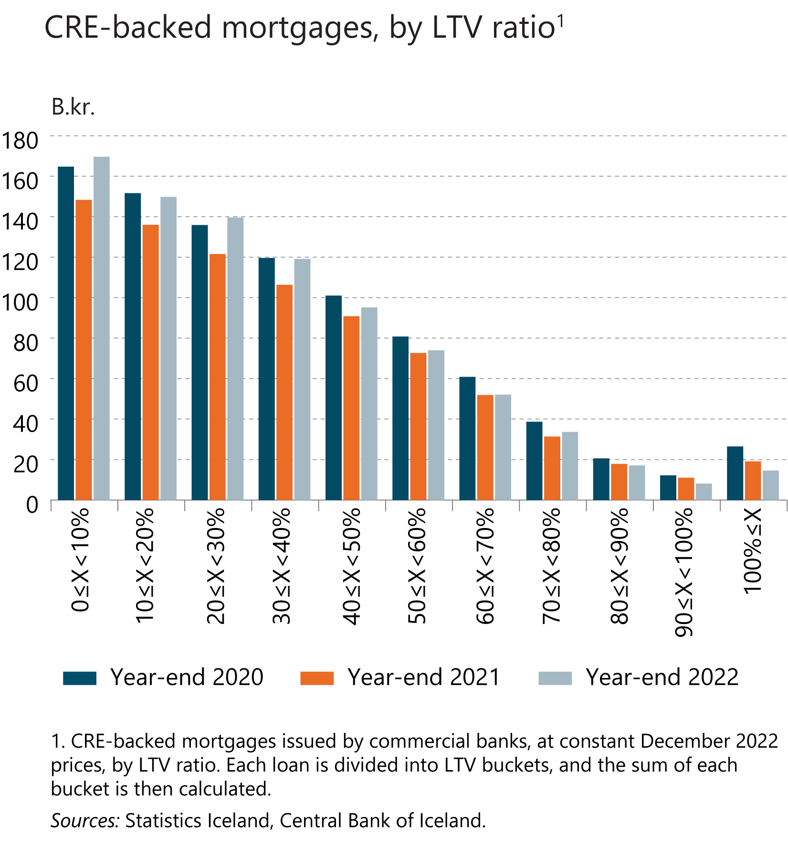
I Financial Stability: Developments and prospects

Slide 35
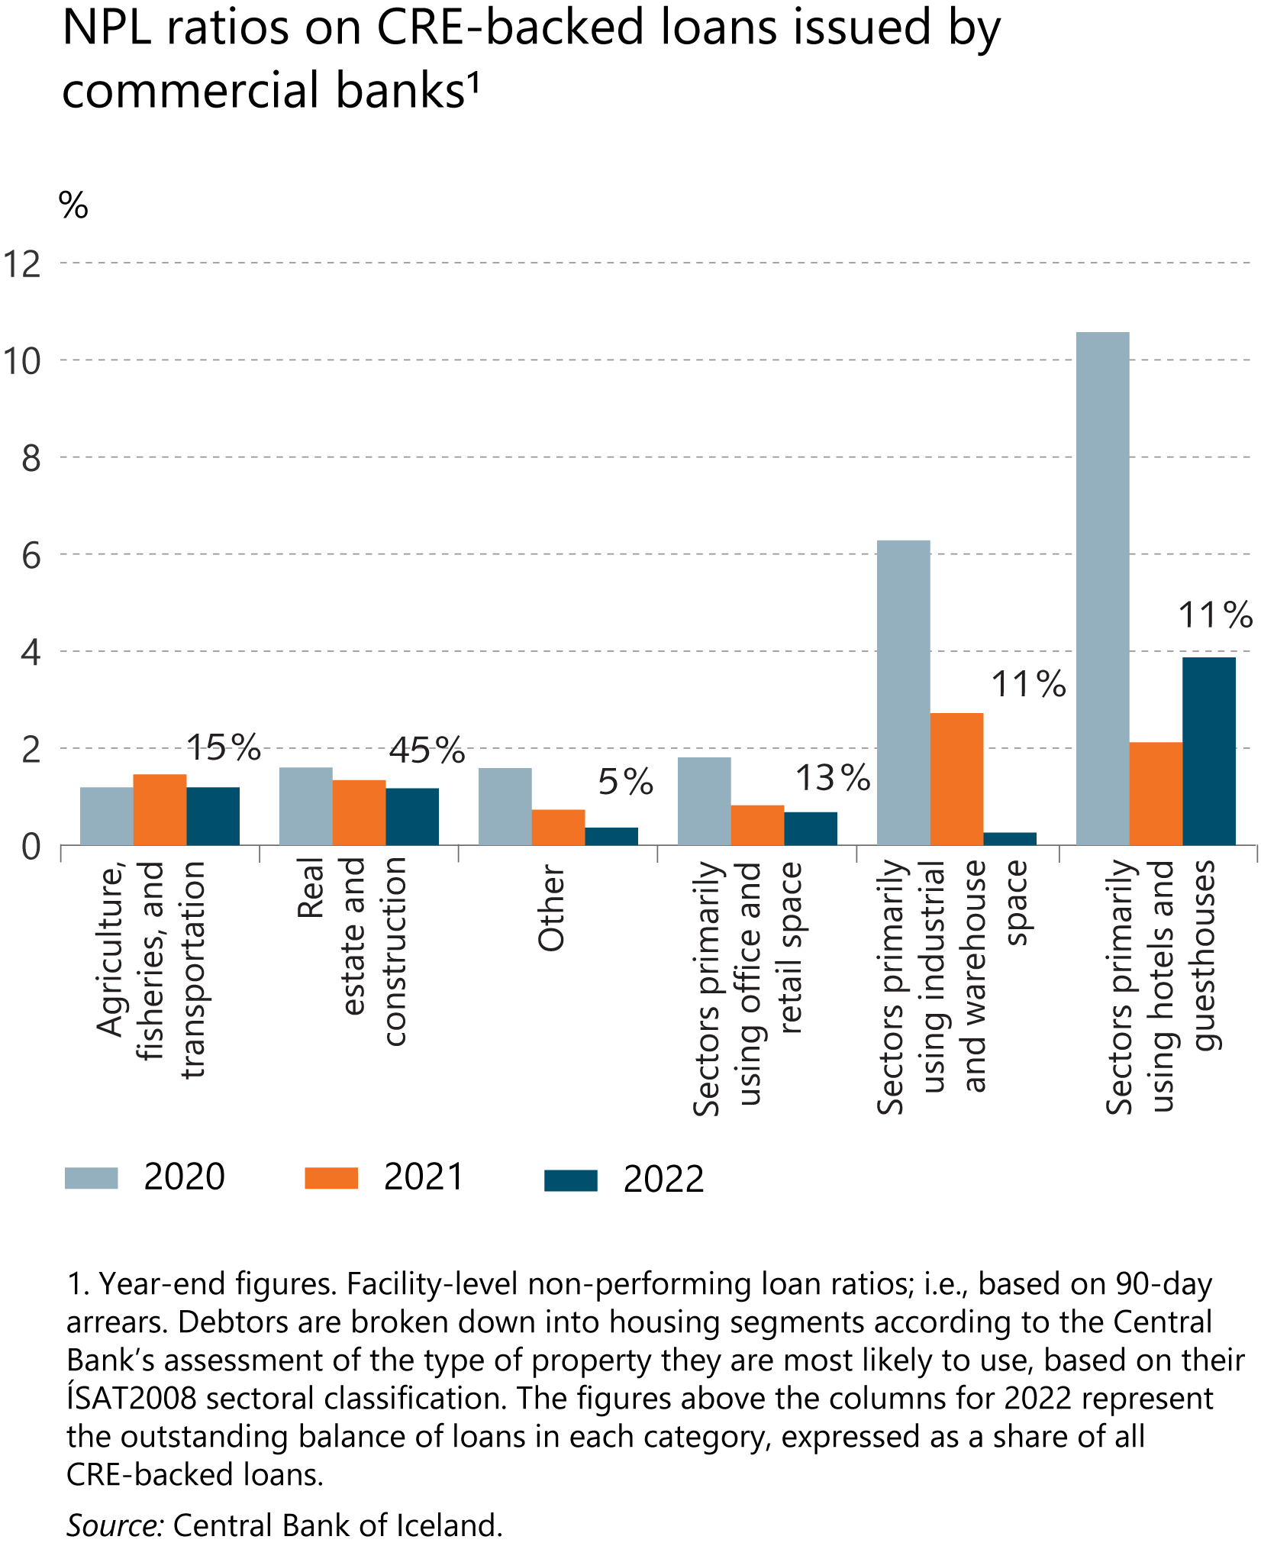
I Financial Stability: Developments and prospects

Slide 36
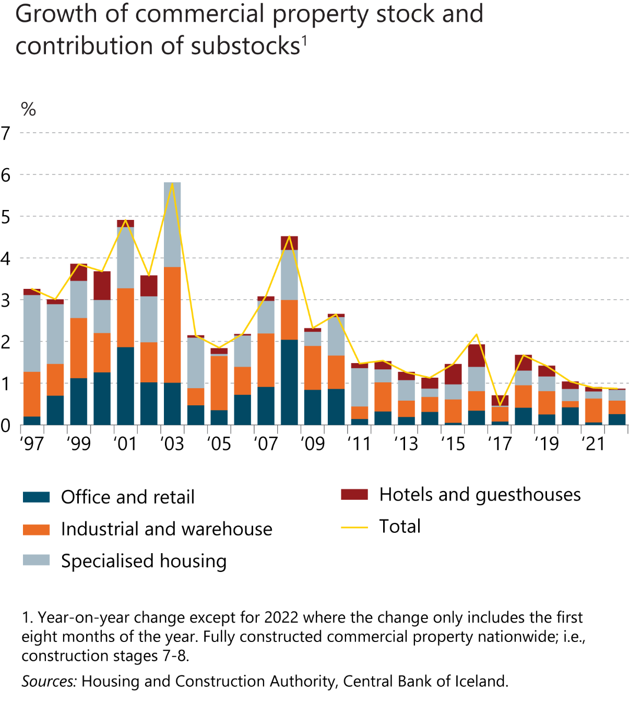
I Financial Stability: Developments and prospects

Slide 37
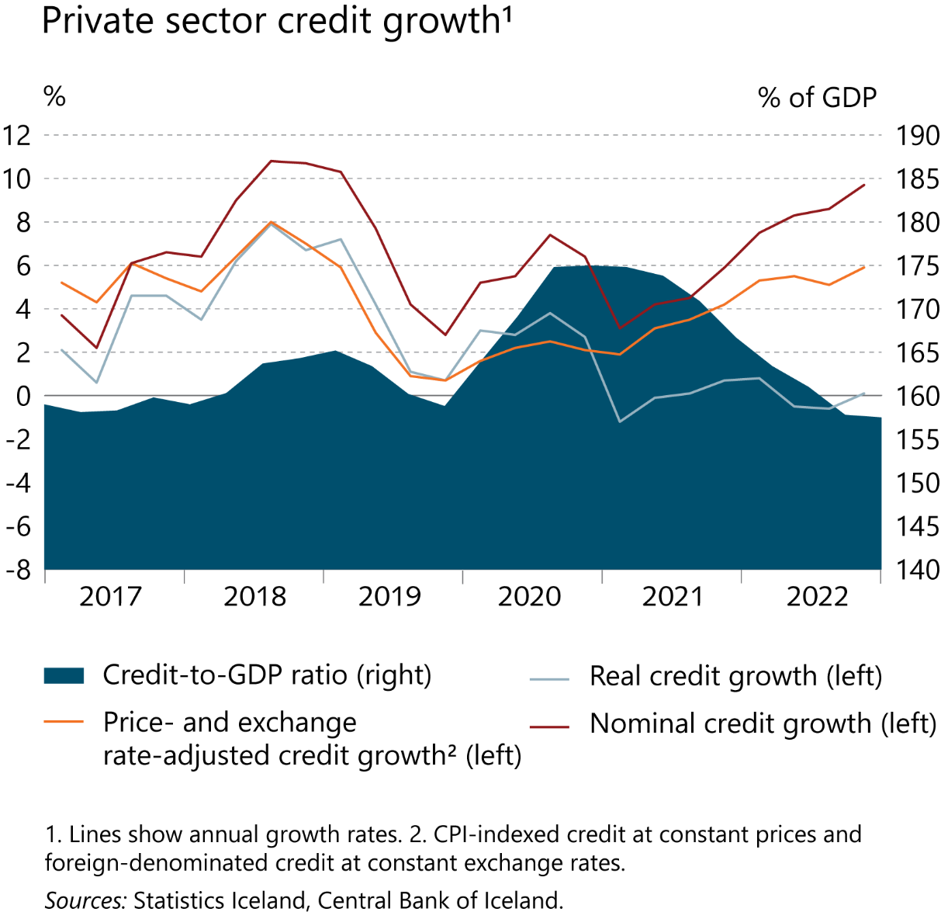
I Financial Stability: Developments and prospects

Slide 38
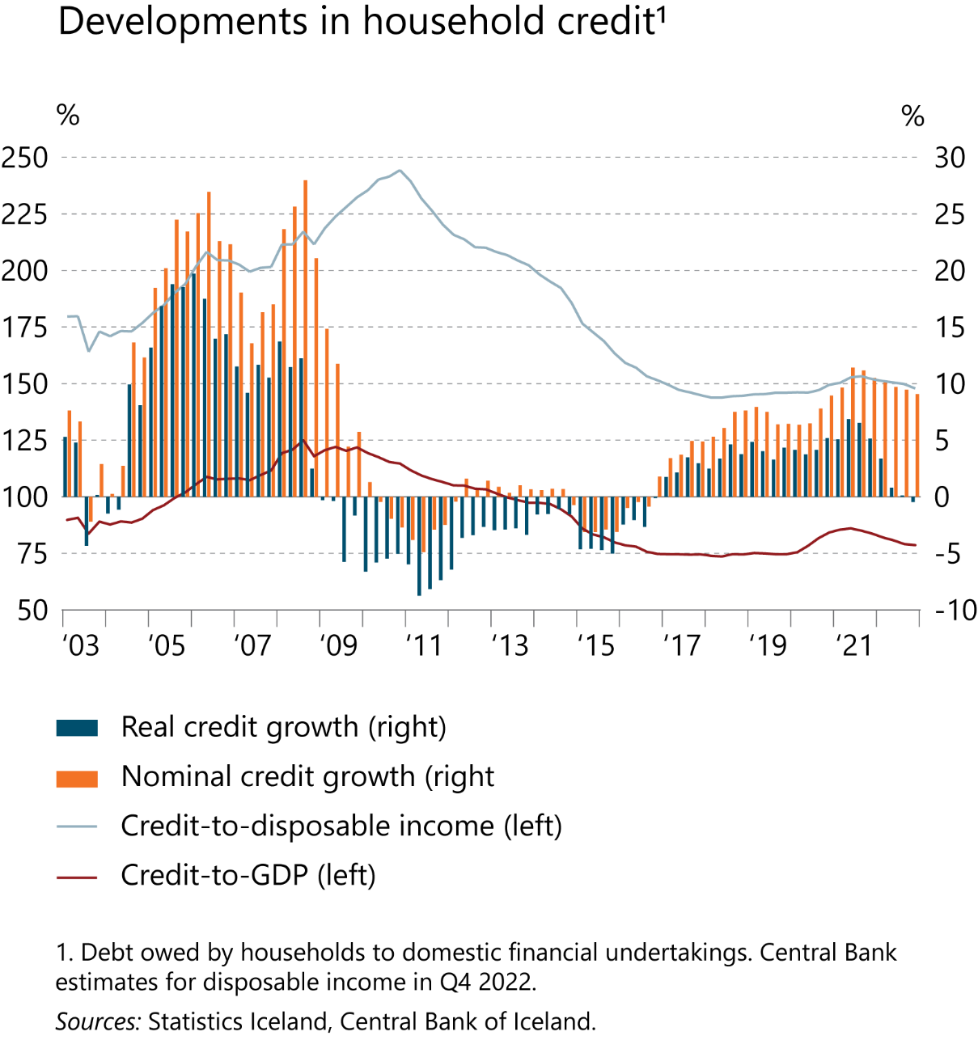
I Financial Stability: Developments and prospects

Slide 39
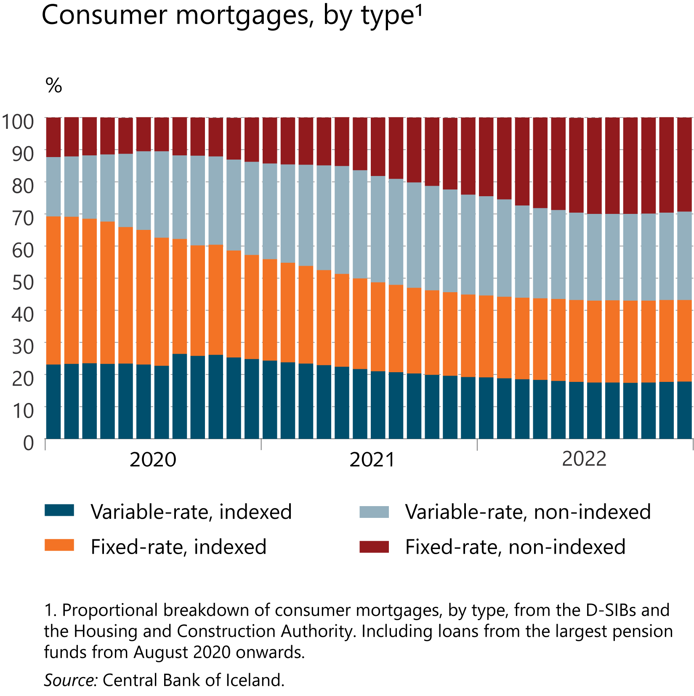
I Financial Stability: Developments and prospects

Slide 40
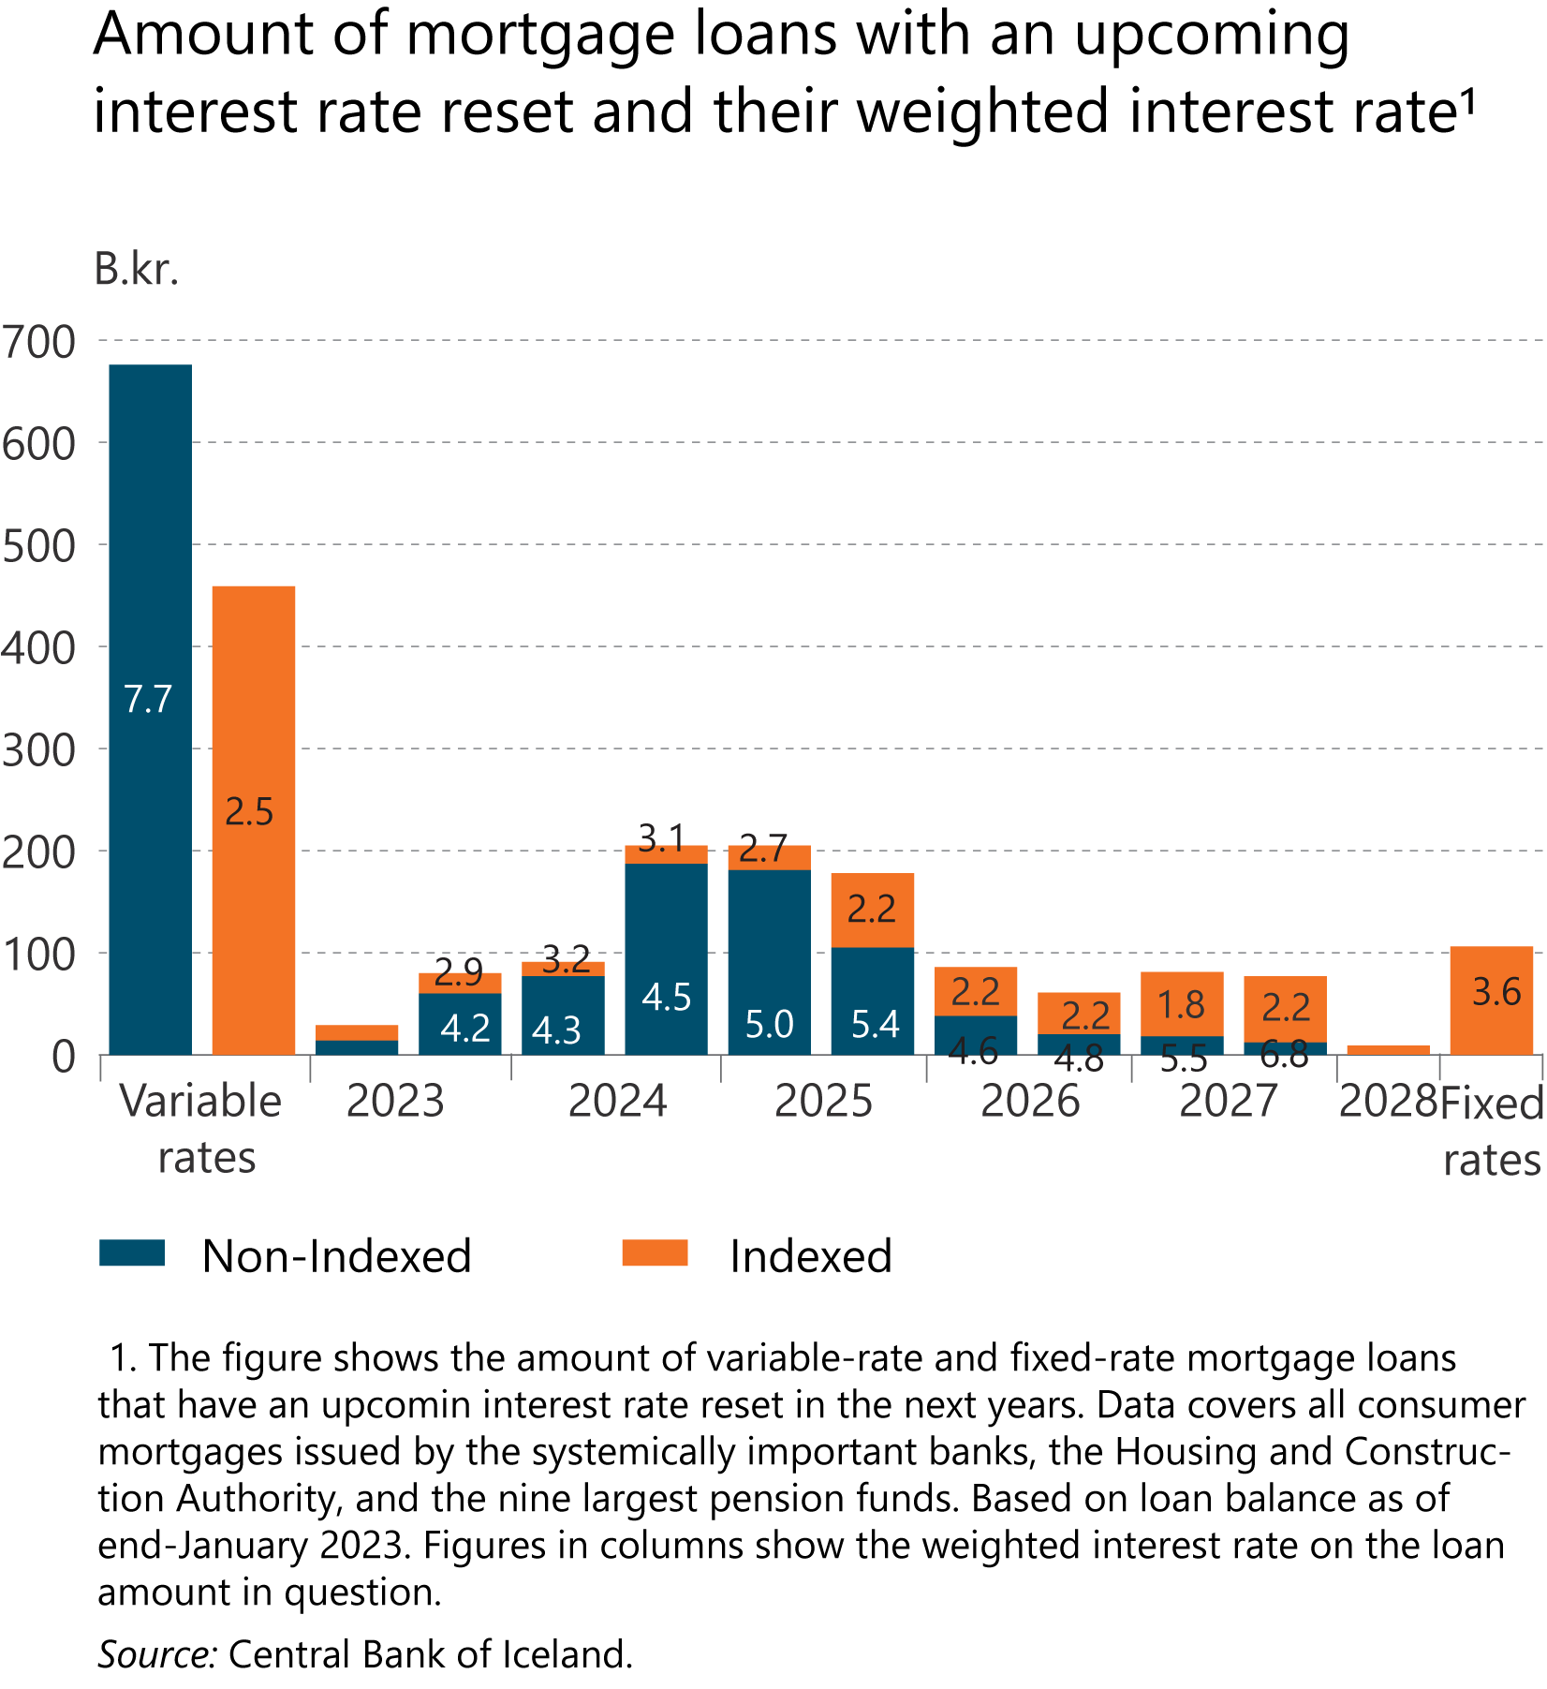
I Financial Stability: Developments and prospects

Slide 41
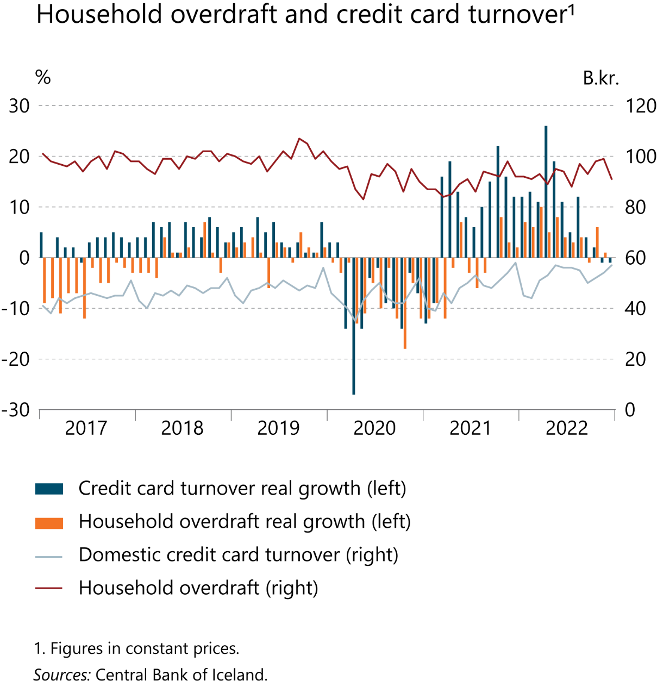
I Financial Stability: Developments and prospects

Slide 42
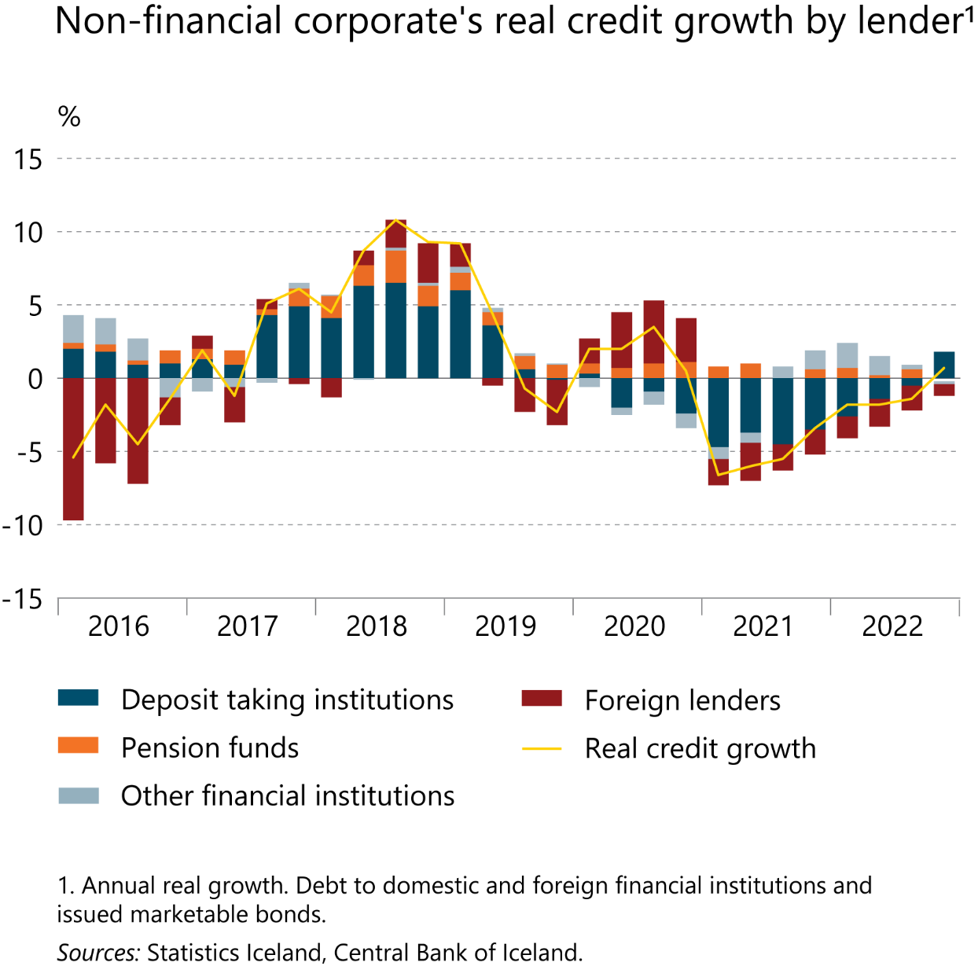
I Financial Stability: Developments and prospects

Slide 43
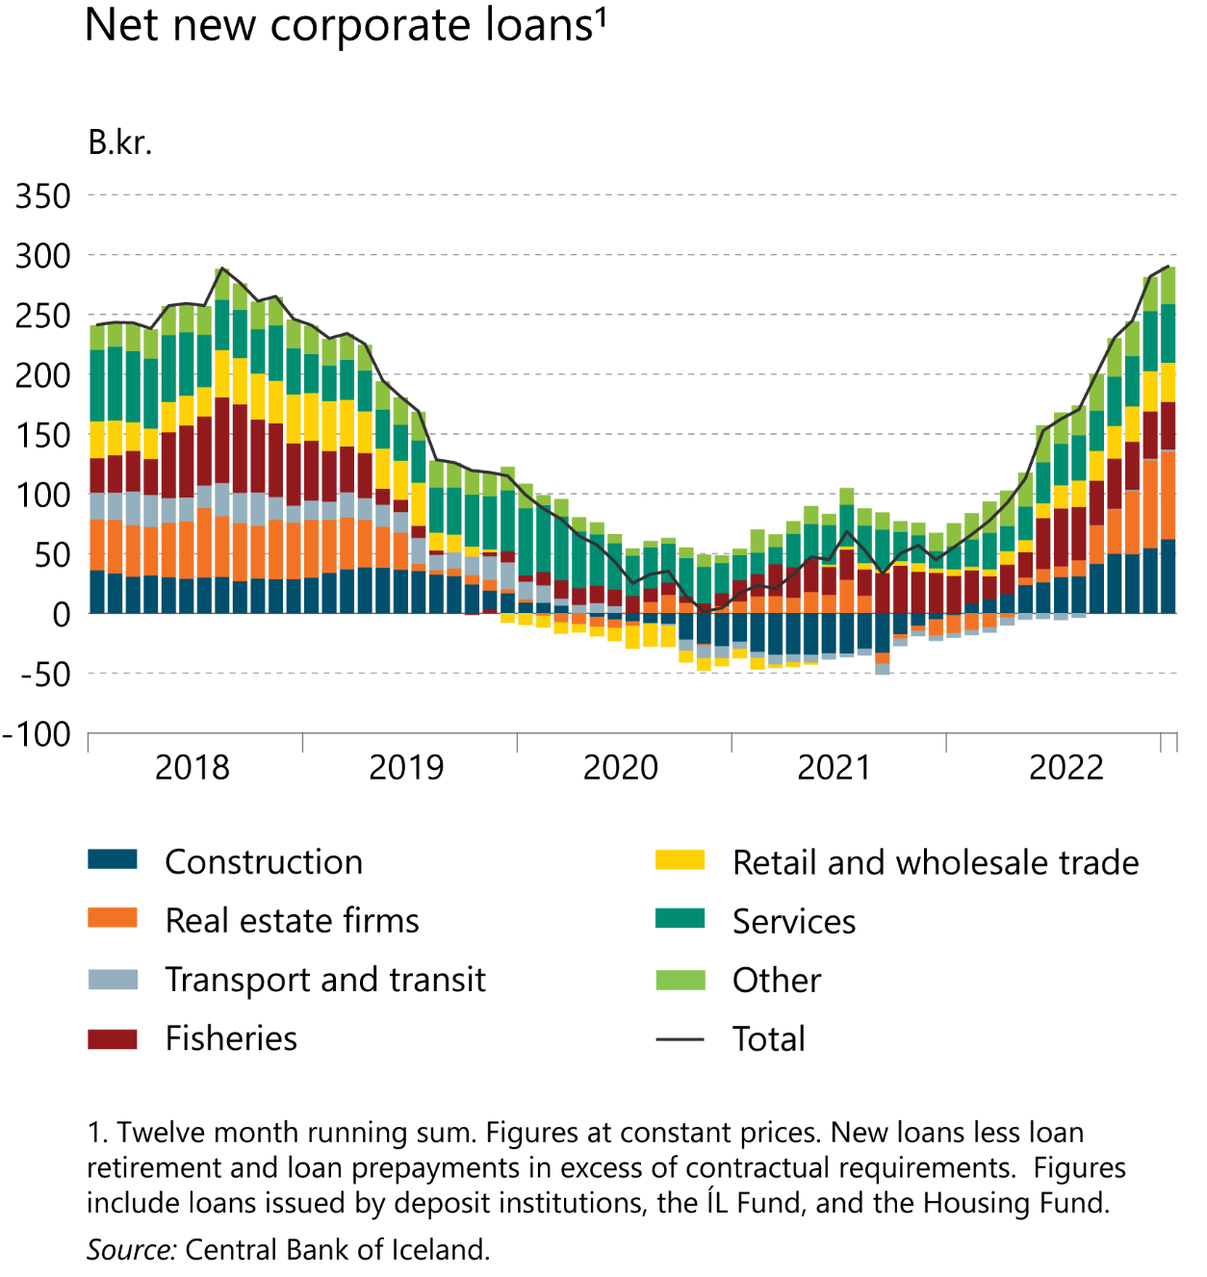
I Financial Stability: Developments and prospects

Slide 44
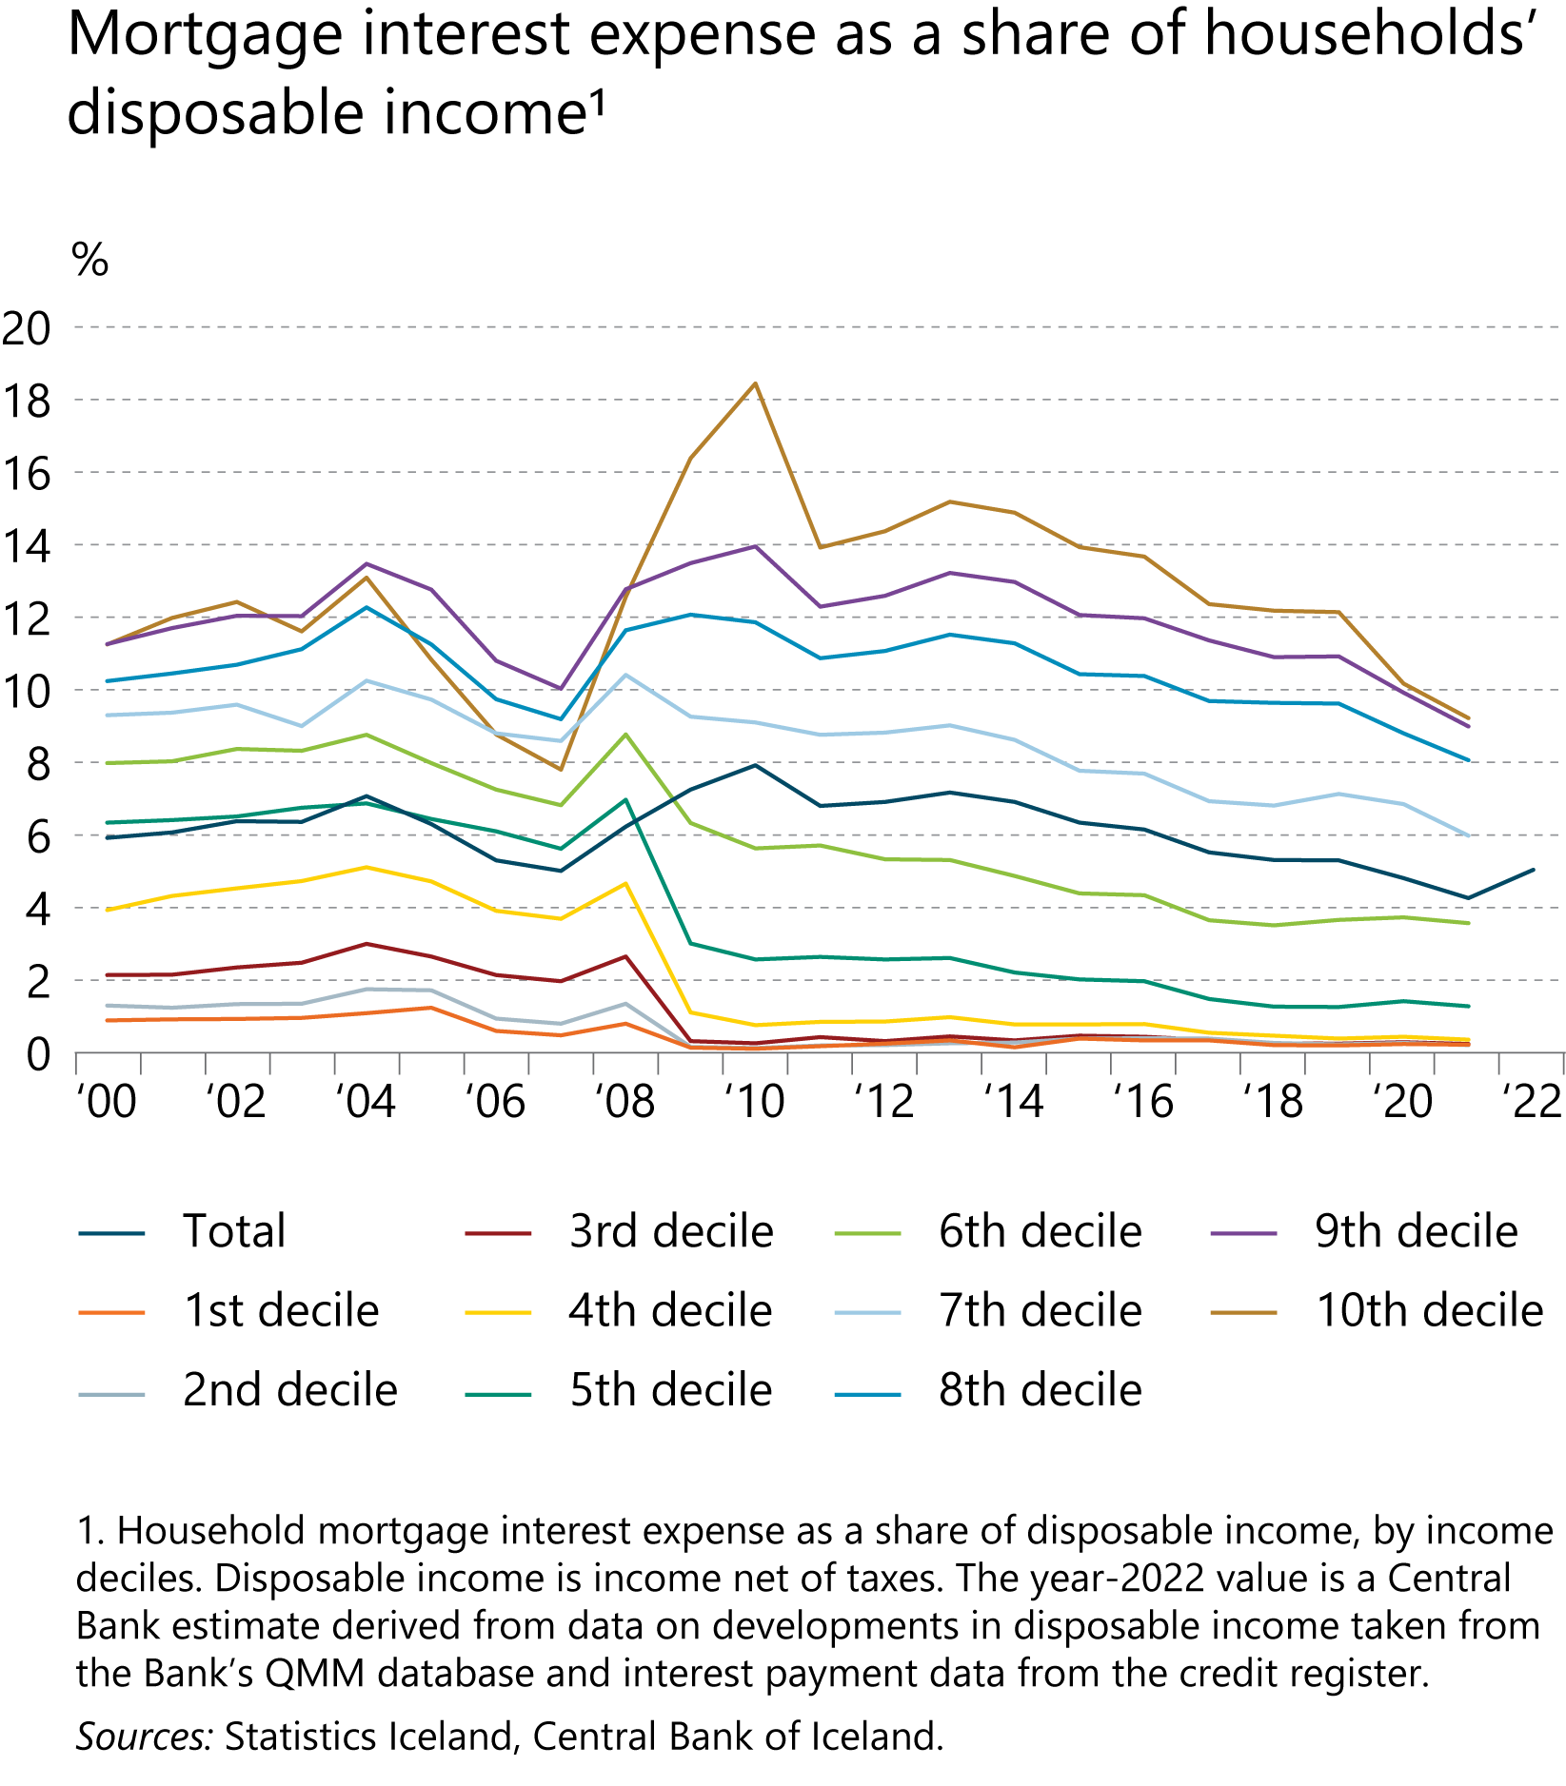
I Financial Stability: Developments and prospects

Slide 45
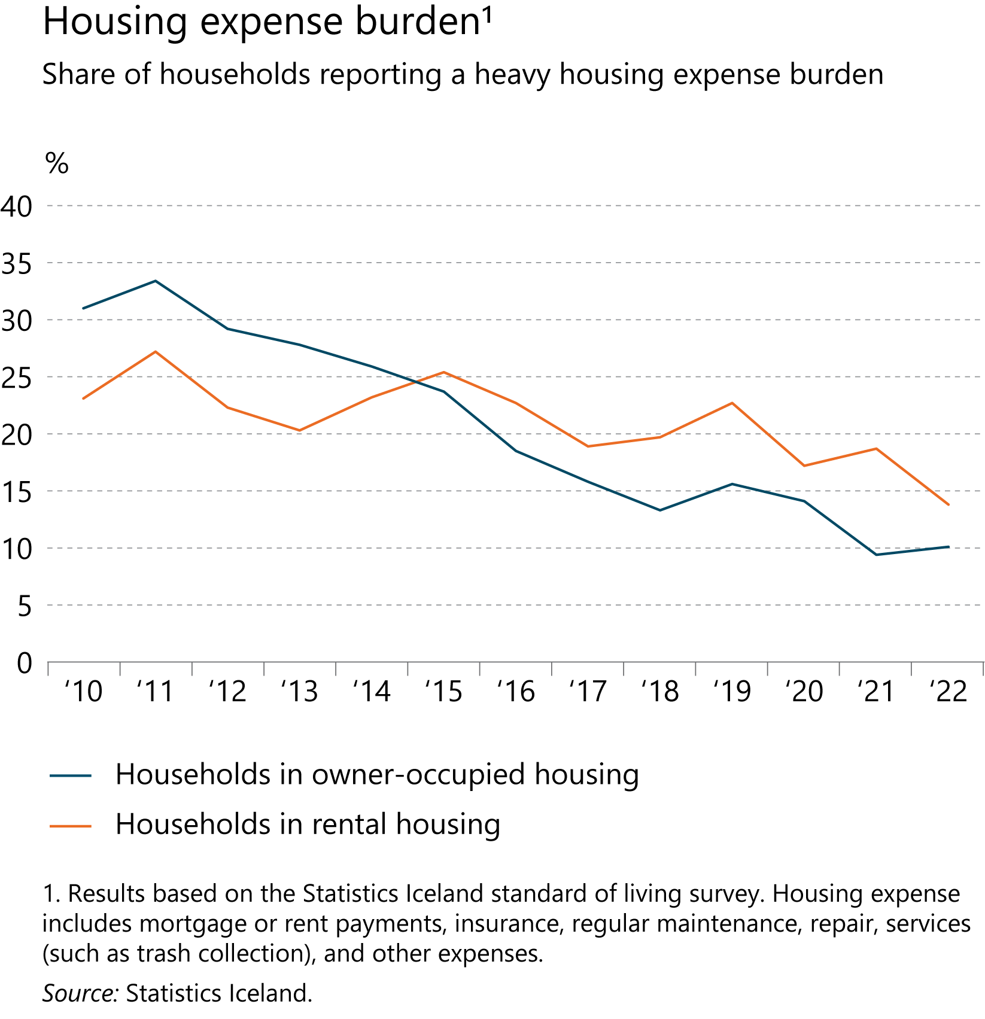
I Financial Stability: Developments and prospects

Slide 46
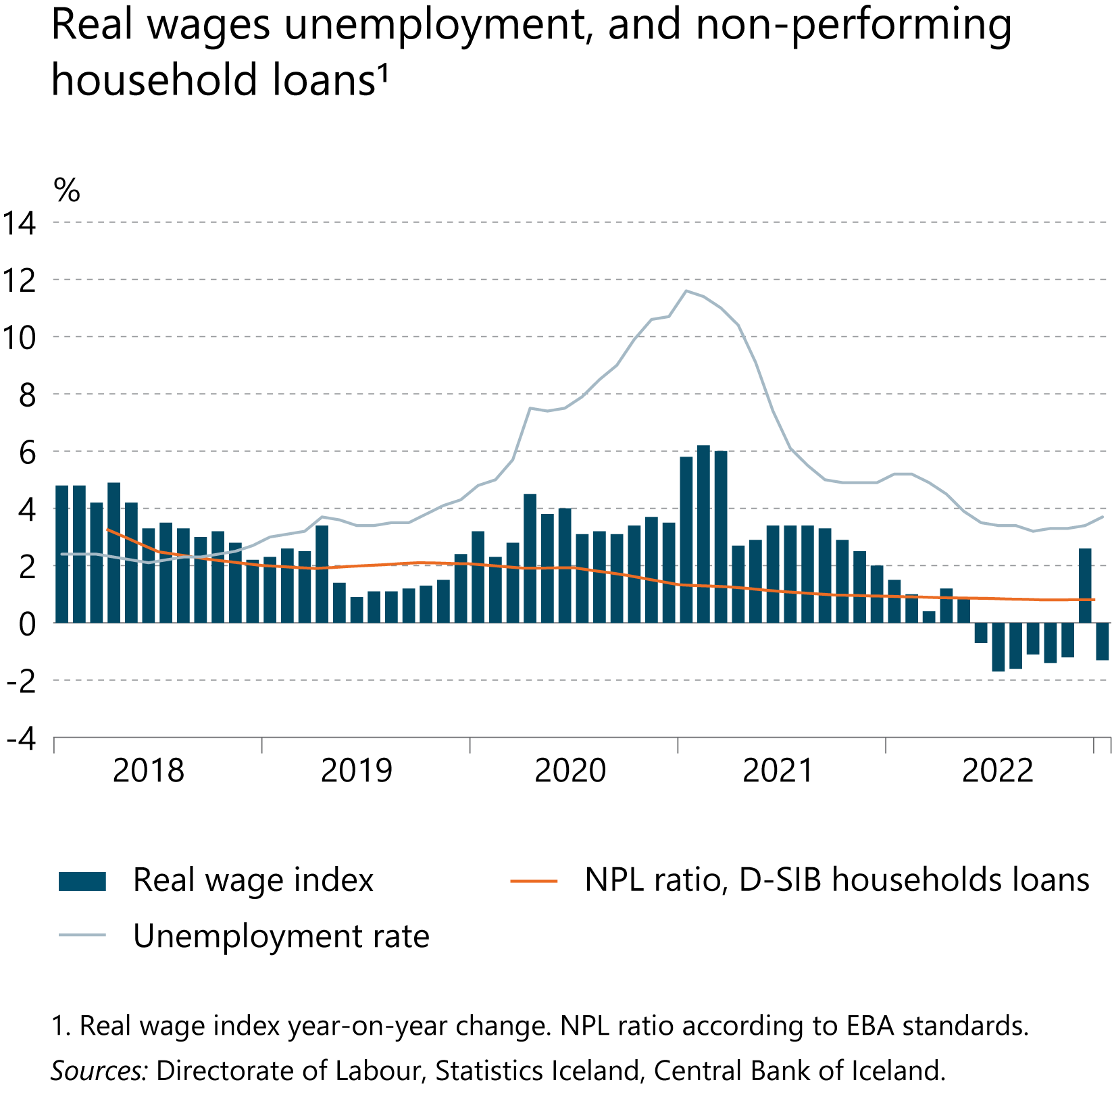
I Financial Stability: Developments and prospects

Slide 47
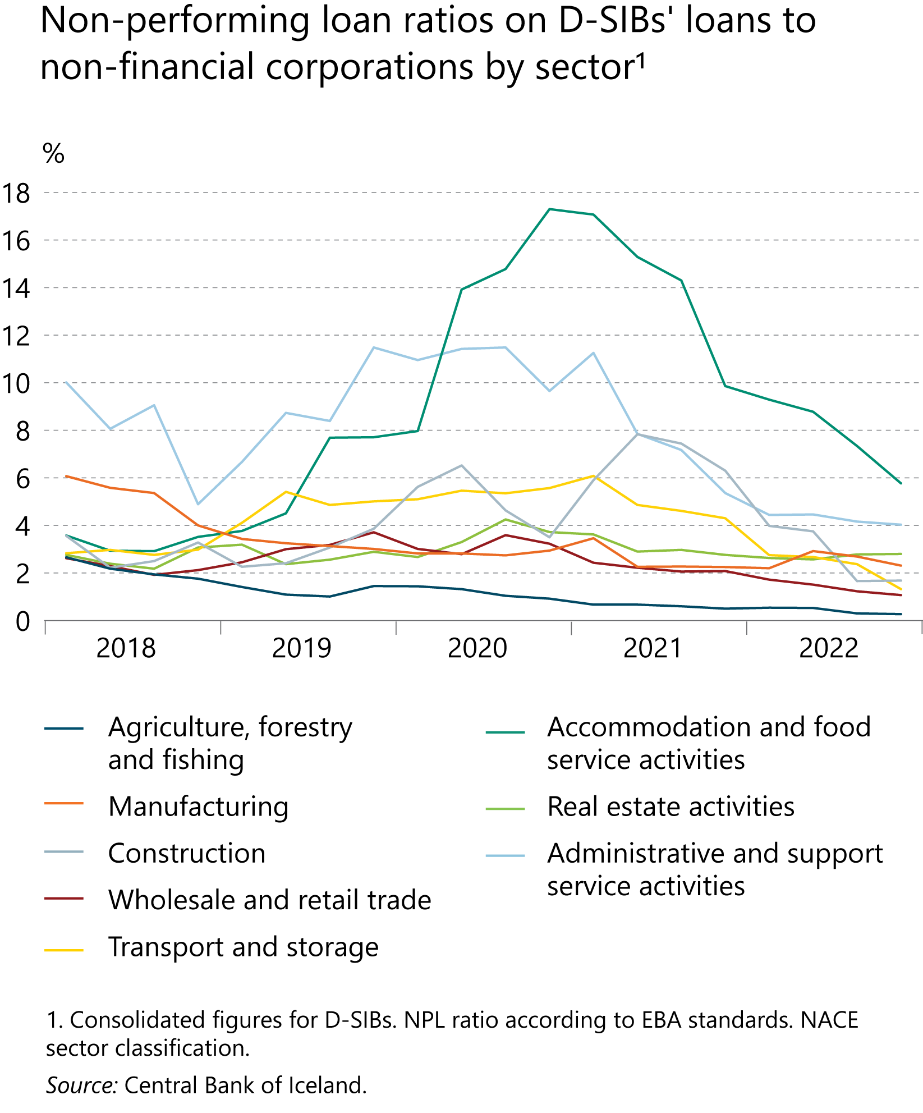
I Financial Stability: Developments and prospects

Slide 48
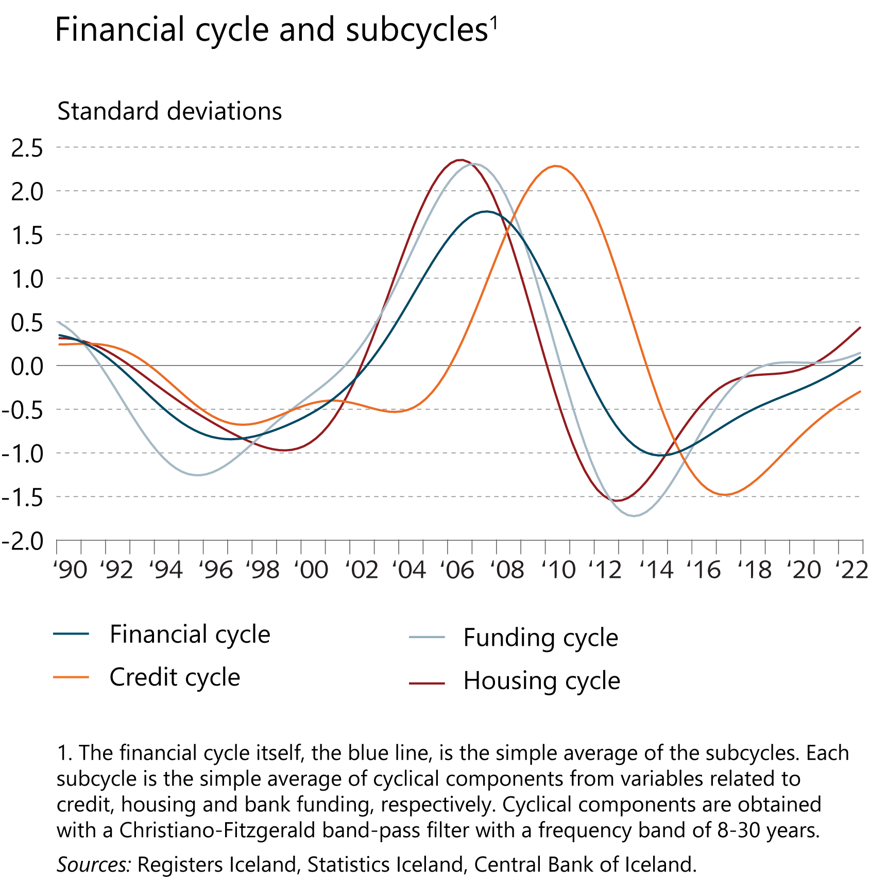
I Financial Stability: Developments and prospects

Slide 49
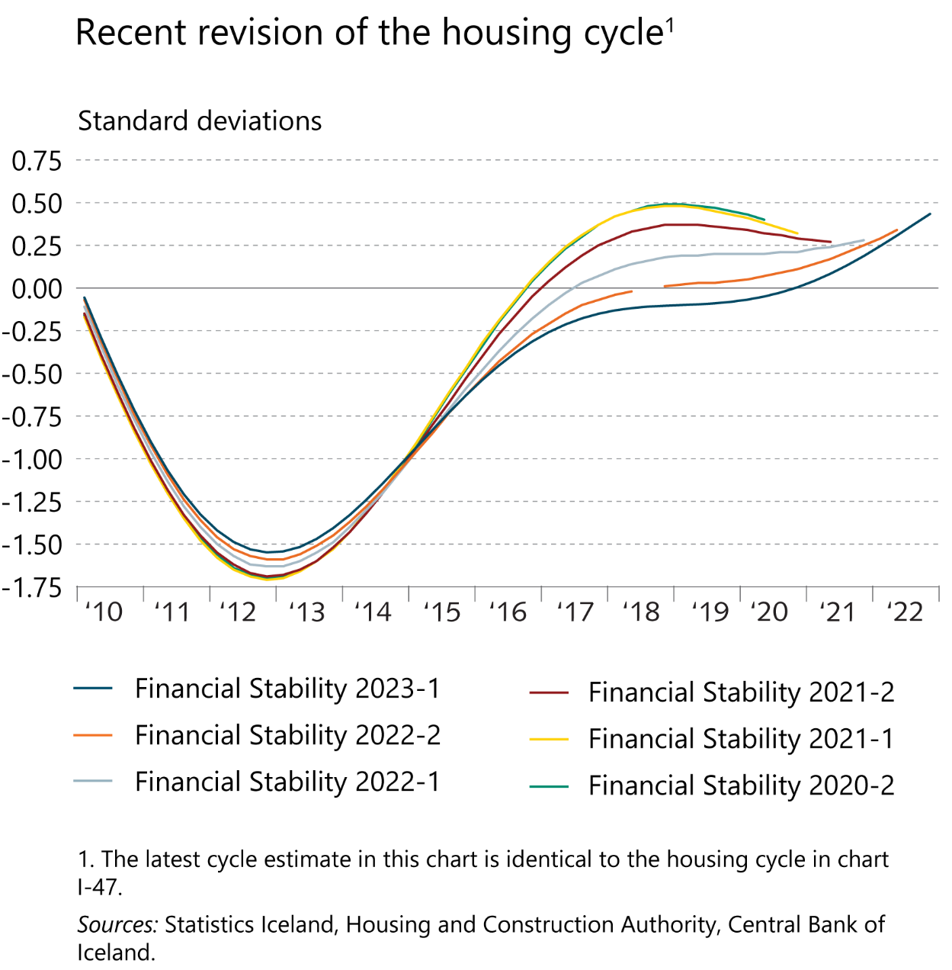
I Financial Stability: Developments and prospects

Slide 50
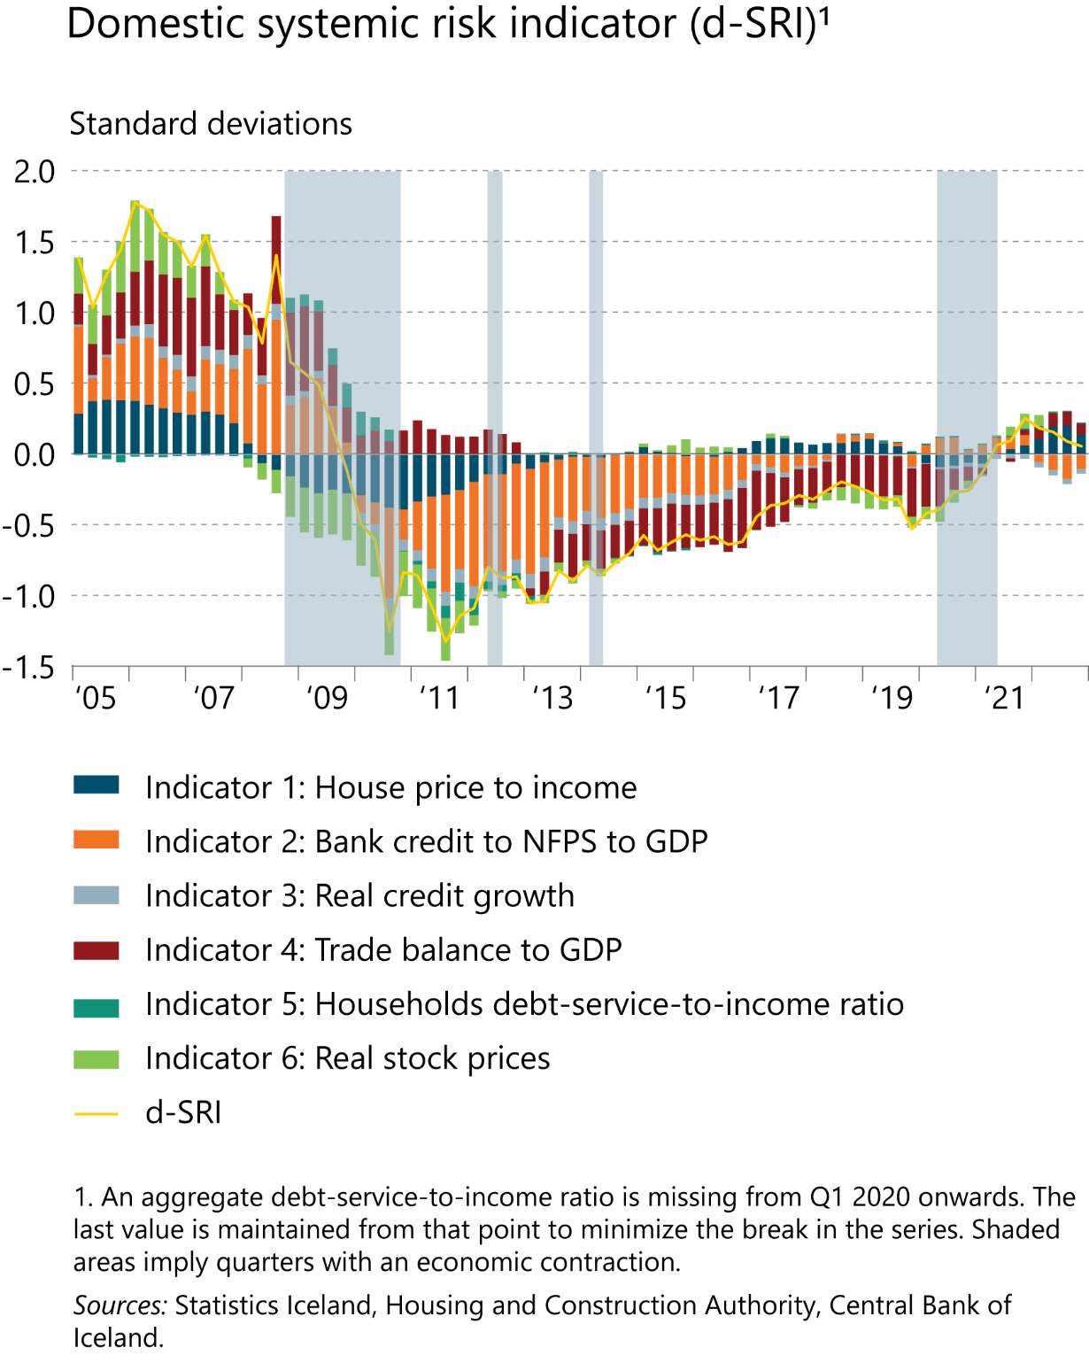
I Financial Stability: Developments and prospects

Slide 51
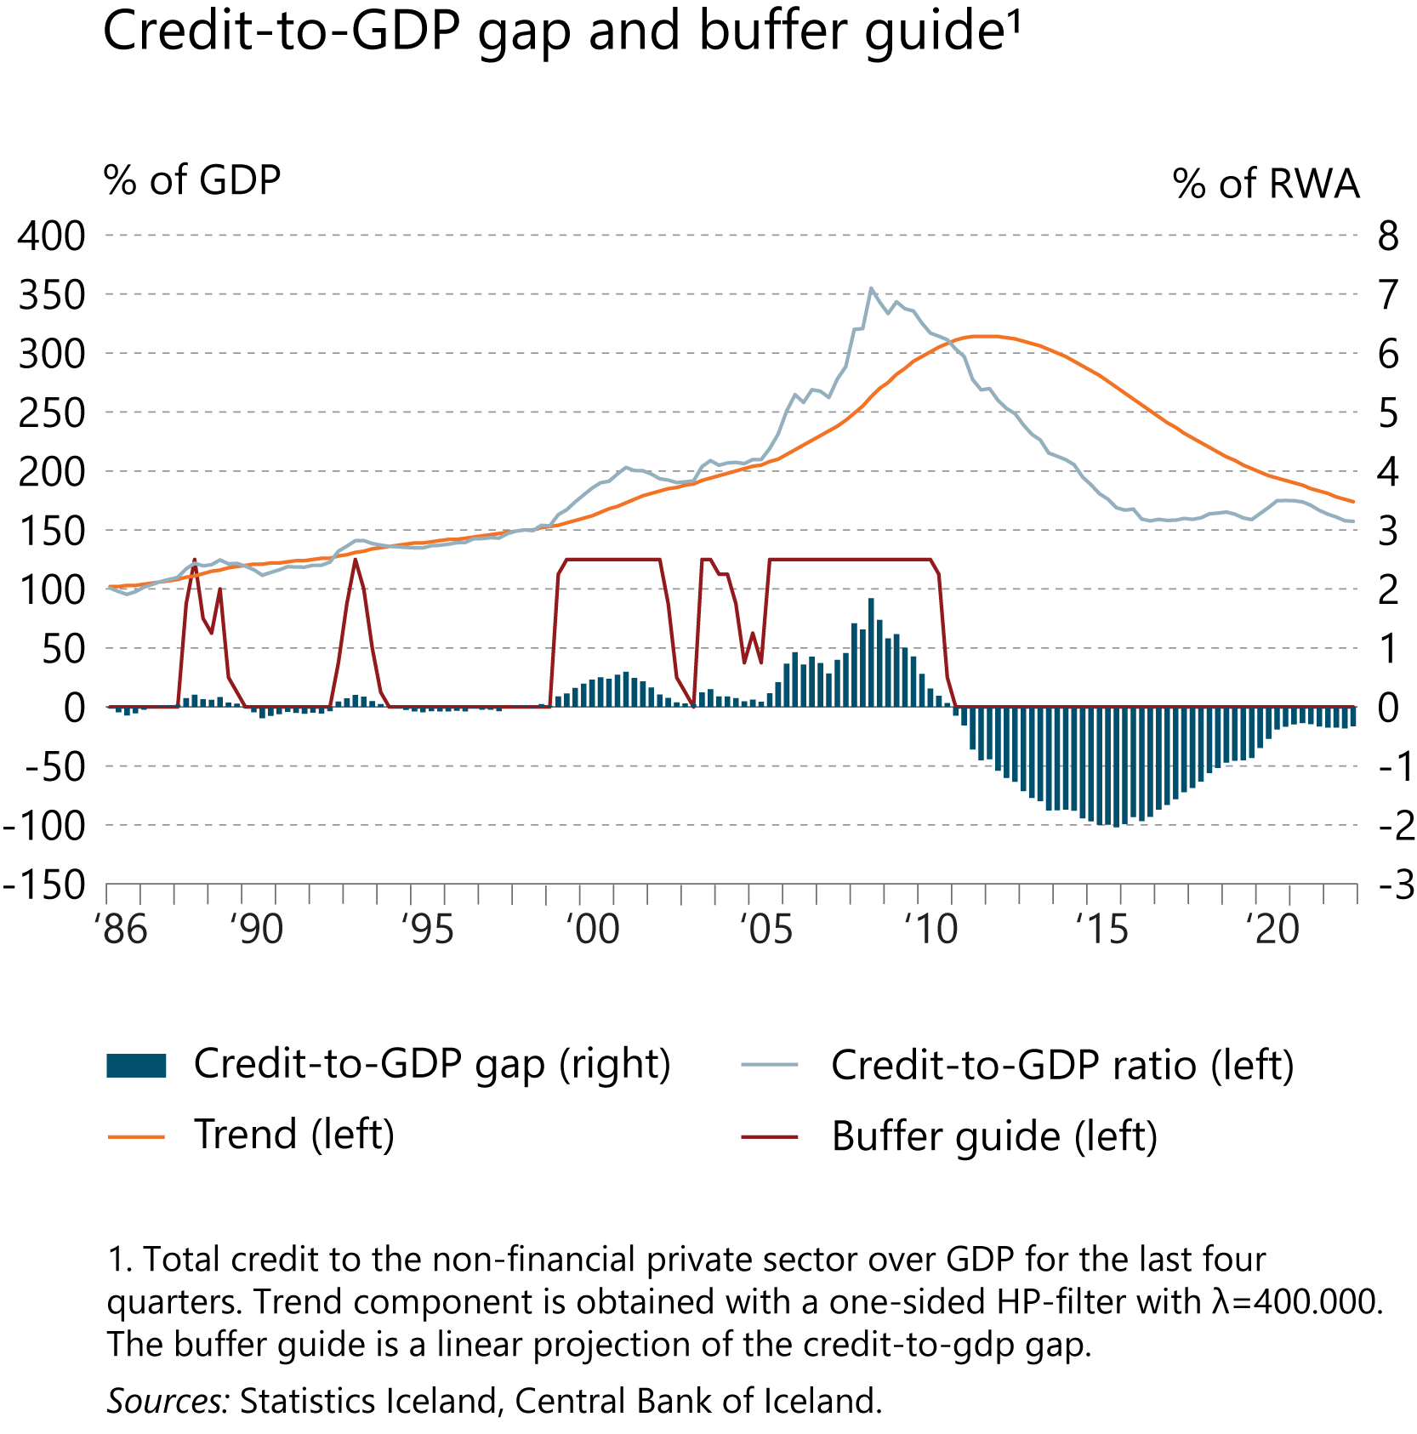
I Financial Stability: Developments and prospects

Slide 52
II The financial system

Slide 53
II The financial system

Slide 54
II The financial system

Slide 55
II The financial system

Slide 56
II The financial system

Slide 57
II The financial system

Slide 58
II The financial system

Slide 59
II The financial system

Slide 60
II The financial system

Slide 61
II The financial system

Slide 62
II The financial system

Slide 63
II The financial system

Slide 64
II The financial system

Slide 65
II The financial system

Slide 66
II The financial system

Slide 67
II The financial system

Slide 68
Box

Slide 69
Box

Slide 70
Box

Slide 71
Box

Slide 72
Box

Slide 73
Box

Slide 74
Box

Slide 75
Box

Slide 76
Box

Slide 77
Box

