Slide 1
Financial Stability 2021/1
Charts
April 2021

Slide 2
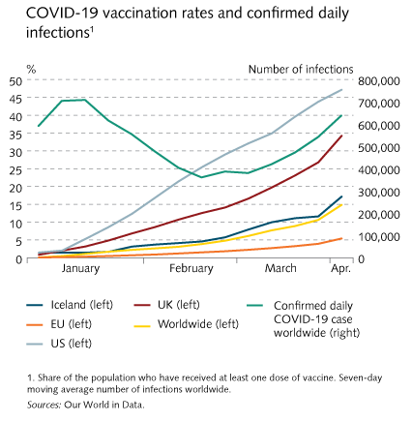
I Financial Stability: Developments and prospects

Slide 3
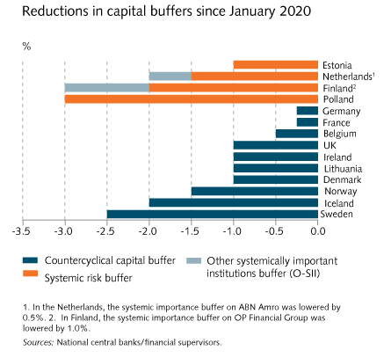
I Financial Stability: Developments and prospects

Slide 4
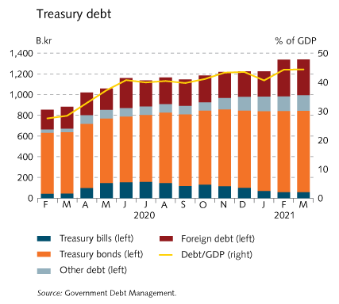
I Financial Stability: Developments and prospects

Slide 5
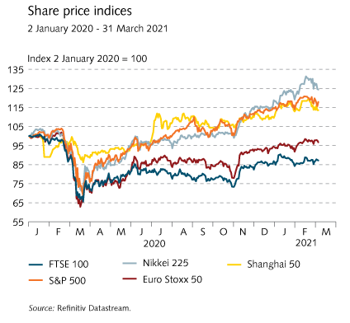
I Financial Stability: Developments and prospects

Slide 6
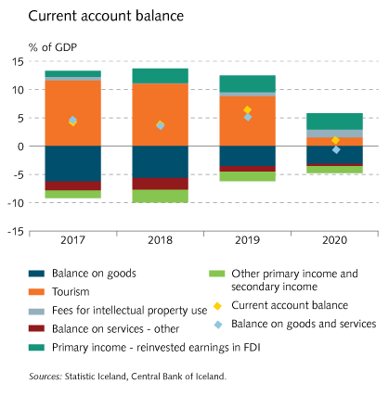
I Financial Stability: Developments and prospects

Slide 7
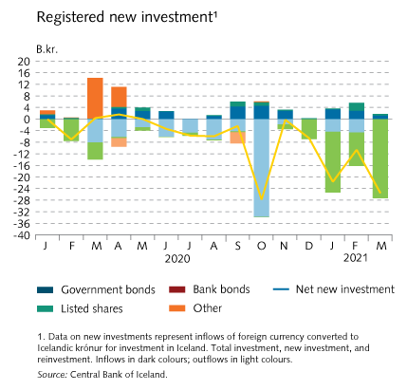
I Financial Stability: Developments and prospects

Slide 8
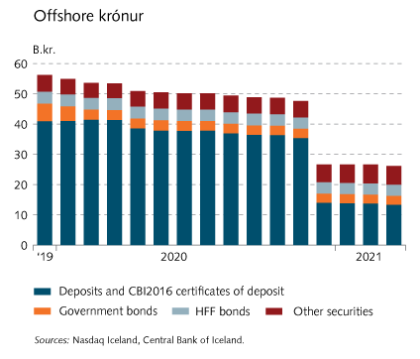
I Financial Stability: Developments and prospects

Slide 9
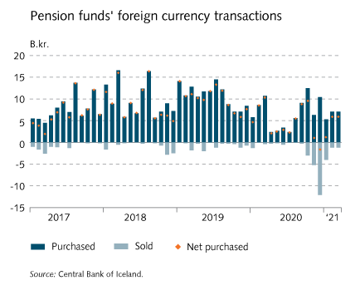
I Financial Stability: Developments and prospects

Slide 10
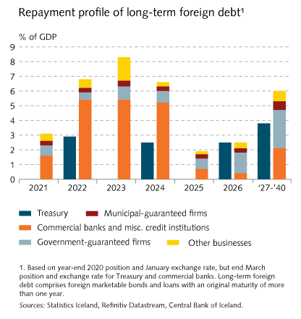
I Financial Stability: Developments and prospects

Slide 11
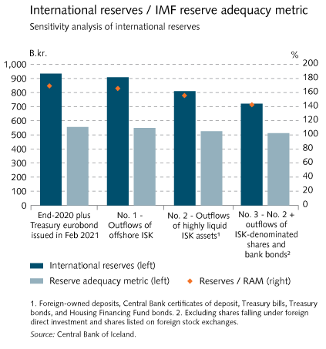
I Financial Stability: Developments and prospects

Slide 12
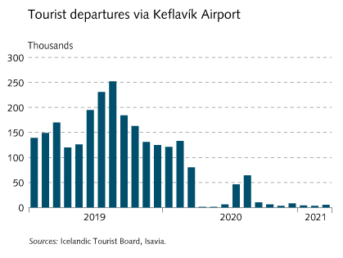
I Financial Stability: Developments and prospects

Slide 13
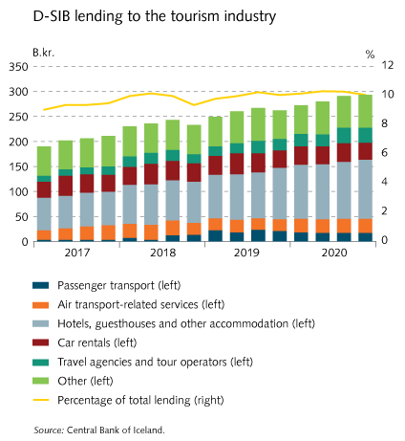
I Financial Stability: Developments and prospects

Slide 14
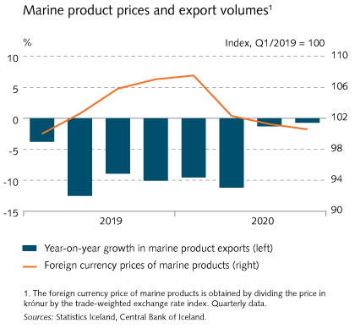
I Financial Stability: Developments and prospects

Slide 15
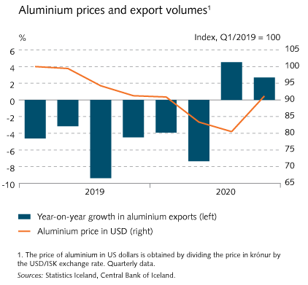
I Financial Stability: Developments and prospects

Slide 16
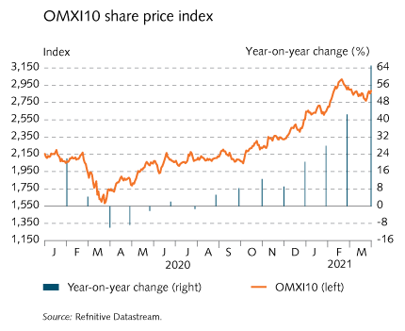
I Financial Stability: Developments and prospects

Slide 17
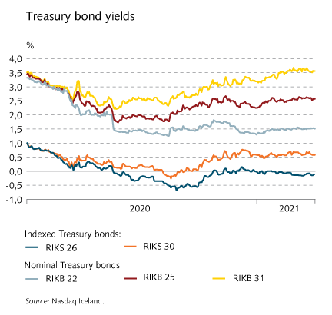
I Financial Stability: Developments and prospects

Slide 18
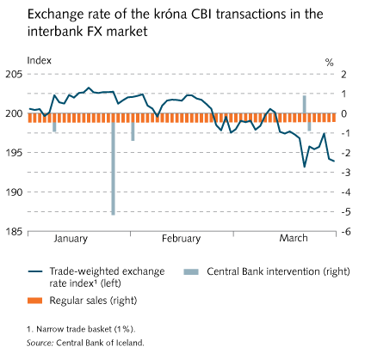
I Financial Stability: Developments and prospects

Slide 19
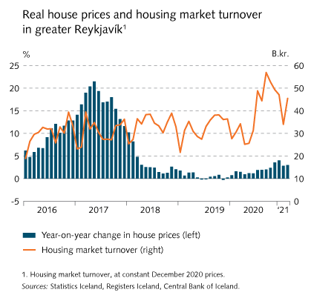
I Financial Stability: Developments and prospects

Slide 20
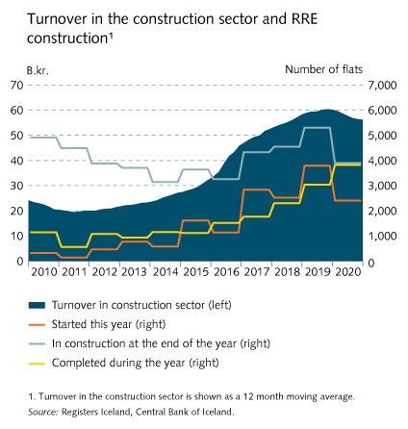
I Financial Stability: Developments and prospects

Slide 21
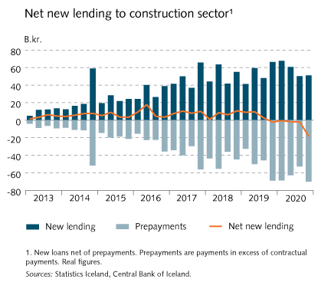
I Financial Stability: Developments and prospects

Slide 22
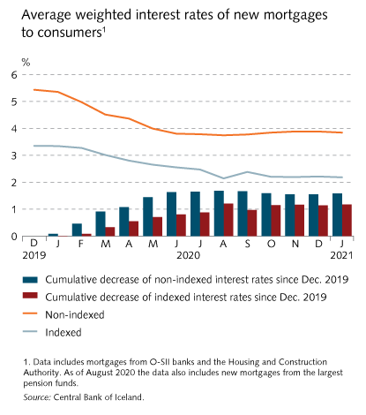
I Financial Stability: Developments and prospects

Slide 23
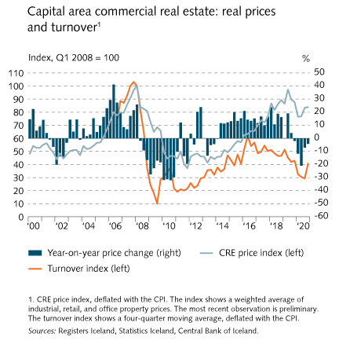
I Financial Stability: Developments and prospects

Slide 24
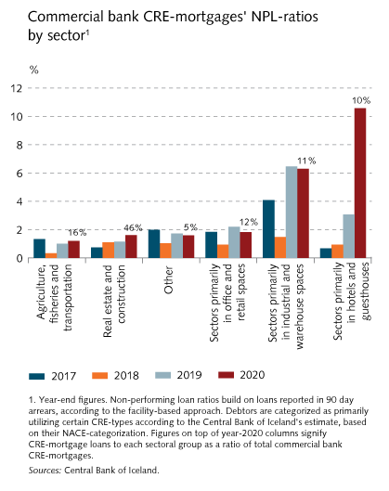
I Financial Stability: Developments and prospects

Slide 25
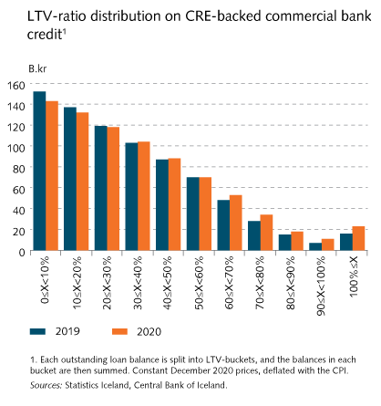
I Financial Stability: Developments and prospects

Slide 26
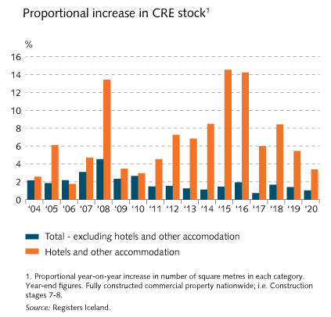
I Financial Stability: Developments and prospects

Slide 27
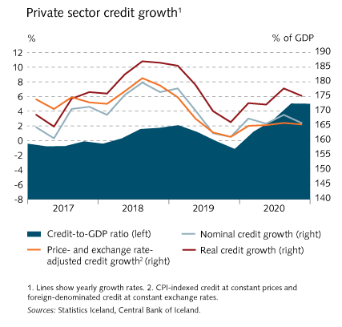
I Financial Stability: Developments and prospects

Slide 28
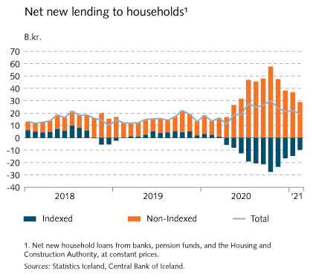
I Financial Stability: Developments and prospects

Slide 29
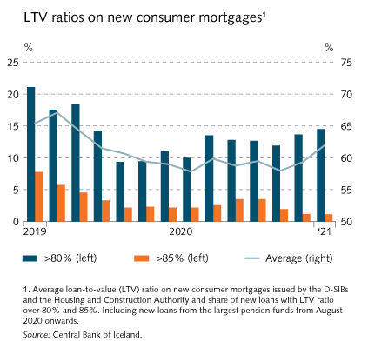
I Financial Stability: Developments and prospects

Slide 30
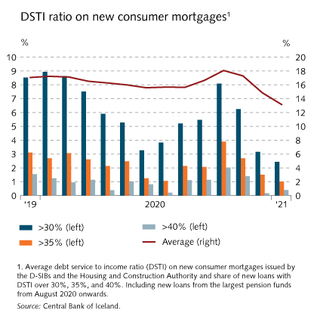
I Financial Stability: Developments and prospects

Slide 31
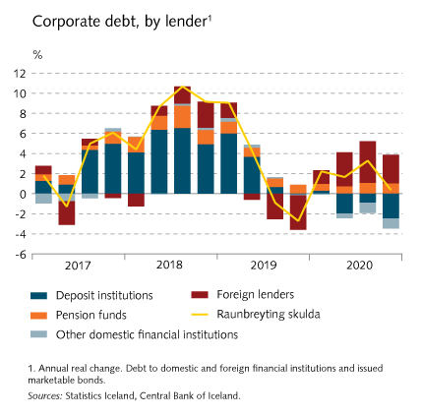
I Financial Stability: Developments and prospects

Slide 32
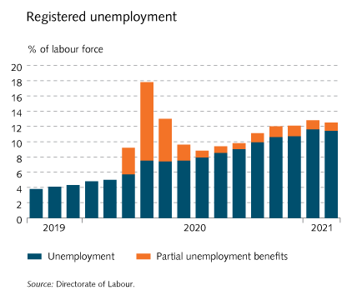
I Financial Stability: Developments and prospects

Slide 33
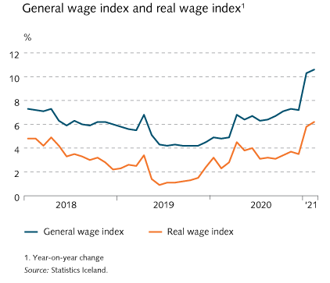
I Financial Stability: Developments and prospects

Slide 34
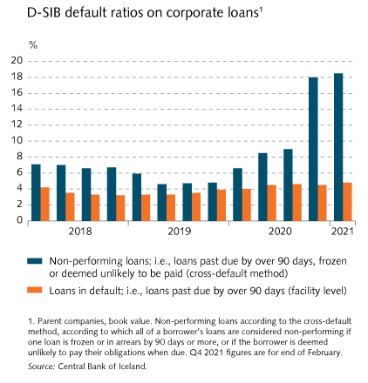
I Financial Stability: Developments and prospects

Slide 35
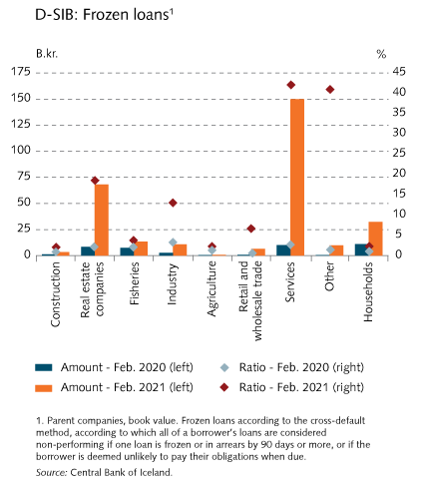
I Financial Stability: Developments and prospects

Slide 36
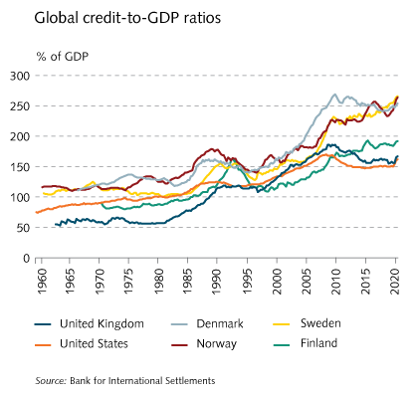
I Financial Stability: Developments and prospects

Slide 37
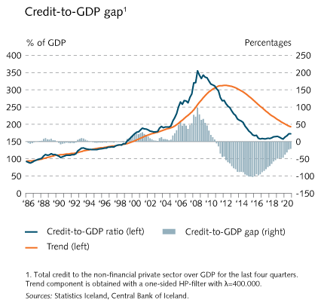
I Financial Stability: Developments and prospects

Slide 38
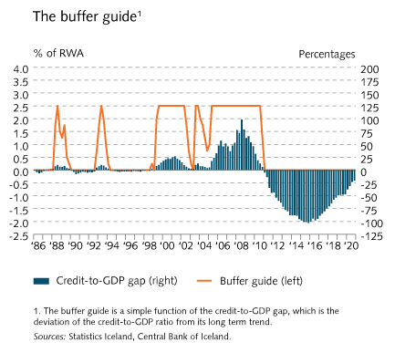
I Financial Stability: Developments and prospects

Slide 39
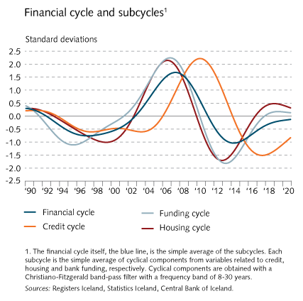
I Financial Stability: Developments and prospects

Slide 40
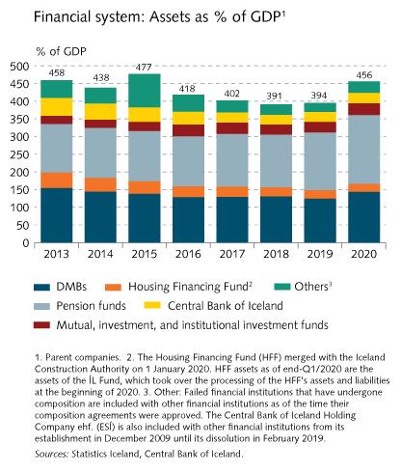
II The financial system

Slide 41
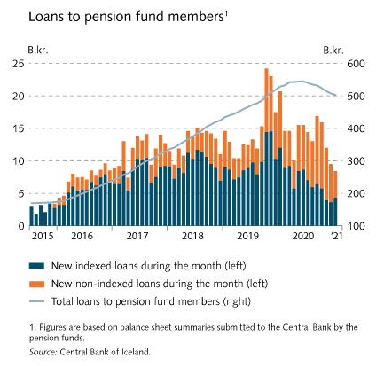
II The financial system

Slide 42
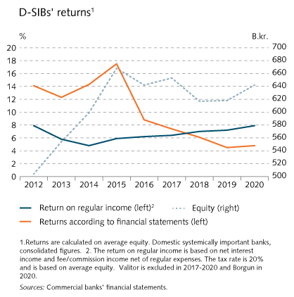
II The financial system

Slide 43
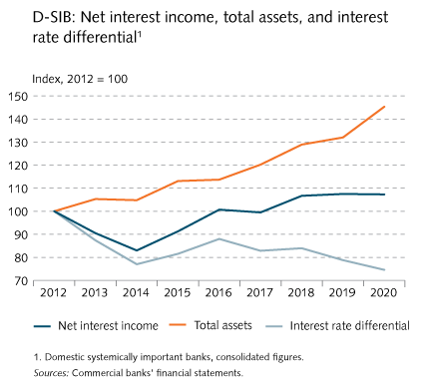
II The financial system

Slide 44
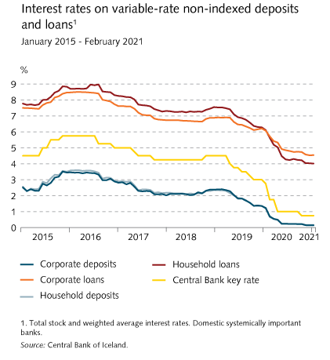
II The financial system

Slide 45
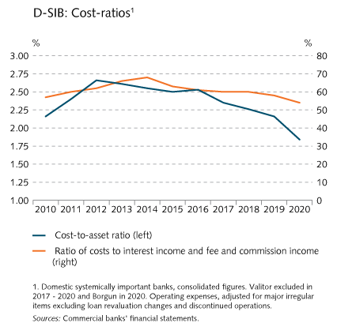
II The financial system

Slide 46
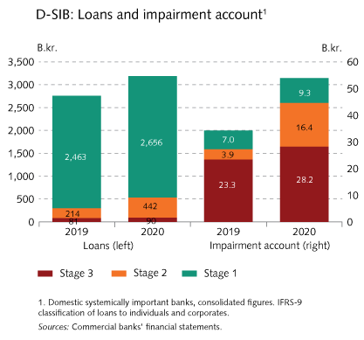
II The financial system

Slide 47
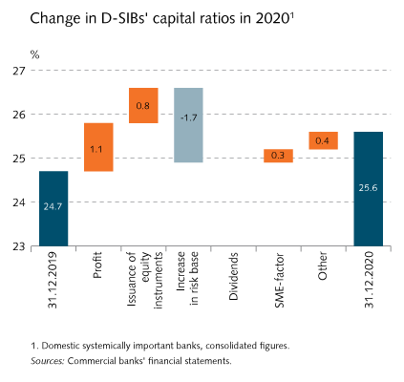
II The financial system

Slide 48
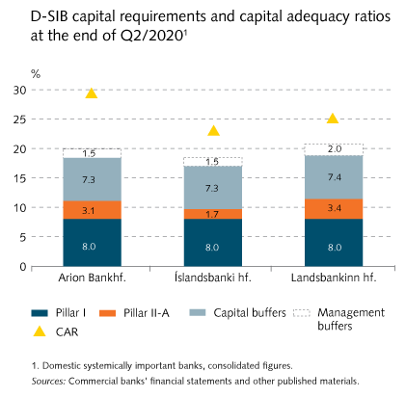
II The financial system

Slide 49
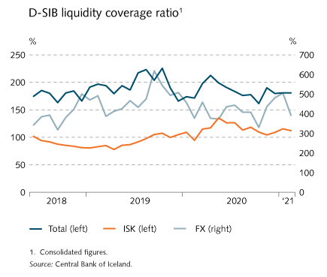
II The financial system

Slide 50
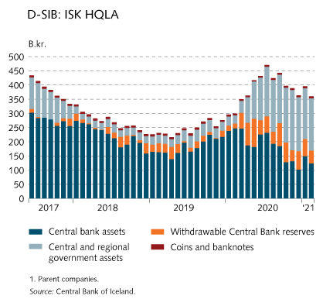
II The financial system

Slide 51
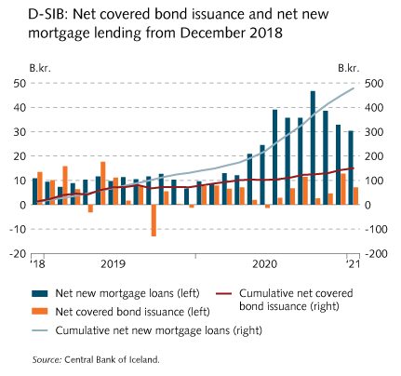
II The financial system

Slide 52
II The financial system

Slide 53
II The financial system

Slide 54
Central Bank scenario analysis

Slide 55
Central Bank scenario analysis

Slide 56
Central Bank scenario analysis

Slide 57
Central Bank scenario analysis

Slide 58
Central Bank scenario analysis

Slide 59
Central Bank scenario analysis

Slide 60
Central Bank scenario analysis

Slide 61
Box

Slide 62
Box

Slide 63
Box

Slide 64
Box

Slide 65
Box

Slide 66
Box

Slide 67
Box

Slide 68
Box

Slide 69
Box

Slide 70
Box

Slide 71
Box

Slide 72
Box

