Slide 1
Central Bank of Iceland
Financial Stability report 2016/2
Charts

Slide 2
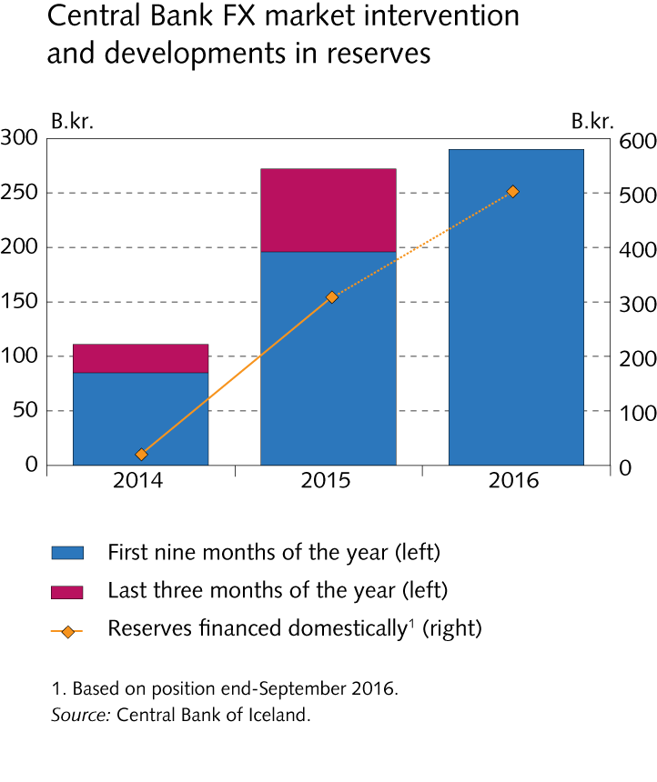
The Financial System – outlook and main risks

Slide 3
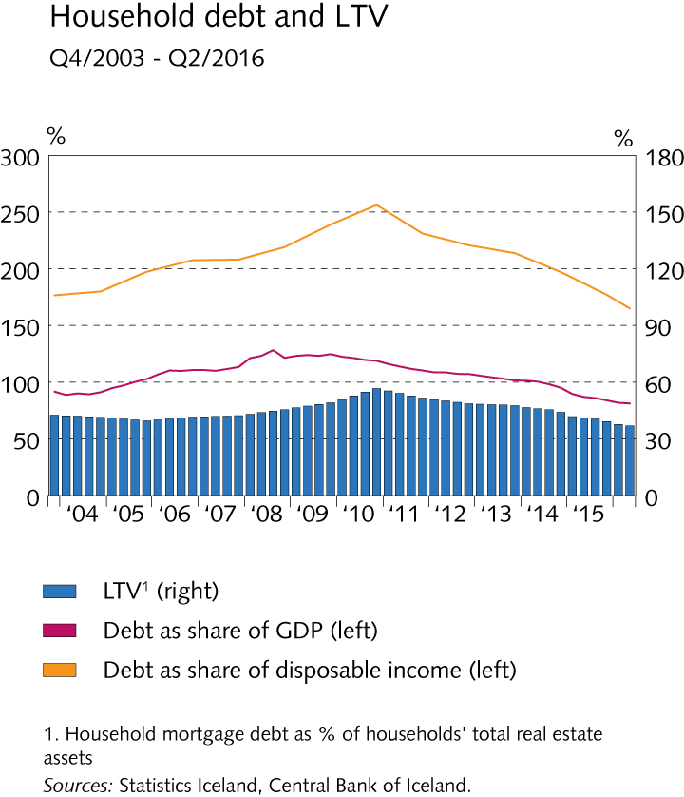
The Financial System – outlook and main risks

Slide 4
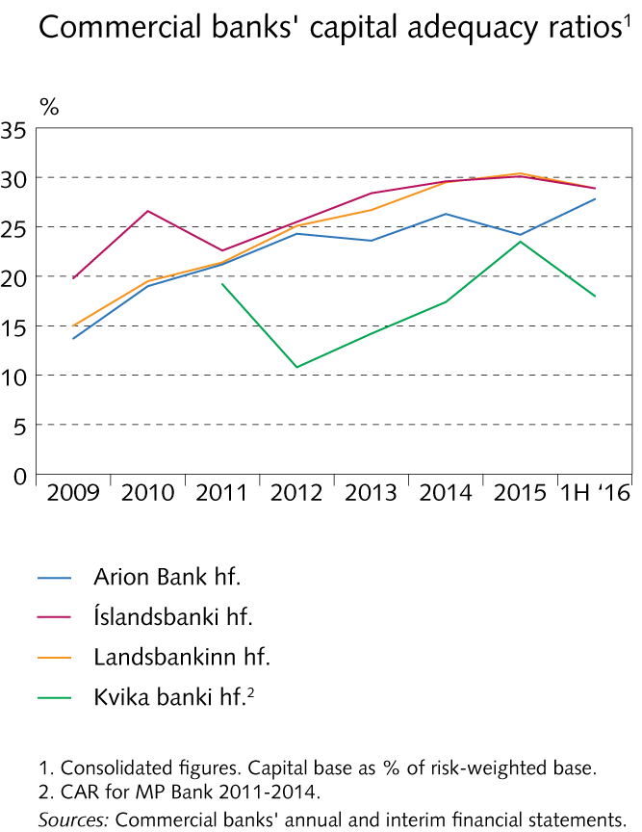
The Financial System – outlook and main risks

Slide 5
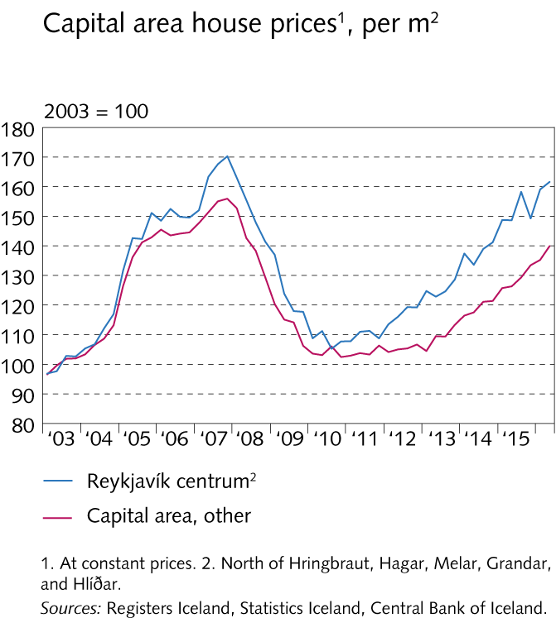
The Financial System – outlook and main risks

Slide 6
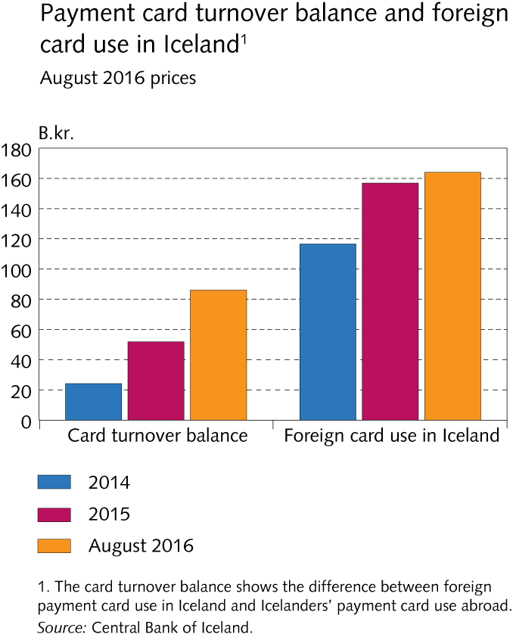
The Financial System – outlook and main risks

Slide 7
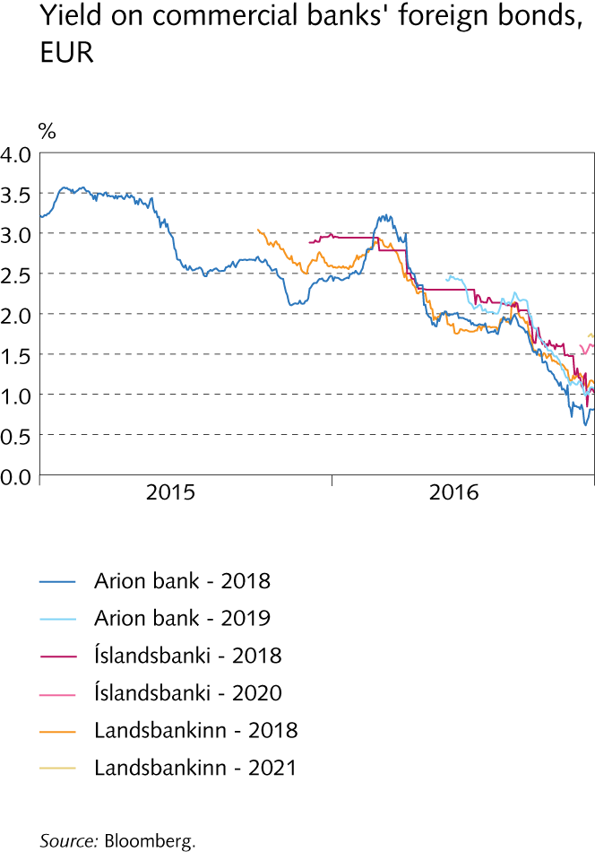
The Financial System – outlook and main risks

Slide 8
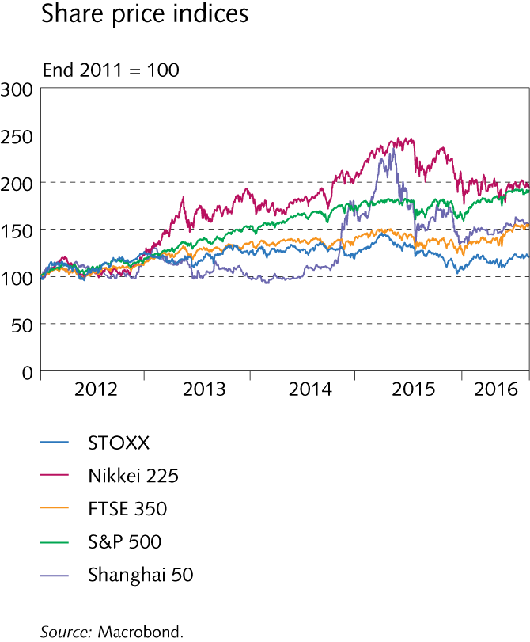
Economic environment and financial markets

Slide 9
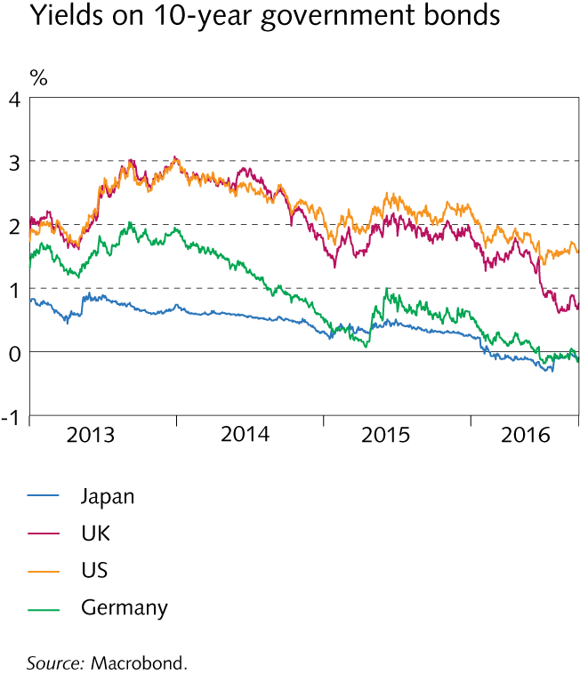
Economic environment and financial markets

Slide 10
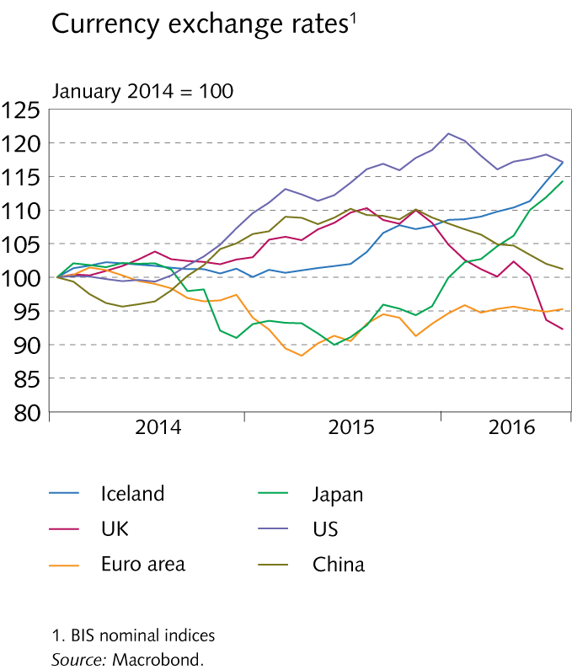
Economic environment and financial markets

Slide 11
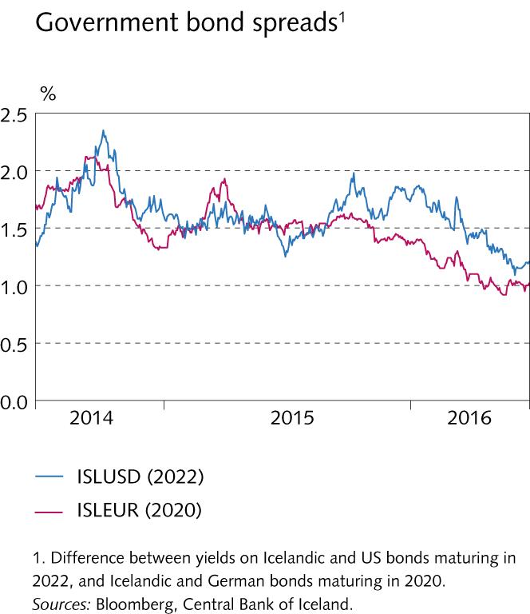
Economic environment and financial markets

Slide 12
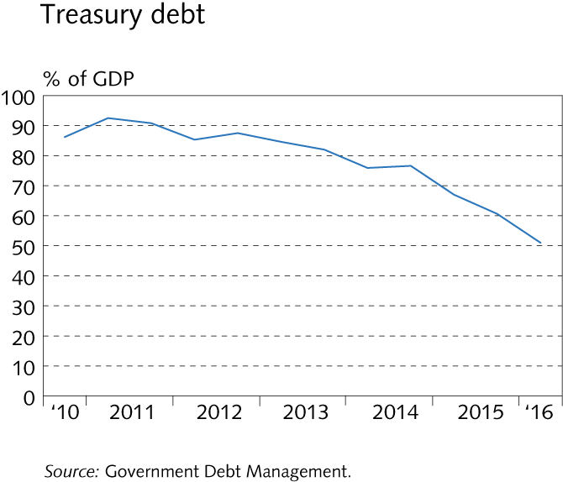
Economic environment and financial markets

Slide 13
Economic environment and financial markets

Slide 14
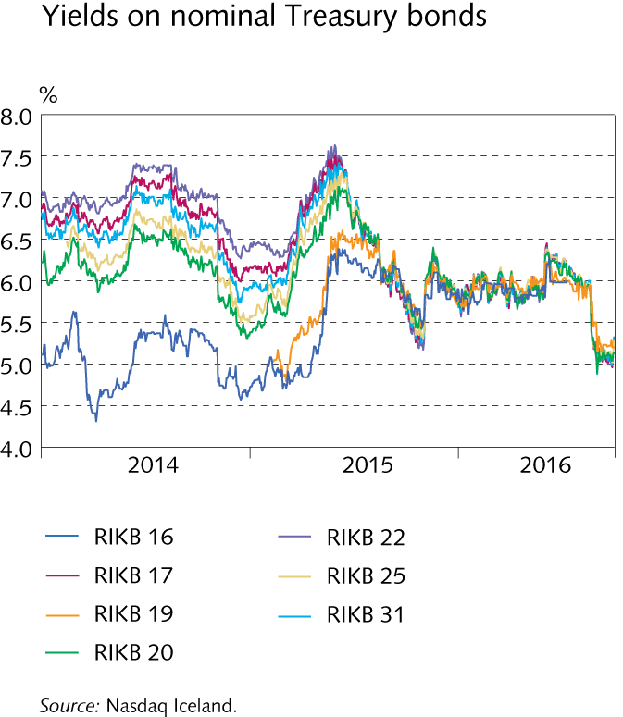
Economic environment and financial markets

Slide 15
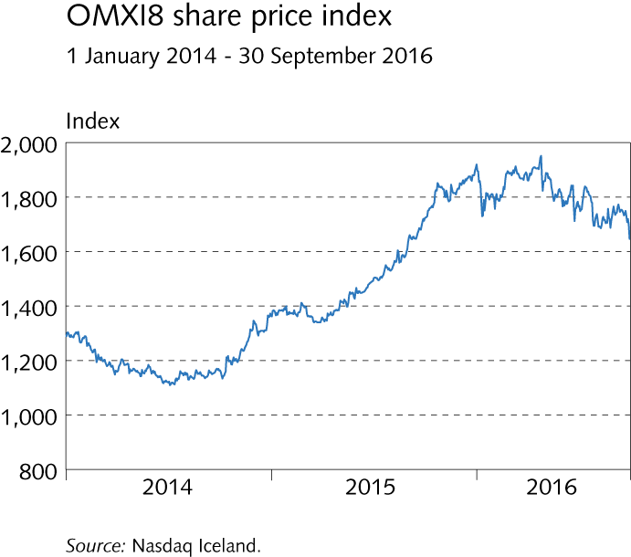
Economic environment and financial markets

Slide 16
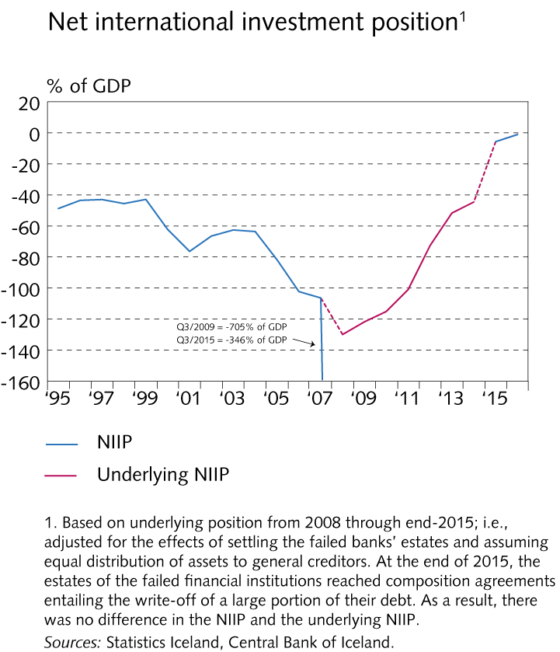
International investment position (IIP)

Slide 17
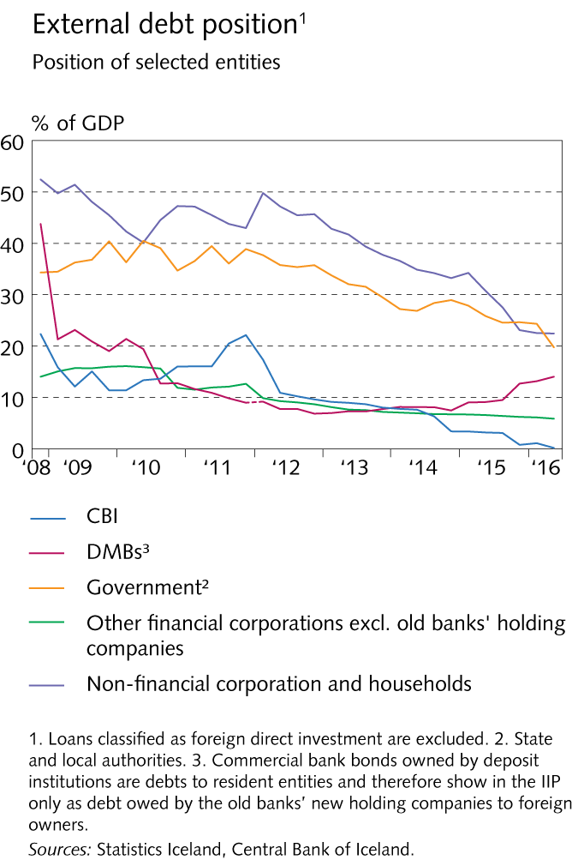
International investment position (IIP)

Slide 18
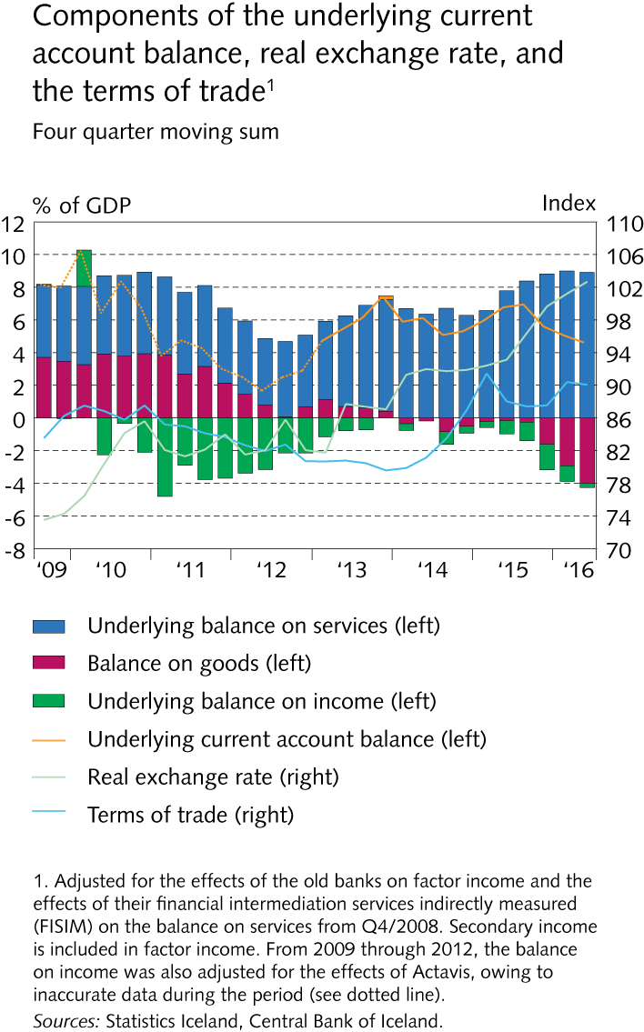
International investment position (IIP)

Slide 19
International investment position (IIP)

Slide 20
International investment position (IIP)

Slide 21
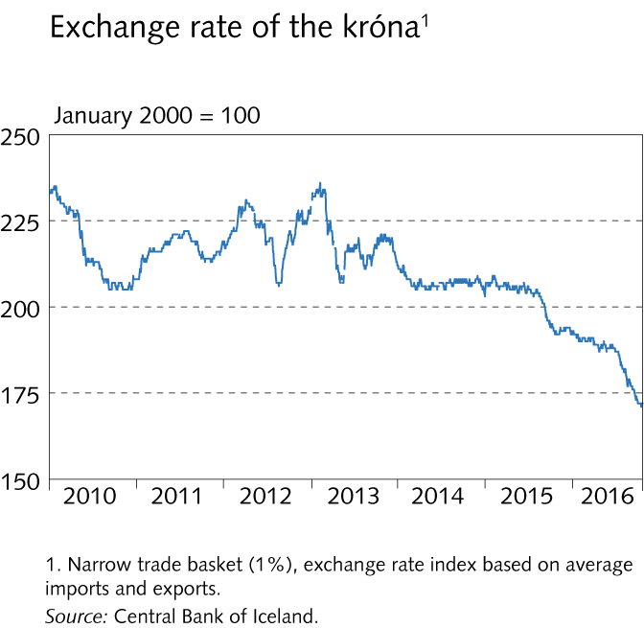
International investment position (IIP)

Slide 22
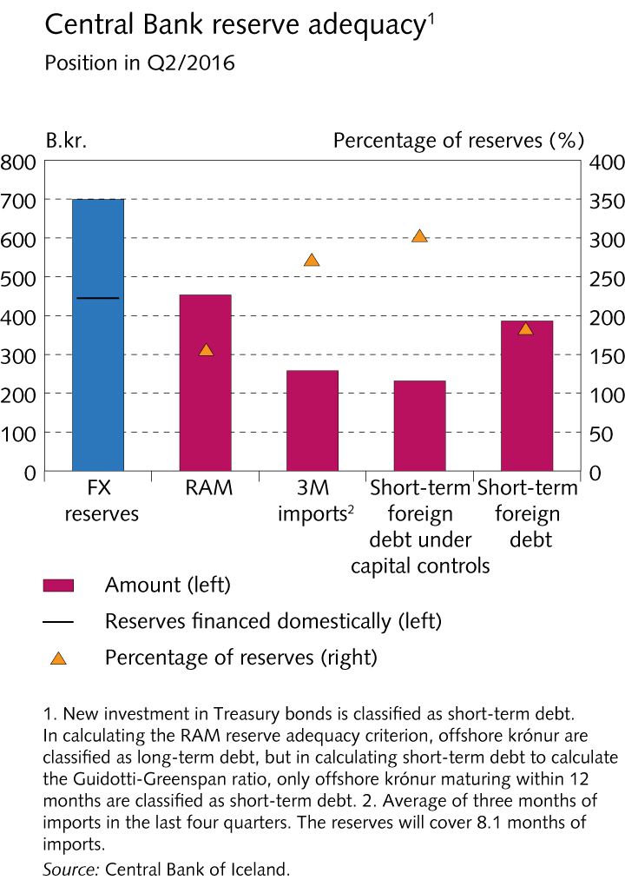
International investment position (IIP)

Slide 23
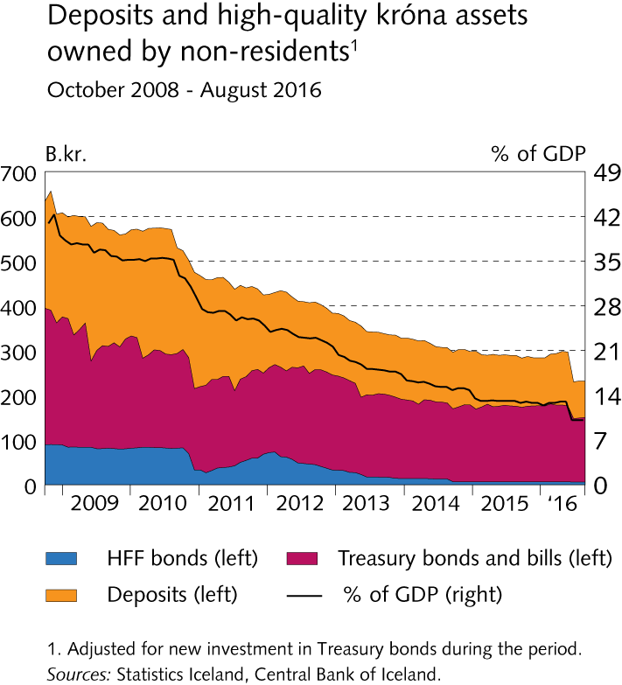
International investment position (IIP)

Slide 24
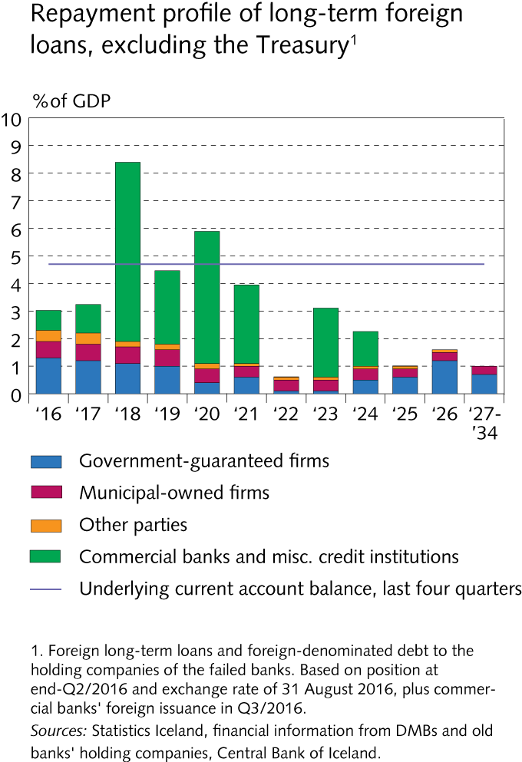
International investment position (IIP)

Slide 25
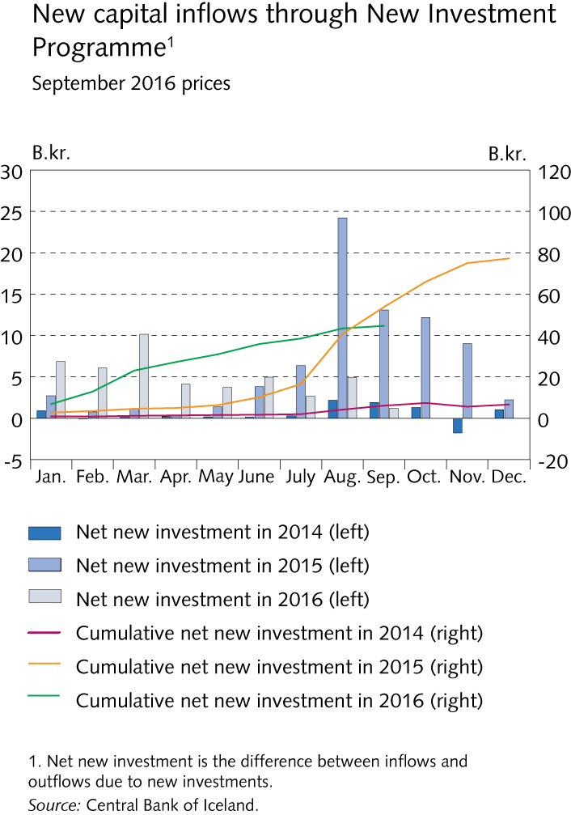
International investment position (IIP)

Slide 26
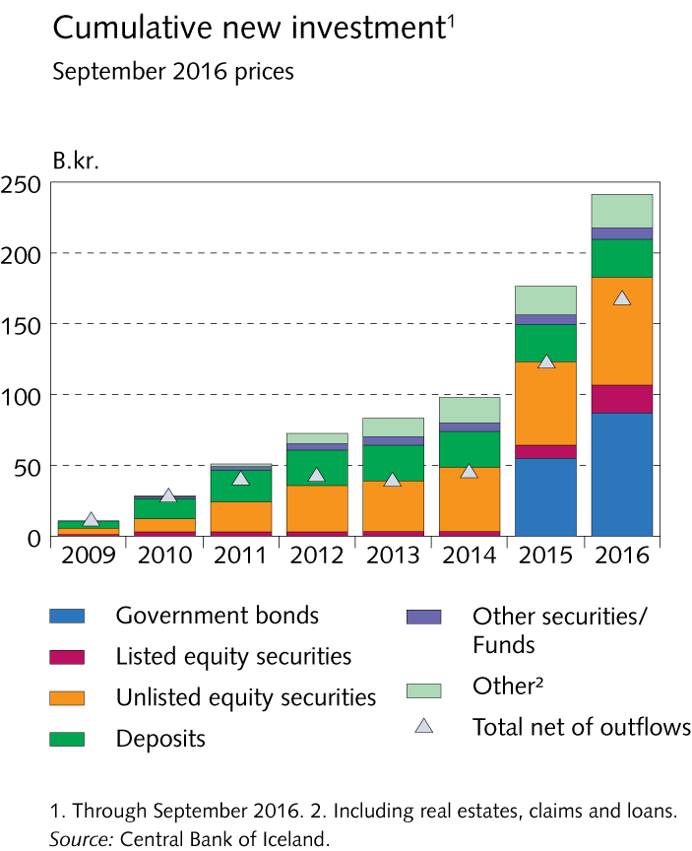
International investment position (IIP)

Slide 27
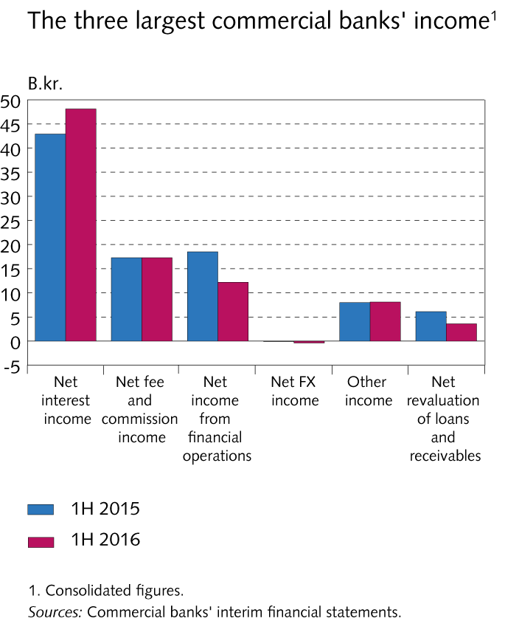
Operations and equity

Slide 28
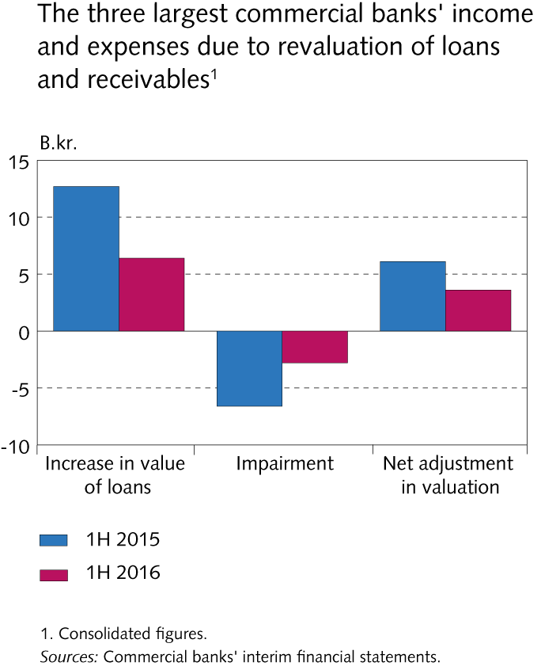
Operations and equity

Slide 29
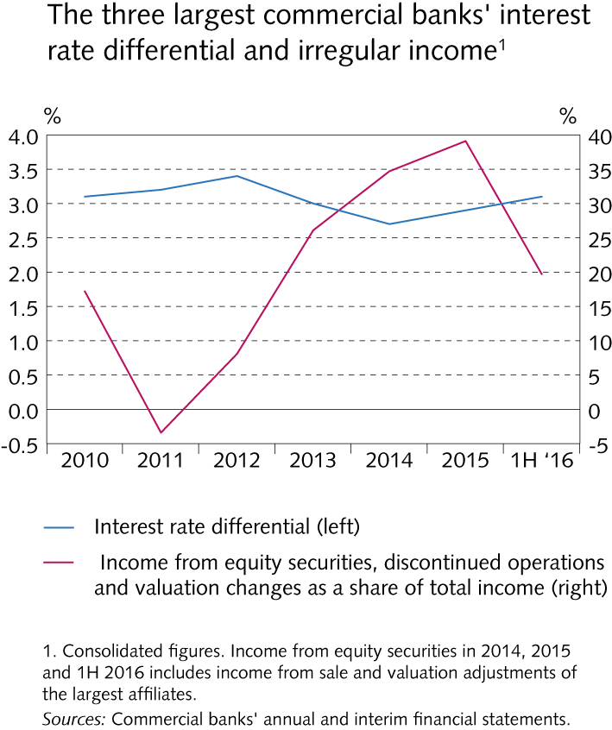
Operations and equity

Slide 30
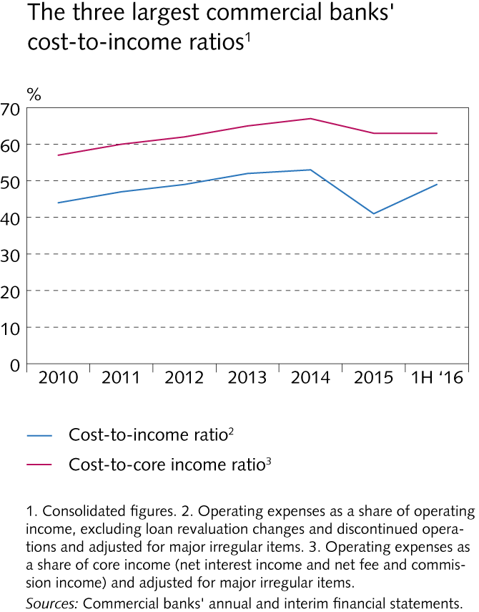
Operations and equity

Slide 31
Operations and equity

Slide 32
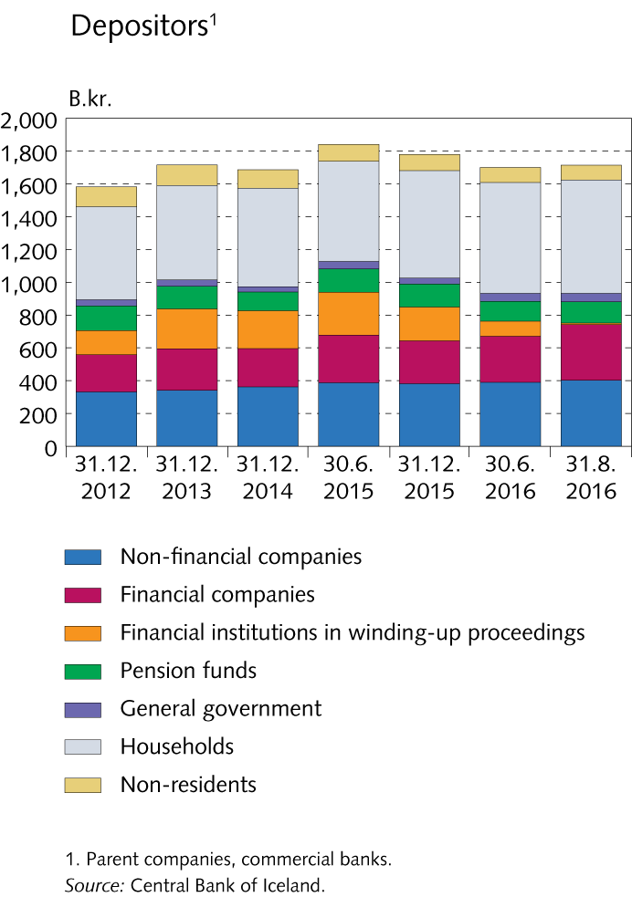
Funding and liquid funds

Slide 33
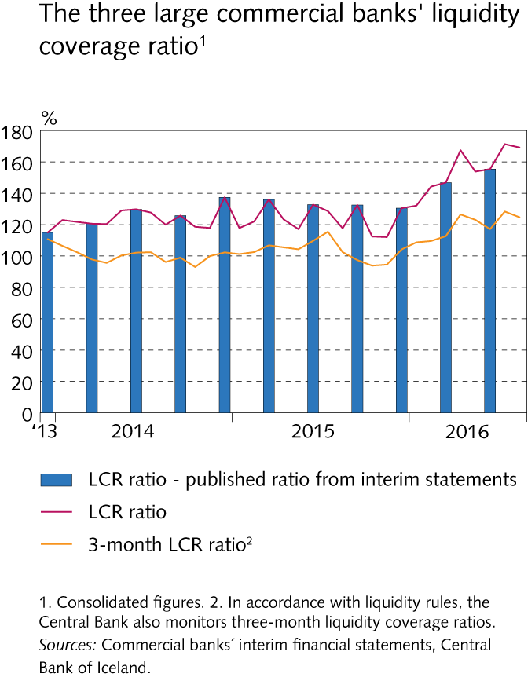
Funding and liquid funds

Slide 34
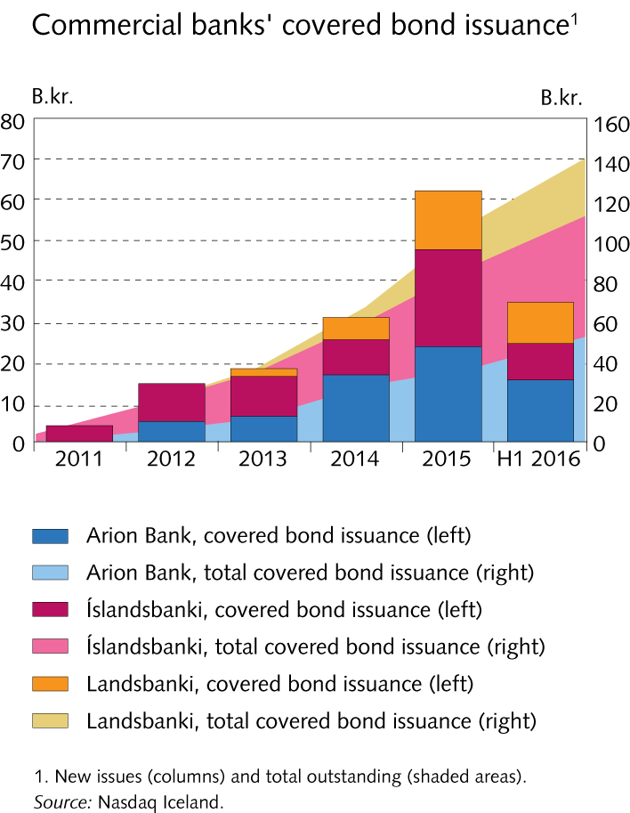
Funding and liquid funds

Slide 35
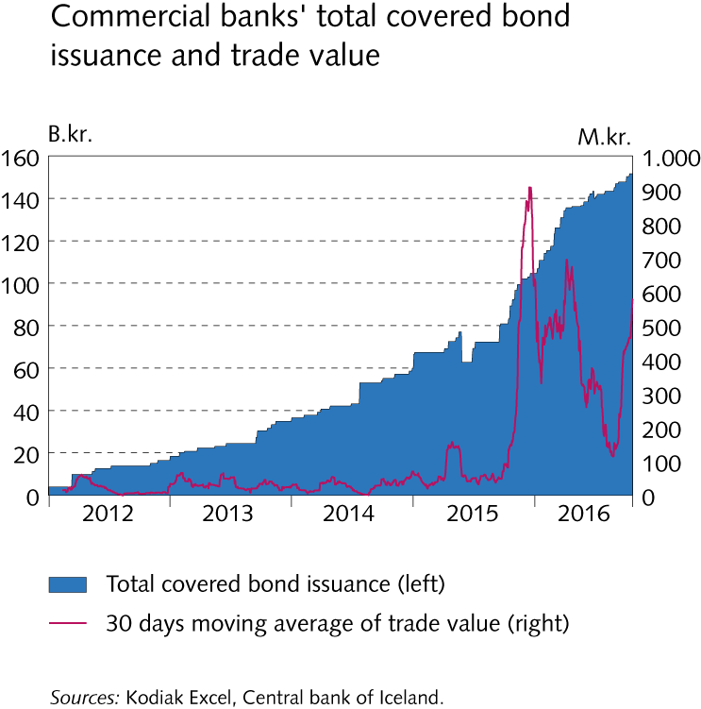
Funding and liquid funds

Slide 36
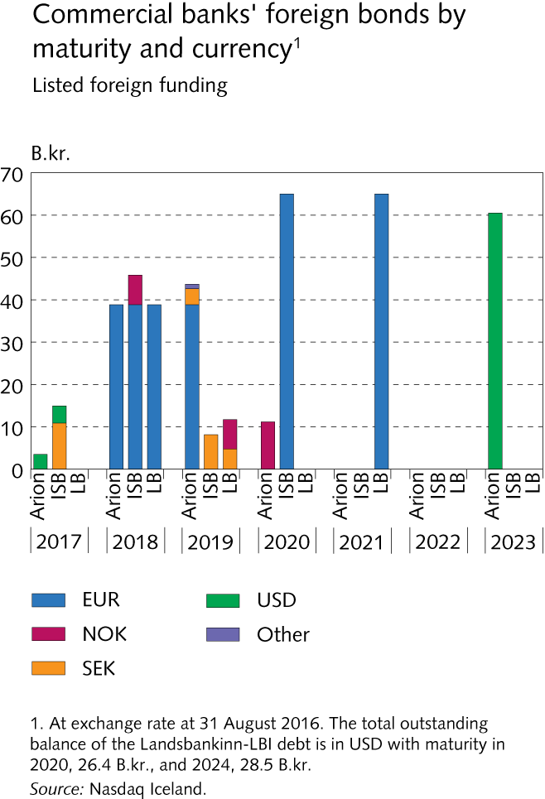
Funding and liquid funds

Slide 37
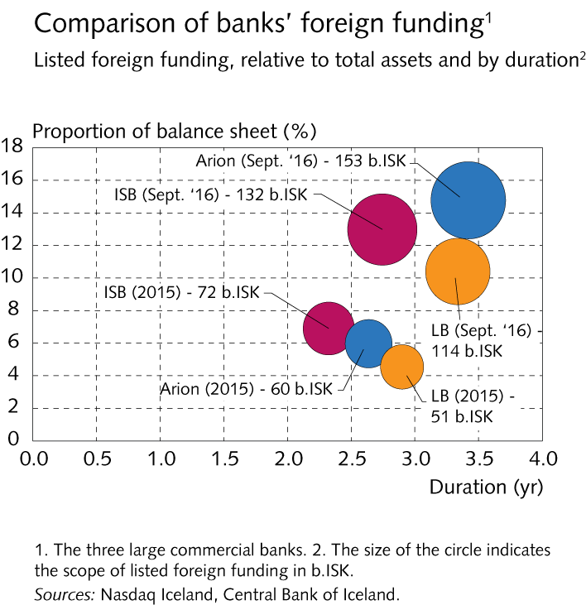
Funding and liquid funds

Slide 38
Funding and liquid funds

Slide 39
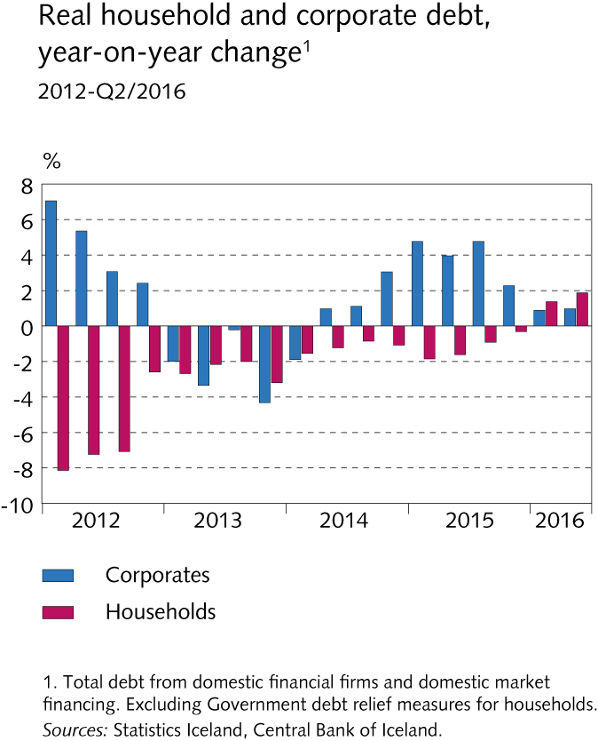
Financial system assets

Slide 40
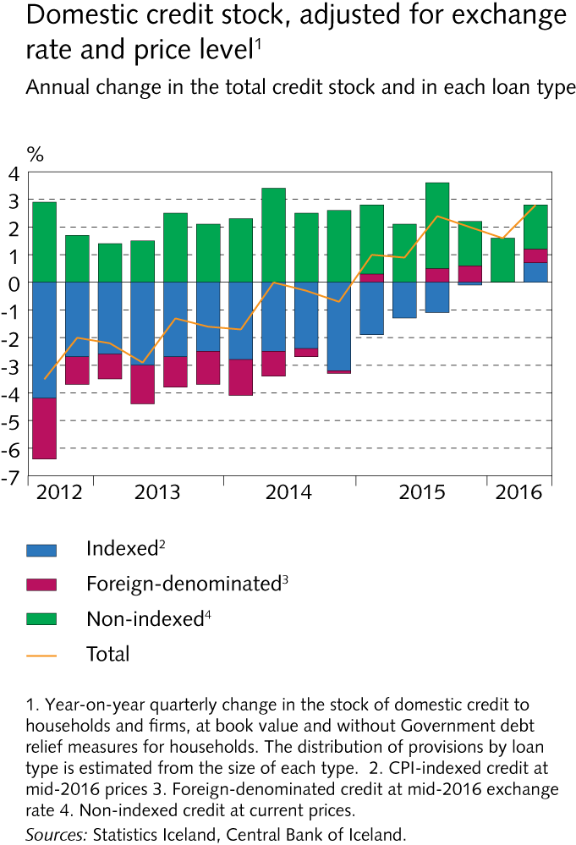
Financial system assets

Slide 41
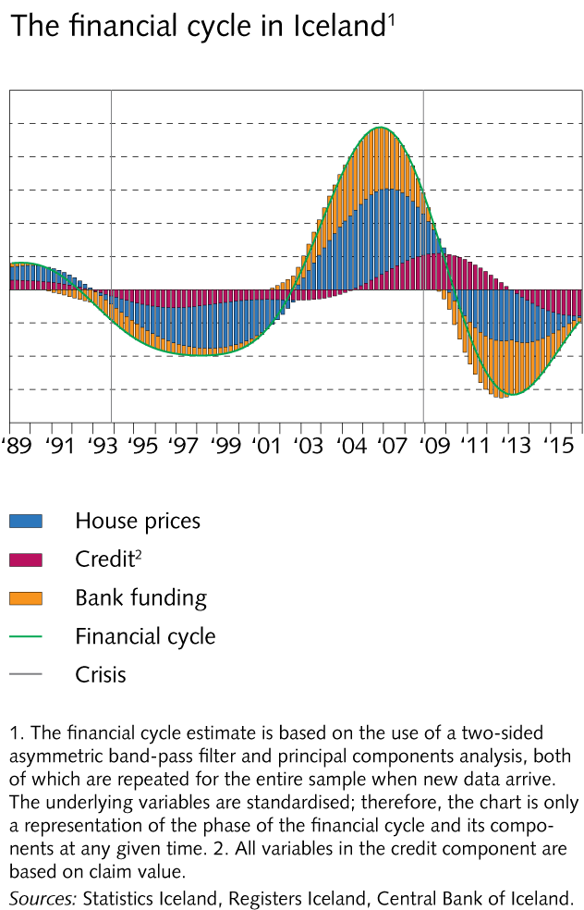
Financial system assets

Slide 42
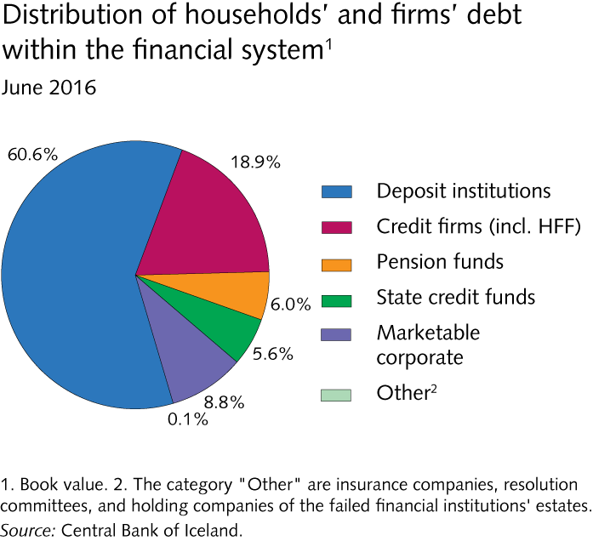
Financial system assets

Slide 43
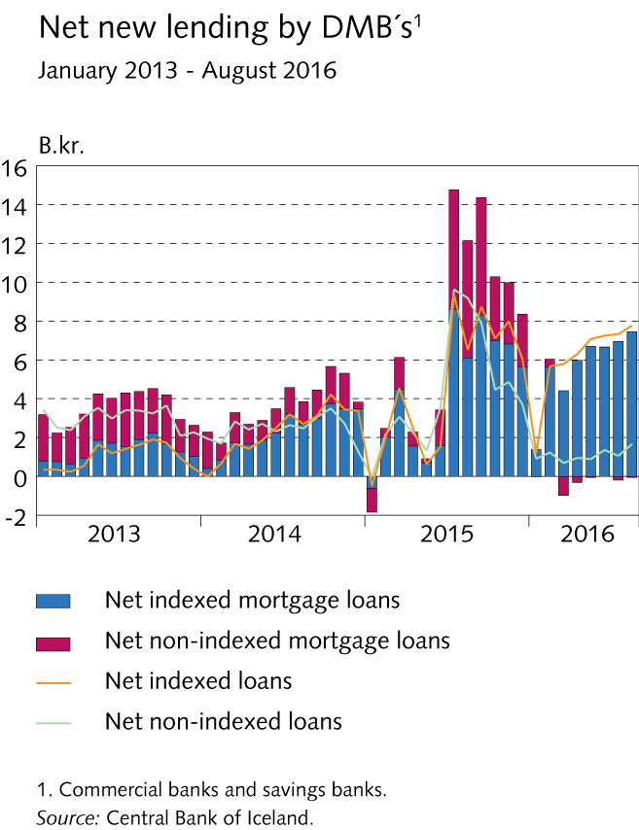
Financial system assets

Slide 44
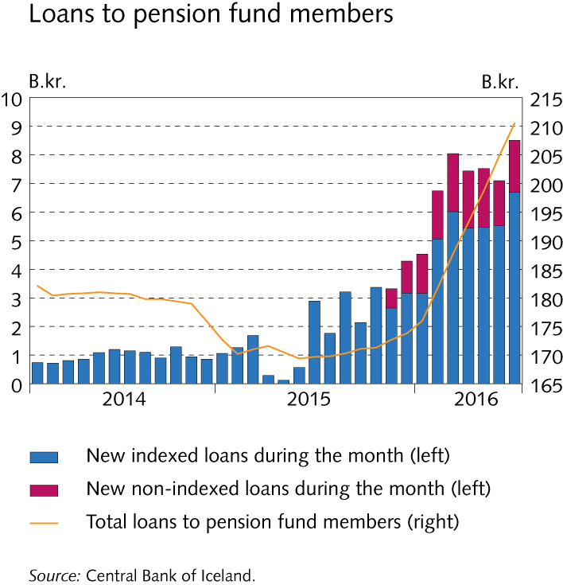
Financial system assets

Slide 45
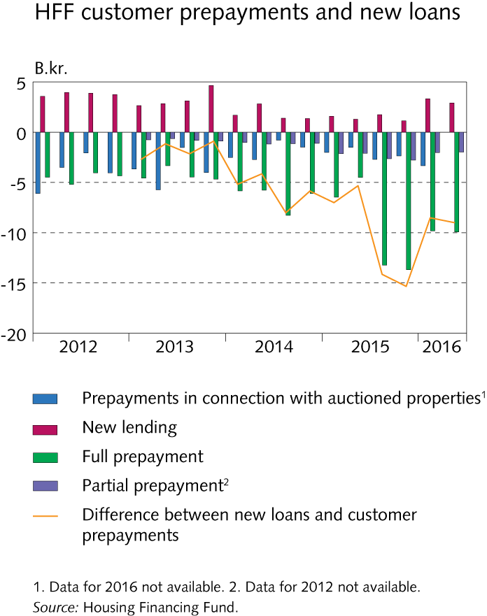
Financial system assets

Slide 46
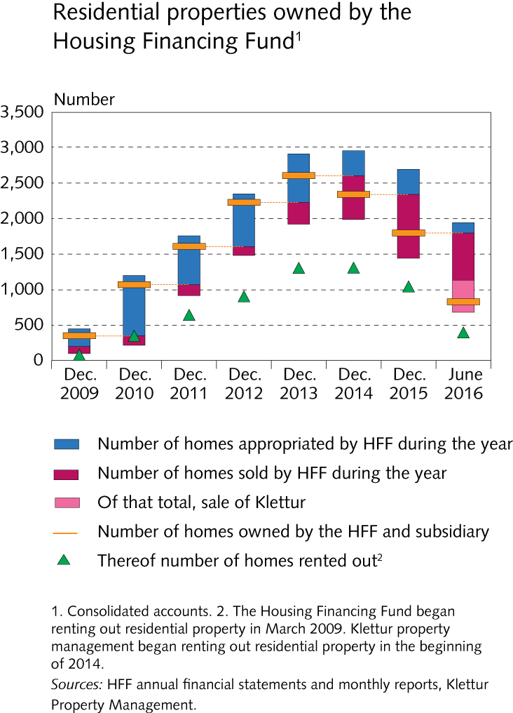
Households

Slide 47
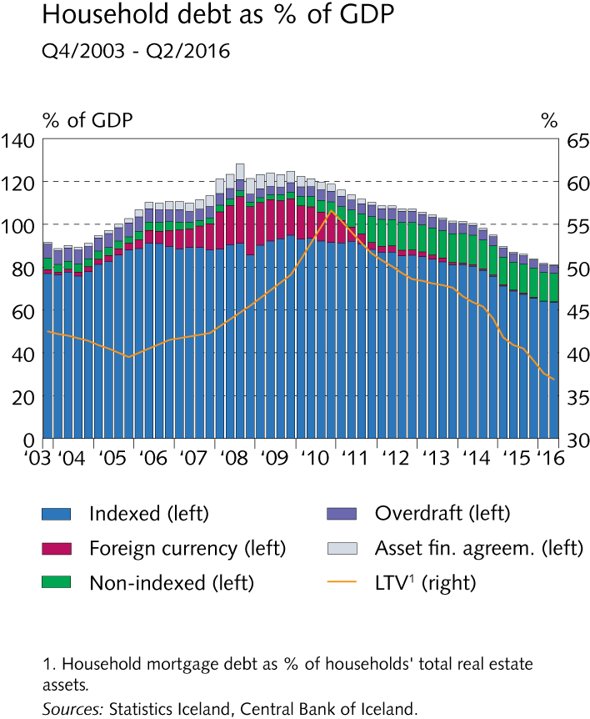
Households

Slide 48
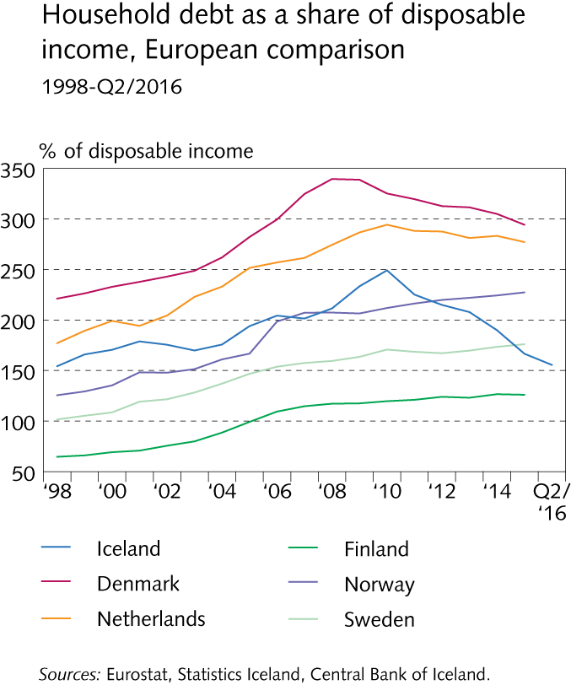
Households

Slide 49
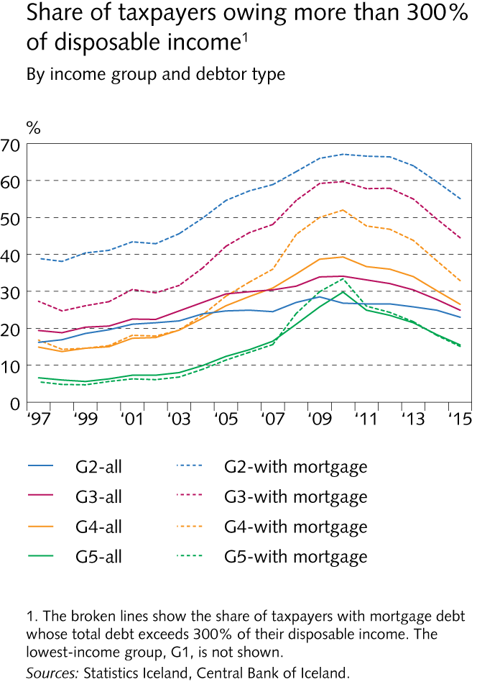
Households

Slide 50
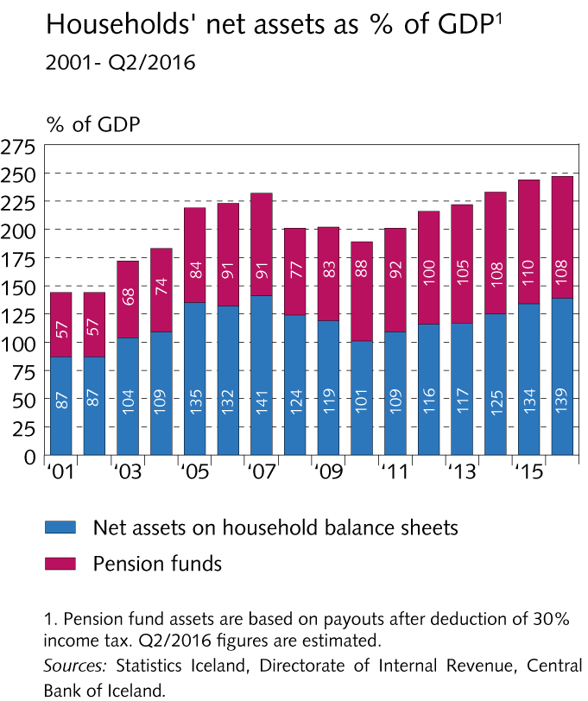
Households

Slide 51
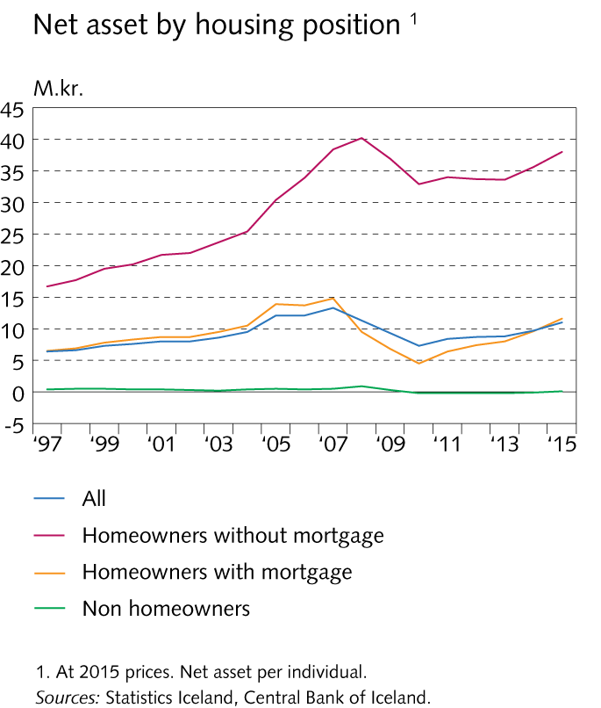
Households

Slide 52
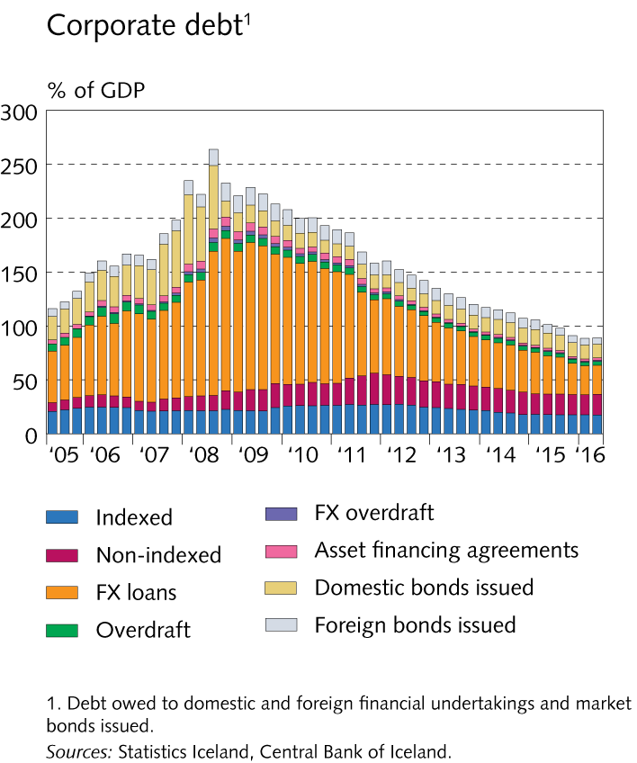
Companies

Slide 53
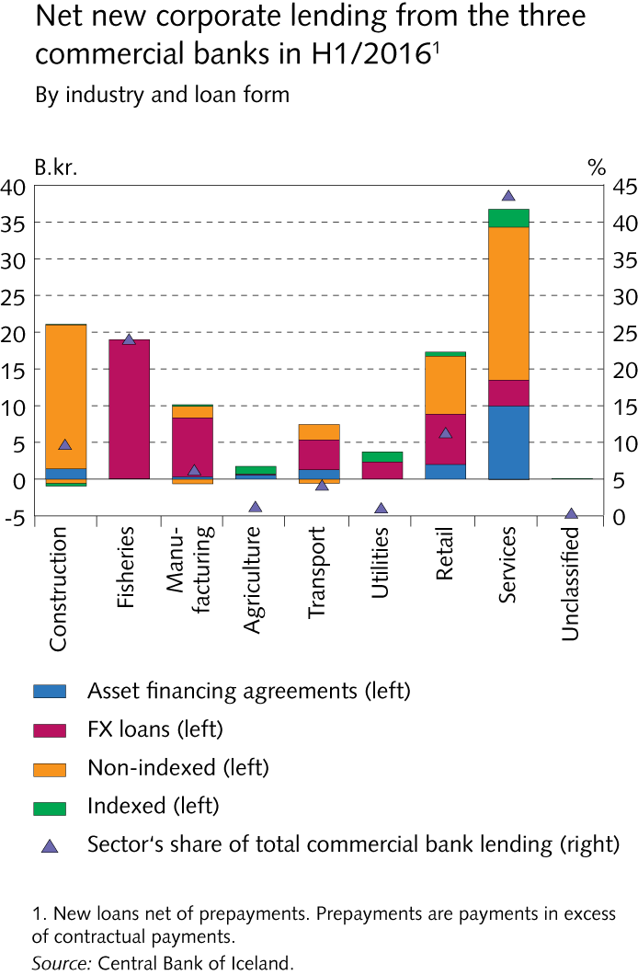
Companies

Slide 54
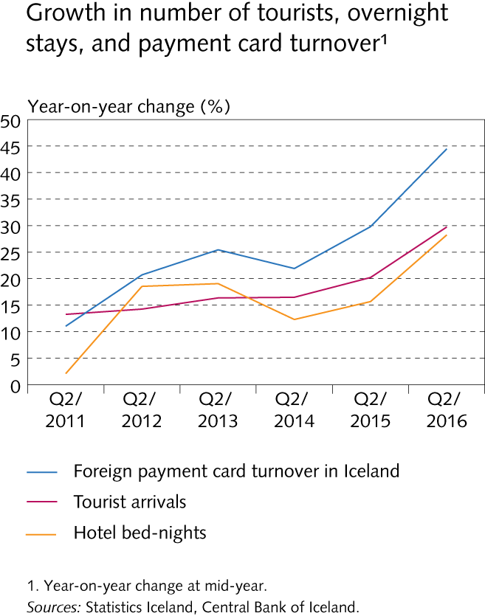
Companies

Slide 55
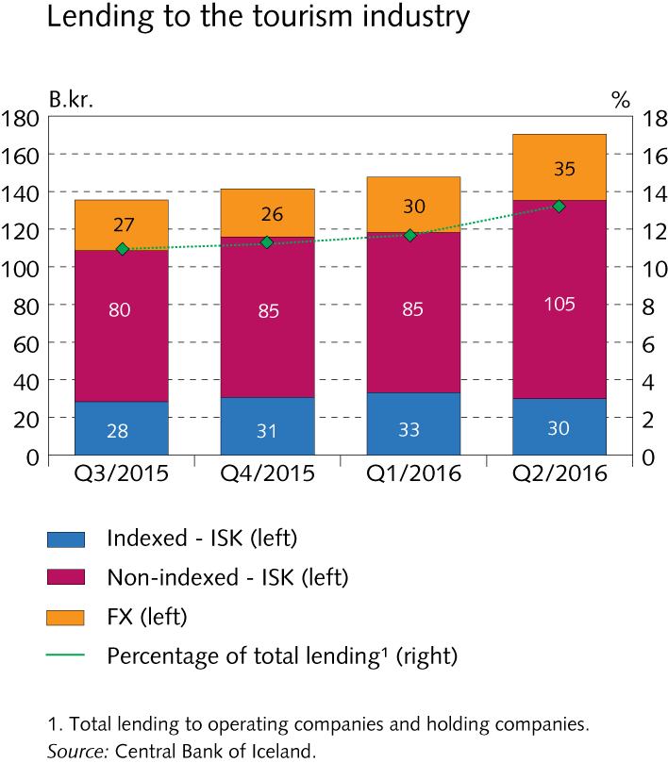
Companies

Slide 56
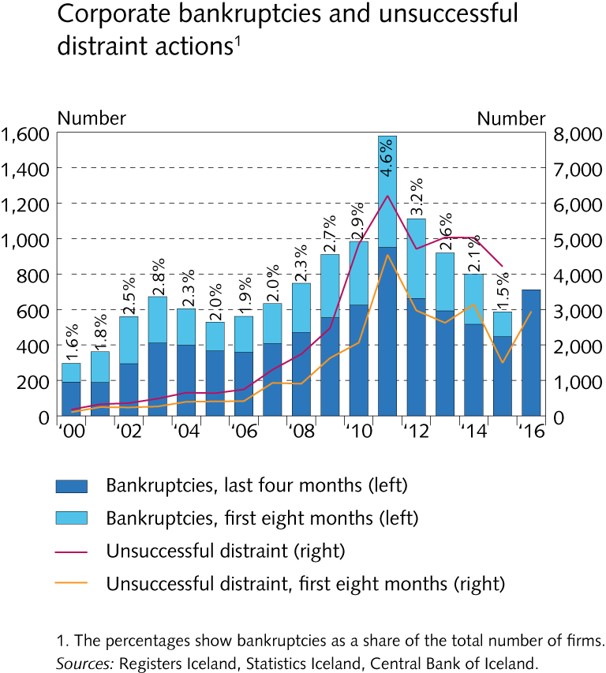
Companies

Slide 57
Stress test

Slide 58
Central Bank stress test 2016

Slide 59
Central Bank stress test 2016

Slide 60
Central Bank stress test 2016

Slide 61
Central Bank stress test 2016

Slide 62
Central Bank stress test 2016

Slide 63
Central Bank stress test 2016

Slide 64
Central Bank stress test 2016

Slide 65
Central Bank stress test 2016

Slide 66
Central Bank stress test 2016

Slide 67
Central Bank stress test 2016

Slide 68
Central Bank stress test 2016

Slide 69
Central Bank stress test 2016

Slide 70
Central Bank stress test 2016

Slide 71
Appendix II

Slide 72
Appendix II

Slide 73
Appendix II

Slide 74
Appendix II

Slide 75
Appendix II

Slide 76
Appendix II

