Slide 1
Central Bank of Iceland
Financial Stability report 2014/2
Charts

Slide 2
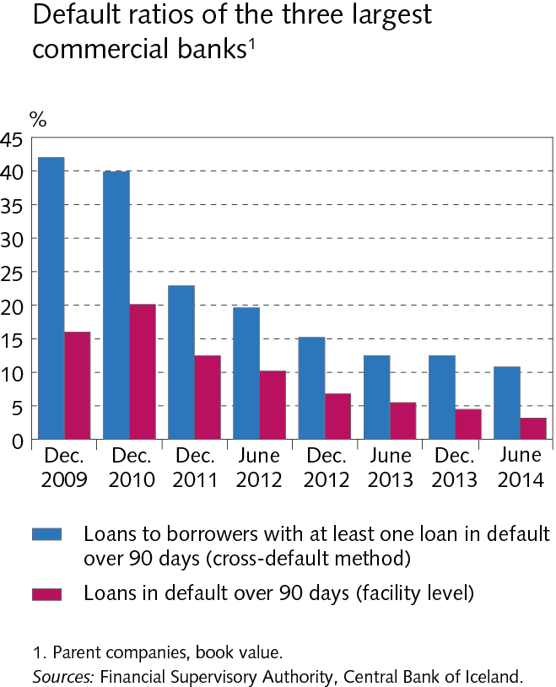
The Financial System – outlook and main risks

Slide 3
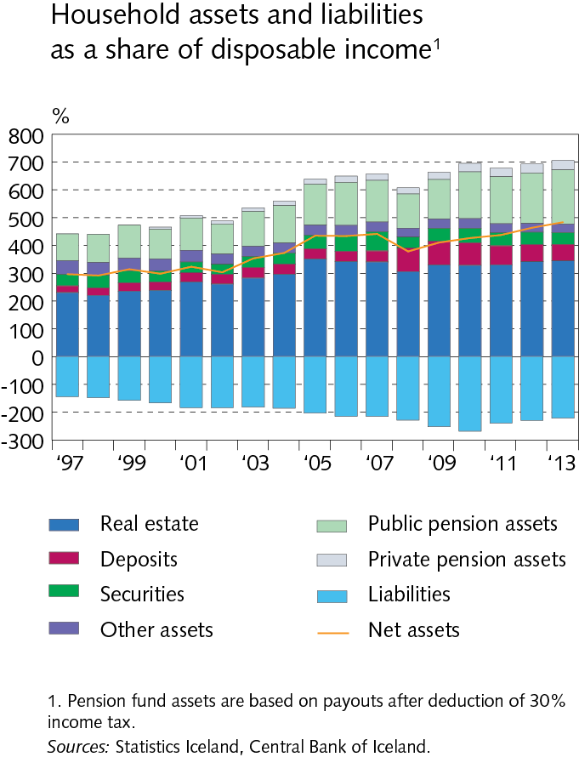
The Financial System – outlook and main risks

Slide 4
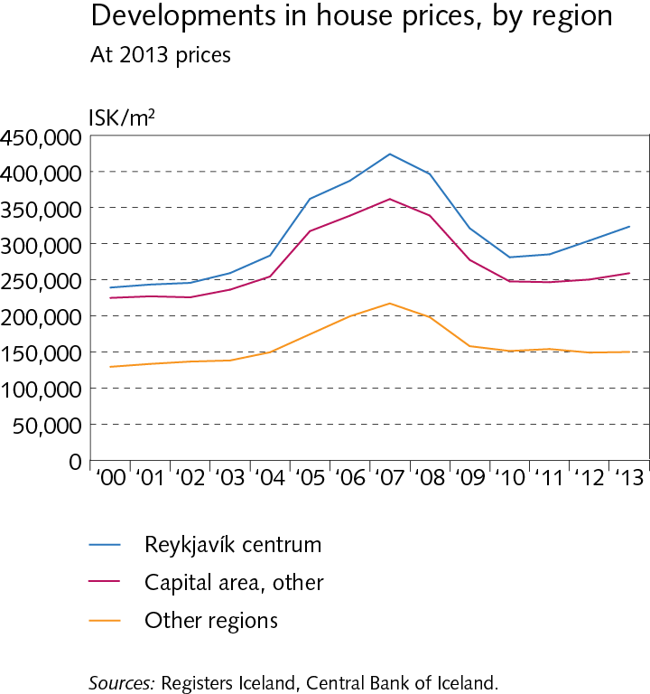
The Financial System – outlook and main risks

Slide 5
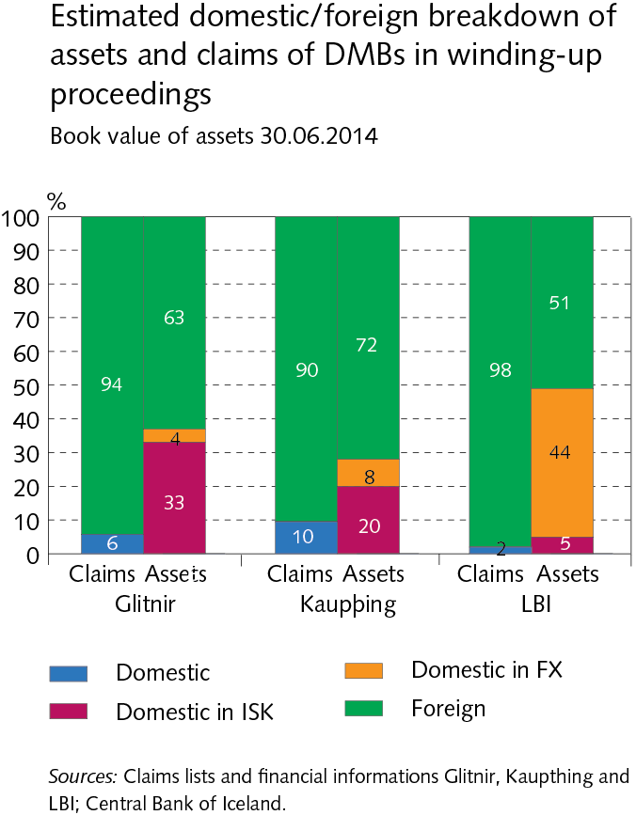
The Financial System – outlook and main risks

Slide 6
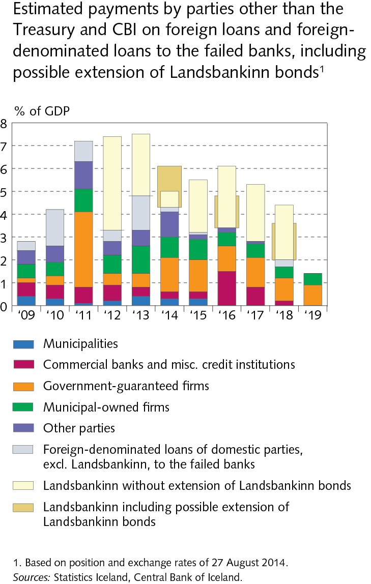
The Financial System – outlook and main risks

Slide 7
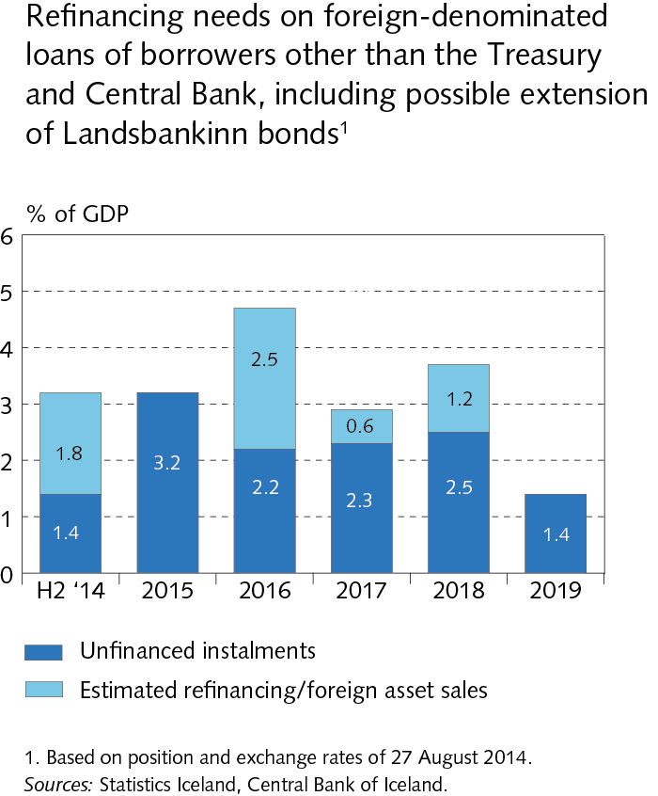
The Financial System – outlook and main risks

Slide 8
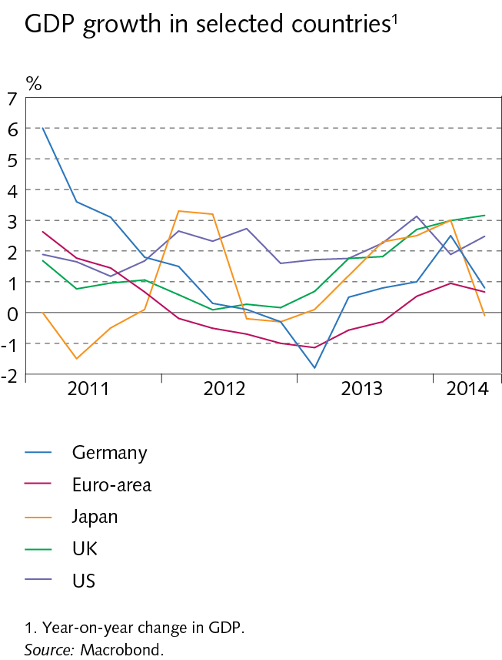
Economic environment

Slide 9
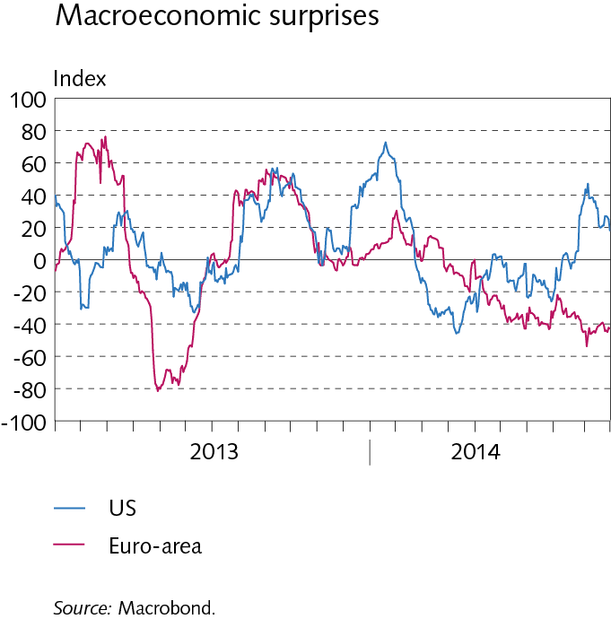
Economic environment

Slide 10
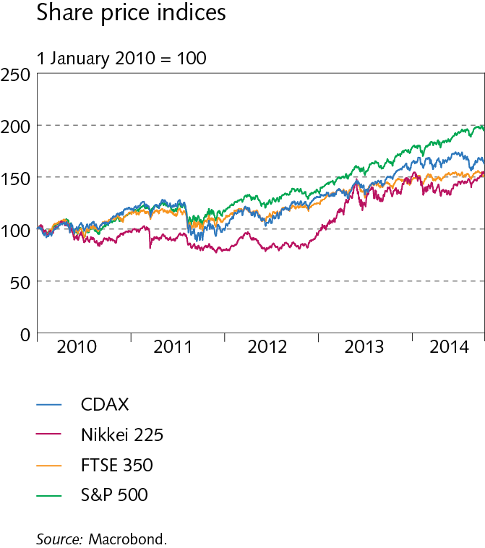
Economic environment

Slide 11
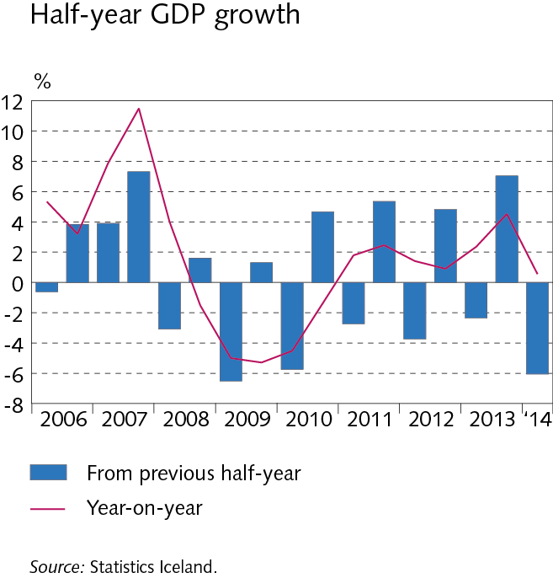
Economic environment

Slide 12
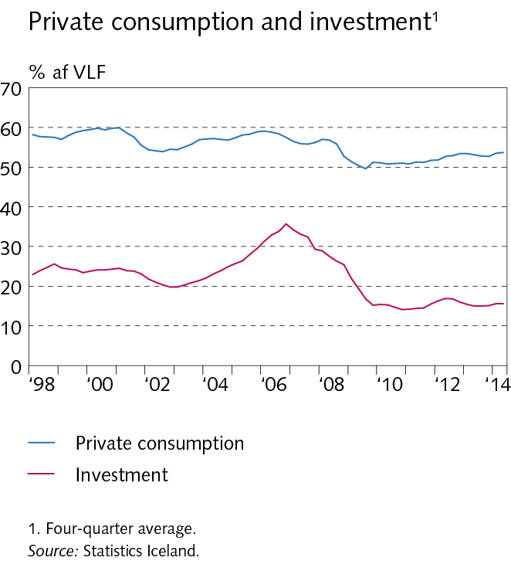
Economic environment

Slide 13
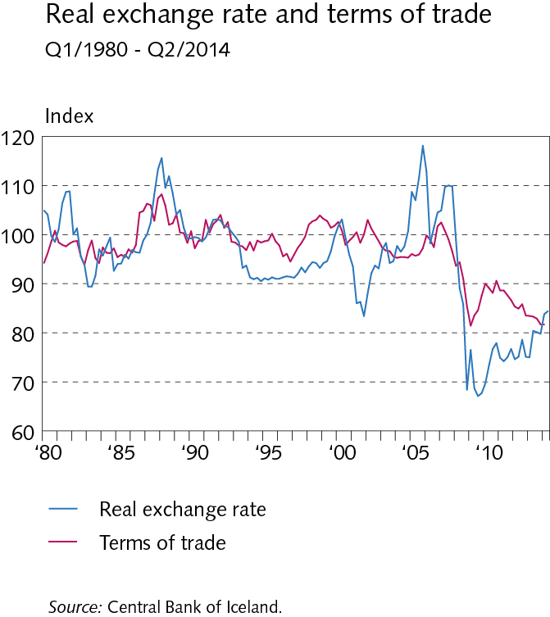
Economic environment

Slide 14
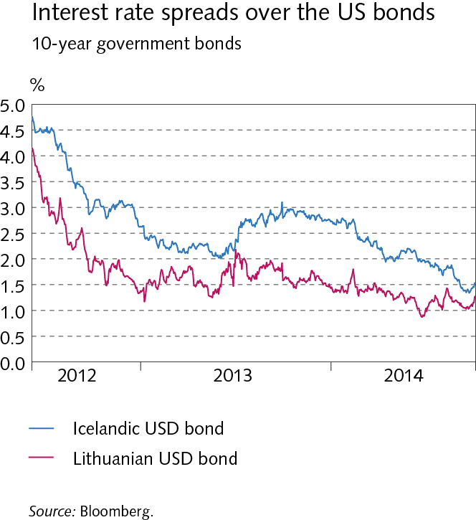
Economic environment

Slide 15
Economic environment

Slide 16
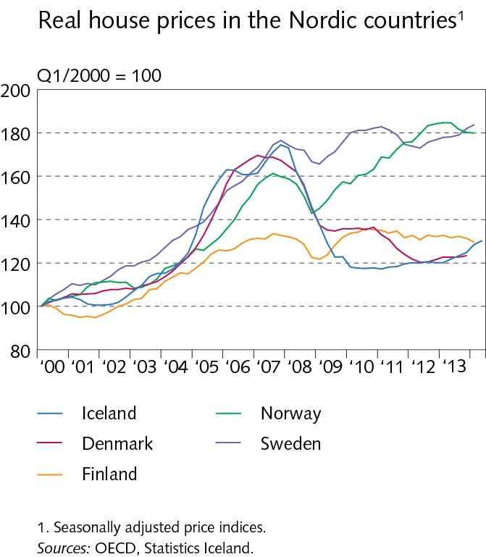
Economic environment

Slide 17
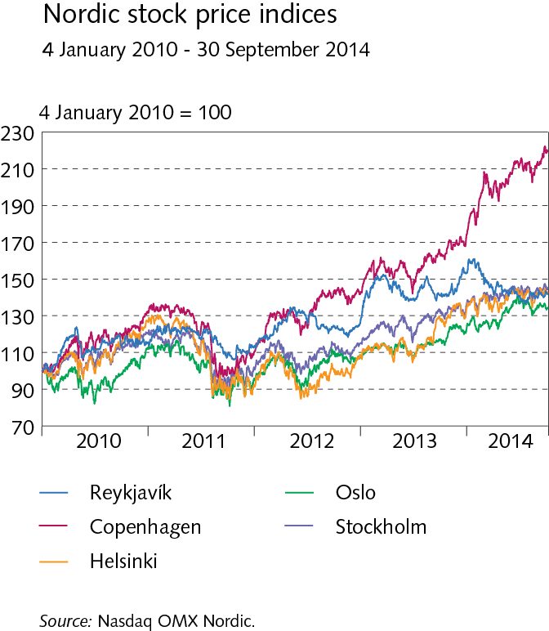
Economic environment

Slide 18
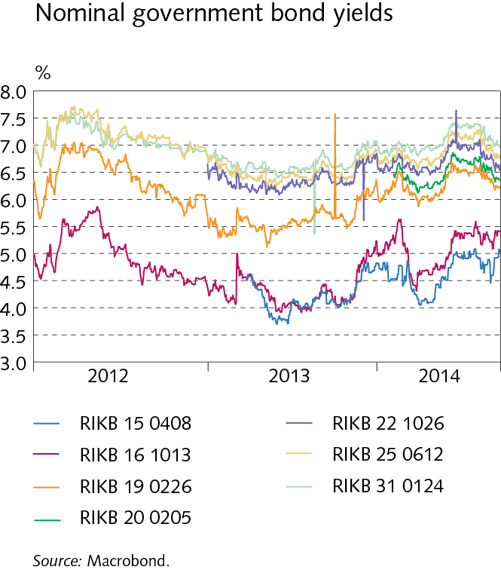
Economic environment

Slide 19
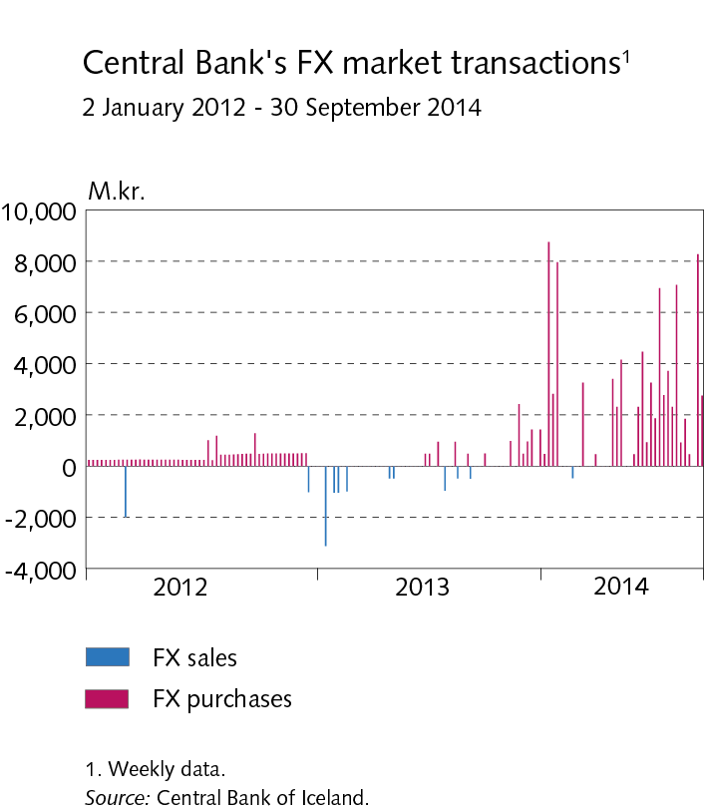
Economic environment

Slide 20
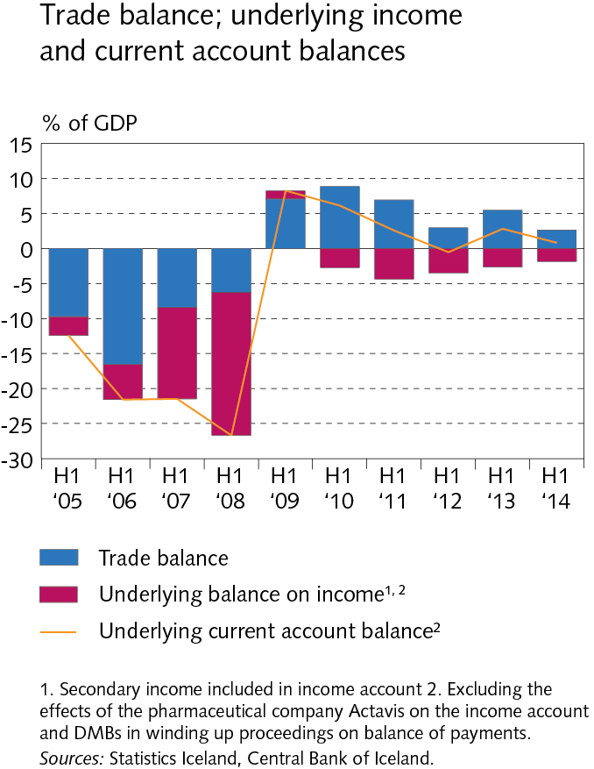
External postition

Slide 21
External postition

Slide 22
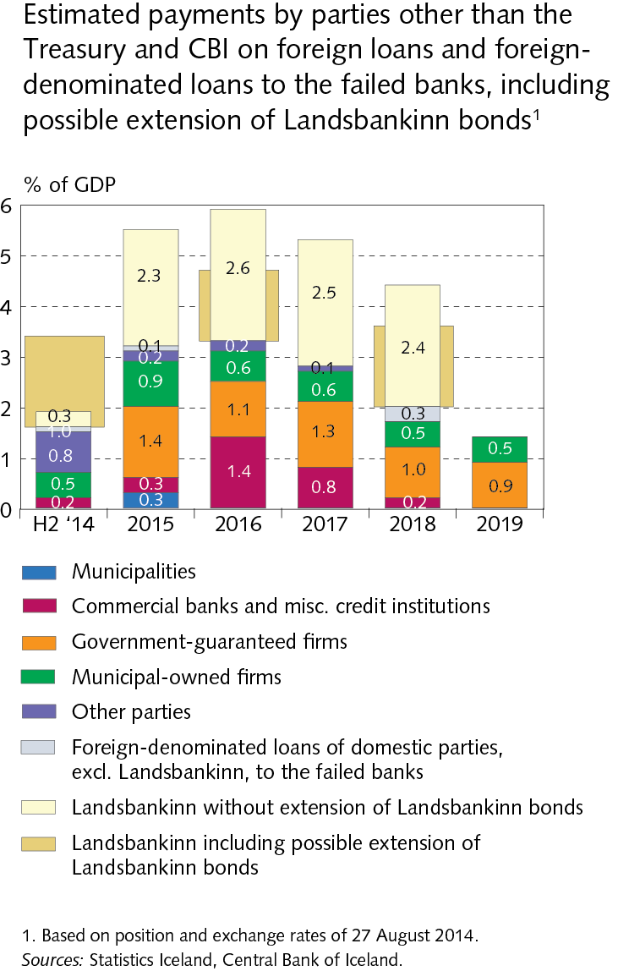
External postition

Slide 23
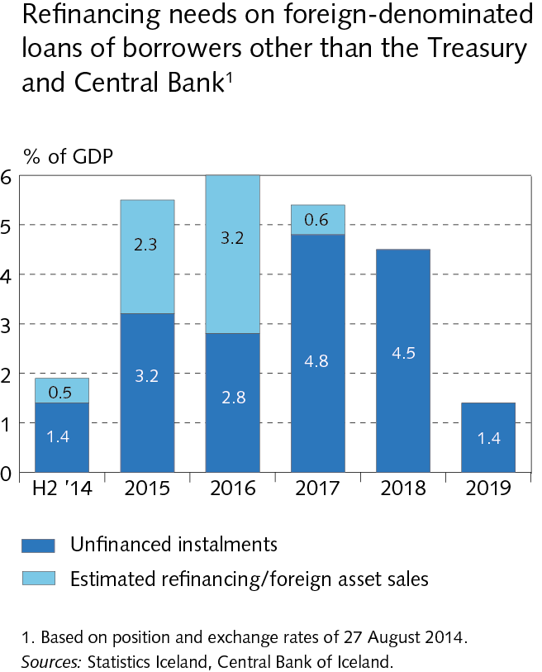
External postition

Slide 24
External postition

Slide 25
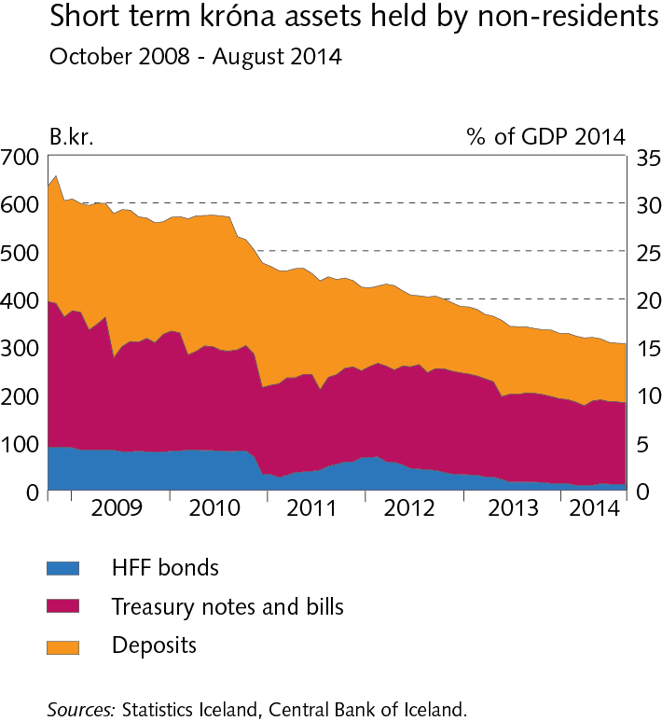
External postition

Slide 26
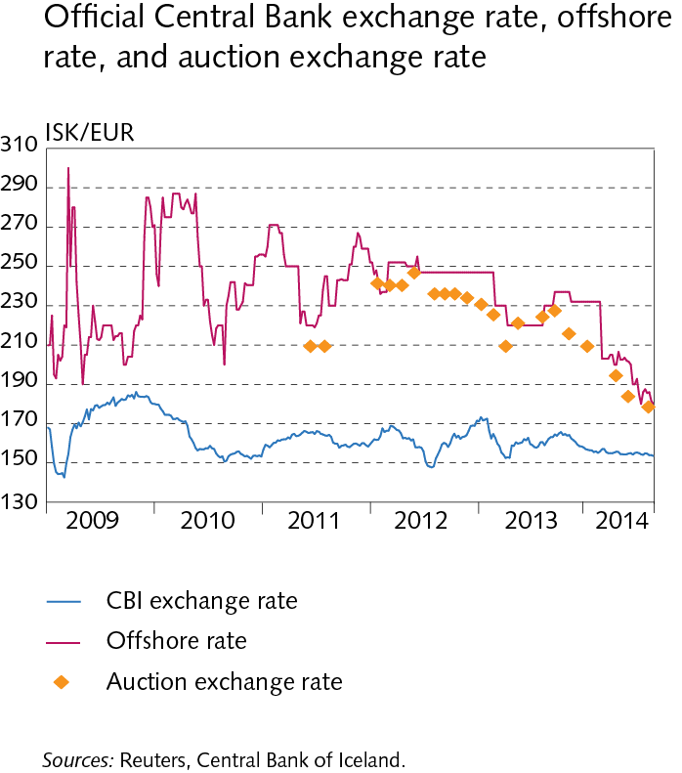
External postition

Slide 27
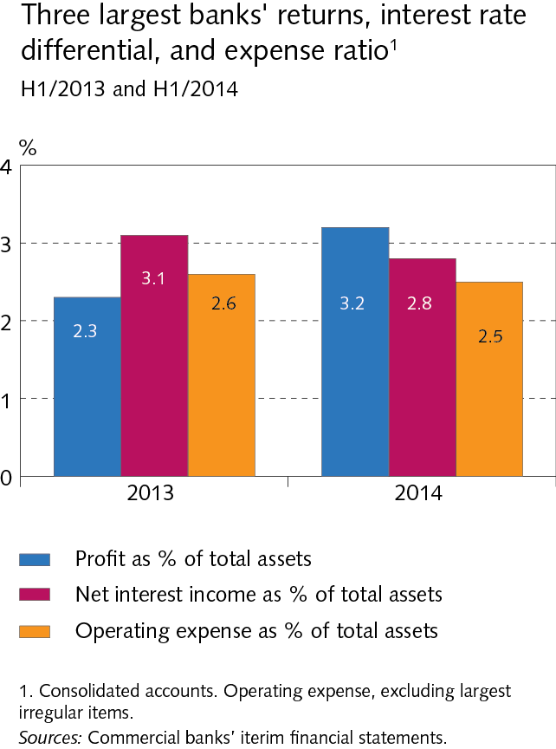
Operations and equity

Slide 28
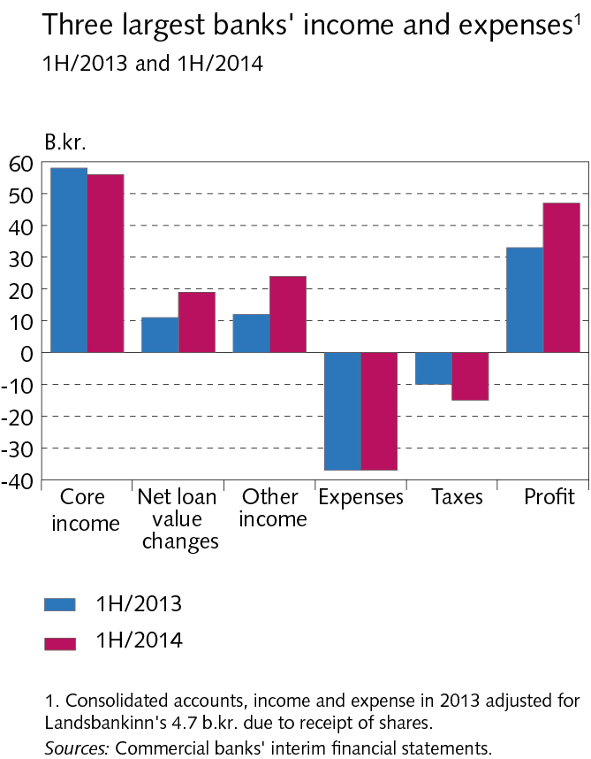
Operations and equity

Slide 29
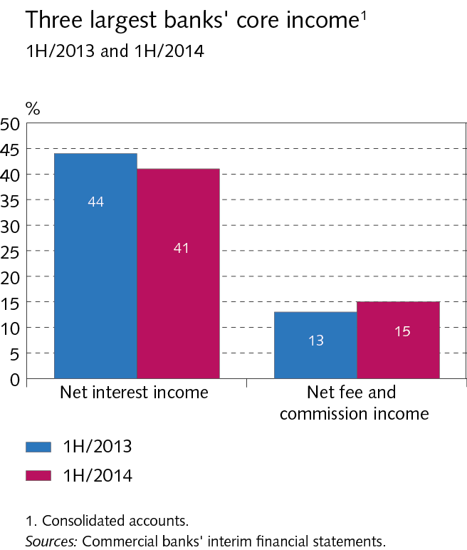
Operations and equity

Slide 30
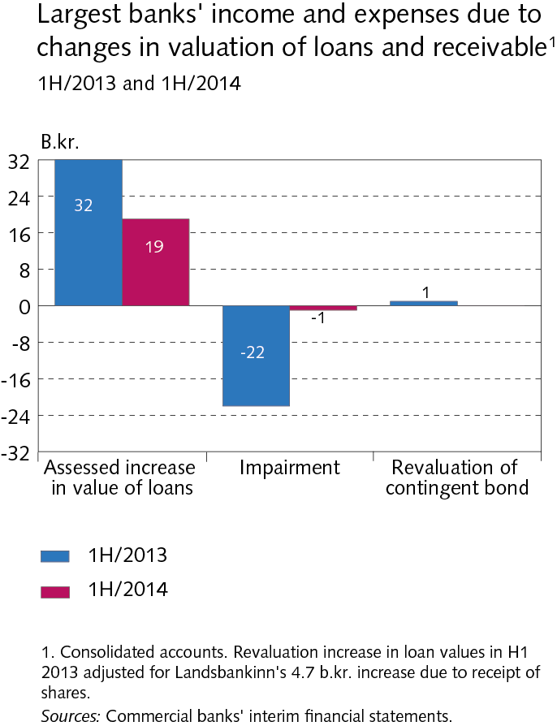
Operations and equity

Slide 31
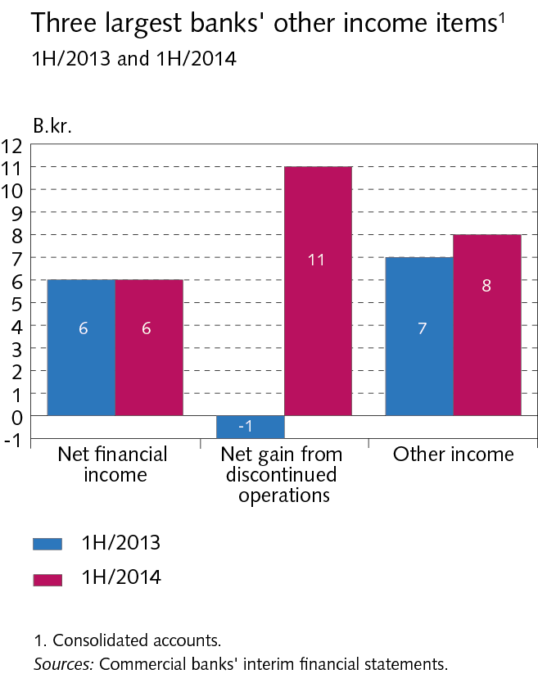
Operations and equity

Slide 32
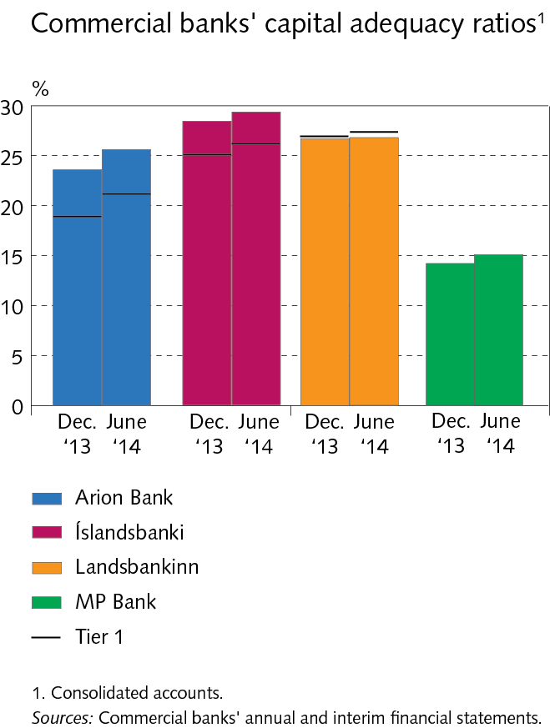
Operations and equity

Slide 33
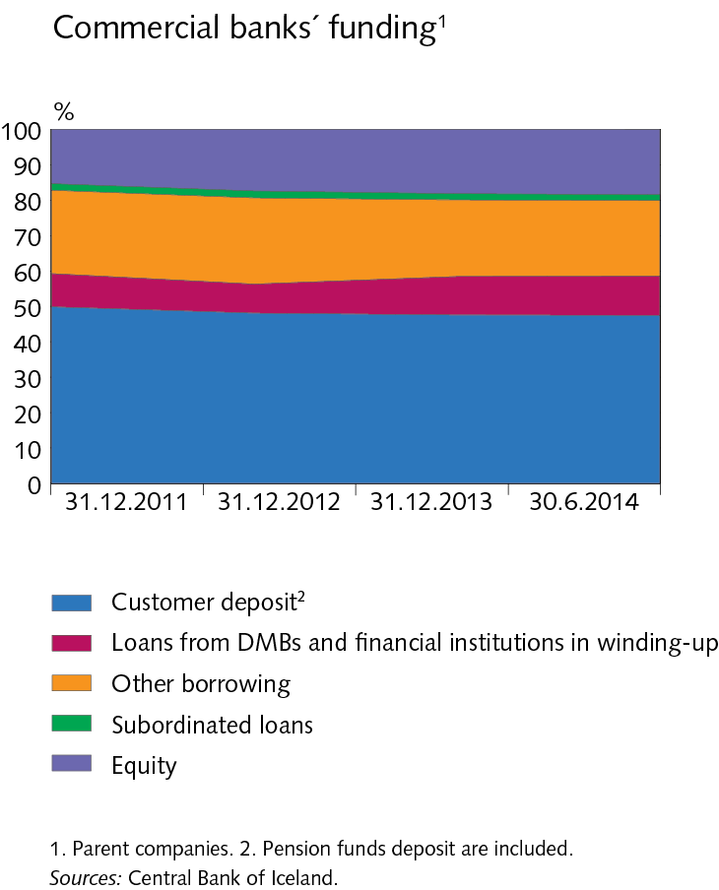
Funding and liquid funds

Slide 34
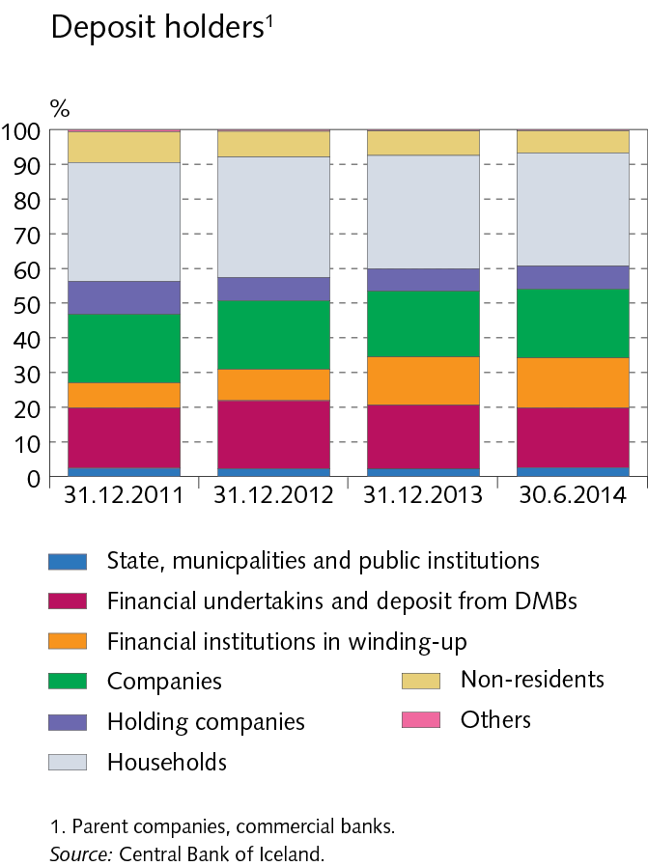
Funding and liquid funds

Slide 35
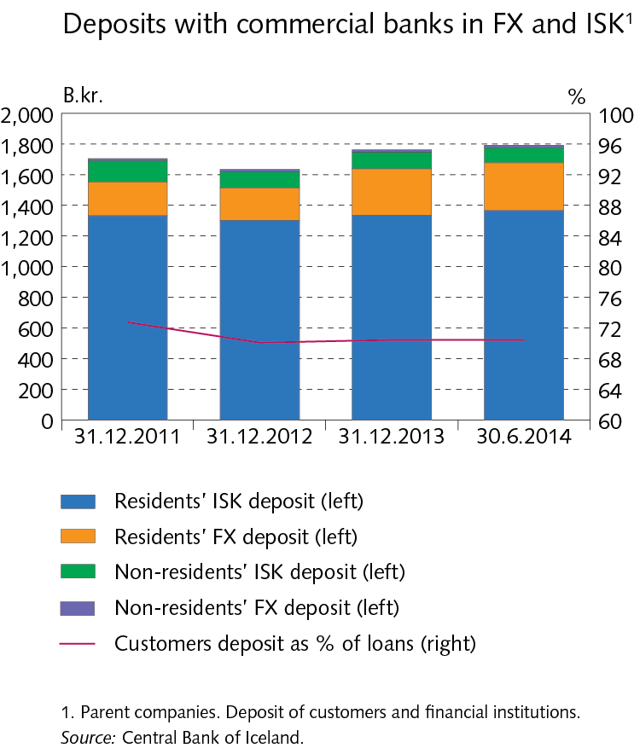
Funding and liquid funds

Slide 36
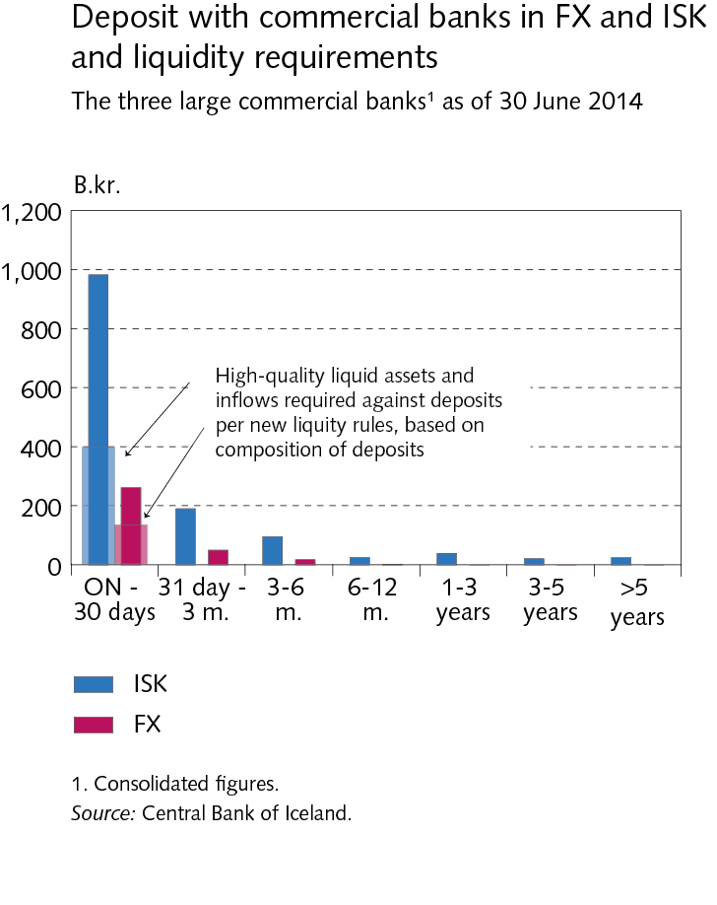
Funding and liquid funds

Slide 37
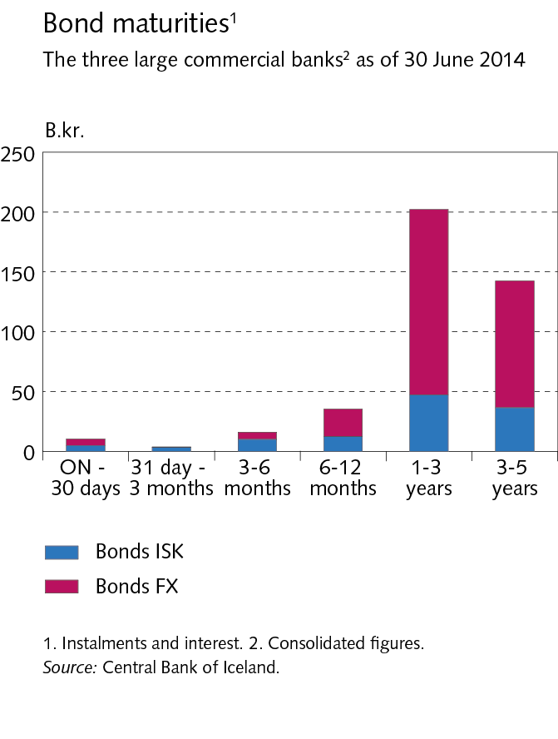
Funding and liquid funds

Slide 38
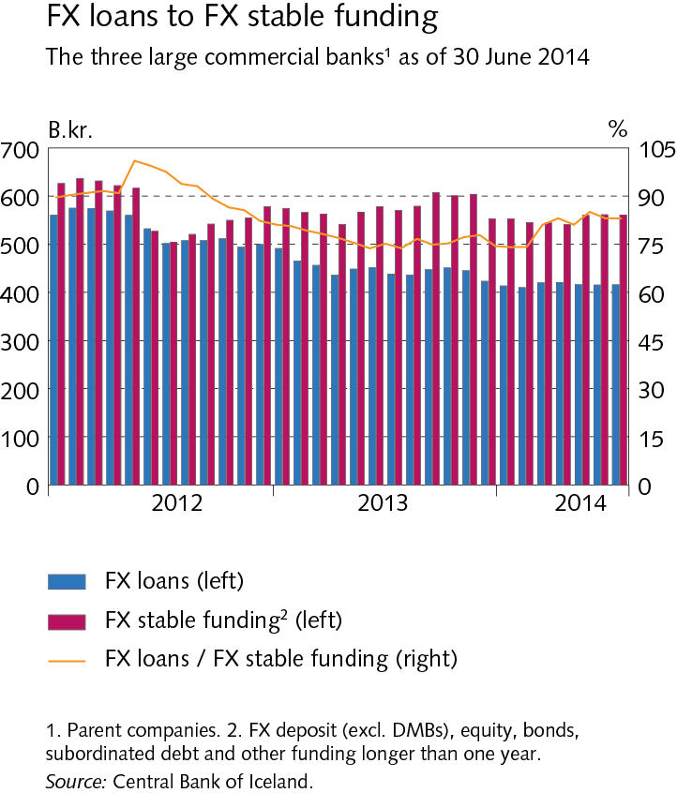
Funding and liquid funds

Slide 39
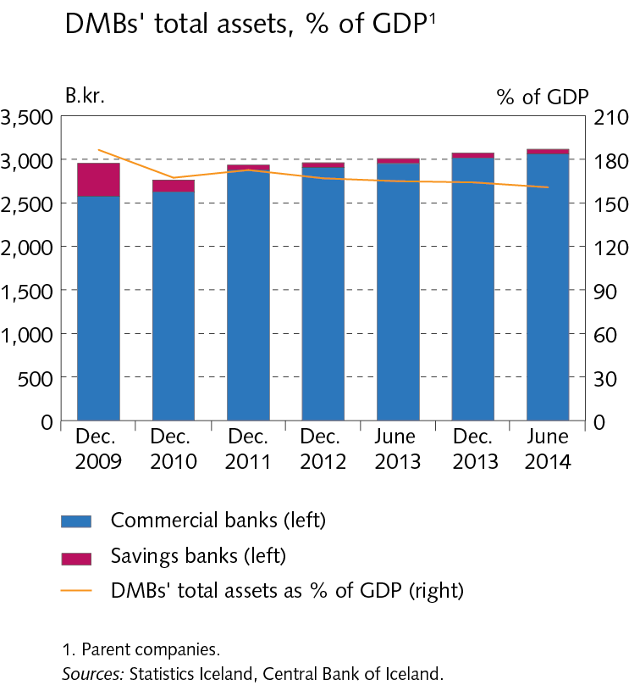
Assets of DMBs

Slide 40
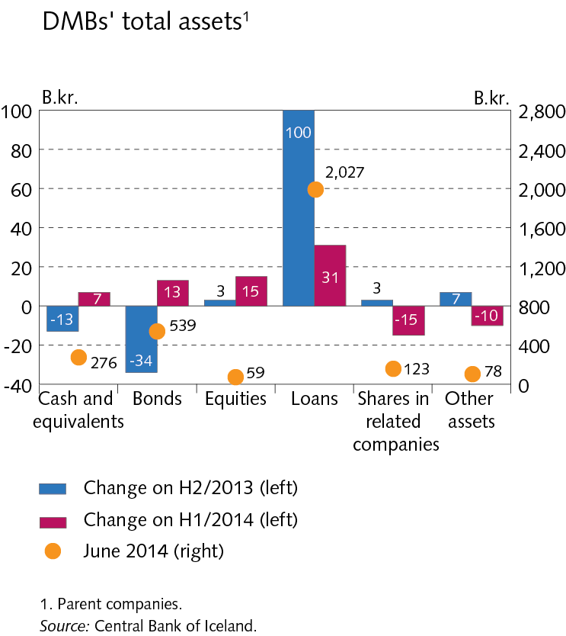
Assets of DMBs

Slide 41
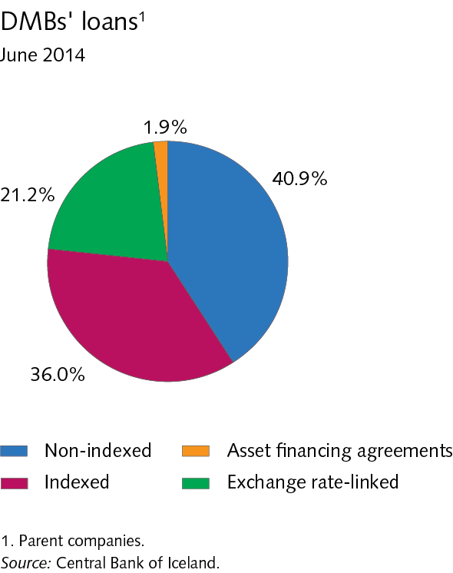
Assets of DMBs

Slide 42
Assets of DMBs

Slide 43
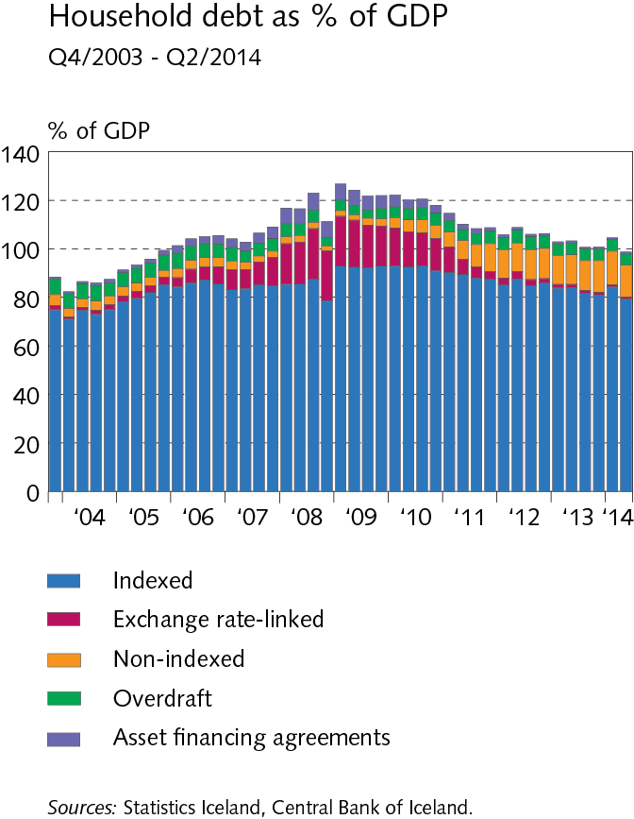
Households

Slide 44
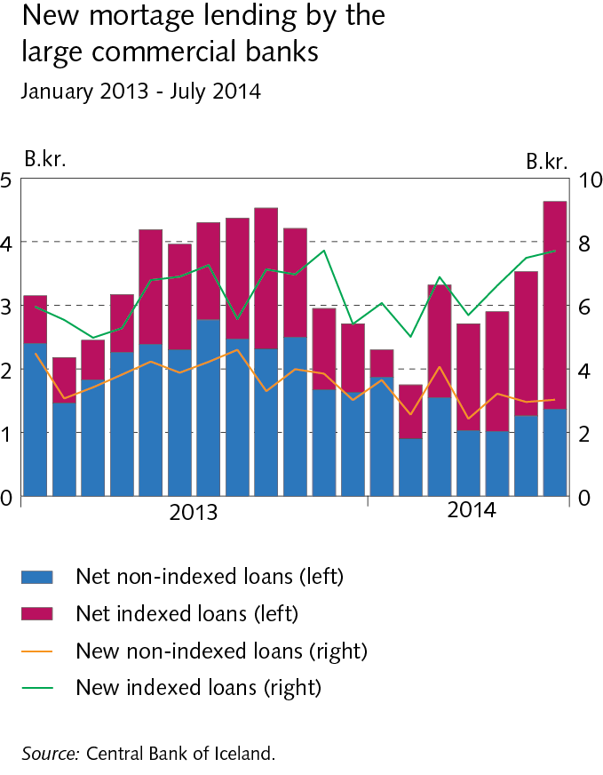
Households

Slide 45
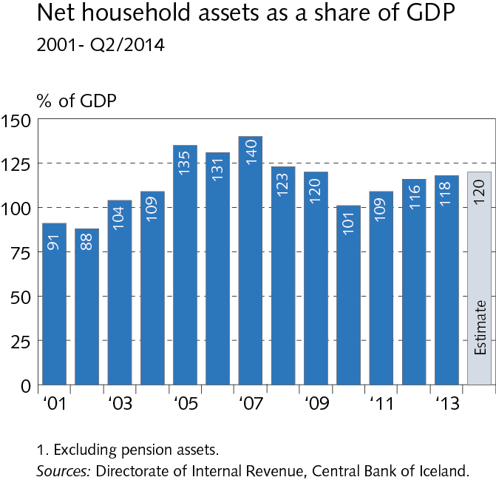
Households

Slide 46
Households

Slide 47
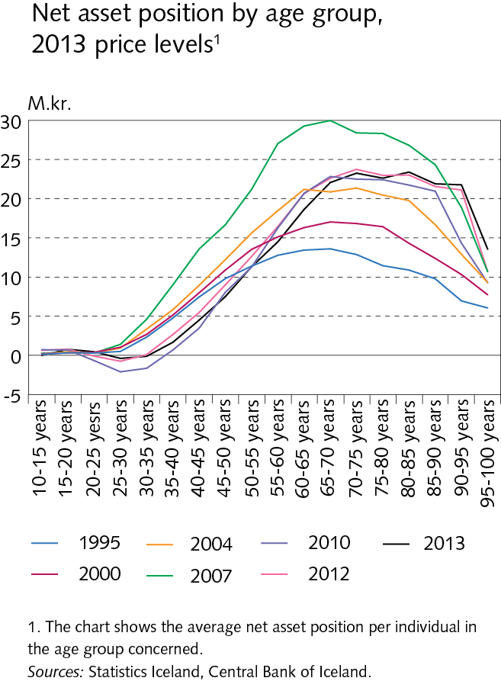
Households

Slide 48
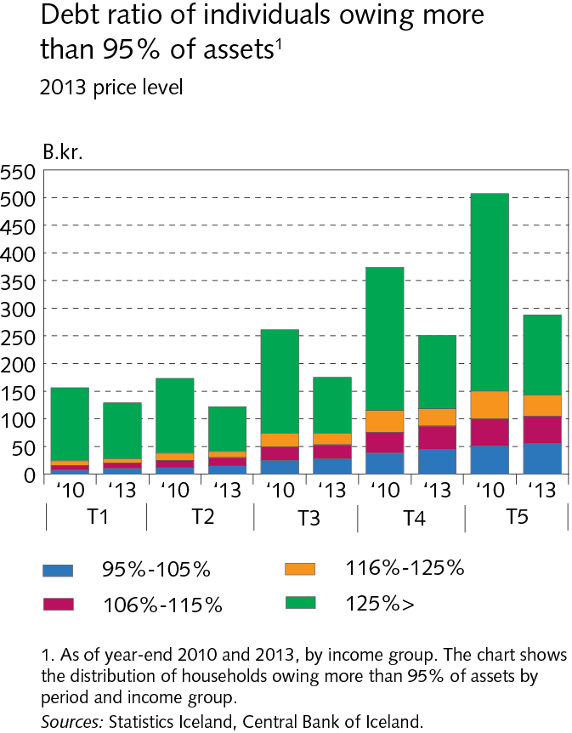
Households

Slide 49
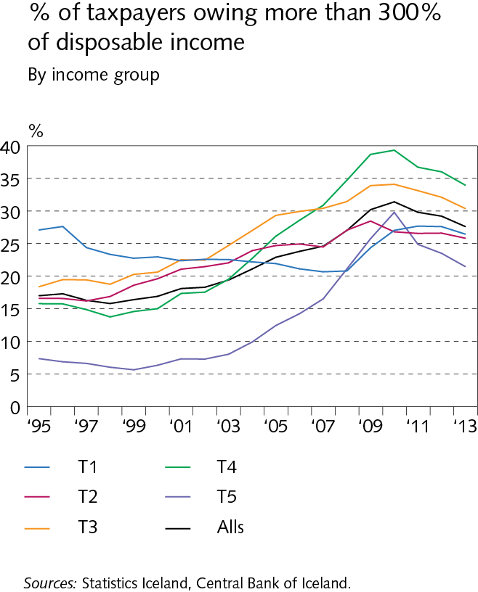
Households

Slide 50
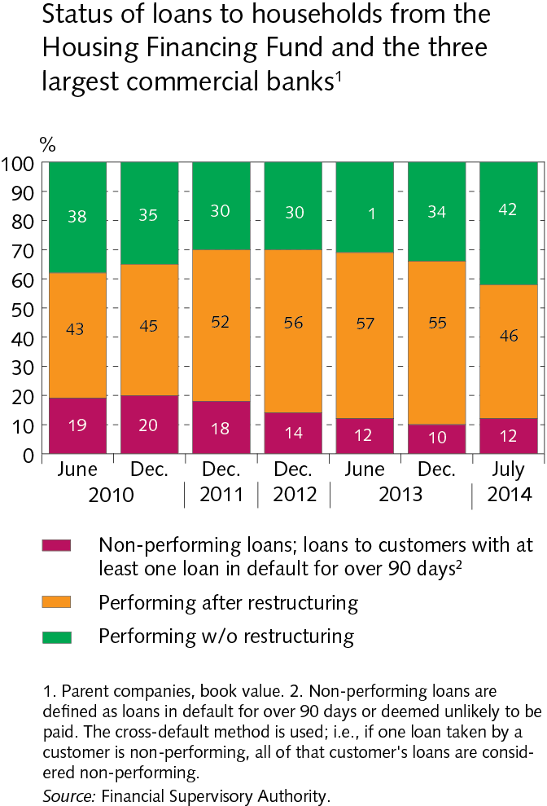
Households

Slide 51
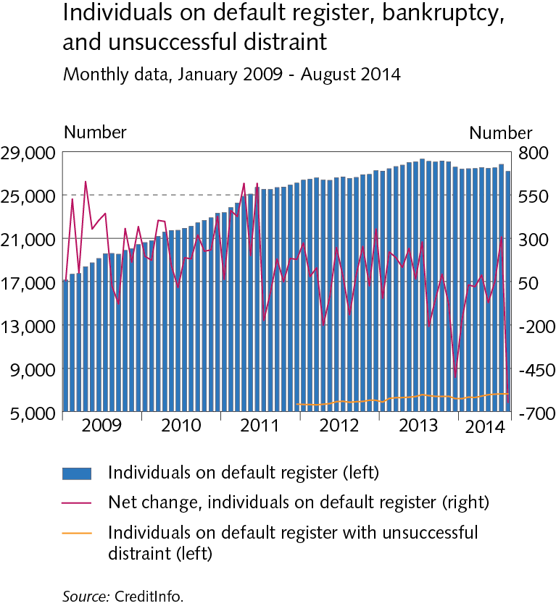
Households

Slide 52
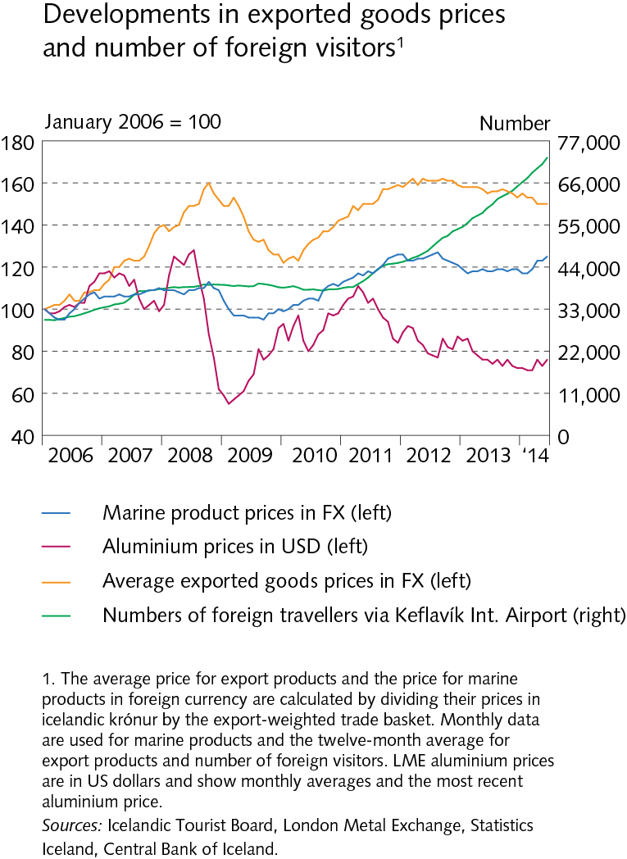
Companies

Slide 53
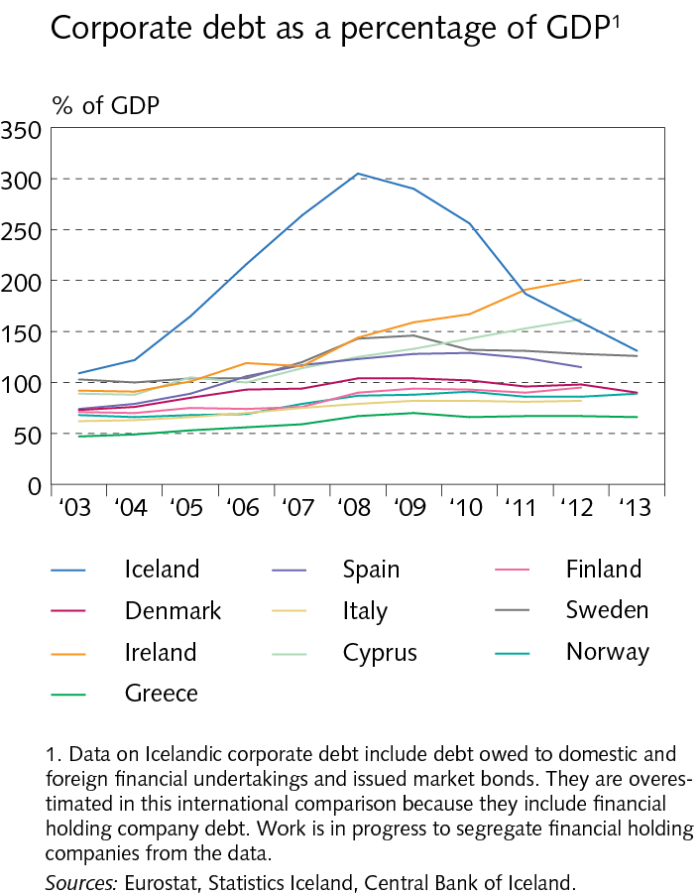
Companies

Slide 54
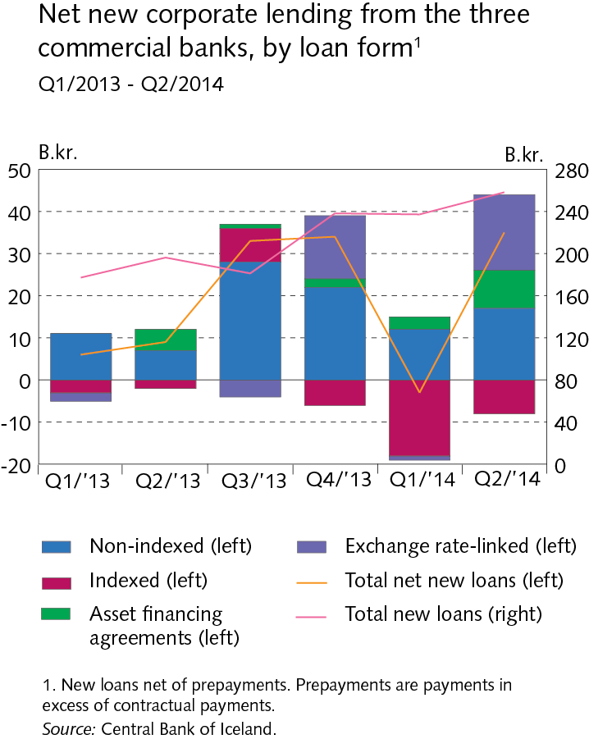
Companies

Slide 55
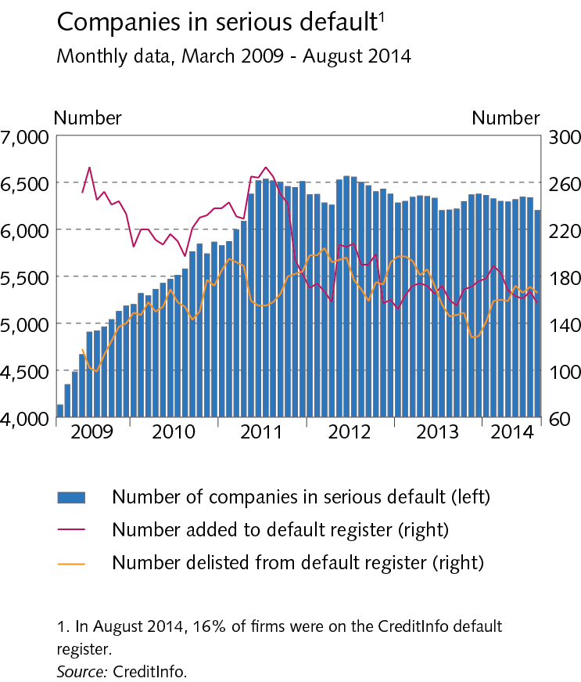
Companies

Slide 56
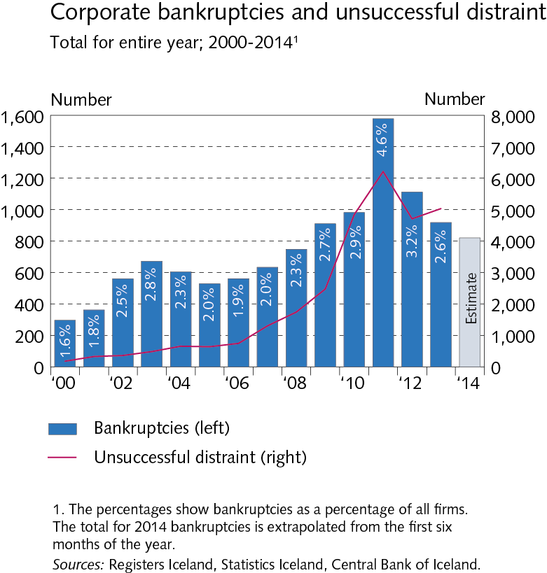
Companies

Slide 57
Companies

Slide 58
Financial market entities

Slide 59
Financial market entities

Slide 60
Financial market entities

Slide 61
Financial market entities

Slide 62
Financial market entities

Slide 63
Financial market entities

Slide 64
Settlement of the failed banks´ estates

Slide 65
Settlement of the failed banks´ estates

Slide 66
Settlement of the failed banks´ estates

Slide 67
Settlement of the failed banks´ estates

Slide 68
Settlement of the failed banks´ estates

Slide 69
Appendix II

Slide 70
Appendix II

Slide 71
Appendix II

Slide 72
Appendix II

Slide 73
Appendix II

Slide 74
Appendix II

