Slide 1
Monetary Bulletin 2010/4
Powerpoint charts from Economic and monetary developments and prospects

Slide 2
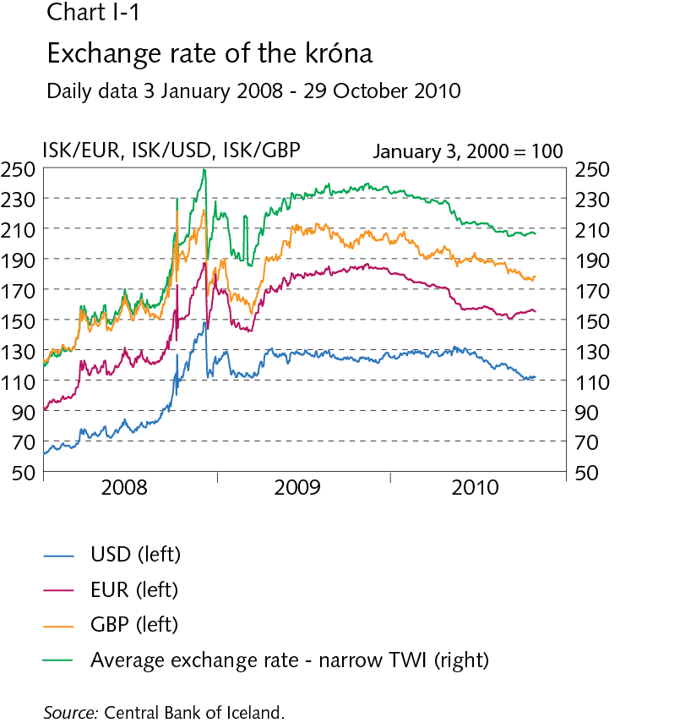
I Economic outlook and main uncertainties

Slide 3
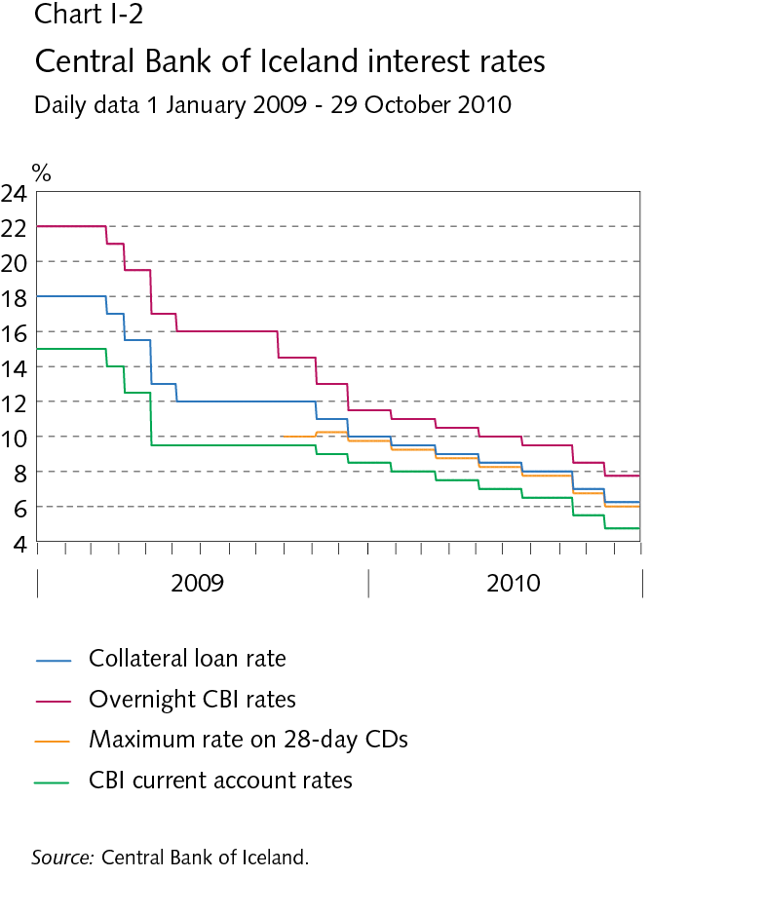
I Economic outlook and main uncertainties

Slide 4
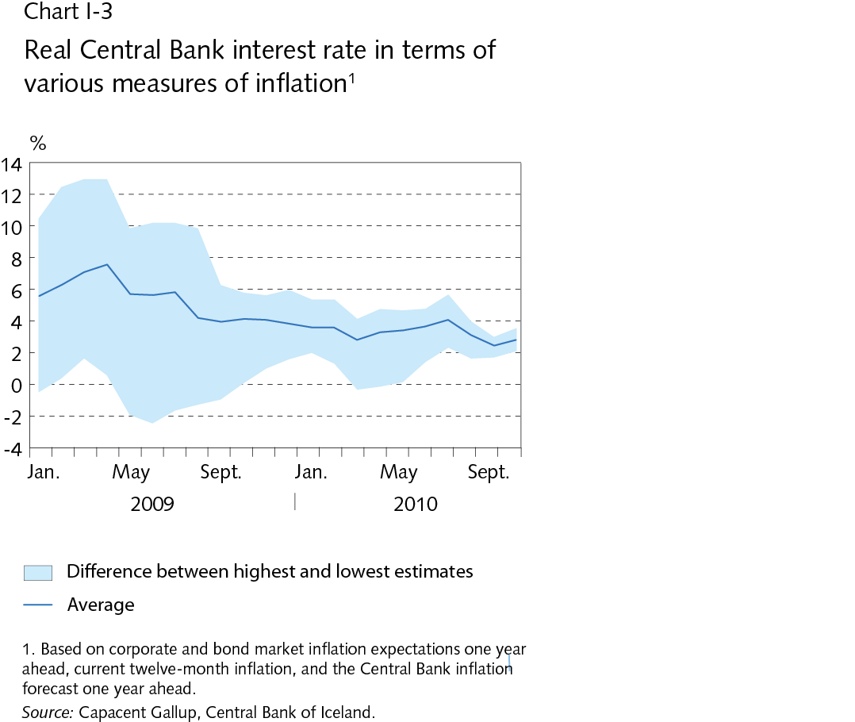
I Economic outlook and main uncertainties

Slide 5
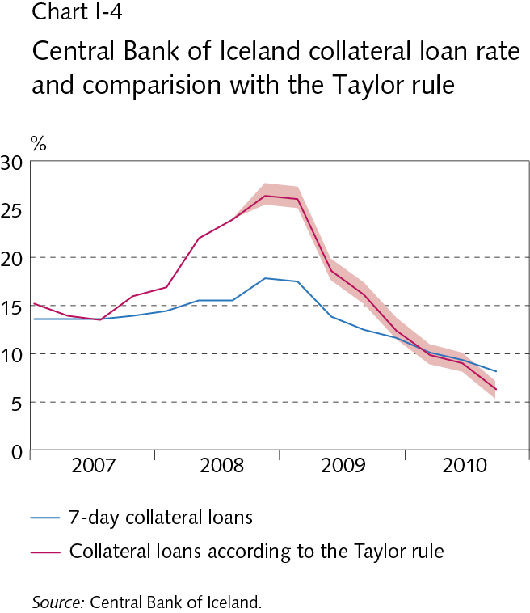
I Economic outlook and main uncertainties

Slide 6
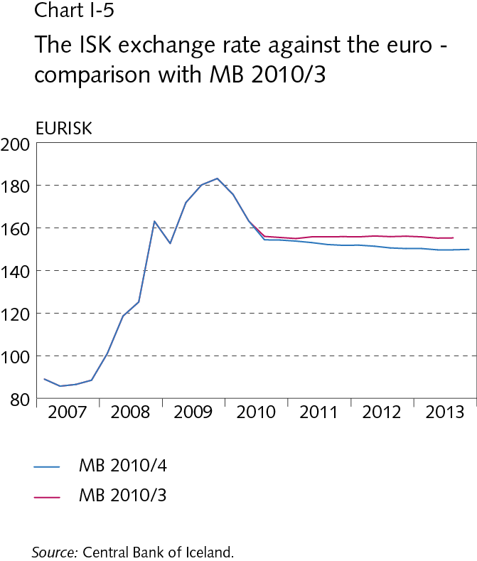
I Economic outlook and main uncertainties

Slide 7
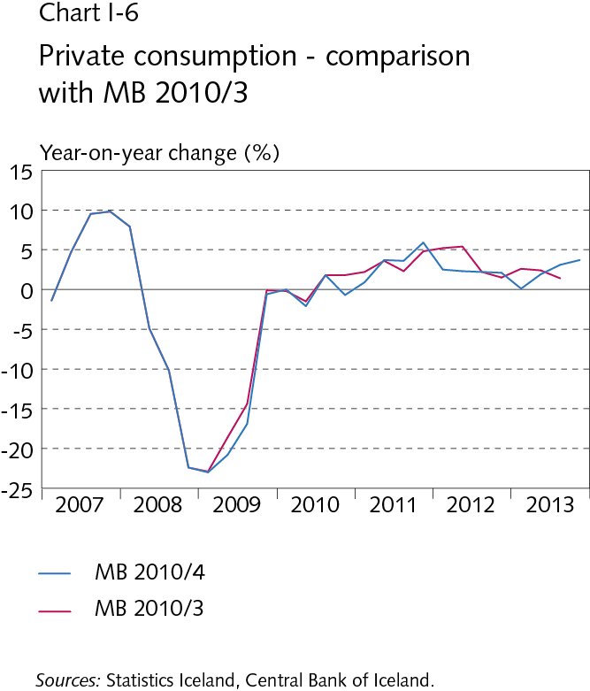
I Economic outlook and main uncertainties

Slide 8
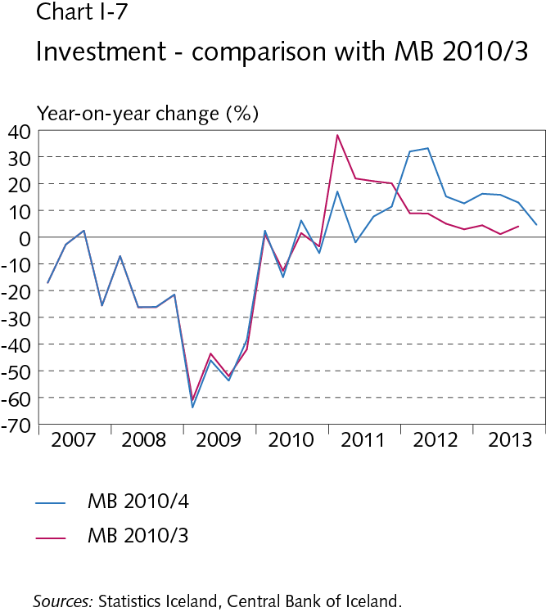
I Economic outlook and main uncertainties

Slide 9
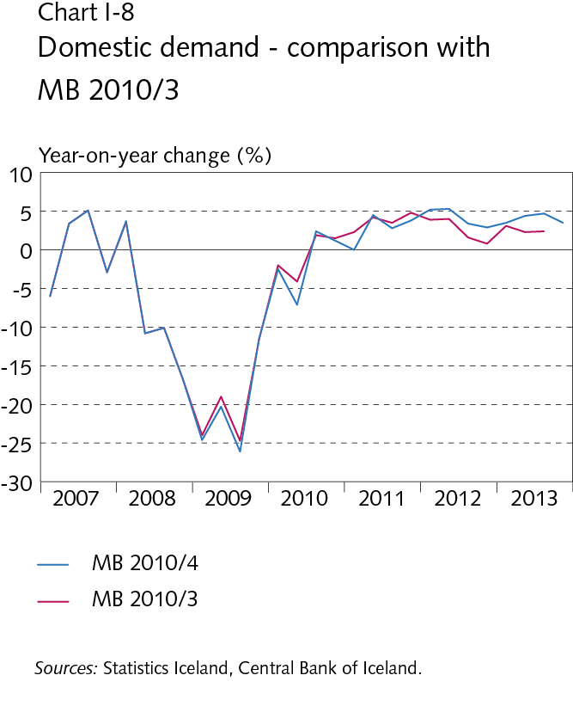
I Economic outlook and main uncertainties

Slide 10
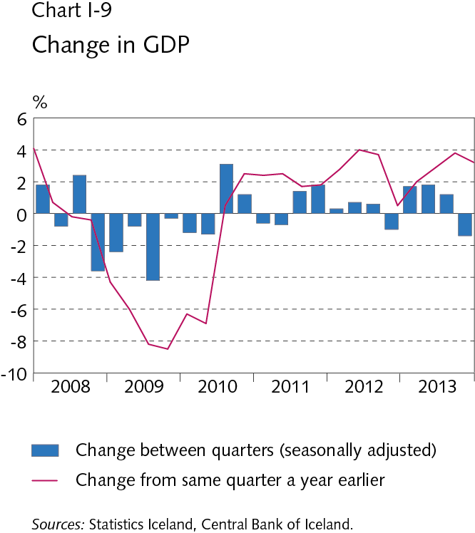
I Economic outlook and main uncertainties

Slide 11
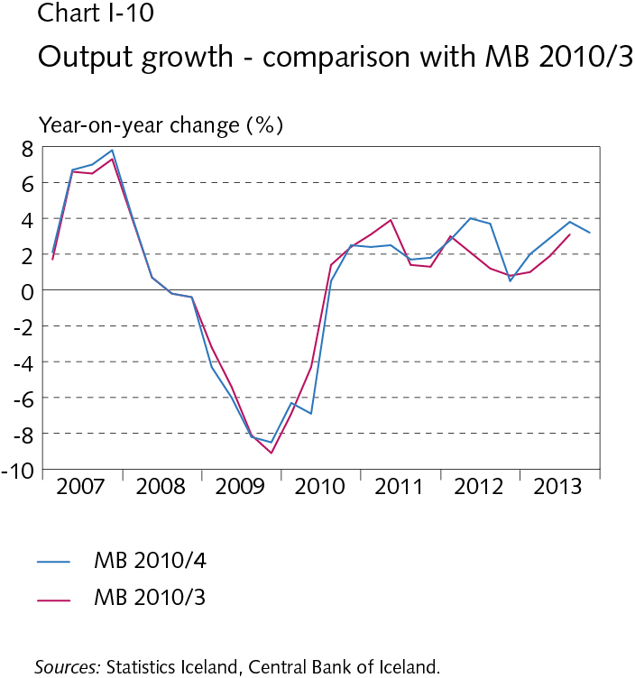
I Economic outlook and main uncertainties

Slide 12
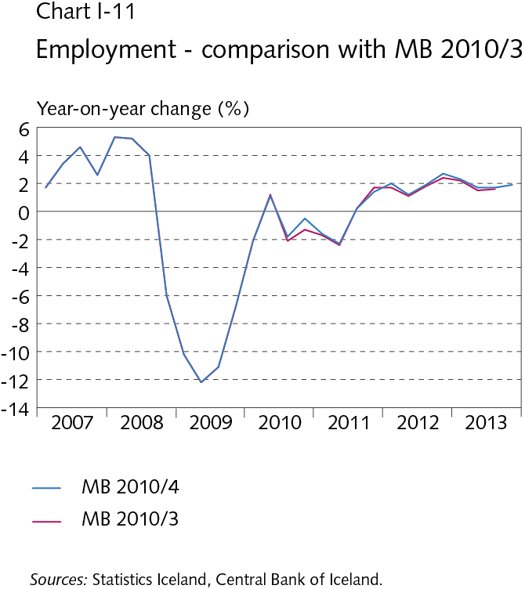
I Economic outlook and main uncertainties

Slide 13
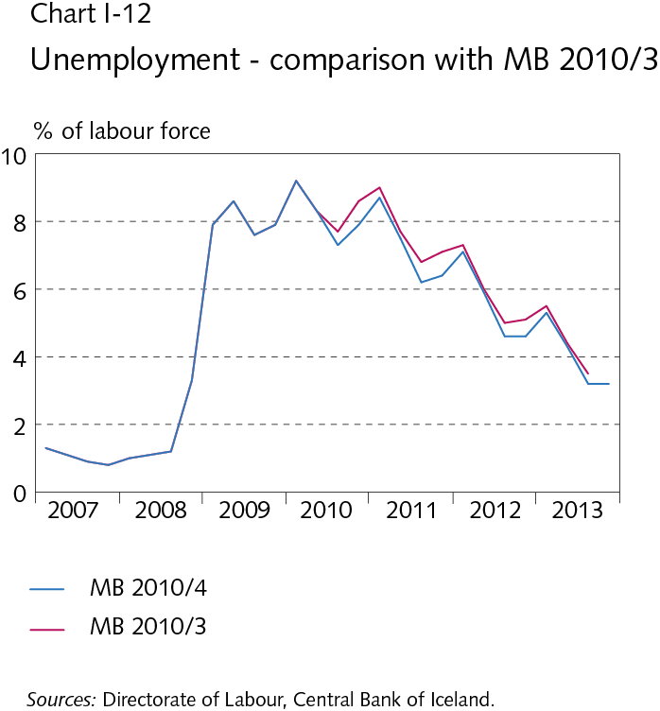
I Economic outlook and main uncertainties

Slide 14
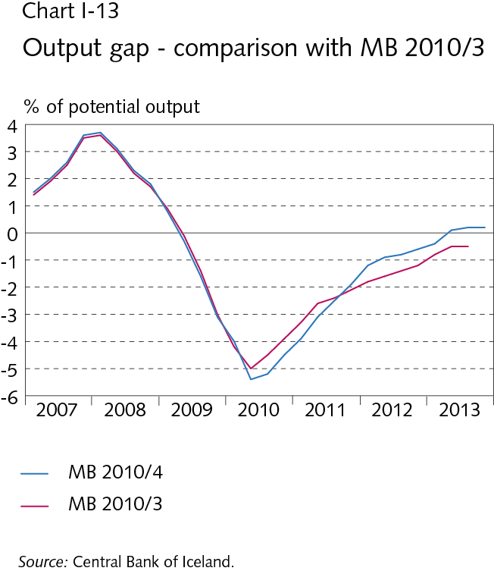
I Economic outlook and main uncertainties

Slide 15
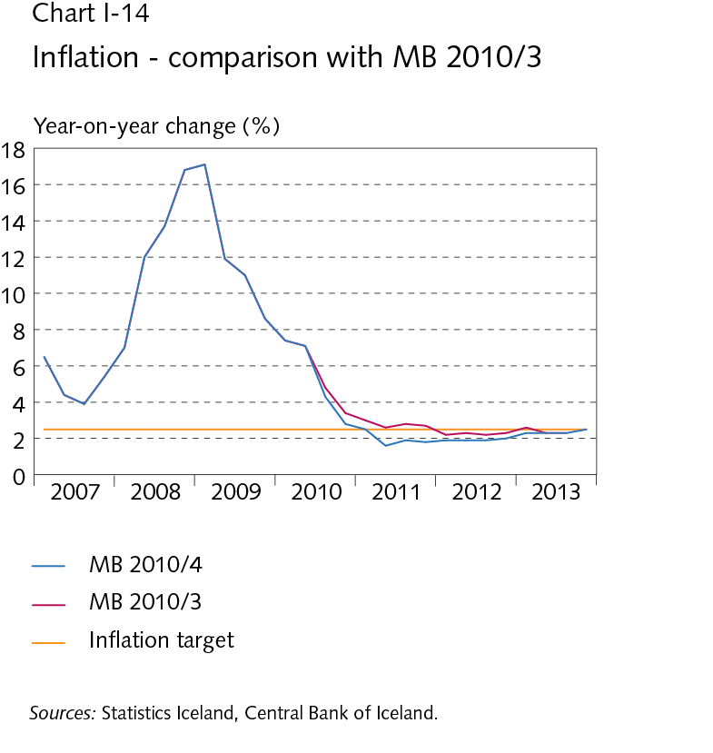
I Economic outlook and main uncertainties

Slide 16
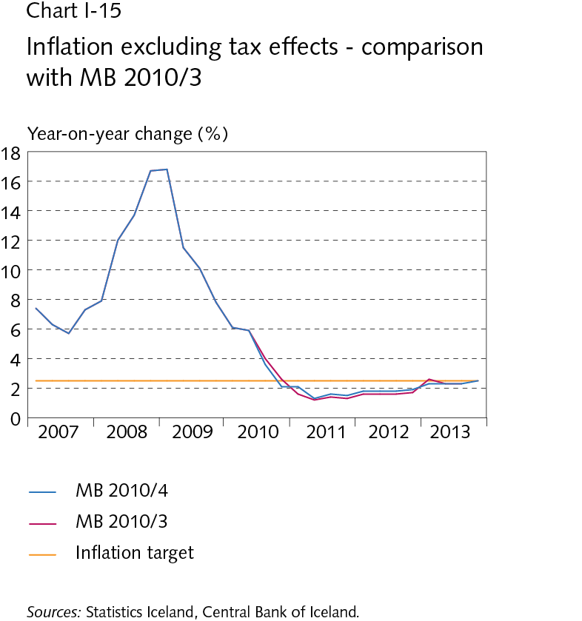
I Economic outlook and main uncertainties

Slide 17
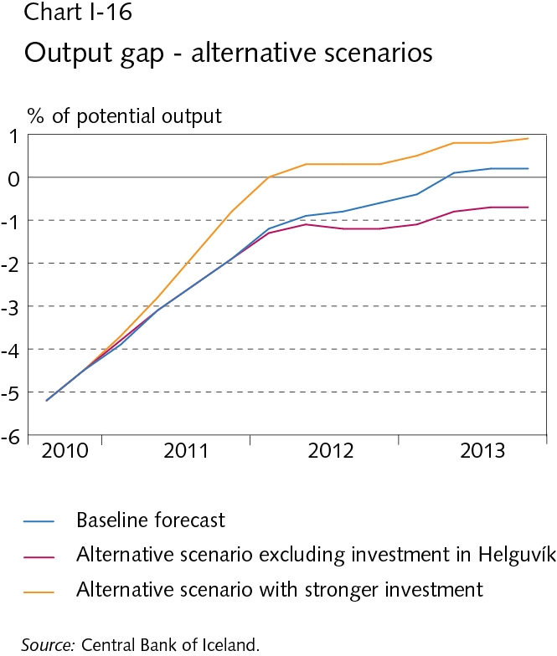
I Economic outlook and main uncertainties

Slide 18
I Economic outlook and main uncertainties

Slide 19
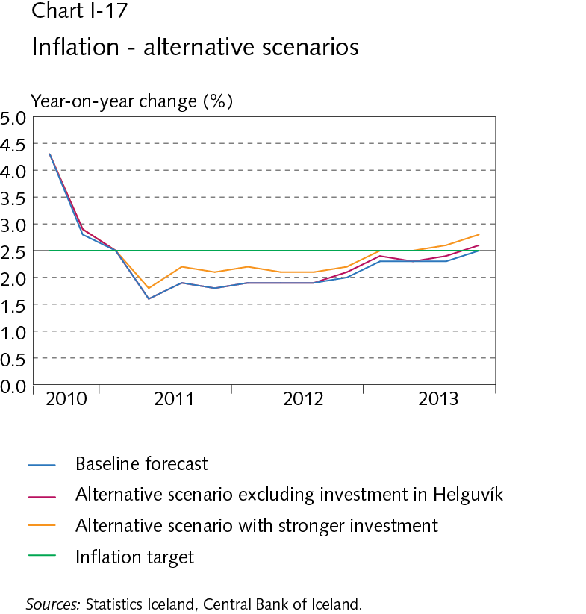
I Economic outlook and main uncertainties

Slide 20
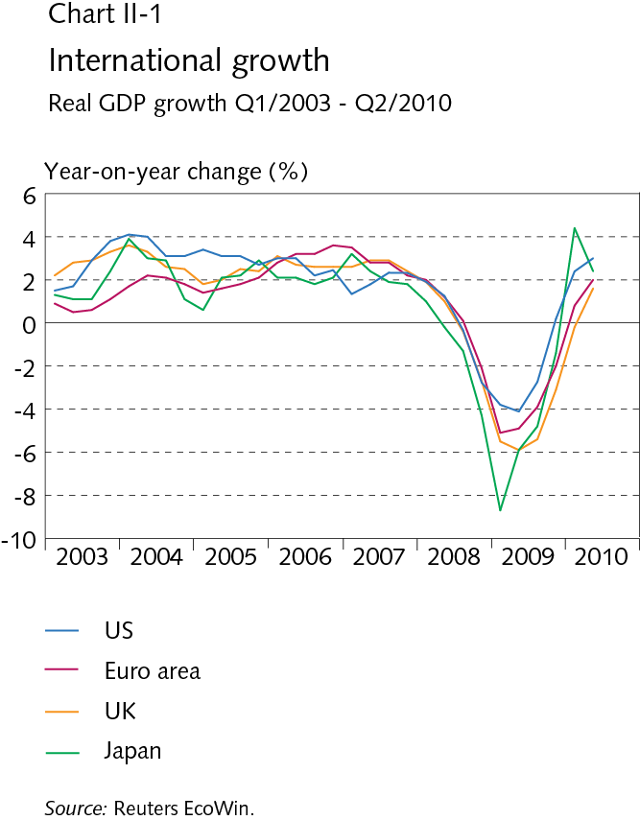
II External conditions and exports

Slide 21
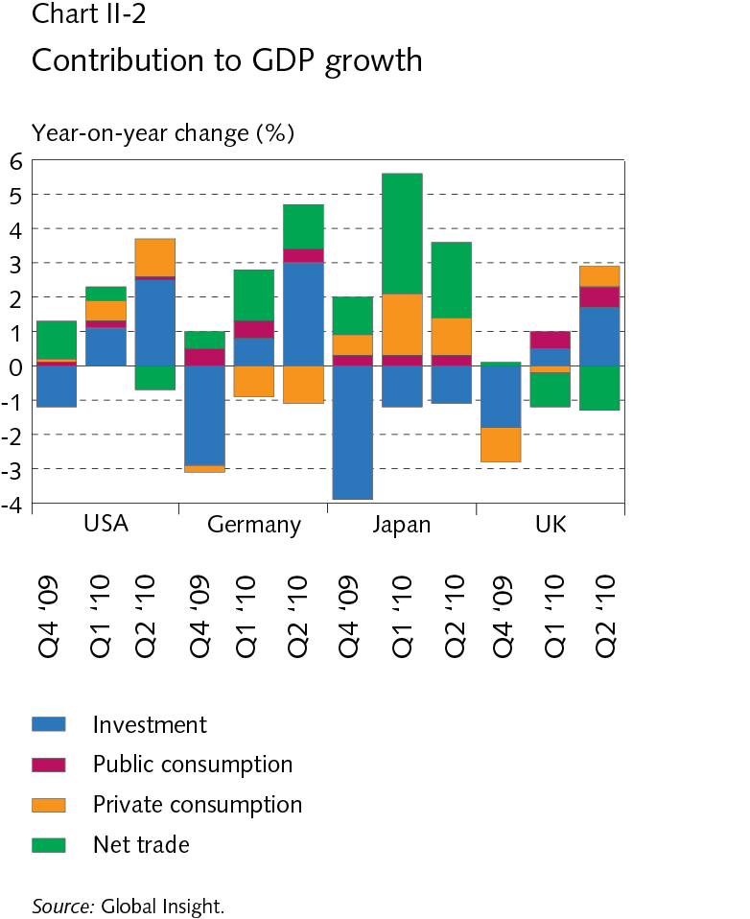
II External conditions and exports

Slide 22
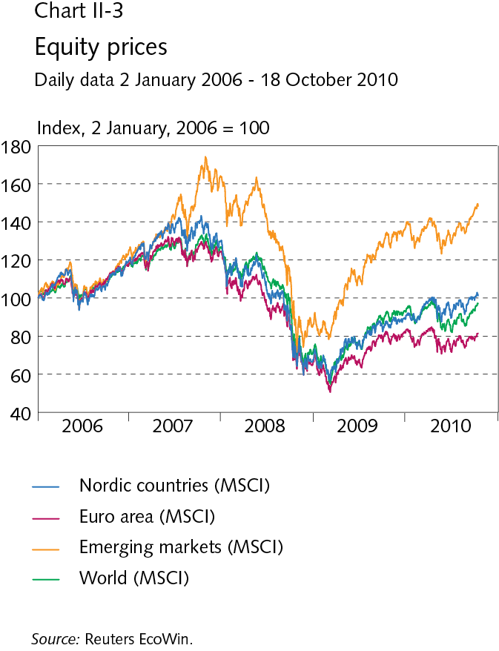
II External conditions and exports

Slide 23
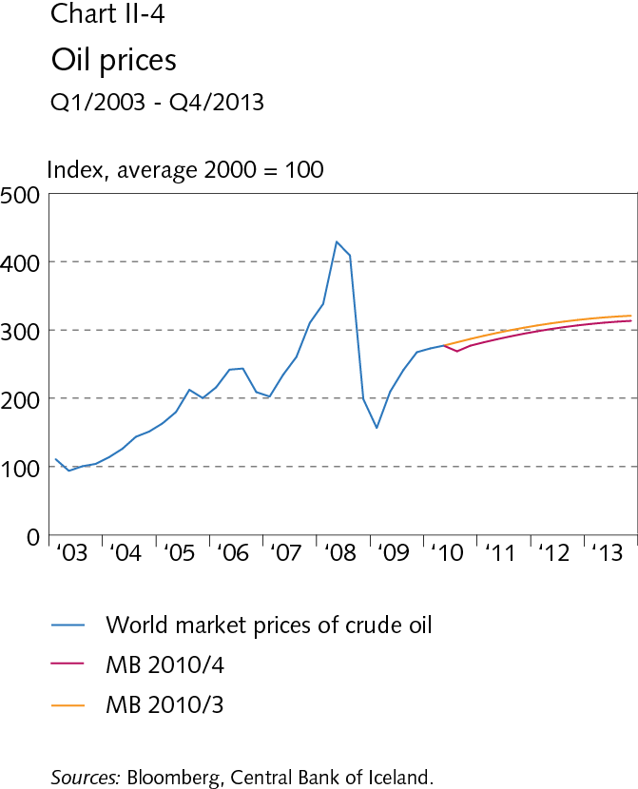
II External conditions and exports

Slide 24
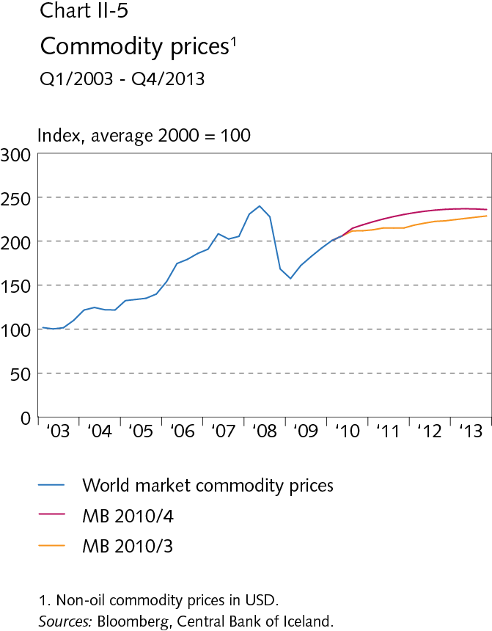
II External conditions and exports

Slide 25
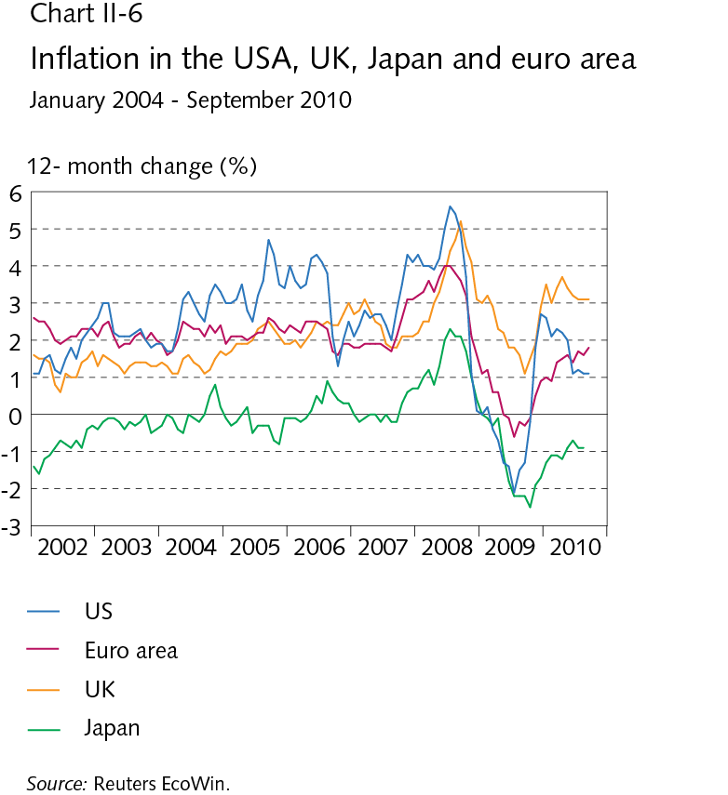
II External conditions and exports

Slide 26
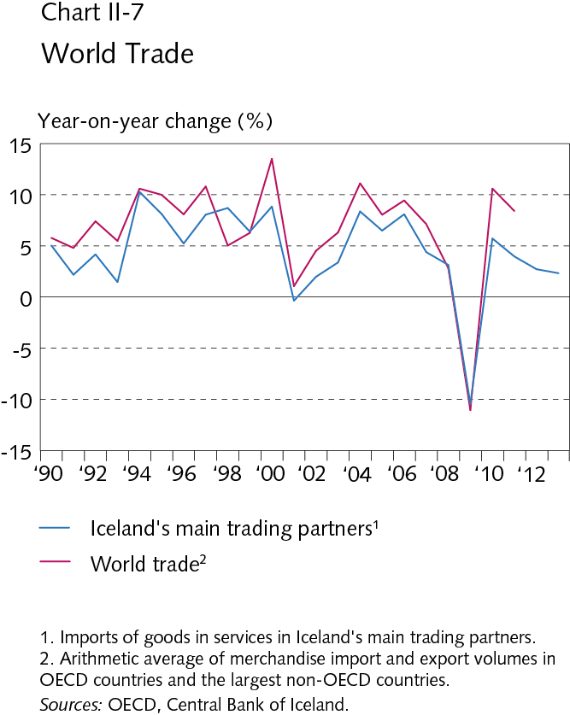
II External conditions and exports

Slide 27
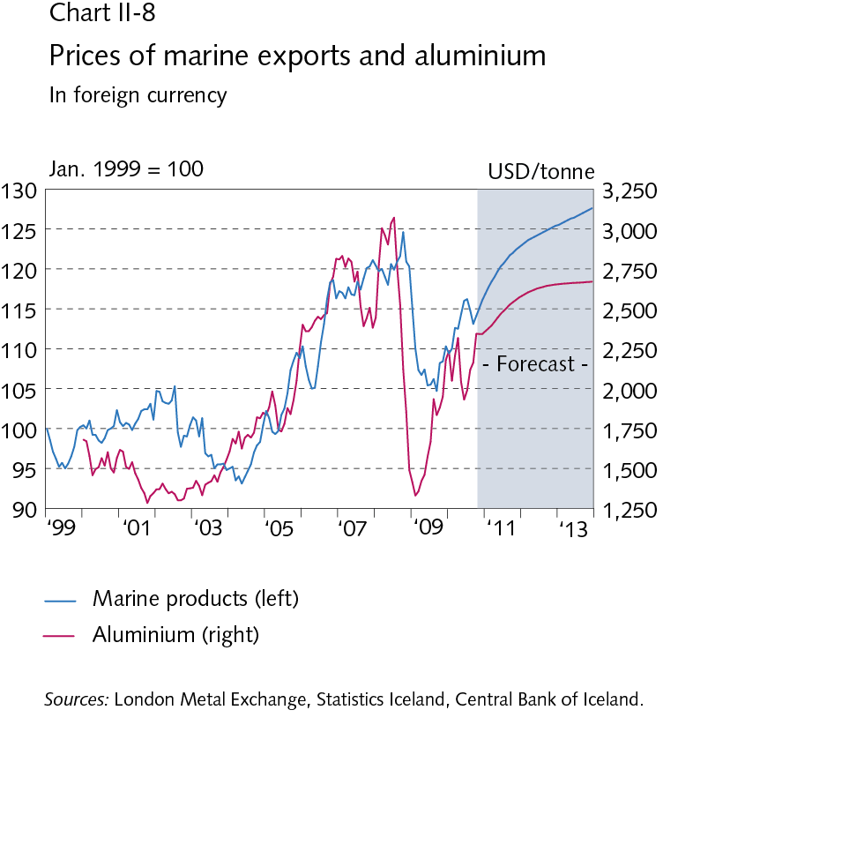
II External conditions and exports

Slide 28
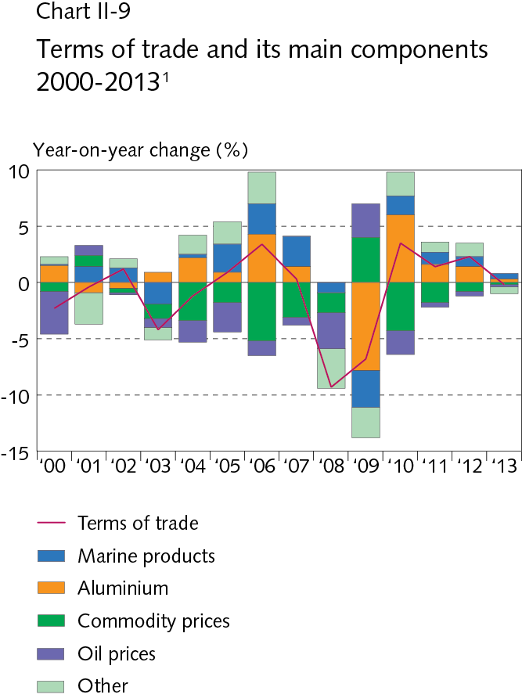
II External conditions and exports

Slide 29
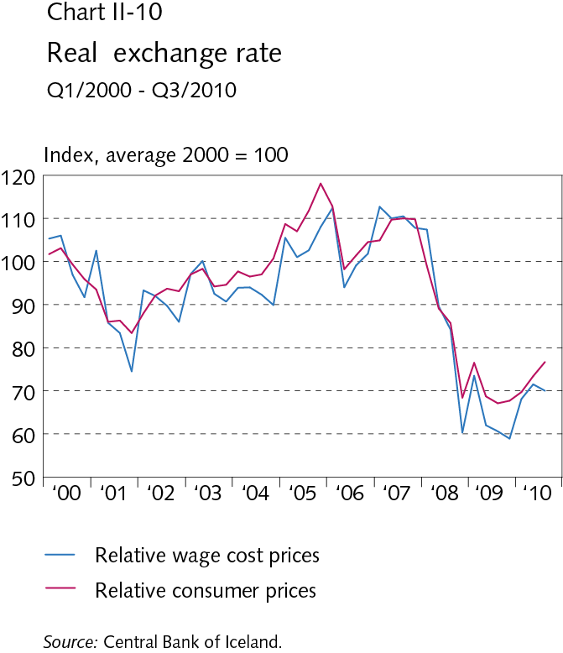
II External conditions and exports

Slide 30
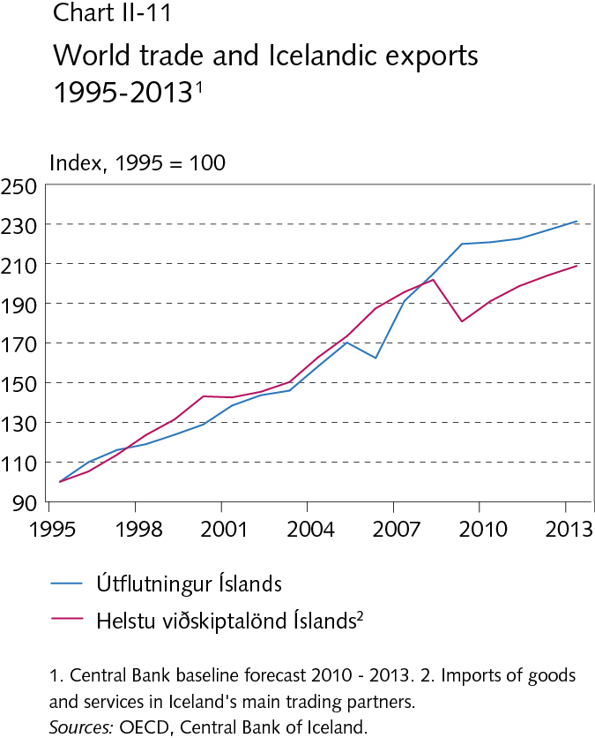
II External conditions and exports

Slide 31
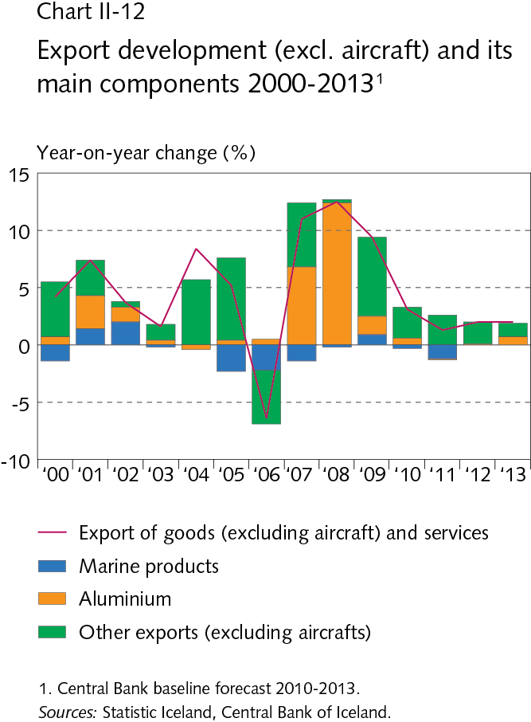
II External conditions and exports

Slide 32
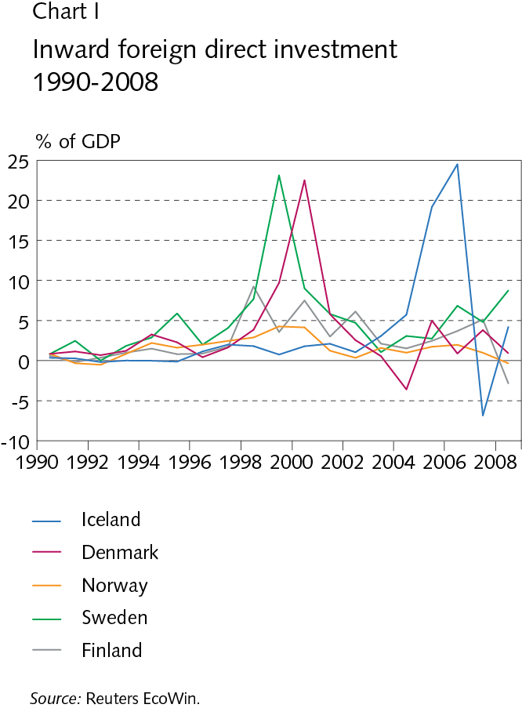
II External conditions and exports

Slide 33
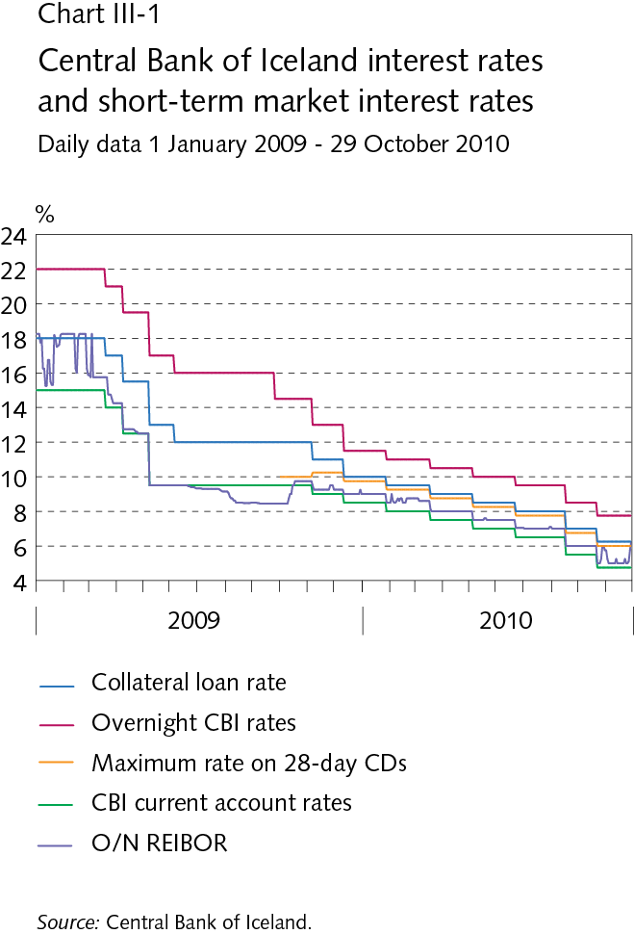
III Financial conditions

Slide 34
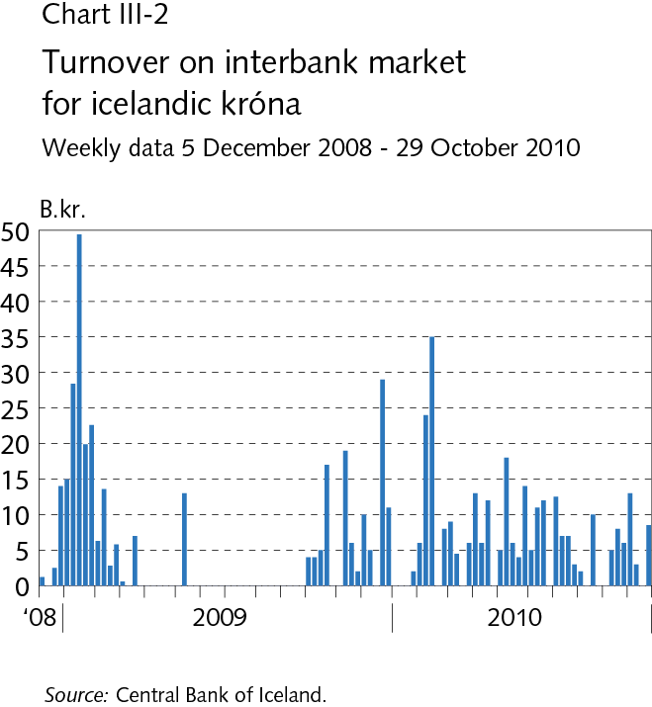
III Financial conditions

Slide 35
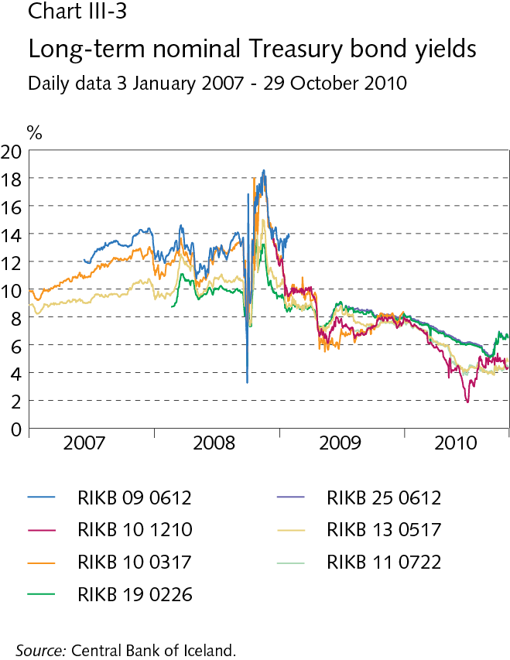
III Financial conditions

Slide 36
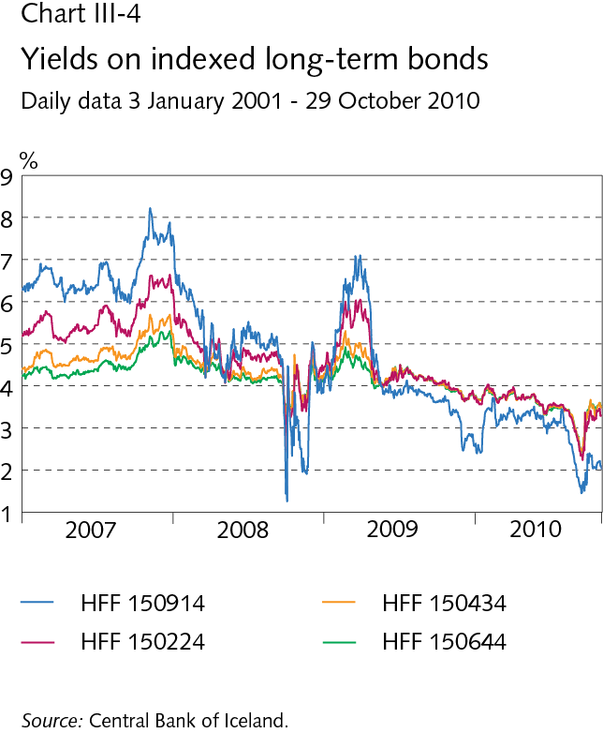
III Financial conditions

Slide 37
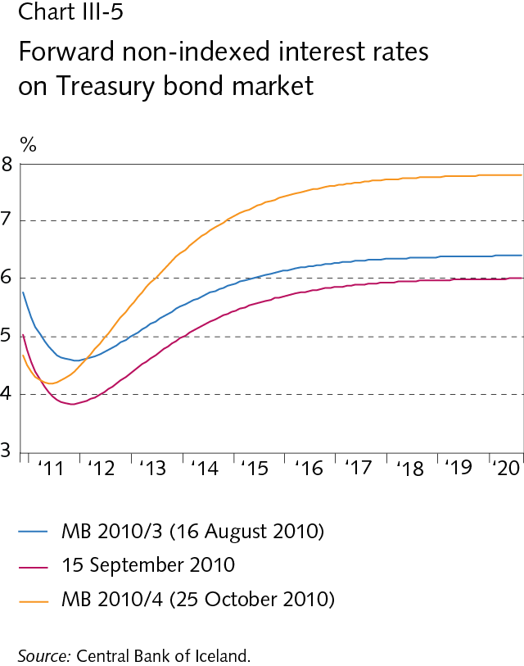
III Financial conditions

Slide 38
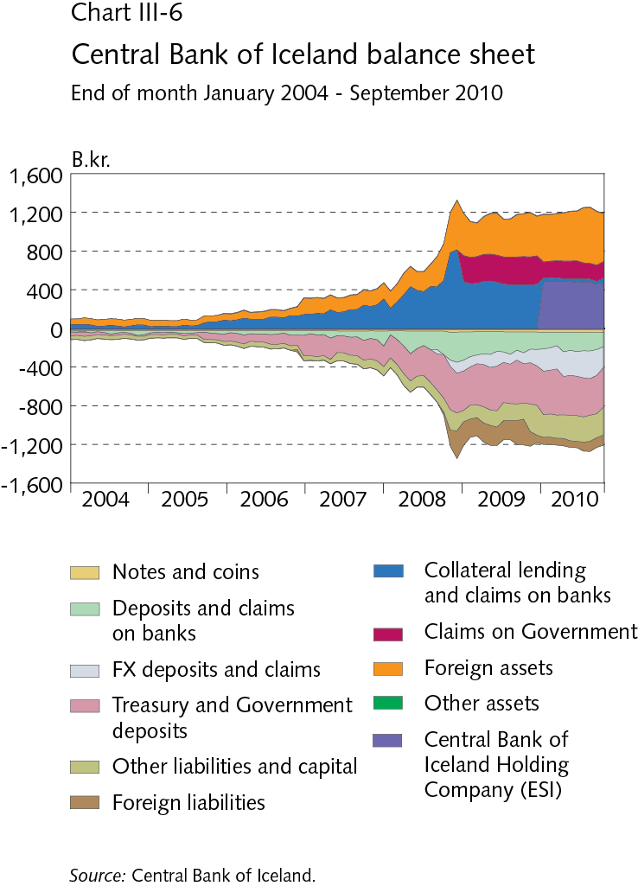
III Financial conditions

Slide 39
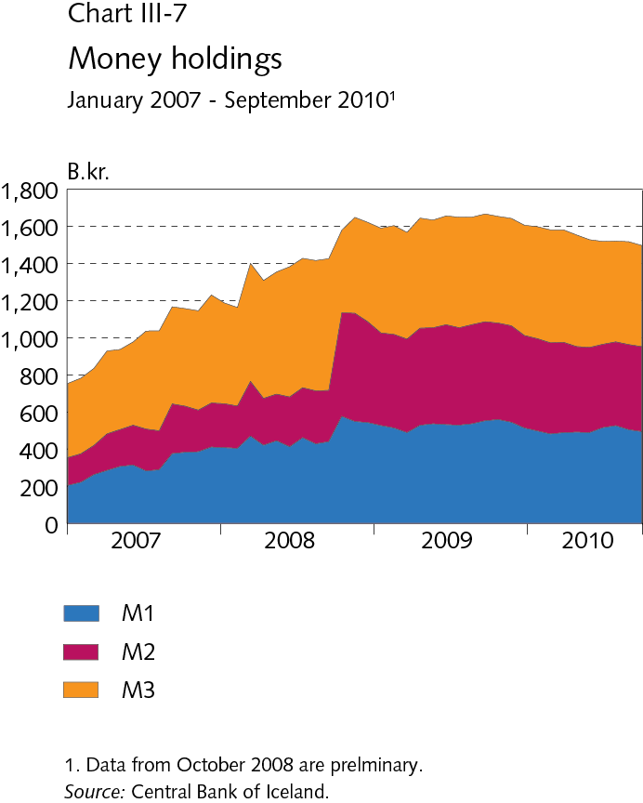
III Financial conditions

Slide 40
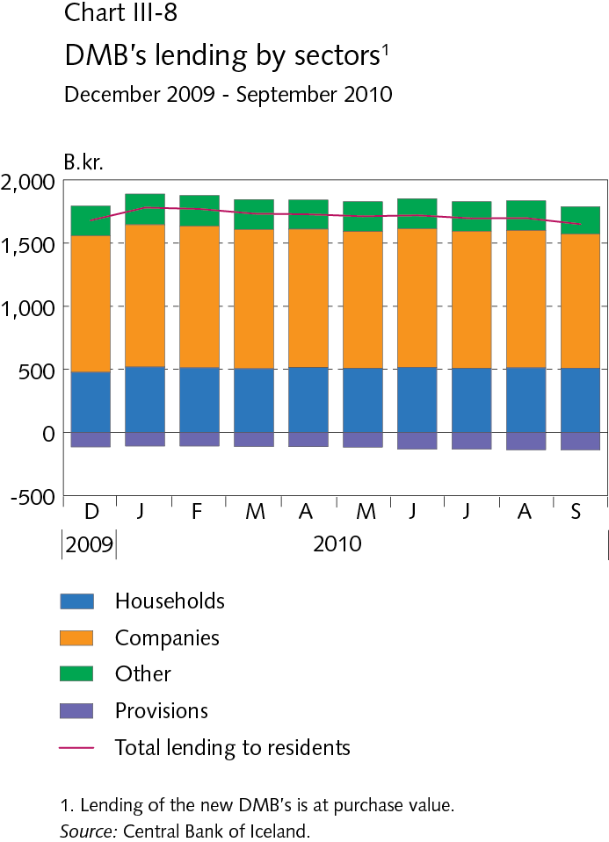
III Financial conditions

Slide 41
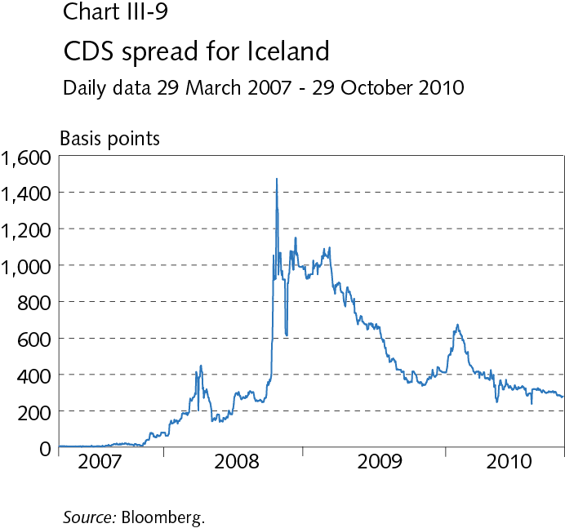
III Financial conditions

Slide 42
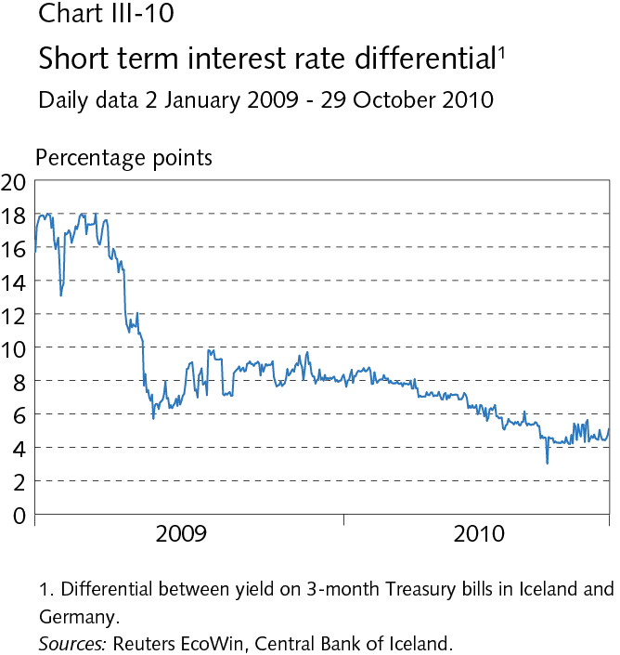
III Financial conditions

Slide 43
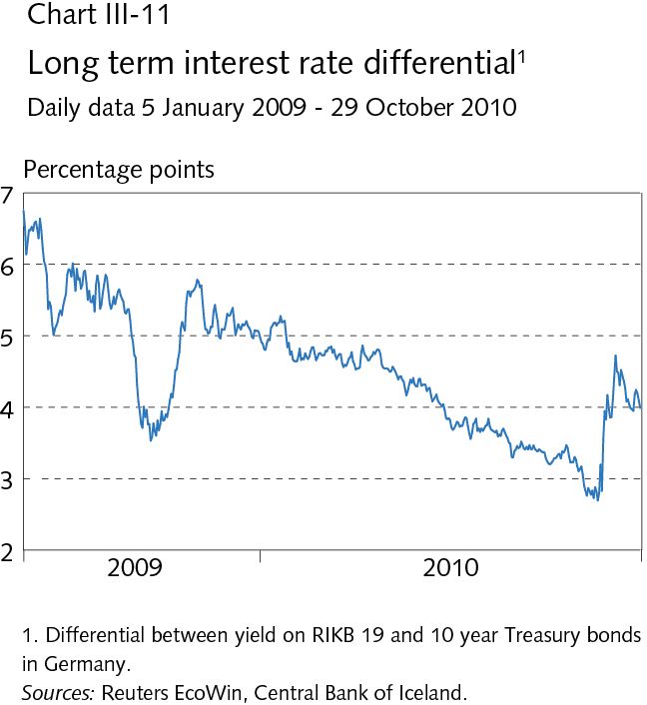
III Financial conditions

Slide 44
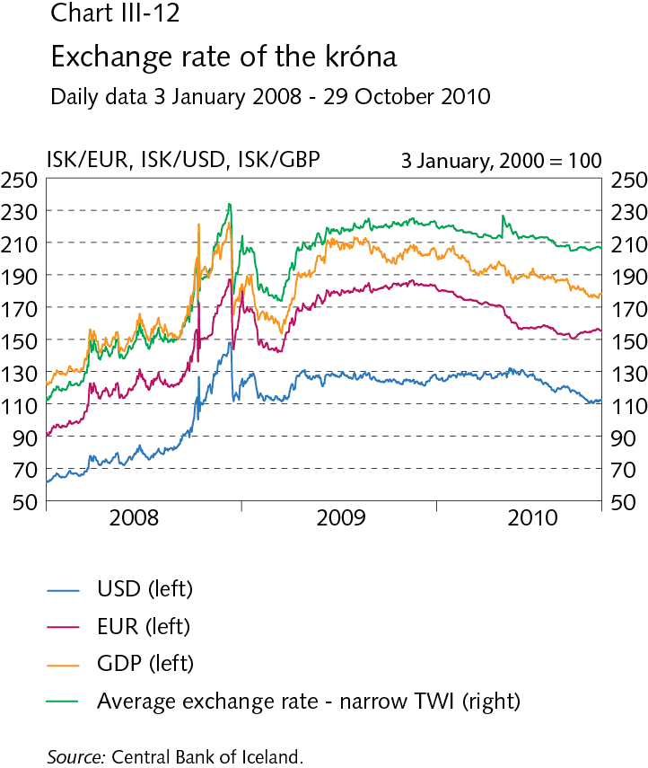
III Financial conditions

Slide 45
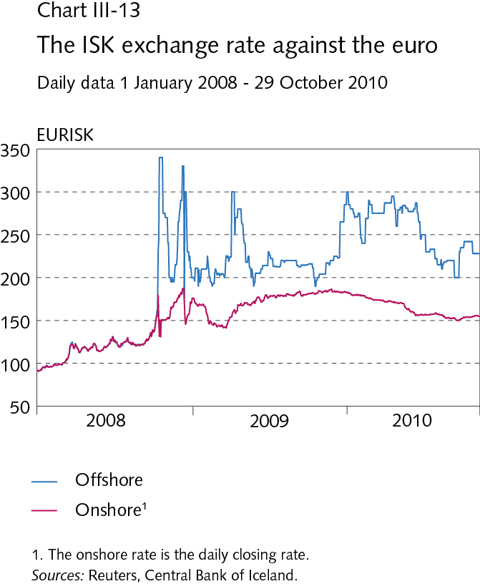
III Financial conditions

Slide 46
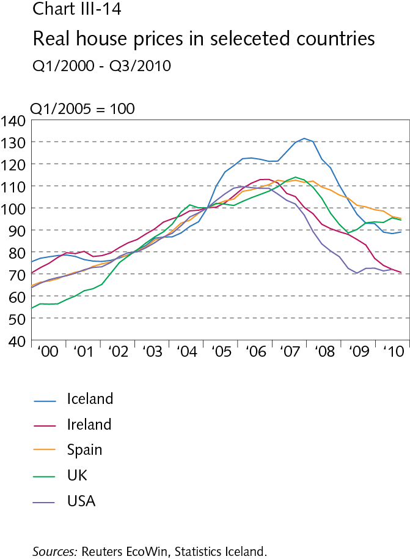
III Financial conditions

Slide 47
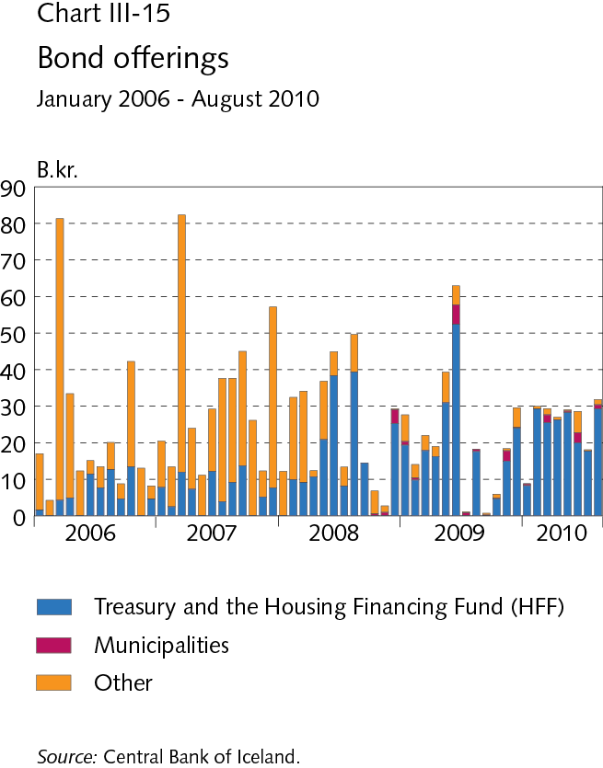
III Financial conditions

Slide 48
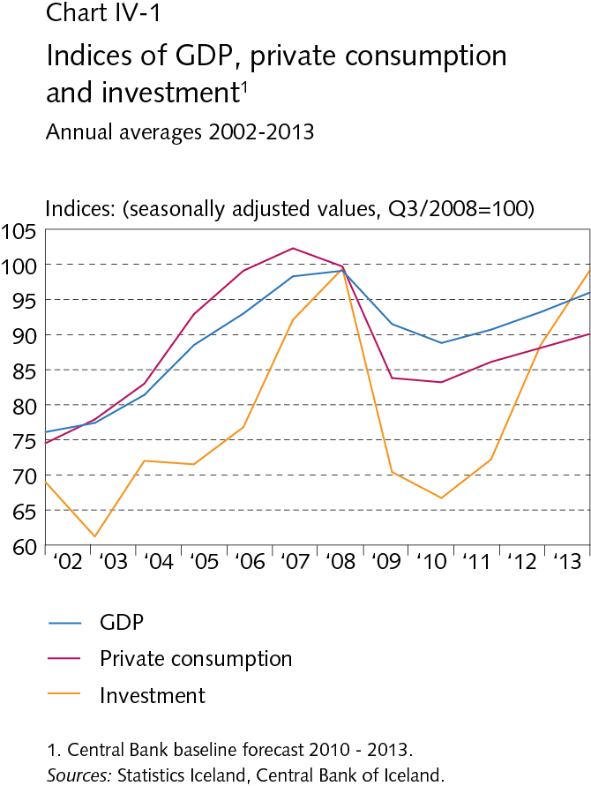
IV Domestic demand and production

Slide 49
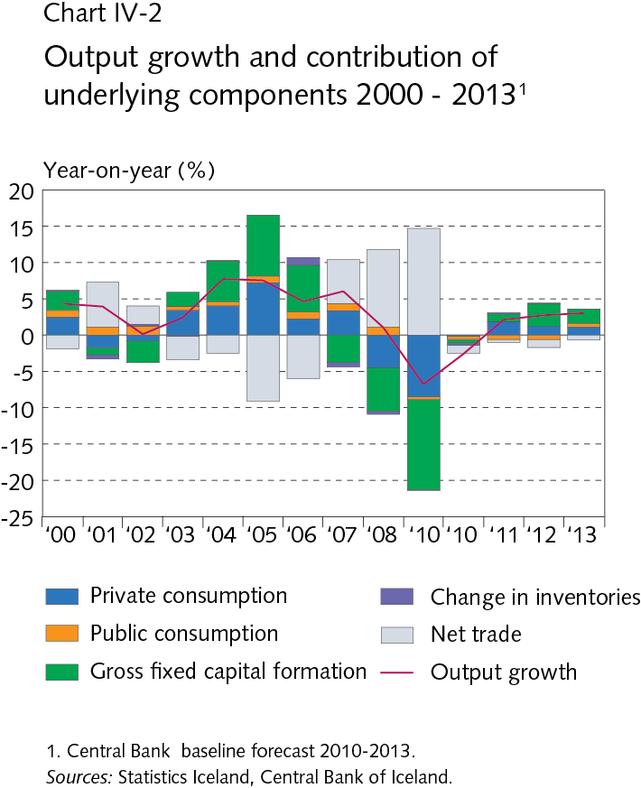
IV Domestic demand and production

Slide 50
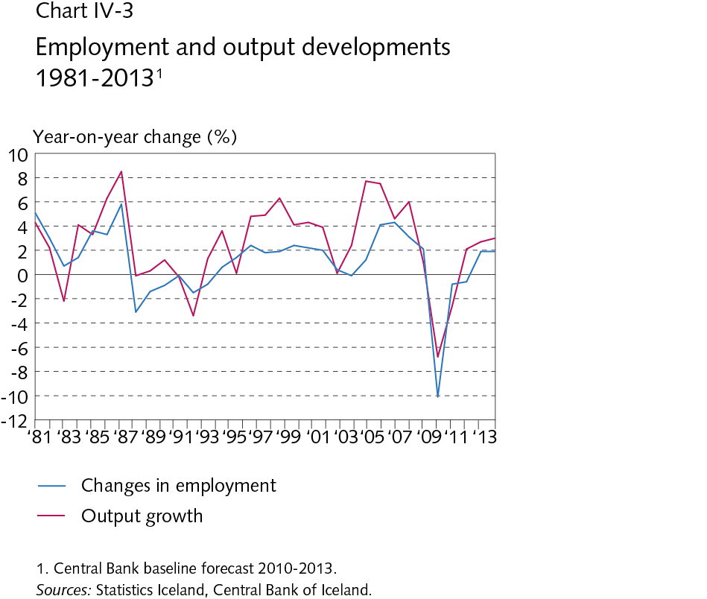
IV Domestic demand and production

Slide 51
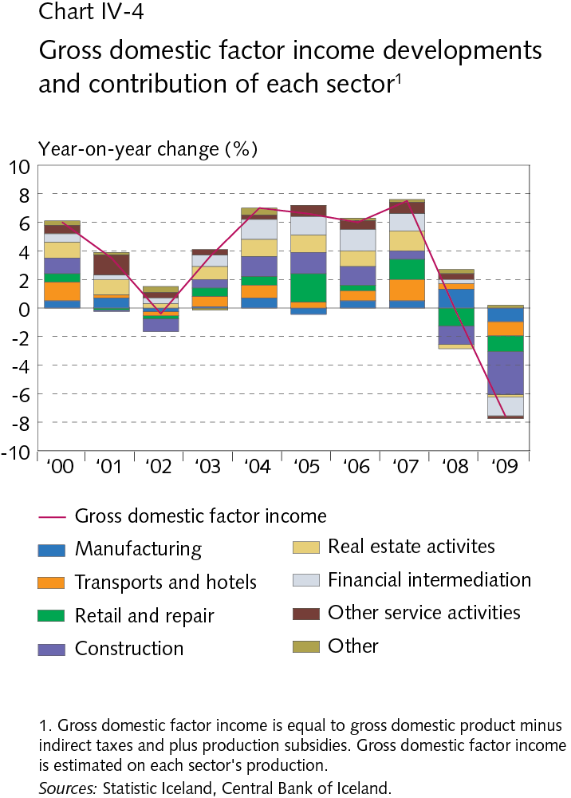
IV Domestic demand and production

Slide 52
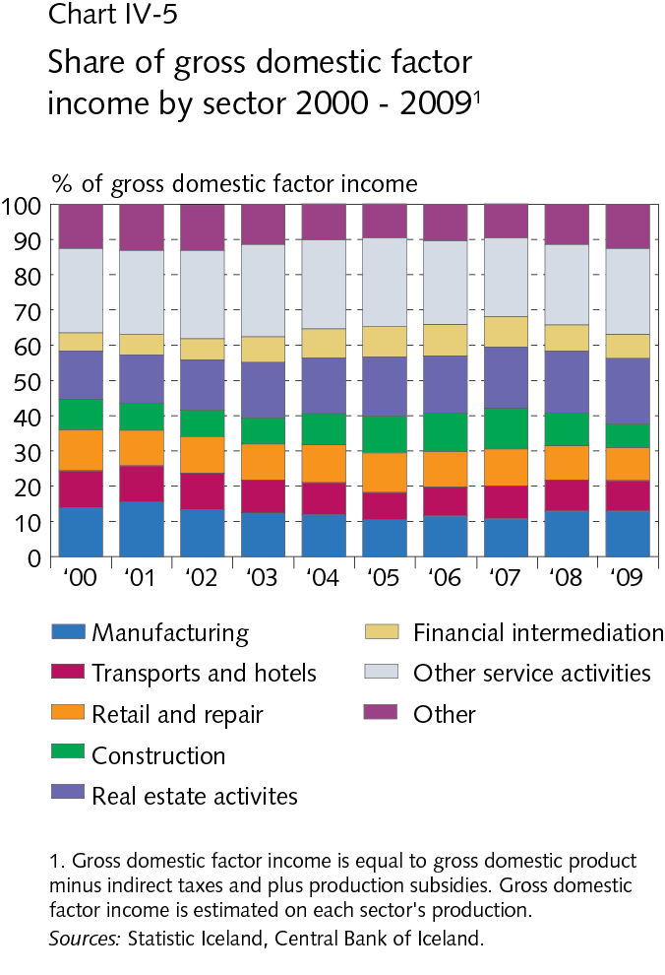
IV Domestic demand and production

Slide 53

IV Domestic demand and production

Slide 54

IV Domestic demand and production

Slide 55

IV Domestic demand and production

Slide 56

IV Domestic demand and production

Slide 57

IV Domestic demand and production

Slide 58

IV Domestic demand and production

Slide 59

IV Domestic demand and production

Slide 60

IV Domestic demand and production

Slide 61

IV Domestic demand and production

Slide 62

IV Domestic demand and production

Slide 63

IV Domestic demand and production

Slide 64

IV Domestic demand and production

Slide 65

IV Domestic demand and production

Slide 66

IV Domestic demand and production

Slide 67

IV Domestic demand and production

Slide 68

IV Domestic demand and production

Slide 69

IV Domestic demand and production

Slide 70

IV Domestic demand and production

Slide 71

V Public sector finances

Slide 72

V Public sector finances

Slide 73

V Public sector finances

Slide 74

V Public sector finances

Slide 75

V Public sector finances

Slide 76

V Public sector finances

Slide 77

VI Labour market and wage developments

Slide 78

VI Labour market and wage developments

Slide 79

VI Labour market and wage developments

Slide 80

VI Labour market and wage developments

Slide 81

VI Labour market and wage developments

Slide 82

VI Labour market and wage developments

Slide 83

VI Labour market and wage developments

Slide 84

VI Labour market and wage developments

Slide 85

VI Labour market and wage developments

Slide 86

VII External conditions

Slide 87

VII External conditions

Slide 88

VII External conditions

Slide 89

VII External conditions

Slide 90

VII External conditions

Slide 91

VIII Price developments and inflation target

Slide 92

VIII Price developments and inflation target

Slide 93

VIII Price developments and inflation target

Slide 94

VIII Price developments and inflation target

Slide 95

VIII Price developments and inflation target

Slide 96

VIII Price developments and inflation target

Slide 97

VIII Price developments and inflation target

Slide 98

VIII Price developments and inflation target

Slide 99

VIII Price developments and inflation target

Slide 100

VIII Price developments and inflation target

Slide 101

VIII Price developments and inflation target

