Slide 1
Monetary Bulletin 2014/2
Powerpoint charts from Economic and monetary developments and prospects

Slide 2
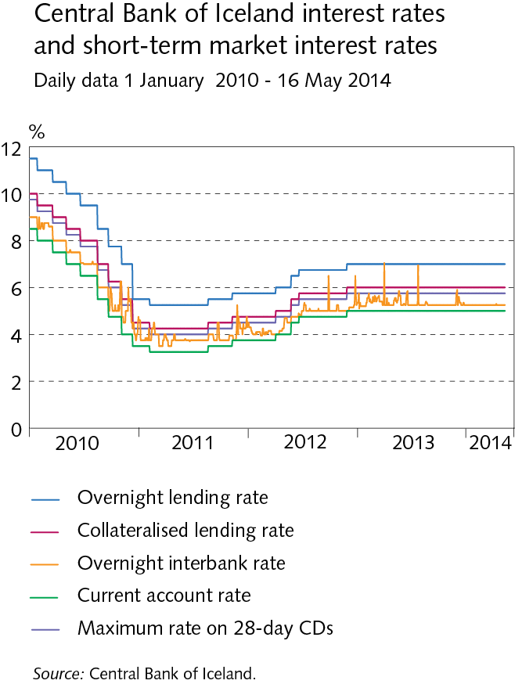
I Economic outlook and key uncertainties

Slide 3
I Economic outlook and key uncertainties

Slide 4
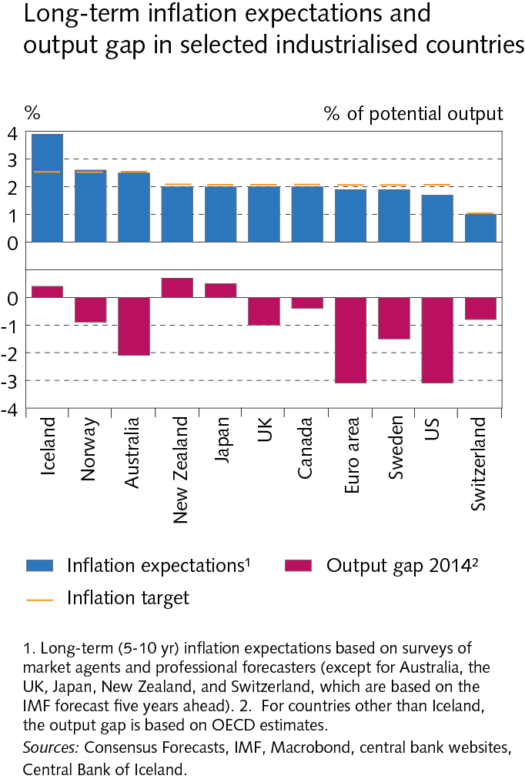
I Economic outlook and key uncertainties

Slide 5
I Economic outlook and key uncertainties

Slide 6
I Economic outlook and key uncertainties

Slide 7
I Economic outlook and key uncertainties

Slide 8
I Economic outlook and key uncertainties

Slide 9
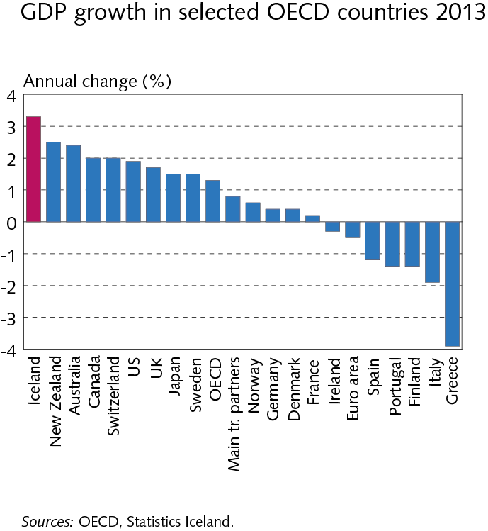
I Economic outlook and key uncertainties

Slide 10
I Economic outlook and key uncertainties

Slide 11
I Economic outlook and key uncertainties

Slide 12
I Economic outlook and key uncertainties

Slide 13
I Economic outlook and key uncertainties

Slide 14
I Economic outlook and key uncertainties

Slide 15
I Economic outlook and key uncertainties

Slide 16
I Economic outlook and key uncertainties

Slide 17
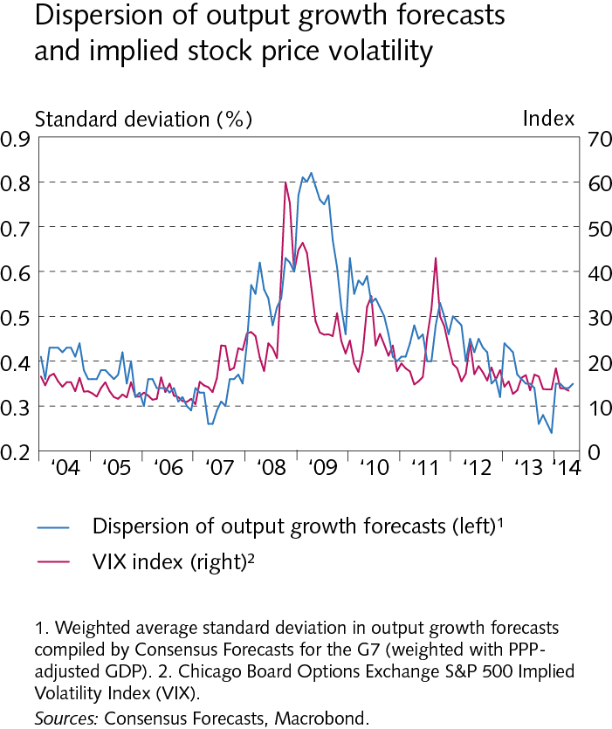
I Economic outlook and key uncertainties

Slide 18
I Economic outlook and key uncertainties

Slide 19
I Economic outlook and key uncertainties

Slide 20
I Economic outlook and key uncertainties

Slide 21
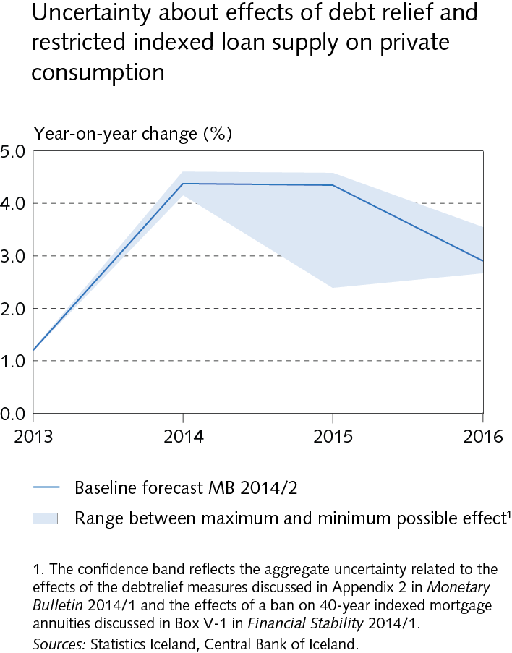
I Economic outlook and key uncertainties

Slide 22
I Economic outlook and key uncertainties

Slide 23
I Economic outlook and key uncertainties

Slide 24
Box I-1 Enhanced economic stability and the role of monetary policy

Slide 25
Box I-1 Enhanced economic stability and the role of monetary policy

Slide 26
Box I-1 Enhanced economic stability and the role of monetary policy

Slide 27
Box I-1 Enhanced economic stability and the role of monetary policy

Slide 28
Box I-1 Enhanced economic stability and the role of monetary policy

Slide 29
Box I-1 Enhanced economic stability and the role of monetary policy

Slide 30
Box I-1 Enhanced economic stability and the role of monetary policy

Slide 31
II External conditions and exports

Slide 32
II External conditions and exports

Slide 33
II External conditions and exports

Slide 34
II External conditions and exports

Slide 35
II External conditions and exports

Slide 36
II External conditions and exports

Slide 37
II External conditions and exports

Slide 38
II External conditions and exports

Slide 39
II External conditions and exports

Slide 40
II External conditions and exports

Slide 41
II External conditions and exports

Slide 42
II External conditions and exports

Slide 43
II External conditions and exports

Slide 44
II External conditions and exports

Slide 45
II External conditions and exports

Slide 46
III Financial conditions

Slide 47
III Financial conditions

Slide 48
III Financial conditions

Slide 49
III Financial conditions

Slide 50
III Financial conditions

Slide 51
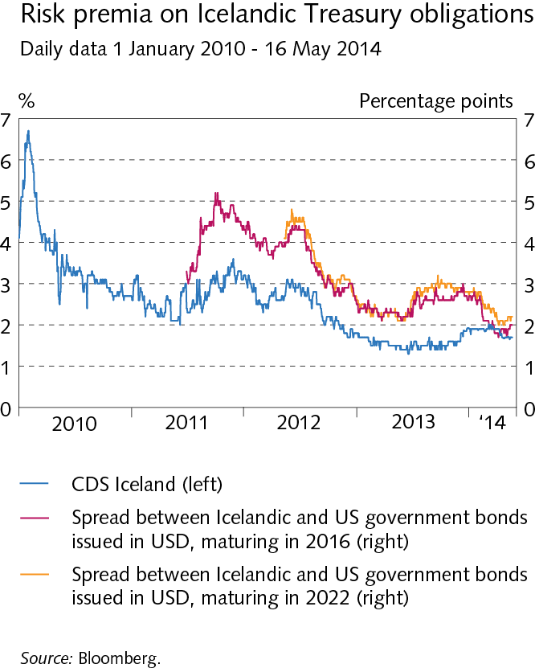
III Financial conditions

Slide 52
III Financial conditions

Slide 53
III Financial conditions

Slide 54
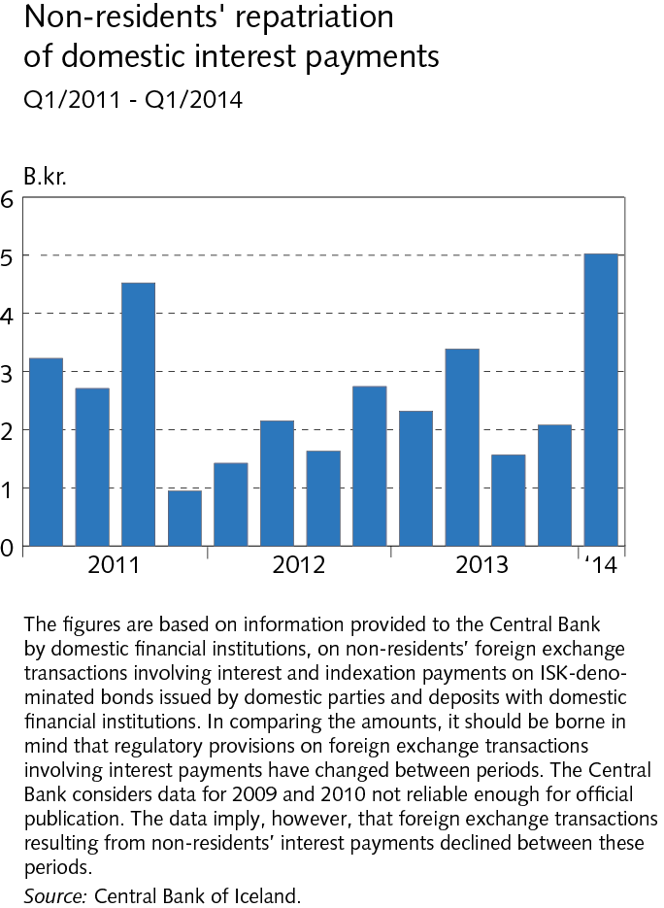
III Financial conditions

Slide 55
III Financial conditions

Slide 56
III Financial conditions

Slide 57
III Financial conditions

Slide 58
III Financial conditions

Slide 59
III Financial conditions

Slide 60
III Financial conditions

Slide 61
III Financial conditions

Slide 62
III Financial conditions

Slide 63
III Financial conditions

Slide 64
III Financial conditions

Slide 65
III Financial conditions

Slide 66
III Financial conditions

Slide 67
III Financial conditions

Slide 68
III Financial conditions

Slide 69
Box III-1 Post-crisis developments in money holdings

Slide 70
Box III-1 Post-crisis developments in money holdings

Slide 71
Box III-1 Post-crisis developments in money holdings

Slide 72
Box III-1 Post-crisis developments in money holdings

Slide 73
Box III-1 Post-crisis developments in money holdings

Slide 74
Box III-1 Post-crisis developments in money holdings

Slide 75
Box III-1 Post-crisis developments in money holdings

Slide 76
IV Domestic demand and production

Slide 77
IV Domestic demand and production

Slide 78
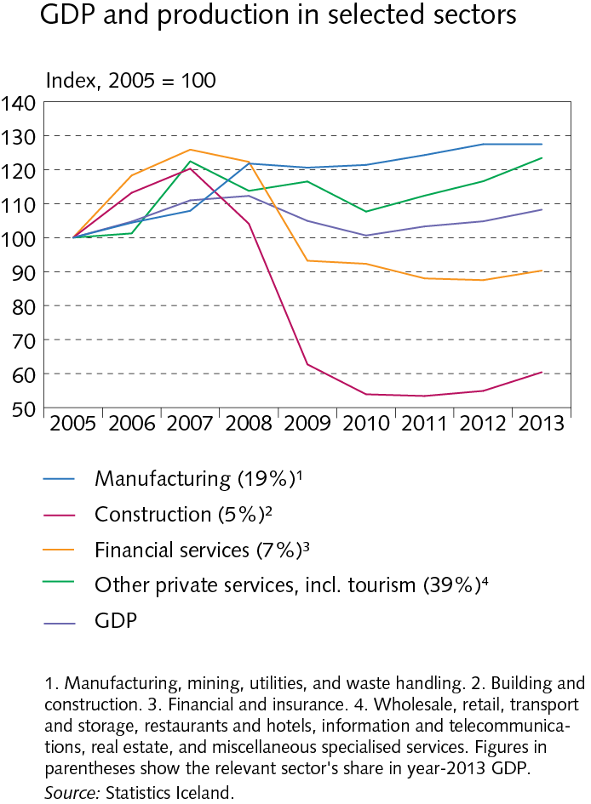
IV Domestic demand and production

Slide 79
IV Domestic demand and production

Slide 80
IV Domestic demand and production

Slide 81
IV Domestic demand and production

Slide 82
IV Domestic demand and production

Slide 83
IV Domestic demand and production

Slide 84
IV Domestic demand and production

Slide 85
IV Domestic demand and production

Slide 86
IV Domestic demand and production

Slide 87
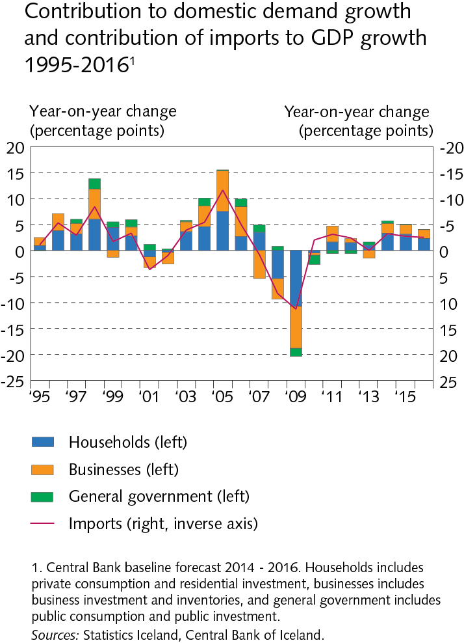
IV Domestic demand and production

Slide 88
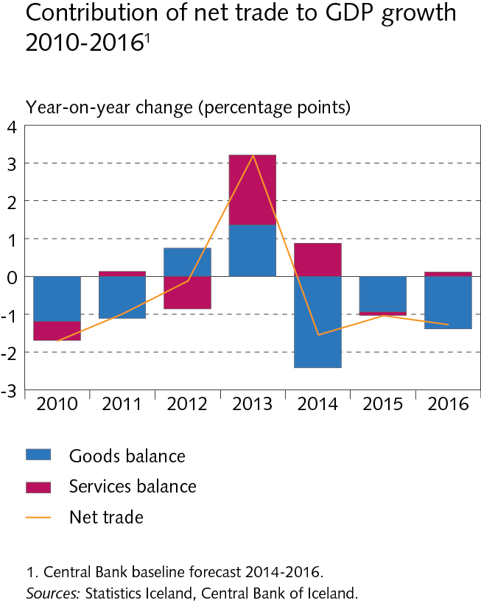
IV Domestic demand and production

Slide 89
IV Domestic demand and production

Slide 90
IV Domestic demand and production

Slide 91
IV Domestic demand and production

Slide 92
IV Domestic demand and production

Slide 93
IV Domestic demand and production

Slide 94
Box IV-2 Indicators of developments in imports based on cross-border payment intermediation orders

Slide 95
V Public sector finances

Slide 96
V Public sector finances

Slide 97
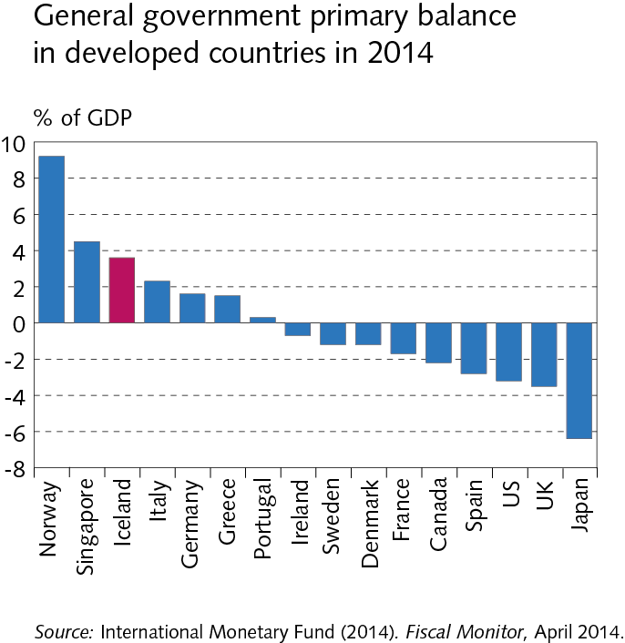
V Public sector finances

Slide 98
V Public sector finances

Slide 99
V Public sector finances

Slide 100
V Public sector finances

Slide 101
V Public sector finances

Slide 102
V Public sector finances

Slide 103
V Public sector finances

Slide 104
VI Labour market and wage developments

Slide 105
VI Labour market and wage developments

Slide 106
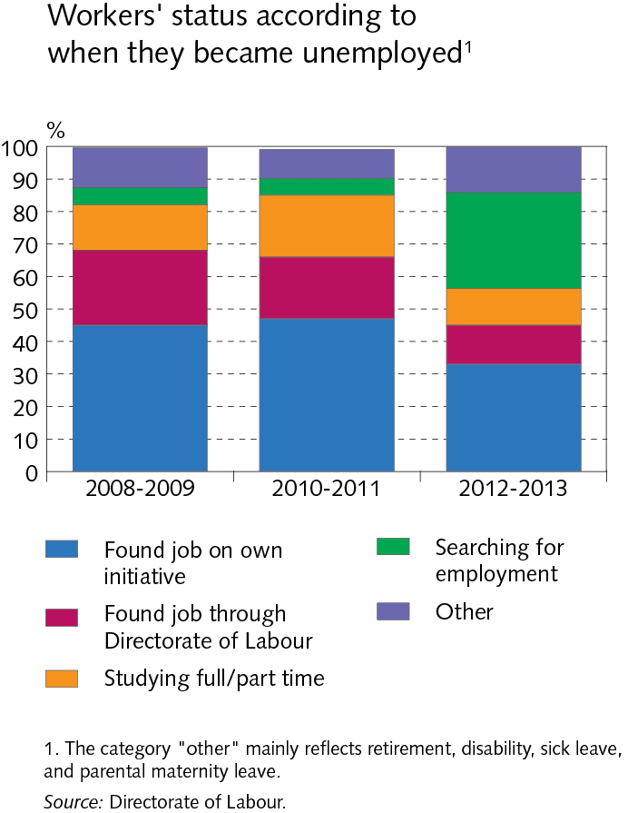
VI Labour market and wage developments

Slide 107
VI Labour market and wage developments

Slide 108
VI Labour market and wage developments

Slide 109
VI Labour market and wage developments

Slide 110
VI Labour market and wage developments

Slide 111
VI Labour market and wage developments

Slide 112
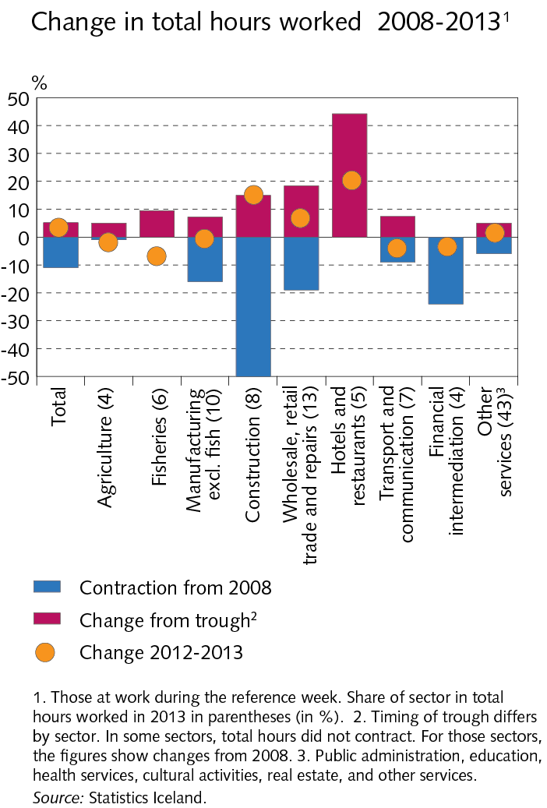
VI Labour market and wage developments

Slide 113
VI Labour market and wage developments

Slide 114
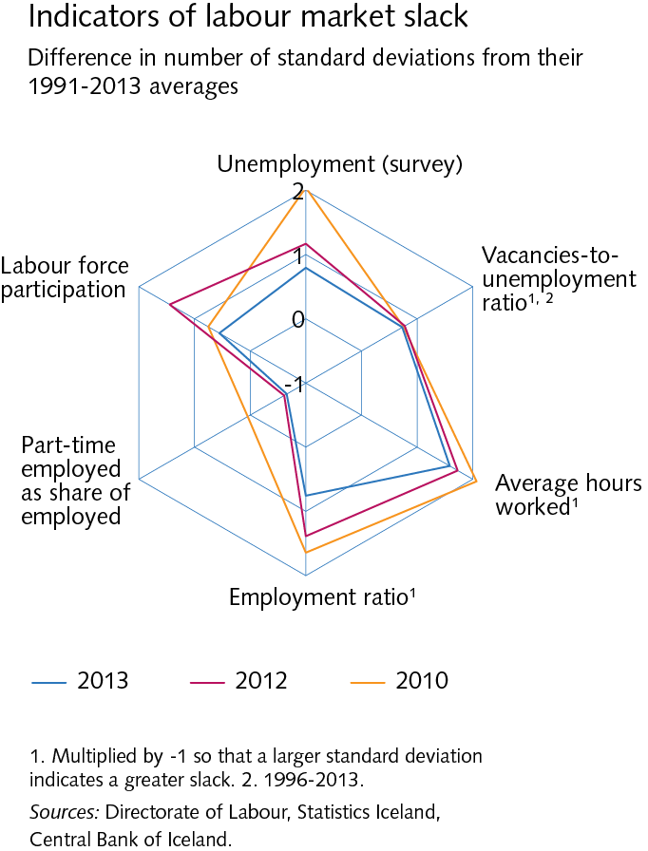
VI Labour market and wage developments

Slide 115
VI Labour market and wage developments

Slide 116
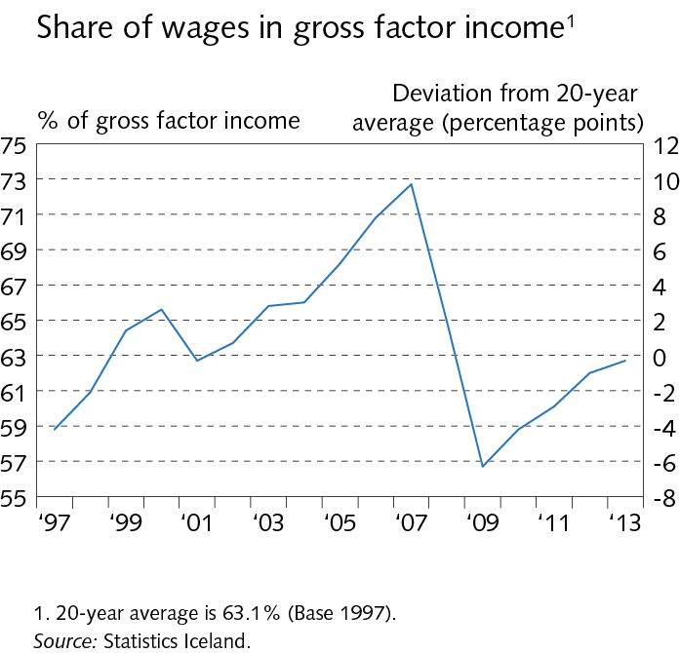
VI Labour market and wage developments

Slide 117
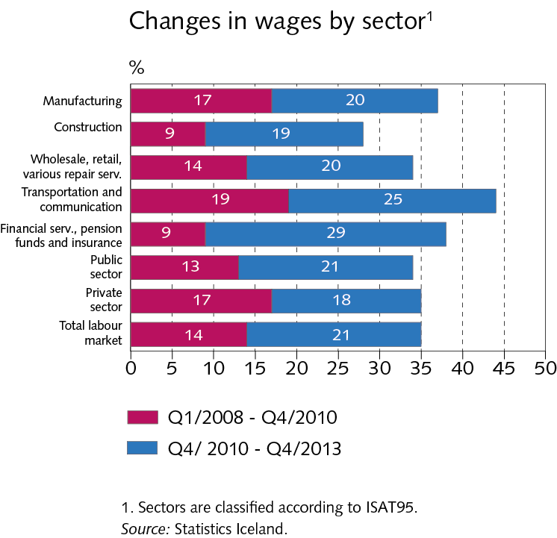
VI Labour market and wage developments

Slide 118
VI Labour market and wage developments

Slide 119
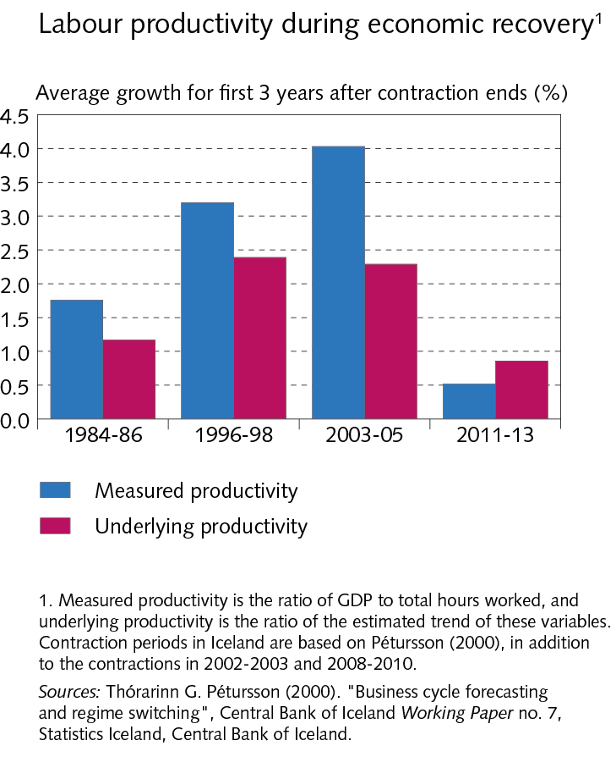
VI Labour market and wage developments

Slide 120
VI Labour market and wage developments

Slide 121
VII External balance

Slide 122
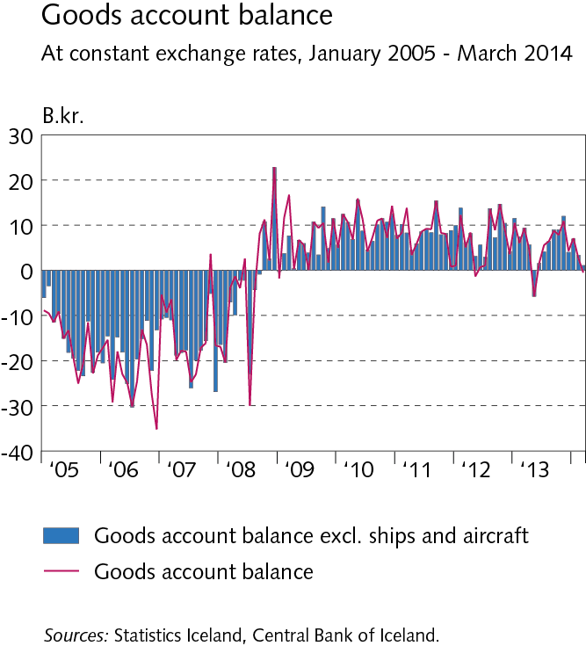
VII External balance

Slide 123
VII External balance

Slide 124
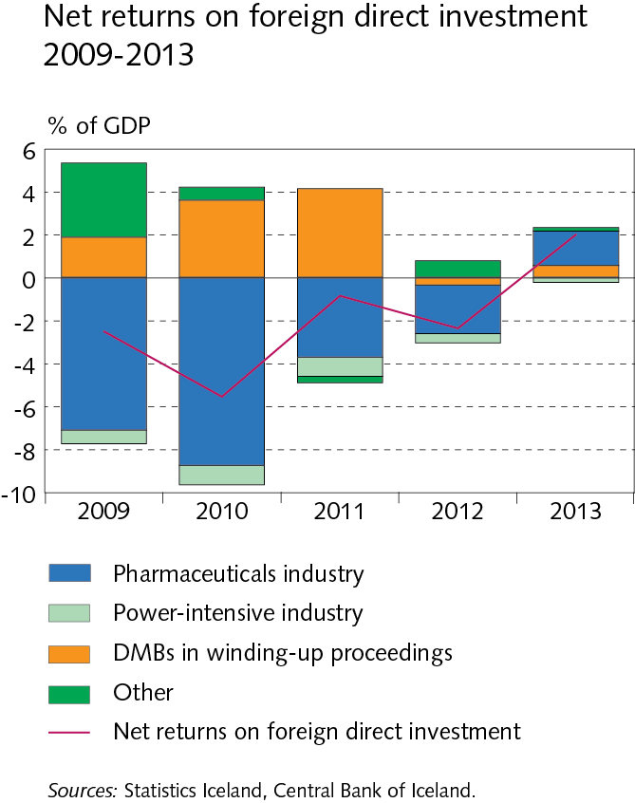
VII External balance

Slide 125
VII External balance

Slide 126
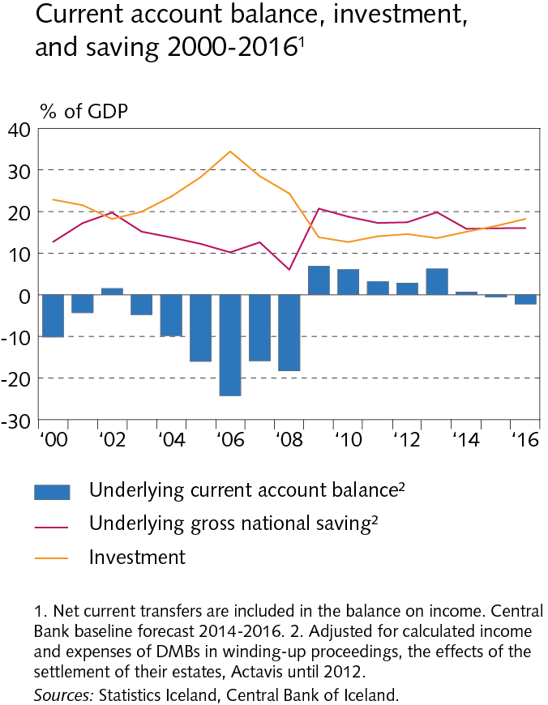
VII External balance

Slide 127
VIII Price developments and inflation outlook

Slide 128
VIII Price developments and inflation outlook

Slide 129
VIII Price developments and inflation outlook

Slide 130
VIII Price developments and inflation outlook

Slide 131
VIII Price developments and inflation outlook

Slide 132
VIII Price developments and inflation outlook

Slide 133
VIII Price developments and inflation outlook

Slide 134
VIII Price developments and inflation outlook

Slide 135
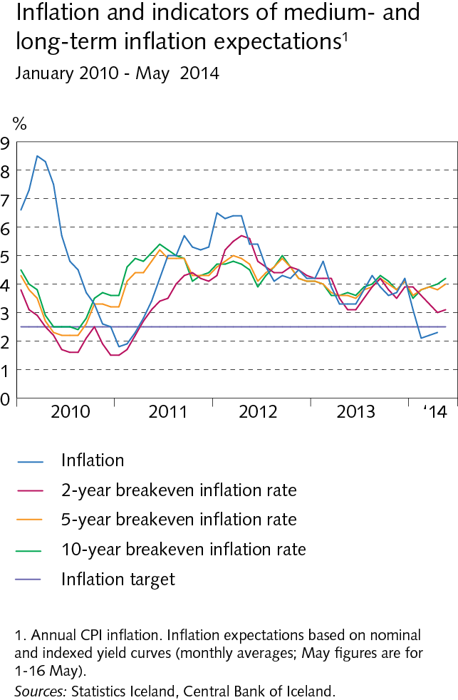
VIII Price developments and inflation outlook

Slide 136
VIII Price developments and inflation outlook

Slide 137
VIII Price developments and inflation outlook

Slide 138
VIII Price developments and inflation outlook

