Slide 1
Monetary Bulletin 2014/1
Charts in Appendix 2:
The economic impact of the Government‘s household mortgage relief measures

Slide 2
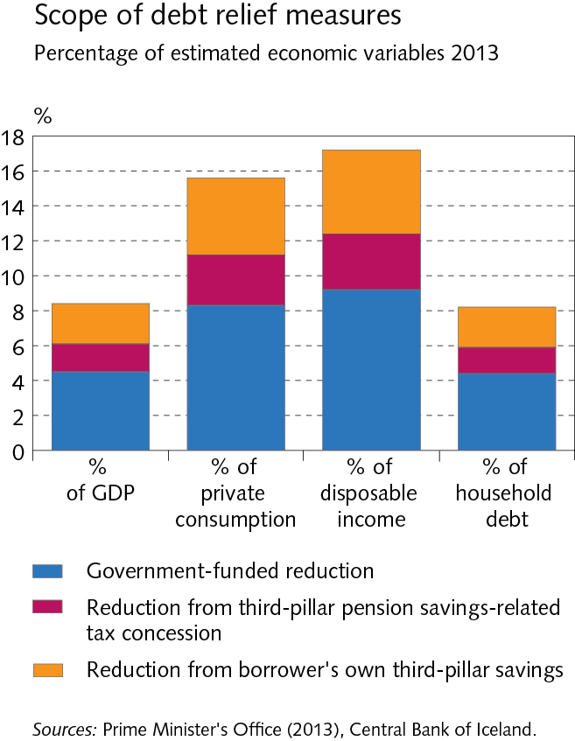

Slide 3
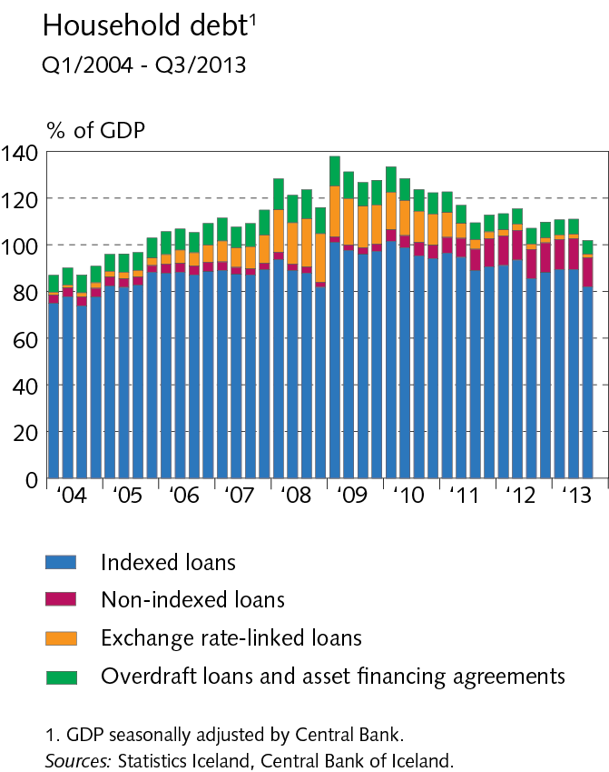

Slide 4
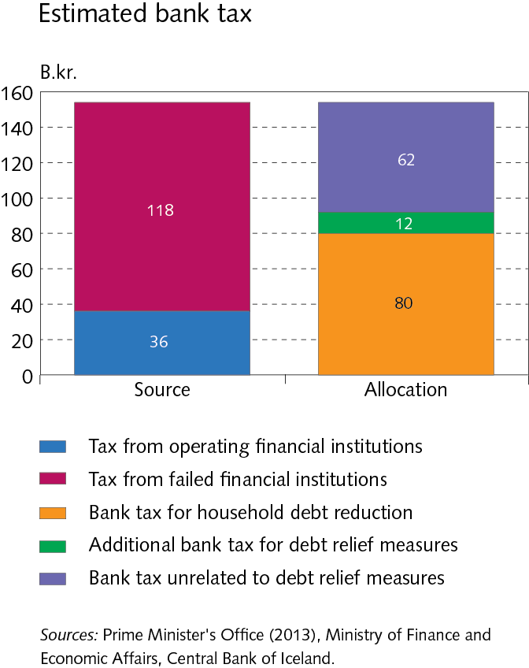

Slide 5
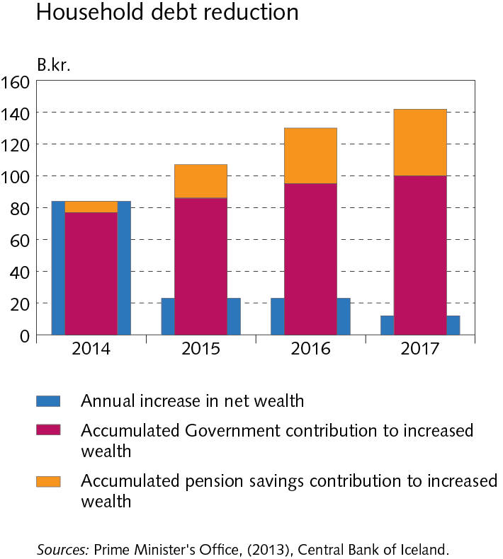

Slide 6
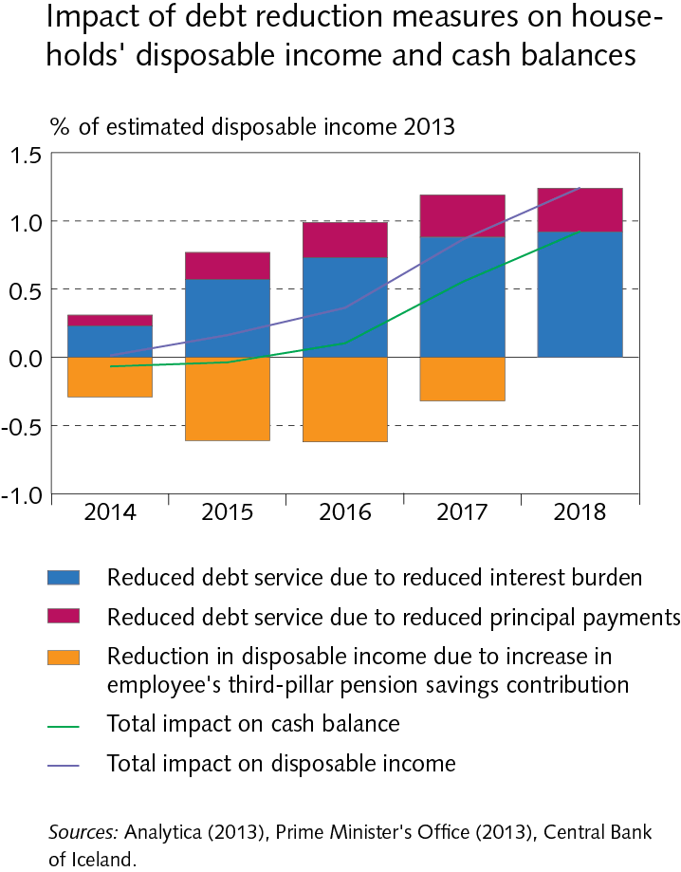

Slide 7
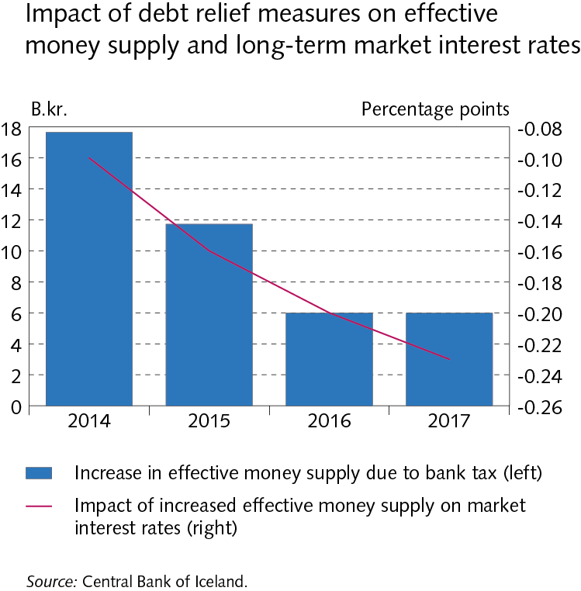

Slide 8
