Slide 1
Monetary Bulletin 2013/2
Powerpoint charts from Economic and monetary developments and prospects

Slide 2
I Economic outlook and key uncertainties

Slide 3
I Economic outlook and key uncertainties

Slide 4
I Economic outlook and key uncertainties

Slide 5
I Economic outlook and key uncertainties

Slide 6
I Economic outlook and key uncertainties

Slide 7
I Economic outlook and key uncertainties

Slide 8
I Economic outlook and key uncertainties

Slide 9
I Economic outlook and key uncertainties

Slide 10
I Economic outlook and key uncertainties

Slide 11
I Economic outlook and key uncertainties

Slide 12
I Economic outlook and key uncertainties

Slide 13
I Economic outlook and key uncertainties

Slide 14
I Economic outlook and key uncertainties

Slide 15
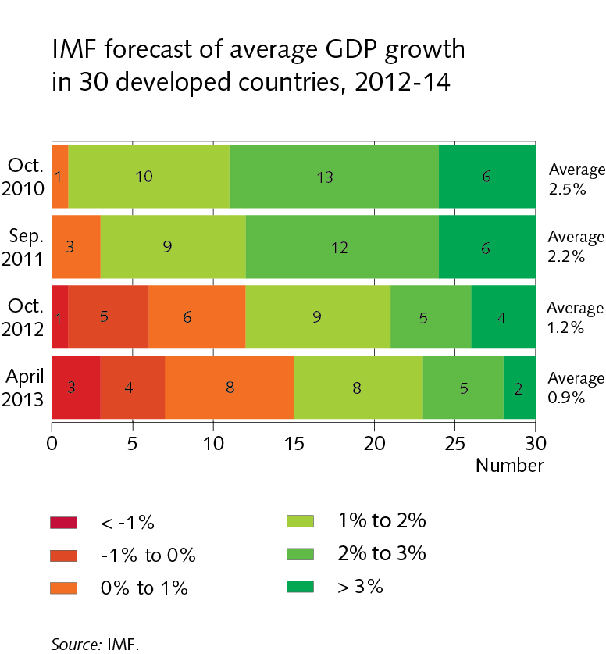
I Economic outlook and key uncertainties

Slide 16
I Economic outlook and key uncertainties

Slide 17
I Economic outlook and key uncertainties

Slide 18
I Economic outlook and key uncertainties

Slide 19
I Economic outlook and key uncertainties

Slide 20
I Economic outlook and key uncertainties

Slide 21
I Economic outlook and key uncertainties

Slide 22
I Economic outlook and key uncertainties

Slide 23
I Economic outlook and key uncertainties

Slide 24
I Economic outlook and key uncertainties

Slide 25
Box I-1

Slide 26
Box I-1

Slide 27
Box I-1

Slide 28
Box I-1

Slide 29
Box I-1

Slide 30
Box I-1

Slide 31
Box I-1

Slide 32
Box I-1

Slide 33
Box I-1

Slide 34
Box I-1

Slide 35
II External conditions and exports

Slide 36
II External conditions and exports

Slide 37
II External conditions and exports

Slide 38
II External conditions and exports

Slide 39
II External conditions and exports

Slide 40
II External conditions and exports

Slide 41
II External conditions and exports

Slide 42
II External conditions and exports

Slide 43
II External conditions and exports

Slide 44
II External conditions and exports

Slide 45
II External conditions and exports

Slide 46
II External conditions and exports

Slide 47
II External conditions and exports

Slide 48
II External conditions and exports

Slide 49
III Financial conditions

Slide 50
III Financial conditions

Slide 51
III Financial conditions

Slide 52
III Financial conditions

Slide 53
III Financial conditions

Slide 54
III Financial conditions

Slide 55
III Financial conditions

Slide 56
III Financial conditions

Slide 57
III Financial conditions

Slide 58
III Financial conditions

Slide 59
III Financial conditions

Slide 60
III Financial conditions

Slide 61
III Financial conditions

Slide 62
III Financial conditions

Slide 63
III Financial conditions

Slide 64
III Financial conditions

Slide 65
III Financial conditions

Slide 66
III Financial conditions

Slide 67
IV Domestic demand and production

Slide 68
IV Domestic demand and production

Slide 69
IV Domestic demand and production

Slide 70
IV Domestic demand and production

Slide 71
IV Domestic demand and production

Slide 72
IV Domestic demand and production

Slide 73
IV Domestic demand and production

Slide 74
IV Domestic demand and production

Slide 75
IV Domestic demand and production

Slide 76
IV Domestic demand and production

Slide 77
IV Domestic demand and production

Slide 78
IV Domestic demand and production

Slide 79
IV Domestic demand and production

Slide 80
IV Domestic demand and production

Slide 81
IV Domestic demand and production

Slide 82
IV Domestic demand and production

Slide 83
IV Domestic demand and production

Slide 84
IV Domestic demand and production

Slide 85
IV Domestic demand and production

Slide 86
IV Domestic demand and production

Slide 87
Box IV-1

Slide 88
Box IV-1

Slide 89
Box IV-1

Slide 90
Box IV-1

Slide 91
V Public sector finances

Slide 92
V Public sector finances

Slide 93
V Public sector finances

Slide 94
V Public sector finances

Slide 95
V Public sector finances

Slide 96
V Public sector finances

Slide 97
V Public sector finances

Slide 98
V Public sector finances

Slide 99
V Public sector finances

Slide 100
VI Labour market and wage developments

Slide 101
VI Labour market and wage developments

Slide 102
VI Labour market and wage developments

Slide 103
VI Labour market and wage developments

Slide 104
VI Labour market and wage developments

Slide 105
VI Labour market and wage developments

Slide 106
VI Labour market and wage developments

Slide 107
VI Labour market and wage developments

Slide 108
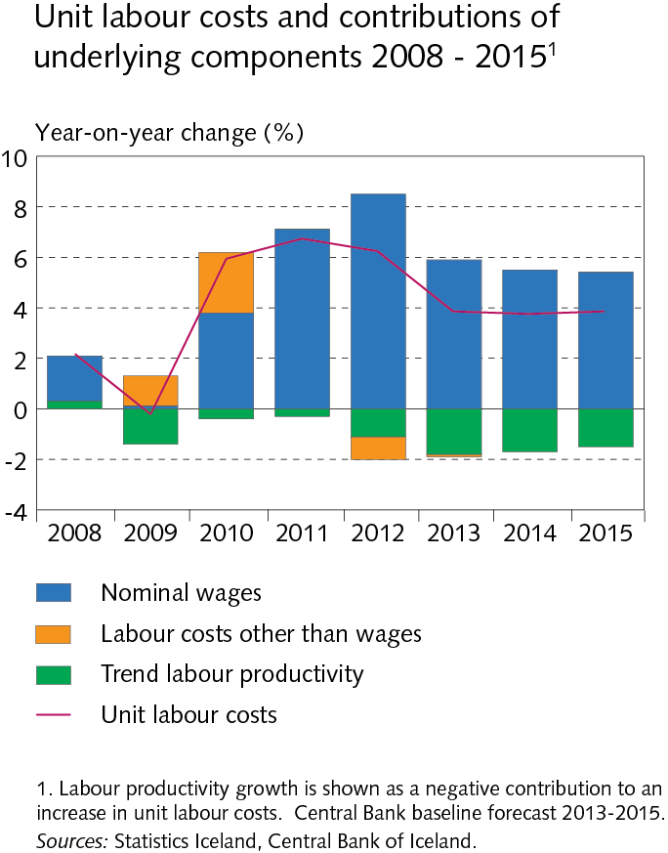
VI Labour market and wage developments

Slide 109
VII External balance

Slide 110
VII External balance

Slide 111
VII External balance

Slide 112
VII External balance

Slide 113
VII External balance

Slide 114
VIII Price developments and inflation outlook

Slide 115
VIII Price developments and inflation outlook

Slide 116
VIII Price developments and inflation outlook

Slide 117
VIII Price developments and inflation outlook

Slide 118
VIII Price developments and inflation outlook

Slide 119
VIII Price developments and inflation outlook

Slide 120
VIII Price developments and inflation outlook

Slide 121
VIII Price developments and inflation outlook

Slide 122
VIII Price developments and inflation outlook

Slide 123
VIII Price developments and inflation outlook

