Slide 1
Monetary Bulletin 2012/4
Powerpoint charts from Economic and monetary developments and prospects

Slide 2
I Economic outlook and key uncertainties

Slide 3
I Economic outlook and key uncertainties

Slide 4
I Economic outlook and key uncertainties

Slide 5
I Economic outlook and key uncertainties

Slide 6
I Economic outlook and key uncertainties

Slide 7
I Economic outlook and key uncertainties

Slide 8
I Economic outlook and key uncertainties

Slide 9
I Economic outlook and key uncertainties

Slide 10
I Economic outlook and key uncertainties

Slide 11
I Economic outlook and key uncertainties

Slide 12
I Economic outlook and key uncertainties

Slide 13
I Economic outlook and key uncertainties

Slide 14
I Economic outlook and key uncertainties

Slide 15
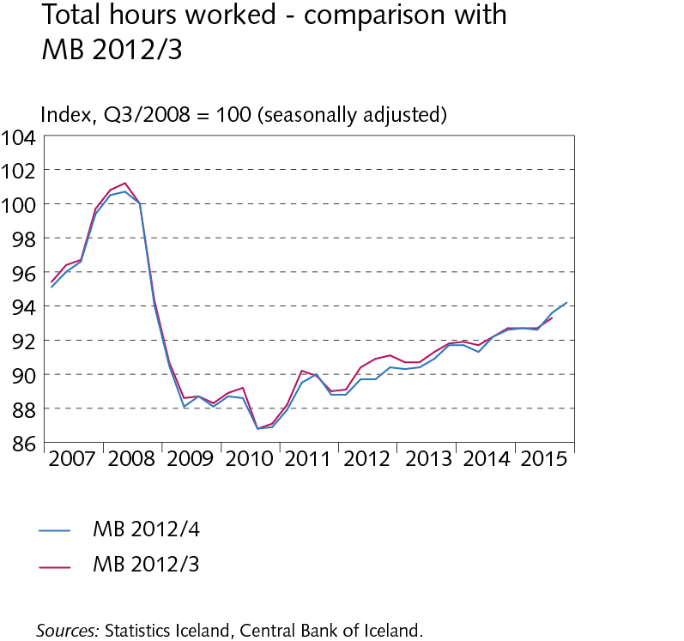
I Economic outlook and key uncertainties

Slide 16
I Economic outlook and key uncertainties

Slide 17
I Economic outlook and key uncertainties

Slide 18
Box I-1 Post-crisis economic developments and Central Bank forecasts

Slide 19
Box I-1 Post-crisis economic developments and Central Bank forecasts

Slide 20
Box I-2 Investment in the aftermath of financial crisis

Slide 21
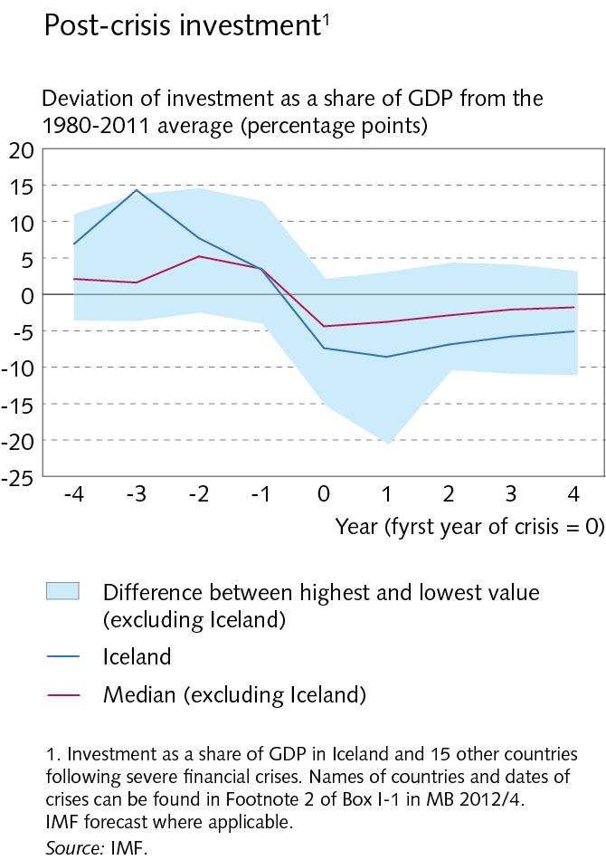
Box I-2 Investment in the aftermath of financial crisis

Slide 22
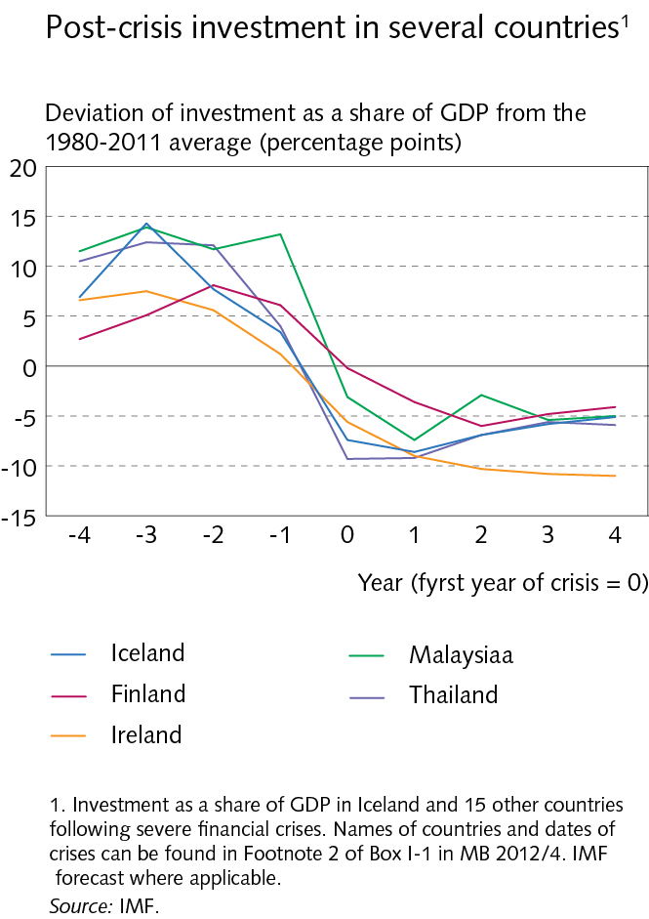
Box I-2 Investment in the aftermath of financial crisis

Slide 23
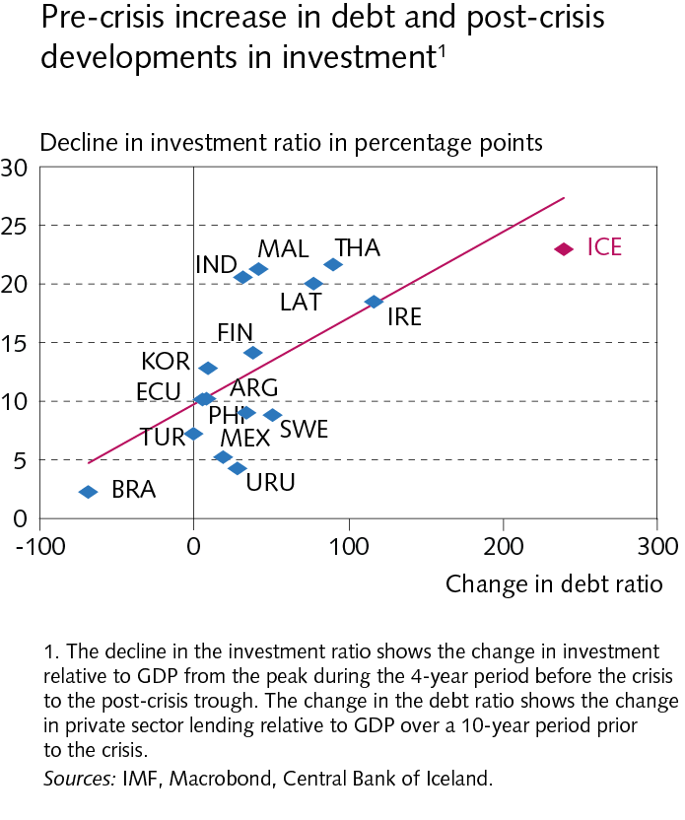
Box I-2 Investment in the aftermath of financial crisis

Slide 24
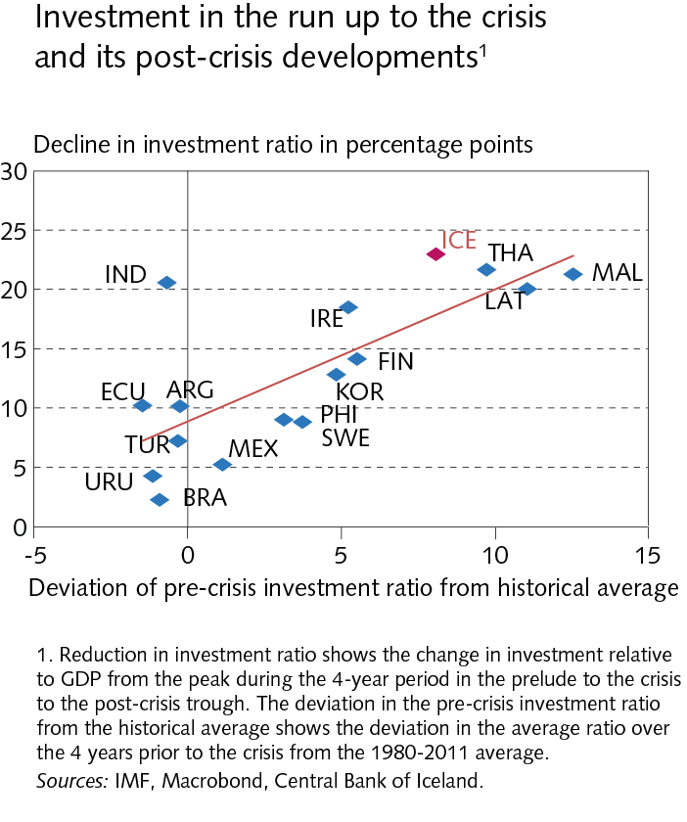
Box I-2 Investment in the aftermath of financial crisis

Slide 25
II External conditions and exports

Slide 26
II External conditions and exports

Slide 27
II External conditions and exports

Slide 28
II External conditions and exports

Slide 29
II External conditions and exports

Slide 30
II External conditions and exports

Slide 31
II External conditions and exports

Slide 32
II External conditions and exports

Slide 33
II External conditions and exports

Slide 34
II External conditions and exports

Slide 35
II External conditions and exports

Slide 36
II External conditions and exports

Slide 37
II External conditions and exports

Slide 38
III Financial conditions

Slide 39
III Financial conditions

Slide 40
III Financial conditions

Slide 41
III Financial conditions

Slide 42
III Financial conditions

Slide 43
III Financial conditions

Slide 44
III Financial conditions

Slide 45
III Financial conditions

Slide 46
III Financial conditions

Slide 47
III Financial conditions

Slide 48
III Financial conditions

Slide 49
III Financial conditions

Slide 50
III Financial conditions

Slide 51
IV Domestic demand and production

Slide 52
IV Domestic demand and production

Slide 53
IV Domestic demand and production

Slide 54
IV Domestic demand and production

Slide 55
IV Domestic demand and production

Slide 56
IV Domestic demand and production

Slide 57
IV Domestic demand and production

Slide 58
IV Domestic demand and production

Slide 59
IV Domestic demand and production

Slide 60
IV Domestic demand and production

Slide 61
IV Domestic demand and production

Slide 62
IV Domestic demand and production

Slide 63
IV Domestic demand and production

Slide 64
IV Domestic demand and production

Slide 65
IV Domestic demand and production

Slide 66
IV Domestic demand and production

Slide 67
IV Domestic demand and production

Slide 68
Box IV-1 Seasonal adjustment of GDP

Slide 69
Box IV-1 Seasonal adjustment of GDP

Slide 70
Box IV-1 Seasonal adjustment of GDP

Slide 71
Box IV-1 Seasonal adjustment of GDP

Slide 72
Box IV-1 Seasonal adjustment of GDP

Slide 73
Box IV-1 Seasonal adjustment of GDP

Slide 74
Box IV-1 Seasonal adjustment of GDP

Slide 75
Box IV-1 Seasonal adjustment of GDP

Slide 76
V Public sector finances

Slide 77
V Public sector finances

Slide 78
V Public sector finances

Slide 79
V Public sector finances

Slide 80
V Public sector finances

Slide 81
V Public sector finances

Slide 82
V Public sector finances

Slide 83
VI Labour market and wage developments

Slide 84
VI Labour market and wage developments

Slide 85
VI Labour market and wage developments

Slide 86
VI Labour market and wage developments

Slide 87
VI Labour market and wage developments

Slide 88
VI Labour market and wage developments

Slide 89
VI Labour market and wage developments

Slide 90
VI Labour market and wage developments

Slide 91
Box VI-1 Post-crisis developments in unemployment

Slide 92
Box VI-1 Post-crisis developments in unemployment

Slide 93
Box VI-1 Post-crisis developments in unemployment

Slide 94
VII External balance

Slide 95
VII External balance

Slide 96
VII External balance

Slide 97
VII External balance

Slide 98
VII External balance

Slide 99
Box VII-1 Changes in Central Bank forecasts of the trade balance

Slide 100
VIII Price developments and inflation outlook

Slide 101
VIII Price developments and inflation outlook

Slide 102
VIII Price developments and inflation outlook

Slide 103
VIII Price developments and inflation outlook

Slide 104
VIII Price developments and inflation outlook

Slide 105
VIII Price developments and inflation outlook

Slide 106
VIII Price developments and inflation outlook

Slide 107
VIII Price developments and inflation outlook

Slide 108
VIII Price developments and inflation outlook

Slide 109
VIII Price developments and inflation outlook

Slide 110
VIII Price developments and inflation outlook

Slide 111
VIII Price developments and inflation outlook

Slide 112
VIII Price developments and inflation outlook

Slide 113
VIII Price developments and inflation outlook

Slide 114
Appendix 2 The Central Bank of Iceland forecasting record

Slide 115
Appendix 2 The Central Bank of Iceland forecasting record

Slide 116
Appendix 2 The Central Bank of Iceland forecasting record

Slide 117
Appendix 2 The Central Bank of Iceland forecasting record

Slide 118
Appendix 2 The Central Bank of Iceland forecasting record

Slide 119
Appendix 2 The Central Bank of Iceland forecasting record

Slide 120
Appendix 2 The Central Bank of Iceland forecasting record

Slide 121
Appendix 2 The Central Bank of Iceland forecasting record

