Slide 1
Monetary Bulletin 2012/2
Powerpoint charts from Economic and monetary developments and prospects

Slide 2
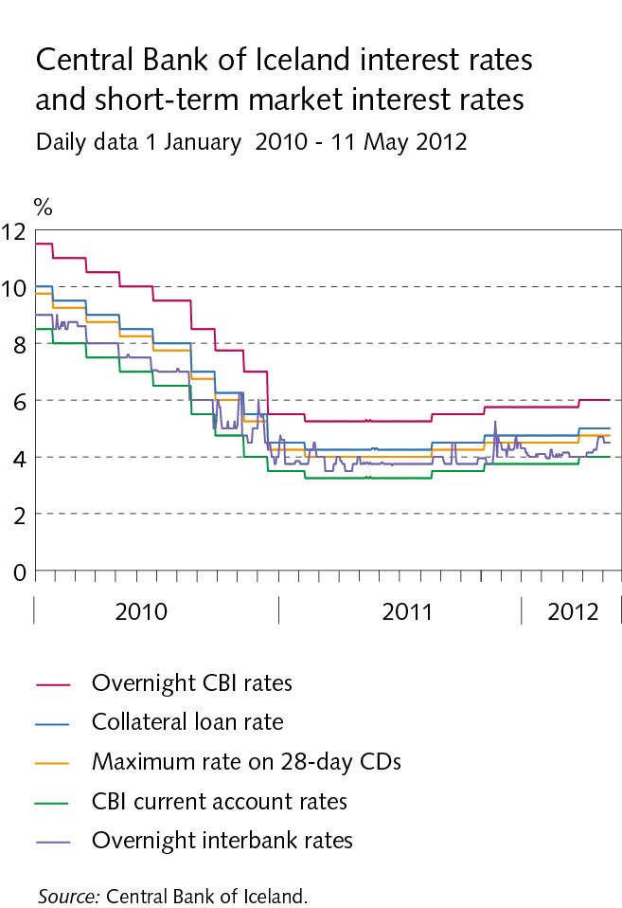
I Economic outlook and key uncertainties

Slide 3
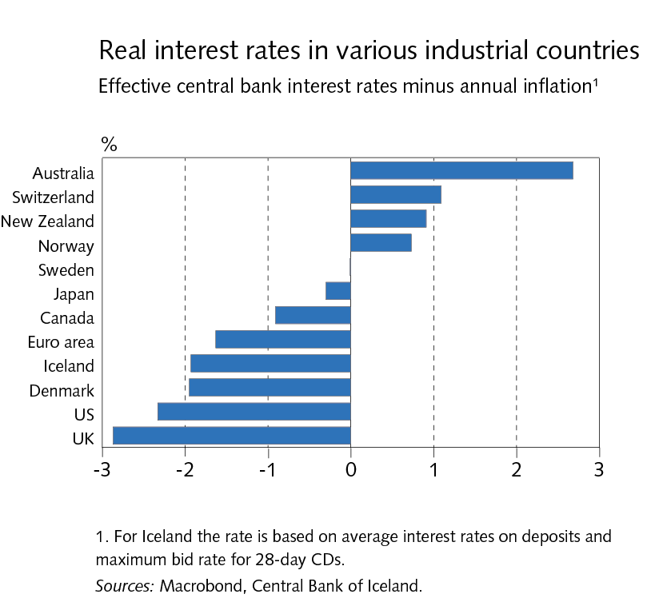
I Economic outlook and key uncertainties

Slide 4
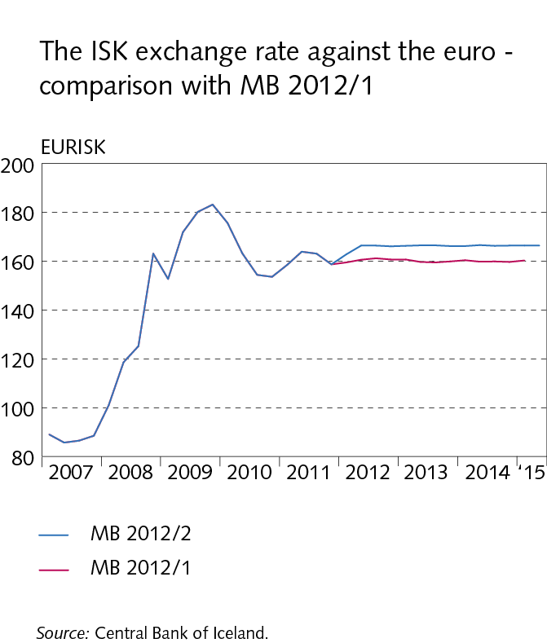
I Economic outlook and key uncertainties

Slide 5
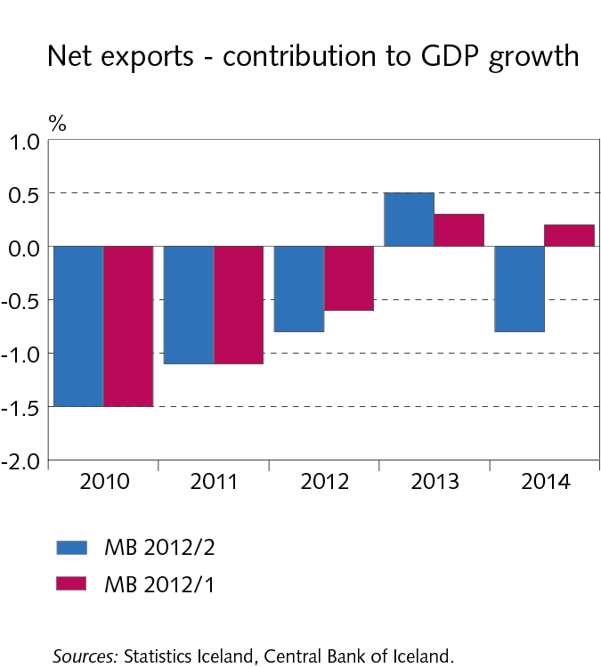
I Economic outlook and key uncertainties

Slide 6
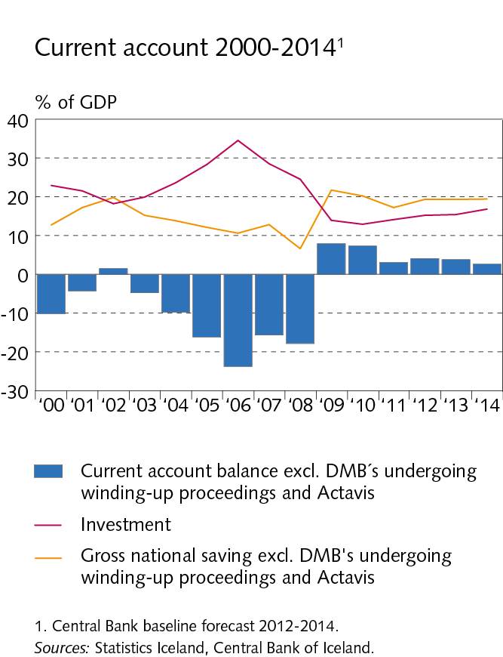
I Economic outlook and key uncertainties

Slide 7
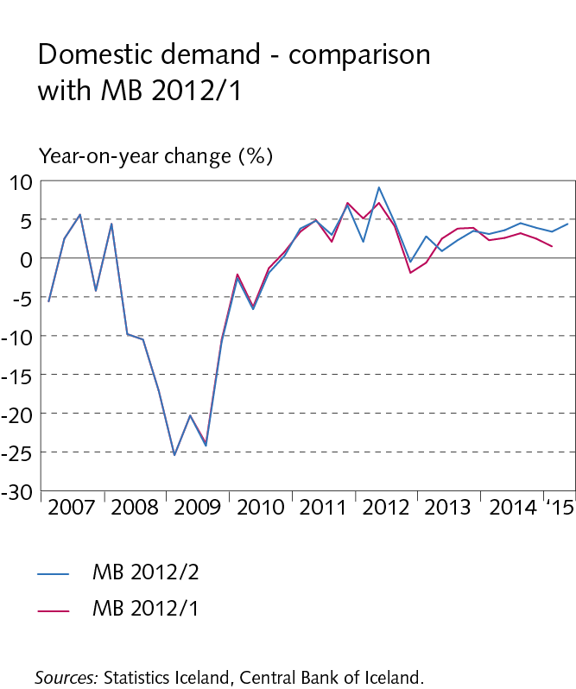
I Economic outlook and key uncertainties

Slide 8
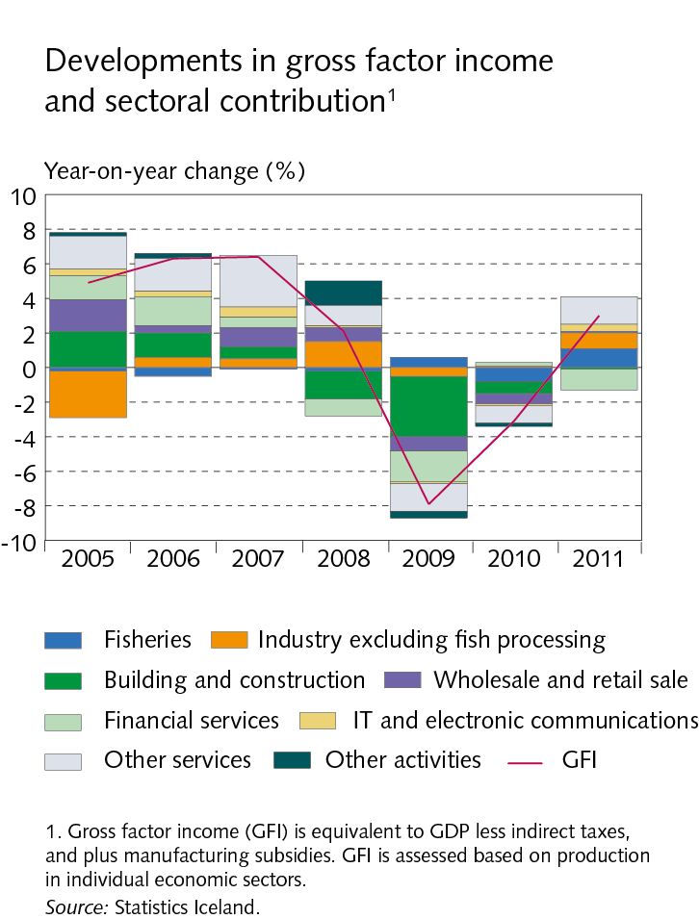
I Economic outlook and key uncertainties

Slide 9
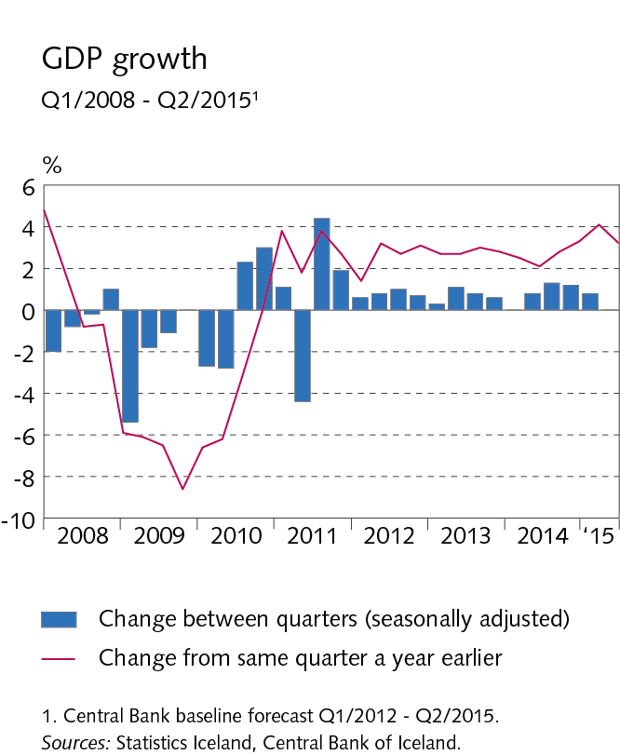
I Economic outlook and key uncertainties

Slide 10
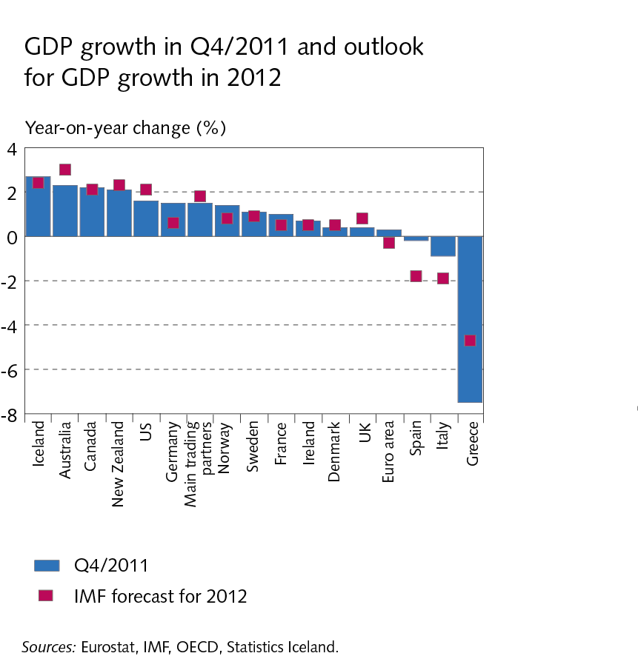
I Economic outlook and key uncertainties

Slide 11
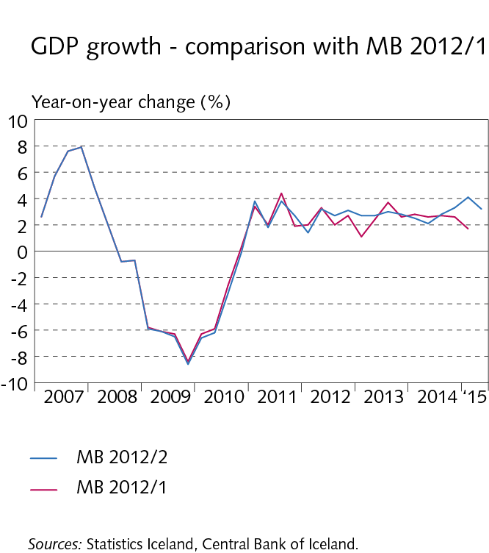
I Economic outlook and key uncertainties

Slide 12
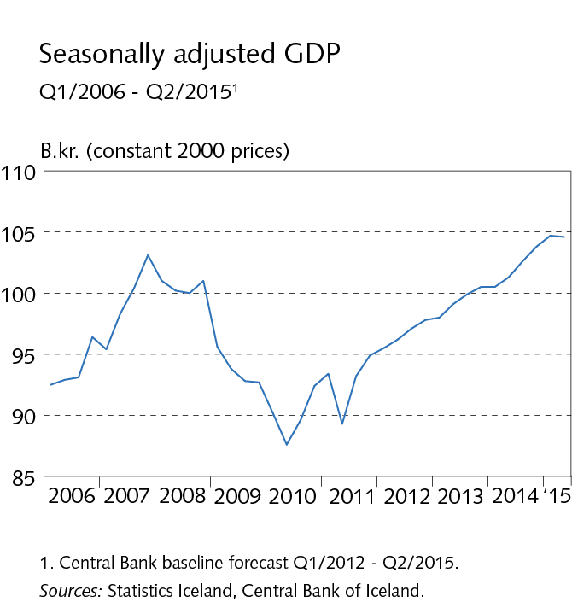
I Economic outlook and key uncertainties

Slide 13
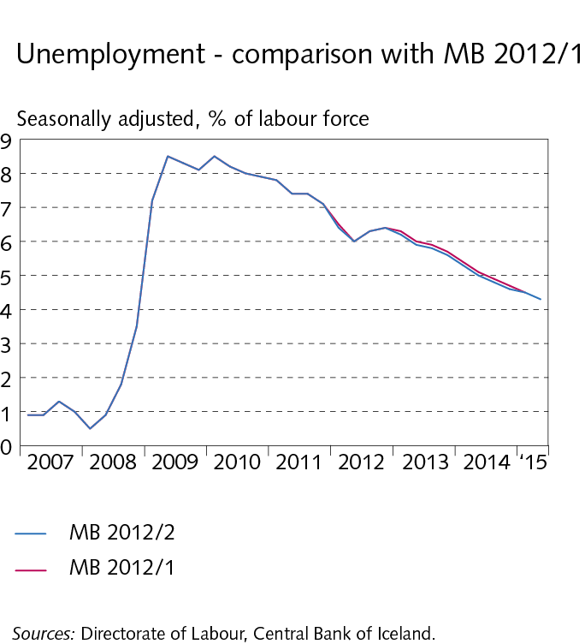
I Economic outlook and key uncertainties

Slide 14
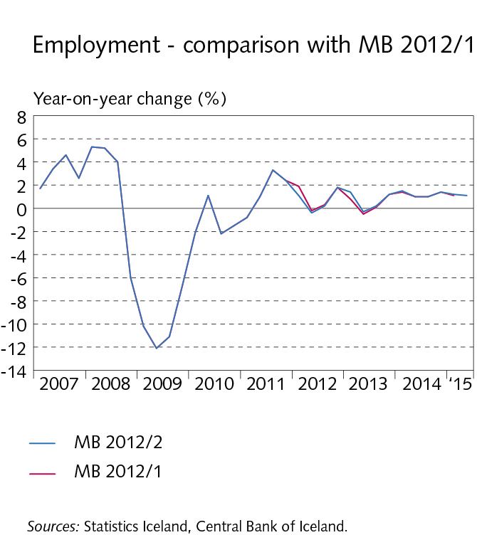
I Economic outlook and key uncertainties

Slide 15
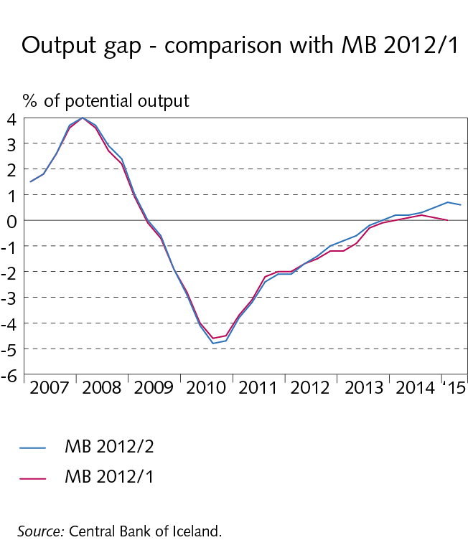
I Economic outlook and key uncertainties

Slide 16
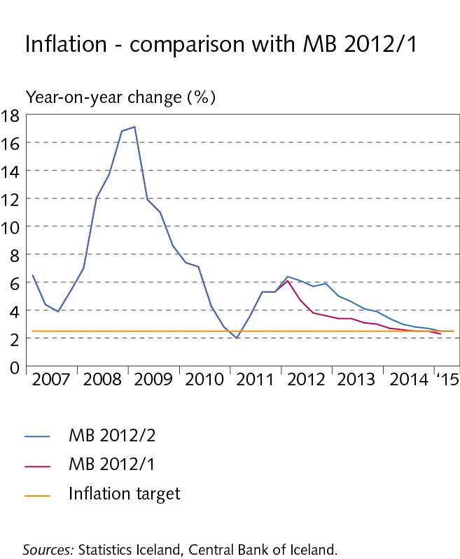
I Economic outlook and key uncertainties

Slide 17
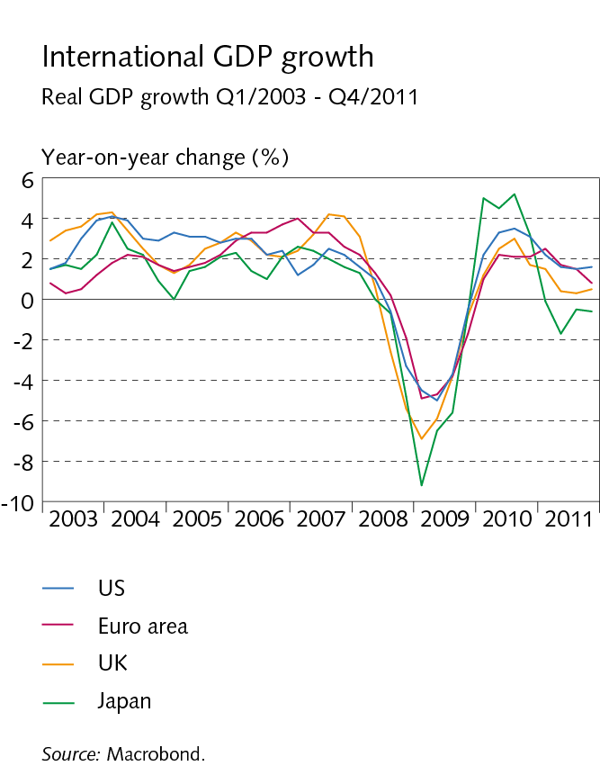
II External conditions and exports

Slide 18
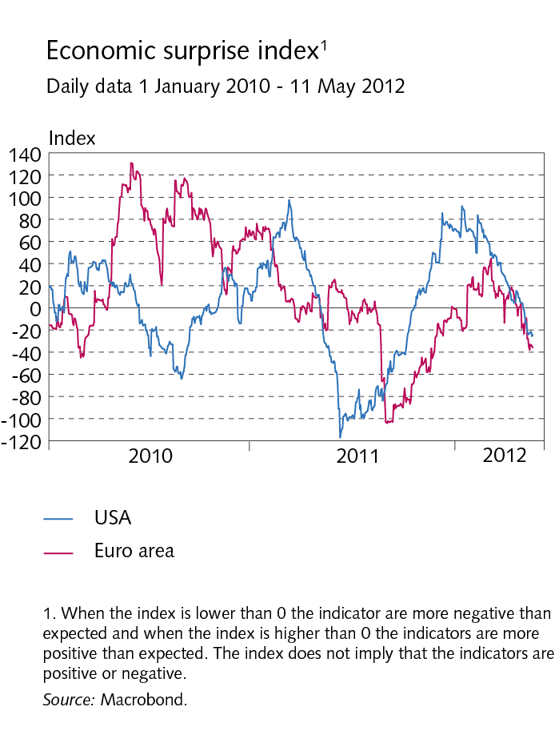
II External conditions and exports

Slide 19
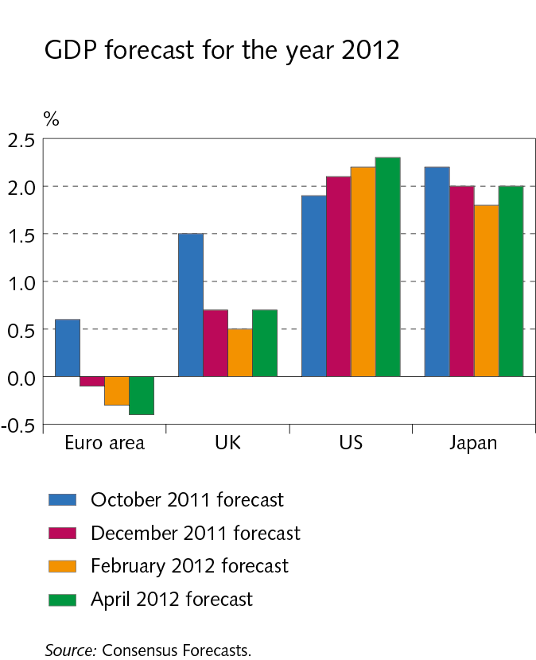
II External conditions and exports

Slide 20
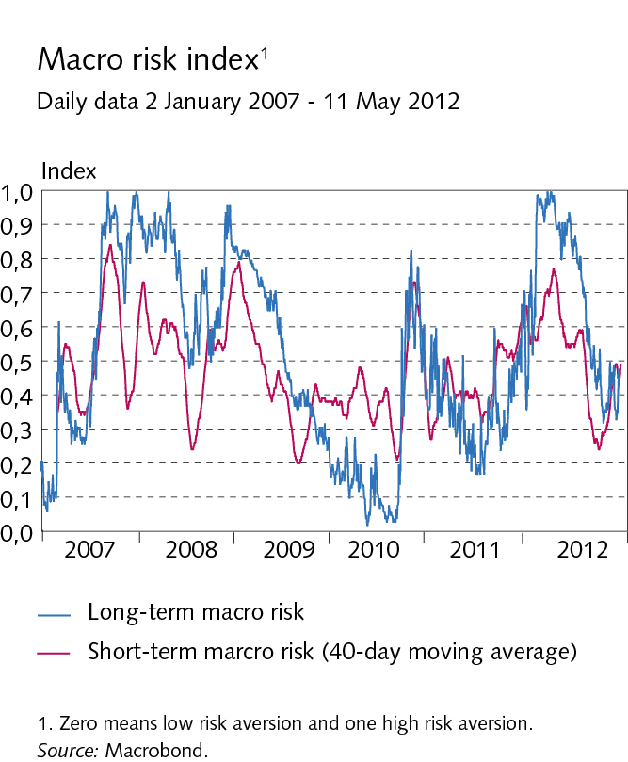
II External conditions and exports

Slide 21
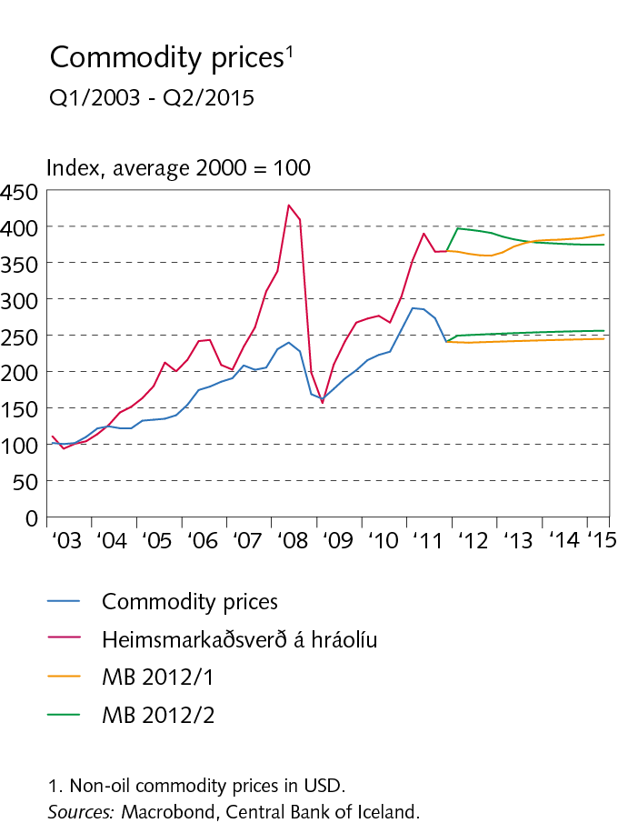
II External conditions and exports

Slide 22
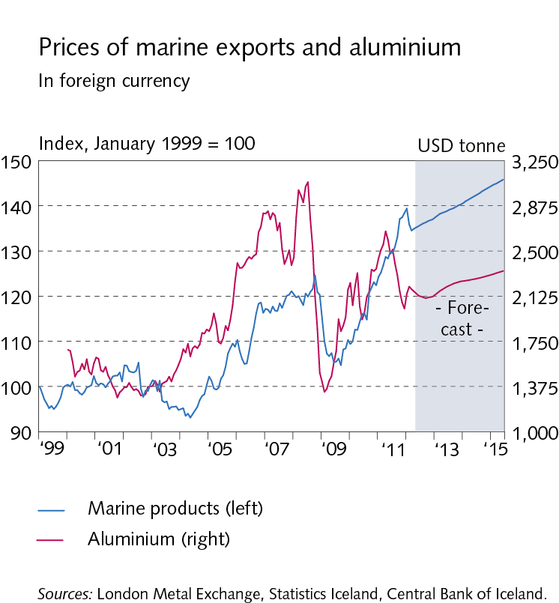
II External conditions and exports

Slide 23
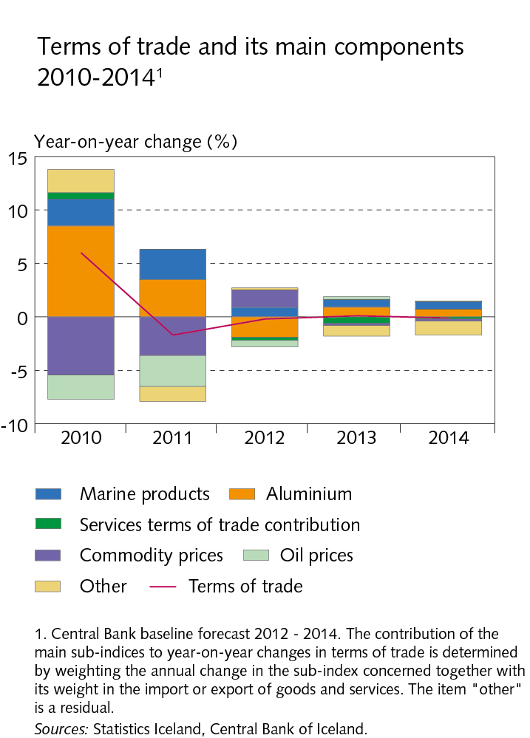
II External conditions and exports

Slide 24
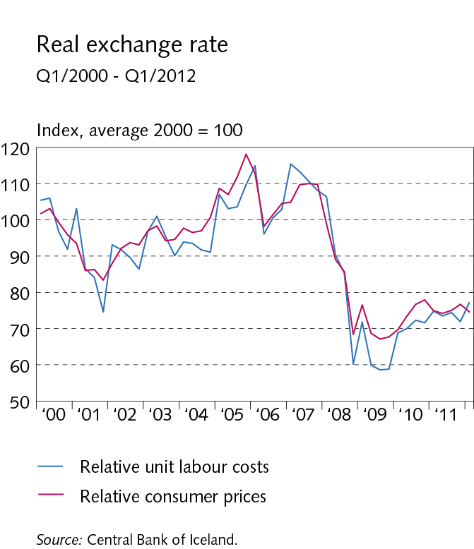
II External conditions and exports

Slide 25
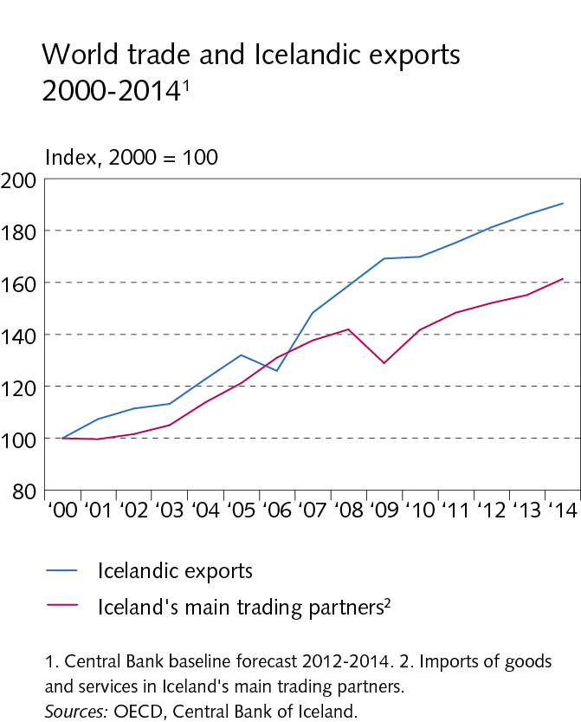
II External conditions and exports

Slide 26
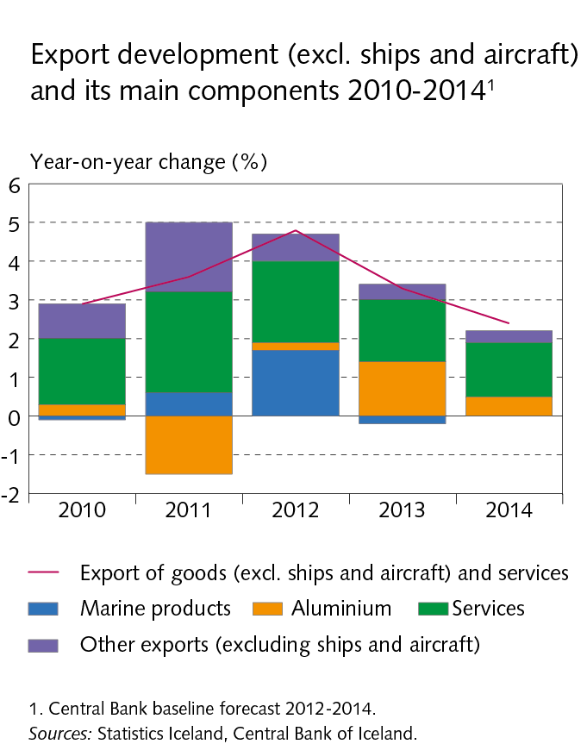
II External conditions and exports

Slide 27
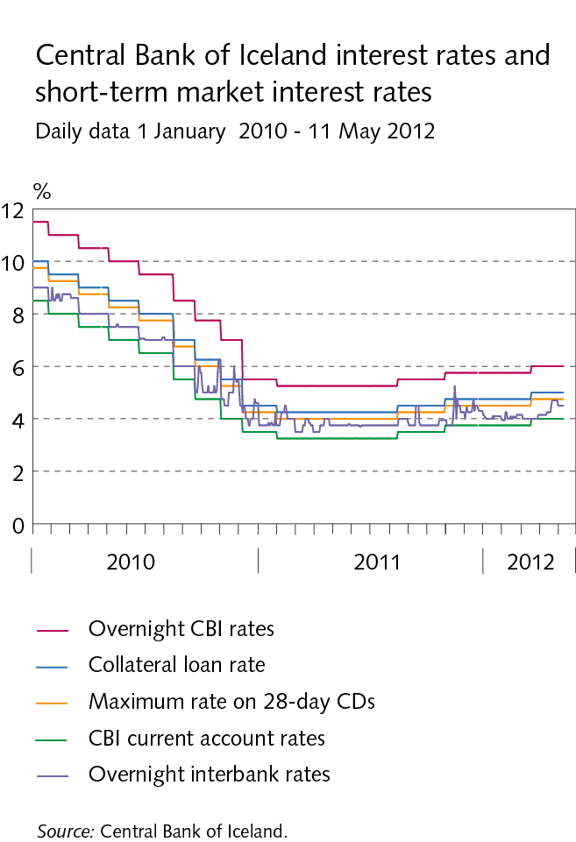
III Financial conditions

Slide 28
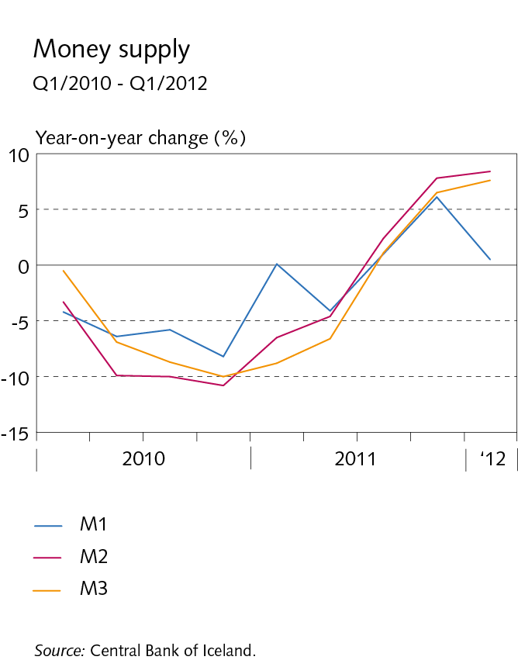
III Financial conditions

Slide 29
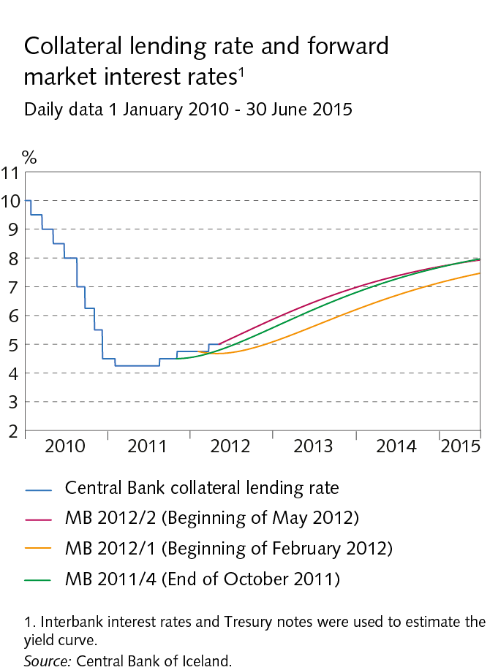
III Financial conditions

Slide 30
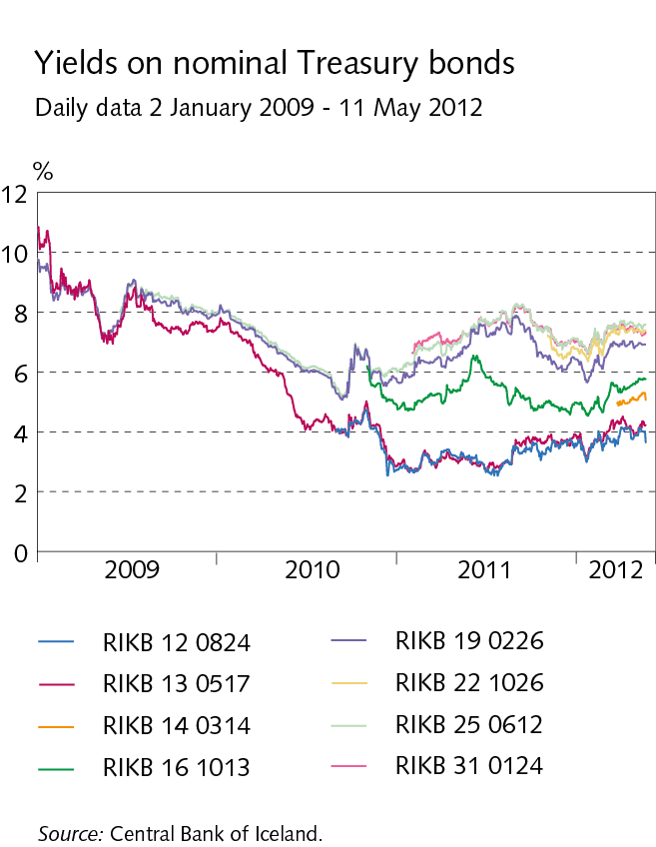
III Financial conditions

Slide 31
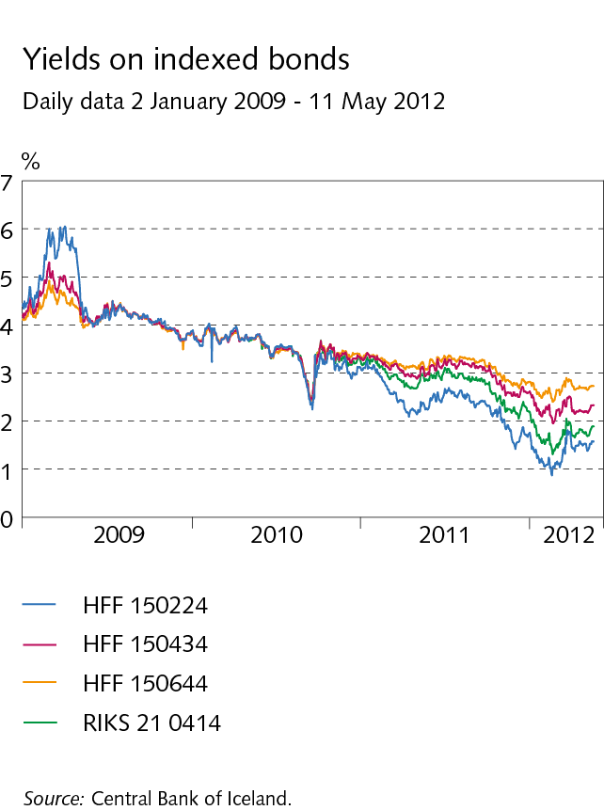
III Financial conditions

Slide 32
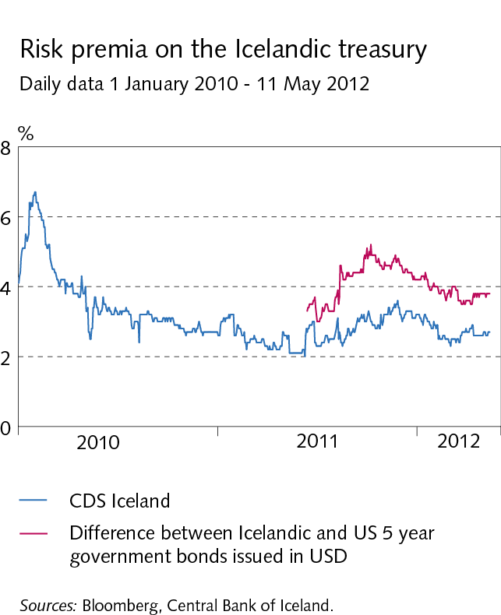
III Financial conditions

Slide 33
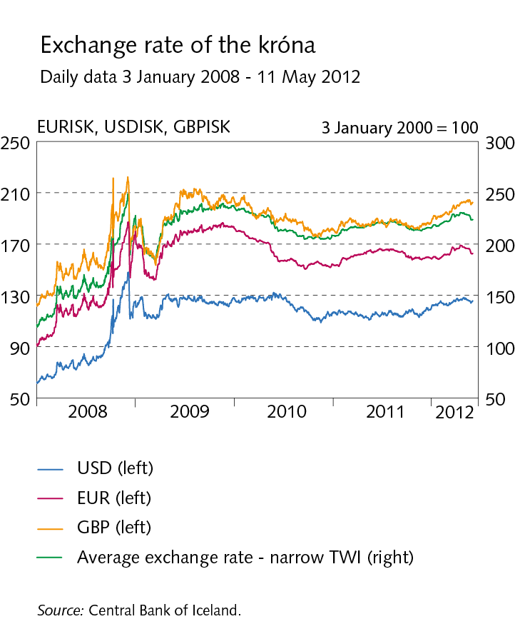
III Financial conditions

Slide 34
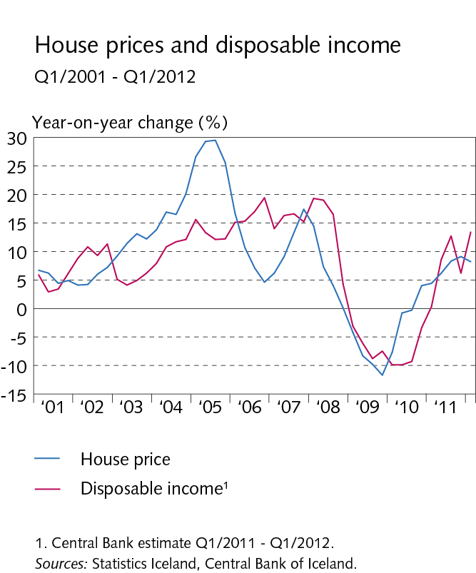
III Financial conditions

Slide 35
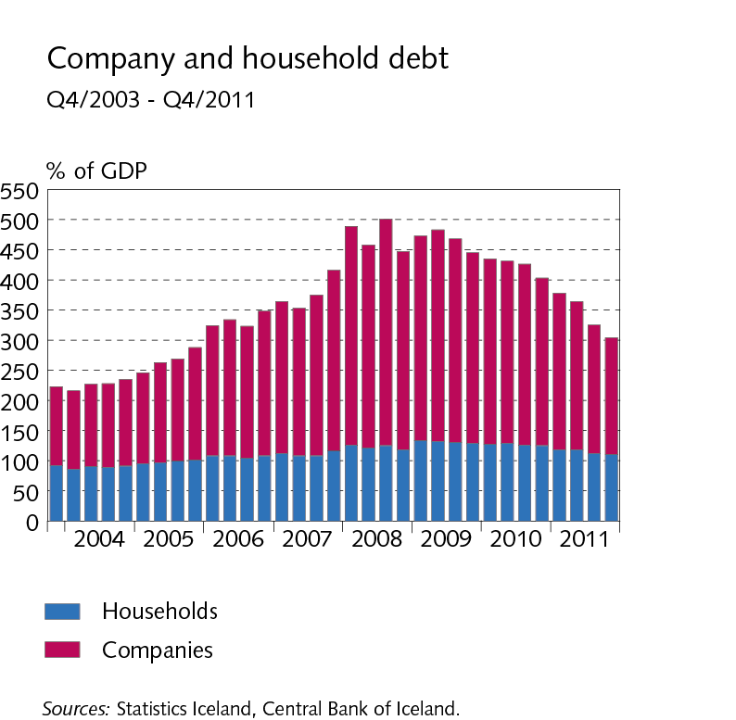
III Financial conditions

Slide 36
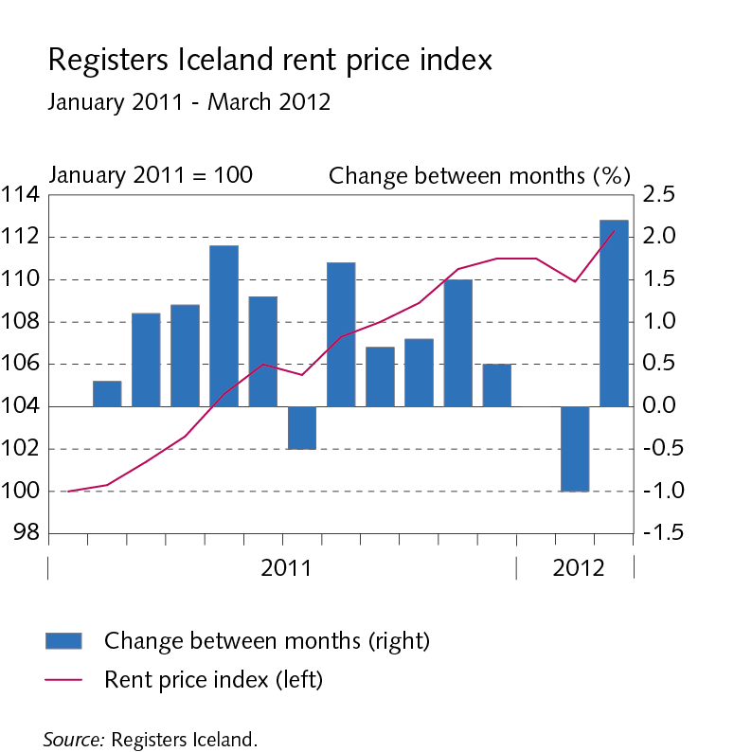
Box III-1 The Icelandic rental market

Slide 37
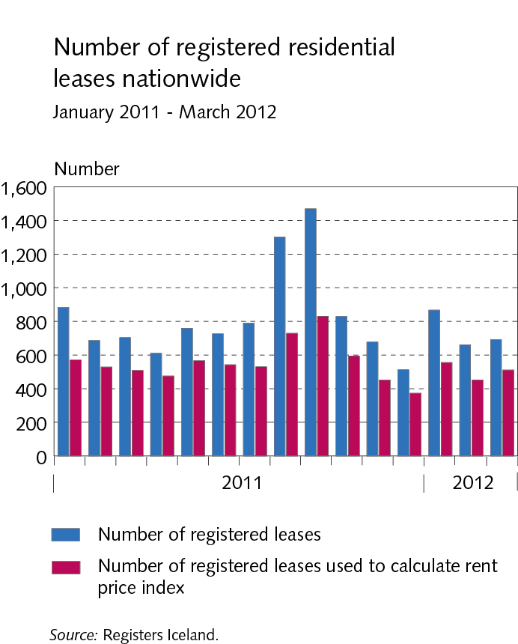
Box III-1 The Icelandic rental market

Slide 38
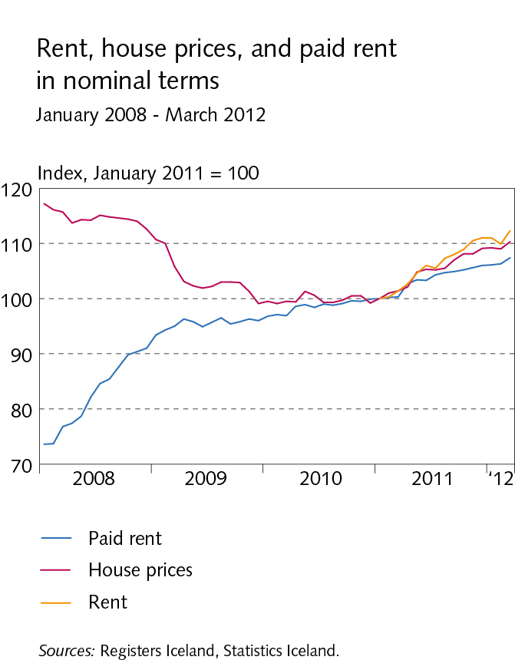
Box III-1 The Icelandic rental market

Slide 39
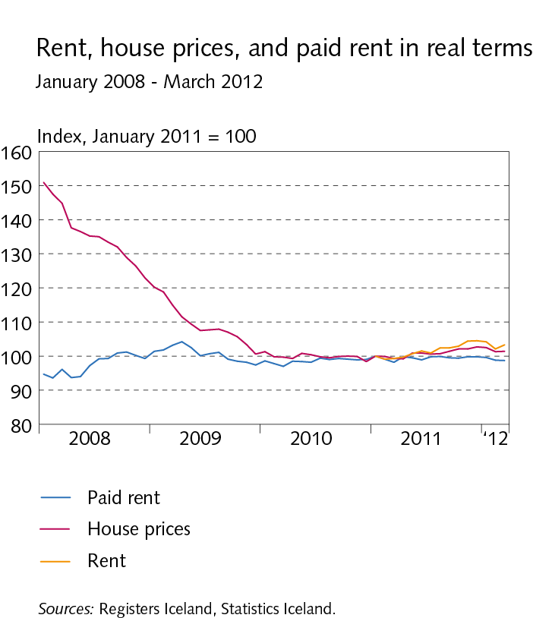
Box III-1 The Icelandic rental market

Slide 40
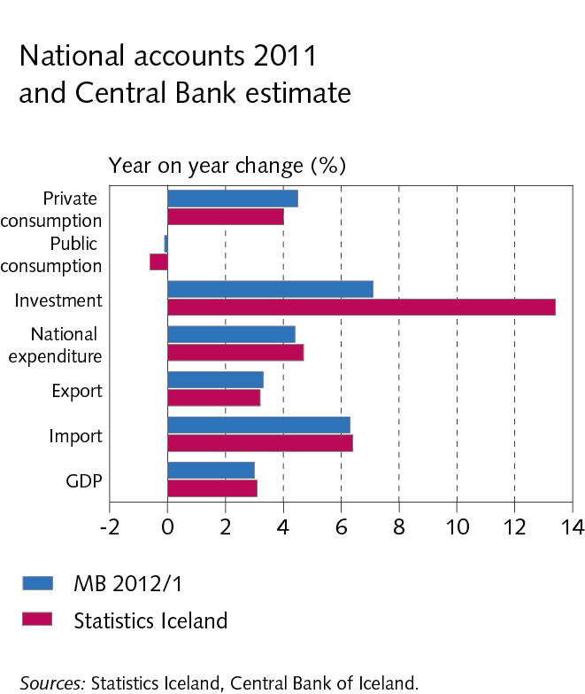
IV Domestic demand and production

Slide 41
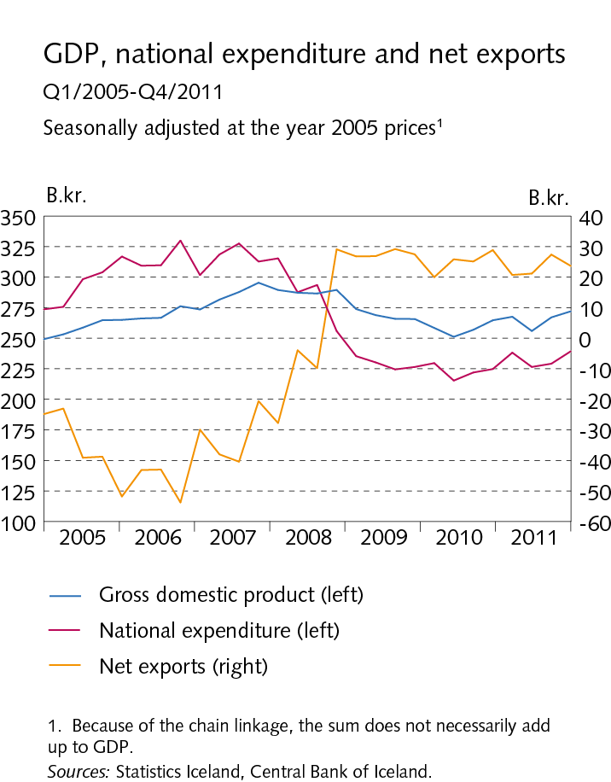
IV Domestic demand and production

Slide 42
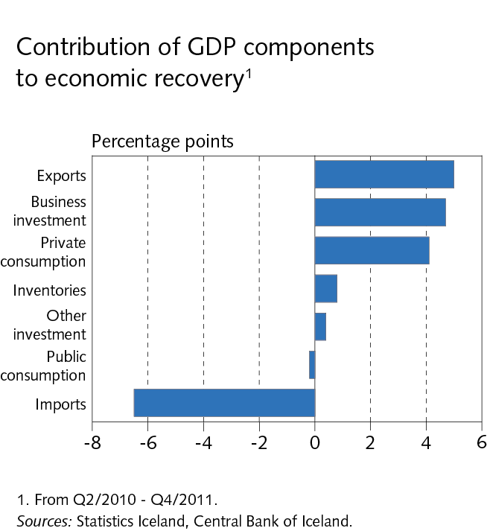
IV Domestic demand and production

Slide 43
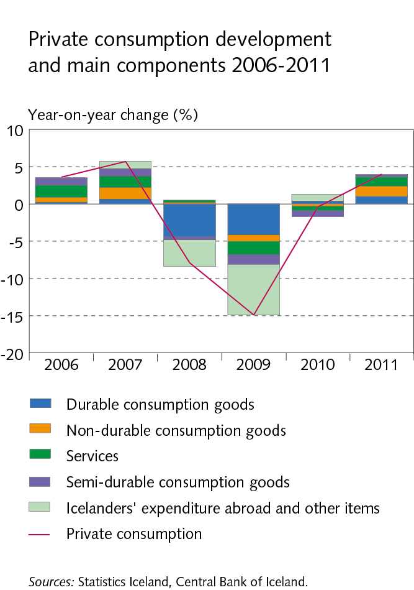
IV Domestic demand and production

Slide 44
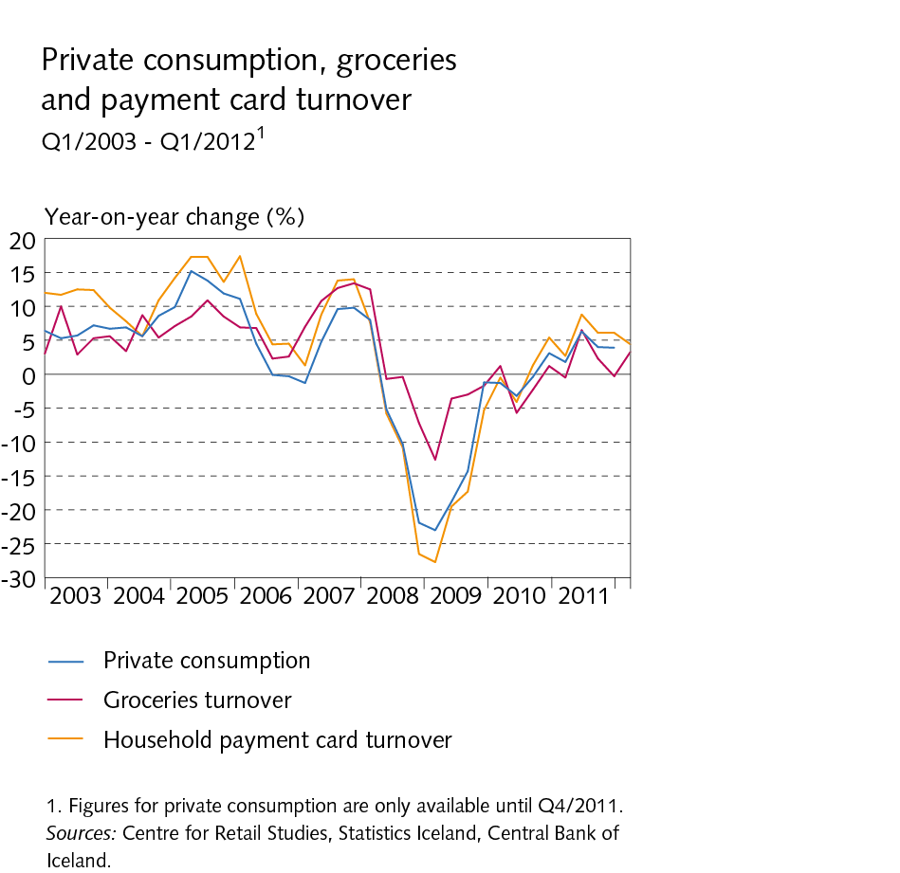
IV Domestic demand and production

Slide 45
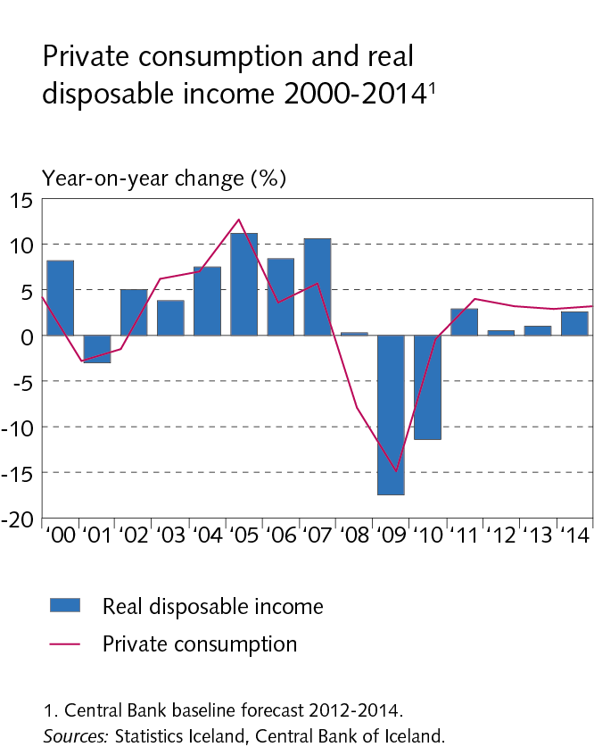
IV Domestic demand and production

Slide 46
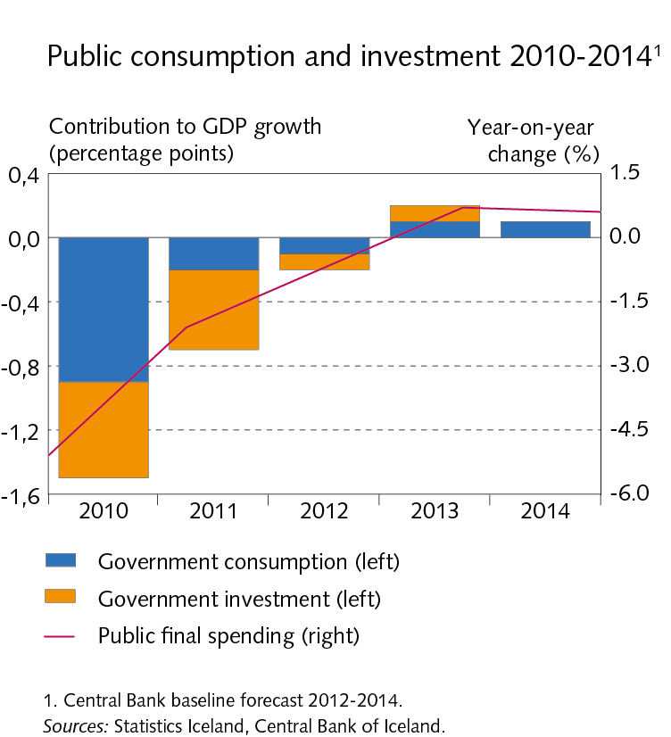
IV Domestic demand and production

Slide 47
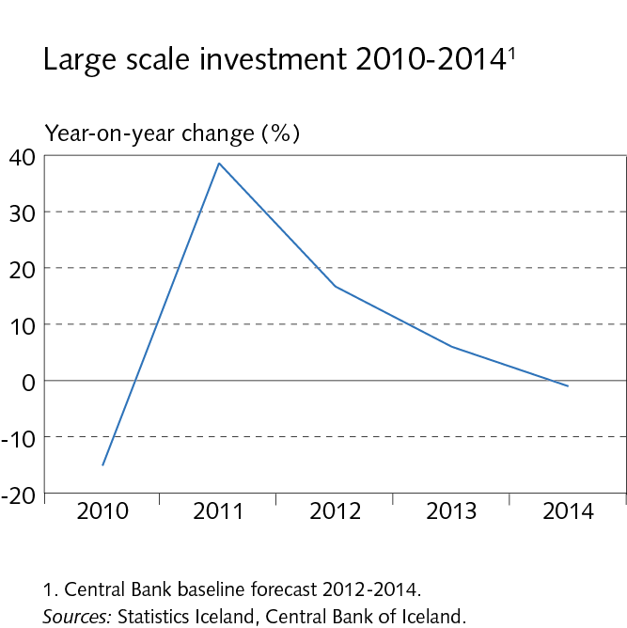
IV Domestic demand and production

Slide 48
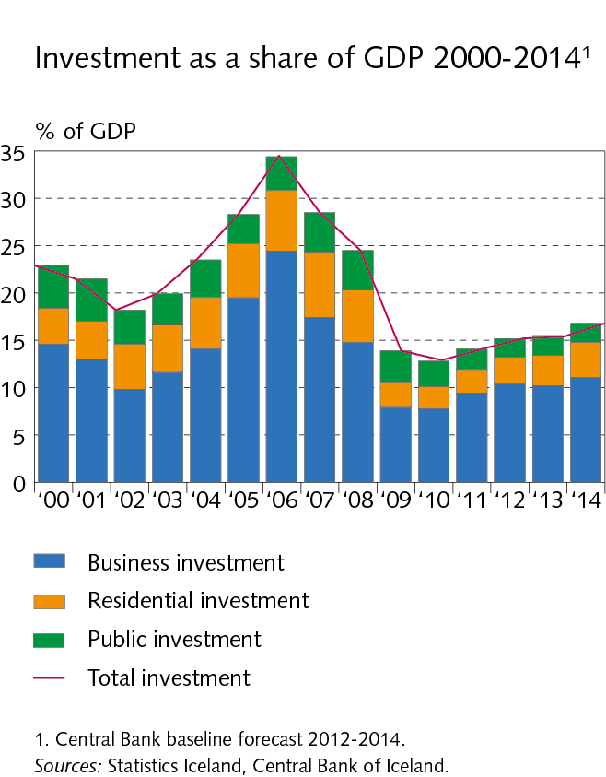
IV Domestic demand and production

Slide 49
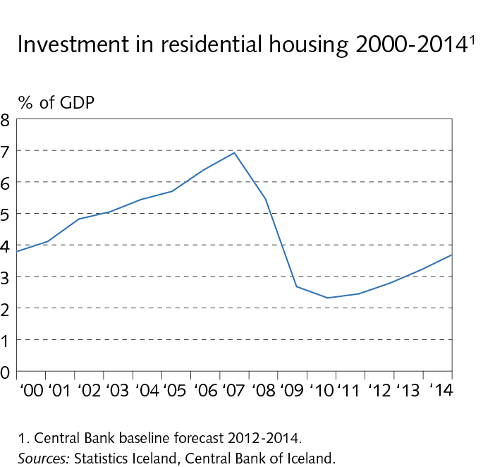
IV Domestic demand and production

Slide 50
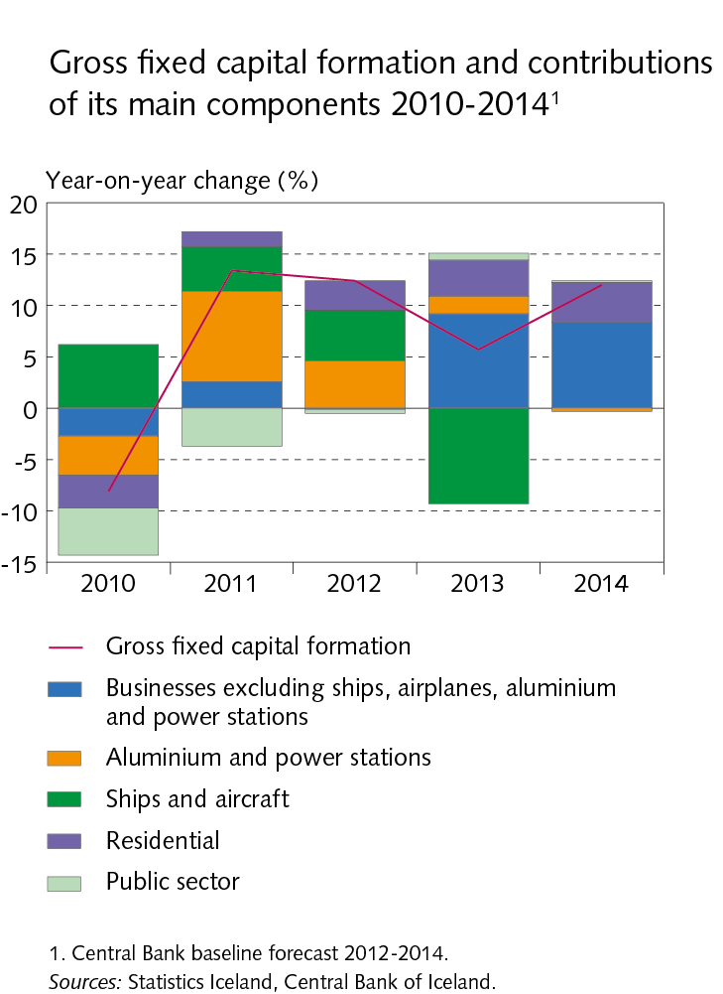
IV Domestic demand and production

Slide 51
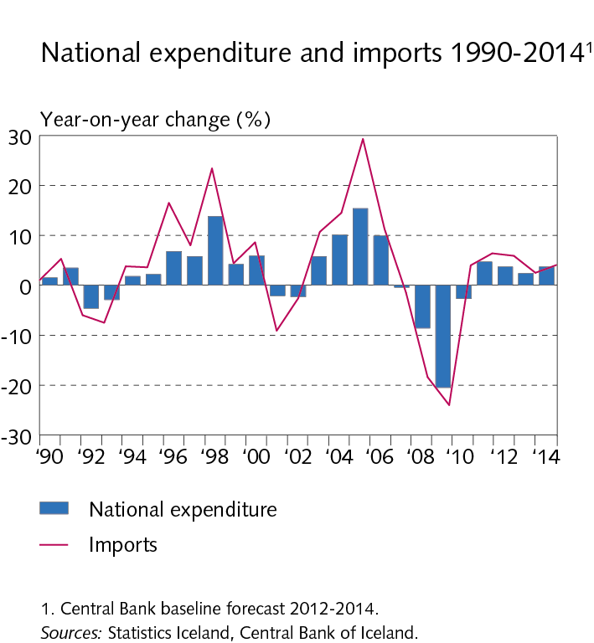
IV Domestic demand and production

Slide 52

IV Domestic demand and production

Slide 53

IV Domestic demand and production

Slide 54

IV Domestic demand and production

Slide 55

Box IV-1 Using high-frequency indicators to forecast private consumption

Slide 56

Box IV-1 Using high-frequency indicators to forecast private consumption

Slide 57

V Public sector finances

Slide 58

V Public sector finances

Slide 59

V Public sector finances

Slide 60

V Public sector finances

Slide 61

V Public sector finances

Slide 62

VI Labour market and wage developments

Slide 63

VI Labour market and wage developments

Slide 64

VI Labour market and wage developments

Slide 65

VI Labour market and wage developments

Slide 66

VI Labour market and wage developments

Slide 67

VI Labour market and wage developments

Slide 68

VI Labour market and wage developments

Slide 69

VII External balance

Slide 70

VII External balance

Slide 71

VII External balance

Slide 72

VII External balance

Slide 73

VII External balance

Slide 74

Box VII-1 The outlook for Iceland‘s external debt and payment flows

Slide 75

Box VII-1 The outlook for Iceland‘s external debt and payment flows

Slide 76

VIII Price developments and inflation outlook

Slide 77

VIII Price developments and inflation outlook

Slide 78

VIII Price developments and inflation outlook

Slide 79

VIII Price developments and inflation outlook

Slide 80

VIII Price developments and inflation outlook

Slide 81

VIII Price developments and inflation outlook

Slide 82

VIII Price developments and inflation outlook

Slide 83

VIII Price developments and inflation outlook

Slide 84

VIII Price developments and inflation outlook

