Slide 1
Central Bank of Iceland
Financial Stability 2013/2
Charts

Slide 2
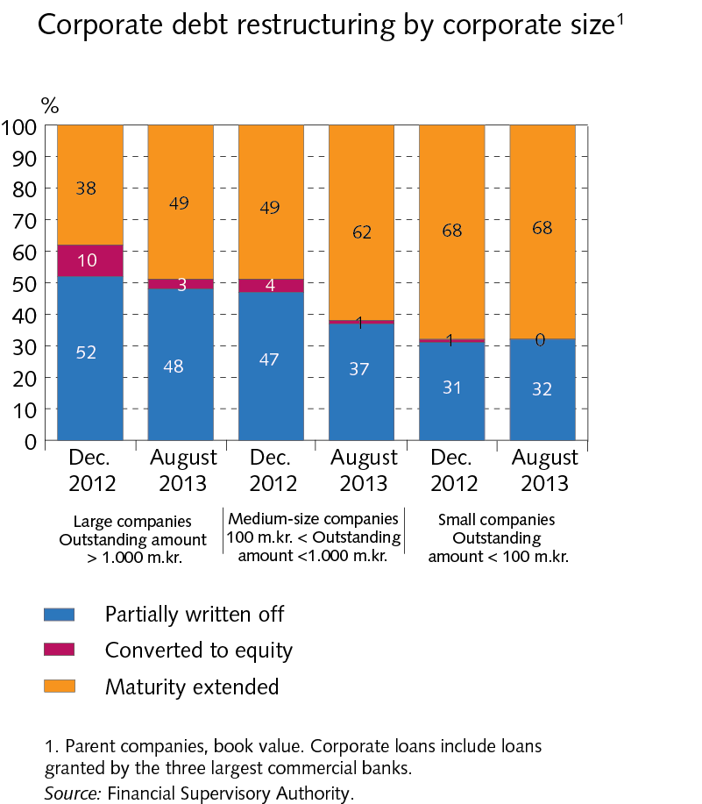
Financial Stability 2013/2

Slide 3
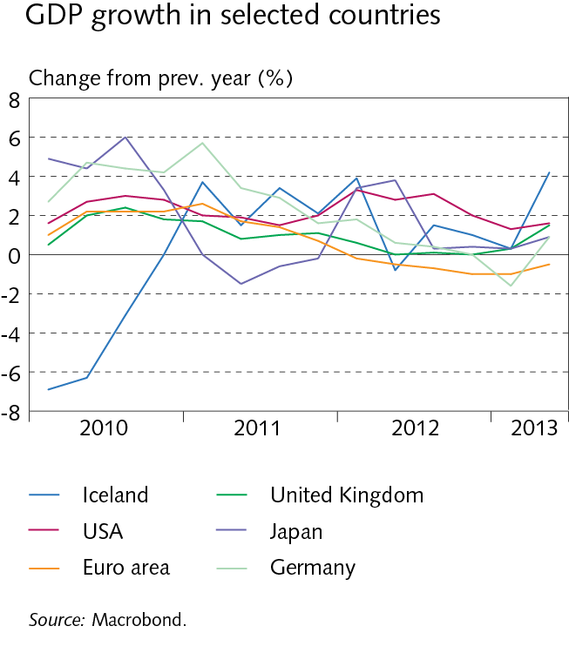
Financial Stability 2013/2

Slide 4
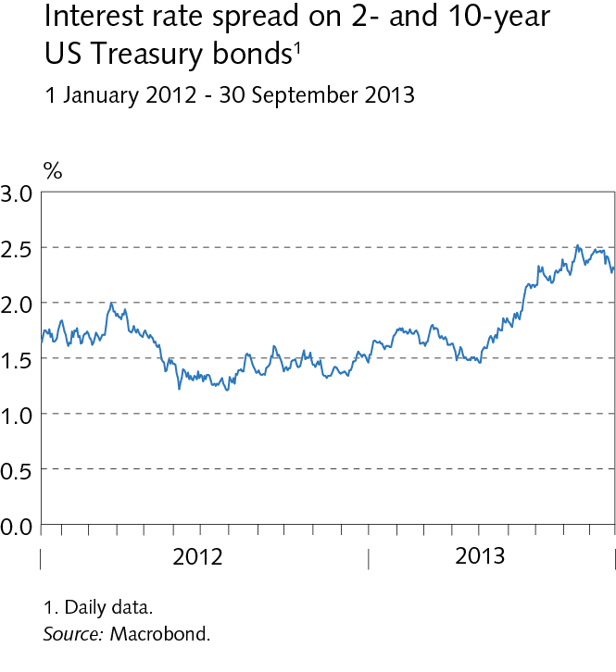
Financial Stability 2013/2

Slide 5
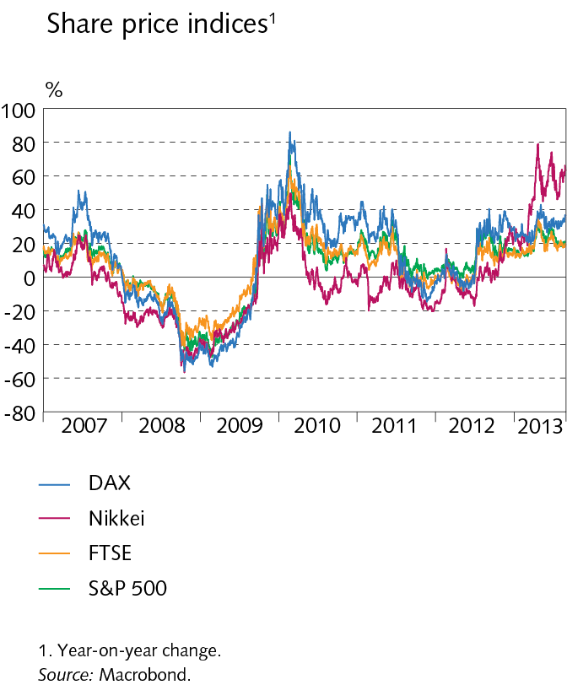
Financial Stability 2013/2

Slide 6
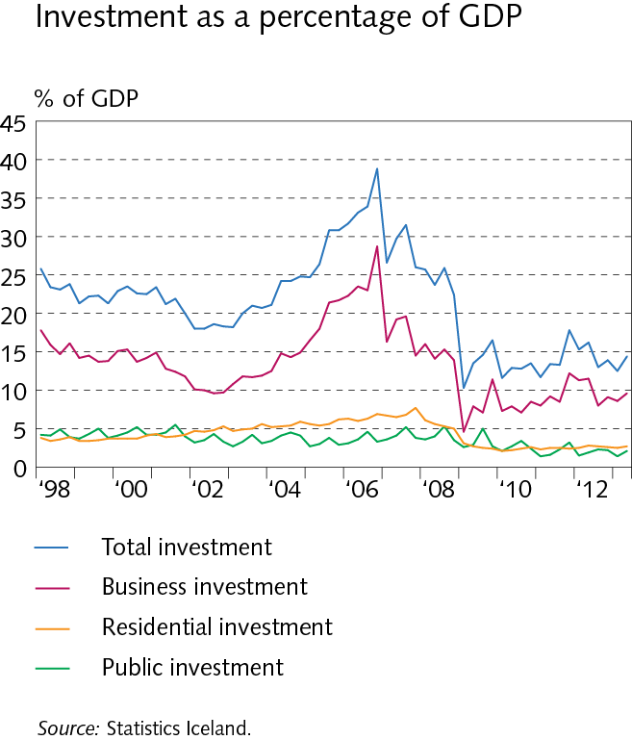
Financial Stability 2013/2

Slide 7
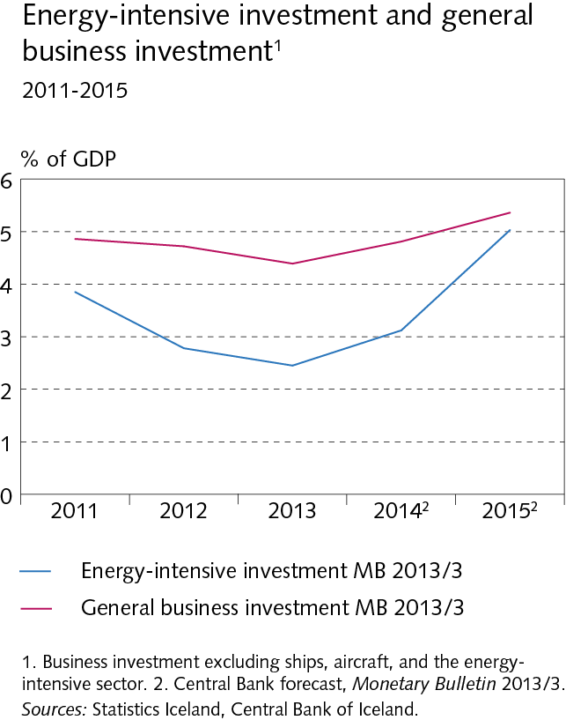
Financial Stability 2013/2

Slide 8
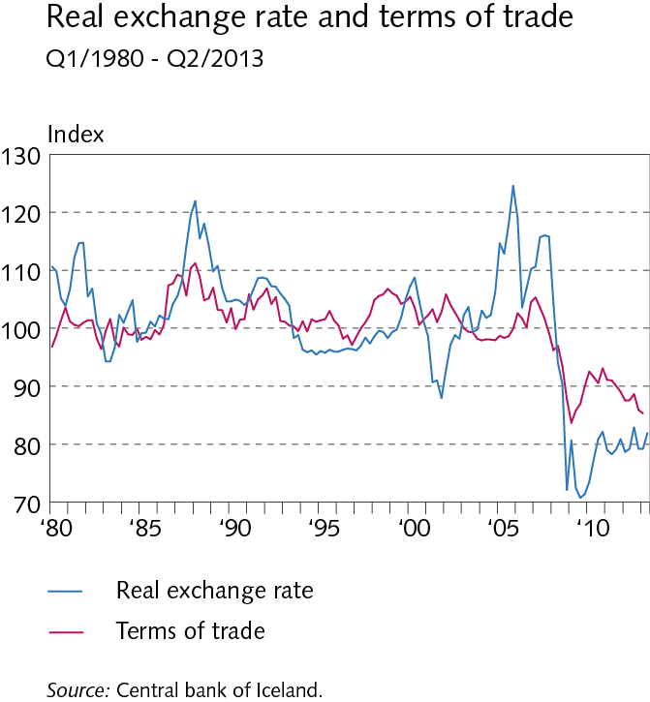
Financial Stability 2013/2

Slide 9
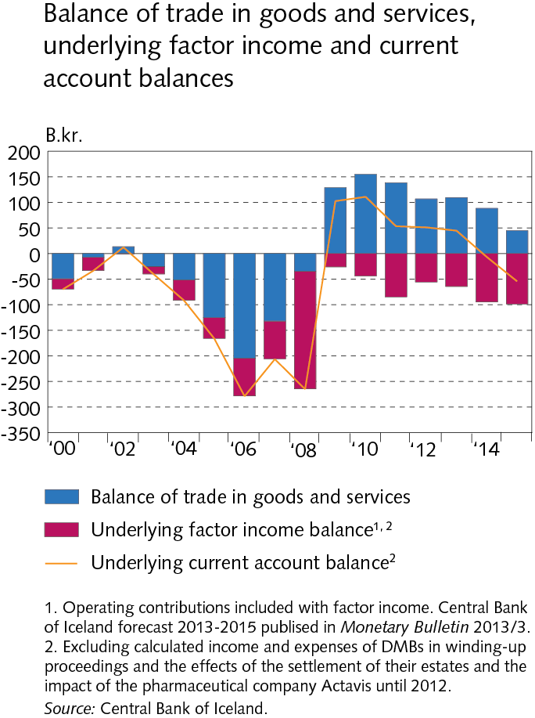
Financial Stability 2013/2

Slide 10
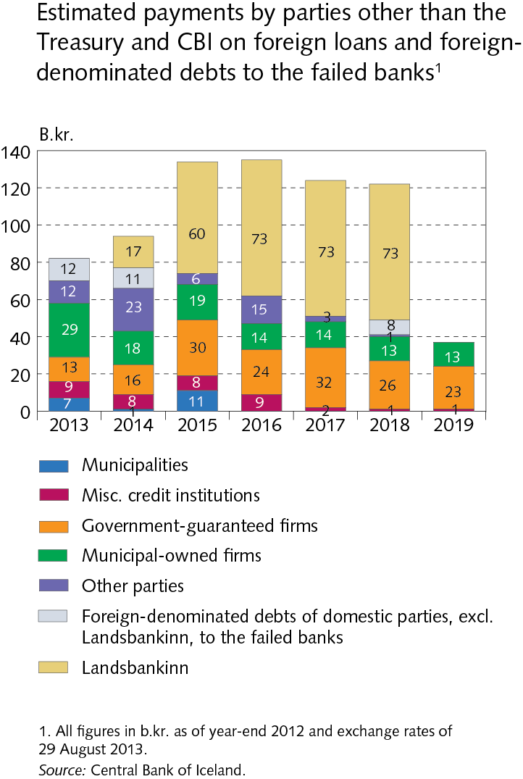
Financial Stability 2013/2

Slide 11
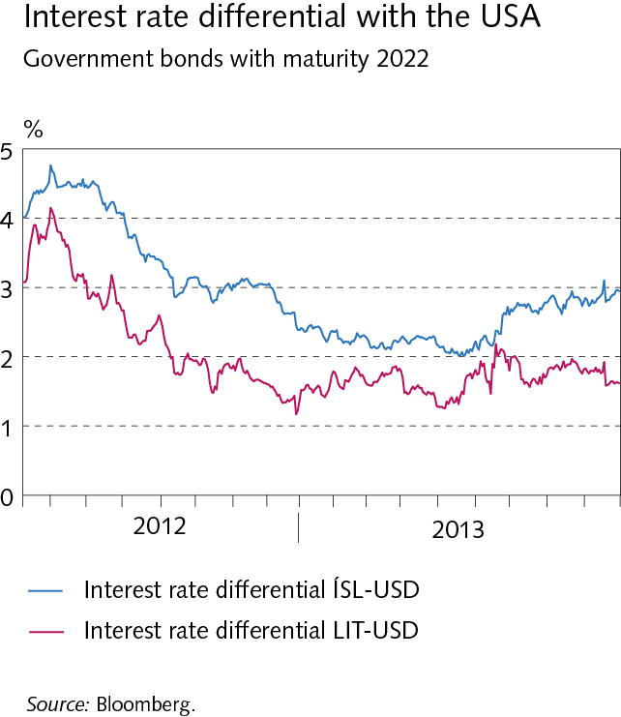
Financial Stability 2013/2

Slide 12
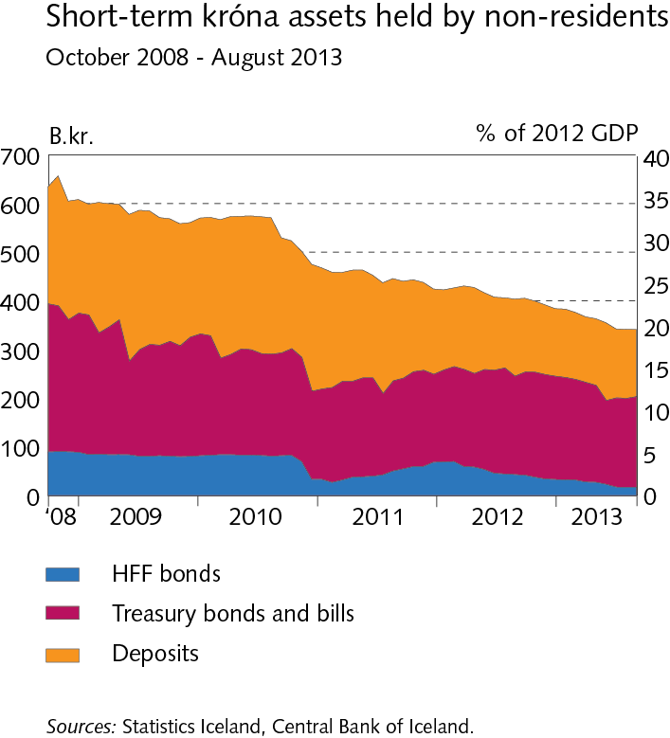
Financial Stability 2013/2

Slide 13
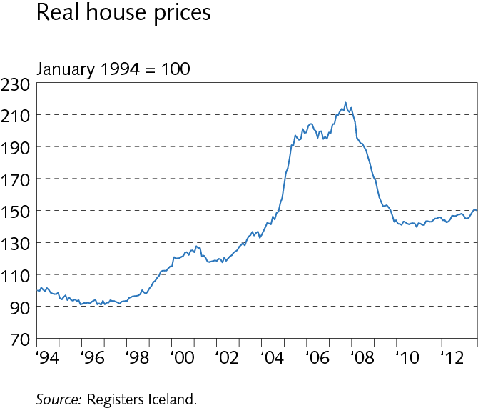
Financial Stability 2013/2

Slide 14
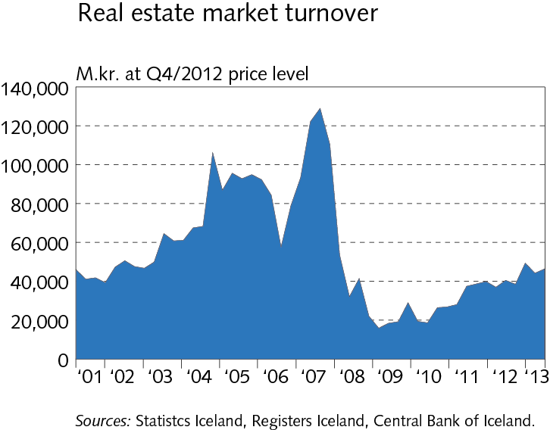
Financial Stability 2013/2

Slide 15
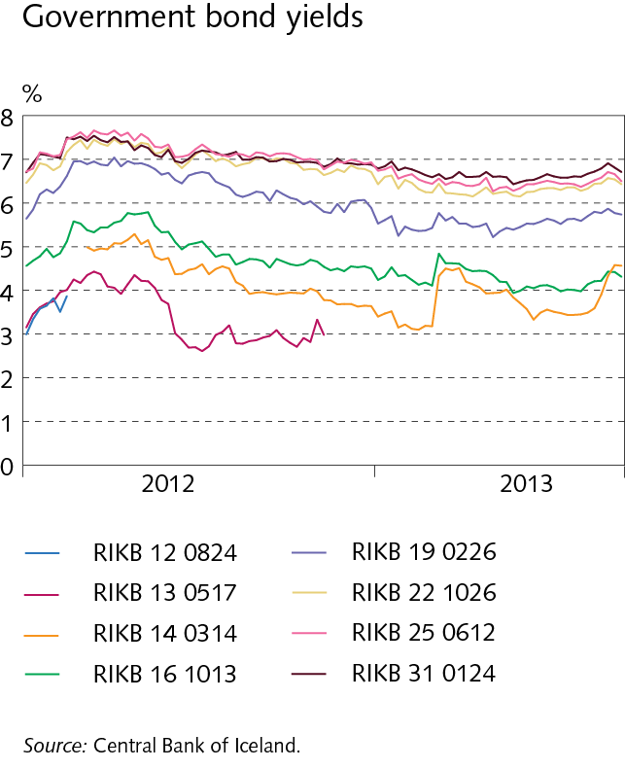
Financial Stability 2013/2

Slide 16
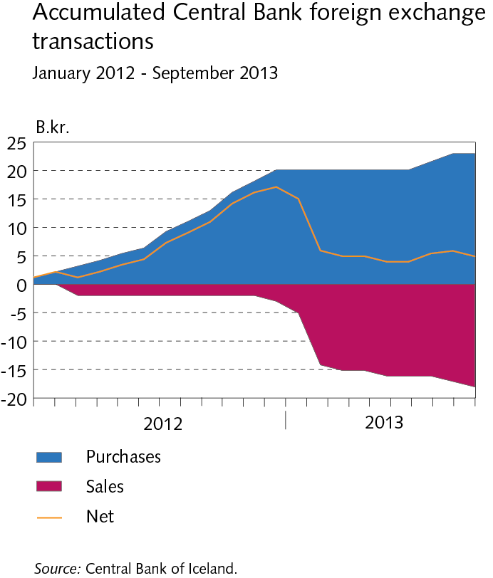
Financial Stability 2013/2

Slide 17
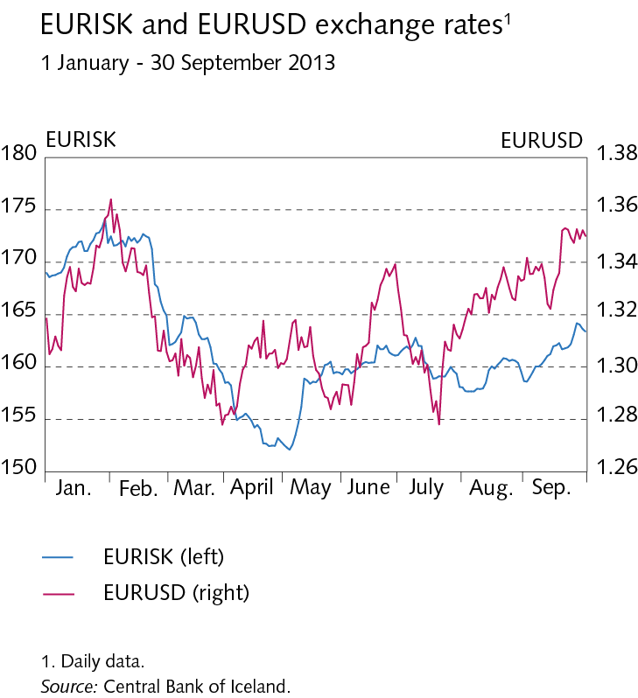
Financial Stability 2013/2

Slide 18
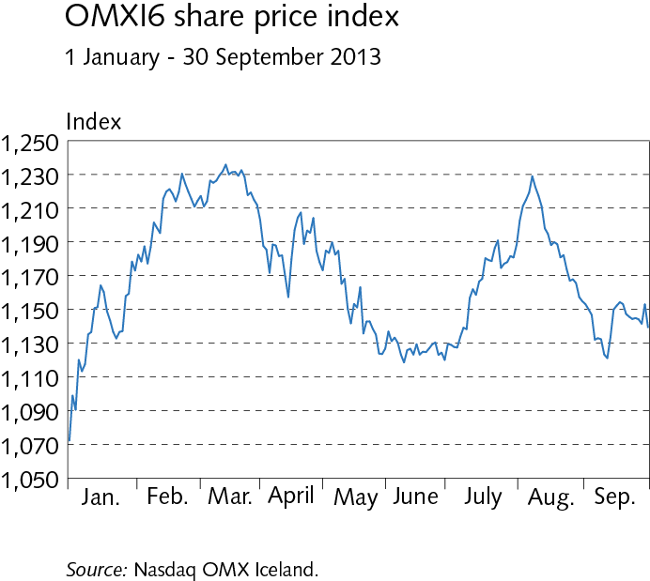
Financial Stability 2013/2

Slide 19
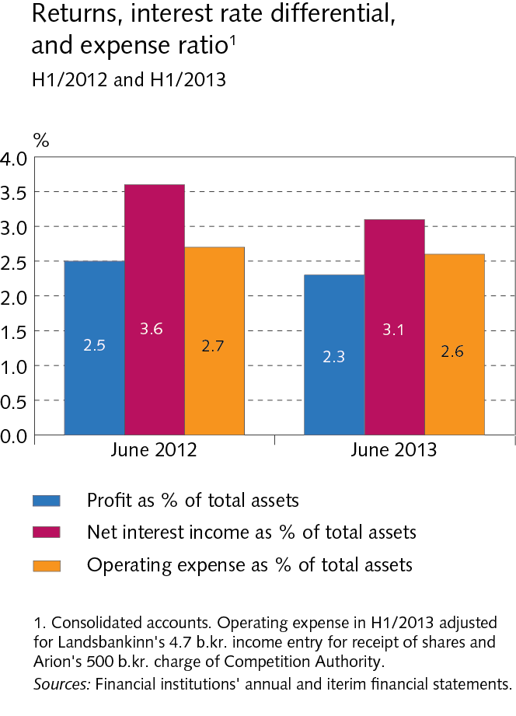
Financial Stability 2013/2

Slide 20
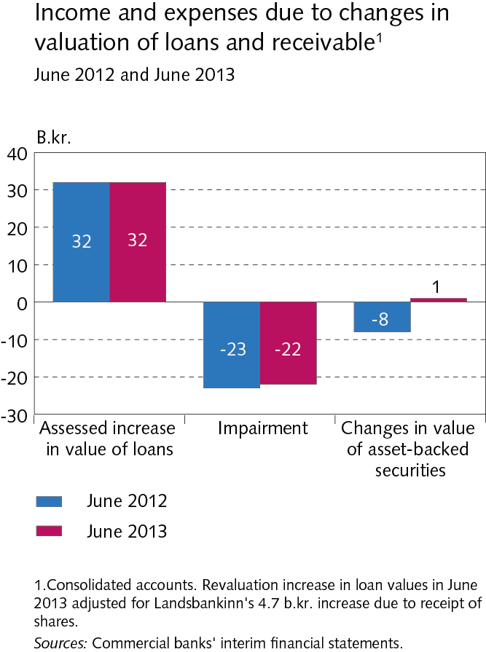
Financial Stability 2013/2

Slide 21
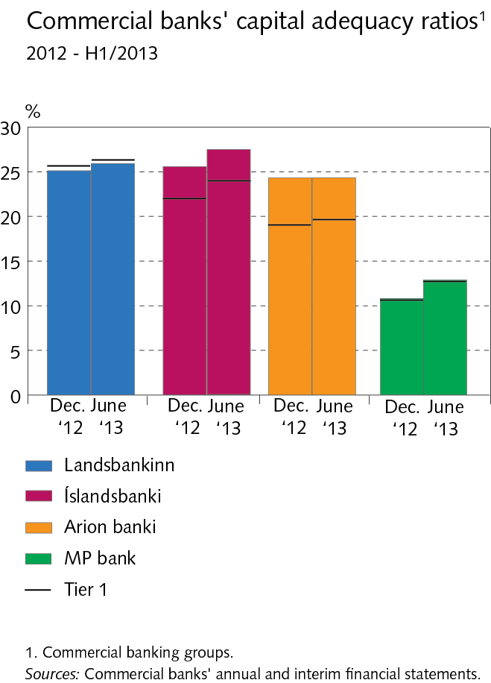
Financial Stability 2013/2

Slide 22
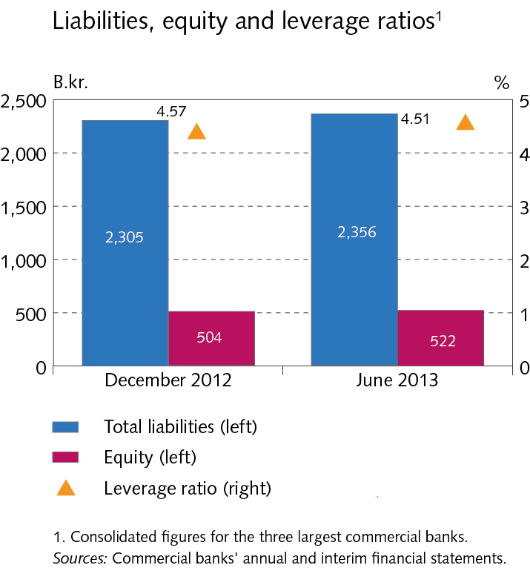
Financial Stability 2013/2

Slide 23
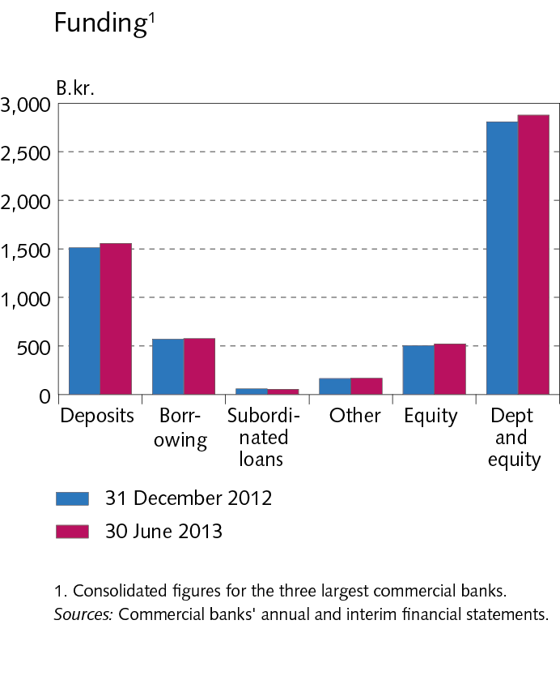
Financial Stability 2013/2

Slide 24
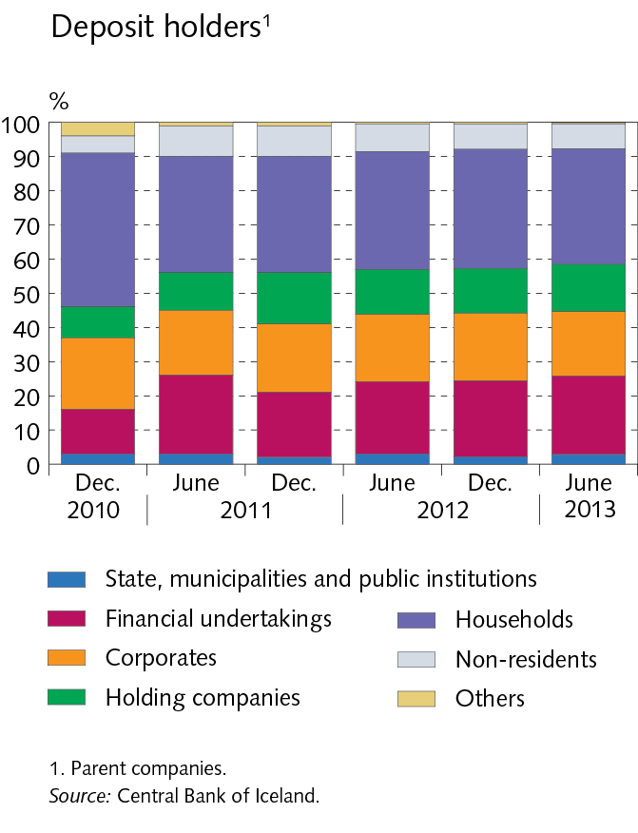
Financial Stability 2013/2

Slide 25
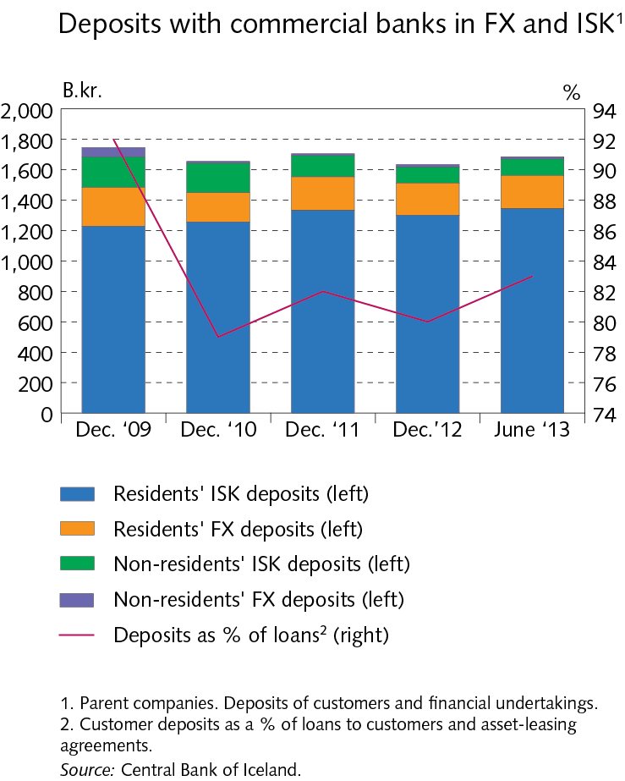
Financial Stability 2013/2

Slide 26
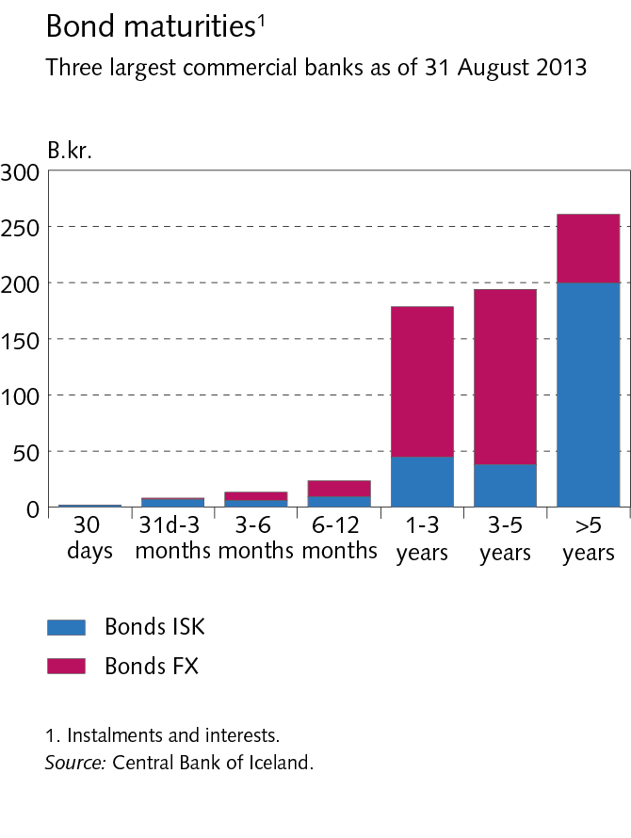
Financial Stability 2013/2

Slide 27
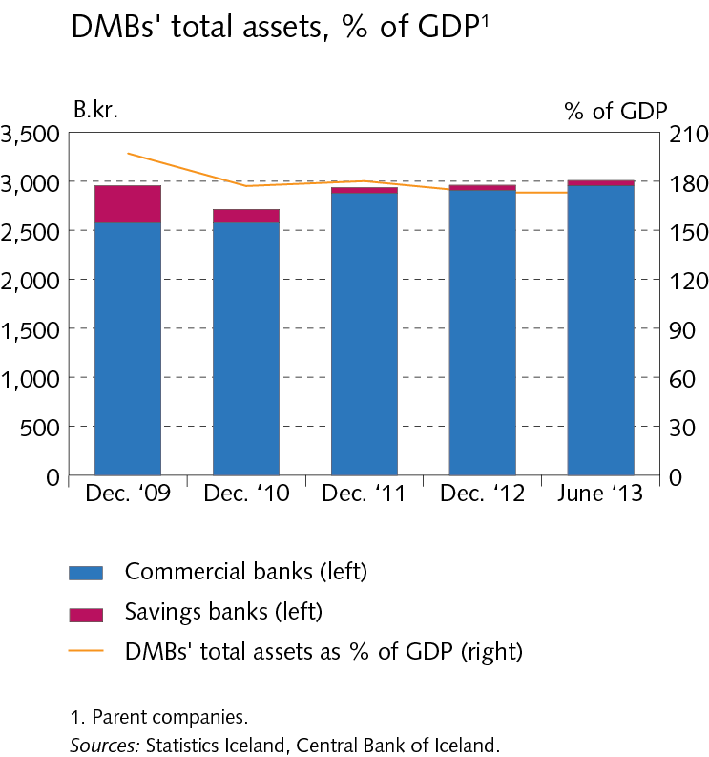
Financial Stability 2013/2

Slide 28
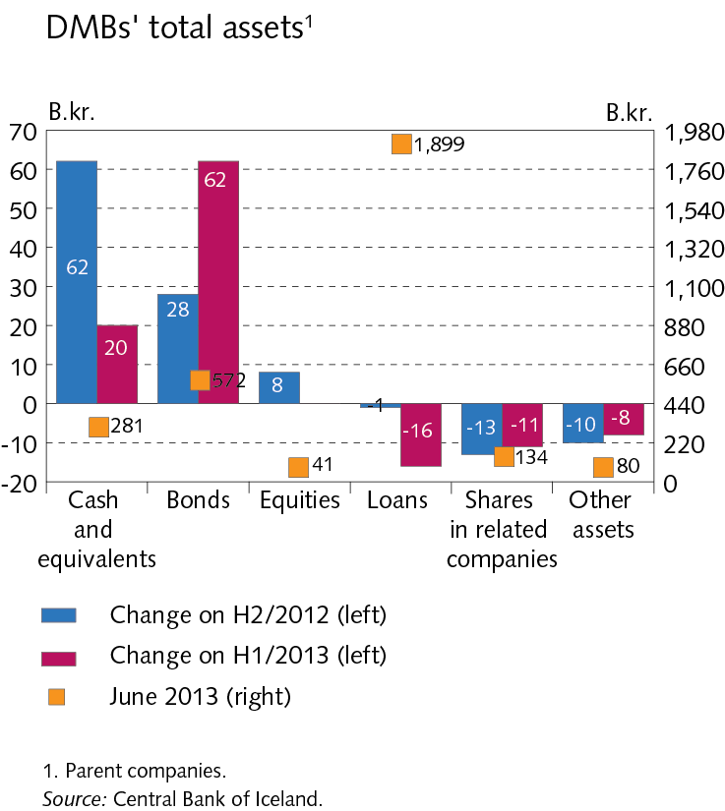
Financial Stability 2013/2

Slide 29
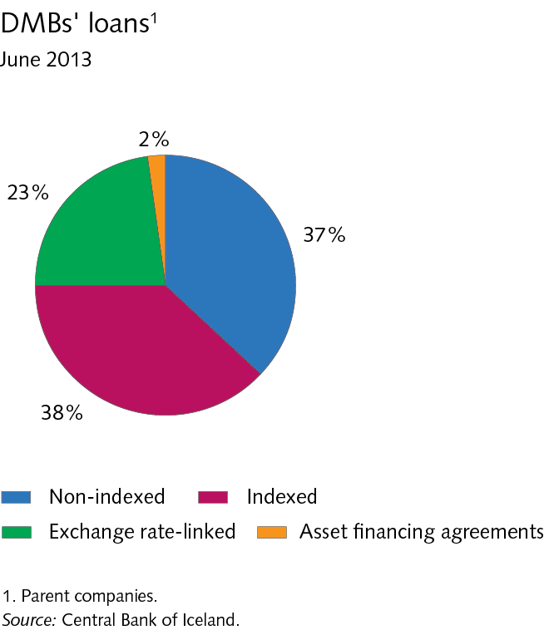
Financial Stability 2013/2

Slide 30
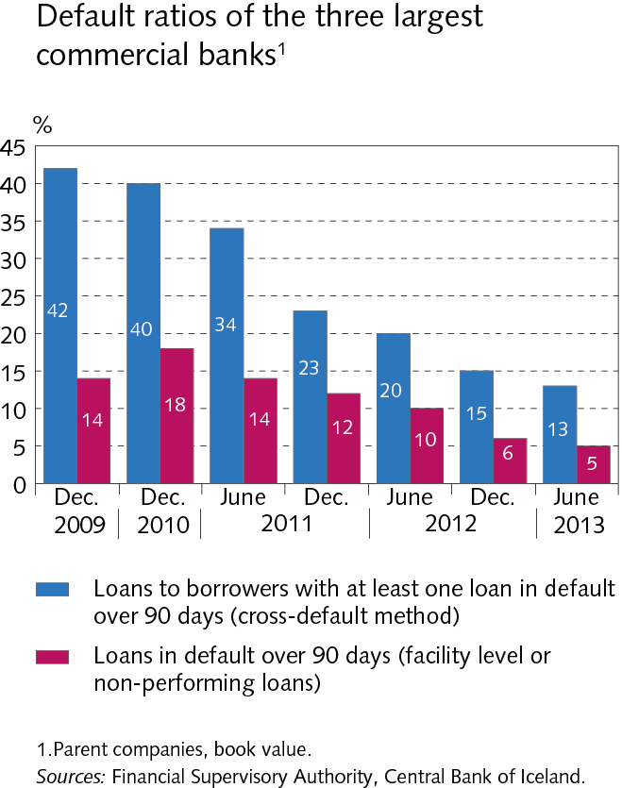
Financial Stability 2013/2

Slide 31
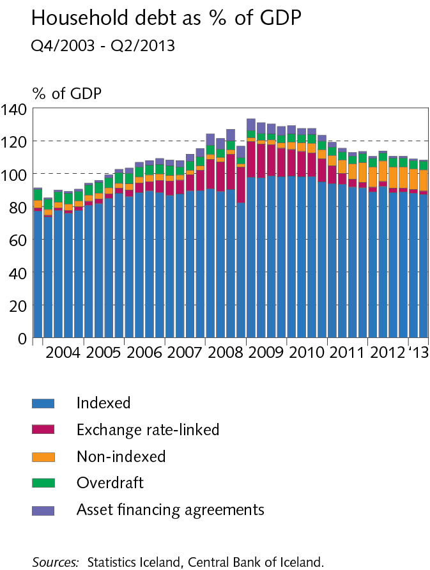
Financial Stability 2013/2

Slide 32
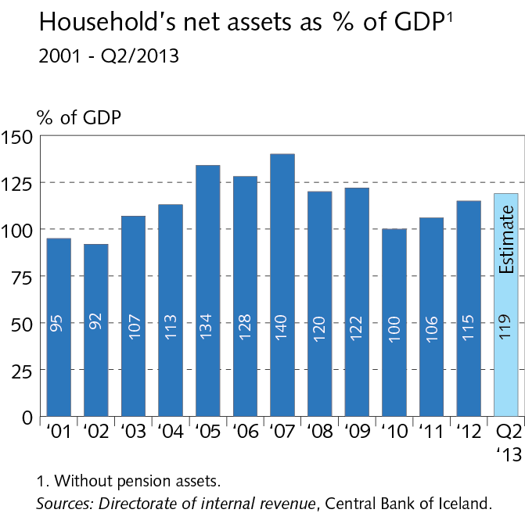
Financial Stability 2013/2

Slide 33
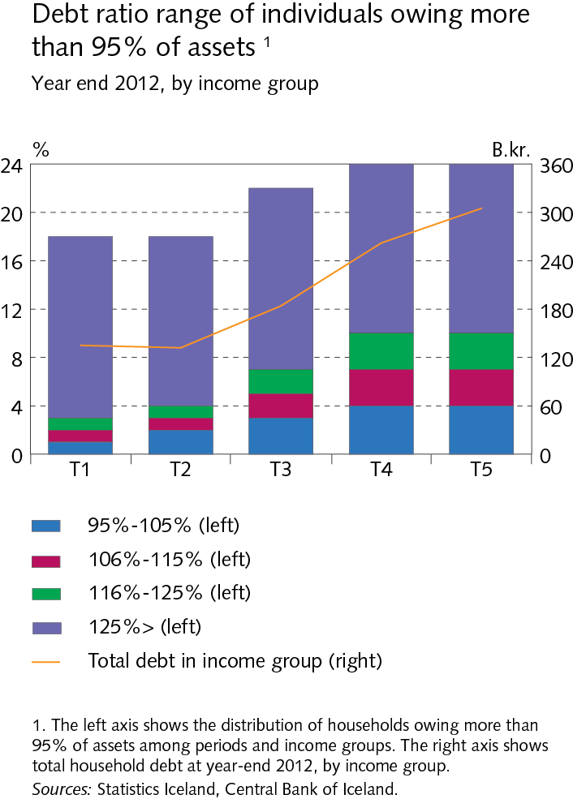
Financial Stability 2013/2

Slide 34
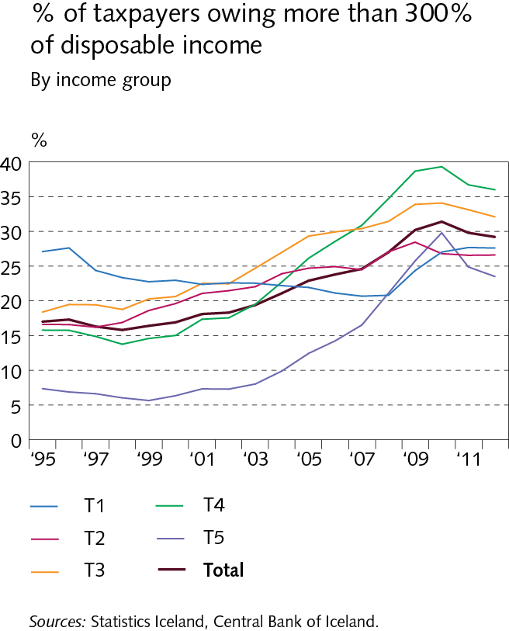
Financial Stability 2013/2

Slide 35
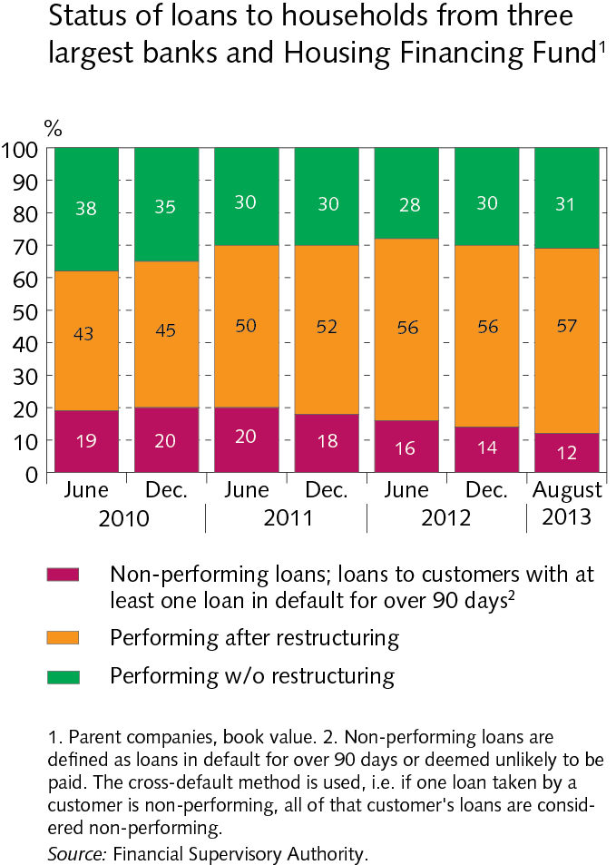
Financial Stability 2013/2

Slide 36
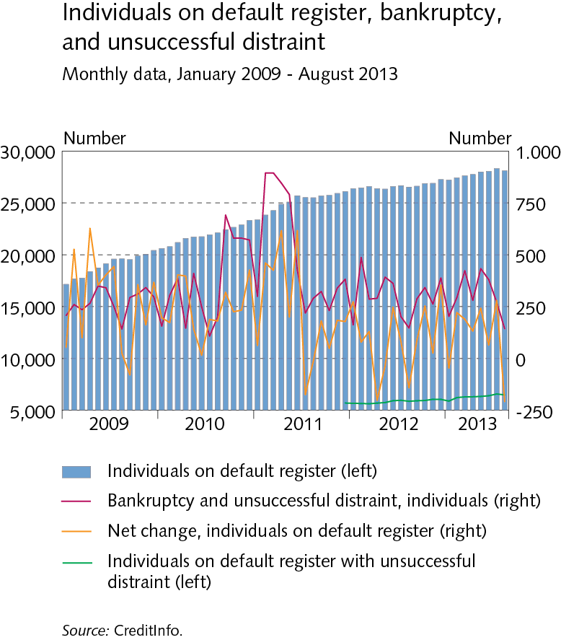
Financial Stability 2013/2

Slide 37
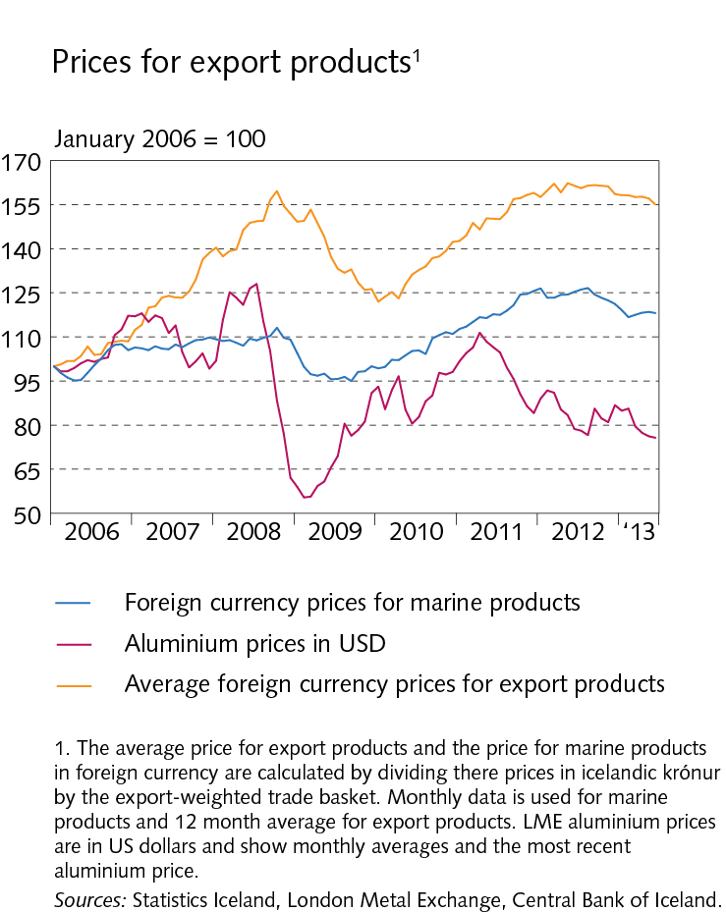
Financial Stability 2013/2

Slide 38
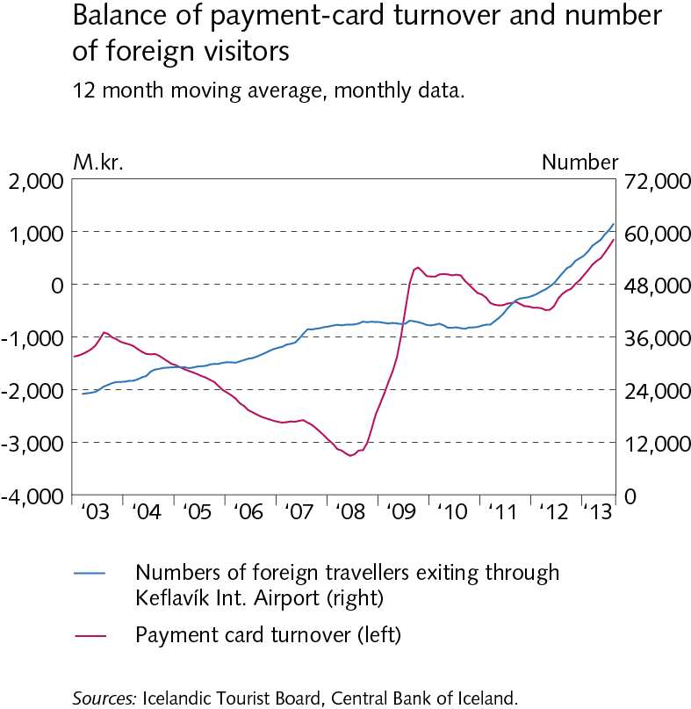
Financial Stability 2013/2

Slide 39
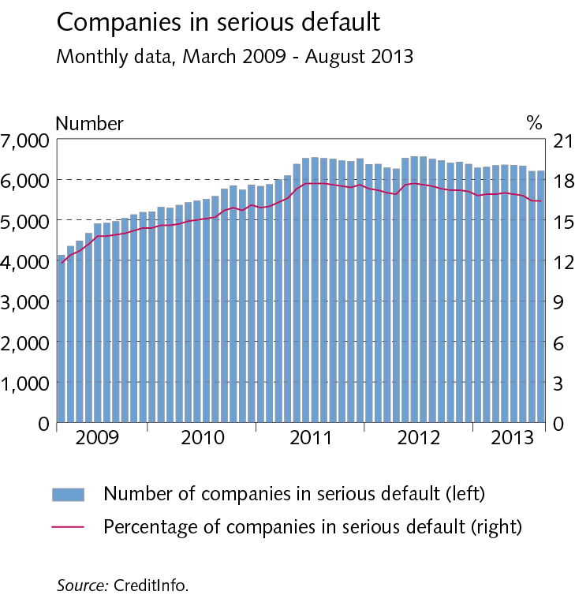
Financial Stability 2013/2

Slide 40
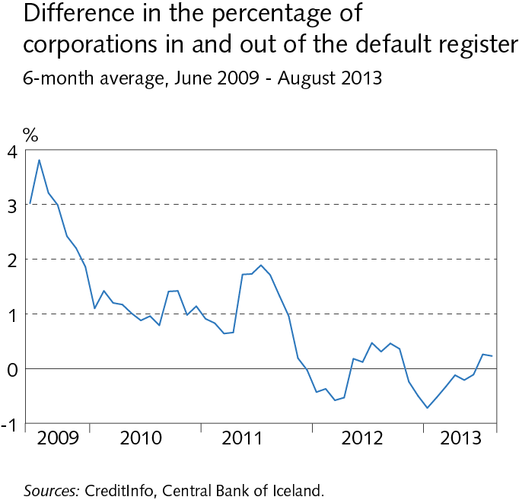
Financial Stability 2013/2

Slide 41
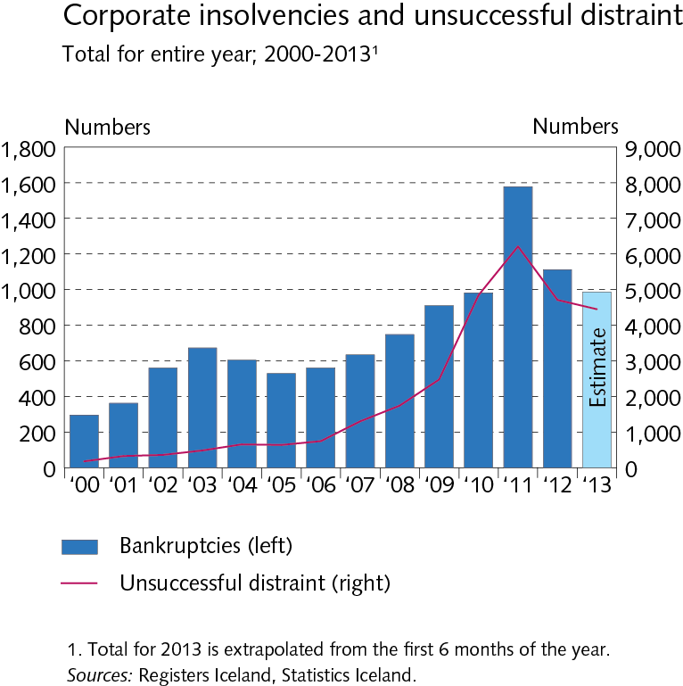
Financial Stability 2013/2

Slide 42
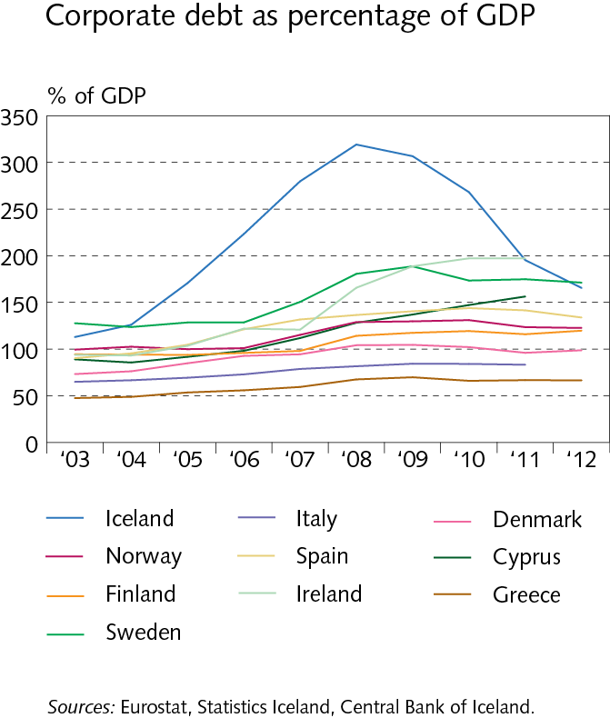
Financial Stability 2013/2

Slide 43
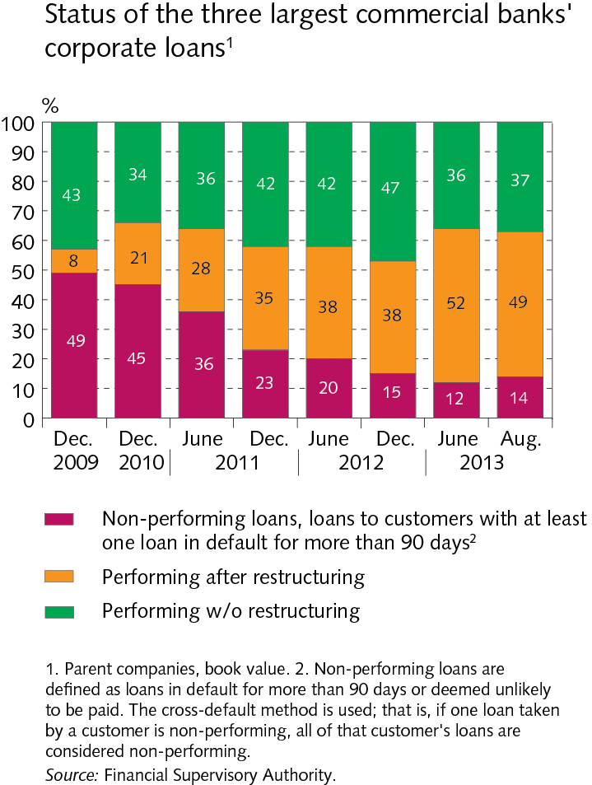
Financial Stability 2013/2

Slide 44
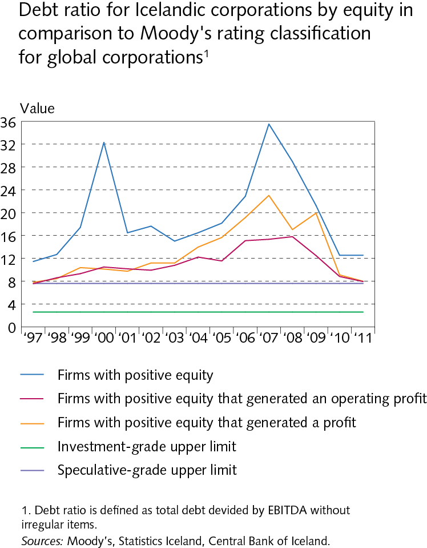
Financial Stability 2013/2

Slide 45
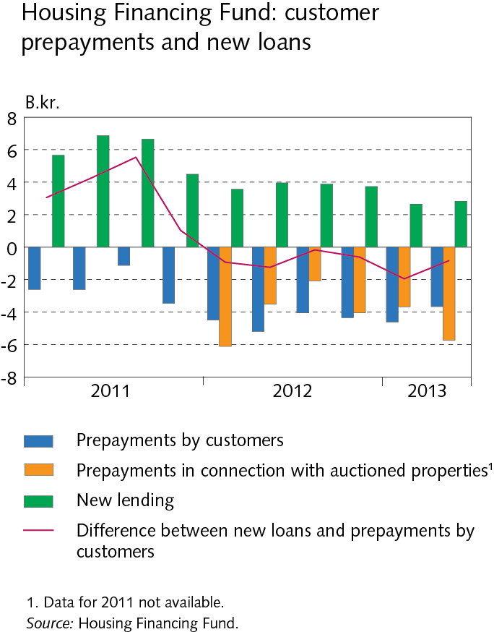
Financial Stability 2013/2

Slide 46
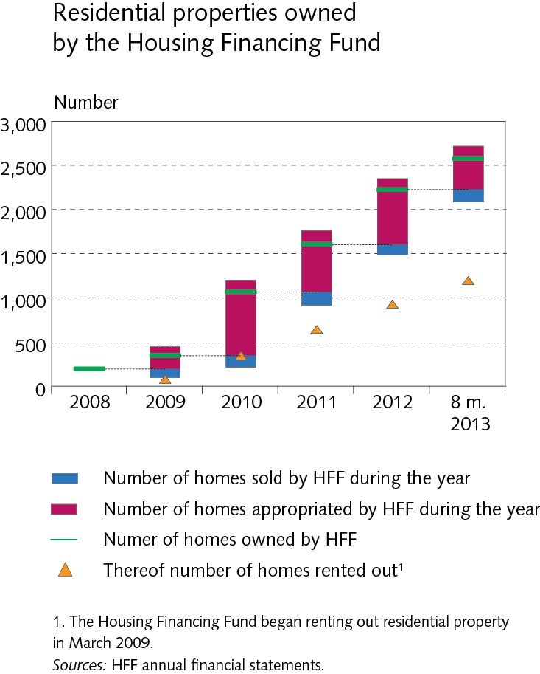
Financial Stability 2013/2

Slide 47
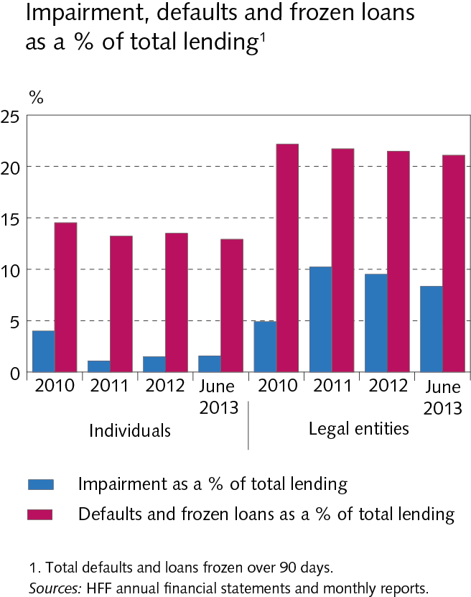
Financial Stability 2013/2

Slide 48
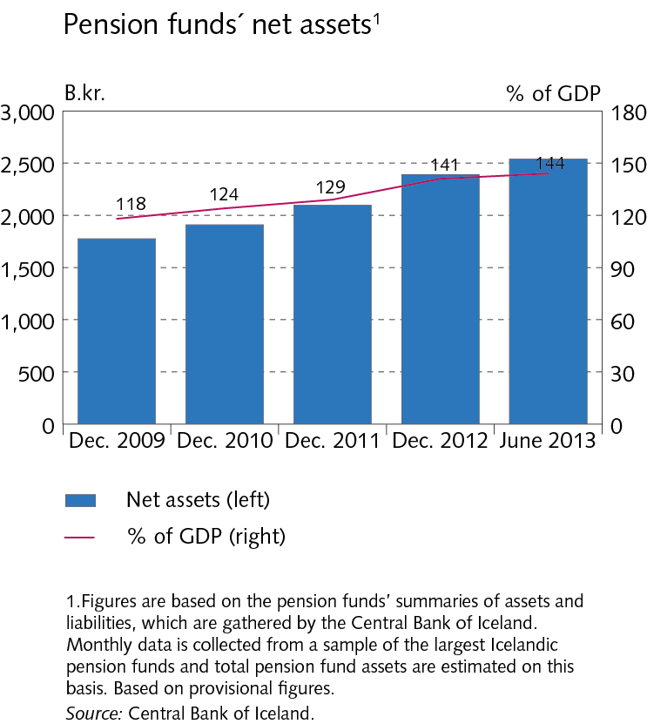
Financial Stability 2013/2

Slide 49
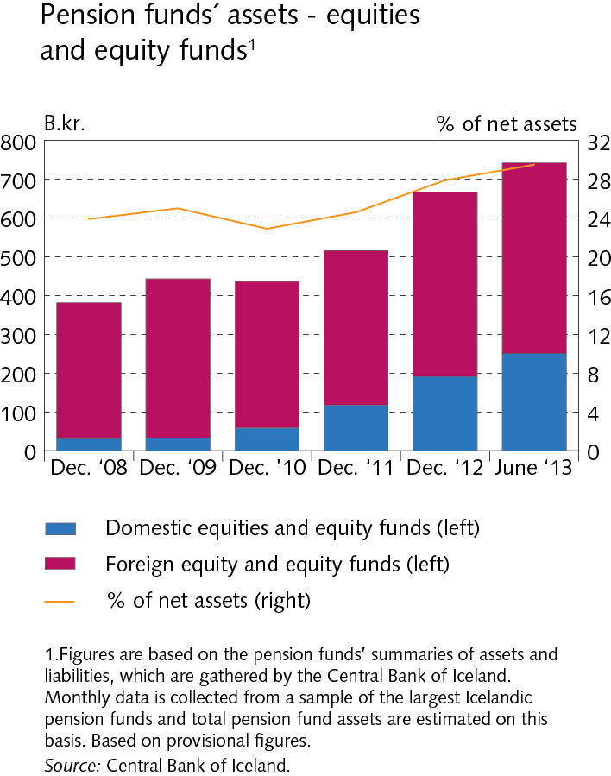
Financial Stability 2013/2

Slide 50
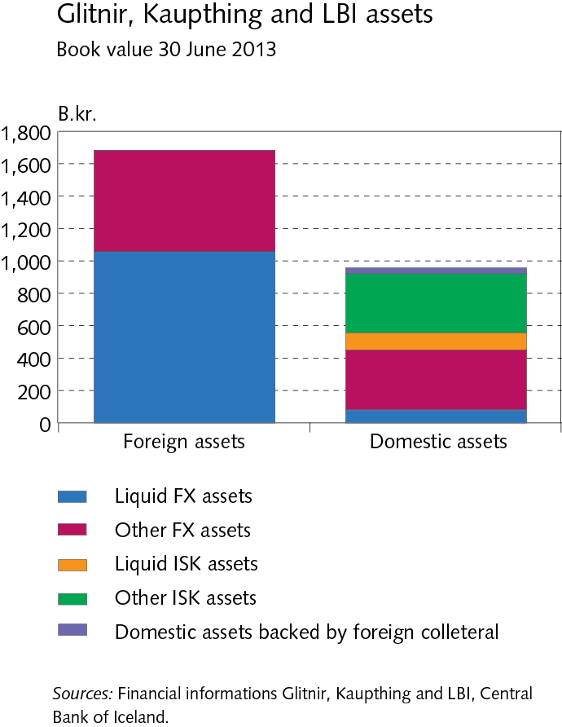
Financial Stability 2013/2

Slide 51
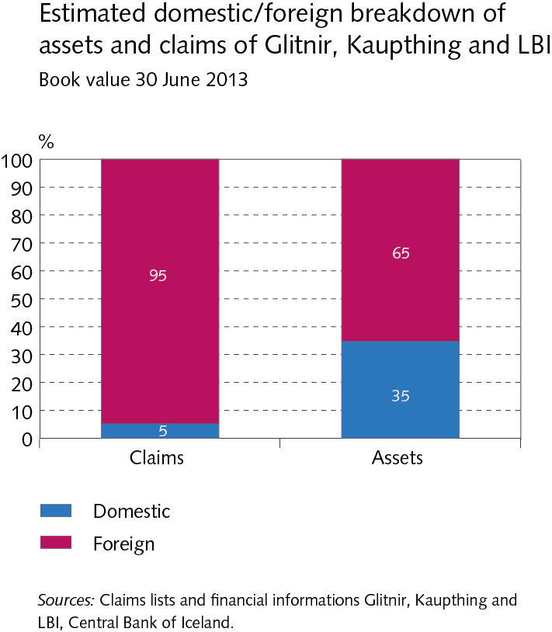
Financial Stability 2013/2

Slide 52
Financial Stability 2013/2

Slide 53
Financial Stability 2013/2

Slide 54
Financial Stability 2013/2

Slide 55
Financial Stability 2013/2

Slide 56
Financial Stability 2013/2

Slide 57
Financial Stability 2013/2

Slide 58
Financial Stability 2013/2

Slide 59
Financial Stability 2013/2

