Slide 1
Central Bank of Iceland
Financial stability 2012/2
Charts

Slide 2
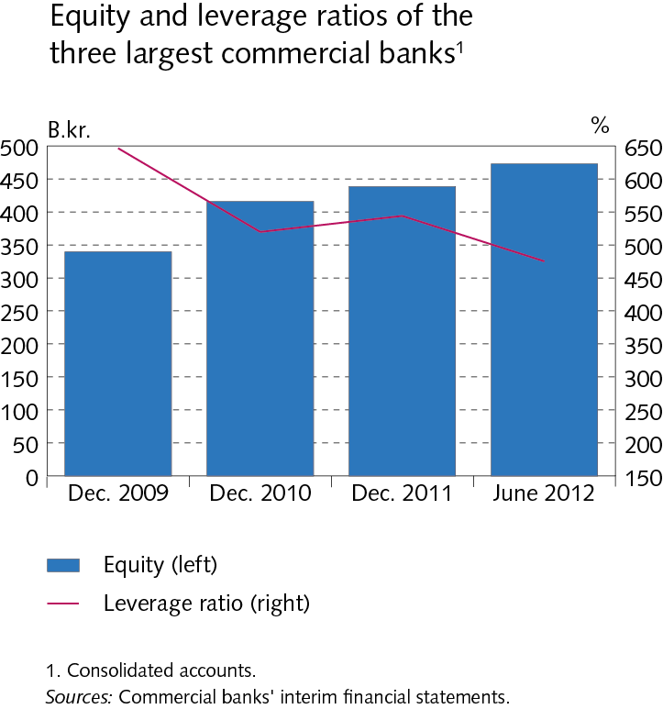
The financial system: outlook and major risks

Slide 3
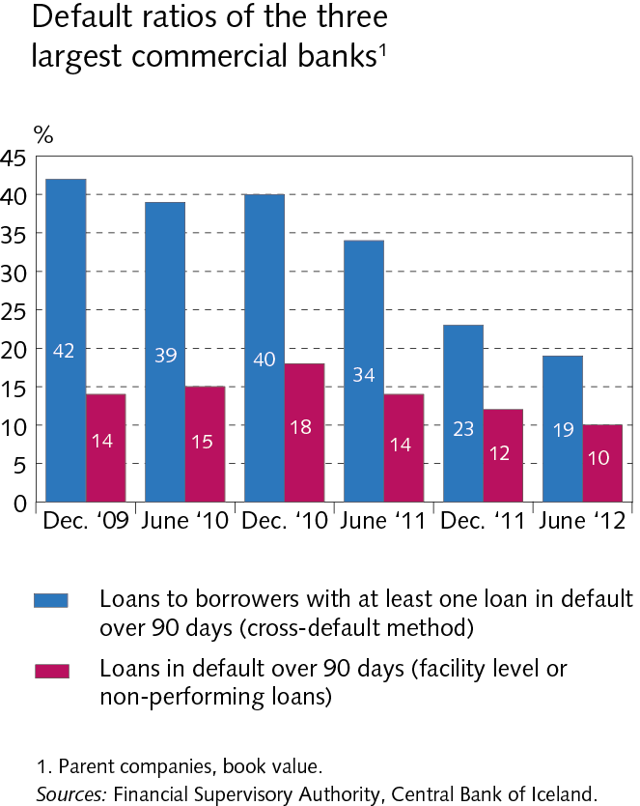
The financial system: outlook and major risks

Slide 4
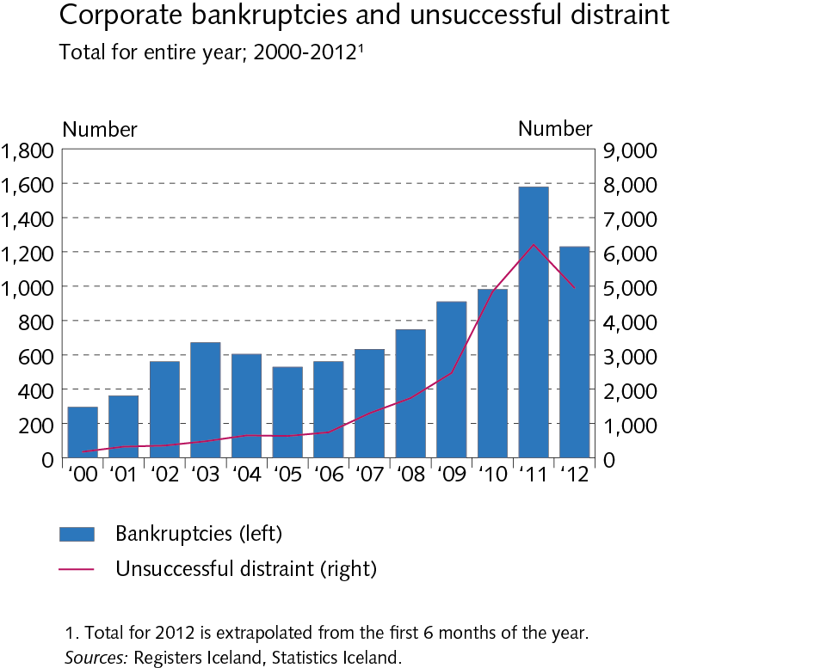
The financial system: outlook and major risks

Slide 5
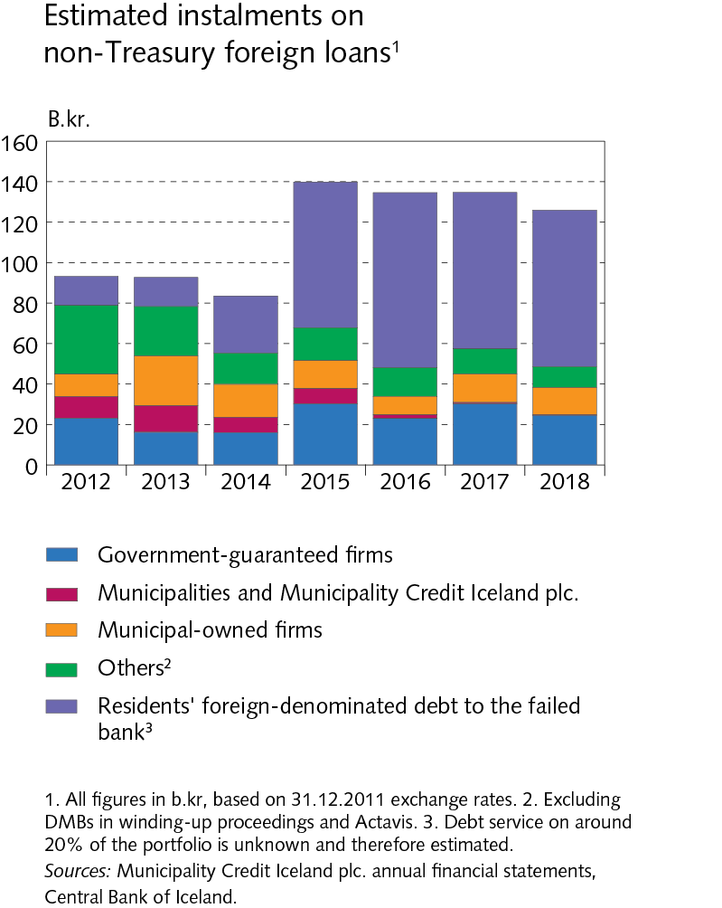
The financial system: outlook and major risks

Slide 6
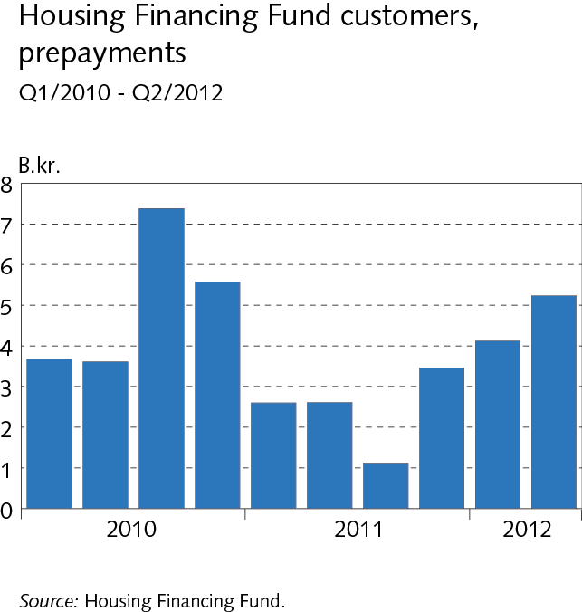
The financial system: outlook and major risks

Slide 7
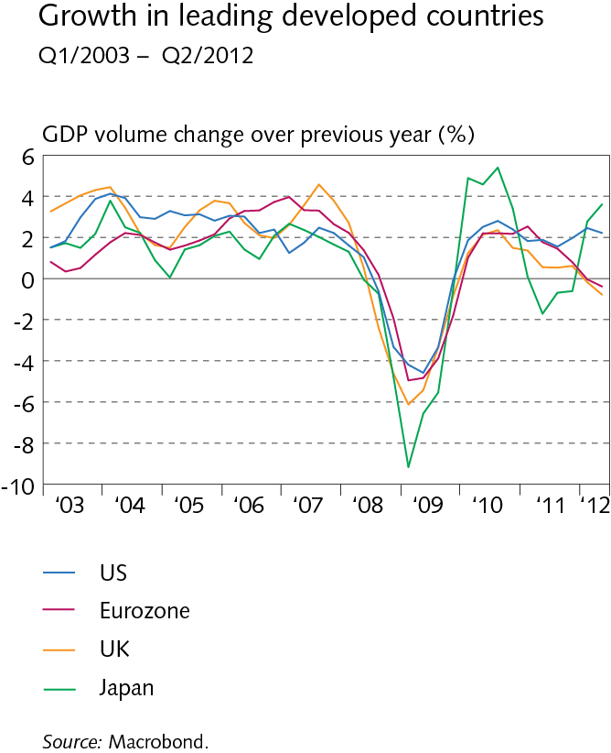
I Macroeconomic environment and financial markets

Slide 8
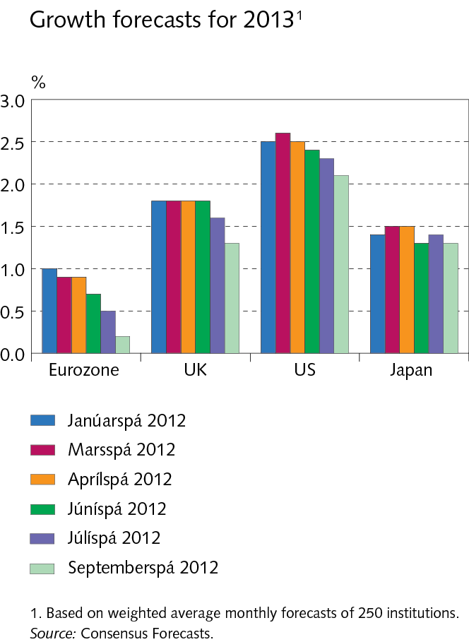
I Macroeconomic environment and financial markets

Slide 9
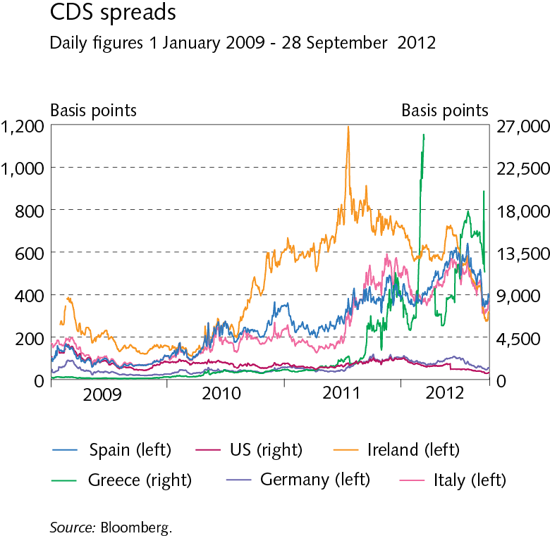
I Macroeconomic environment and financial markets

Slide 10
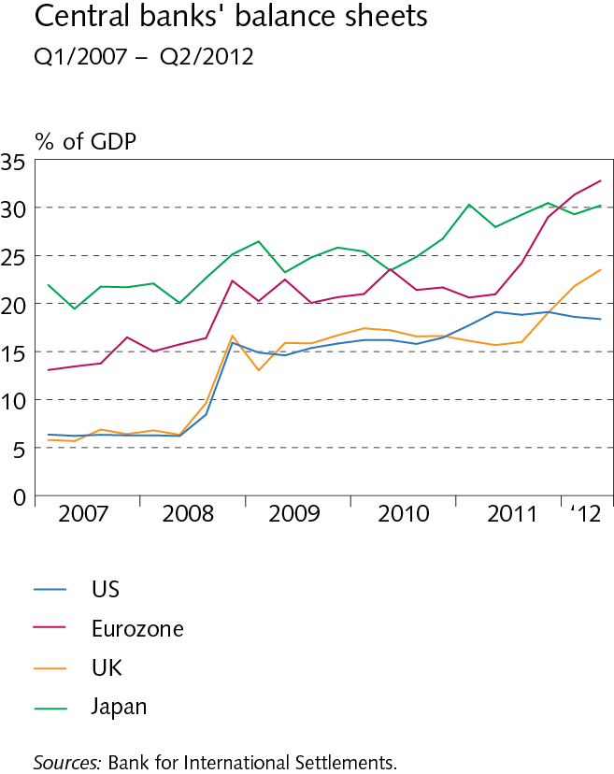
I Macroeconomic environment and financial markets

Slide 11
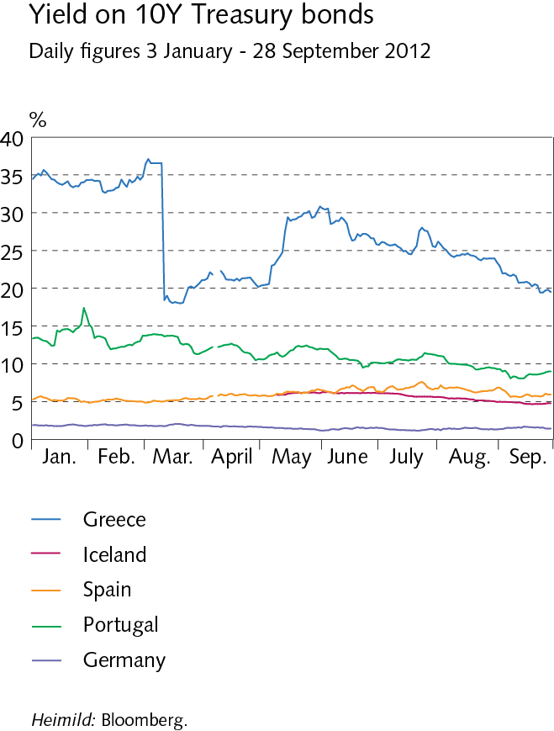
I Macroeconomic environment and financial markets

Slide 12
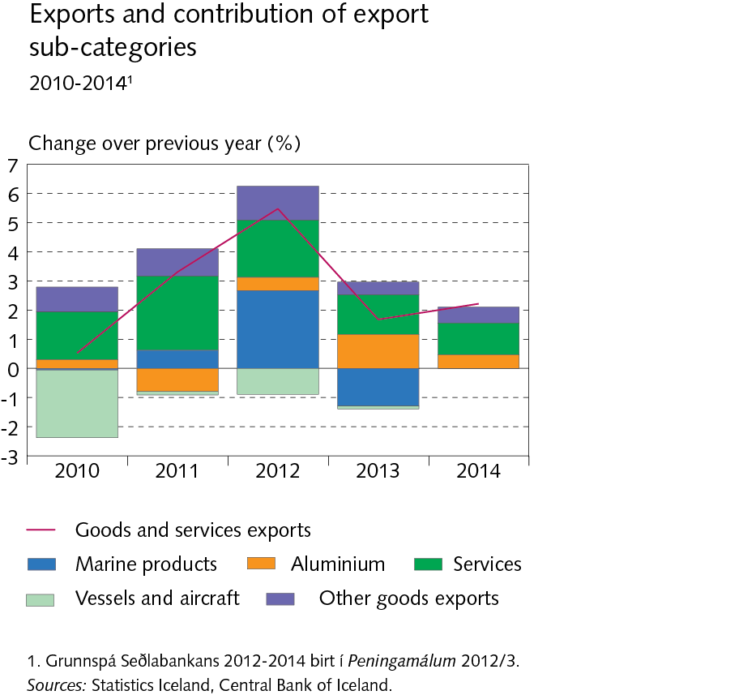
I Macroeconomic environment and financial markets

Slide 13
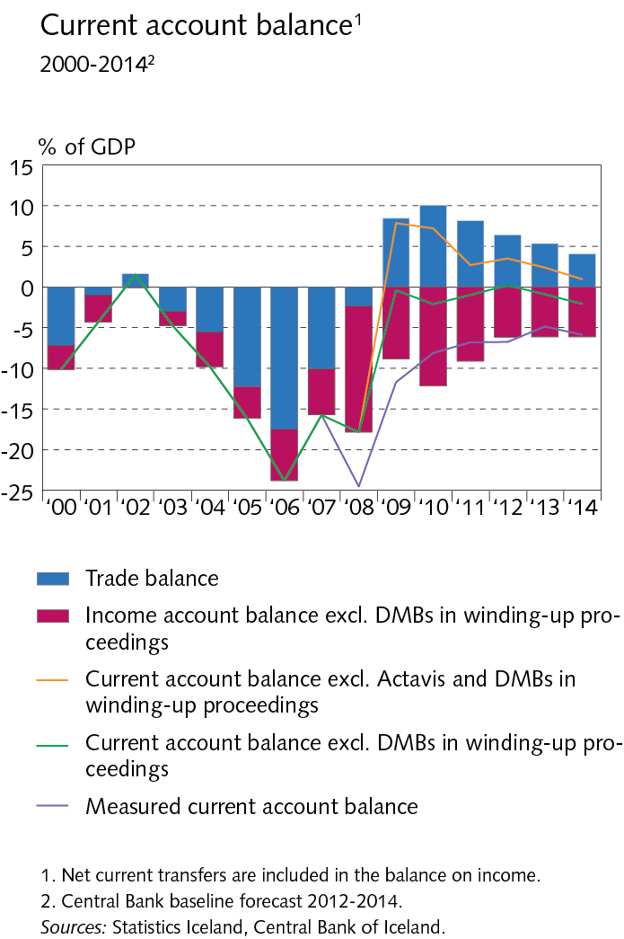
I Macroeconomic environment and financial markets

Slide 14
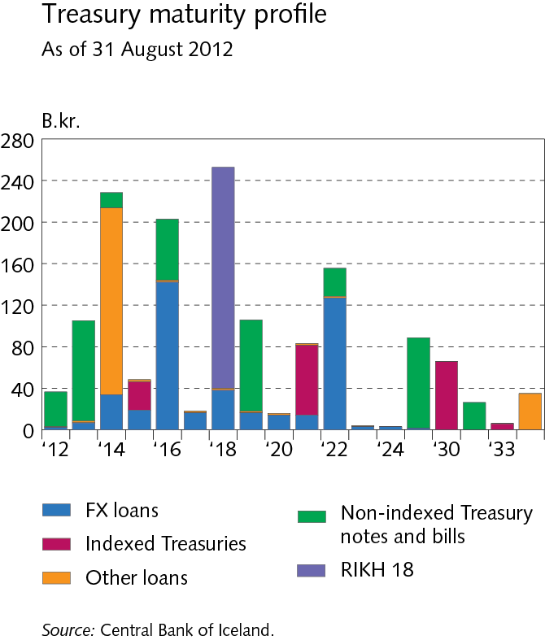
I Macroeconomic environment and financial markets

Slide 15
I Macroeconomic environment and financial markets

Slide 16
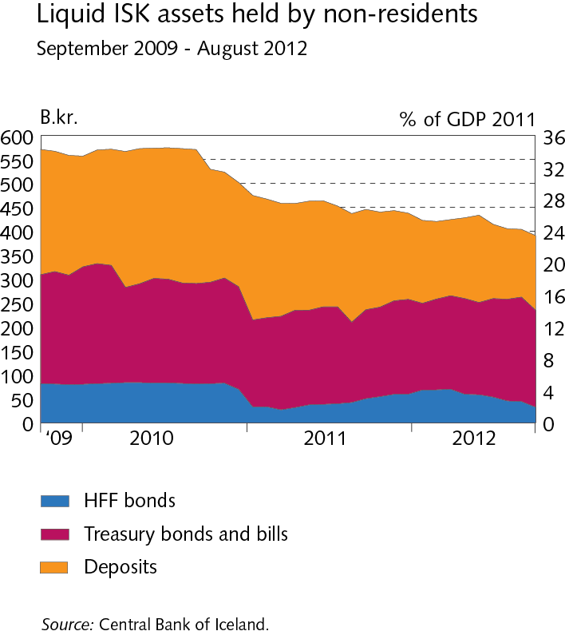
I Macroeconomic environment and financial markets

Slide 17
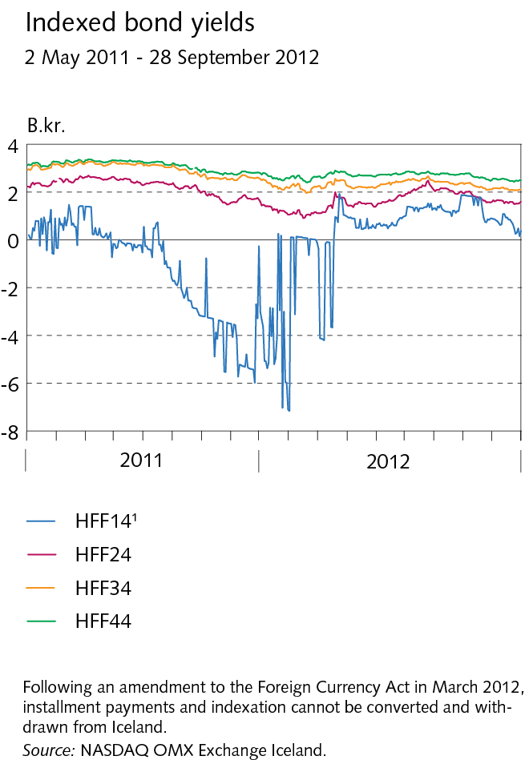
I Macroeconomic environment and financial markets

Slide 18
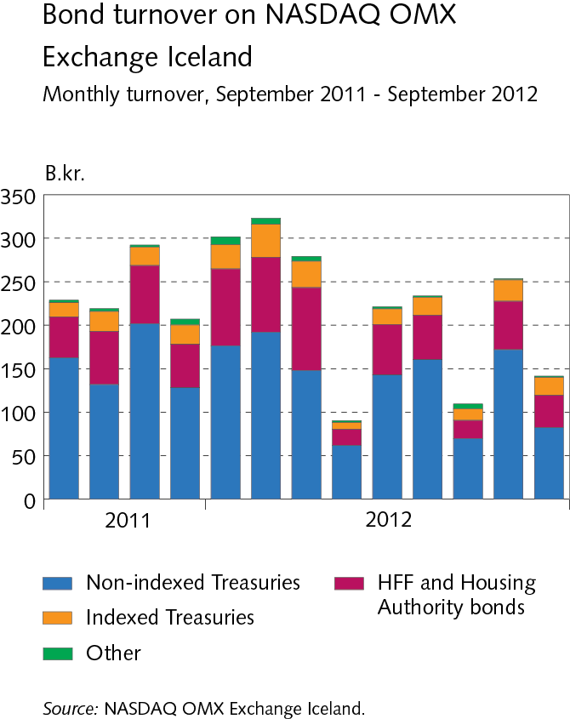
I Macroeconomic environment and financial markets

Slide 19
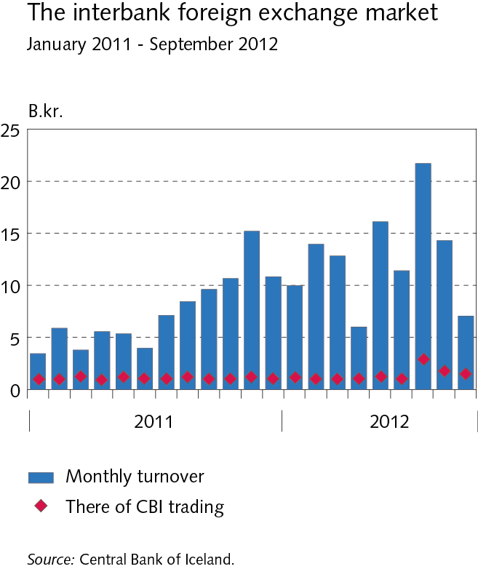
I Macroeconomic environment and financial markets

Slide 20
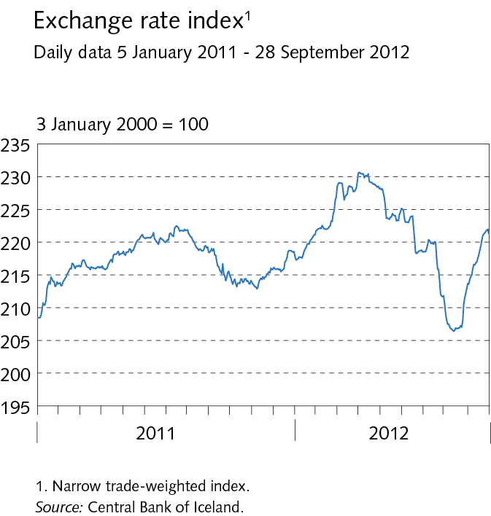
I Macroeconomic environment and financial markets

Slide 21
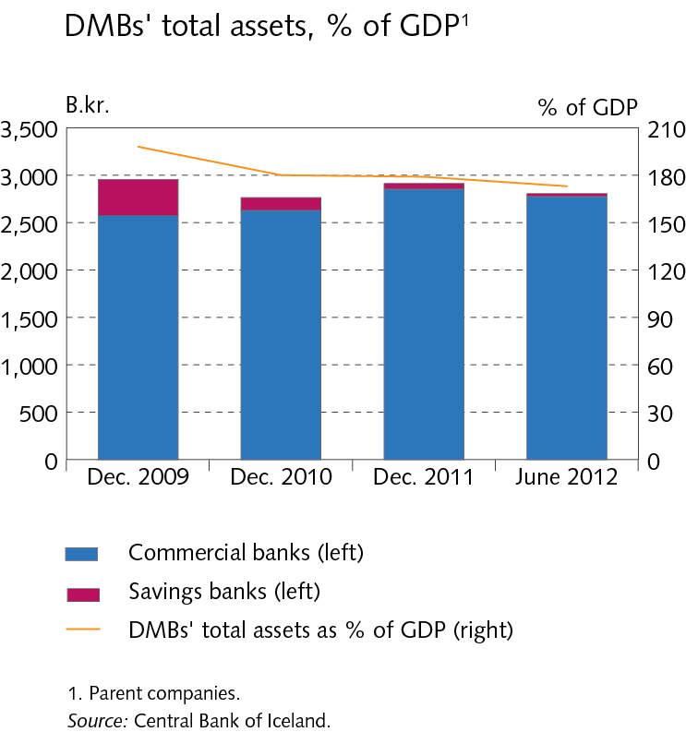
II The scope of financial institutions‘ operations

Slide 22
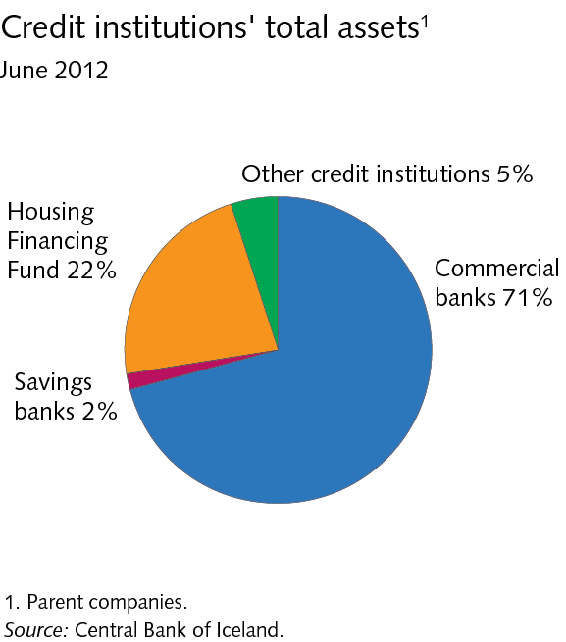
II The scope of financial institutions‘ operations

Slide 23
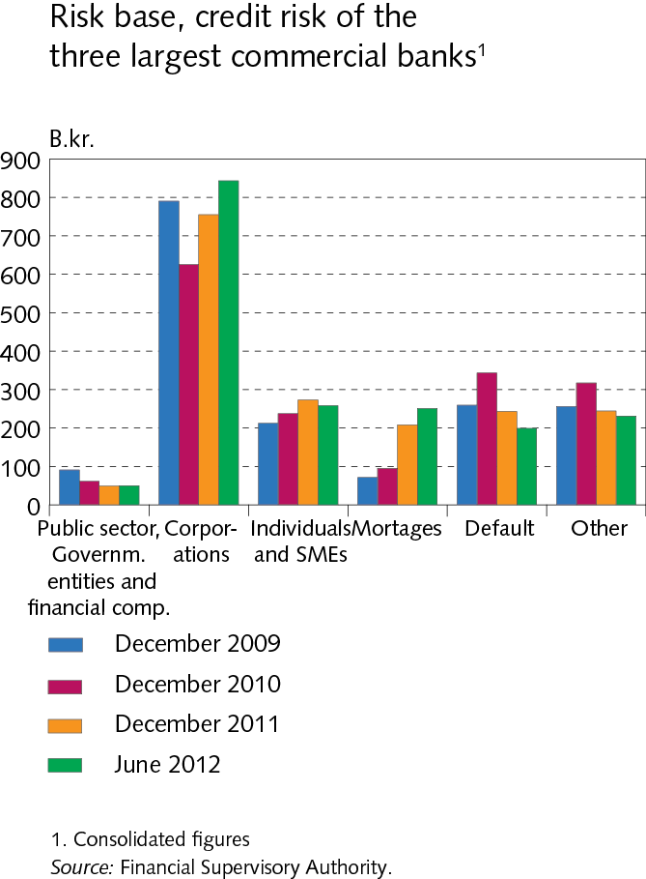
II The scope of financial institutions‘ operations

Slide 24
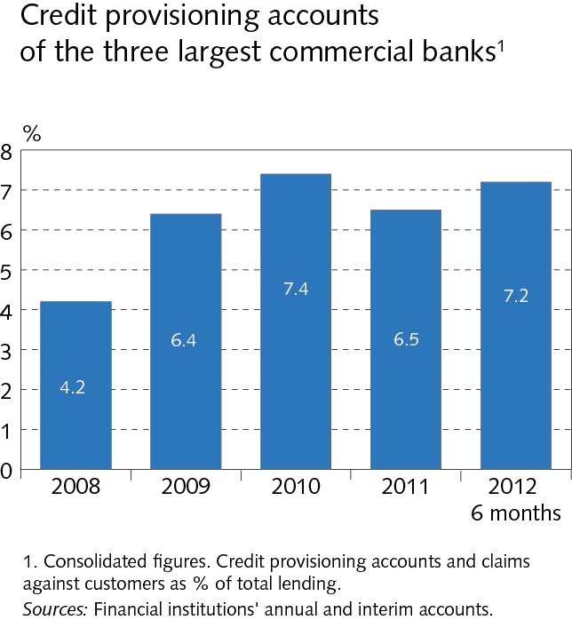
II The scope of financial institutions‘ operations

Slide 25
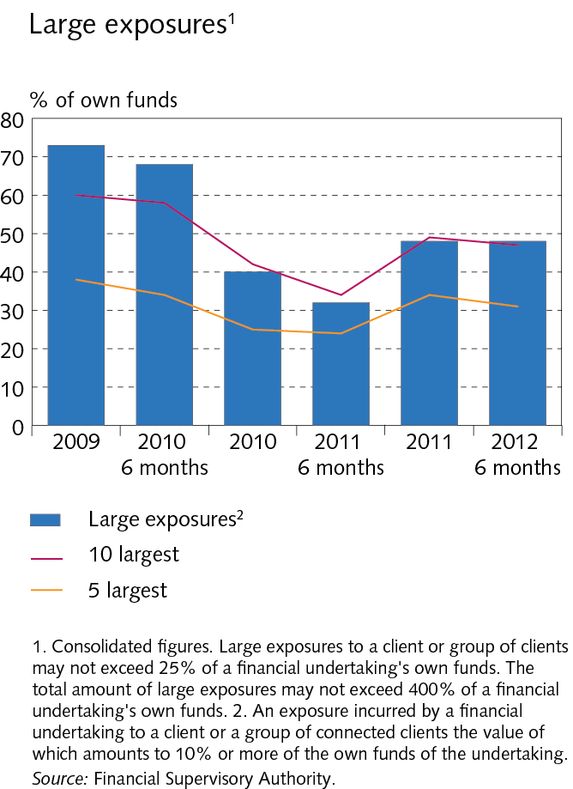
II The scope of financial institutions‘ operations

Slide 26
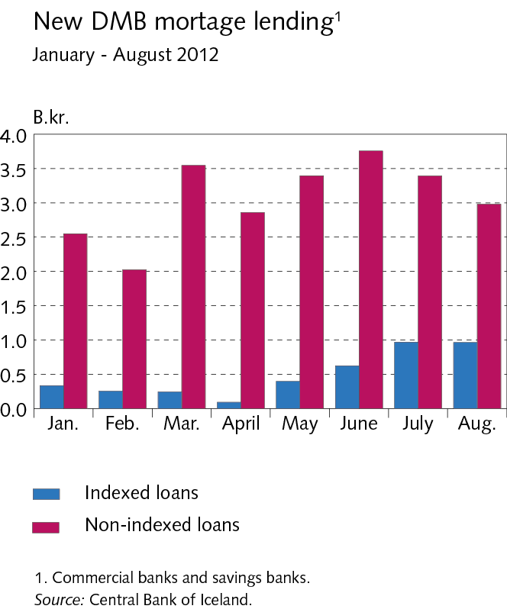
II The scope of financial institutions‘ operations

Slide 27
II The scope of financial institutions‘ operations

Slide 28
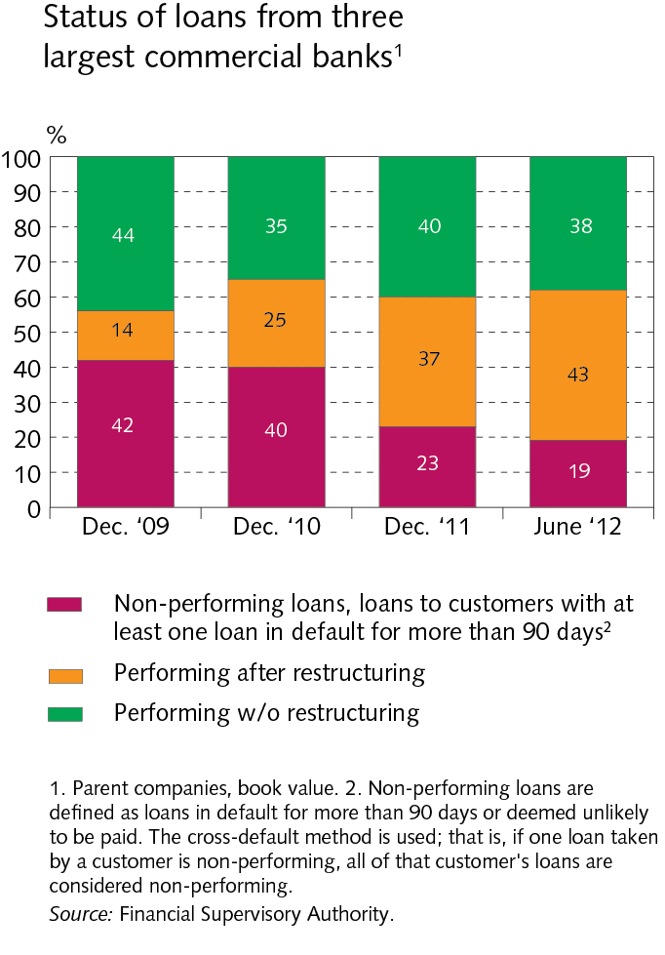
II The scope of financial institutions‘ operations

Slide 29
II The scope of financial institutions‘ operations

Slide 30
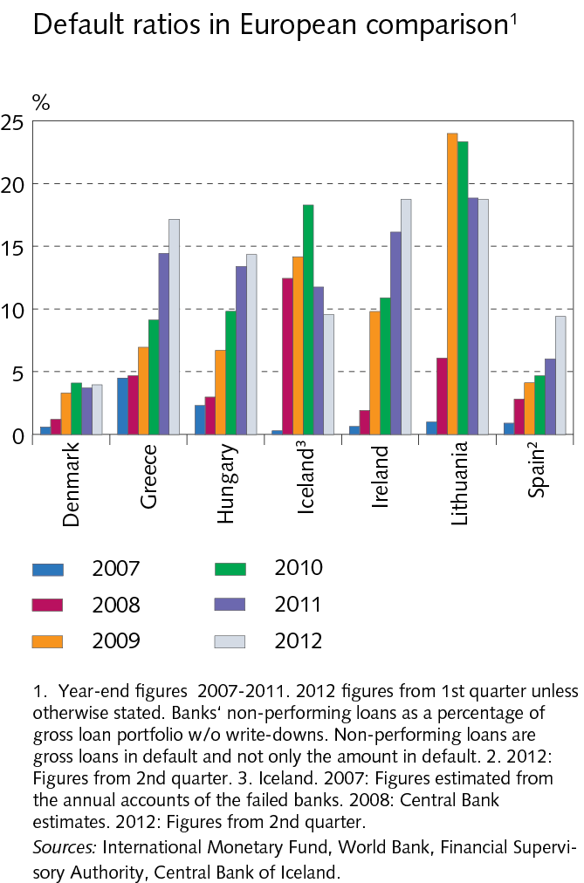
II The scope of financial institutions‘ operations

Slide 31
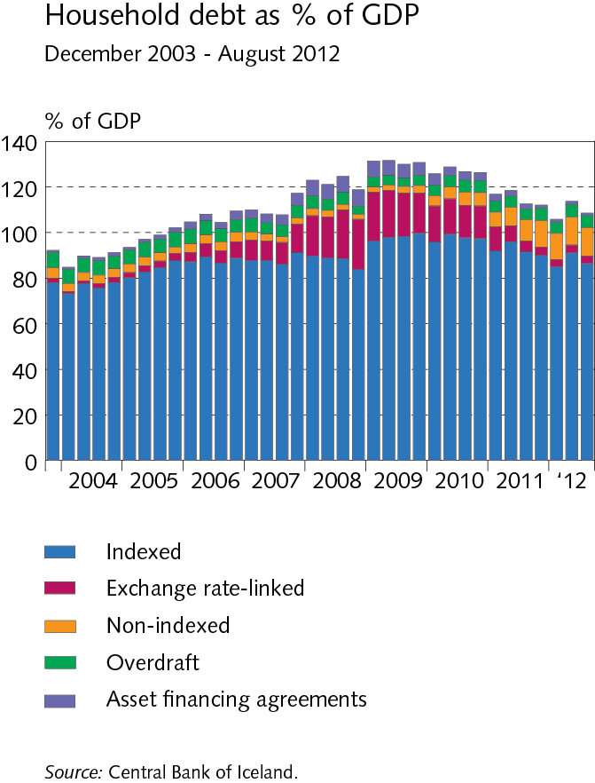
III Borrowers and credit risk

Slide 32
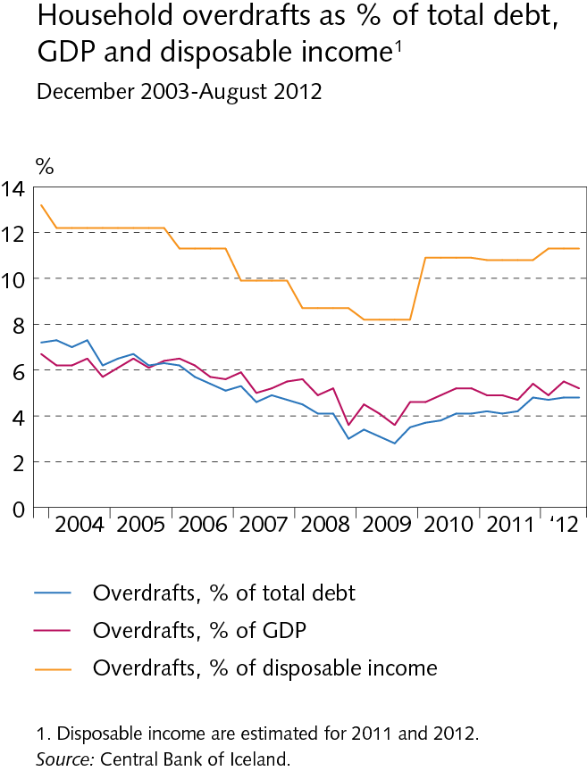
III Borrowers and credit risk

Slide 33
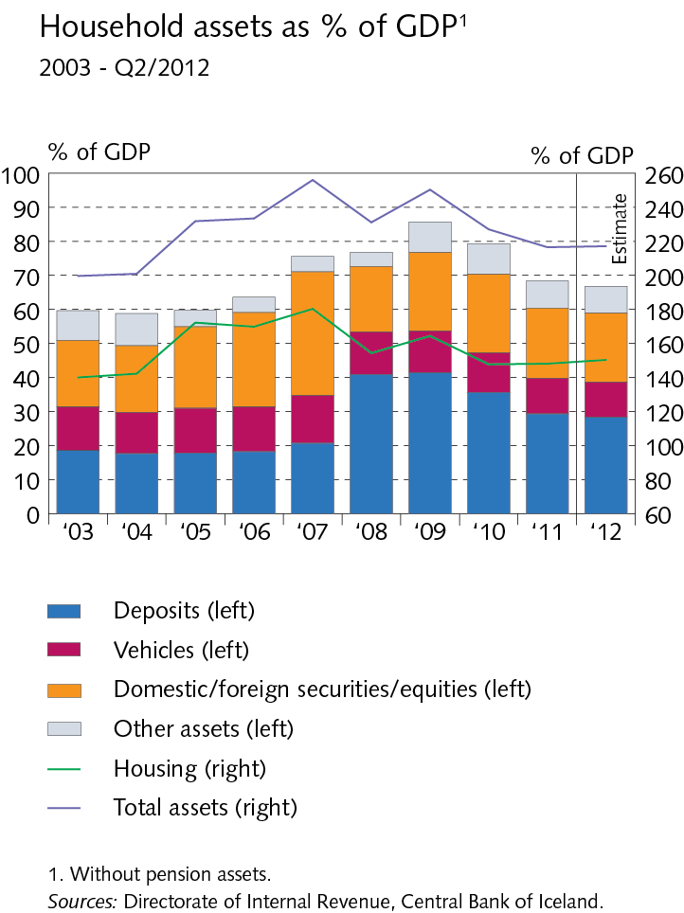
III Borrowers and credit risk

Slide 34
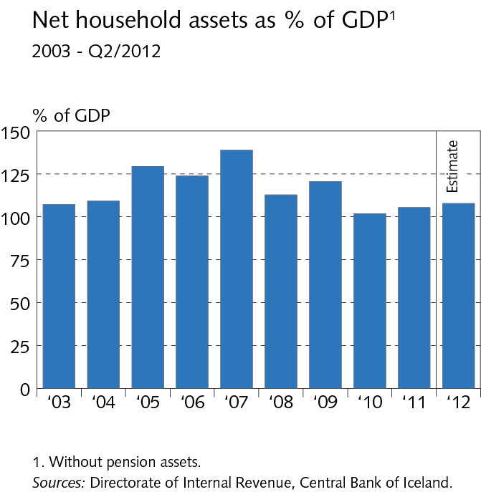
III Borrowers and credit risk

Slide 35
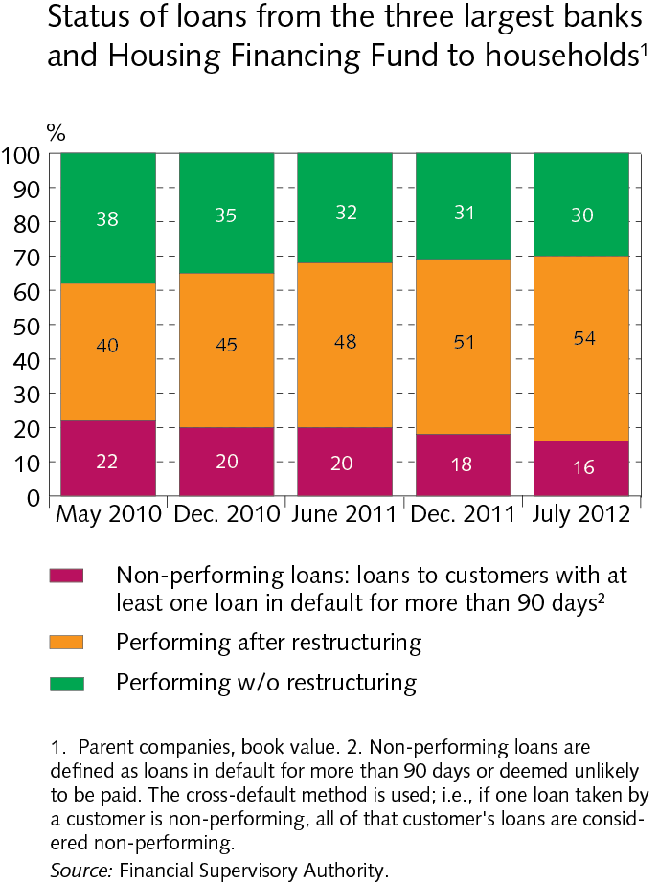
III Borrowers and credit risk

Slide 36
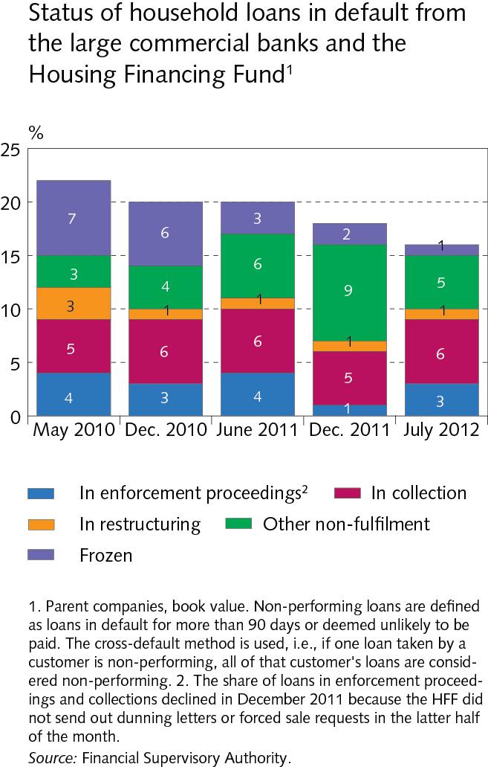
III Borrowers and credit risk

Slide 37
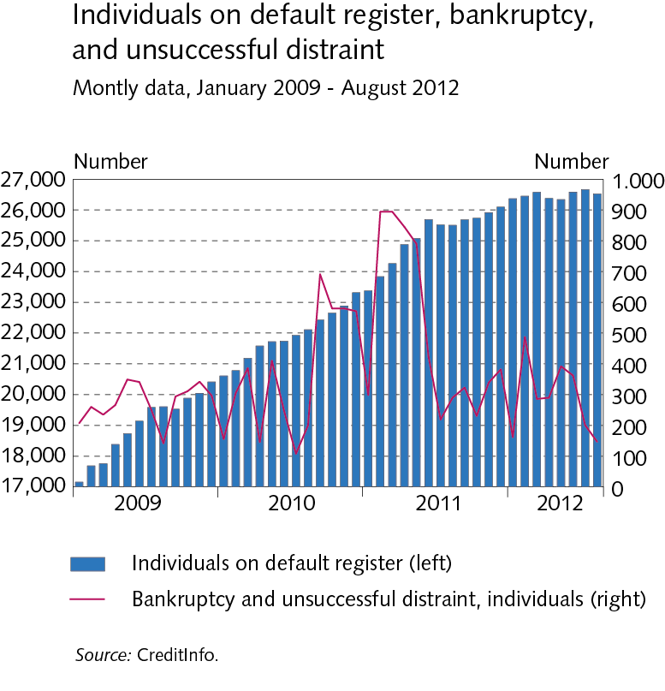
III Borrowers and credit risk

Slide 38
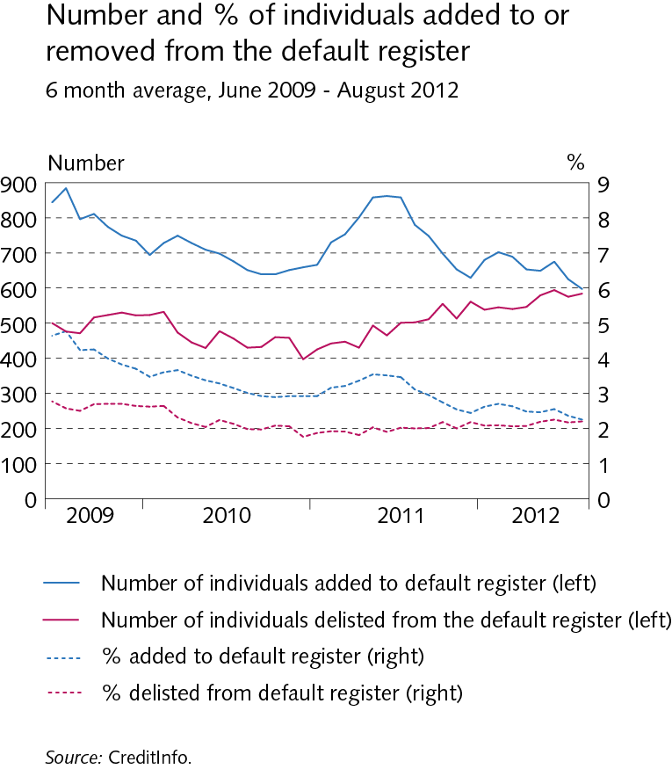
III Borrowers and credit risk

Slide 39
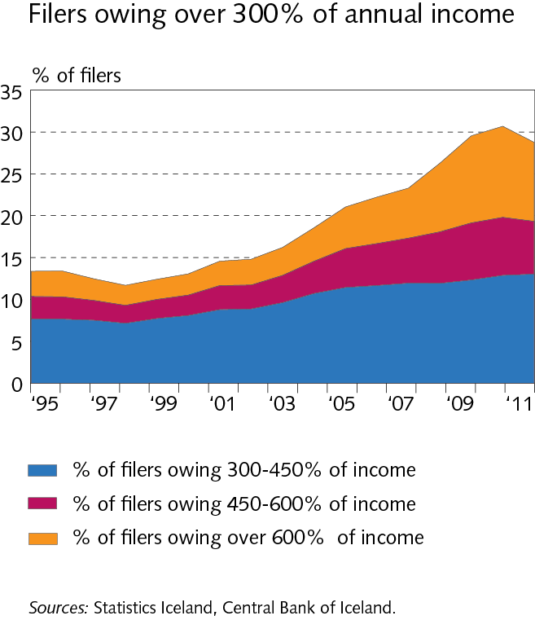
III Borrowers and credit risk

Slide 40
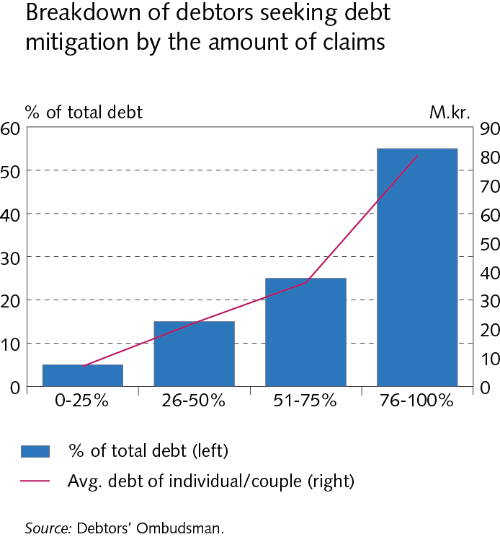
III Borrowers and credit risk

Slide 41
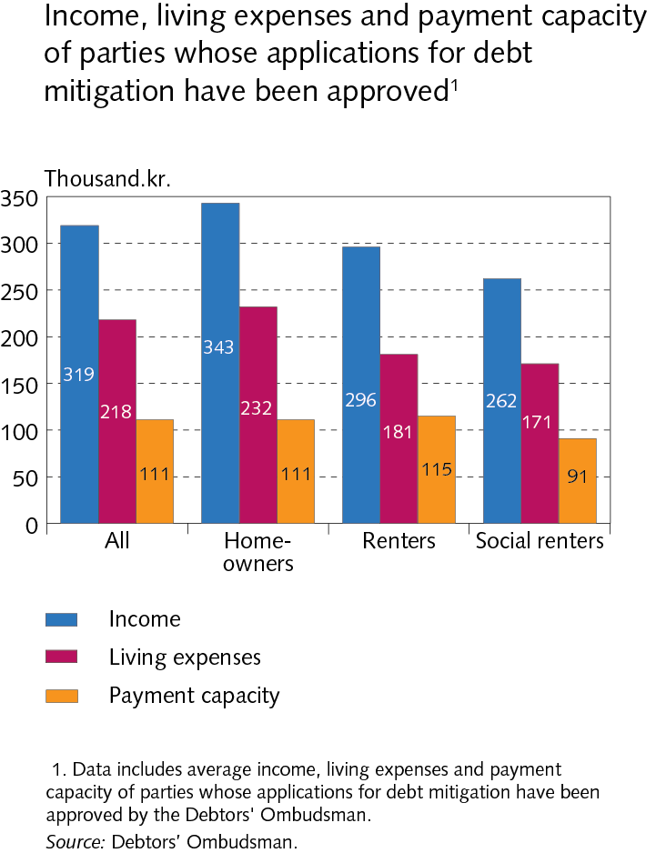
III Borrowers and credit risk

Slide 42
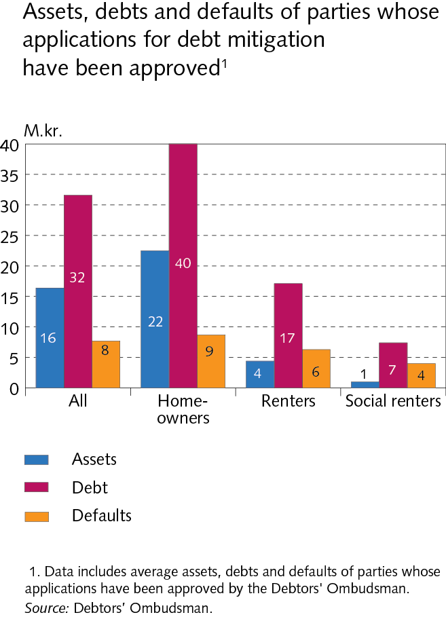
III Borrowers and credit risk

Slide 43
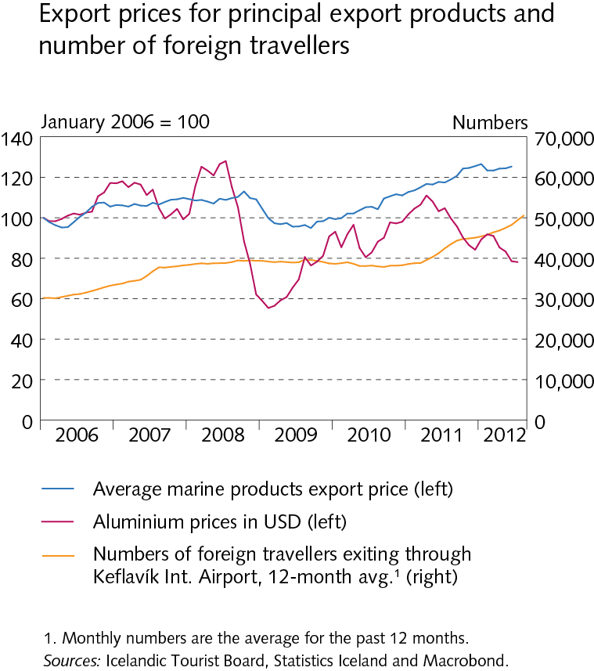
III Borrowers and credit risk

Slide 44
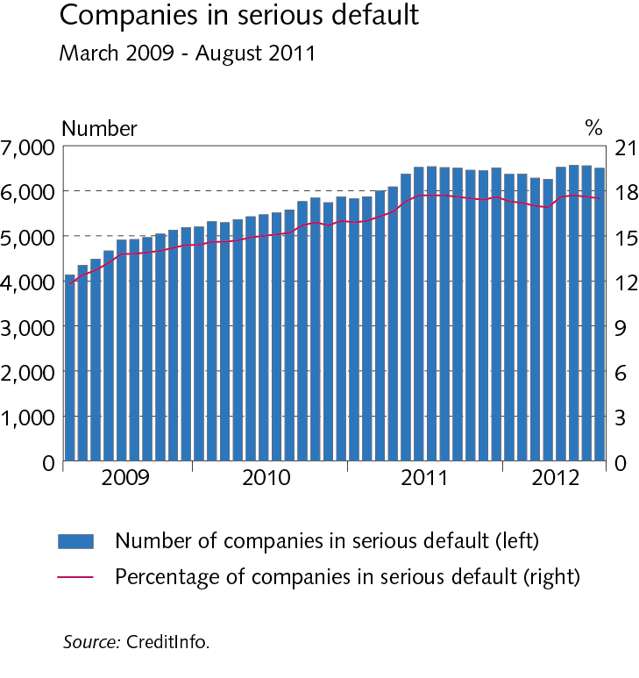
III Borrowers and credit risk

Slide 45
III Borrowers and credit risk

Slide 46
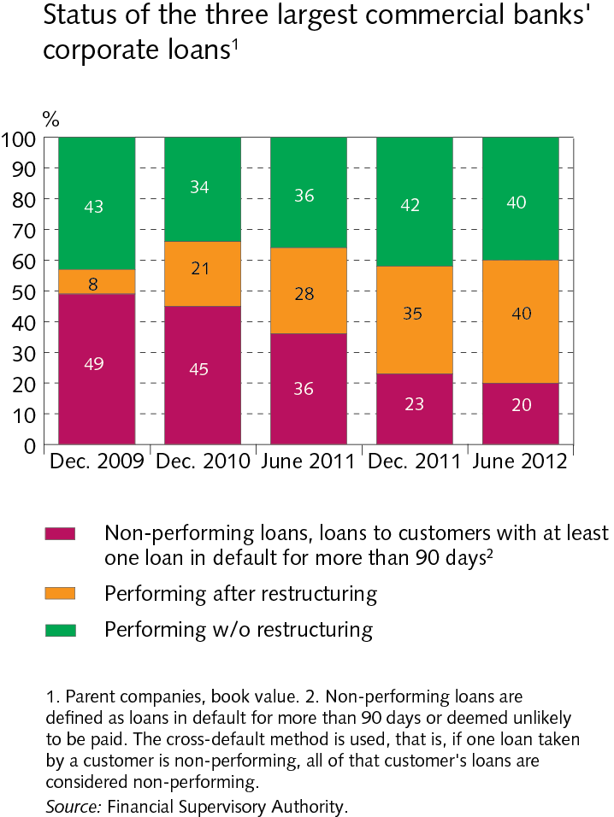
III Borrowers and credit risk

Slide 47
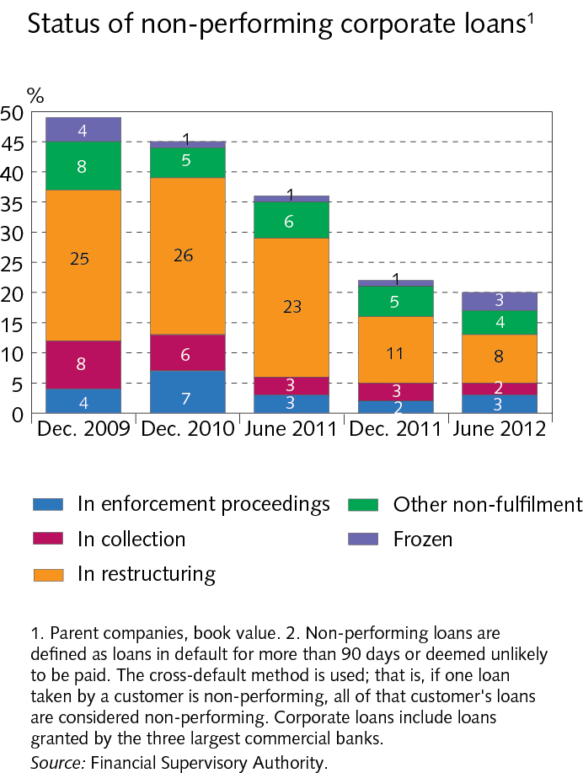
III Borrowers and credit risk

Slide 48
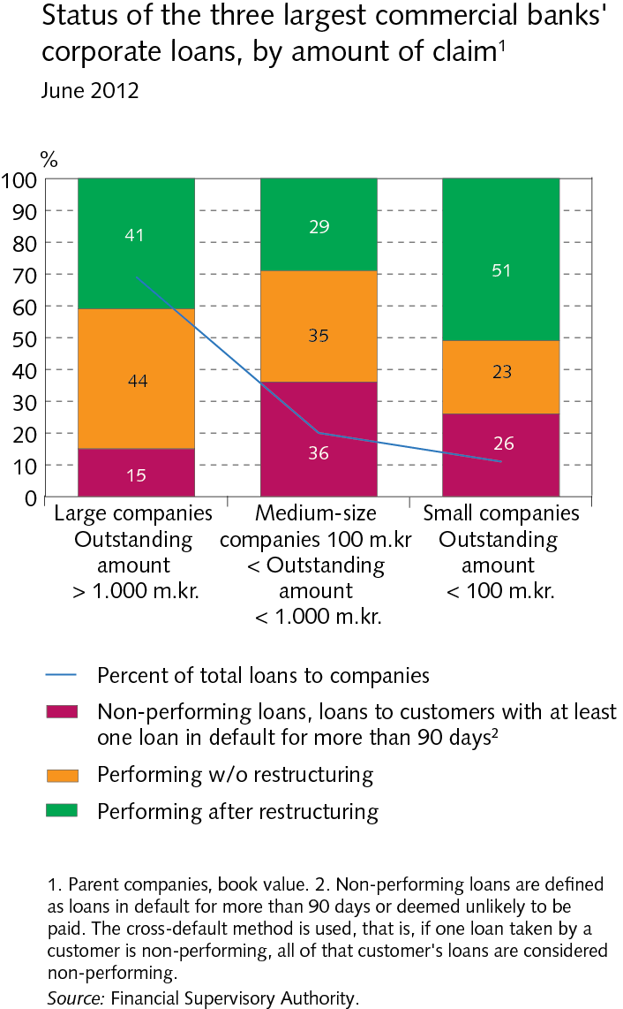
III Borrowers and credit risk

Slide 49
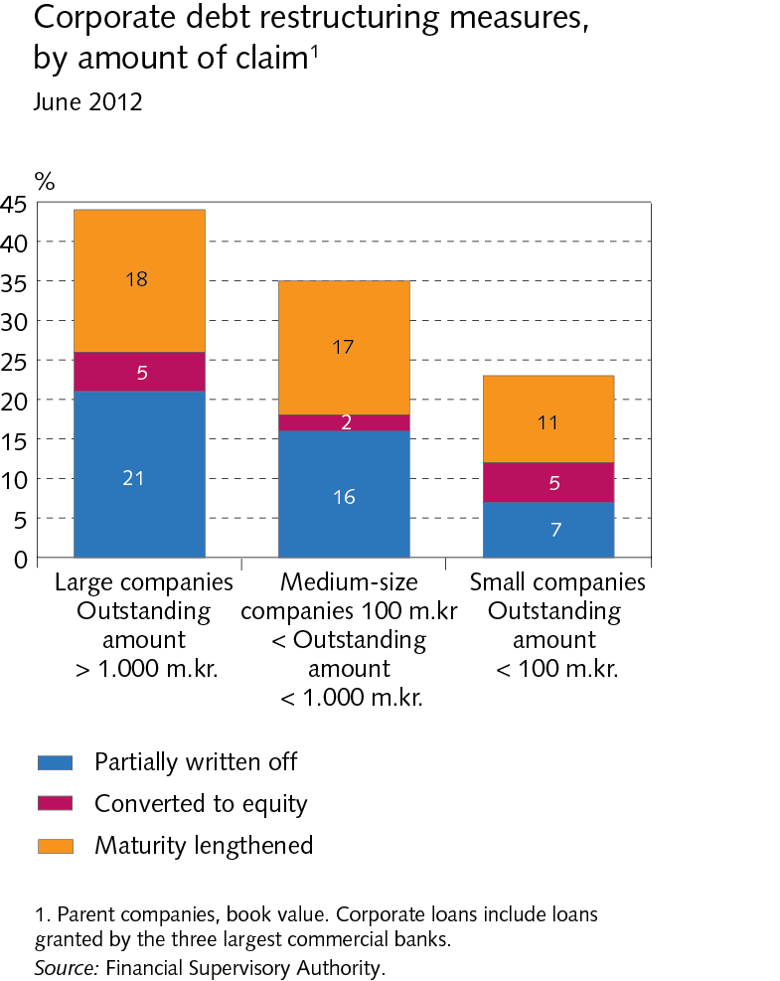
III Borrowers and credit risk

Slide 50
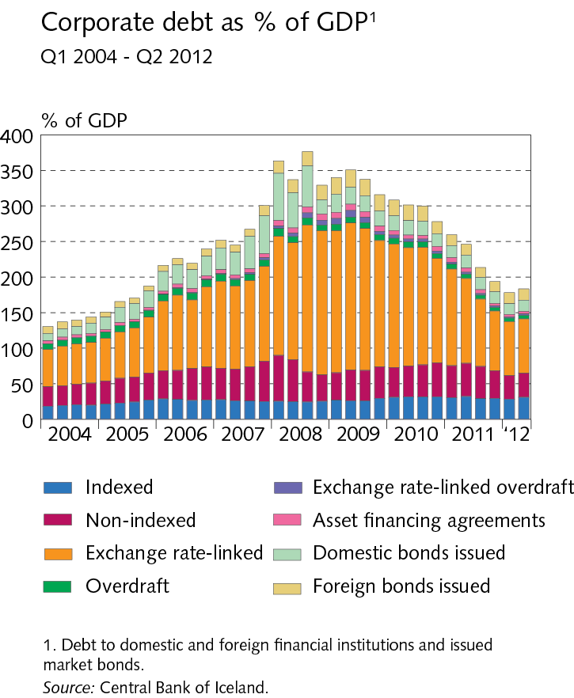
III Borrowers and credit risk

Slide 51
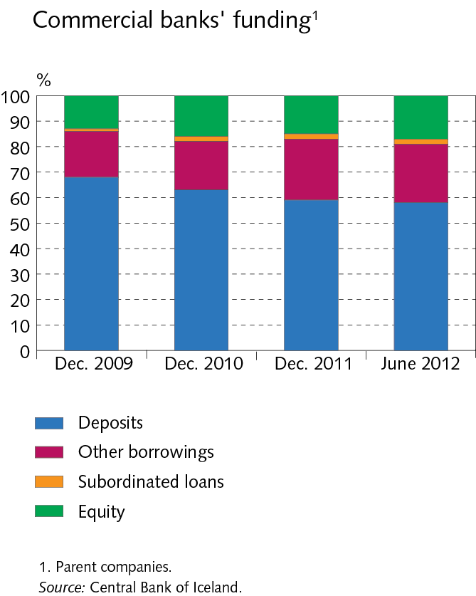
IV Funding

Slide 52
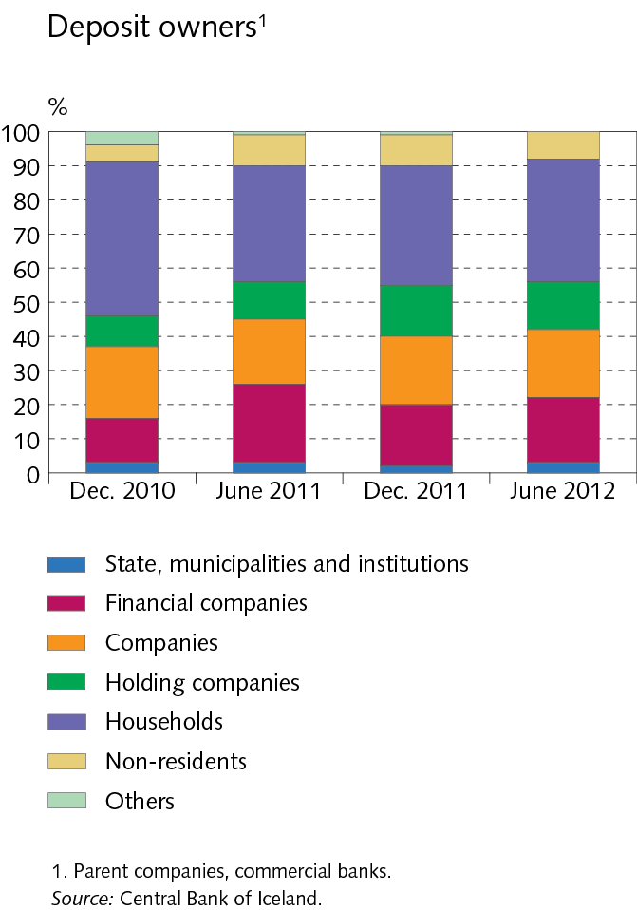
IV Funding

Slide 53
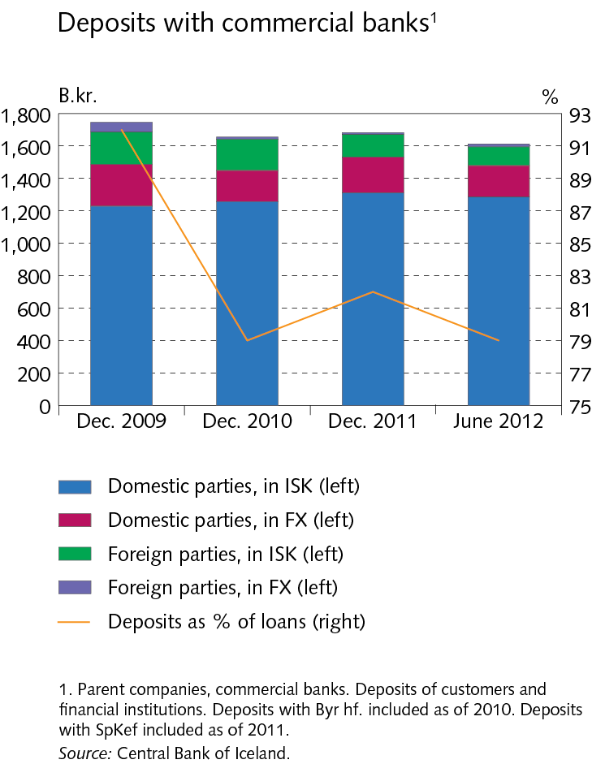
IV Funding

Slide 54
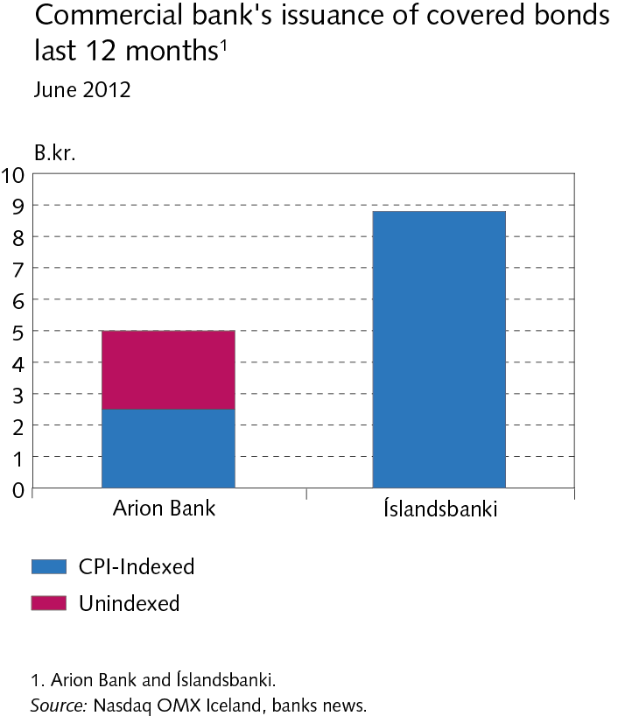
IV Funding

Slide 55
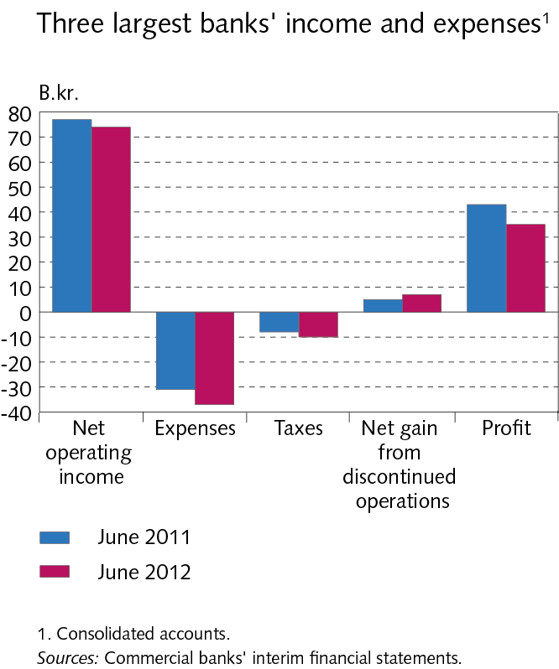
V Operations and equity

Slide 56
V Operations and equity

Slide 57
V Operations and equity

Slide 58
V Operations and equity

Slide 59
V Operations and equity

Slide 60
V Operations and equity

Slide 61
V Operations and equity

Slide 62
V Operations and equity

Slide 63
Appendix I Nordic comparison

Slide 64
Appendix I Nordic comparison

Slide 65
Appendix I Nordic comparison

Slide 66
Appendix I Nordic comparison

Slide 67
Appendix I Nordic comparison

Slide 68
Appendix I Nordic comparison

