Slide 1
Central Bank of Iceland
Financial stability 2011/2
Charts

Slide 2
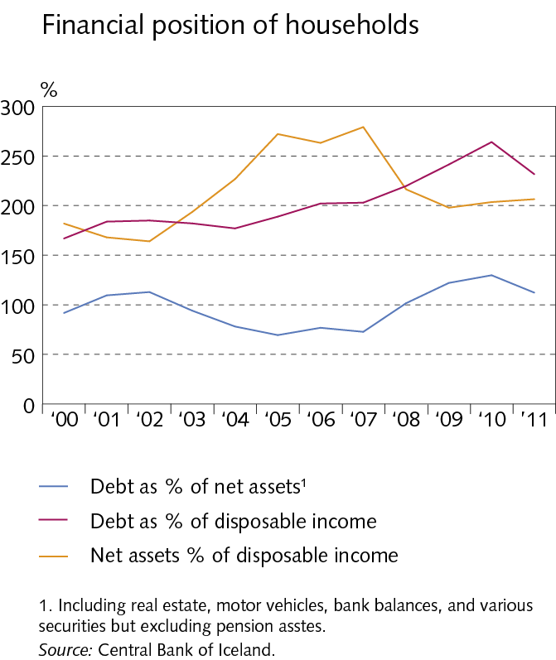
Outlook and major risks

Slide 3
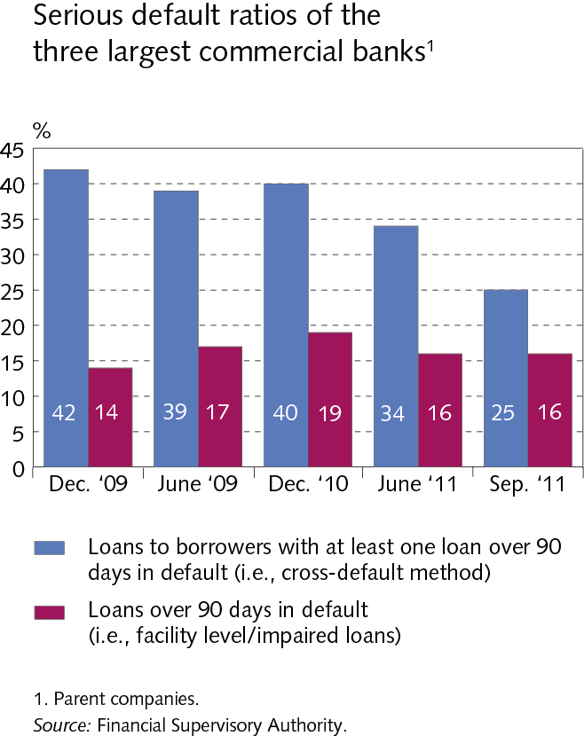
Outlook and major risks

Slide 4
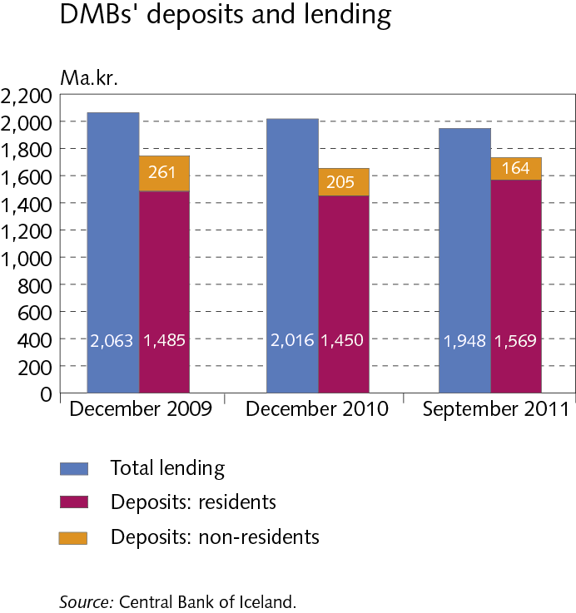
Outlook and major risks

Slide 5
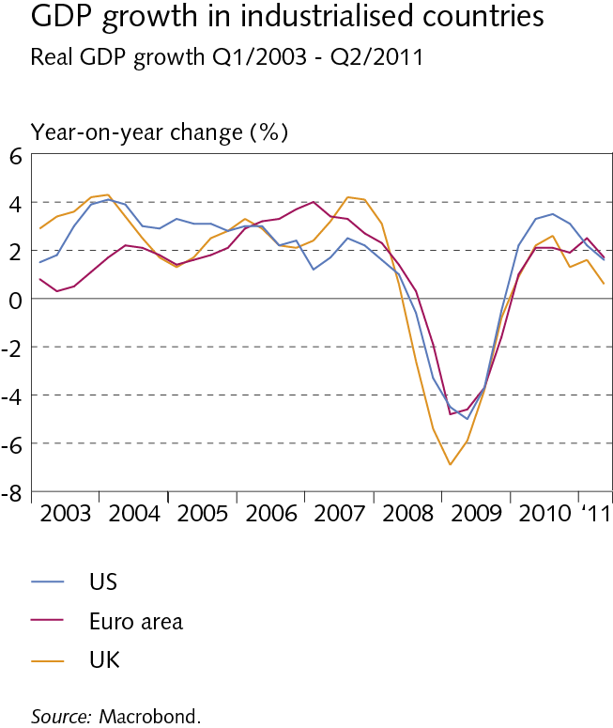
I Macroeconomic environment and markets

Slide 6
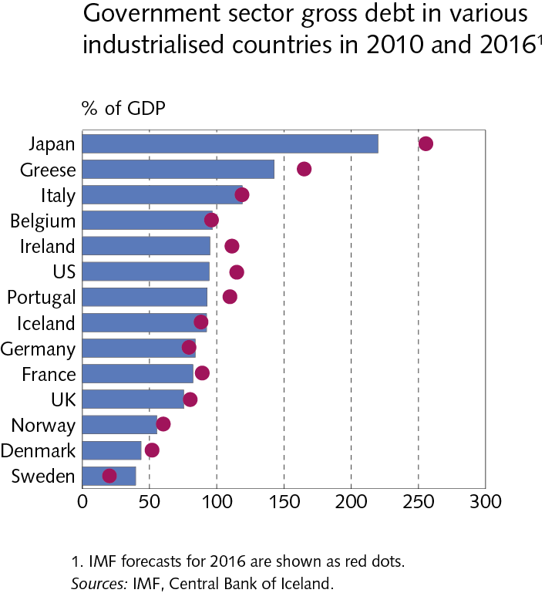
I Macroeconomic environment and markets

Slide 7
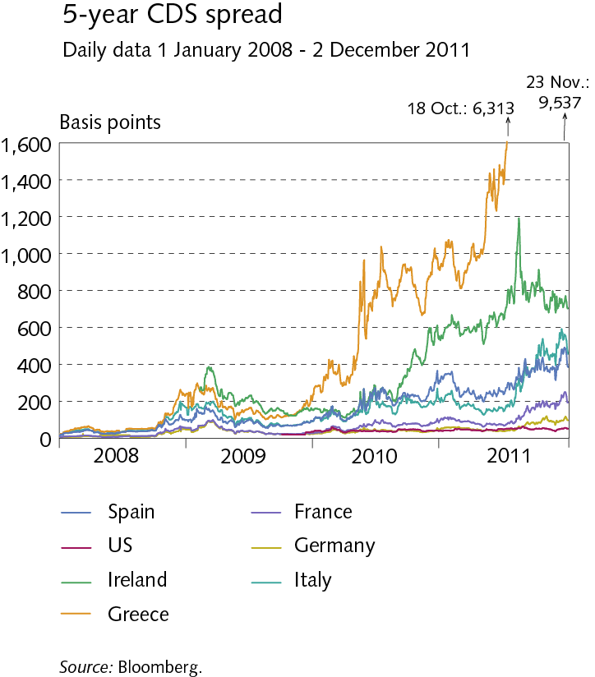
I Macroeconomic environment and markets

Slide 8
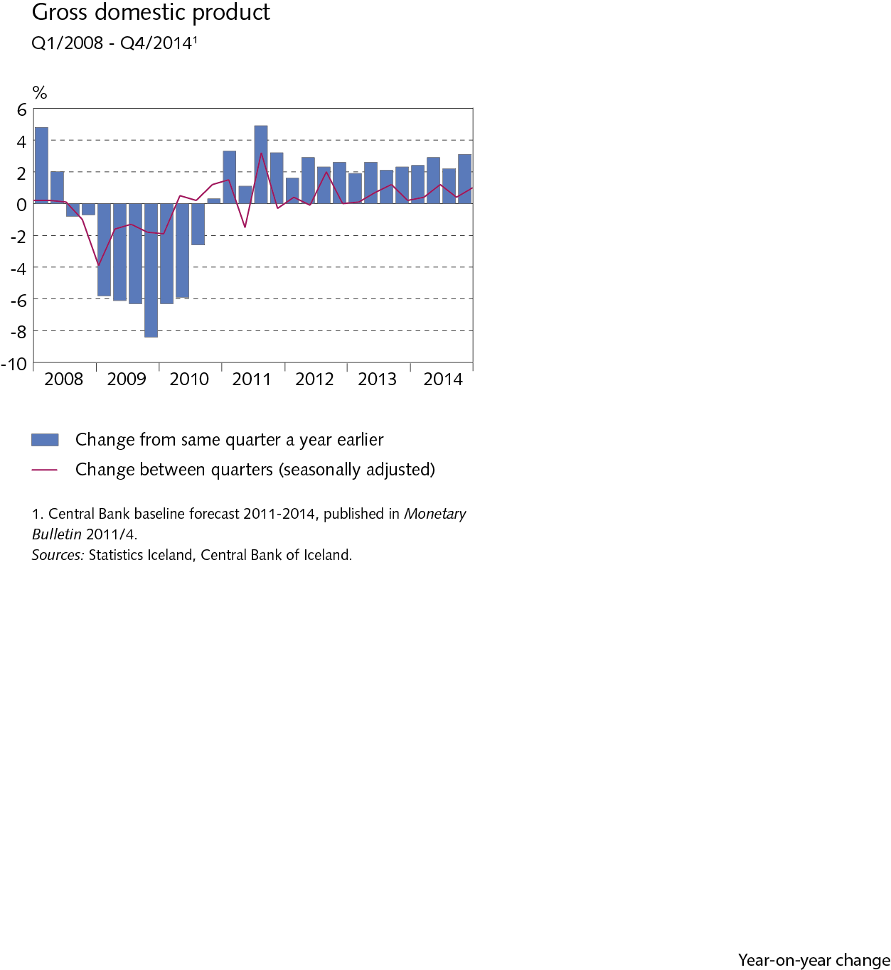
I Macroeconomic environment and markets

Slide 9
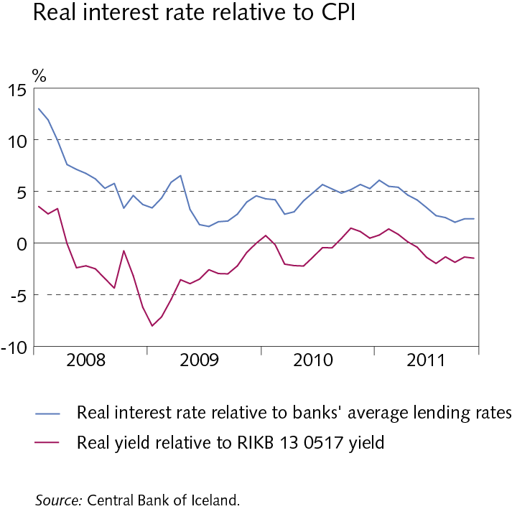
I Macroeconomic environment and markets

Slide 10
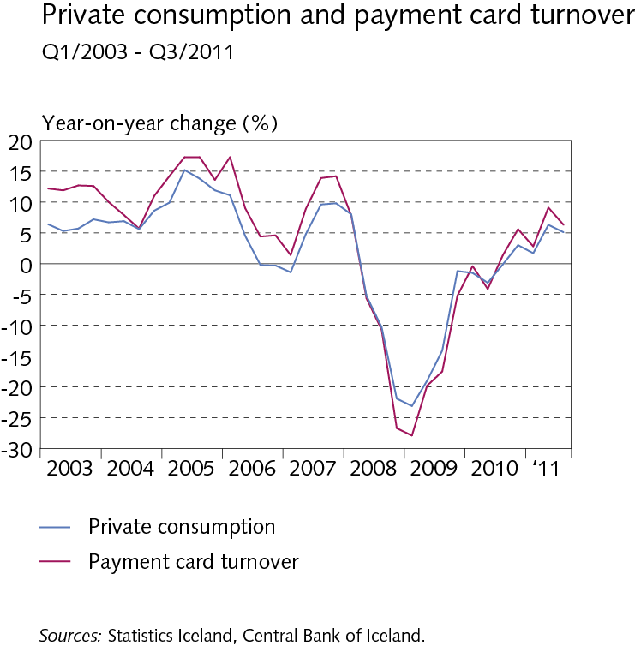
I Macroeconomic environment and markets

Slide 11
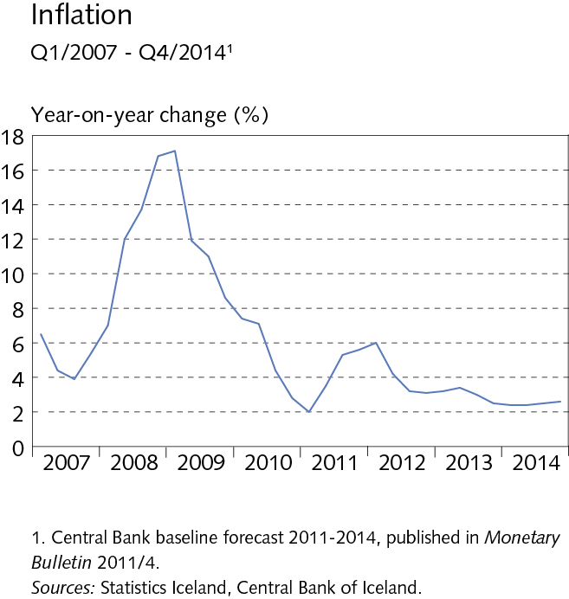
I Macroeconomic environment and markets

Slide 12
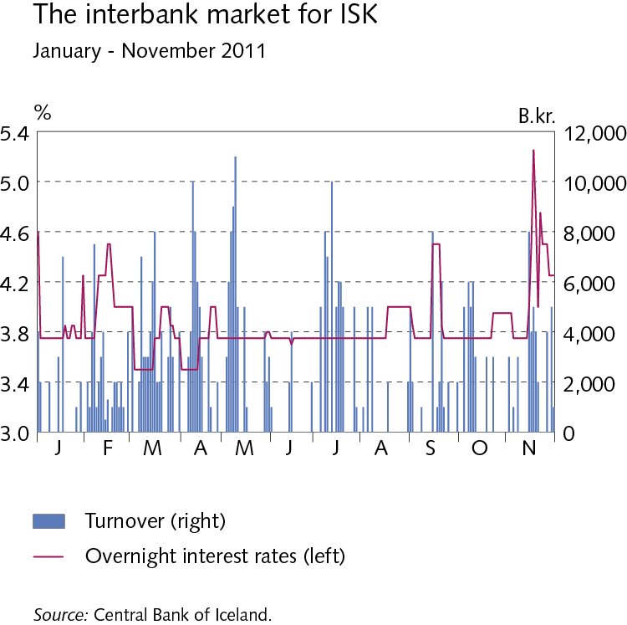
I Macroeconomic environment and markets

Slide 13
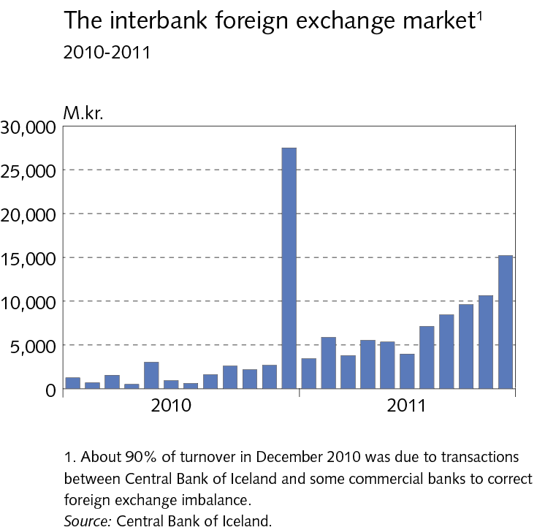
I Macroeconomic environment and markets

Slide 14
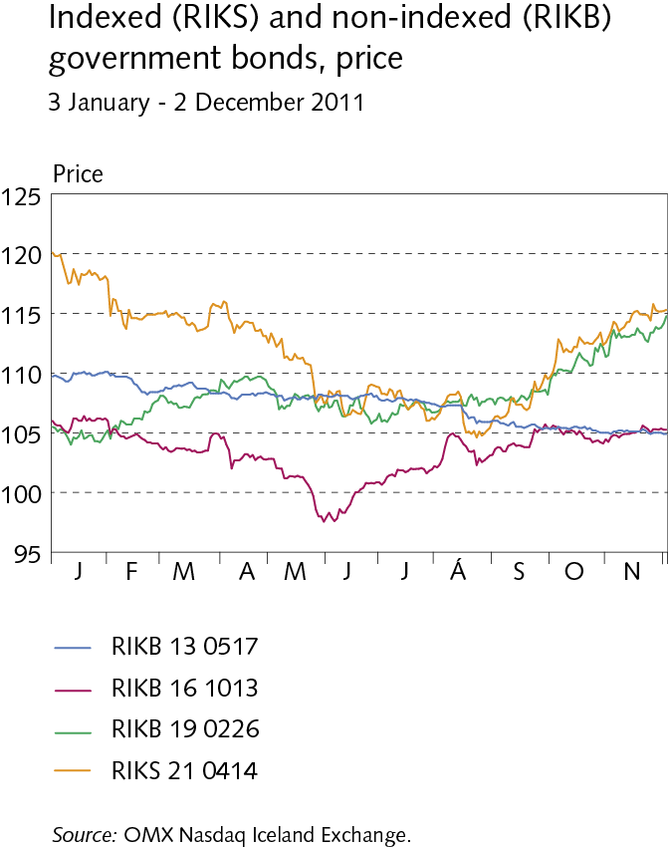
I Macroeconomic environment and markets

Slide 15
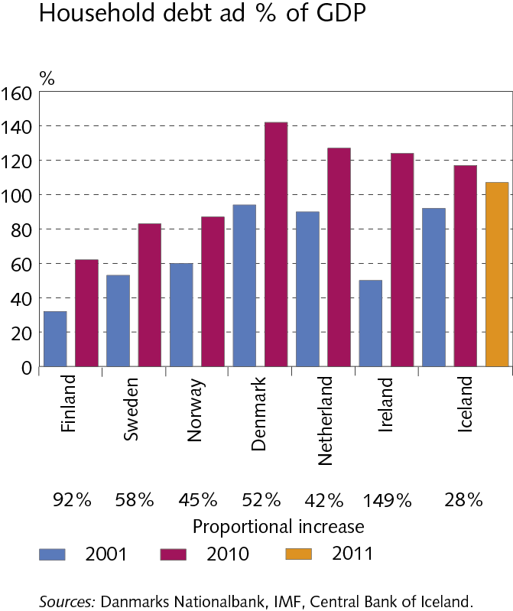
I Macroeconomic environment and markets

Slide 16
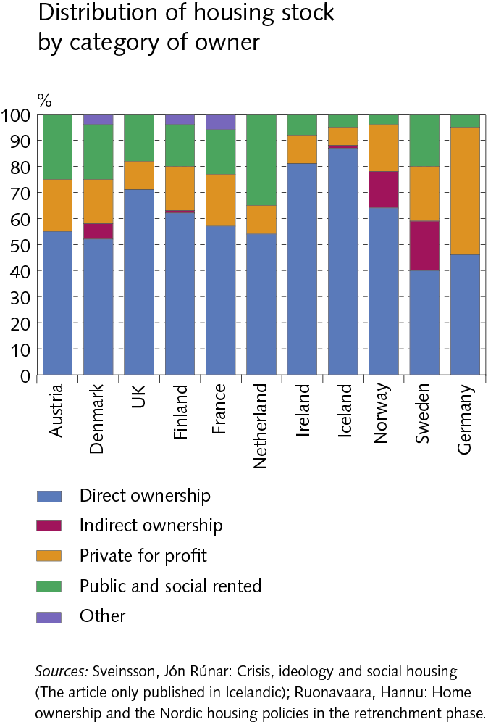
I Macroeconomic environment and markets

Slide 17
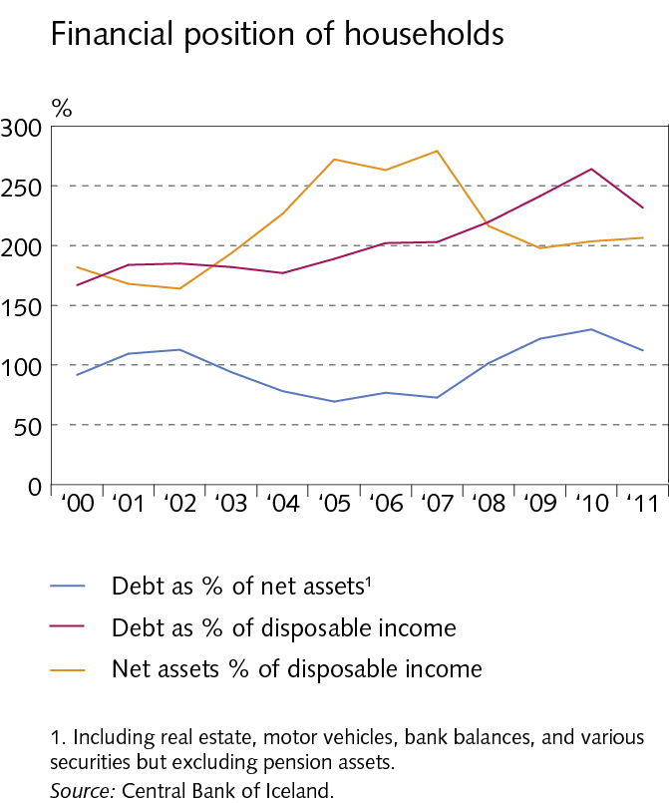
I Macroeconomic environment and markets

Slide 18
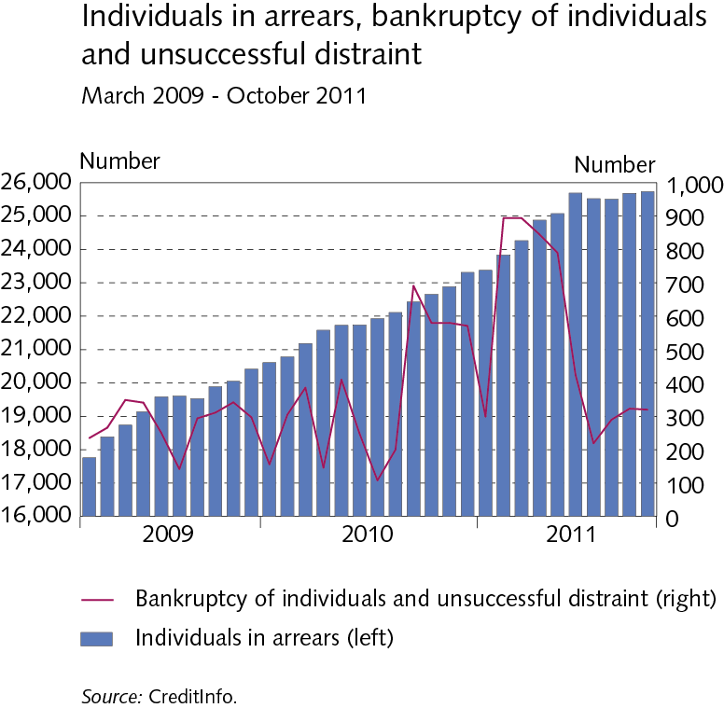
I Macroeconomic environment and markets

Slide 19
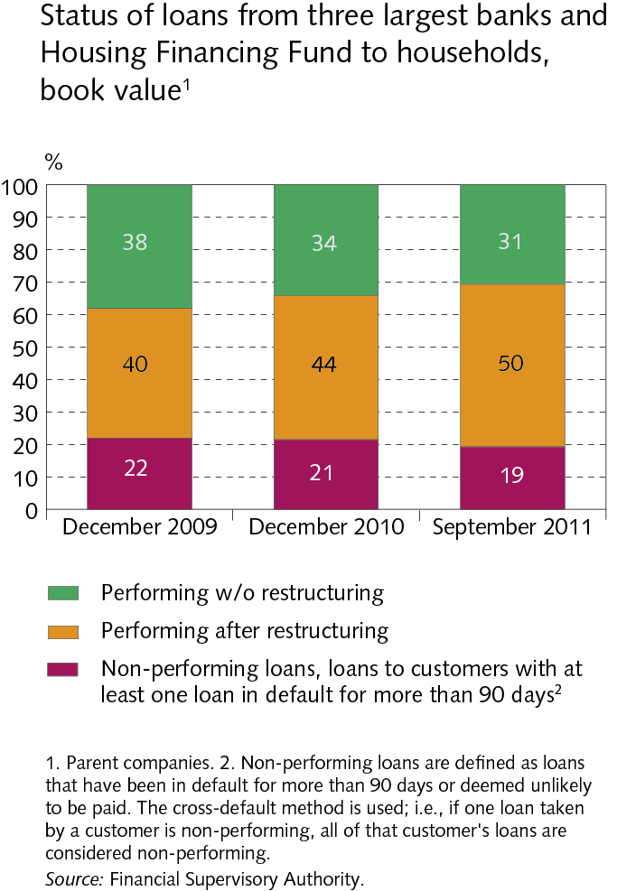
I Macroeconomic environment and markets

Slide 20
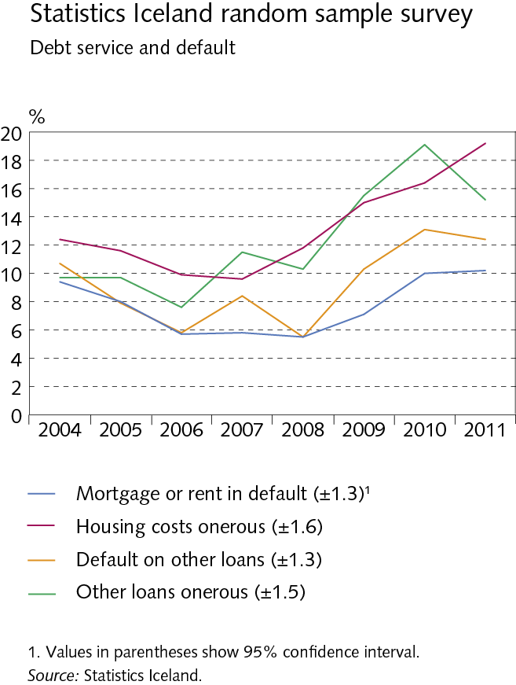
I Macroeconomic environment and markets

Slide 21
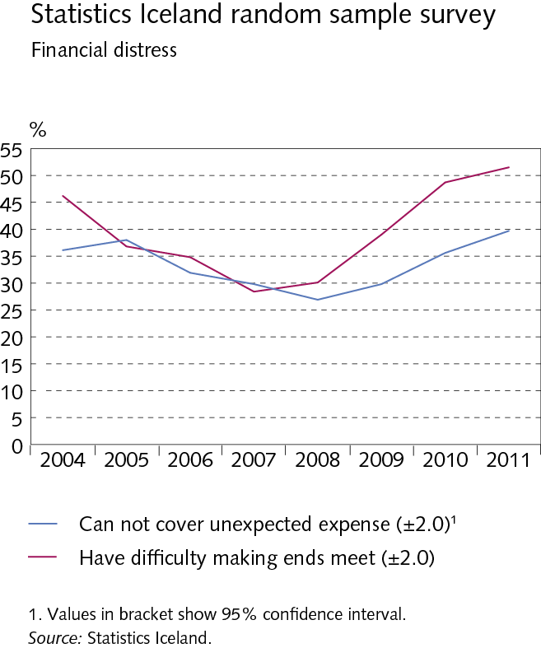
I Macroeconomic environment and markets

Slide 22
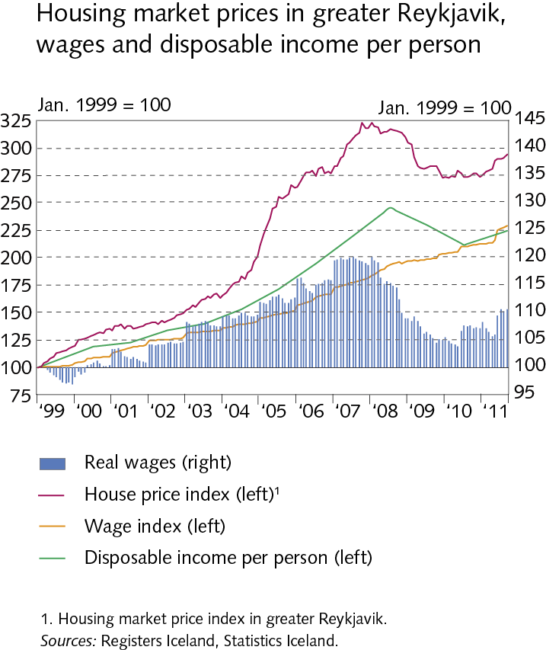
I Macroeconomic environment and markets

Slide 23
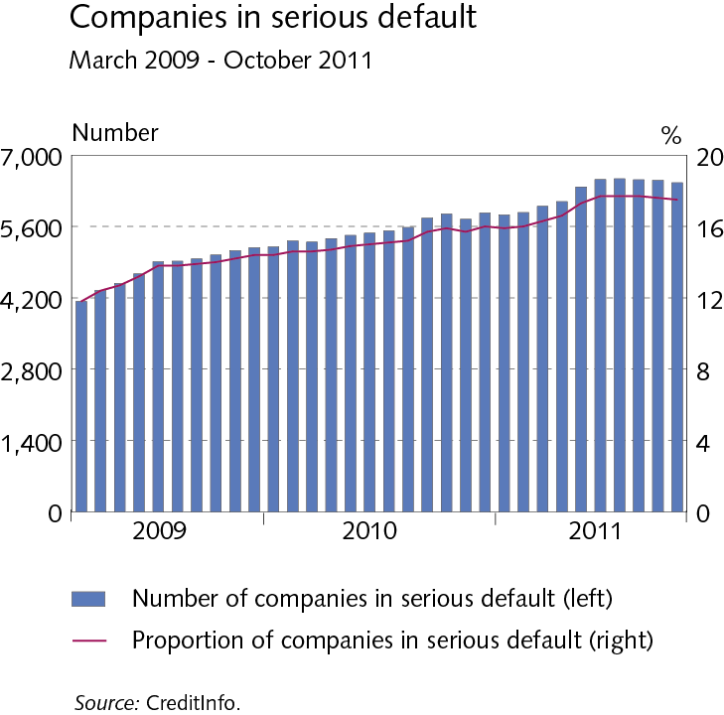
I Macroeconomic environment and markets

Slide 24
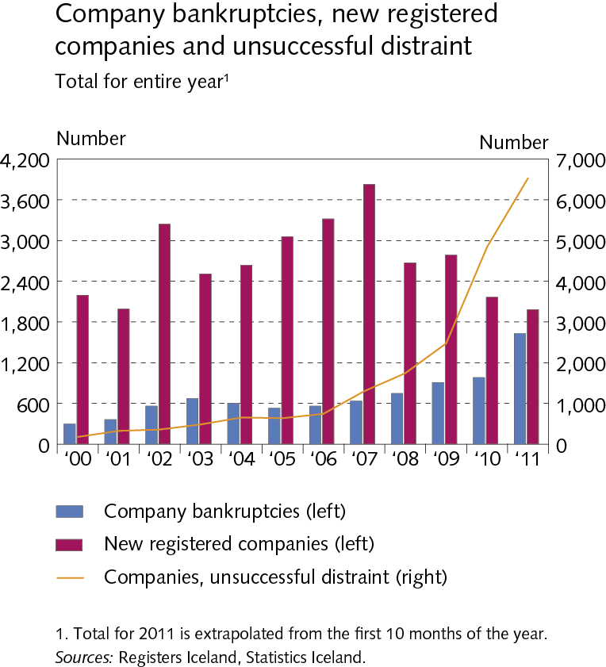
I Macroeconomic environment and markets

Slide 25
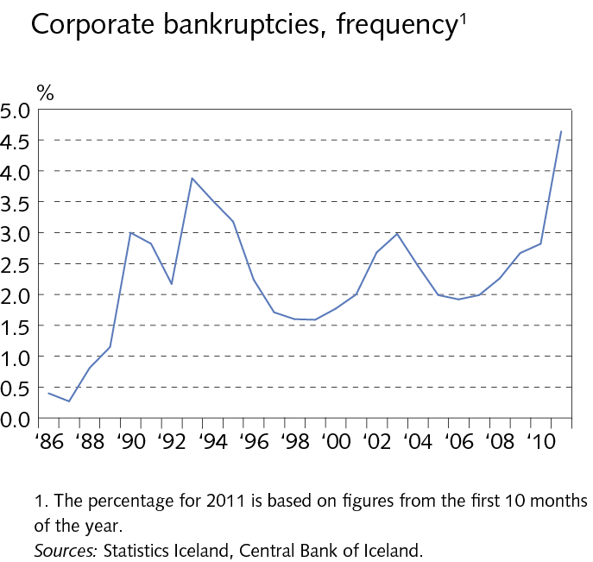
I Macroeconomic environment and markets

Slide 26
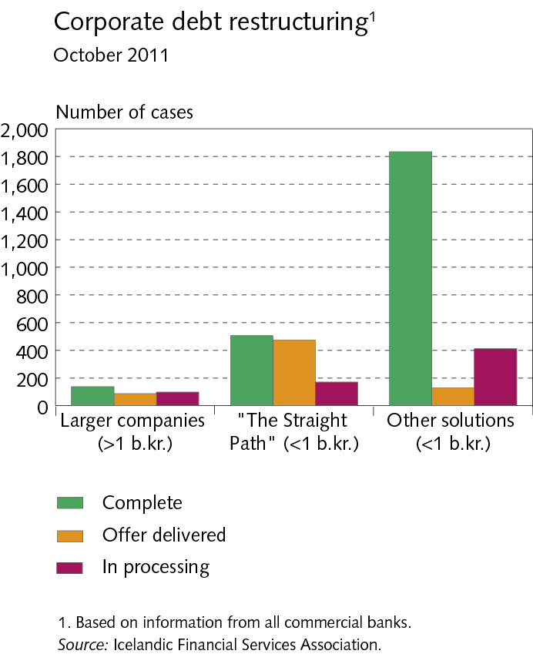
I Macroeconomic environment and markets

Slide 27
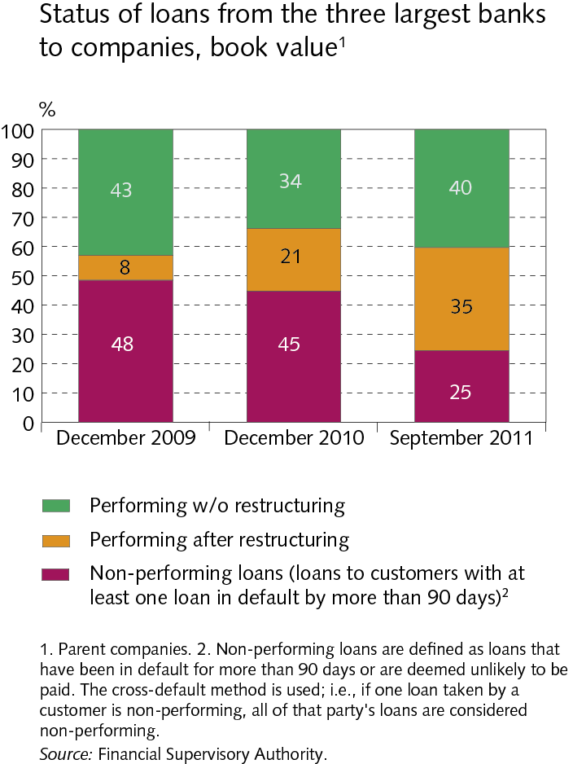
I Macroeconomic environment and markets

Slide 28
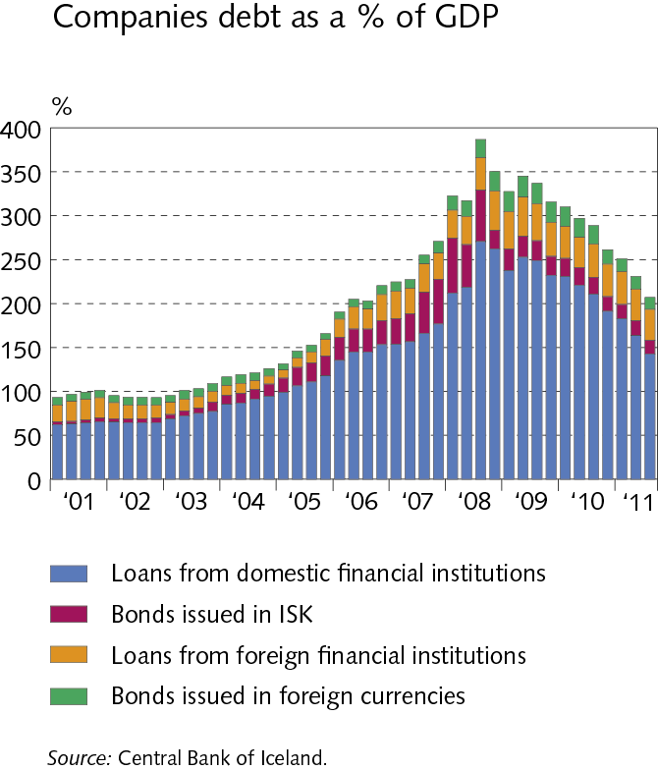
I Macroeconomic environment and markets

Slide 29
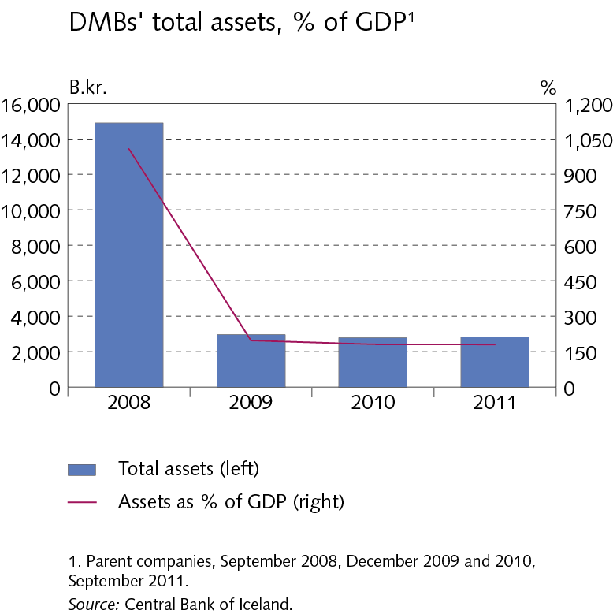
II Credit institutions

Slide 30
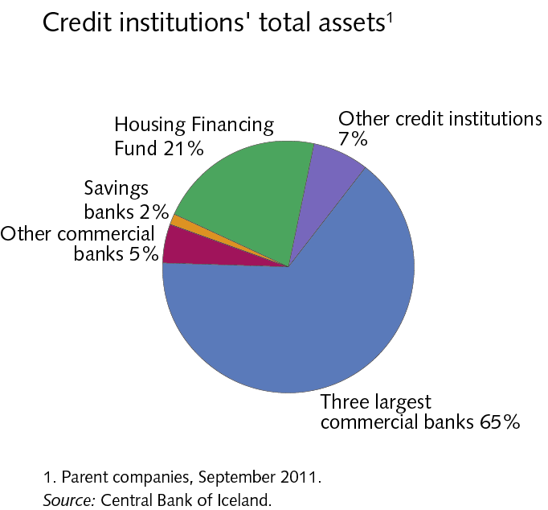
II Credit institutions

Slide 31
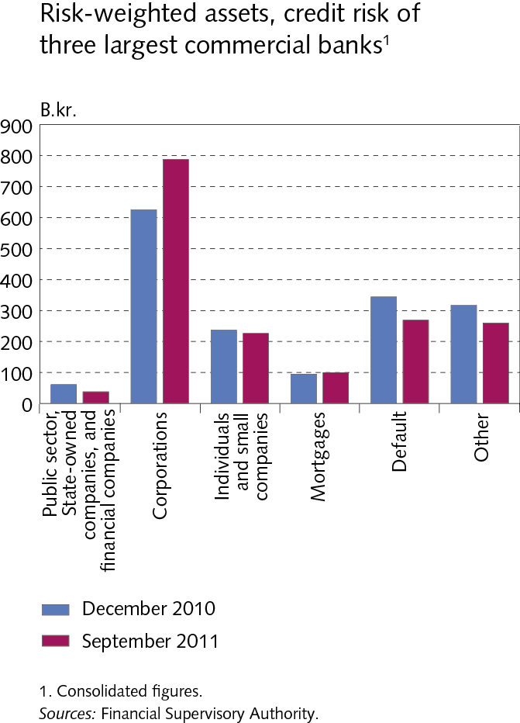
II Credit institutions

Slide 32
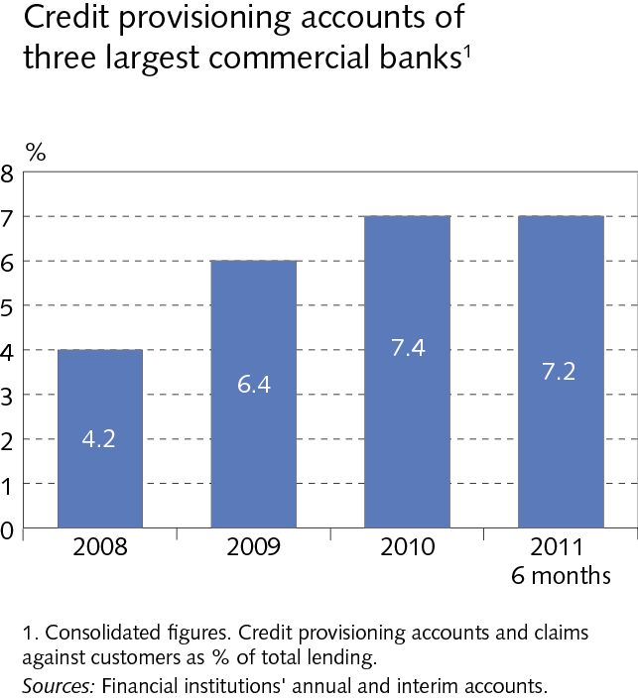
II Credit institutions

Slide 33
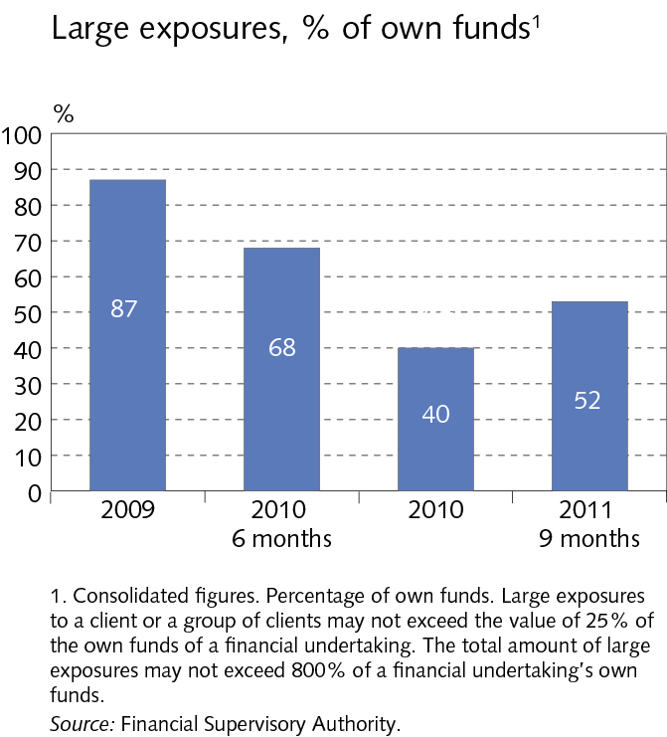
II Credit institutions

Slide 34
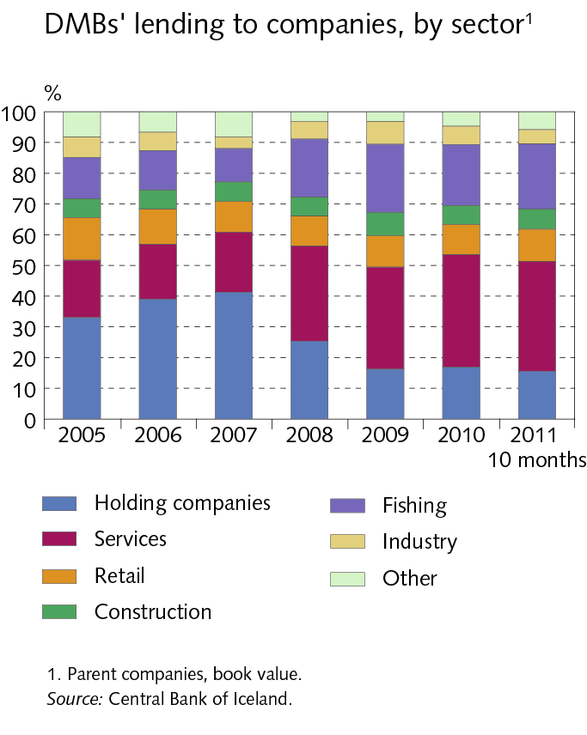
II Credit institutions

Slide 35
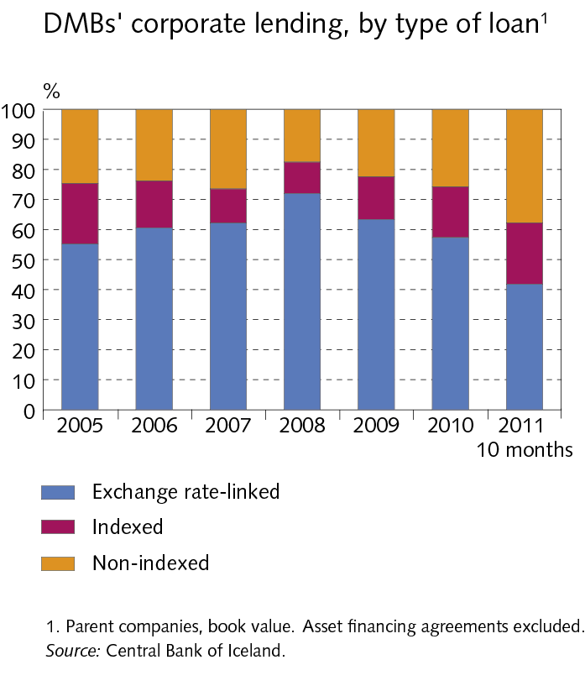
II Credit institutions

Slide 36
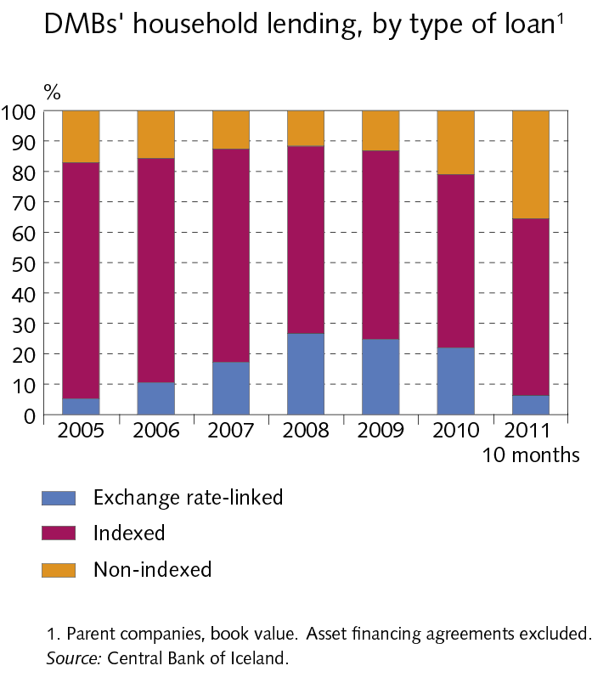
II Credit institutions

Slide 37
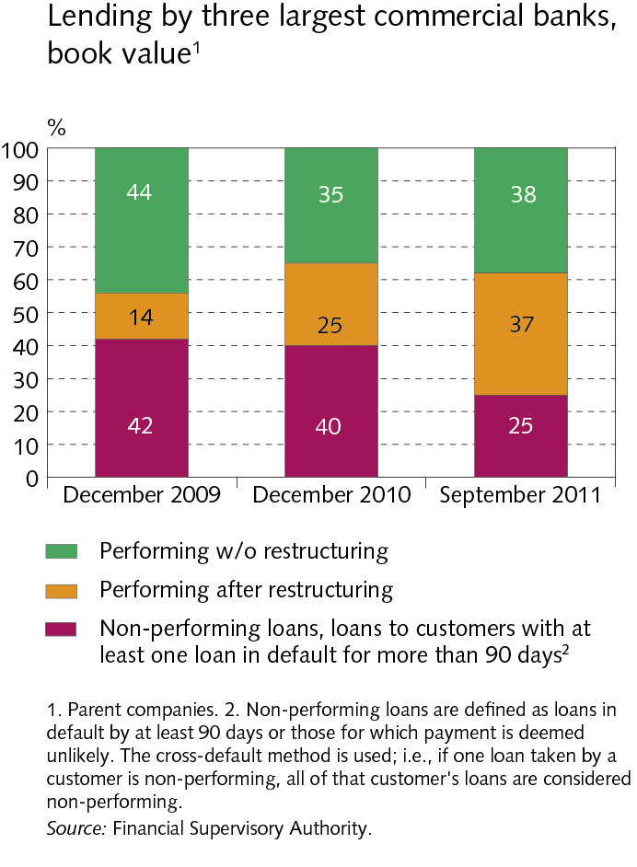
II Credit institutions

Slide 38
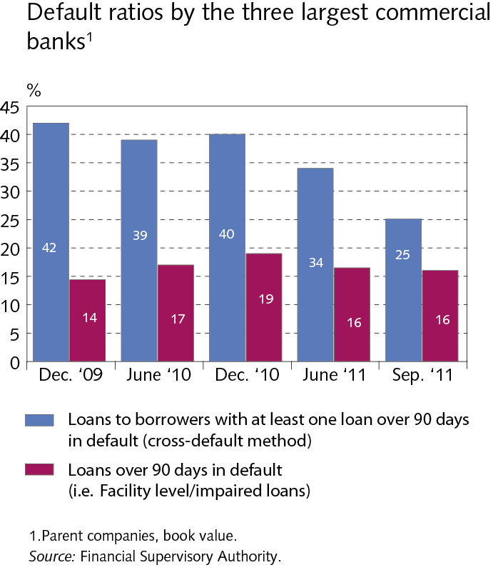
II Credit institutions

Slide 39
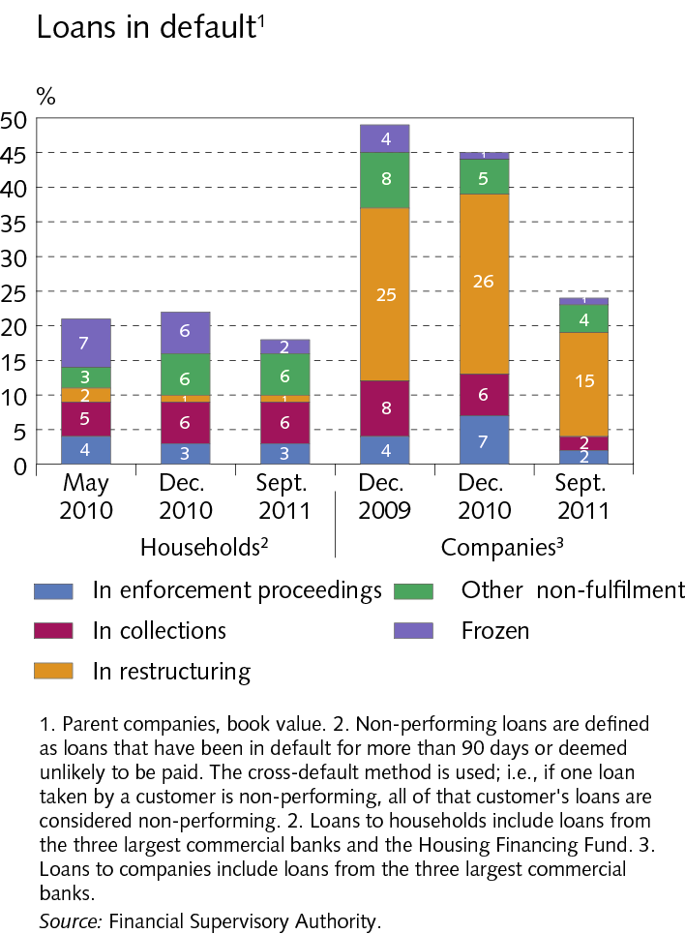
II Credit institutions

Slide 40
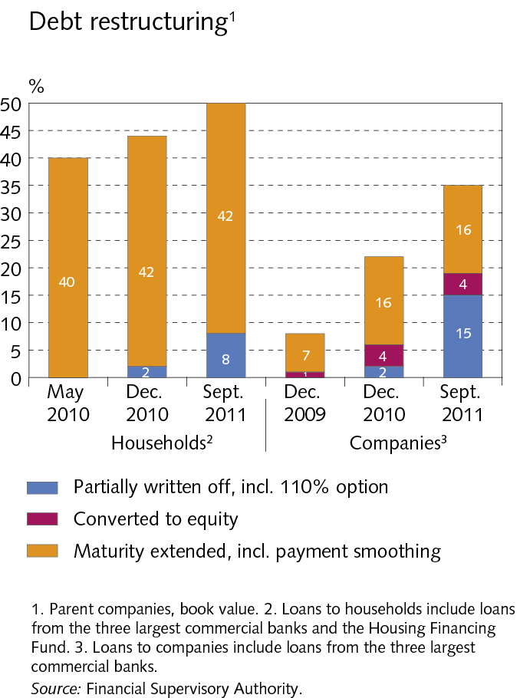
II Credit institutions

Slide 41
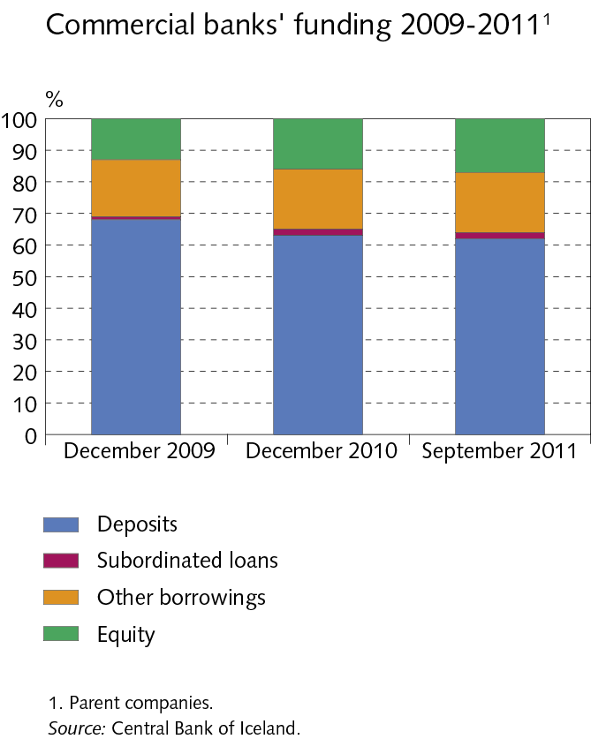
II Credit institutions

Slide 42
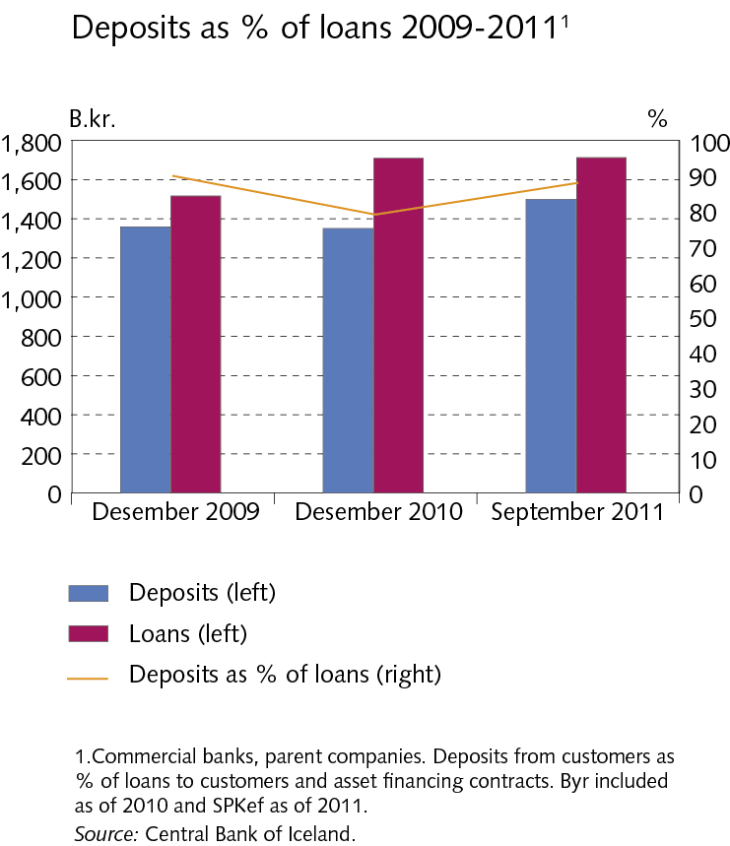
II Credit institutions

Slide 43
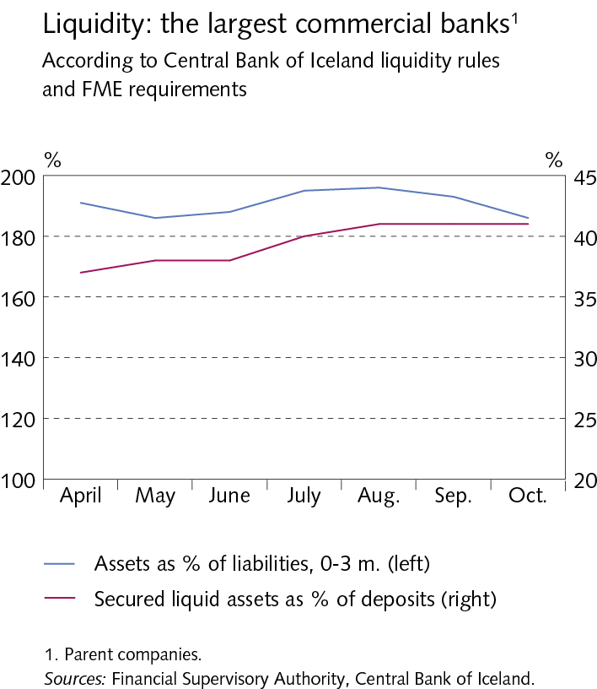
II Credit institutions

Slide 44
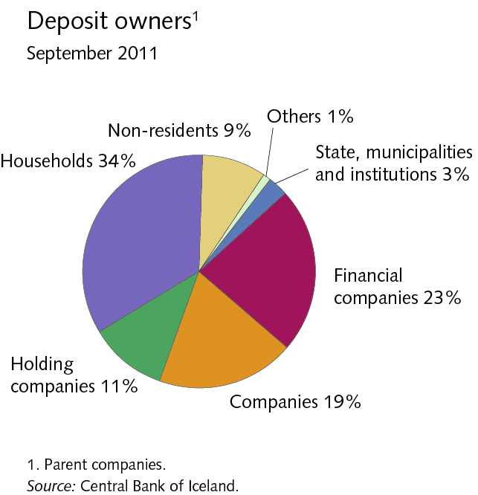
II Credit institutions

Slide 45
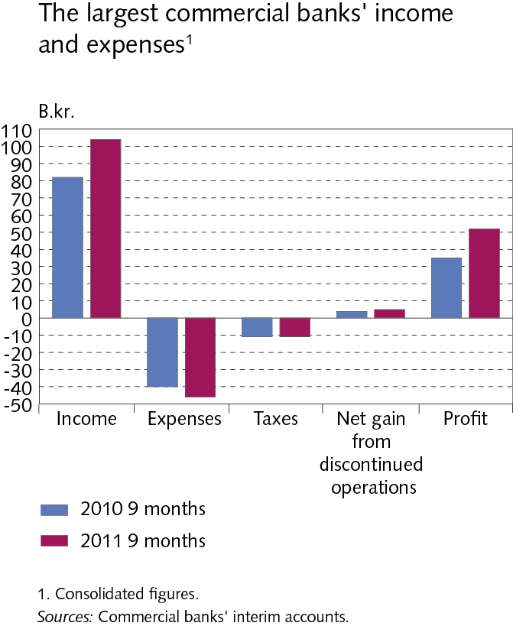
II Credit institutions

Slide 46
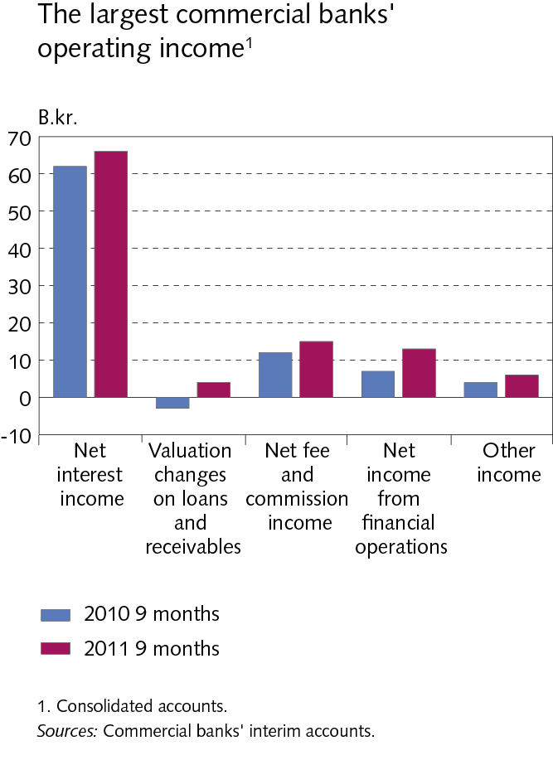
II Credit institutions

Slide 47
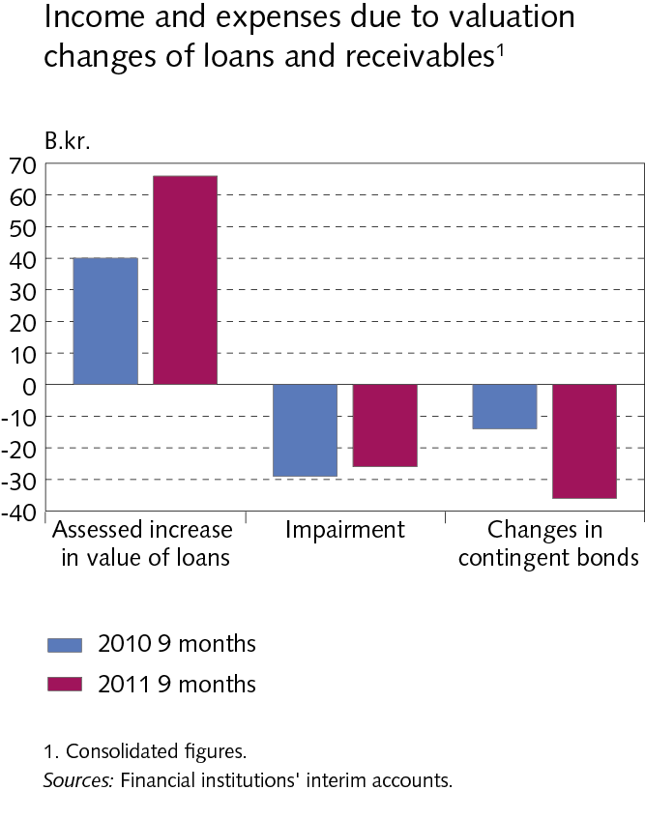
II Credit institutions

Slide 48
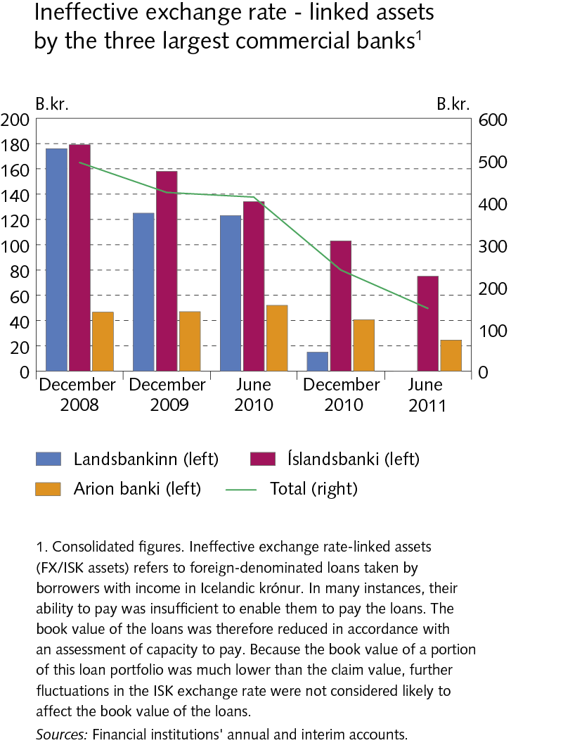
II Credit institutions

Slide 49
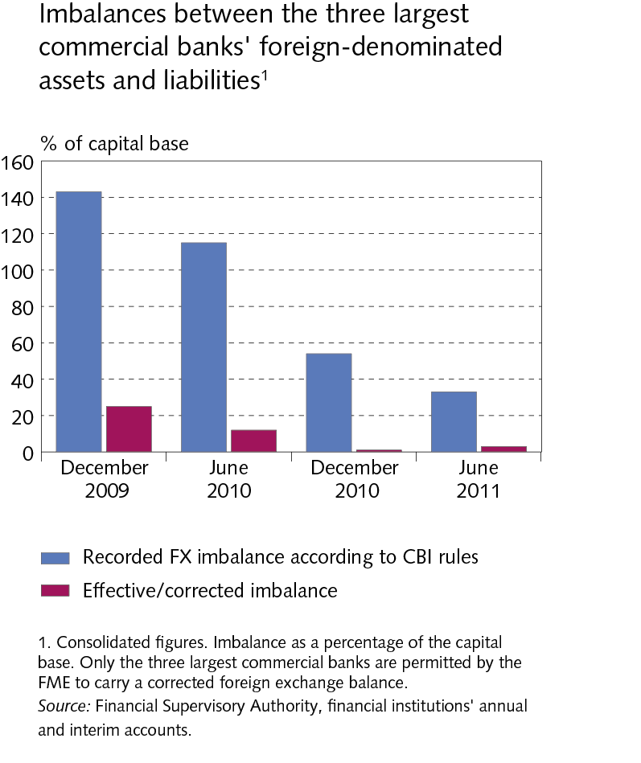
II Credit institutions

Slide 50
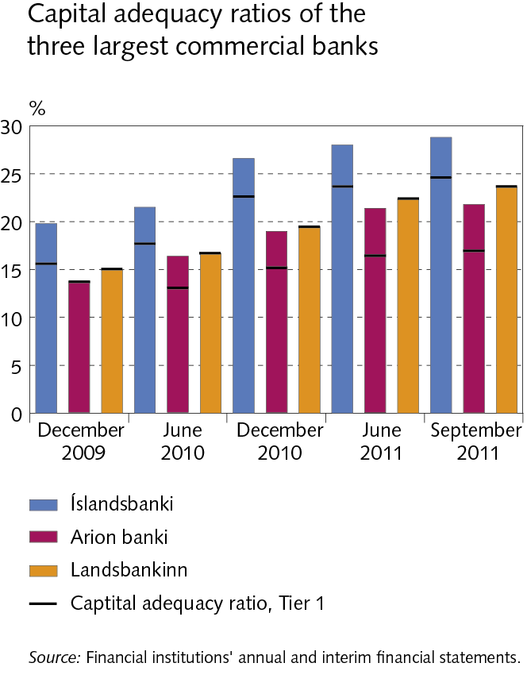
II Credit institutions

Slide 51
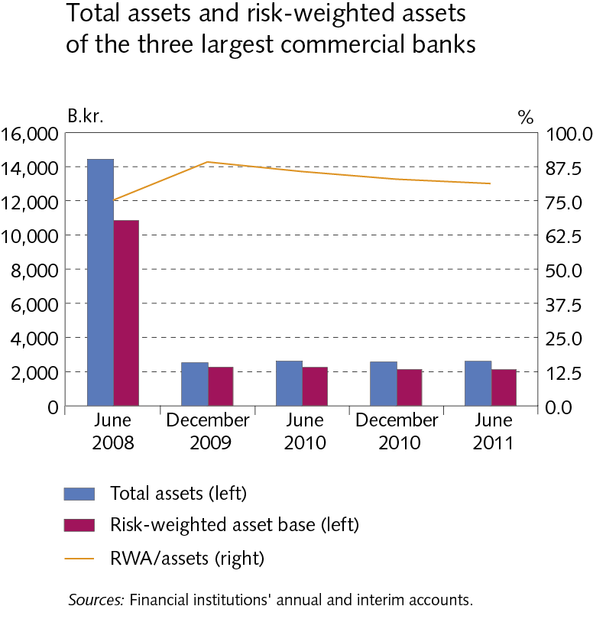
II Credit institutions

Slide 52
II Credit institutions

Slide 53
Nordic comparison

Slide 54
Nordic comparison

Slide 55
Nordic comparison

Slide 56
Nordic comparison

Slide 57
Nordic comparison

Slide 58
Nordic comparison

