Slide 1
Financial Stability 2018/2
Charts
October 2018

Slide 2
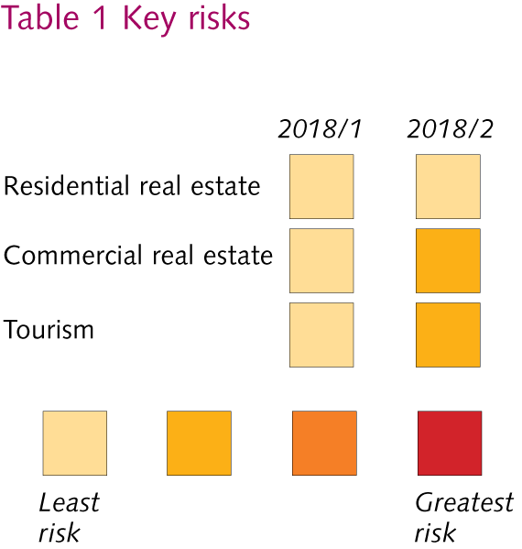
Key risks

Slide 3
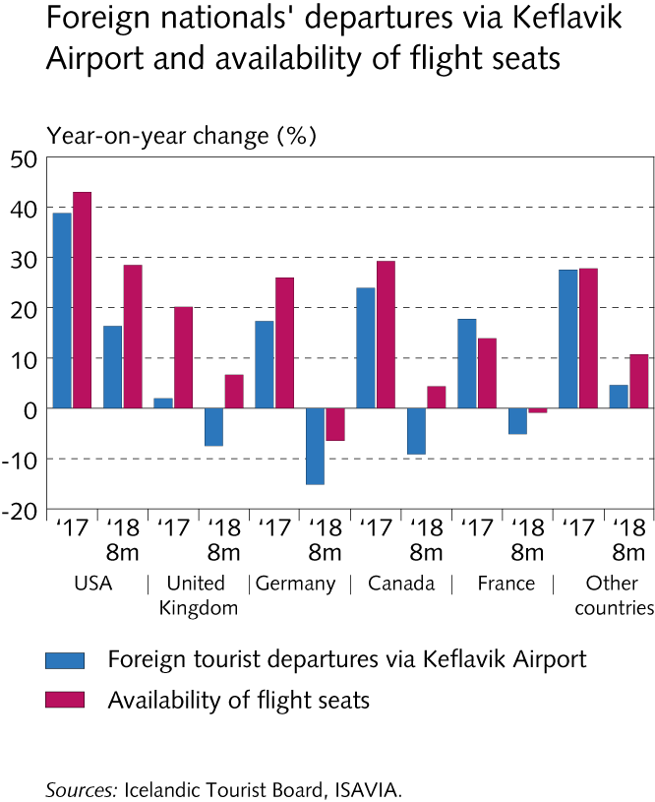
Key risks

Slide 4
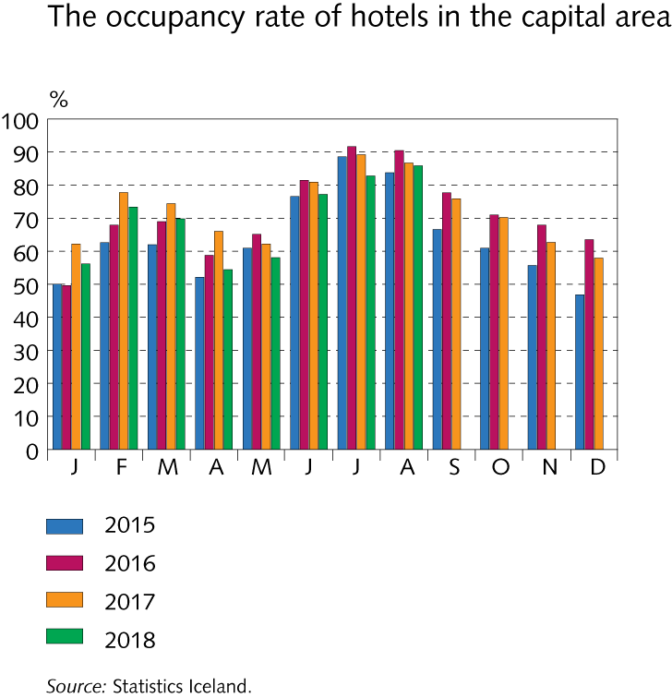
Key risks

Slide 5
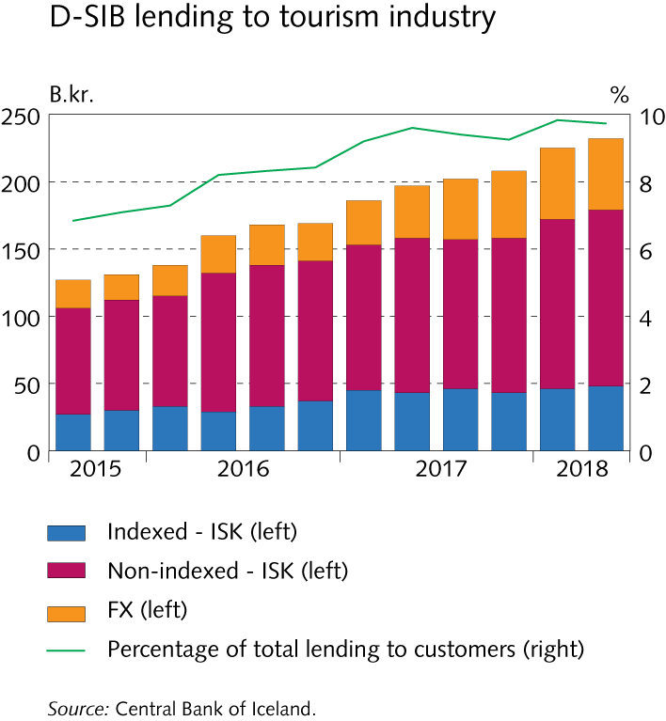
Key risks

Slide 6
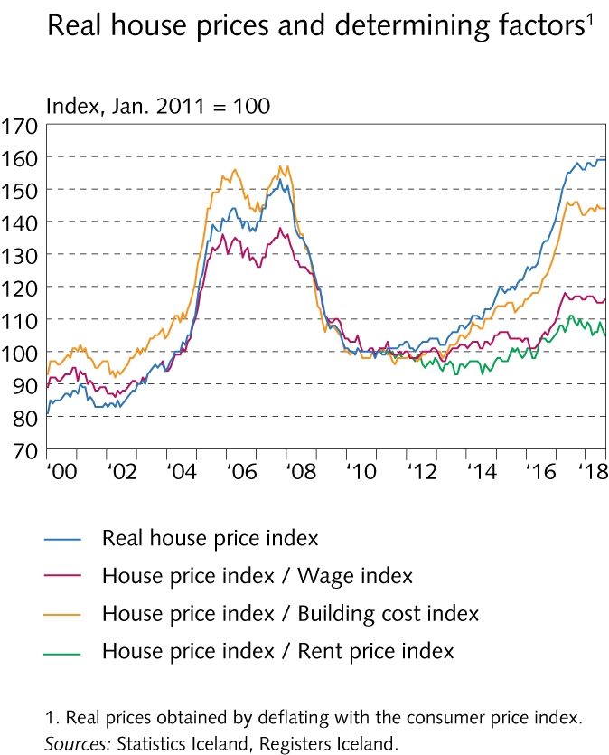
Key risks

Slide 7
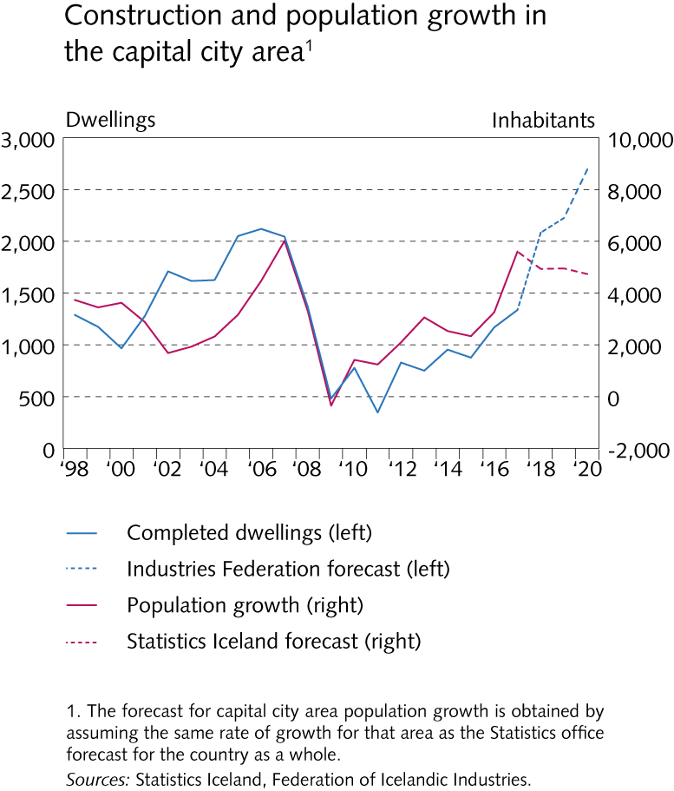
Key risks

Slide 8
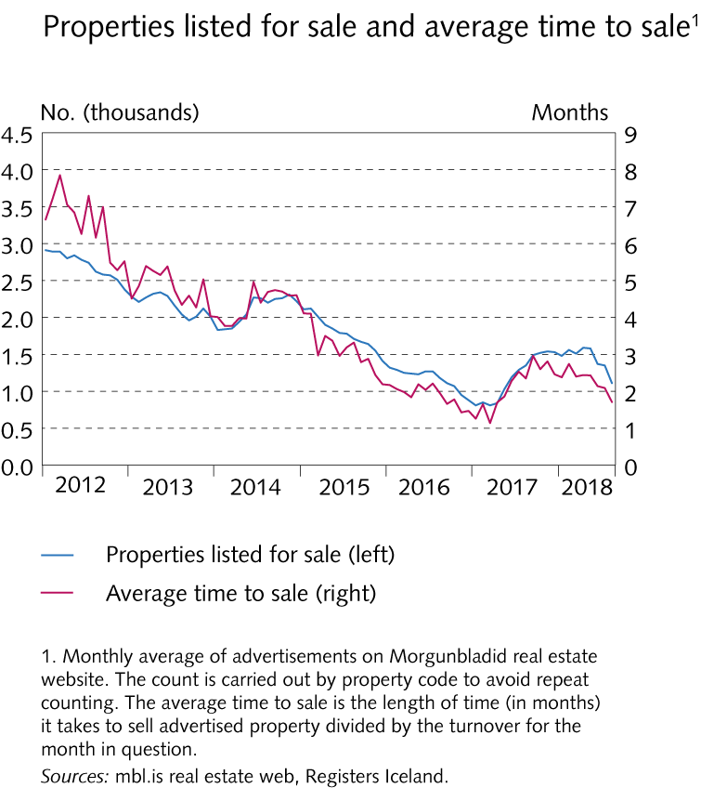
Key risks

Slide 9
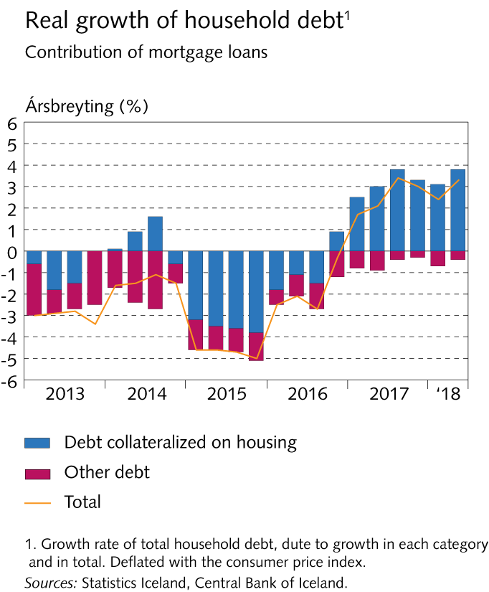
Key risks

Slide 10
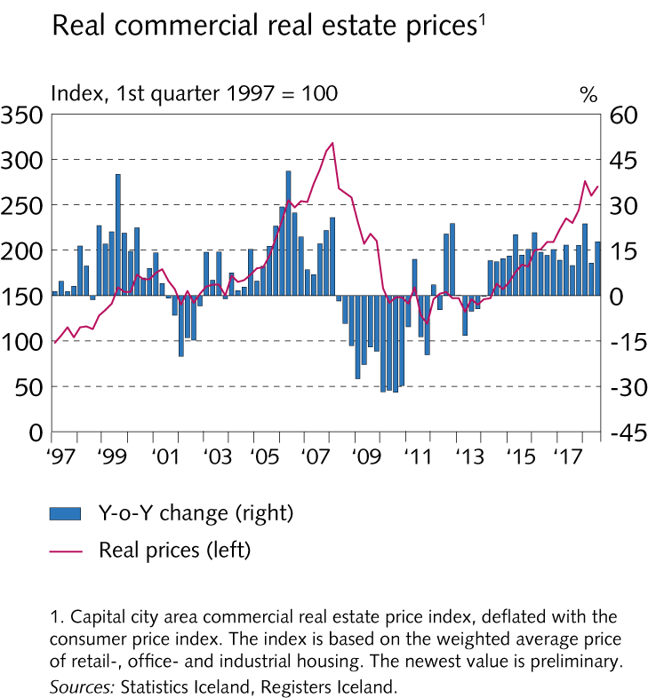
Key risks

Slide 11
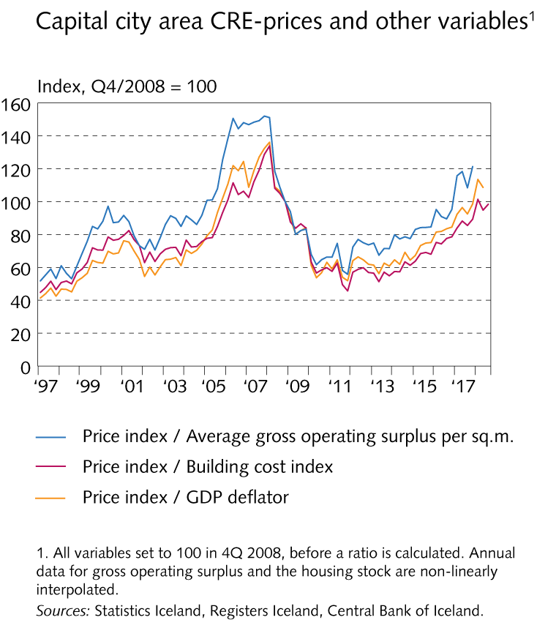
Key risks

Slide 12
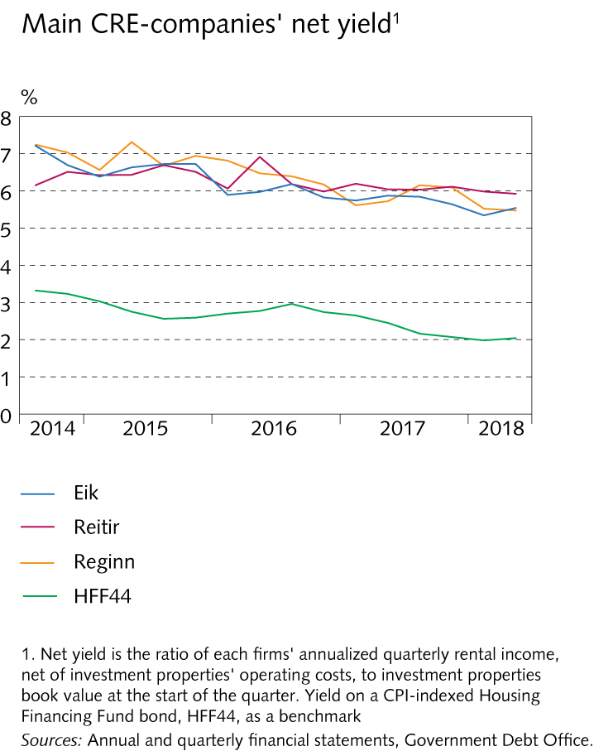
Key risks

Slide 13
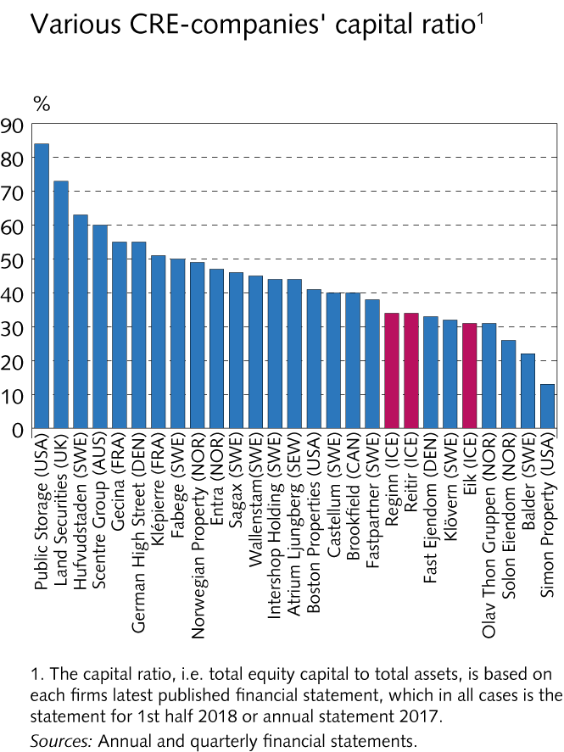
Key risks

Slide 14
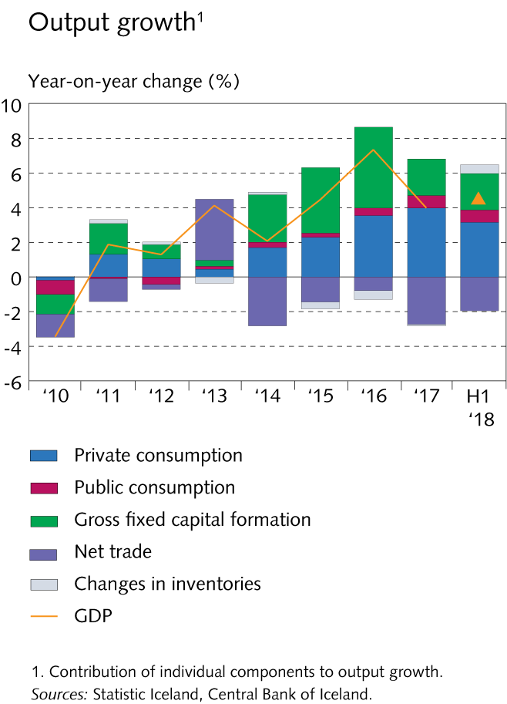
Financial institutions‘ operating environment

Slide 15
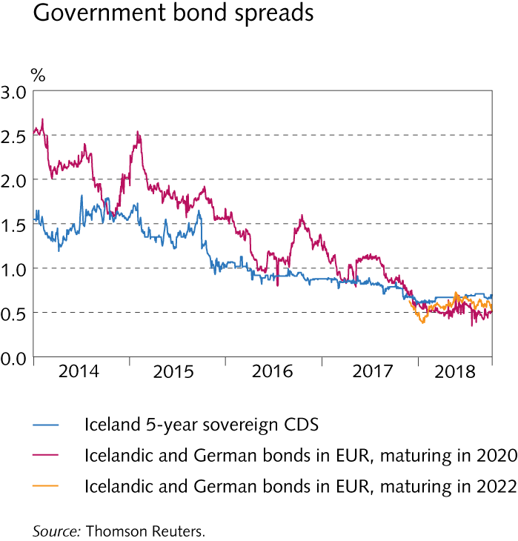
Financial institutions‘ operating environment

Slide 16
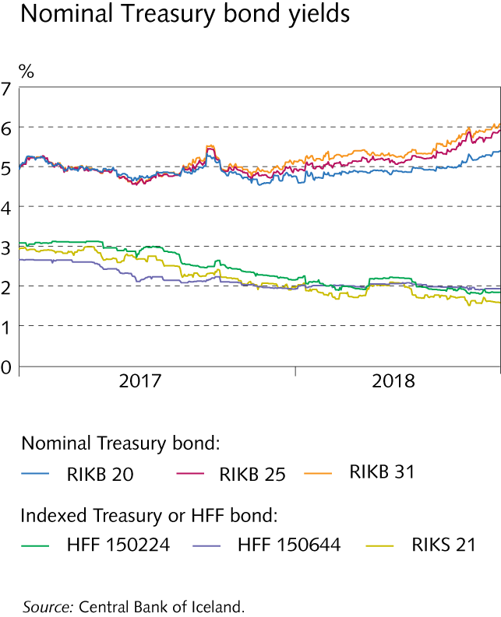
Financial institutions‘ operating environment

Slide 17
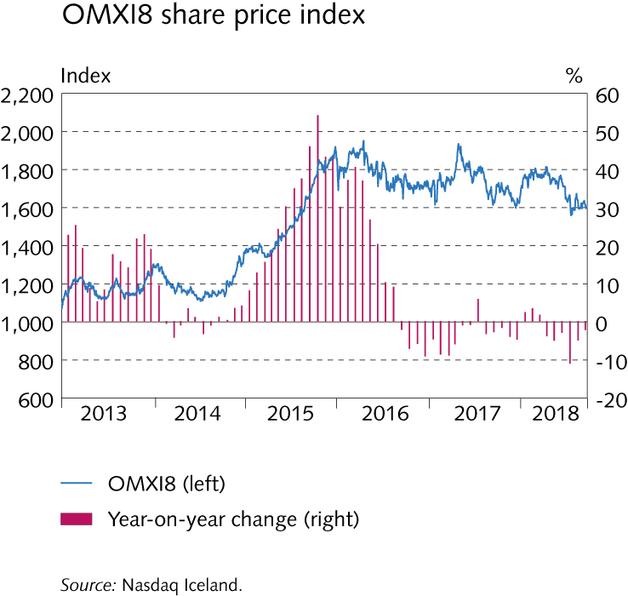
Financial institutions‘ operating environment

Slide 18
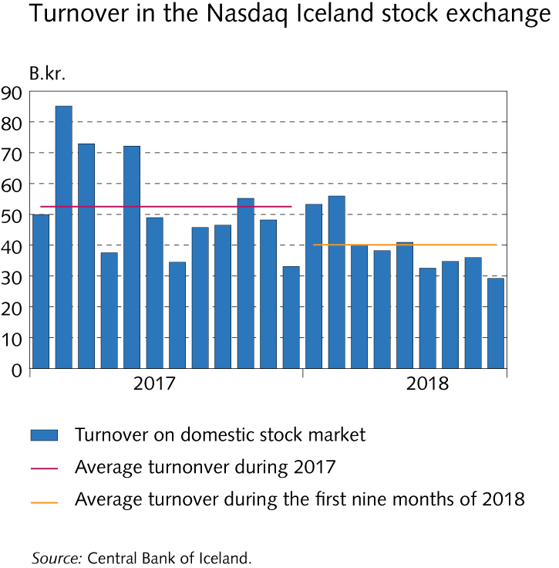
Financial institutions‘ operating environment

Slide 19
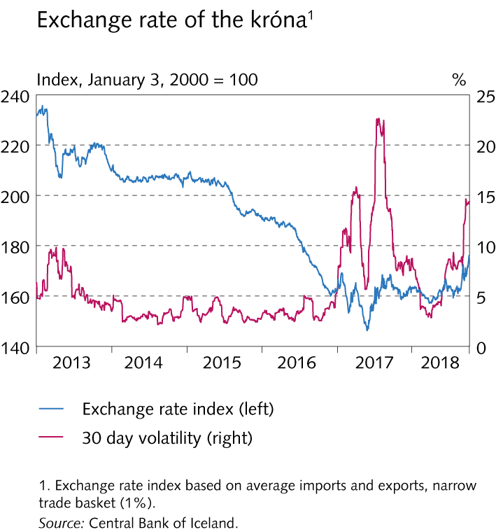
Financial institutions‘ operating environment

Slide 20
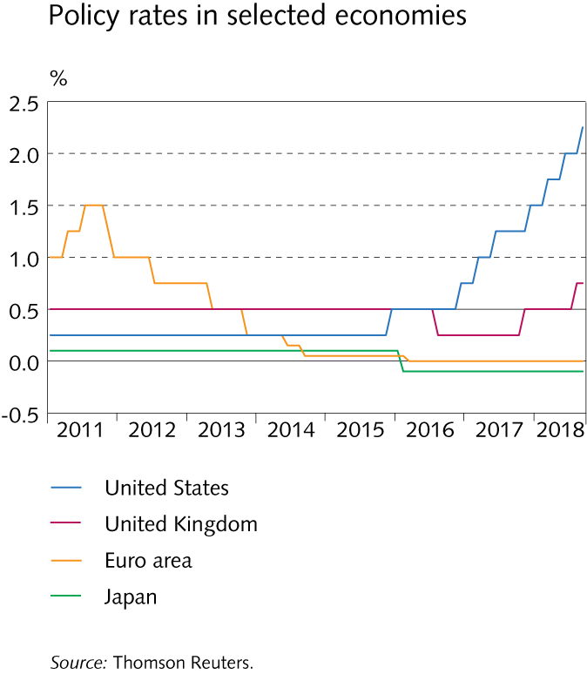
Financial institutions‘ operating environment

Slide 21
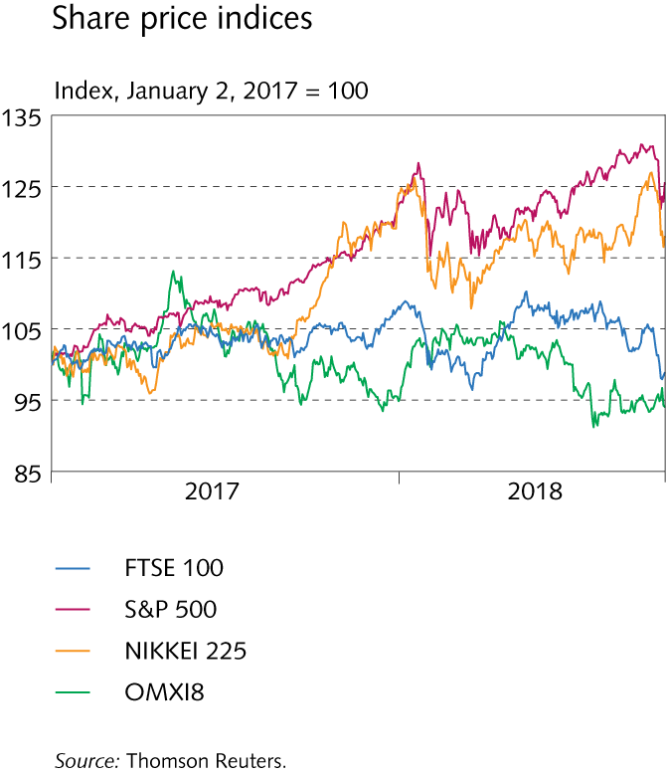
Financial institutions‘ operating environment

Slide 22
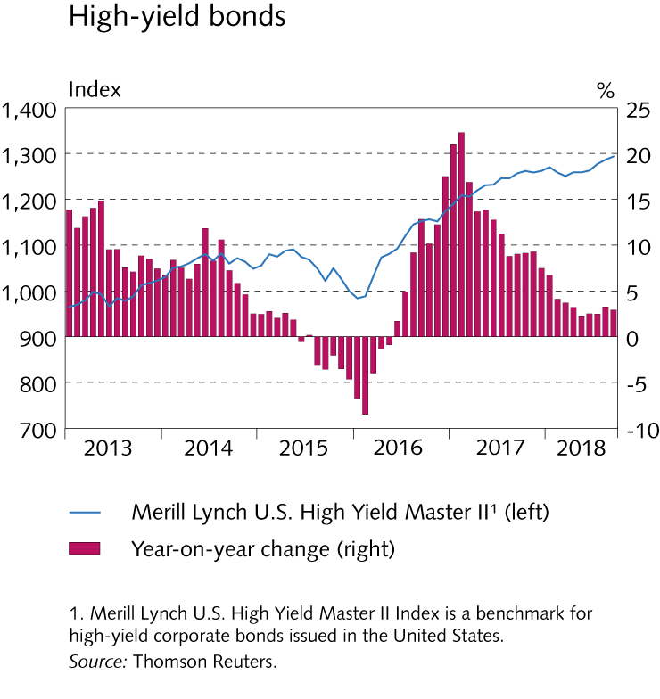
Financial institutions‘ operating environment

Slide 23
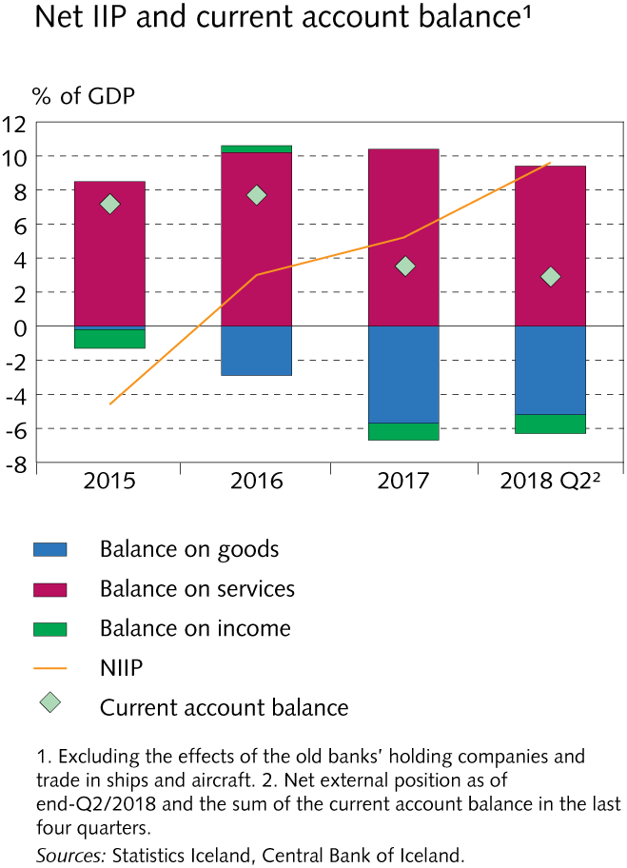
Financial institutions‘ operating environment

Slide 24
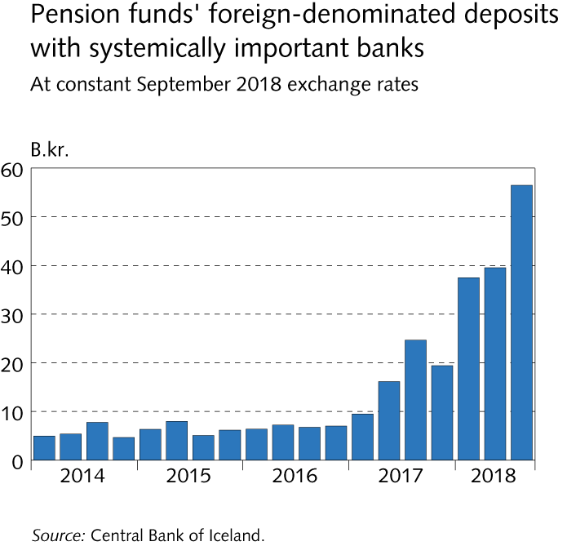
Financial institutions‘ operating environment

Slide 25
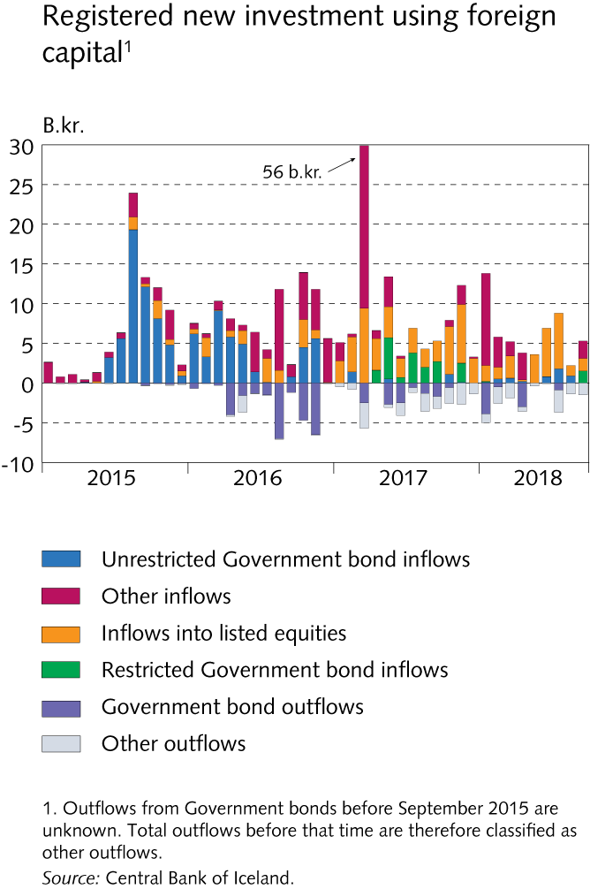
Financial institutions‘ operating environment

Slide 26
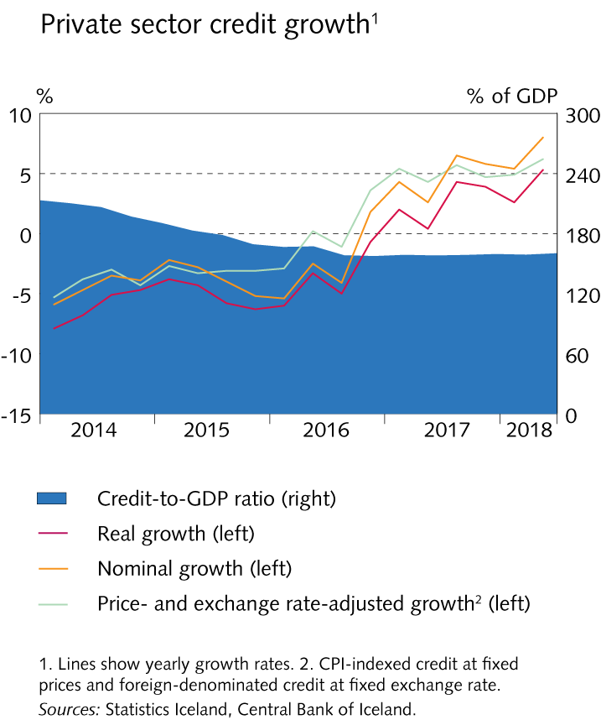
Financial institutions‘ operating environment

Slide 27
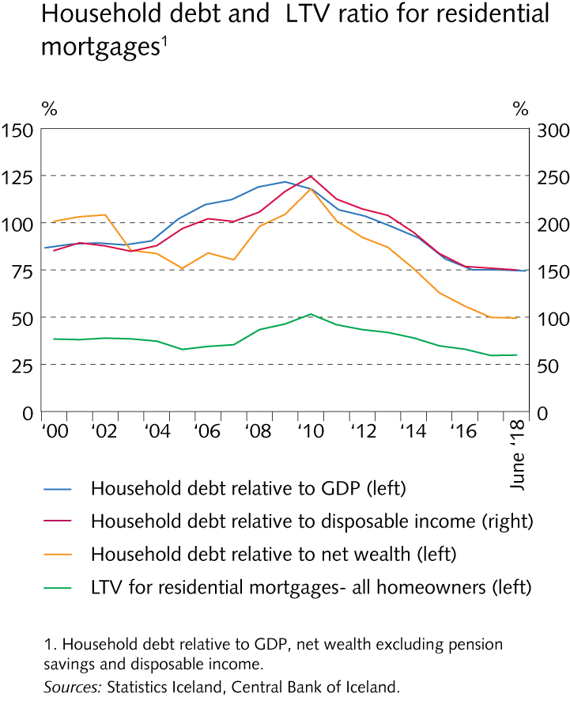
Financial institutions‘ operating environment

Slide 28
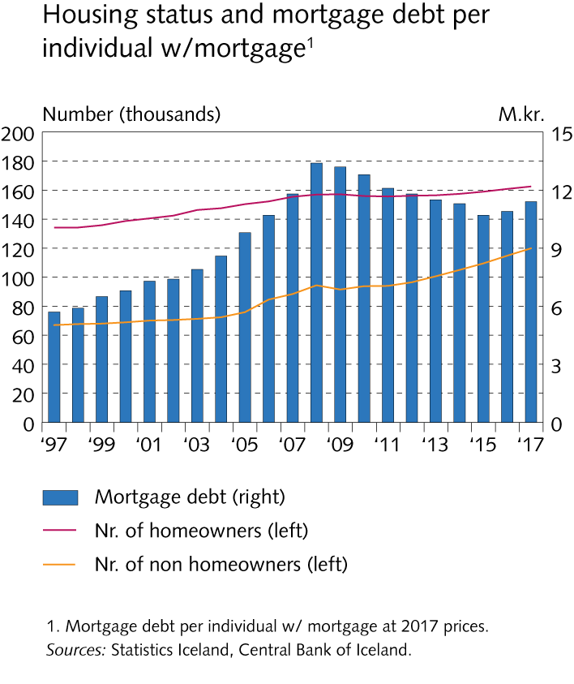
Financial institutions‘ operating environment

Slide 29
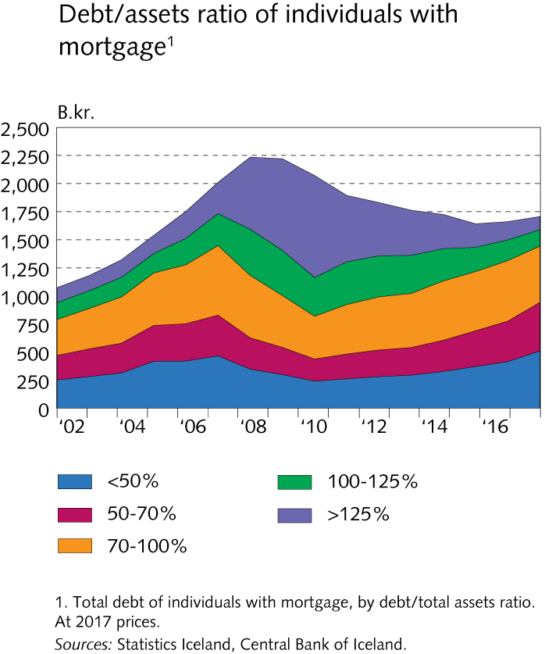
Financial institutions‘ operating environment

Slide 30
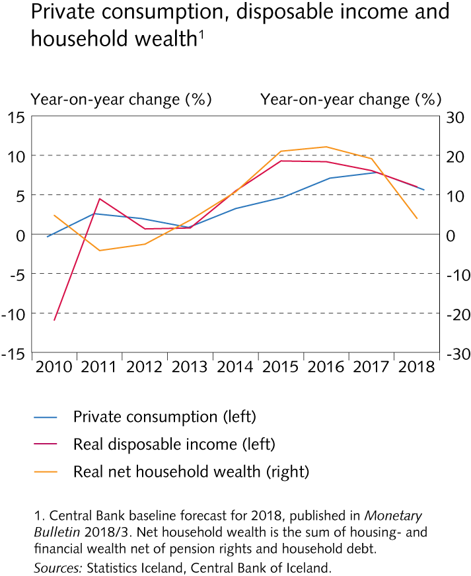
Financial institutions‘ operating environment

Slide 31
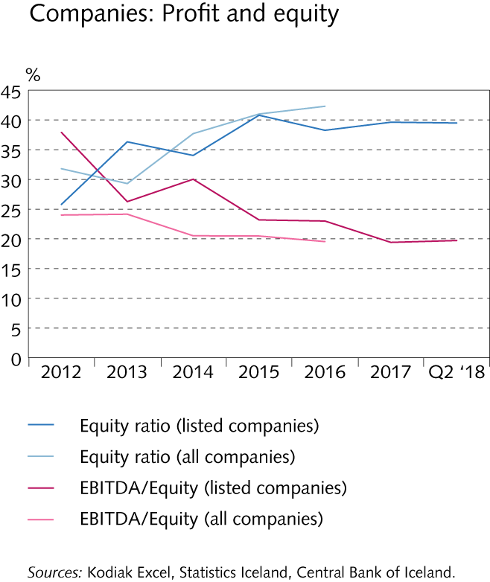
Financial institutions‘ operating environment

Slide 32
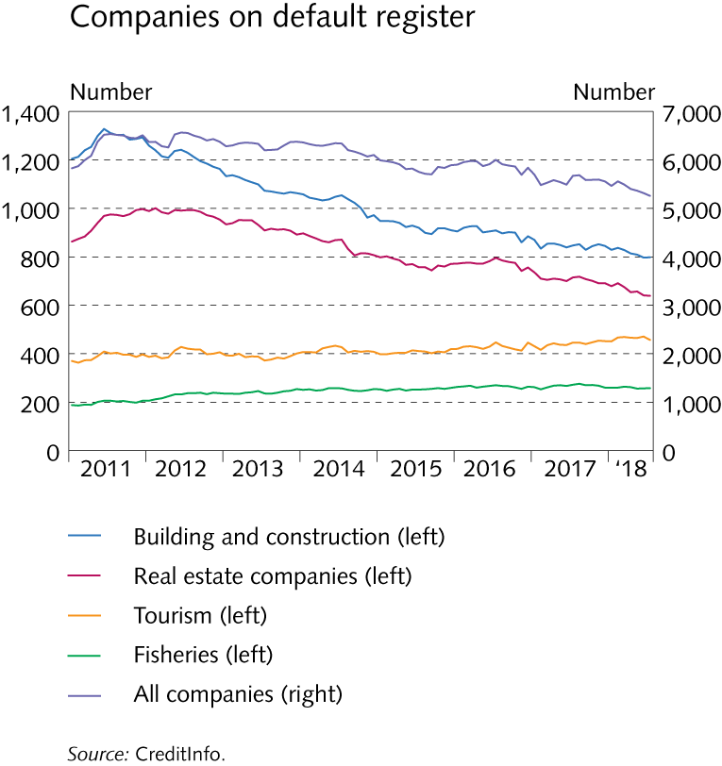
Financial institutions‘ operating environment

Slide 33
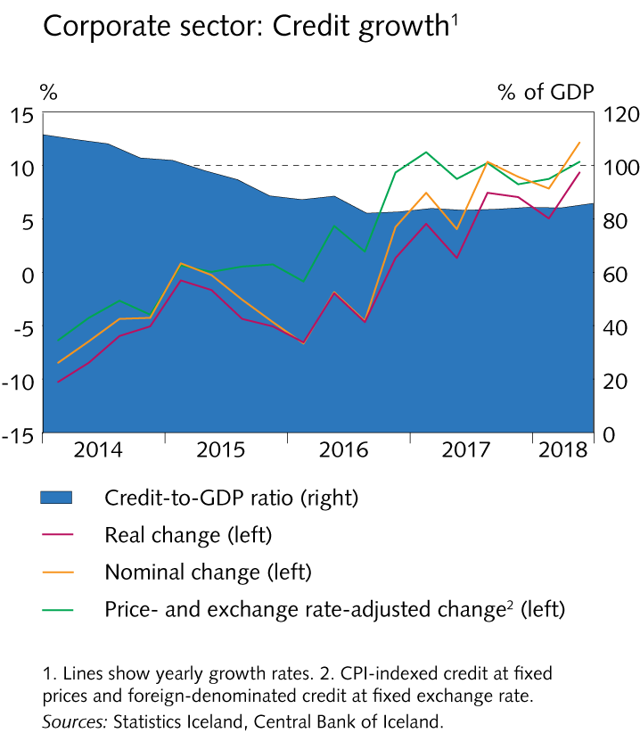
Financial institutions‘ operating environment

Slide 34
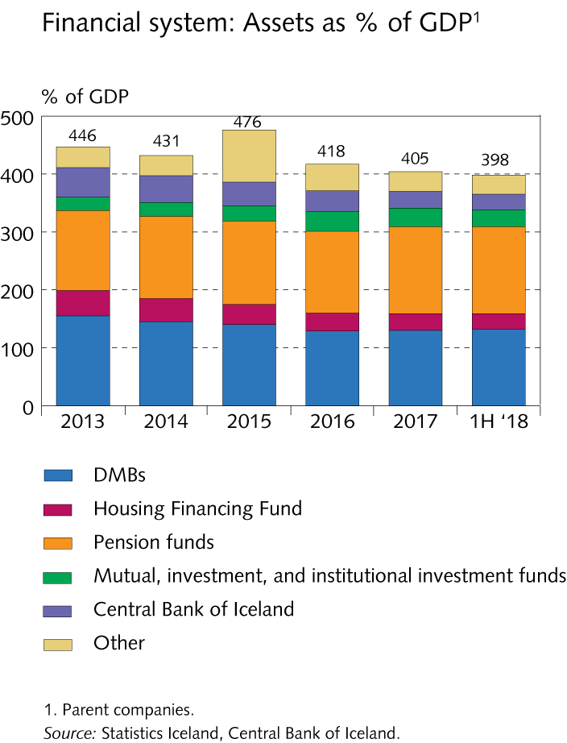
Financial institutions and other lenders

Slide 35
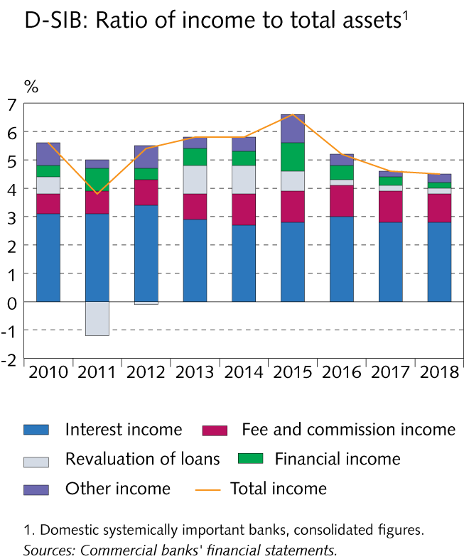
Financial institutions and other lenders

Slide 36
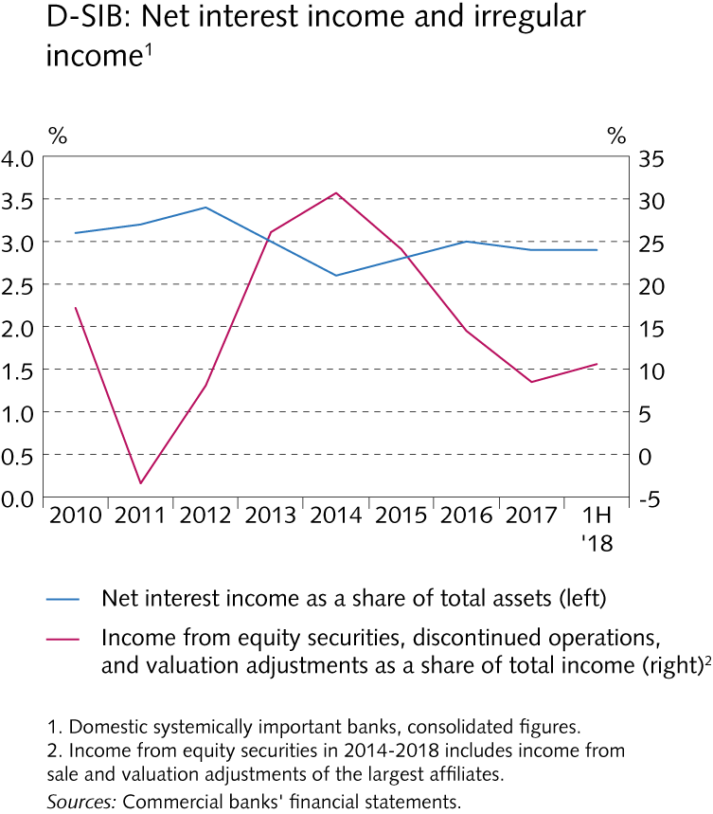
Financial institutions and other lenders

Slide 37
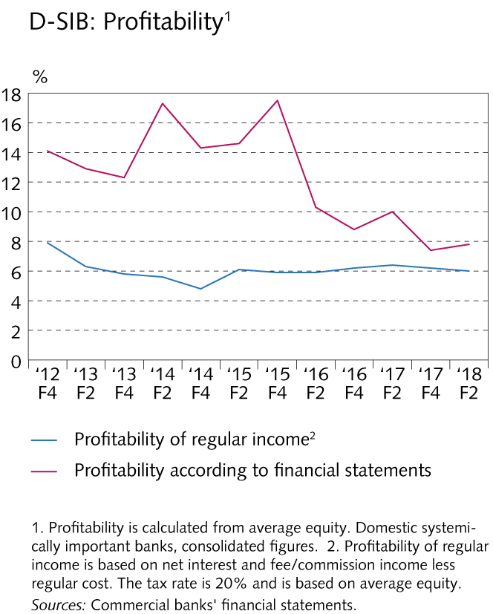
Financial institutions and other lenders

Slide 38
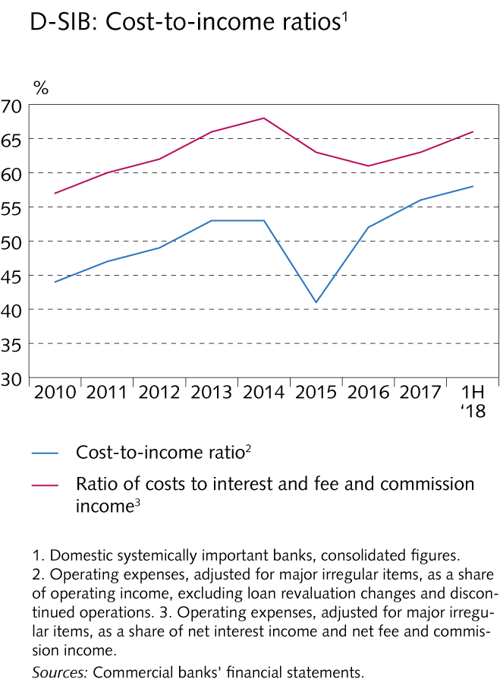
Financial institutions and other lenders

Slide 39
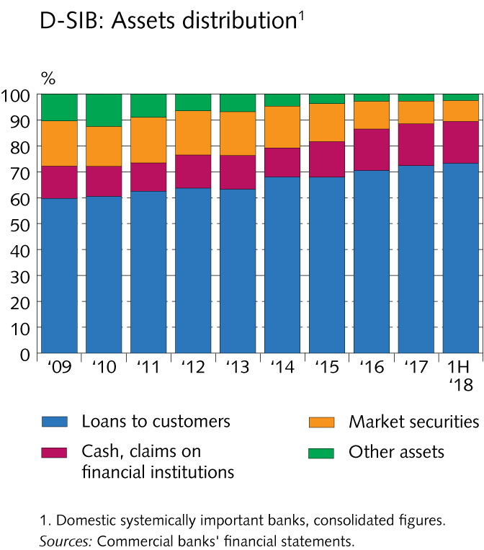
Financial institutions and other lenders

Slide 40
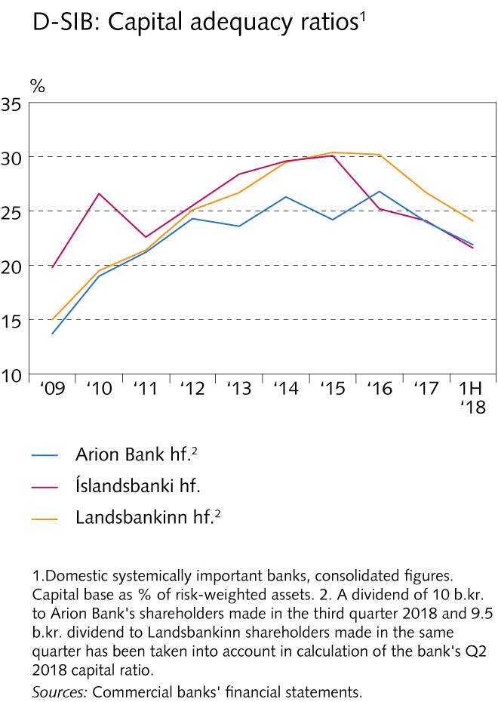
Financial institutions and other lenders

Slide 41
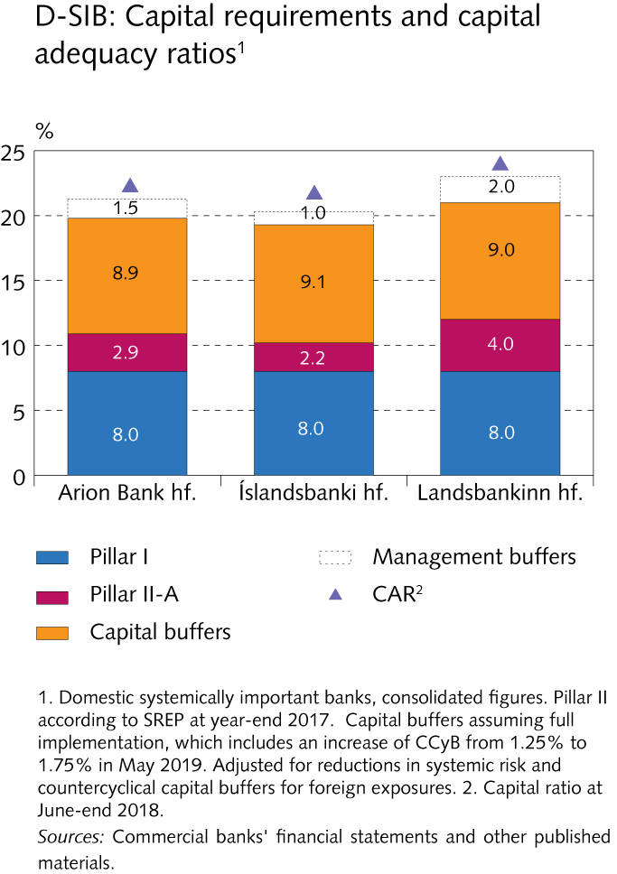
Financial institutions and other lenders

Slide 42
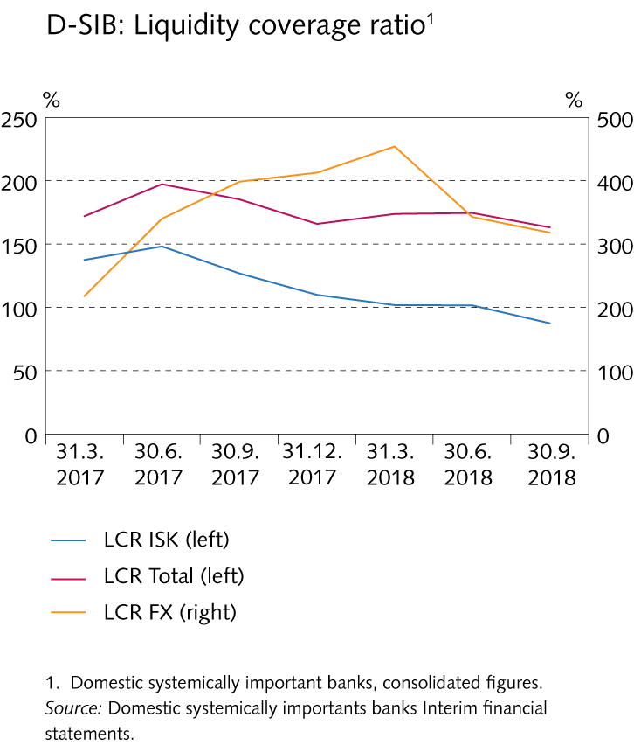
Financial institutions and other lenders

Slide 43
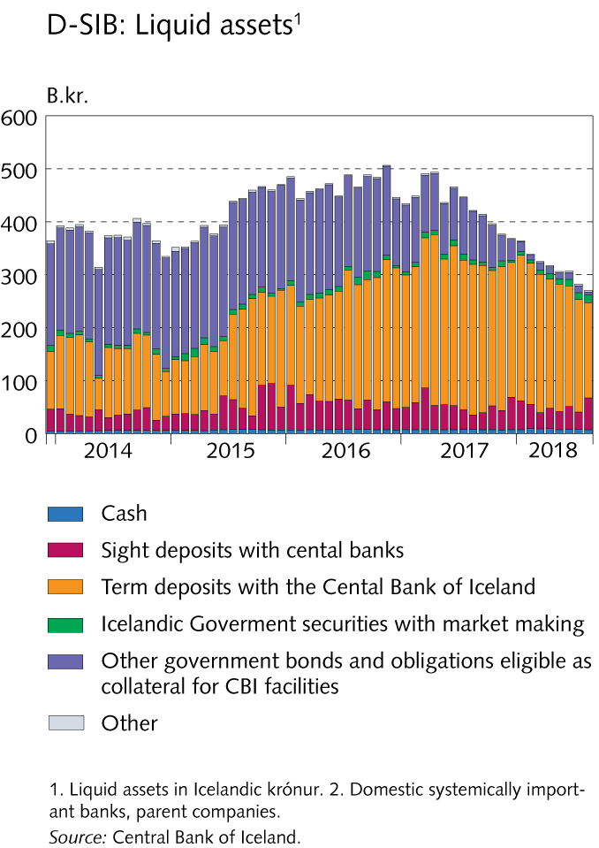
Financial institutions and other lenders

Slide 44
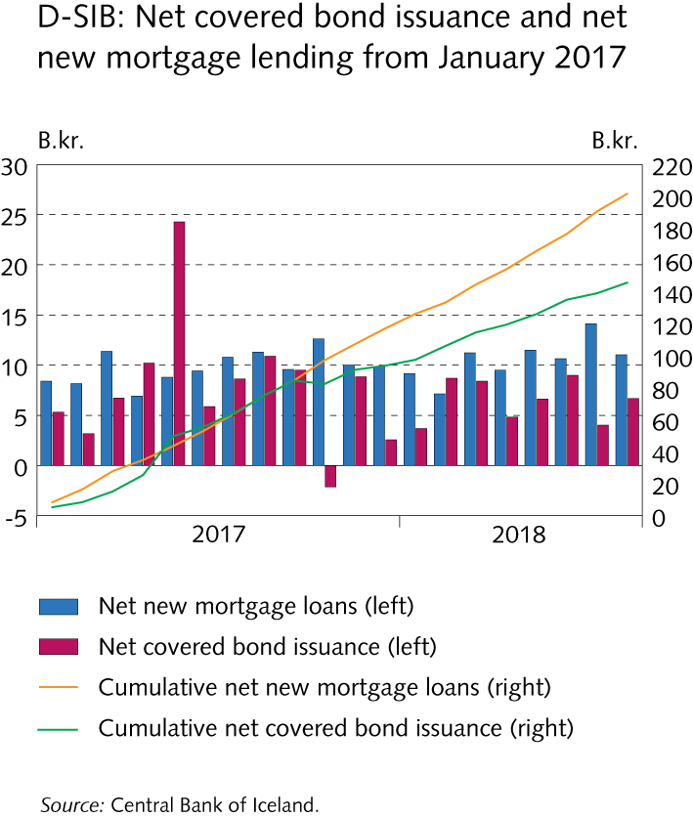
Financial institutions and other lenders

Slide 45
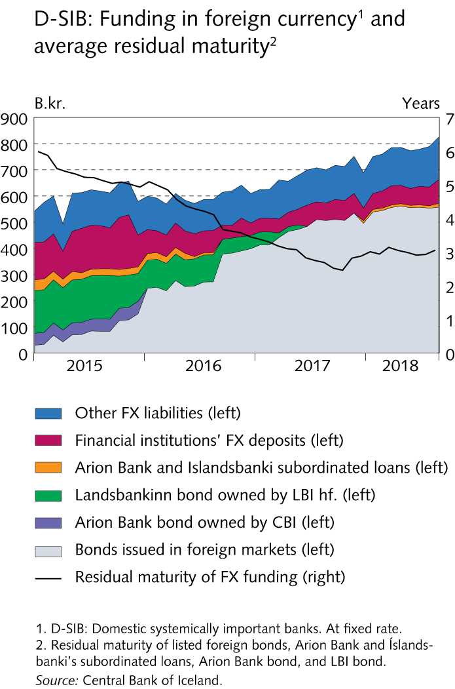
Financial institutions and other lenders

Slide 46
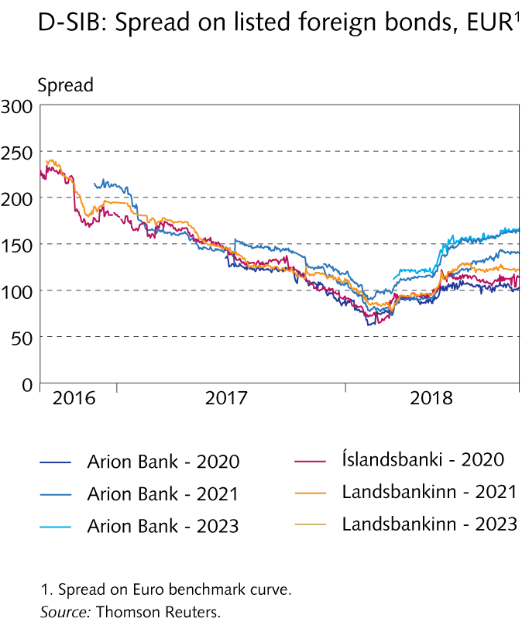
Financial institutions and other lenders

Slide 47
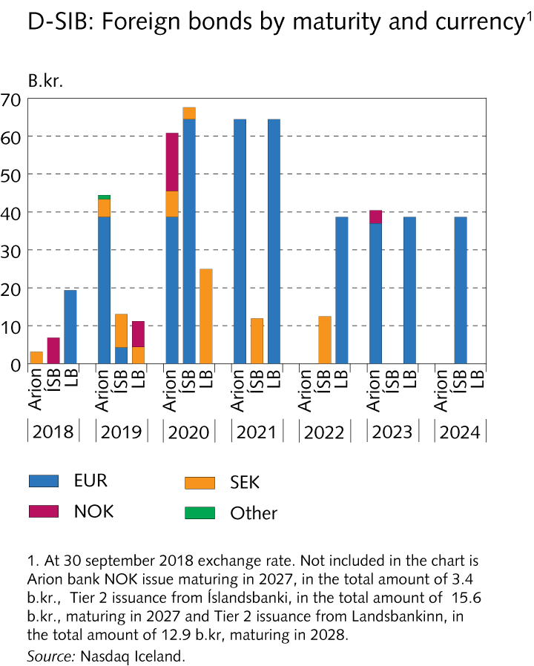
Financial institutions and other lenders

Slide 48
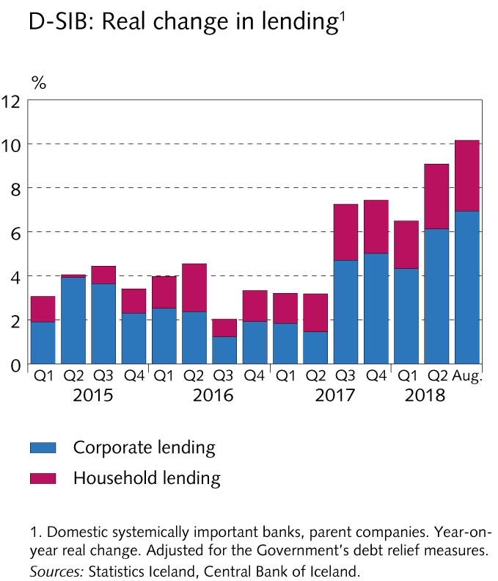
Financial institutions and other lenders

Slide 49
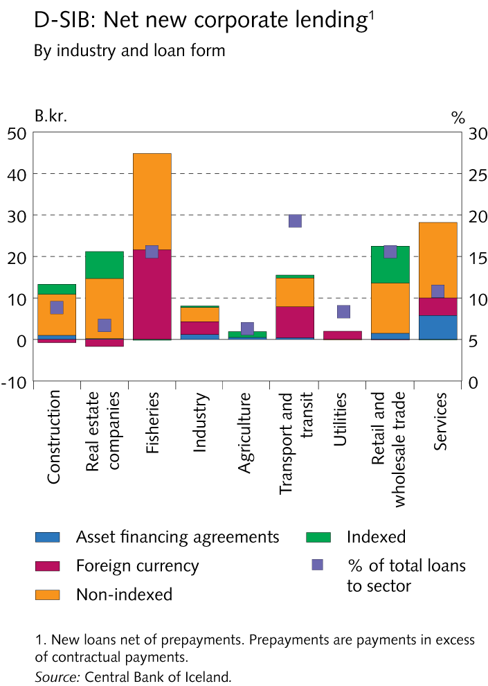
Financial institutions and other lenders

Slide 50
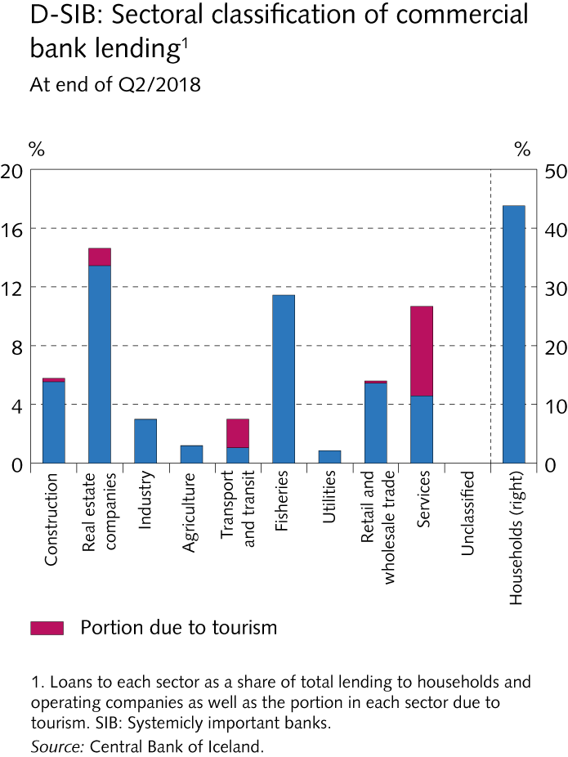
Financial institutions and other lenders

Slide 51
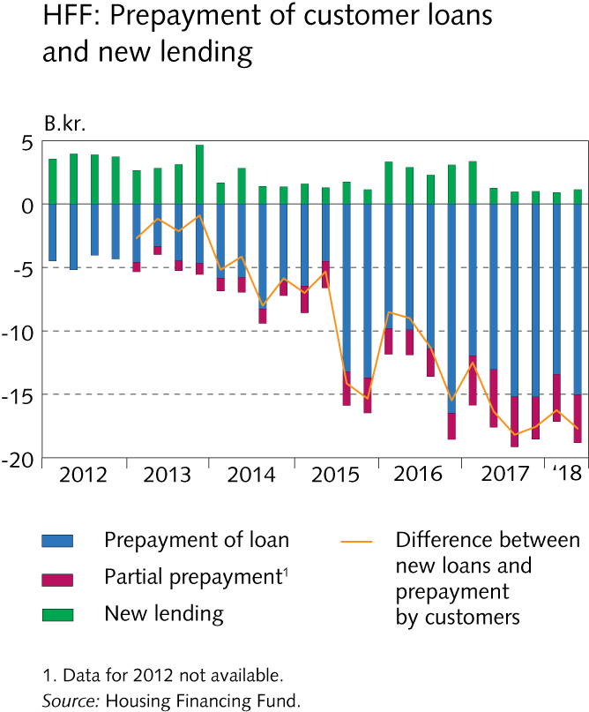
Financial institutions and other lenders

Slide 52
Financial institutions and other lenders

Slide 53
Financial institutions and other lenders

Slide 54
Financial institutions and other lenders

Slide 55
Financial institutions and other lenders

Slide 56
Central Bank stress test 2018

Slide 57
Central Bank stress test 2018

Slide 58
Central Bank stress test 2018

Slide 59
Central Bank stress test 2018

Slide 60
Central Bank stress test 2018

Slide 61
Central Bank stress test 2018

Slide 62
Central Bank stress test 2018

Slide 63
Central Bank stress test 2018

Slide 64
Central Bank stress test 2018

Slide 65
Central Bank stress test 2018

Slide 66
Central Bank stress test 2018

Slide 67
Central Bank stress test 2018

Slide 68
Central Bank stress test 2018

Slide 69
Central Bank stress test 2018

Slide 70
Appendix I

Slide 71
Appendix I

Slide 72
Appendix I

Slide 73
Appendix I

Slide 74
Appendix I

Slide 75
Appendix I

Slide 76
Appendix I

Slide 77
Appendix I

Slide 78
Appendix I

Slide 79
Appendix I

Slide 80
Appendix I

Slide 81
Appendix I

Slide 82
Appendix I

Slide 83
Appendix I

Slide 84
Appendix I

Slide 85
Appendix I

Slide 86
Appendix I

Slide 87
Appendix I

Slide 88
Appendix I

Slide 89
Appendix I

Slide 90
Appendix I

Slide 91
Appendix I

Slide 92
Appendix I

Slide 93
Appendix I

Slide 94
Appendix I

Slide 95
Appendix I

Slide 96
Appendix I

Slide 97
Appendix I

Slide 98
Appendix I

Slide 99
Appendix I

Slide 100
Appendix I

Slide 101
Appendix I

Slide 102
Appendix I

Slide 103
Appendix I

Slide 104
Appendix I

Slide 105
Appendix I

Slide 106
Appendix I

Slide 107
Appendix I

Slide 108
Appendix I

Slide 109
Appendix I

Slide 110
Appendix I

Slide 111
Appendix I

Slide 112
Appendix I

Slide 113
Appendix I

Slide 114
Appendix I

Slide 115
Appendix I

Slide 116
Appendix I

Slide 117
Appendix I

Slide 118
Appendix I

Slide 119
Appendix I

Slide 120
Appendix I

Slide 121
Appendix I

Slide 122
Appendix I

Slide 123
Appendix I

Slide 124
Appendix I

Slide 125
Appendix I

Slide 126
Appendix I

Slide 127
Appendix I

Slide 128
Appendix I

Slide 129
Appendix I

Slide 130
Appendix I

Slide 131
Appendix I

Slide 132
Appendix I

Slide 133
Appendix I

Slide 134
Appendix I

Slide 135
Appendix I

Slide 136
Appendix I

Slide 137
Appendix I

Slide 138
Appendix I

Slide 139
Appendix I

Slide 140
Appendix I

Slide 141
Appendix I

Slide 142
Appendix I

Slide 143
Appendix I

Slide 144
Appendix I

Slide 145
Appendix I

Slide 146
Appendix I

