Slide 1
Central Bank of Iceland
Financial Stability report 2015/2
Charts

Slide 2
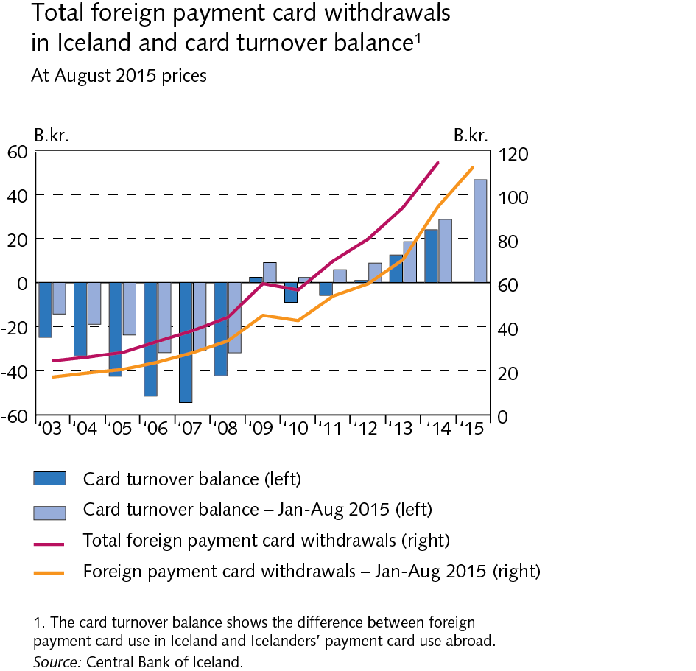
The Financial System – outlook and main risks

Slide 3
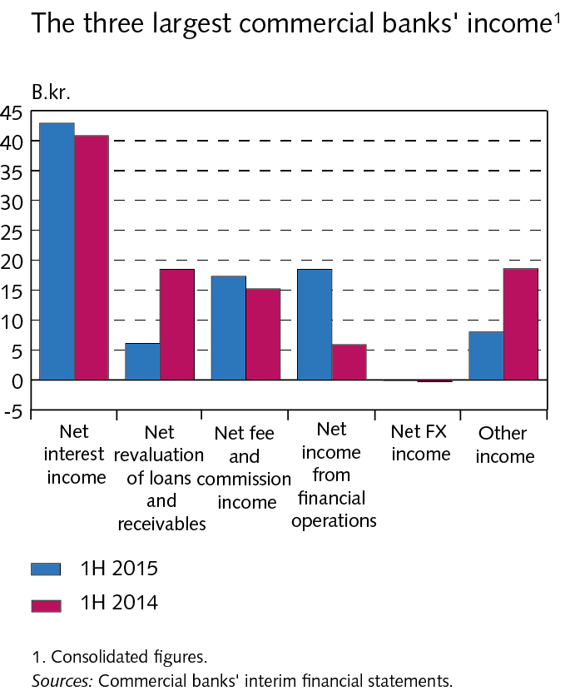
The Financial System – outlook and main risks

Slide 4
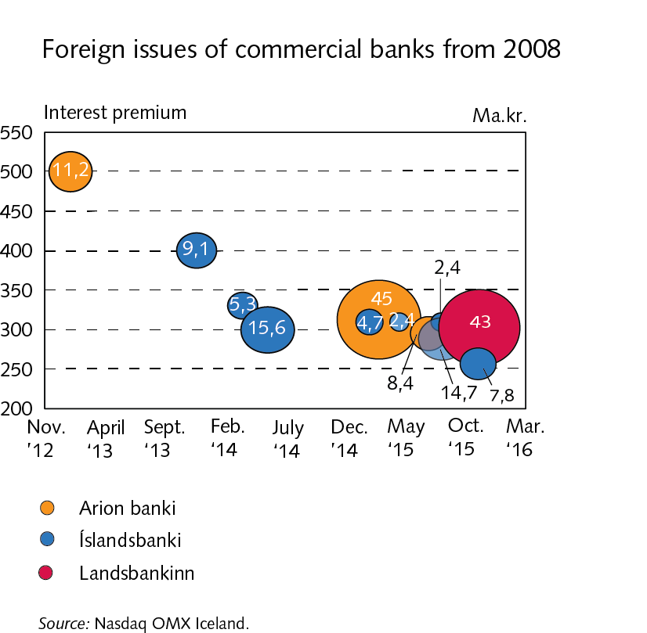
The Financial System – outlook and main risks

Slide 5
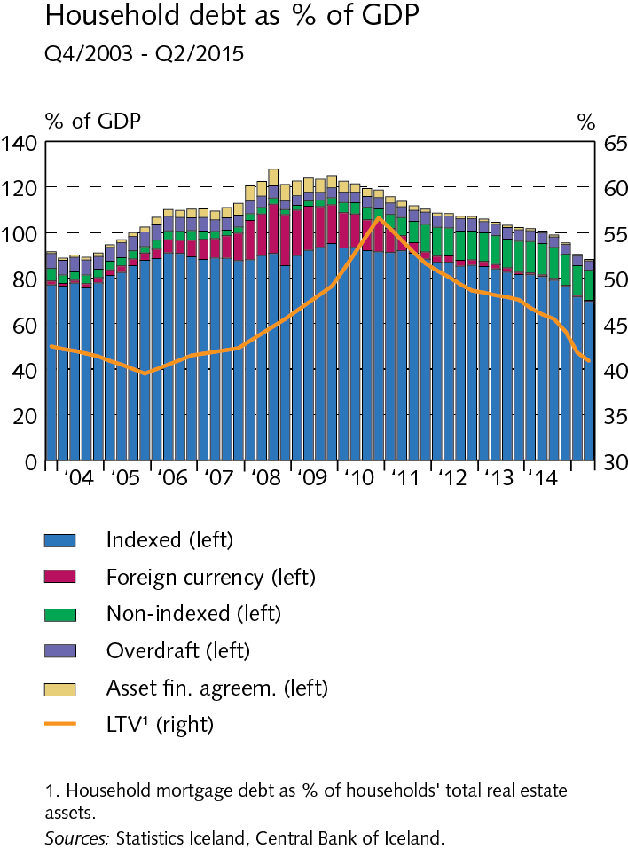
The Financial System – outlook and main risks

Slide 6
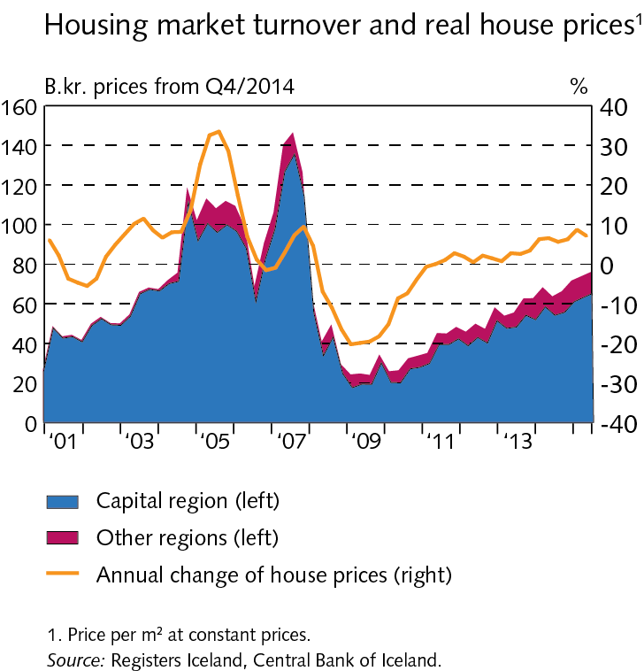
The Financial System – outlook and main risks

Slide 7
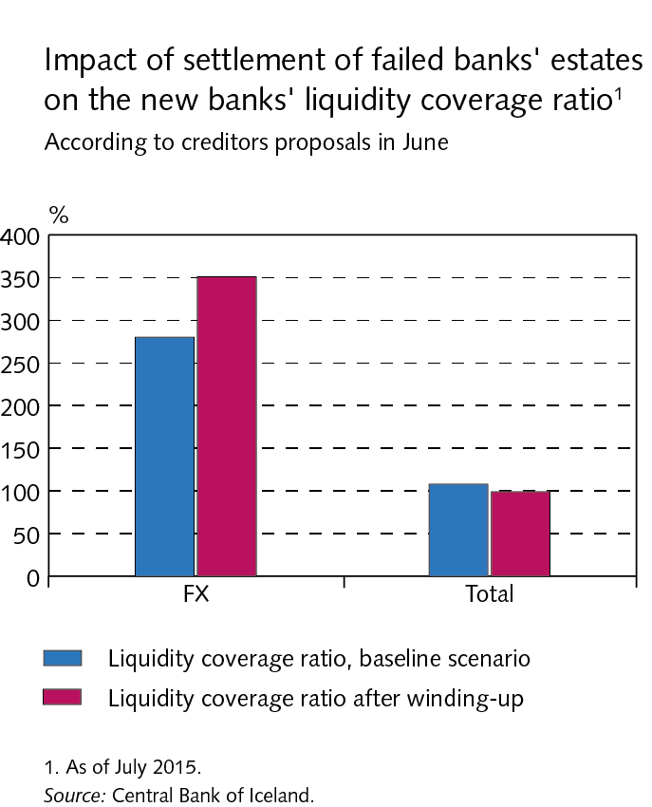
The Financial System – outlook and main risks

Slide 8
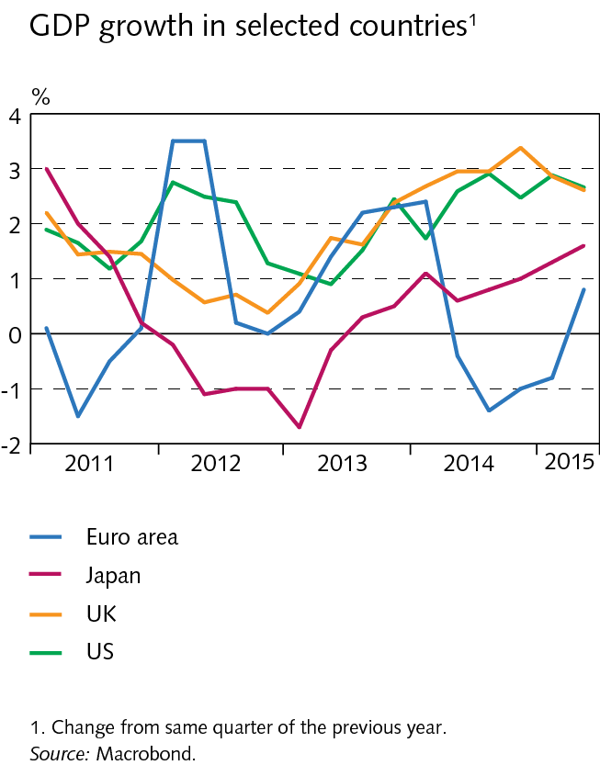
Economic environment

Slide 9
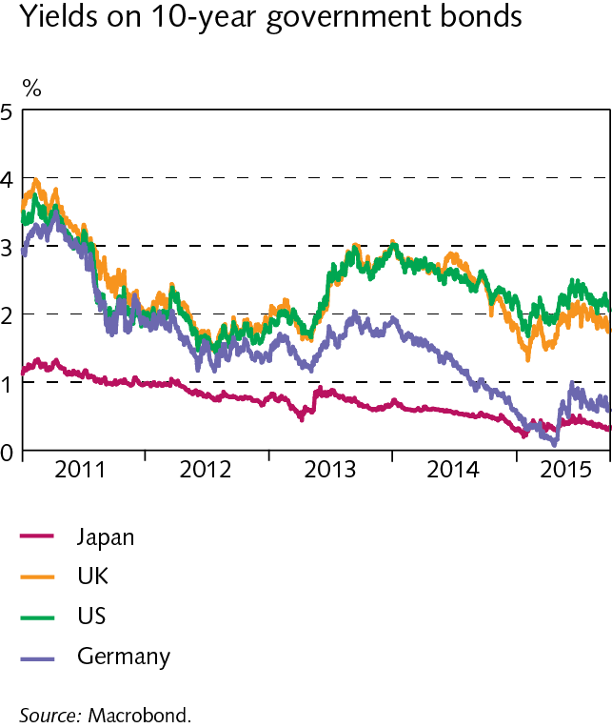
Economic environment

Slide 10
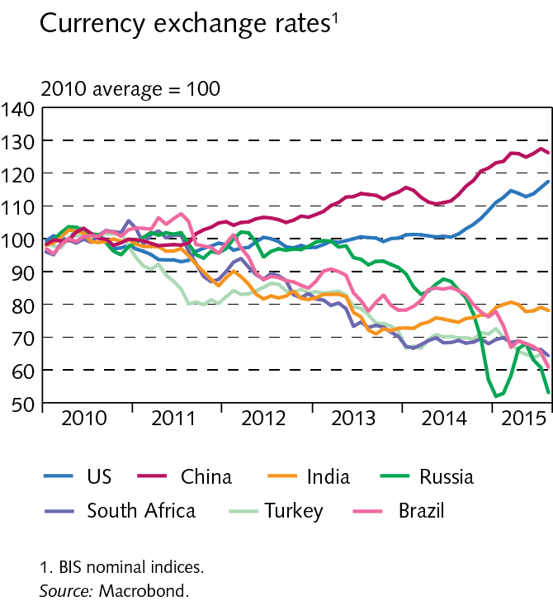
Economic environment

Slide 11
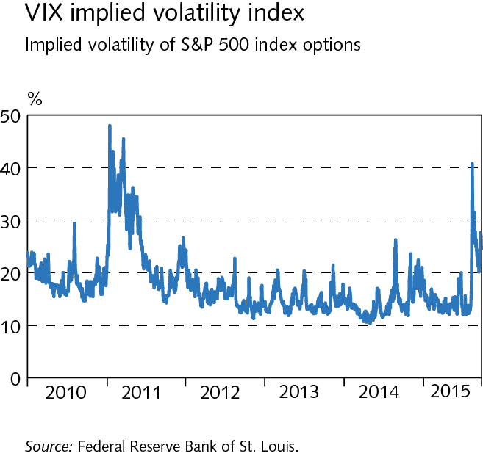
Economic environment

Slide 12
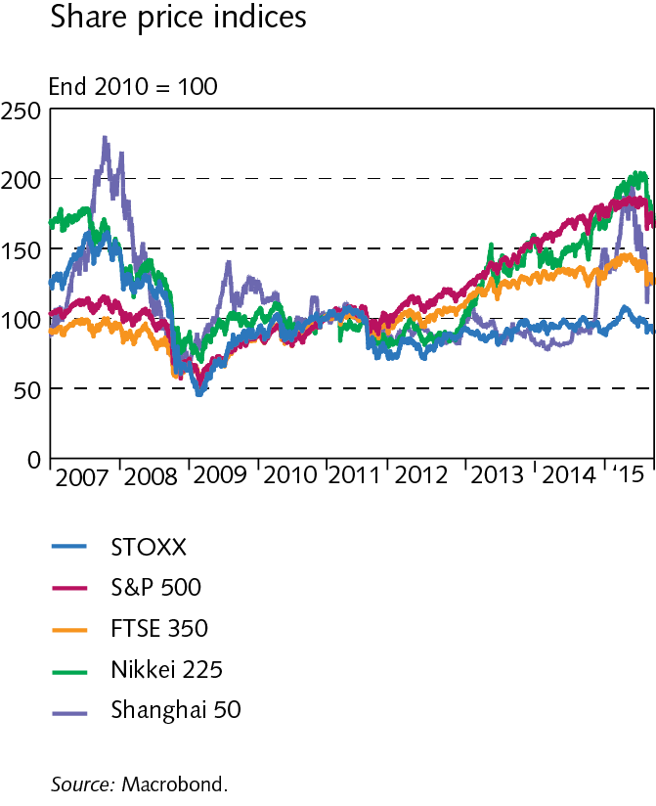
Economic environment

Slide 13
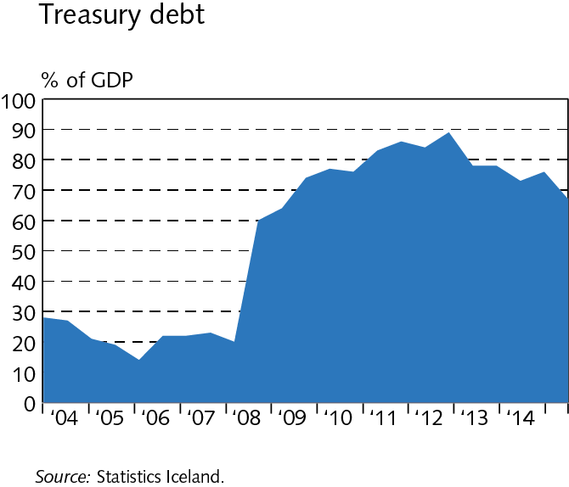
Economic environment

Slide 14
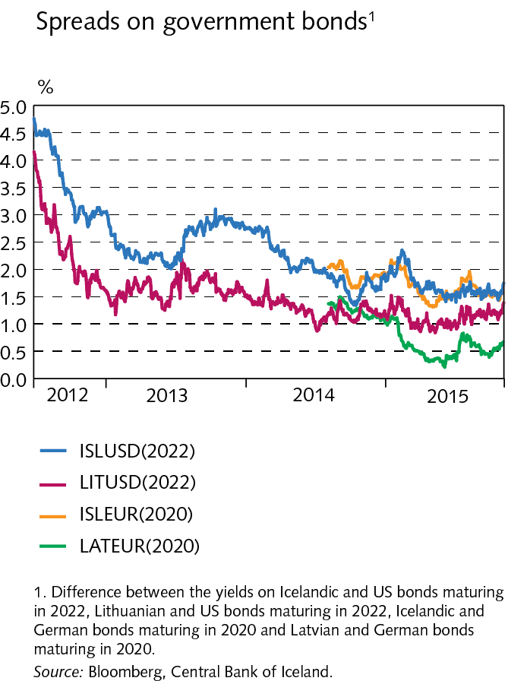
Economic environment

Slide 15
Domestic markets

Slide 16
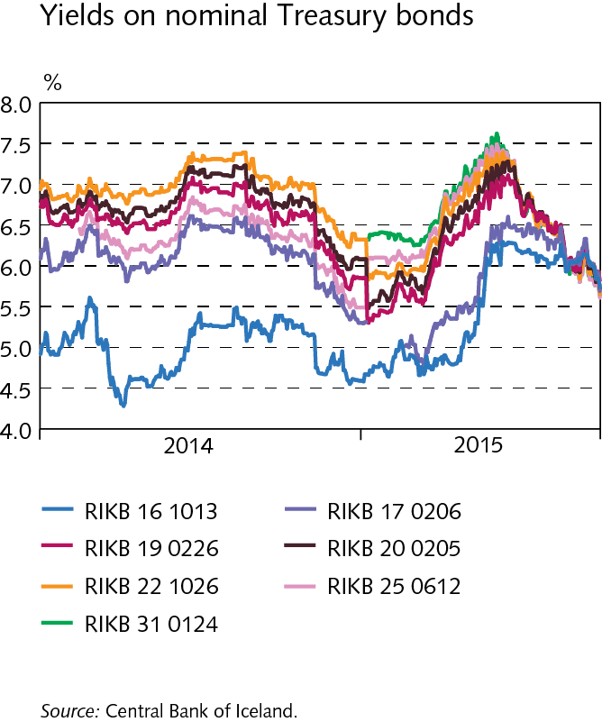
Domestic markets

Slide 17
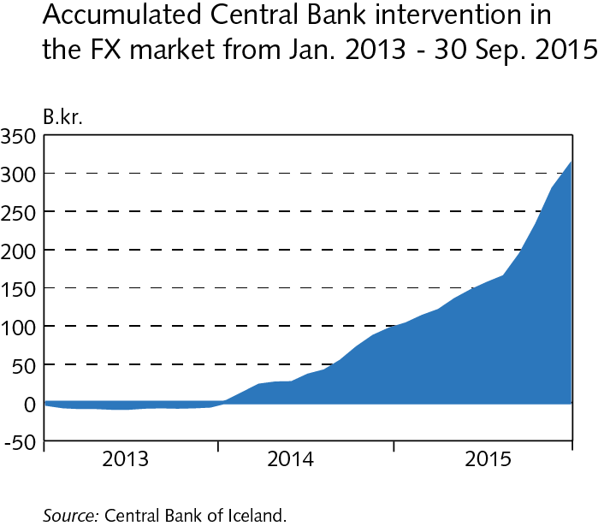
Domestic markets

Slide 18
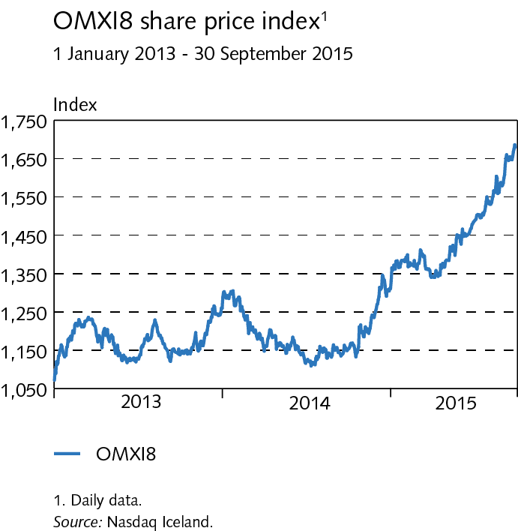
Domestic markets

Slide 19
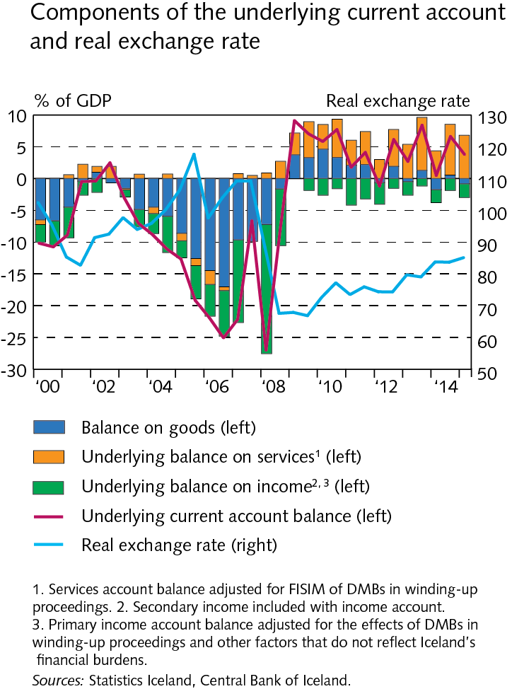
External postition

Slide 20
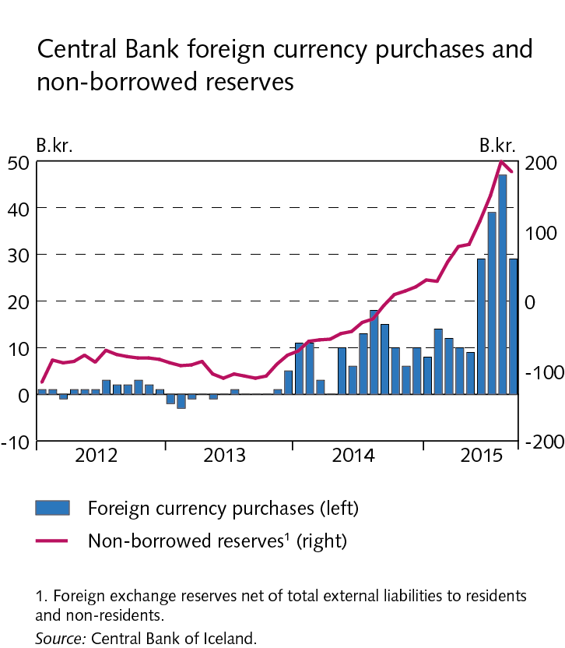
External postition

Slide 21
External postition

Slide 22
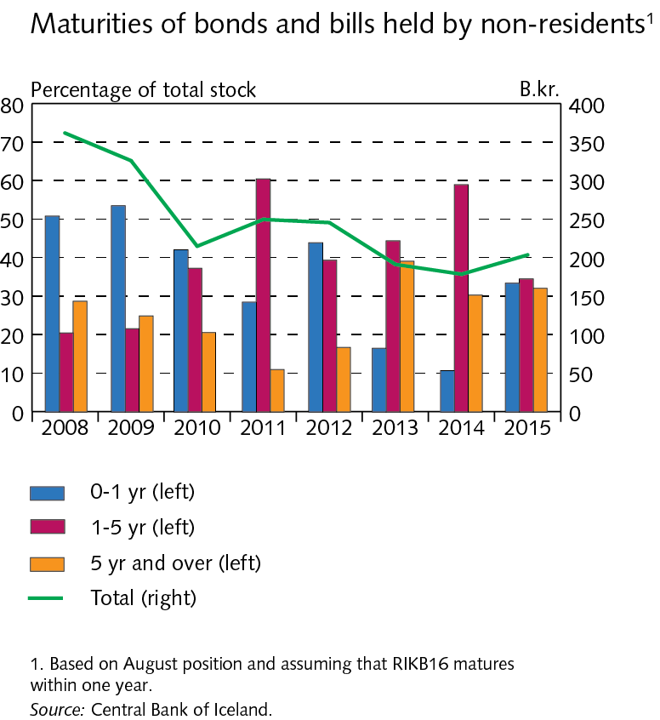
External postition

Slide 23
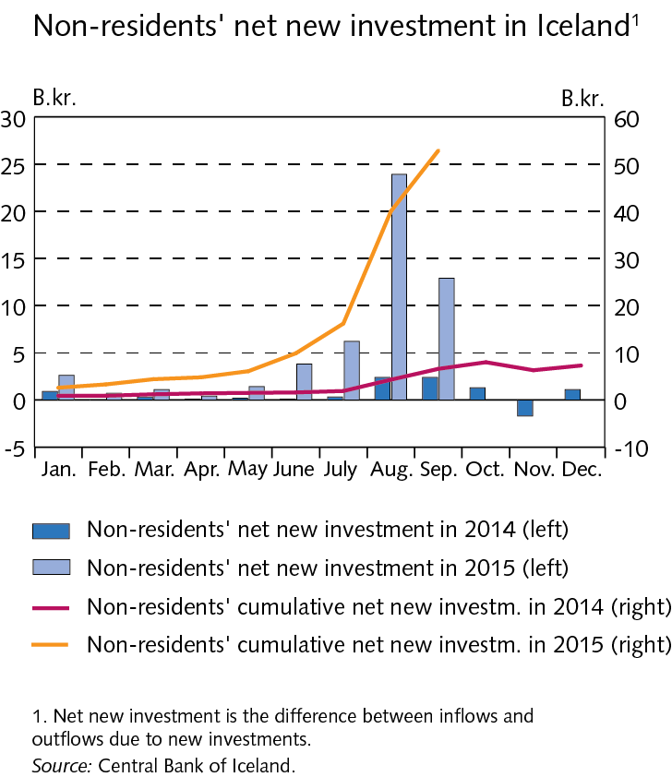
External postition

Slide 24
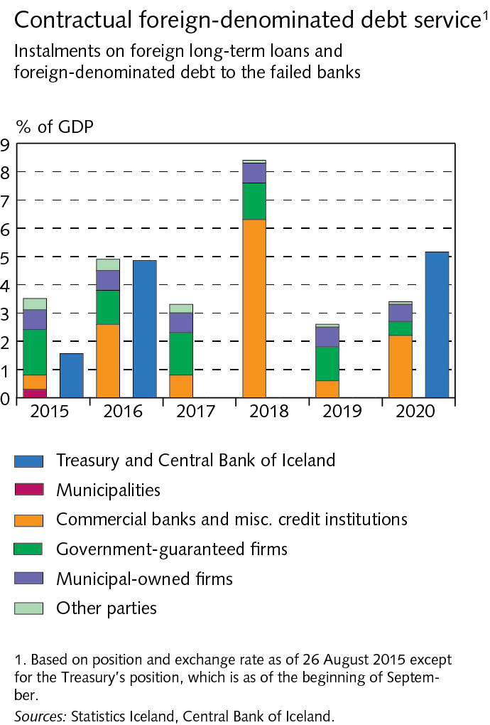
External postition

Slide 25
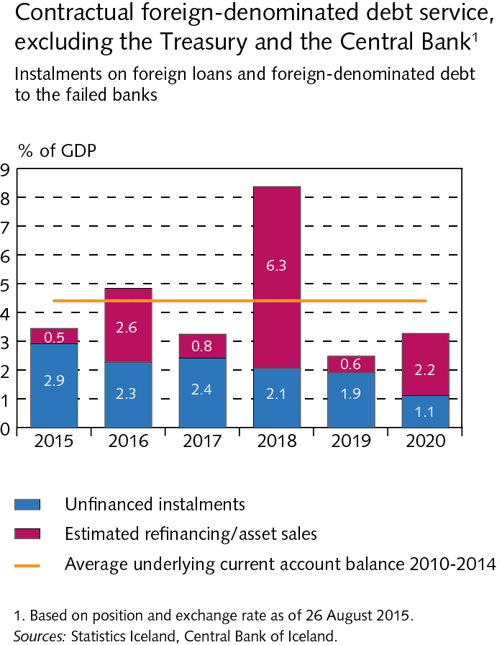
External postition

Slide 26
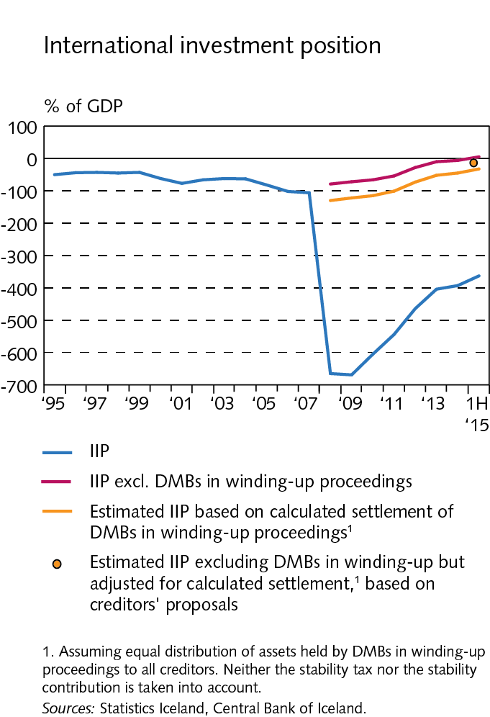
External postition

Slide 27
External postition

Slide 28
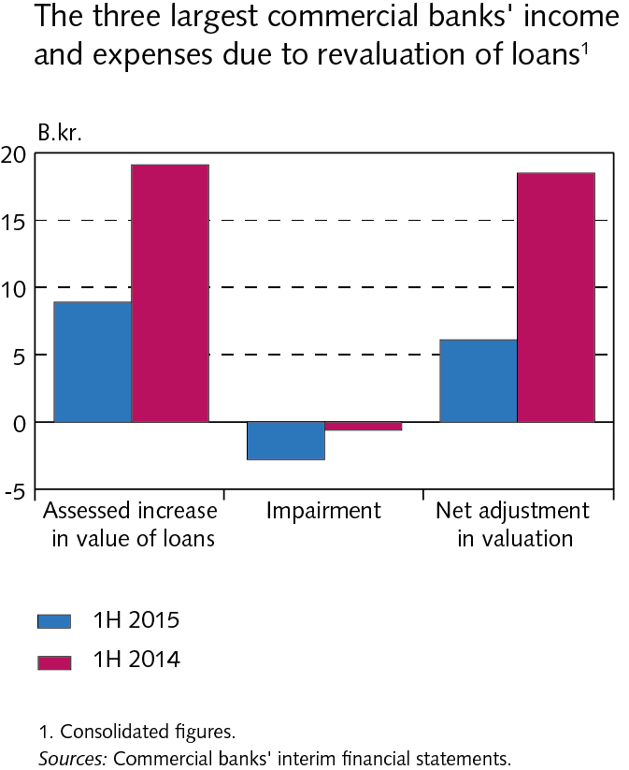
External postition

Slide 29
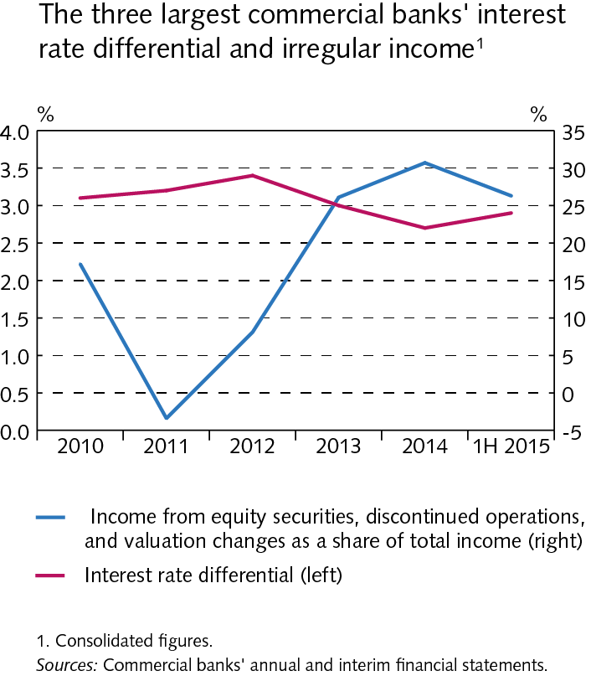
Operations and equity

Slide 30
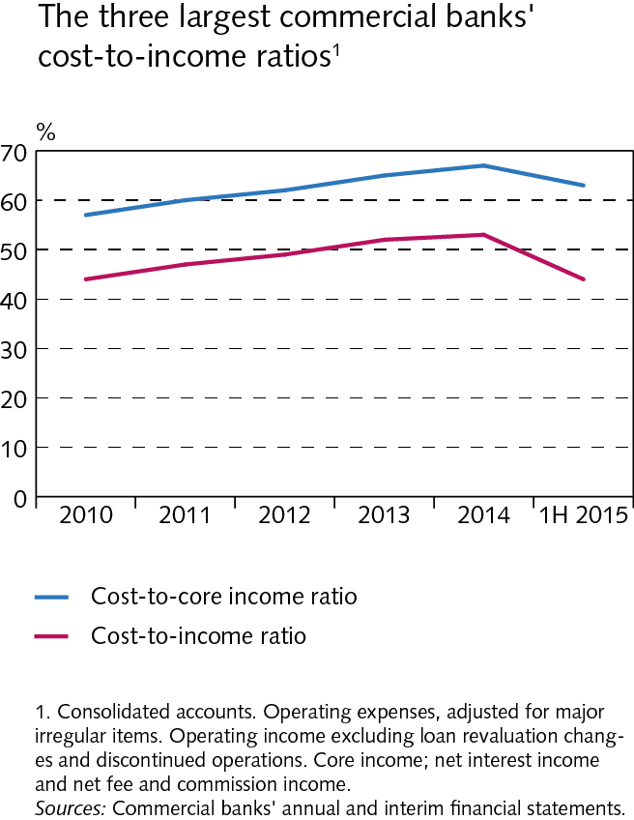
Operations and equity

Slide 31
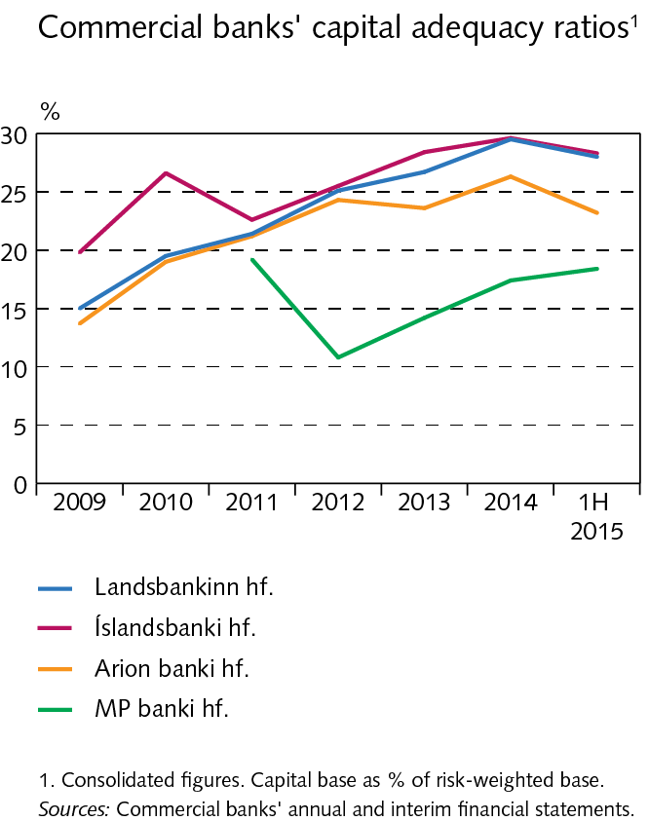
Operations and equity

Slide 32
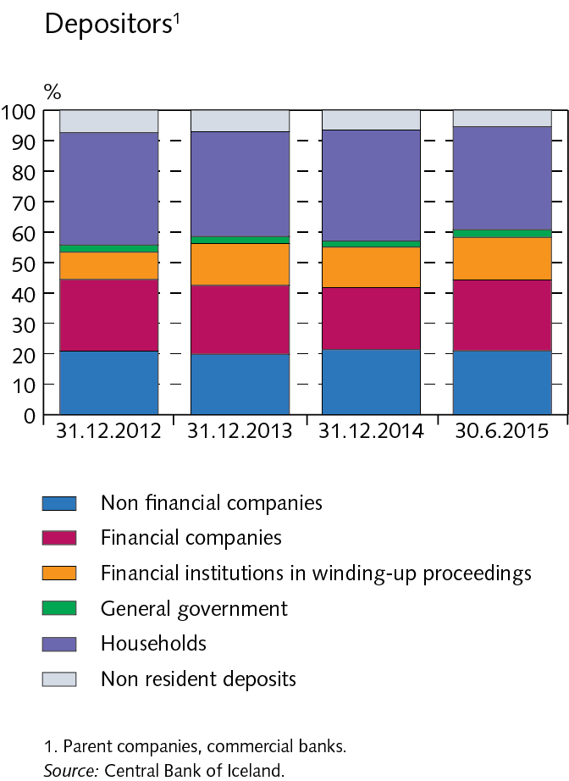
Funding and liquid funds

Slide 33
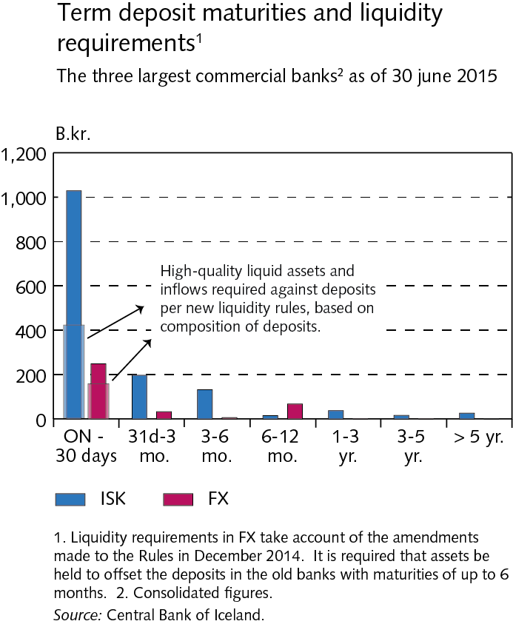
Funding and liquid funds

Slide 34
Funding and liquid funds

Slide 35
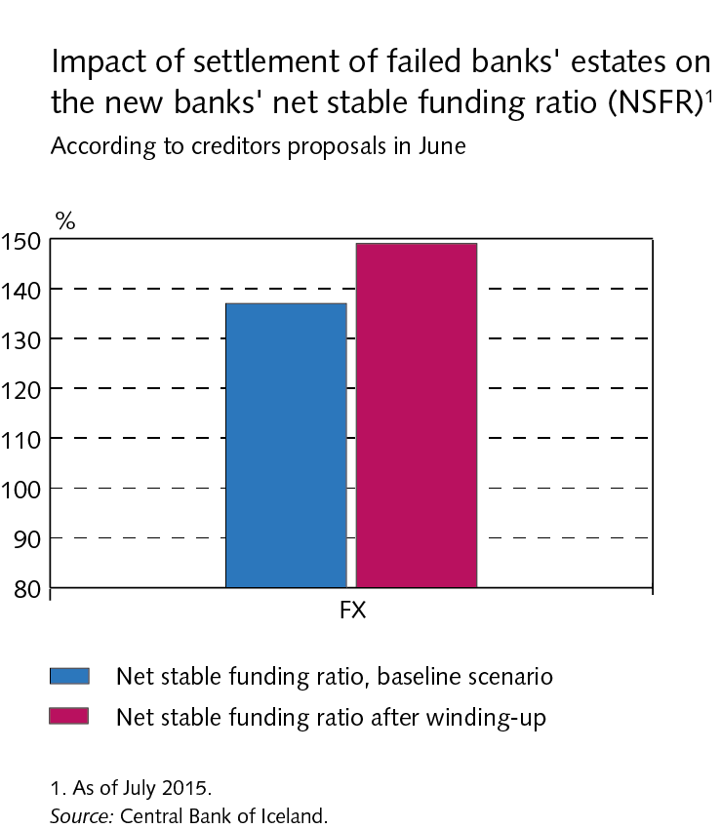
Funding and liquid funds

Slide 36
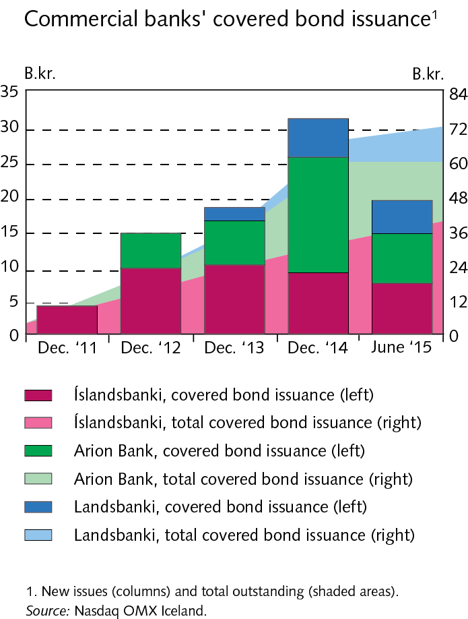
Funding and liquid funds

Slide 37
Funding and liquid funds

Slide 38
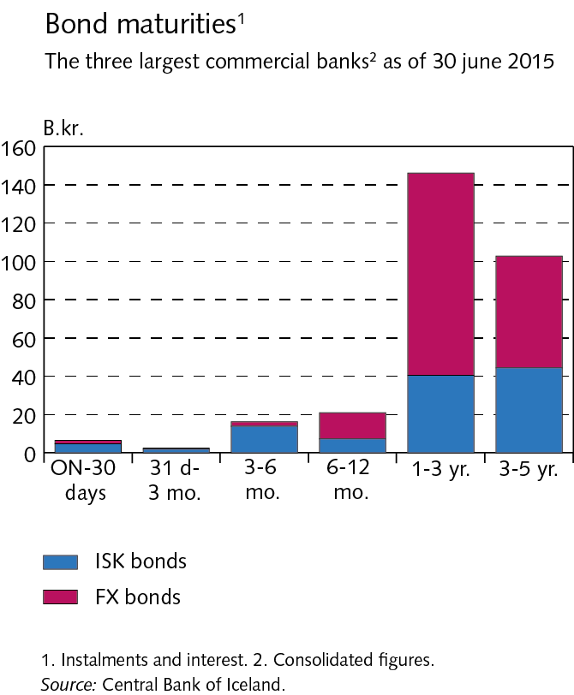
Funding and liquid funds

Slide 39
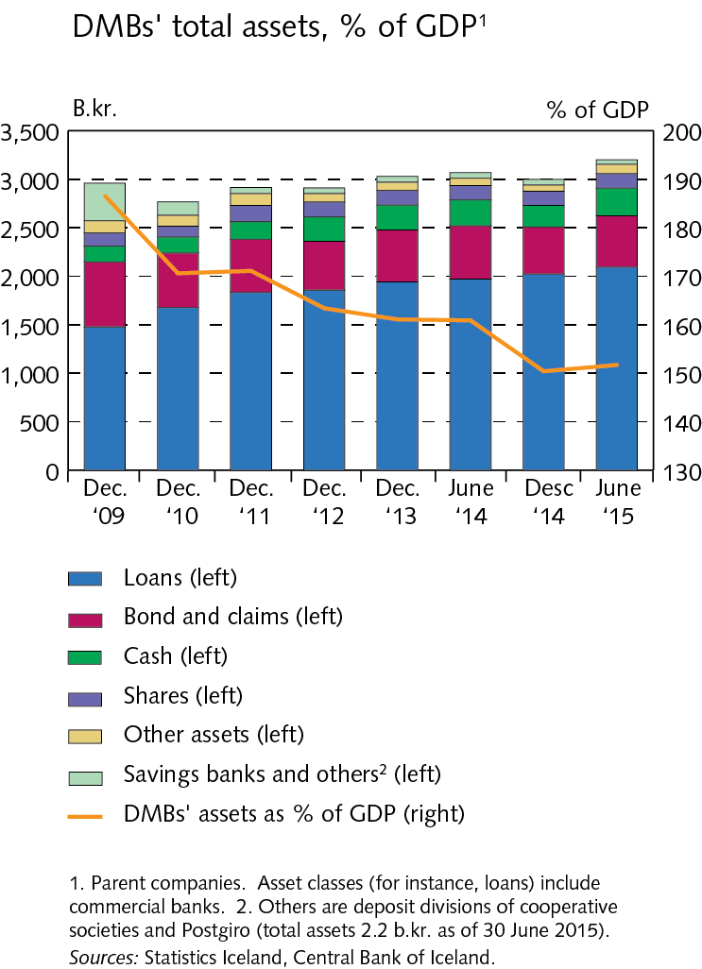
Assets of DMBs

Slide 40
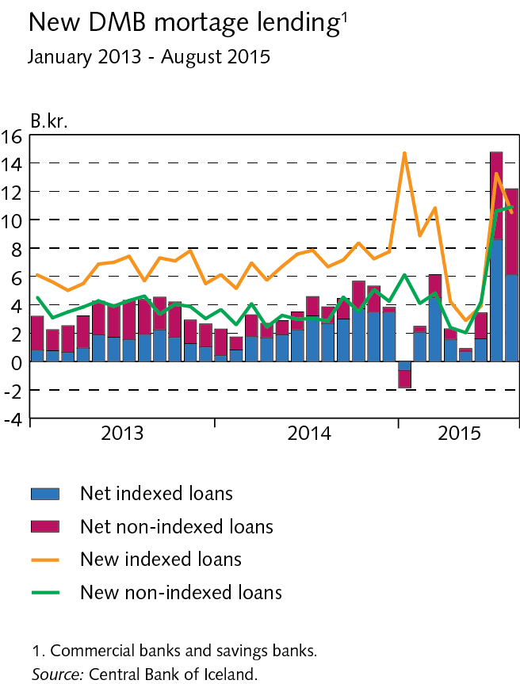
Assets of DMBs

Slide 41
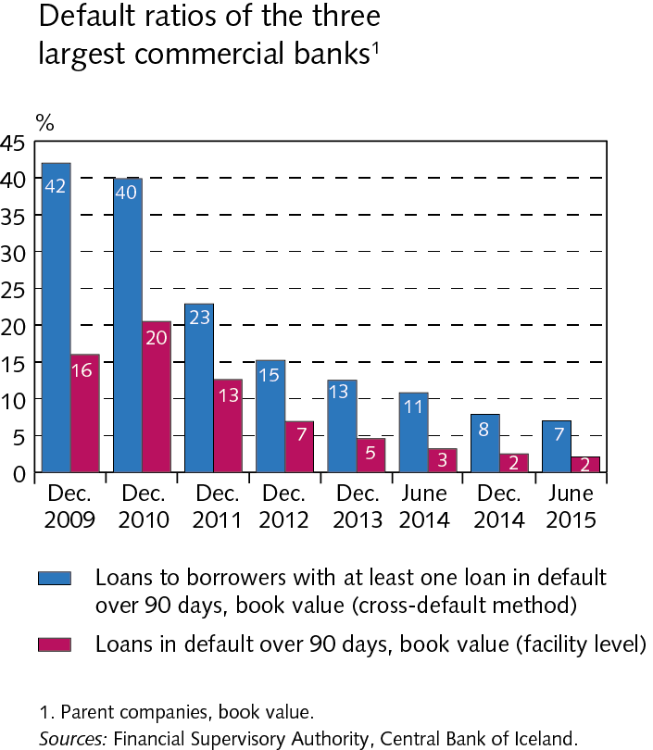
Assets of DMBs

Slide 42
Households

Slide 43
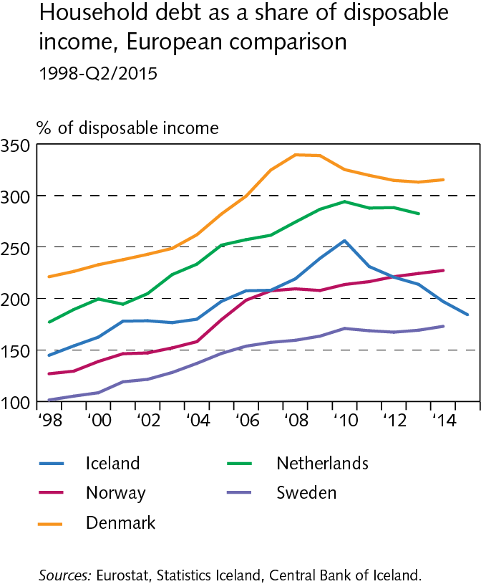
Households

Slide 44
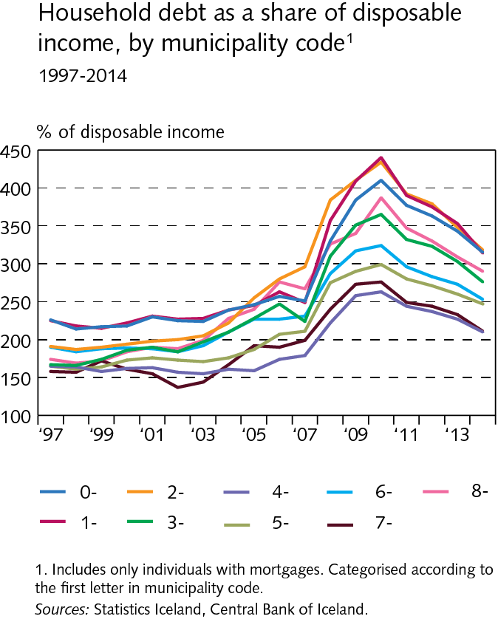
Households

Slide 45
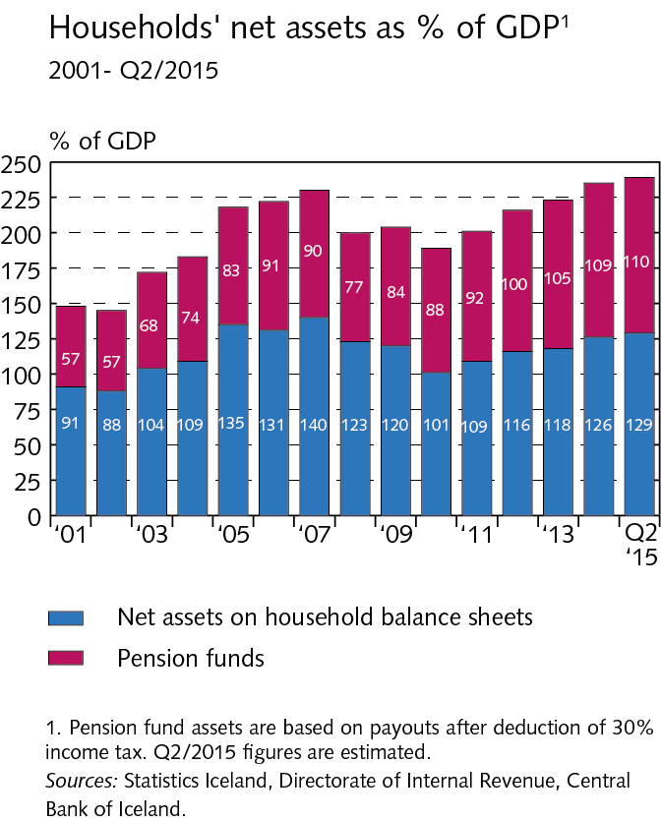
Households

Slide 46
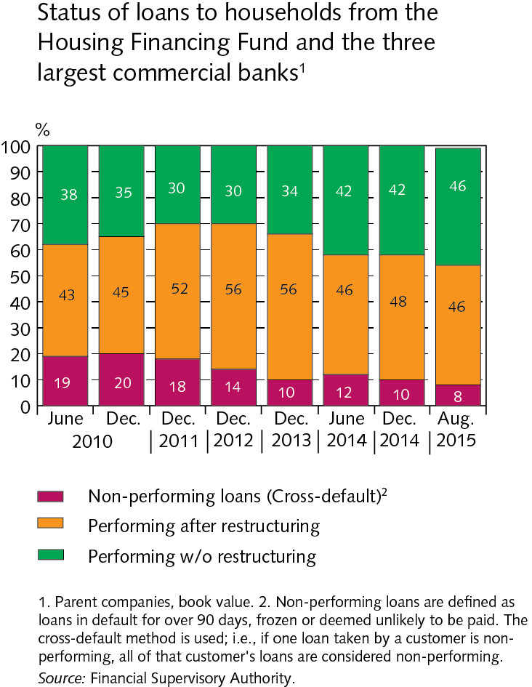
Households

Slide 47
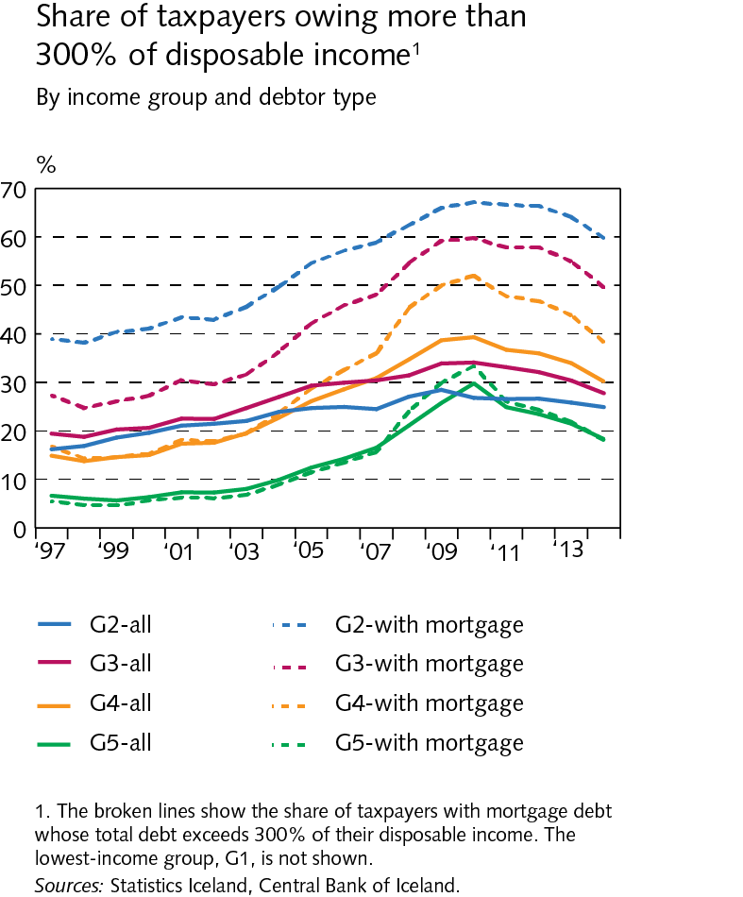
Households

Slide 48
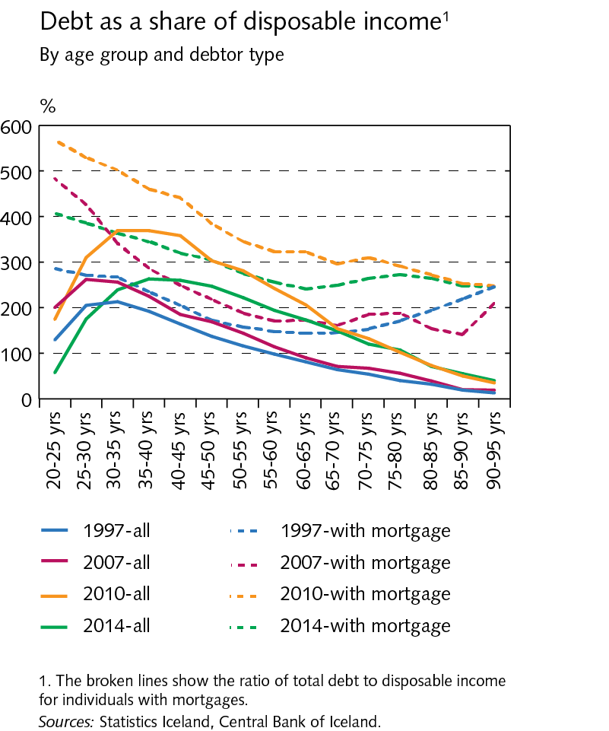
Households

Slide 49
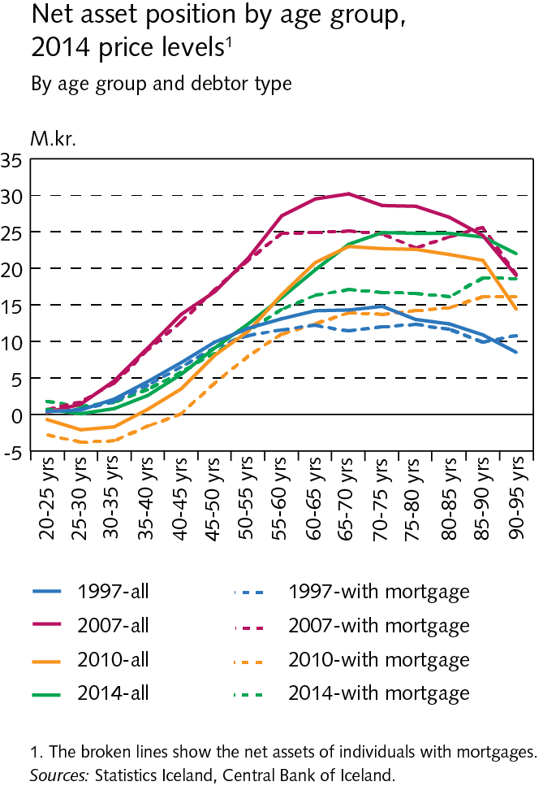
Households

Slide 50
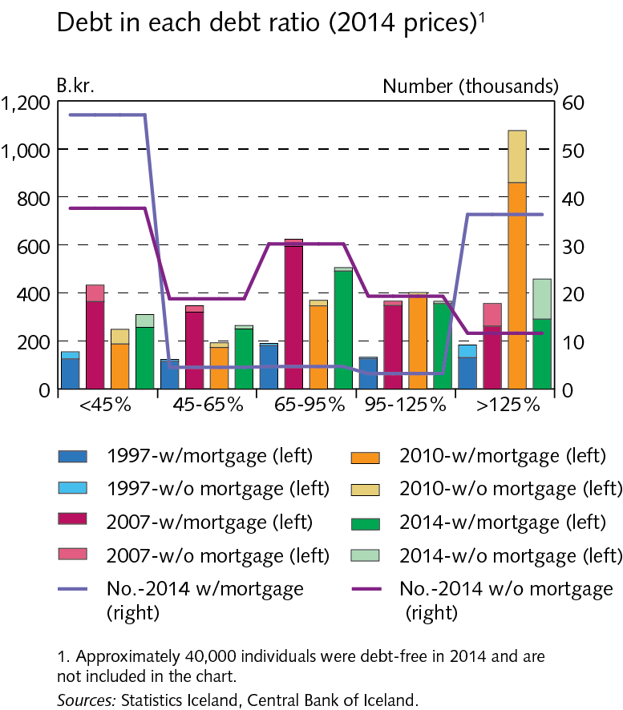
Households

Slide 51
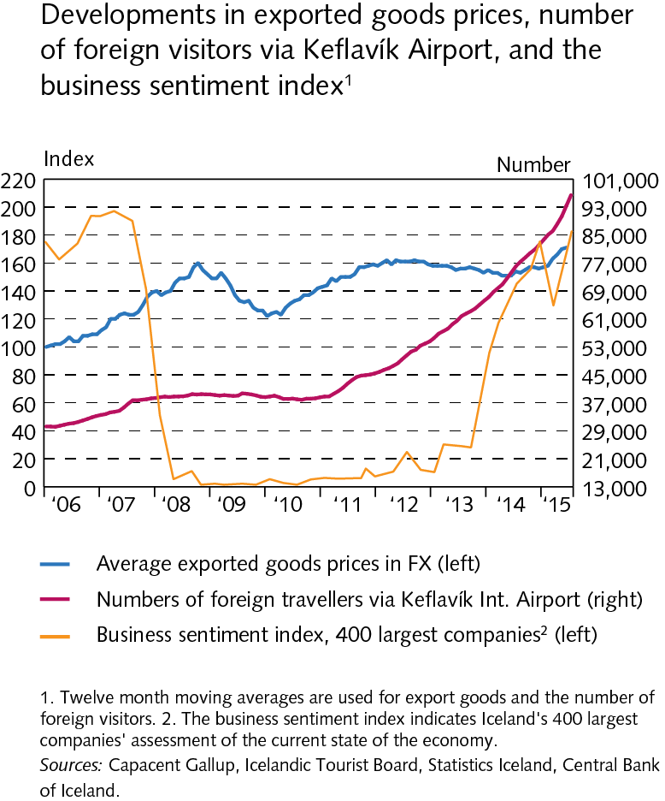
Companies

Slide 52
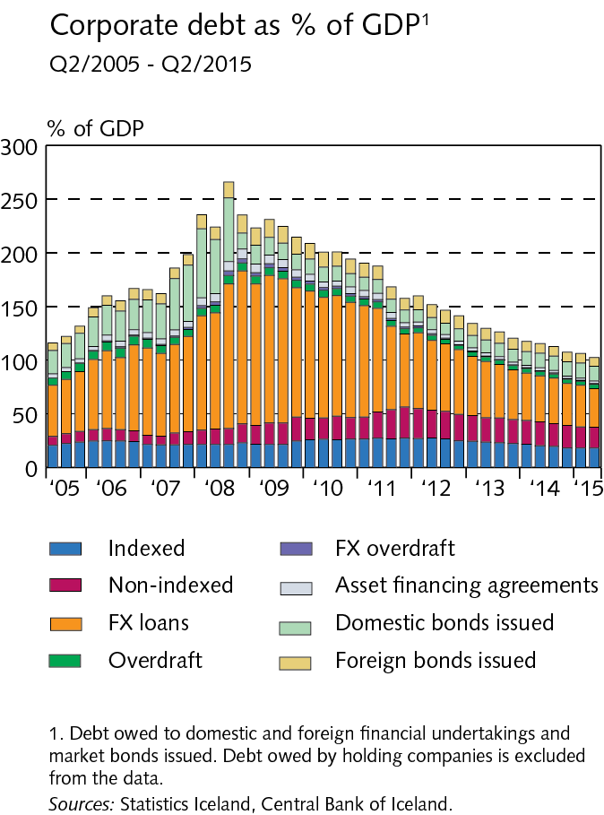
Companies

Slide 53
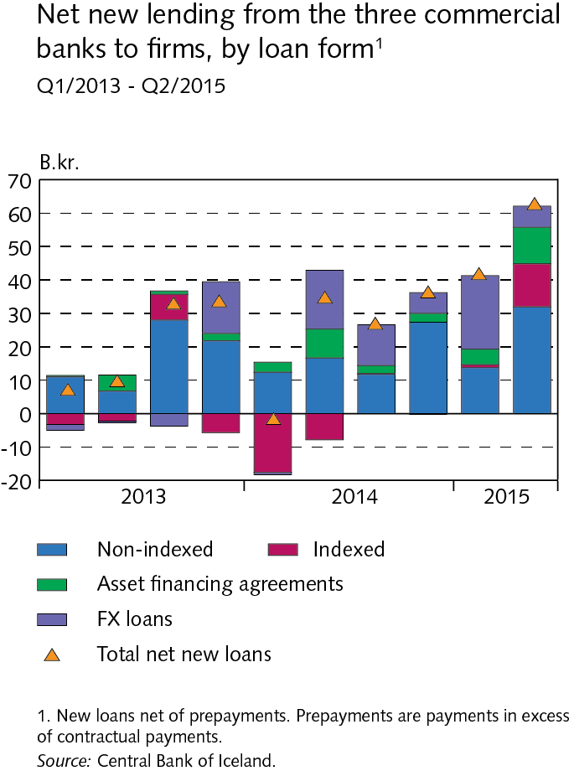
Companies

Slide 54
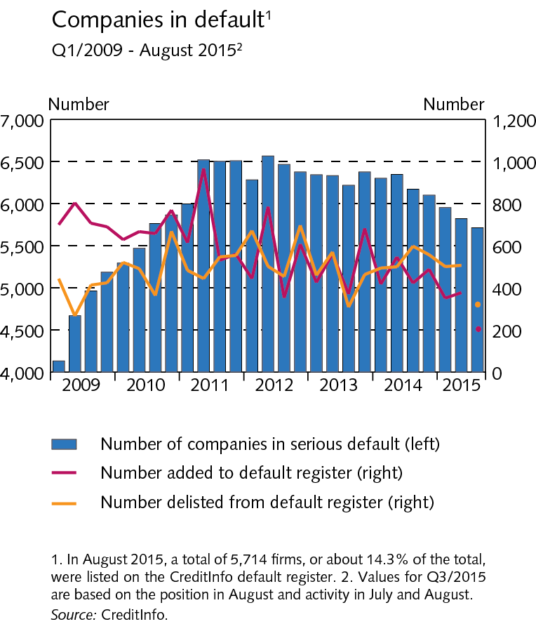
Companies

Slide 55
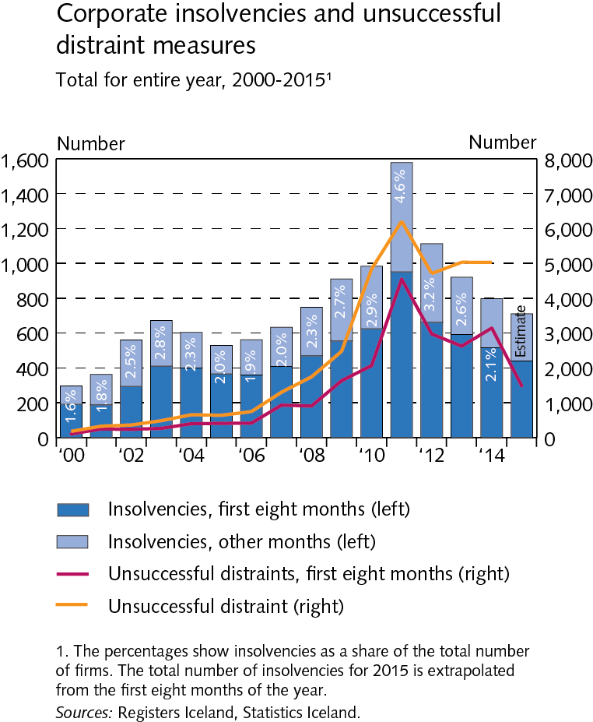
Companies

Slide 56
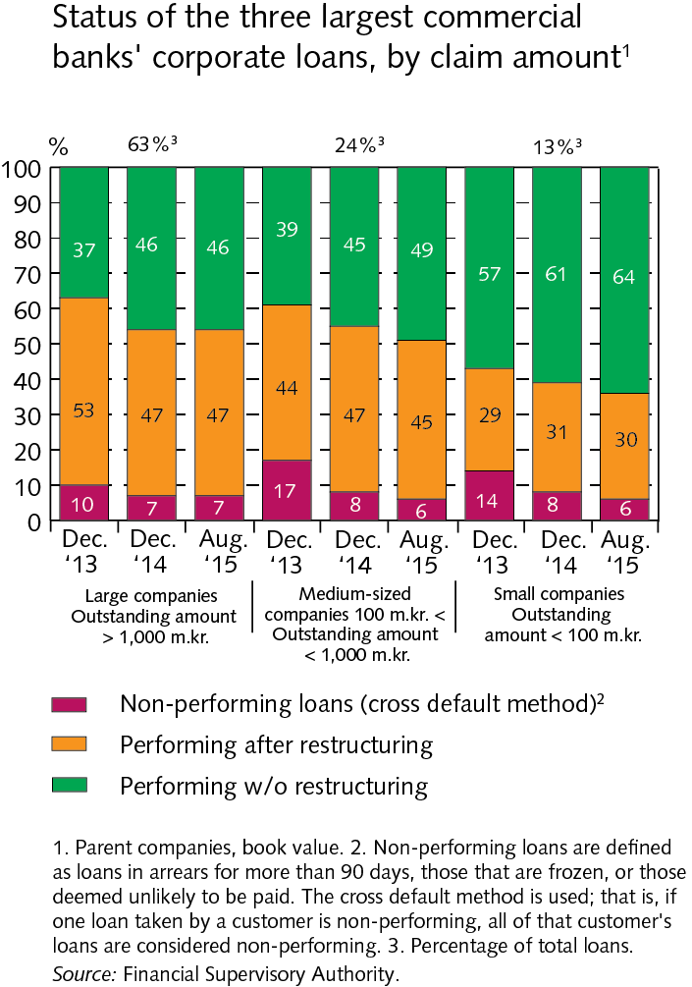
Companies

Slide 57
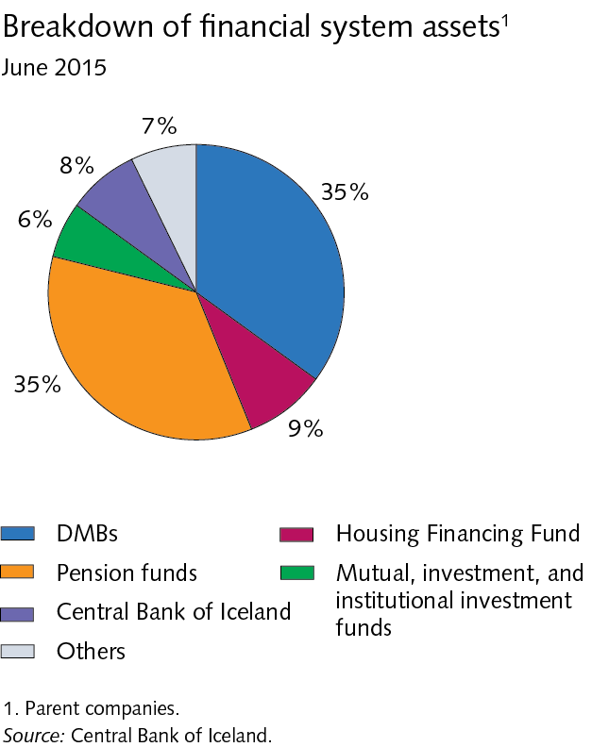
Financial market entities

Slide 58
Financial market entities

Slide 59
Financial market entities

Slide 60
Financial market entities

Slide 61
Financial market entities

Slide 62
Financial market entities

Slide 63
Settlement of the failed banks´ estates

Slide 64
Settlement of the failed banks´ estates

Slide 65
Settlement of the failed banks´ estates

Slide 66
Settlement of the failed banks´ estates

Slide 67
Settlement of the failed banks´ estates

Slide 68
Stress test

Slide 69
Stress test

Slide 70
Stress test

Slide 71
Stress test

Slide 72
Stress test

Slide 73
Stress test

Slide 74
Stress test

Slide 75
Stress test

Slide 76
Stress test

Slide 77
Stress test

Slide 78
Stress test

Slide 79
Stress test

Slide 80
Appendix II

Slide 81
Appendix II

Slide 82
Appendix II

Slide 83
Appendix II

Slide 84
Appendix II

Slide 85
Appendix II

