Slide 1
Central Bank of Iceland
Financial Stability report 2015/1
Charts

Slide 2
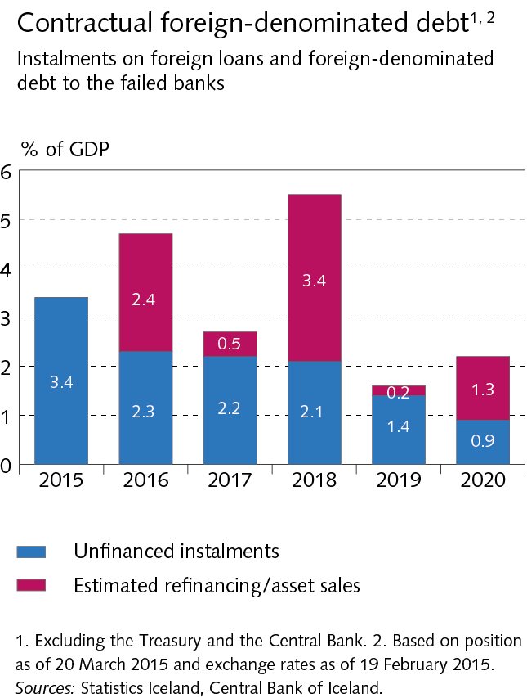
The Financial System – outlook and main risks

Slide 3
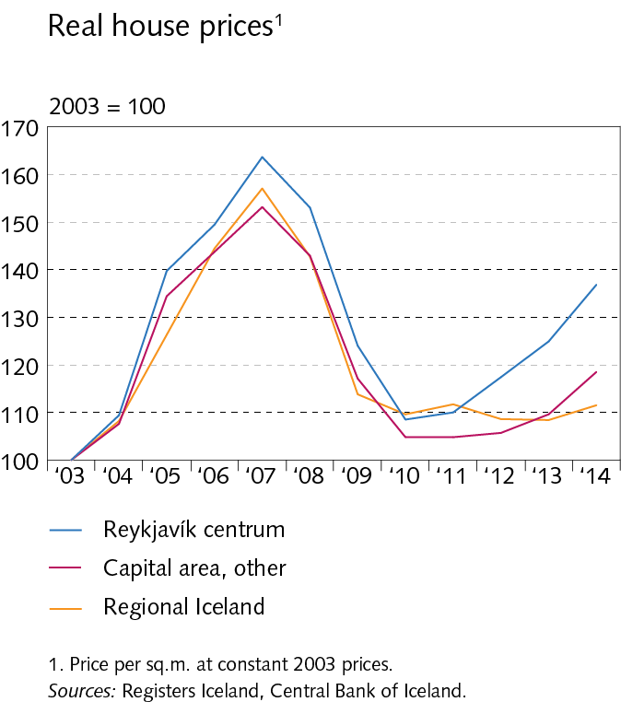
The Financial System – outlook and main risks

Slide 4
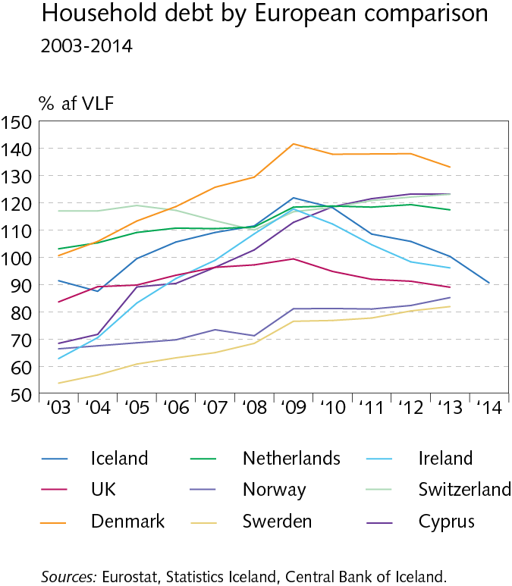
The Financial System – outlook and main risks

Slide 5
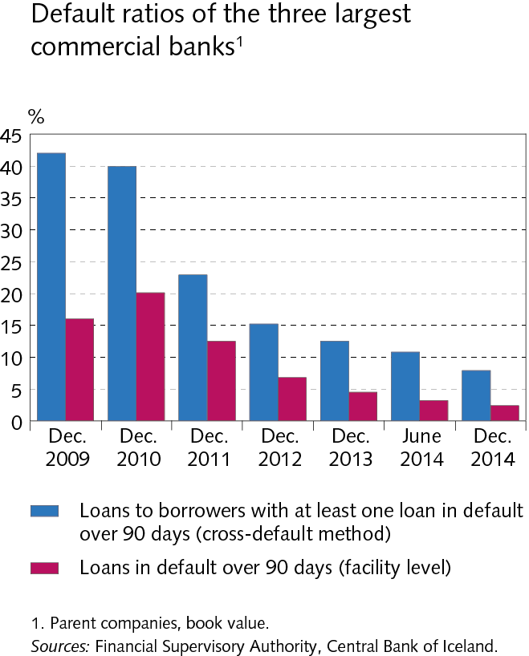
The Financial System – outlook and main risks

Slide 6
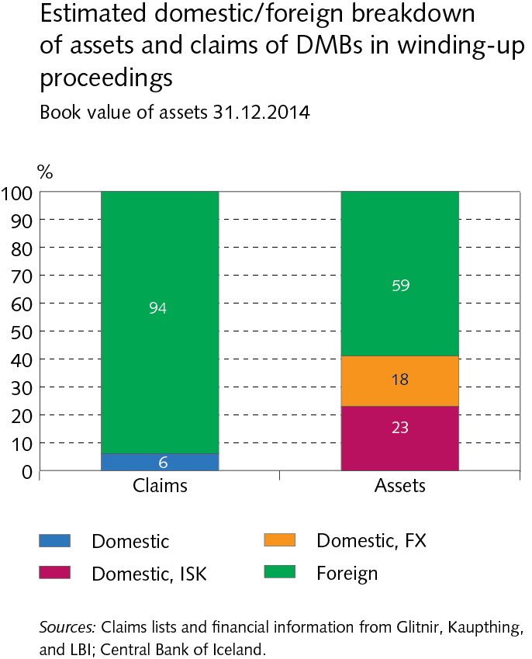
The Financial System – outlook and main risks

Slide 7
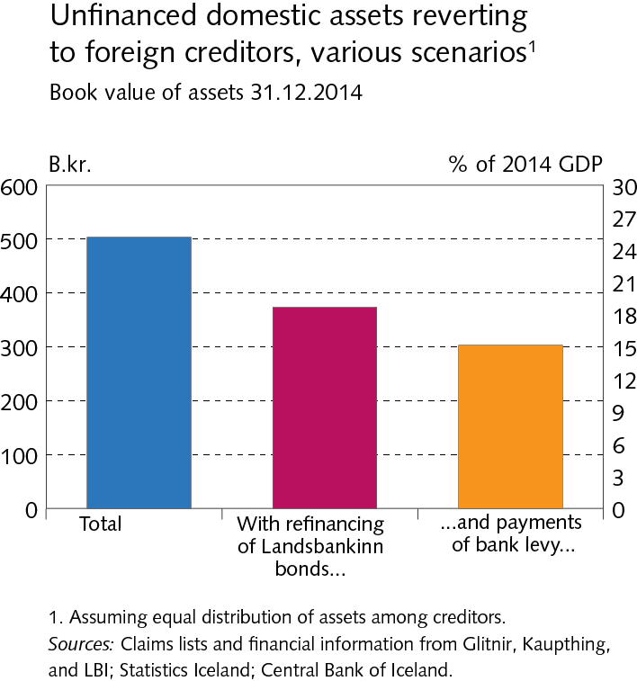
The Financial System – outlook and main risks

Slide 8
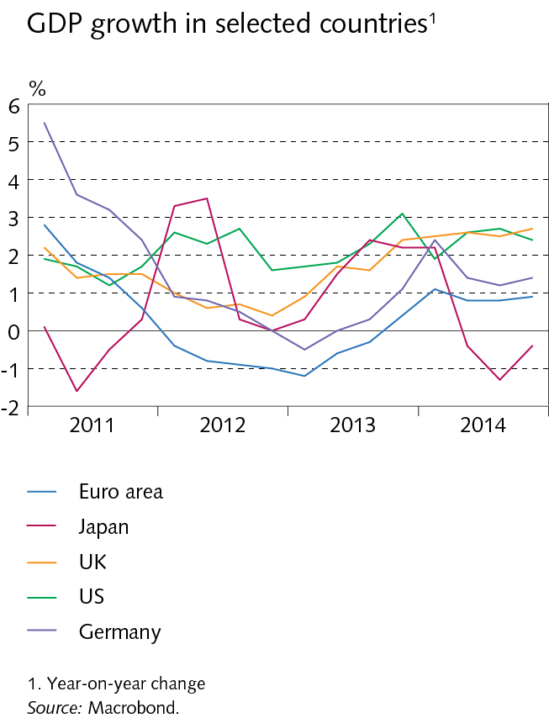
I Economic environment

Slide 9
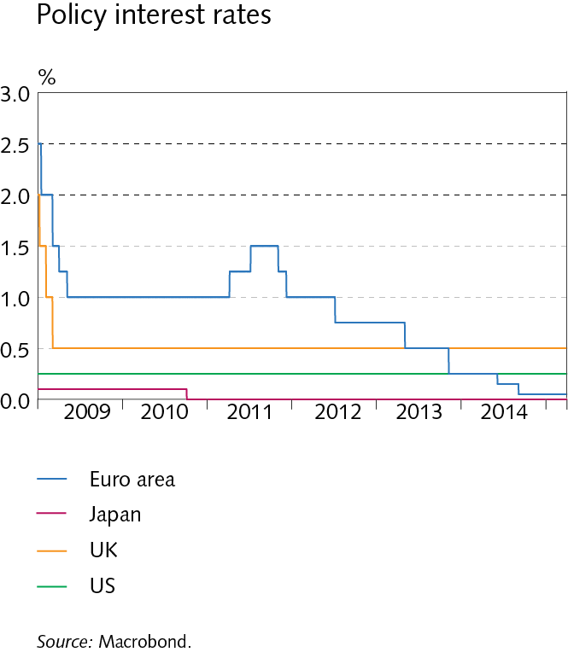
I Economic environment

Slide 10
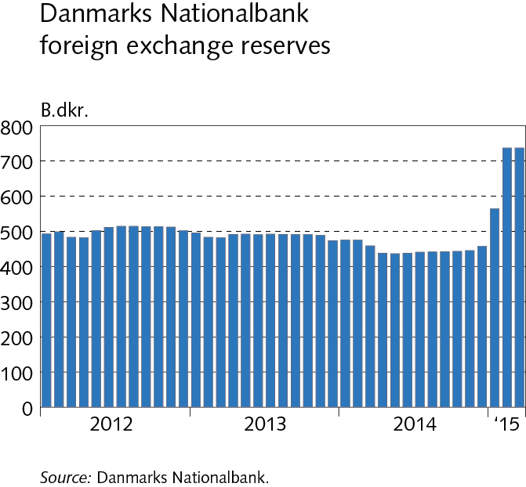
I Economic environment

Slide 11
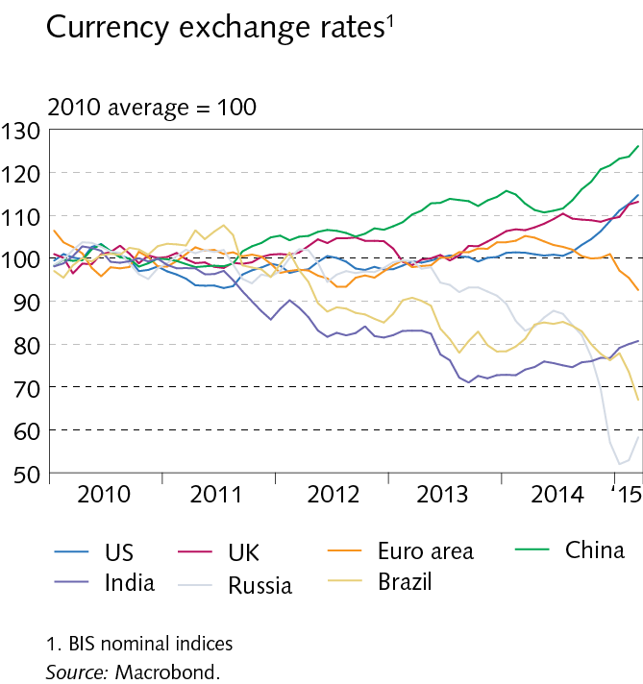
I Economic environment

Slide 12
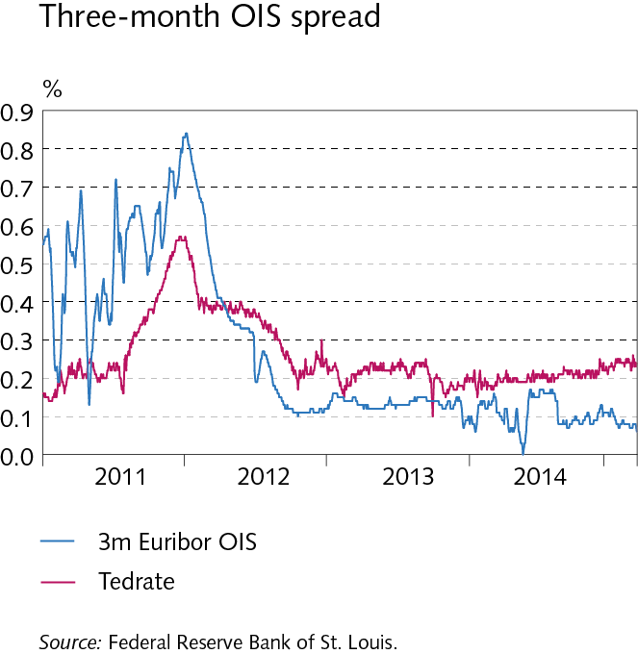
I Economic environment

Slide 13
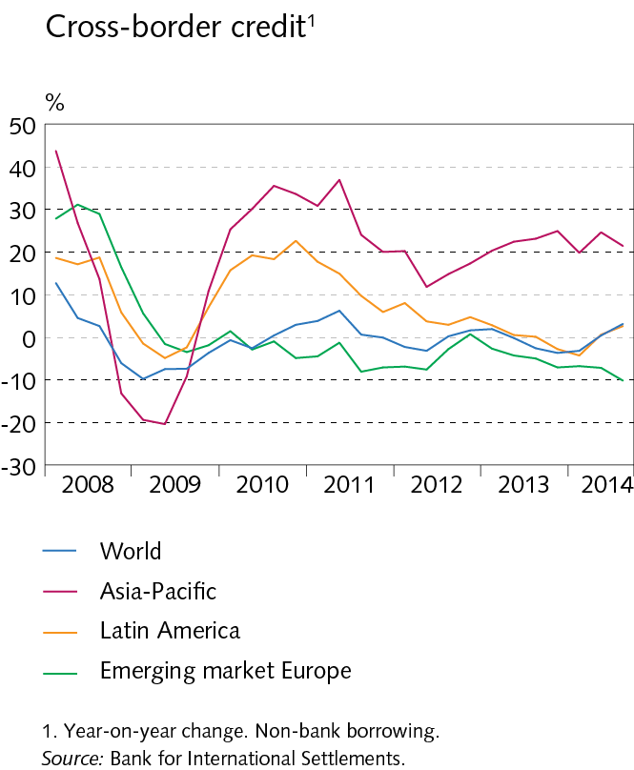
I Economic environment

Slide 14
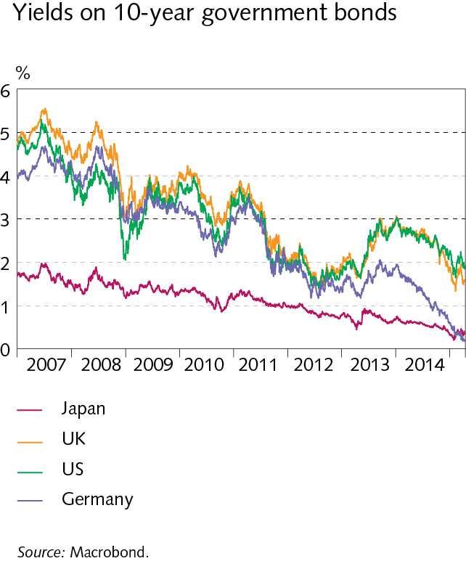
I Economic environment

Slide 15
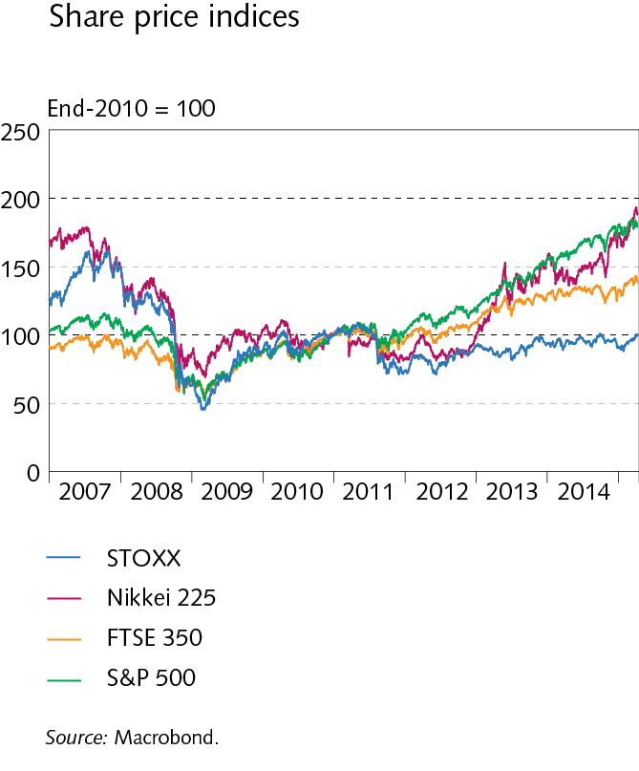
I Economic environment

Slide 16
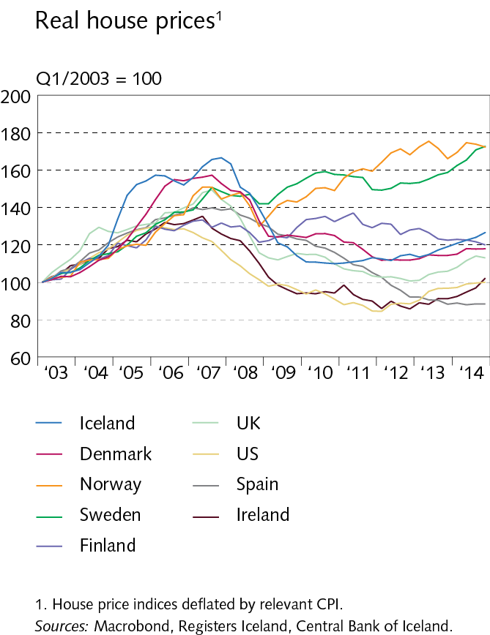
I Economic environment

Slide 17
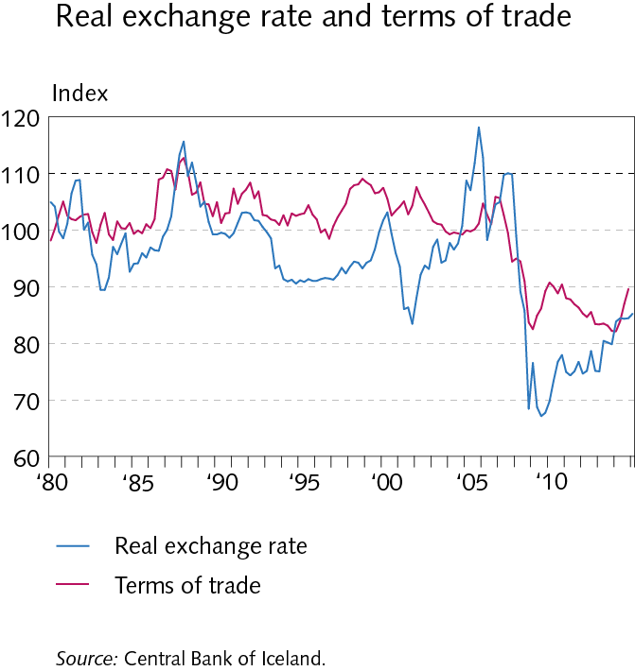
I Economic environment

Slide 18
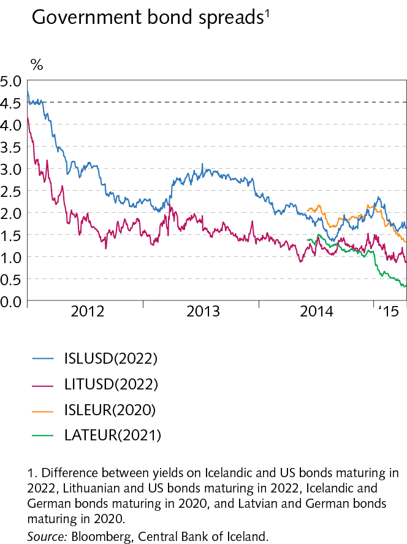
I Economic environment

Slide 19
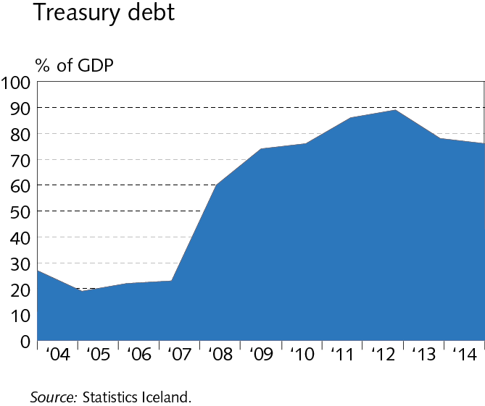
I Economic environment

Slide 20
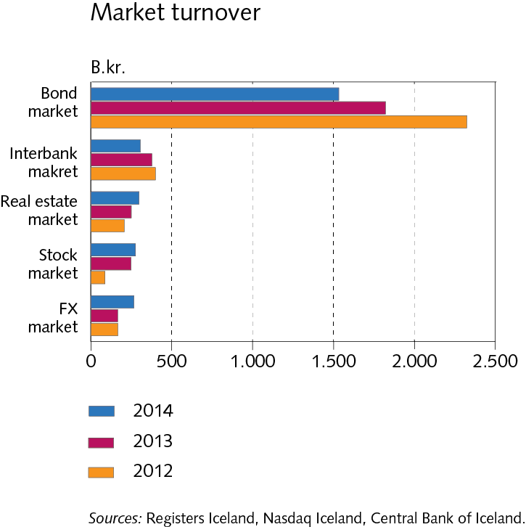
I Economic environment

Slide 21
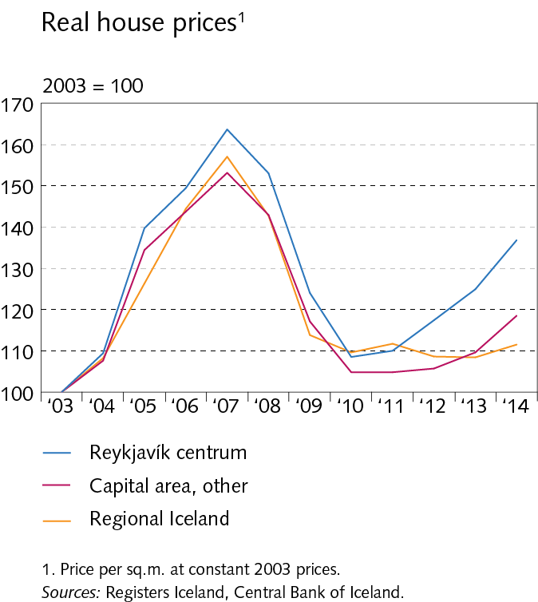
I Economic environment

Slide 22
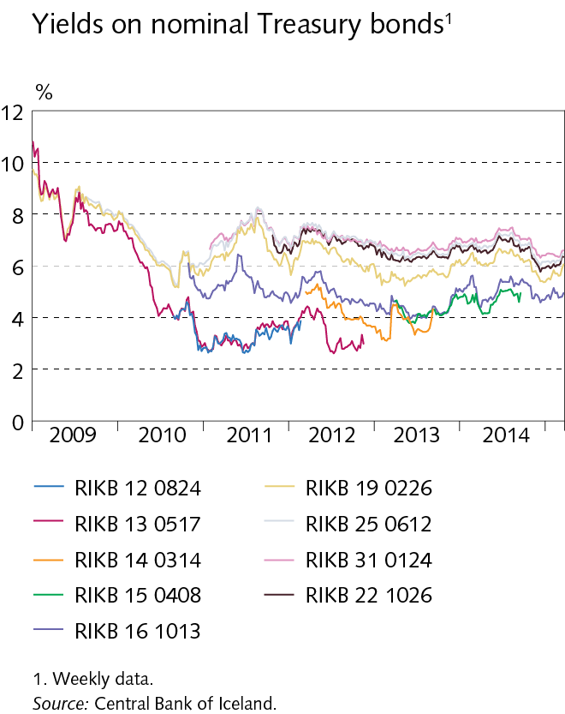
I Economic environment

Slide 23
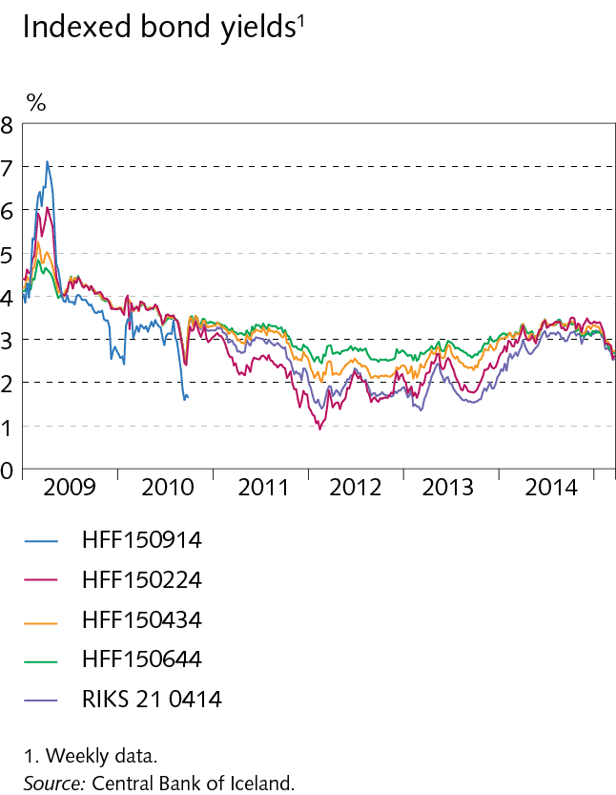
I Economic environment

Slide 24
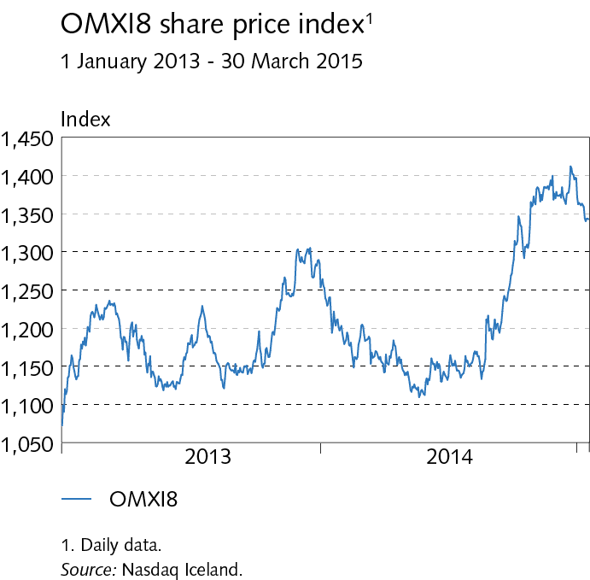
I Economic environment

Slide 25
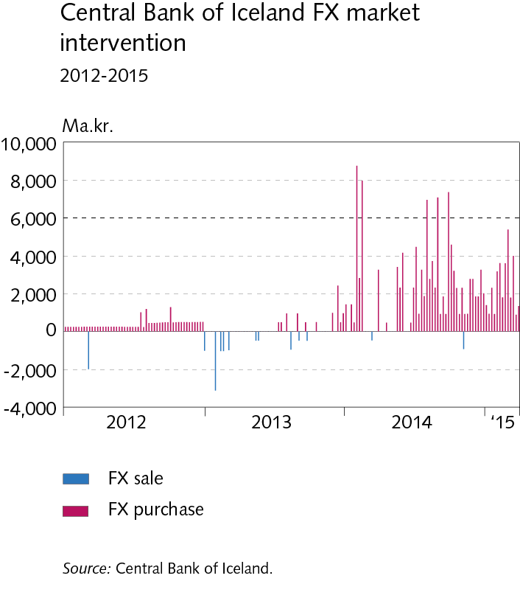
I Economic environment

Slide 26
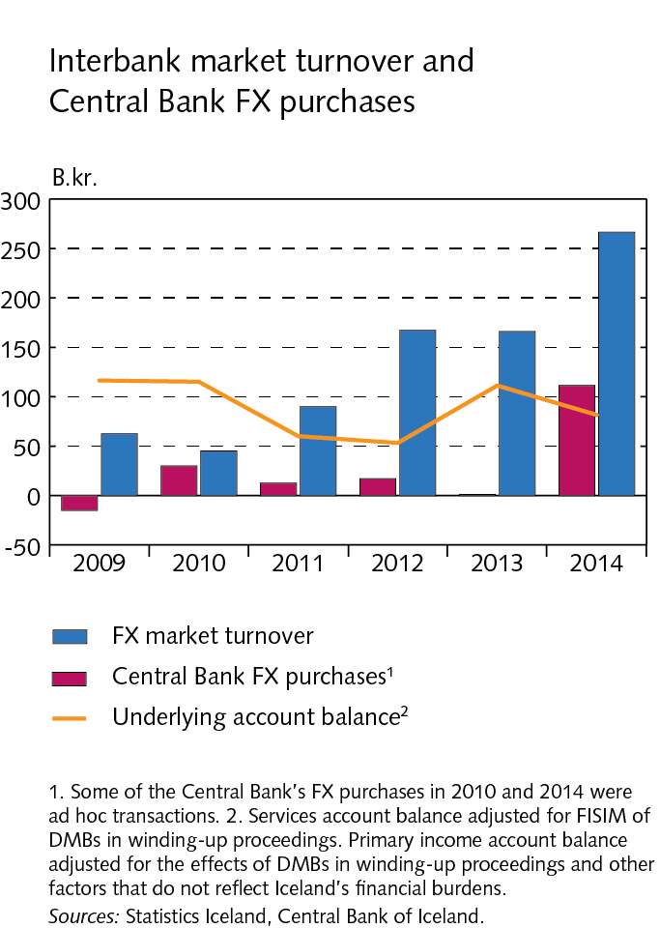
Box I-1

Slide 27
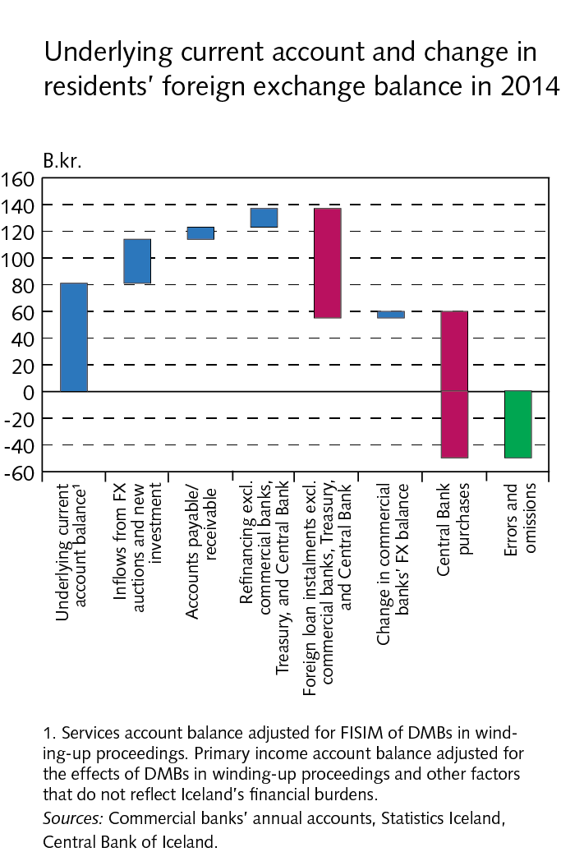
Box I-1

Slide 28
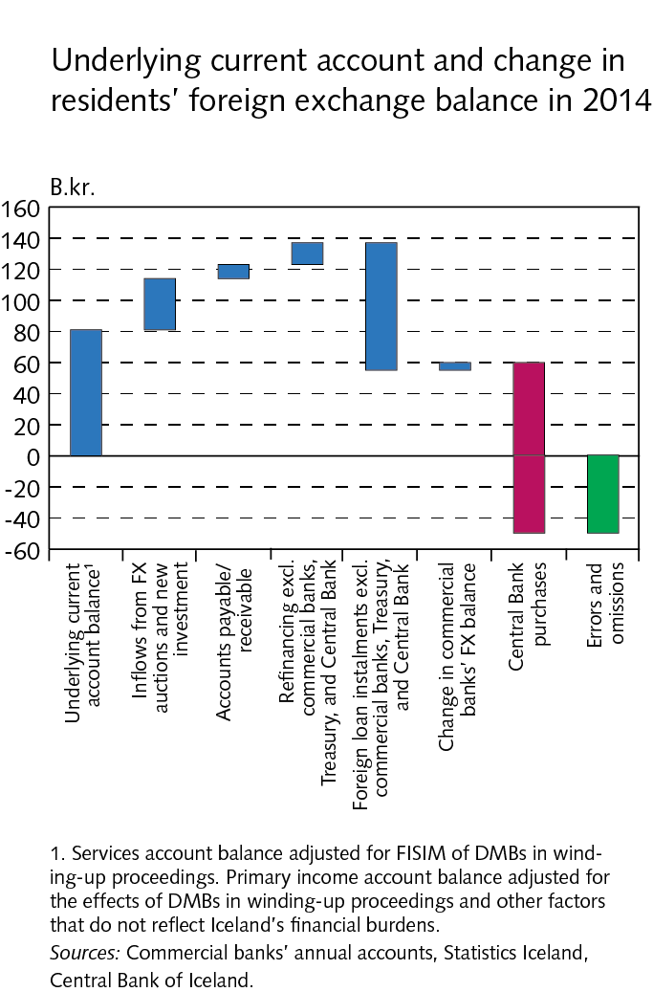
Box I-1

Slide 29
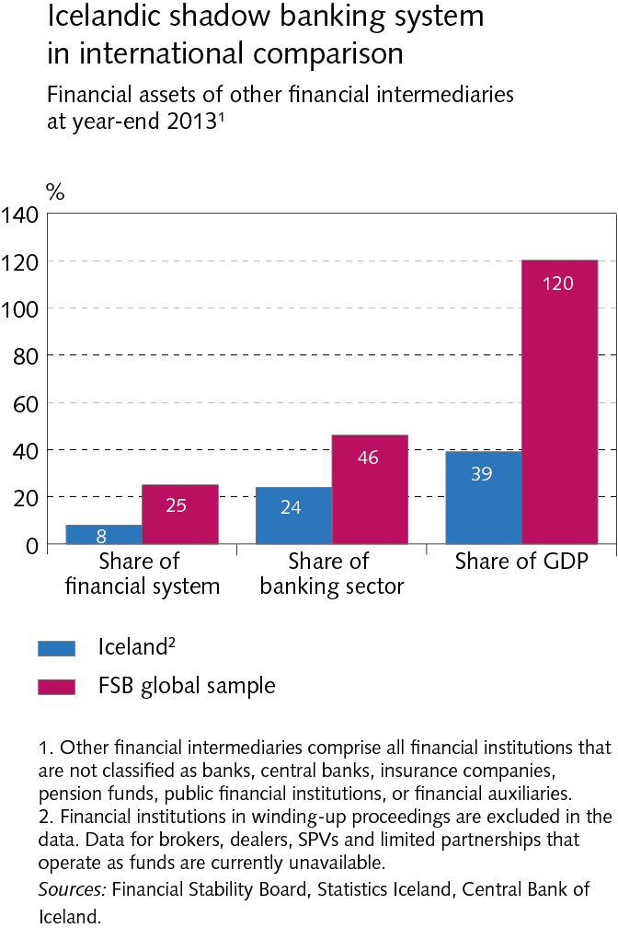
Box I-2

Slide 30
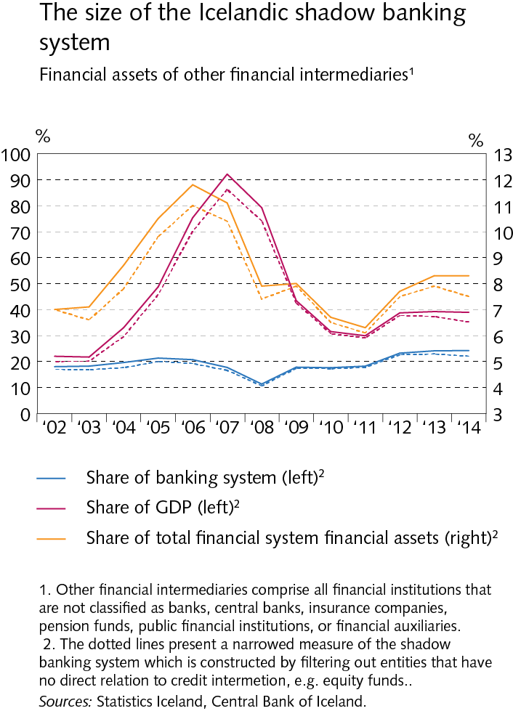
Box I-2

Slide 31
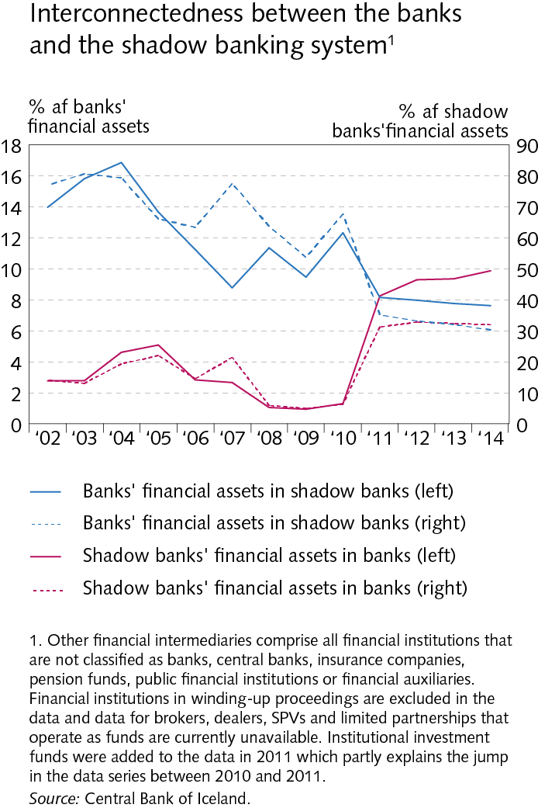
Box I-2

Slide 32
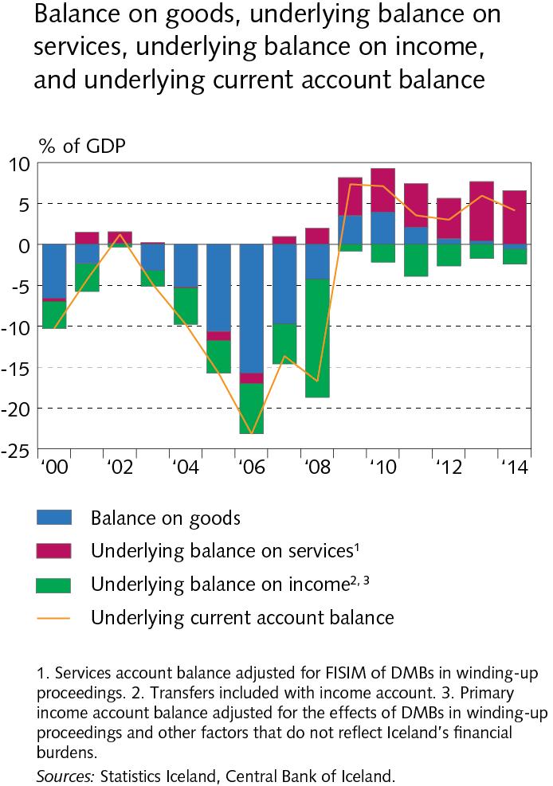
II External postition

Slide 33
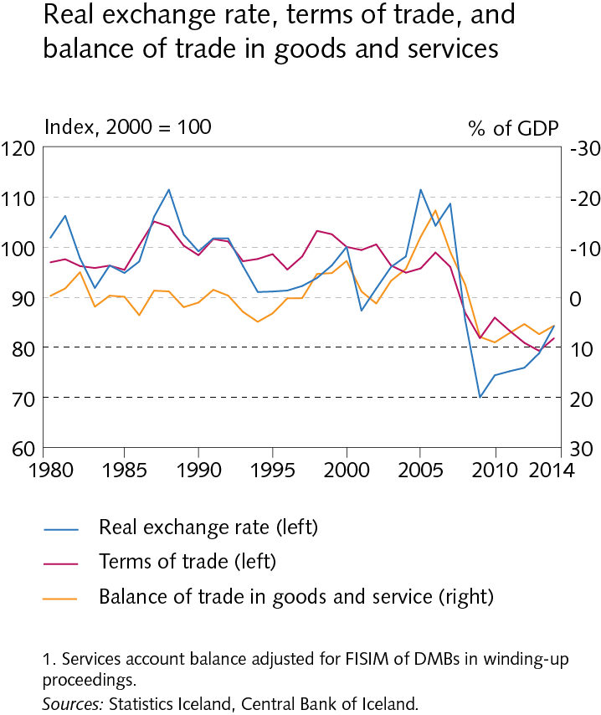
II External postition

Slide 34
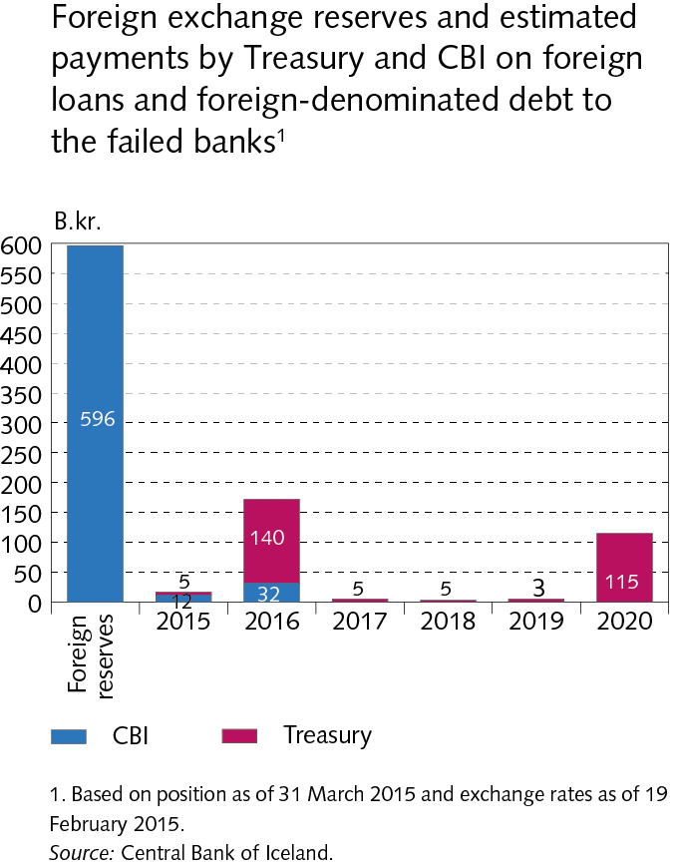
II External postition

Slide 35
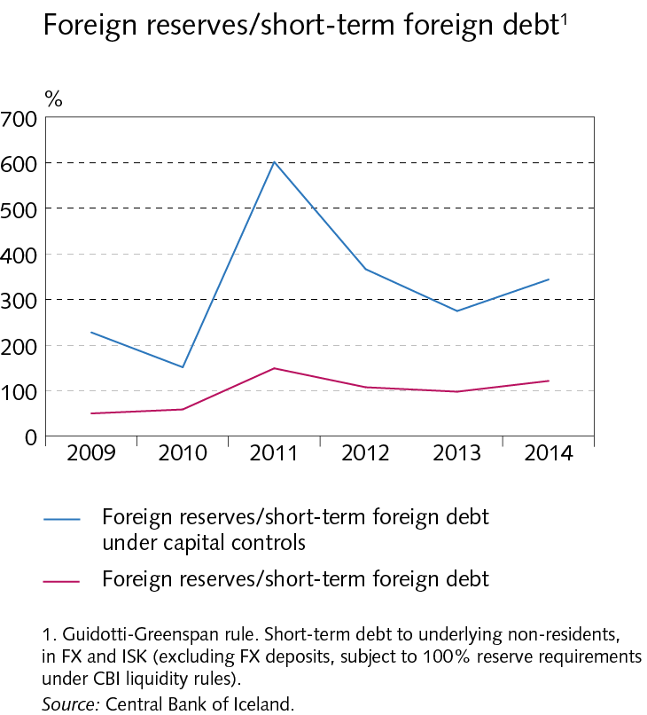
II External postition

Slide 36
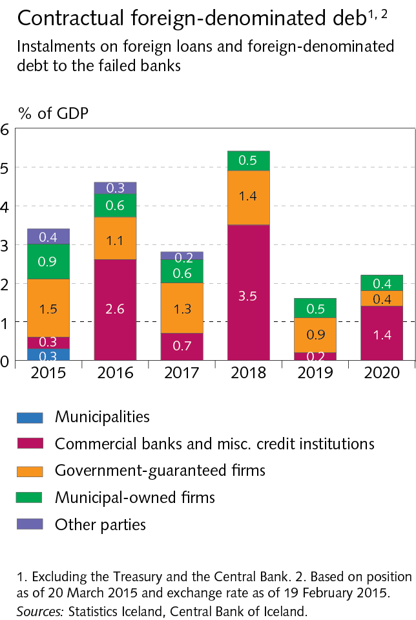
II External postition

Slide 37
II External postition

Slide 38
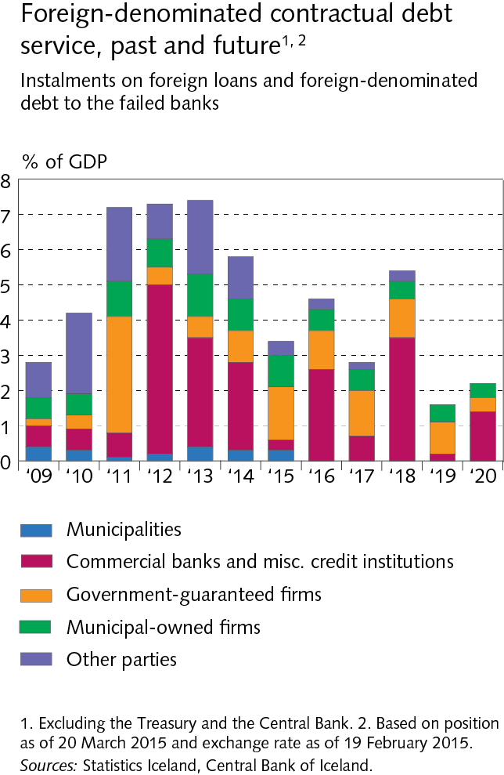
II External postition

Slide 39
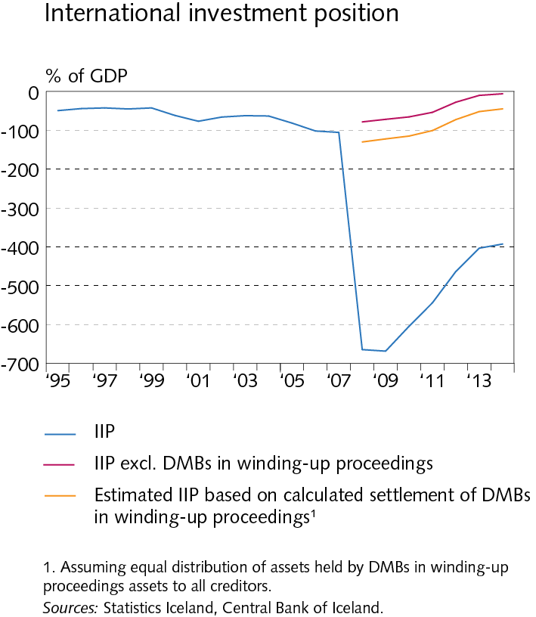
II External postition

Slide 40
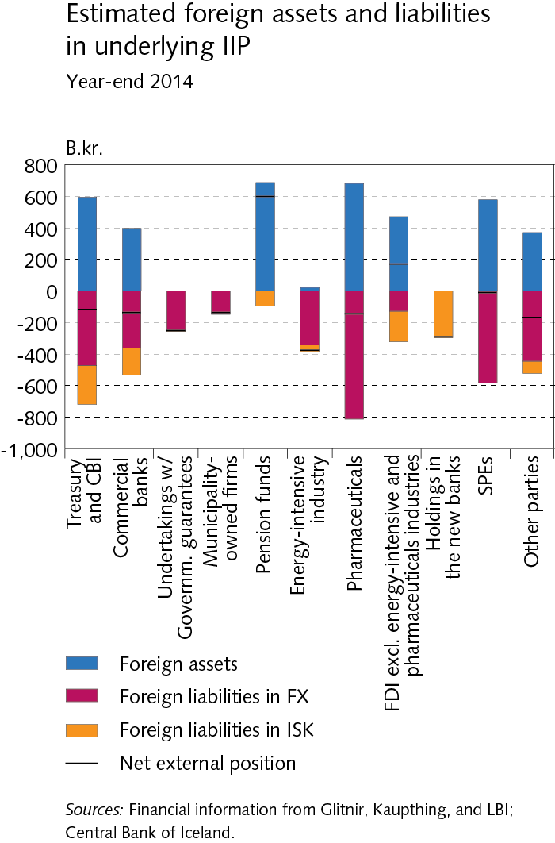
II External postition

Slide 41
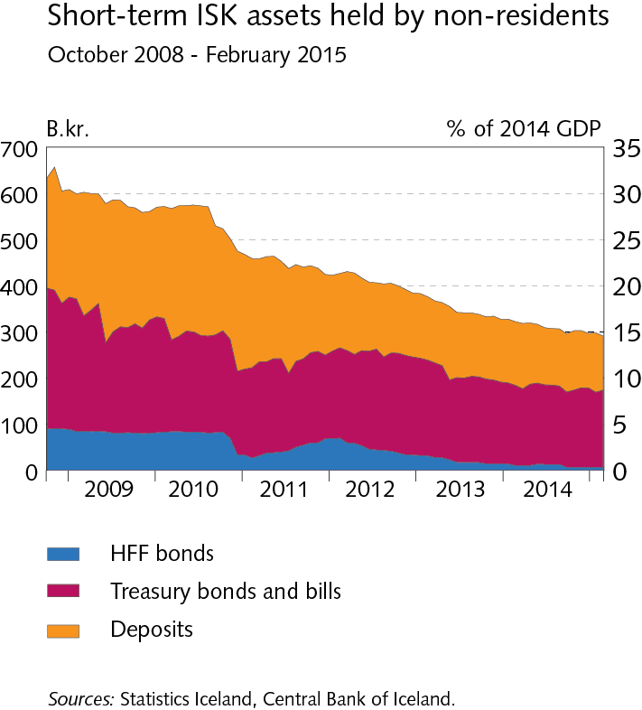
II External postition

Slide 42
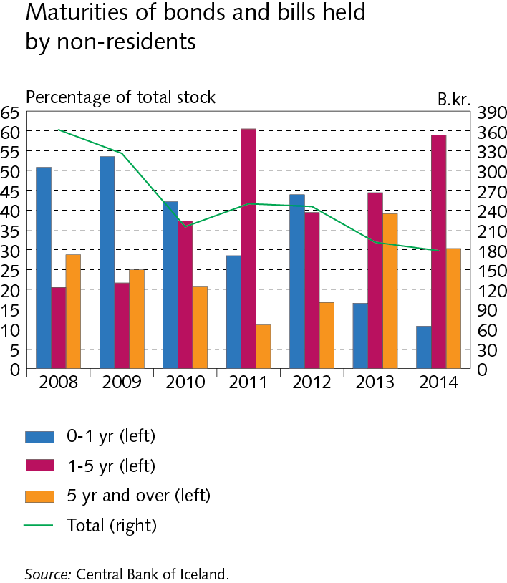
II External postition

Slide 43
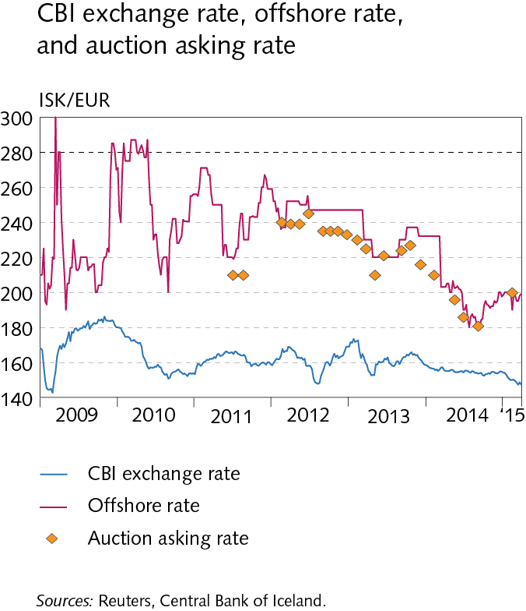
II External postition

Slide 44
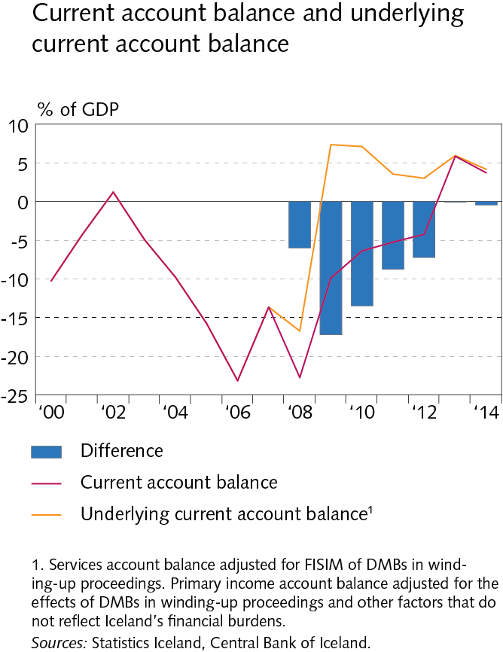
Box II-1

Slide 45
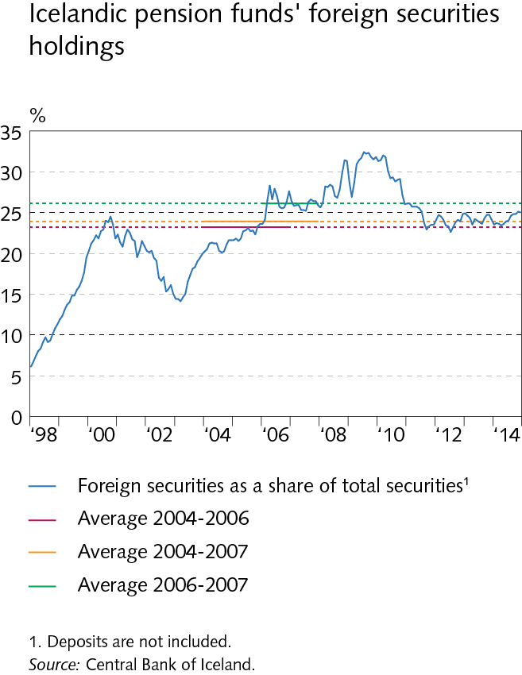
Box II-2

Slide 46
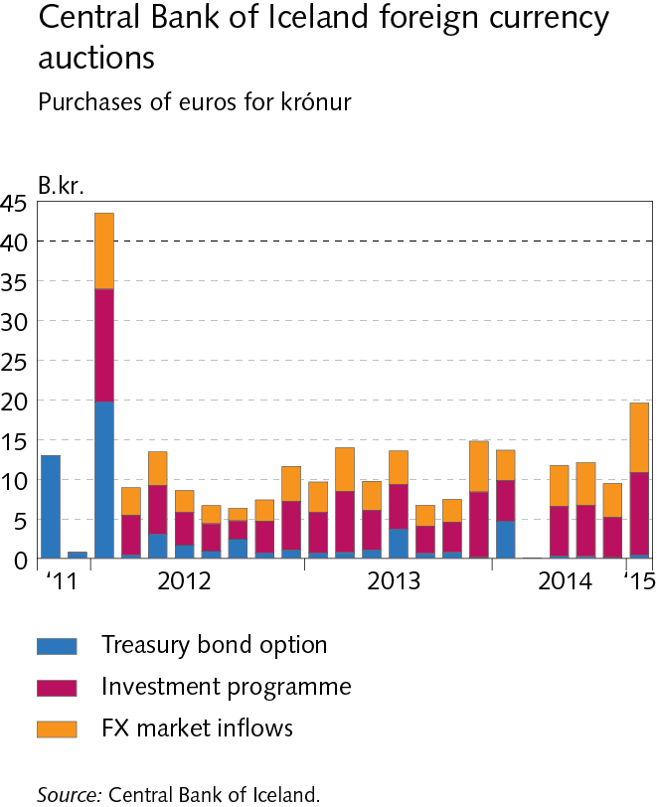
Box II-3

Slide 47
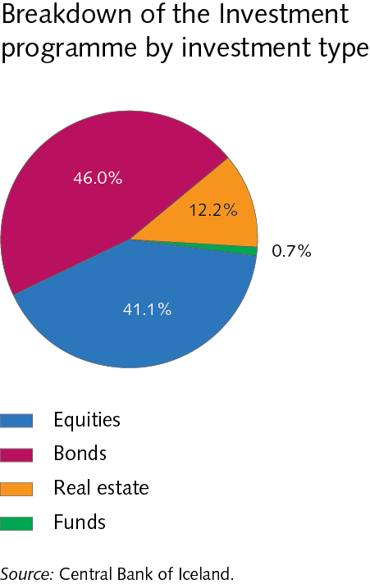
Box II-3

Slide 48
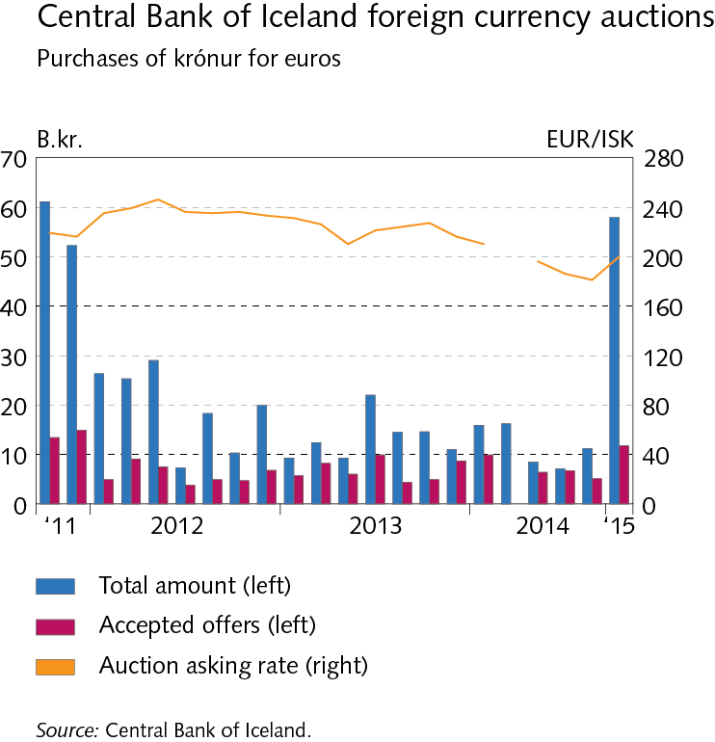
Box II-3

Slide 49
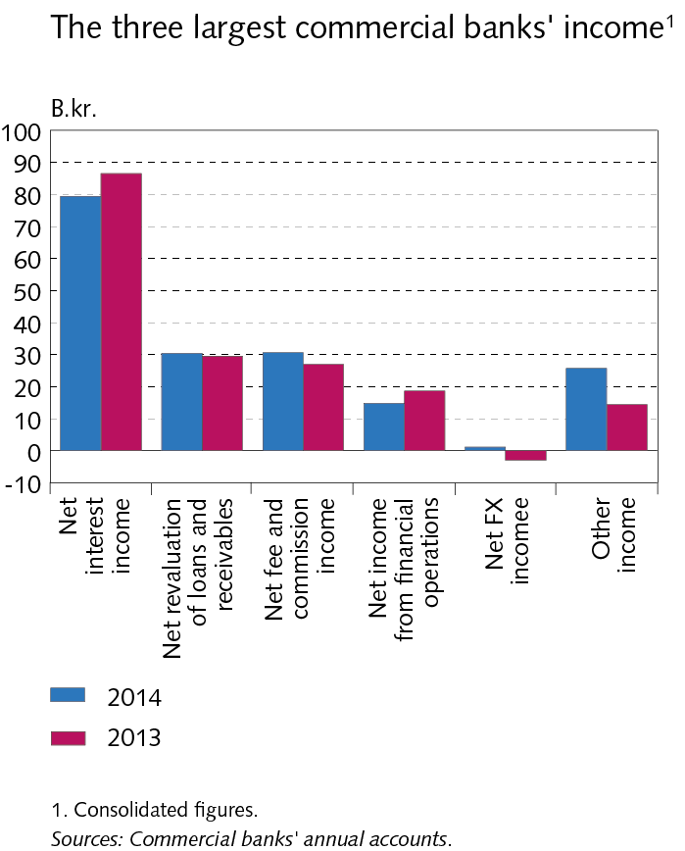
III Operations and equity

Slide 50
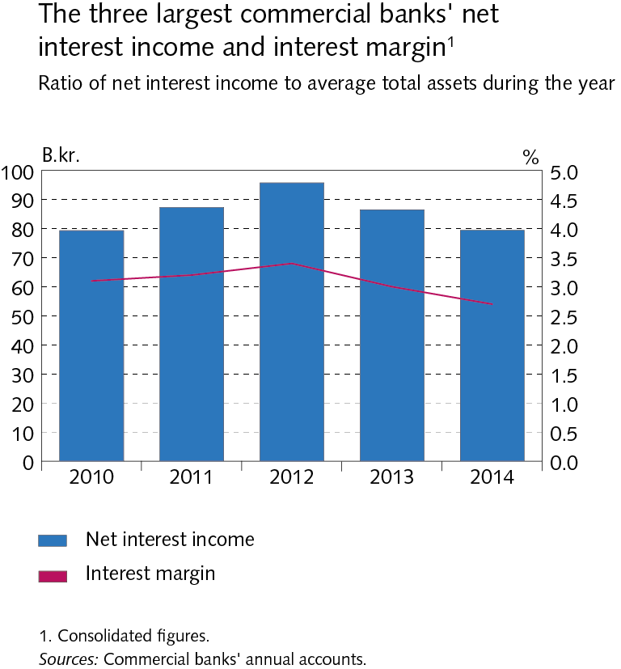
III Operations and equity

Slide 51
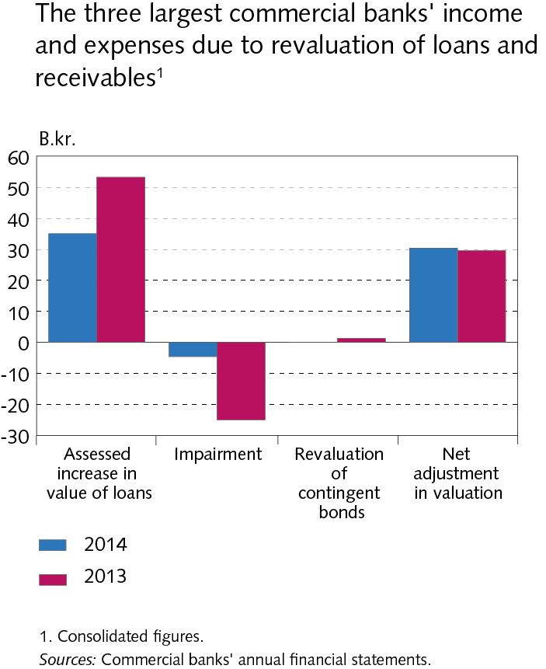
III Operations and equity

Slide 52
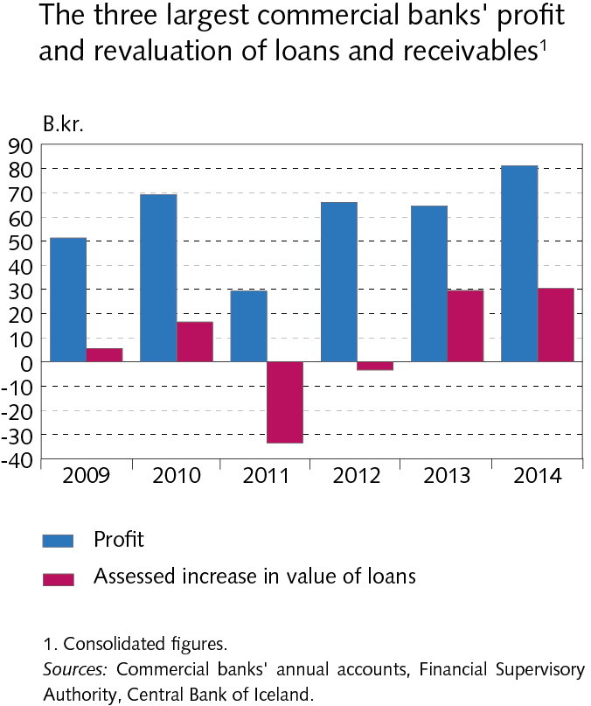
III Operations and equity

Slide 53
III Operations and equity

Slide 54
III Operations and equity

Slide 55
III Operations and equity

Slide 56
III Operations and equity

Slide 57
III Operations and equity

Slide 58
III Operations and equity

Slide 59
III Operations and equity

Slide 60
III Operations and equity

Slide 61
III Operations and equity

Slide 62
Box III-2

Slide 63
Box III-2

Slide 64
Box III-2

Slide 65
Box III-2

Slide 66
IV Funding and liquid funds

Slide 67
IV Funding and liquid funds

Slide 68
IV Funding and liquid funds

Slide 69
IV Funding and liquid funds

Slide 70
IV Funding and liquid funds

Slide 71
IV Funding and liquid funds

Slide 72
IV Funding and liquid funds

Slide 73
IV Funding and liquid funds

Slide 74
IV Funding and liquid funds

Slide 75
IV Funding and liquid funds

Slide 76
IV Funding and liquid funds

Slide 77
IV Funding and liquid funds

Slide 78
IV Funding and liquid funds

Slide 79
V Assets of DMBs and borrowers´ situation

Slide 80
V Assets of DMBs and borrowers´ situation

Slide 81
V Assets of DMBs and borrowers´ situation

Slide 82
V Assets of DMBs and borrowers´ situation

Slide 83
V Assets of DMBs and borrowers´ situation

Slide 84
V Assets of DMBs and borrowers´ situation

Slide 85
V Assets of DMBs and borrowers´ situation

Slide 86
V Assets of DMBs and borrowers´ situation

Slide 87
V Assets of DMBs and borrowers´ situation

Slide 88
V Assets of DMBs and borrowers´ situation

Slide 89
V Assets of DMBs and borrowers´ situation

Slide 90
V Assets of DMBs and borrowers´ situation

Slide 91
V Assets of DMBs and borrowers´ situation

Slide 92
V Assets of DMBs and borrowers´ situation

Slide 93
V Assets of DMBs and borrowers´ situation

Slide 94
V Assets of DMBs and borrowers´ situation

Slide 95
V Assets of DMBs and borrowers´ situation

Slide 96
V Assets of DMBs and borrowers´ situation

Slide 97
V Assets of DMBs and borrowers´ situation

Slide 98
V Assets of DMBs and borrowers´ situation

Slide 99
V Assets of DMBs and borrowers´ situation

Slide 100
V Assets of DMBs and borrowers´ situation

Slide 101
V Assets of DMBs and borrowers´ situation

Slide 102
V Assets of DMBs and borrowers´ situation

Slide 103
V Assets of DMBs and borrowers´ situation

Slide 104
V Assets of DMBs and borrowers´ situation

Slide 105
V Assets of DMBs and borrowers´ situation

Slide 106
V Assets of DMBs and borrowers´ situation

Slide 107
V Assets of DMBs and borrowers´ situation

Slide 108
V Assets of DMBs and borrowers´ situation

Slide 109
V Assets of DMBs and borrowers´ situation

Slide 110
V Assets of DMBs and borrowers´ situation

Slide 111
V Assets of DMBs and borrowers´ situation

Slide 112
V Assets of DMBs and borrowers´ situation

Slide 113
V Assets of DMBs and borrowers´ situation

Slide 114
Box V-1

Slide 115
Box V-1

Slide 116
Box V-1

Slide 117
VI Financial market entities

Slide 118
VI Financial market entities

Slide 119
VI Financial market entities

Slide 120
VI Financial market entities

Slide 121
VI Financial market entities

Slide 122
VI Financial market entities

Slide 123
VI Financial market entities

Slide 124
VI Financial market entities

Slide 125
VI Financial market entities

Slide 126
VI Financial market entities

Slide 127
VI Financial market entities

Slide 128
VI Financial market entities

Slide 129
VII Settlement of the failed banks´ estates

Slide 130
VII Settlement of the failed banks´ estates

Slide 131
VII Settlement of the failed banks´ estates

Slide 132
VII Settlement of the failed banks´ estates

Slide 133
VII Settlement of the failed banks´ estates

Slide 134
VII Settlement of the failed banks´ estates

Slide 135
VII Settlement of the failed banks´ estates

Slide 136
VII Settlement of the failed banks´ estates

Slide 137
VII Settlement of the failed banks´ estates

Slide 138
Appendix I

Slide 139
Appendix III

Slide 140
Appendix III

Slide 141
Appendix III

Slide 142
Appendix III

Slide 143
Appendix III

Slide 144
Appendix III

