Slide 1
Central Bank of Iceland
Financial Stability report 2014/1
Charts

Slide 2
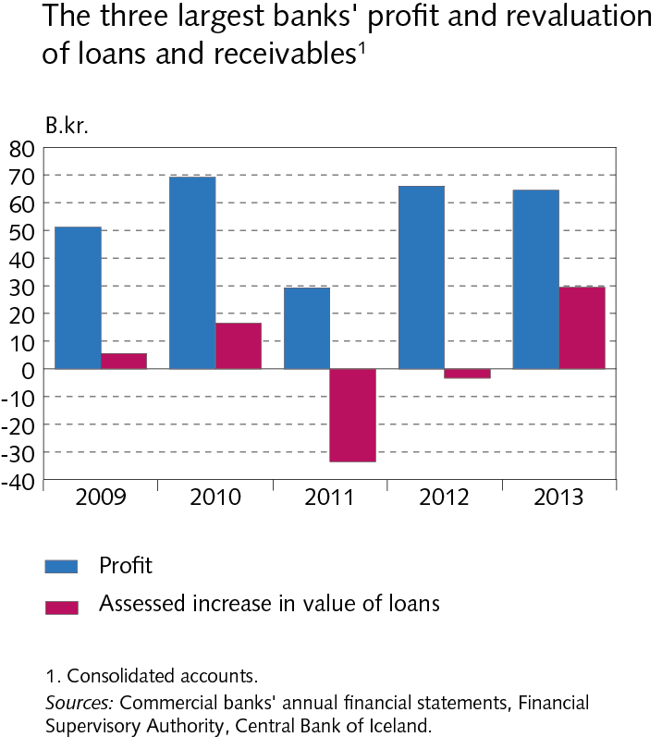
The Financial System – outlook and main risks

Slide 3
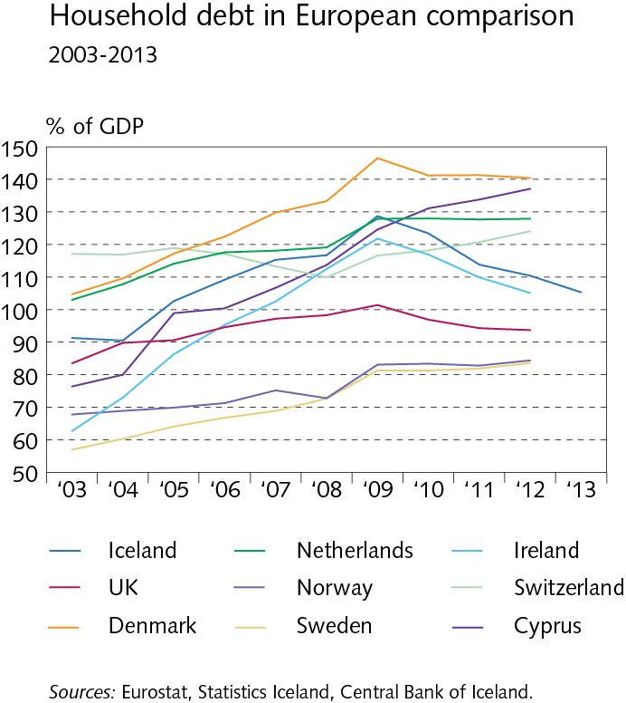
The Financial System – outlook and main risks

Slide 4
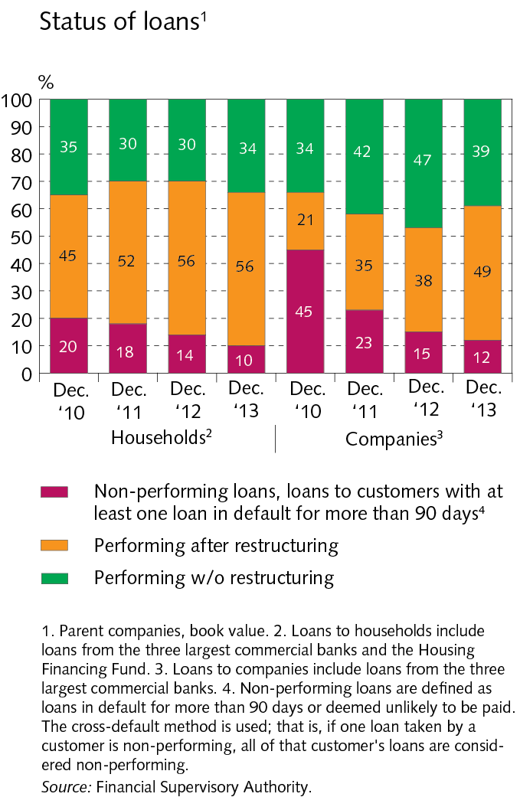
The Financial System – outlook and main risks

Slide 5
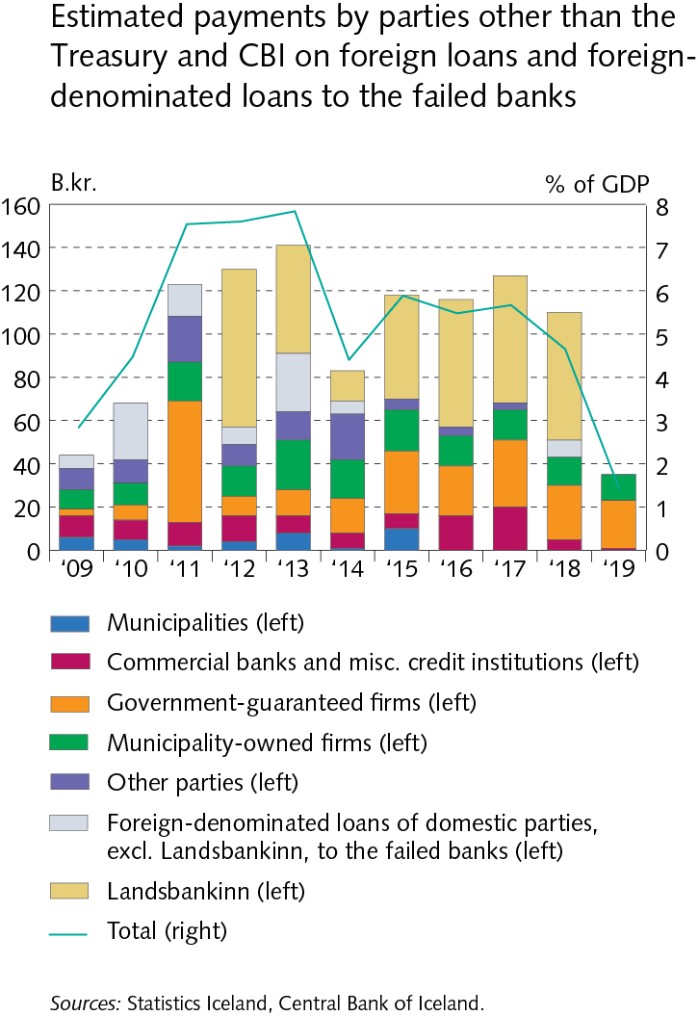
The Financial System – outlook and main risks

Slide 6
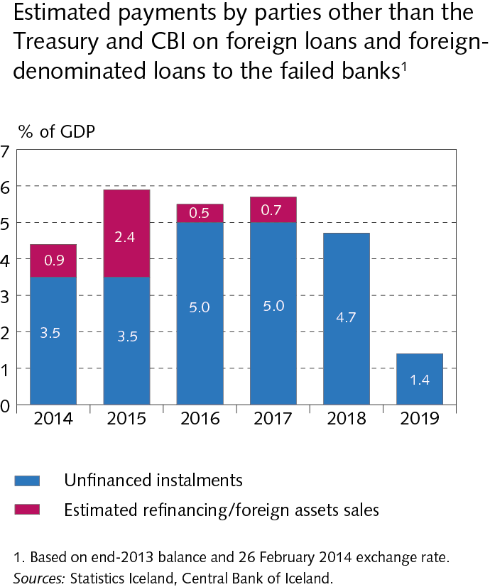
The Financial System – outlook and main risks

Slide 7
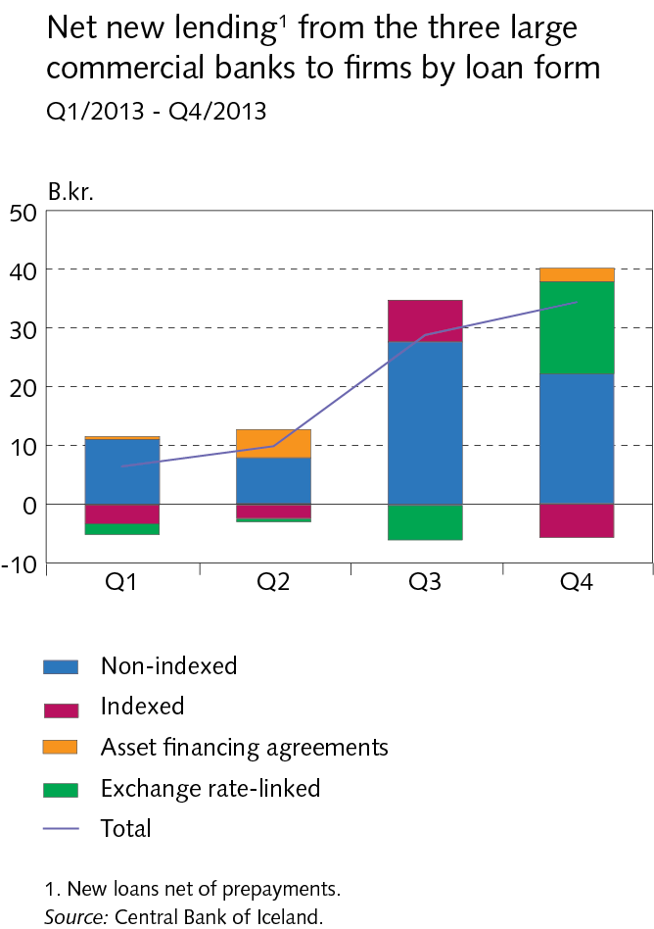
The Financial System – outlook and main risks

Slide 8
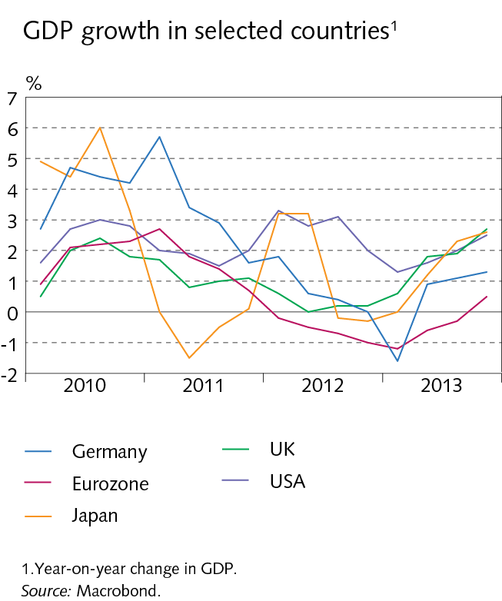
I Economic environment

Slide 9
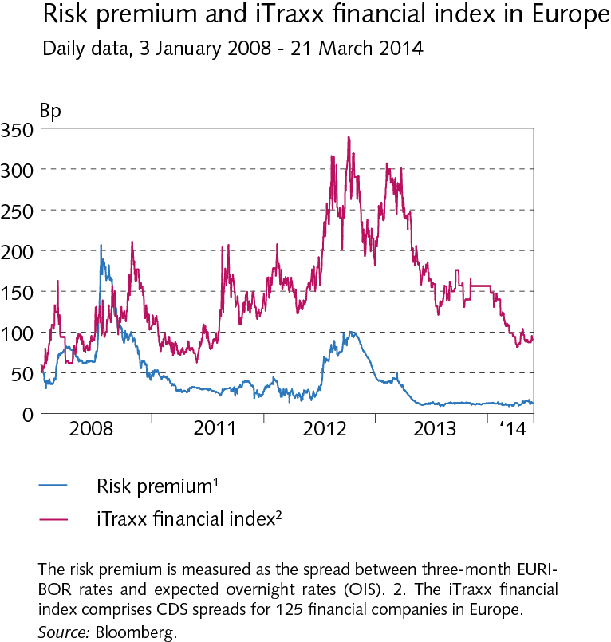
I Economic environment

Slide 10
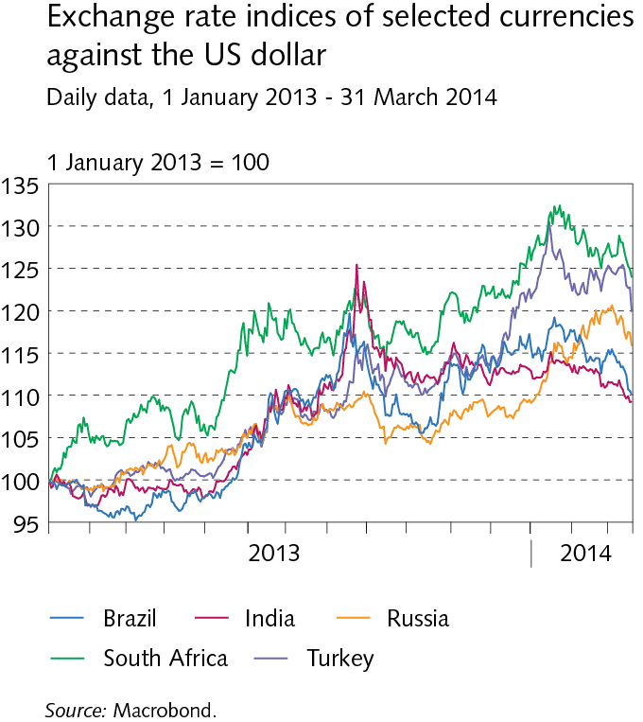
I Economic environment

Slide 11
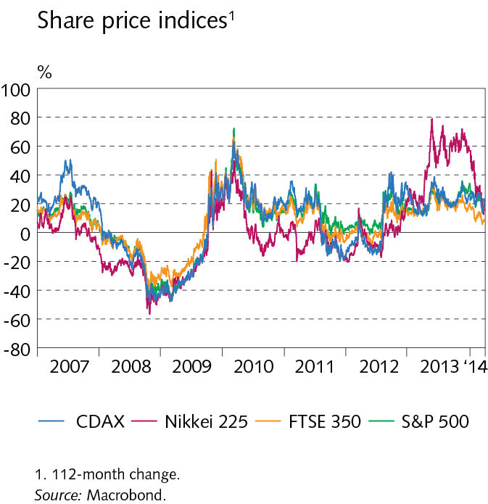
I Economic environment

Slide 12
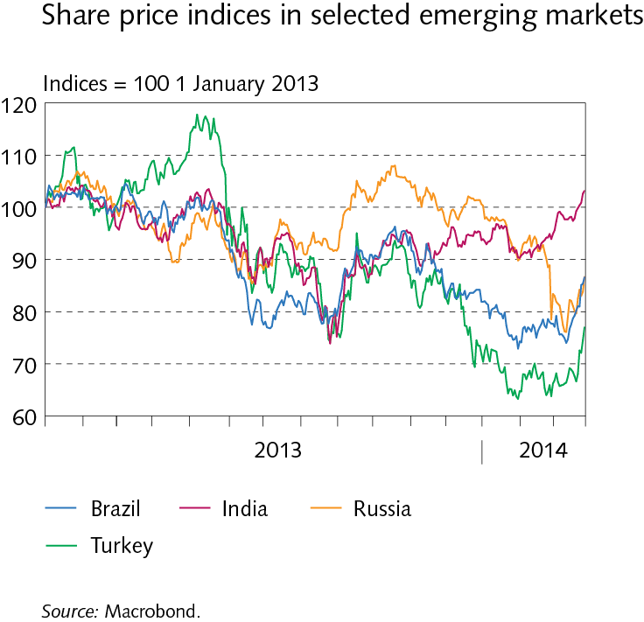
I Economic environment

Slide 13
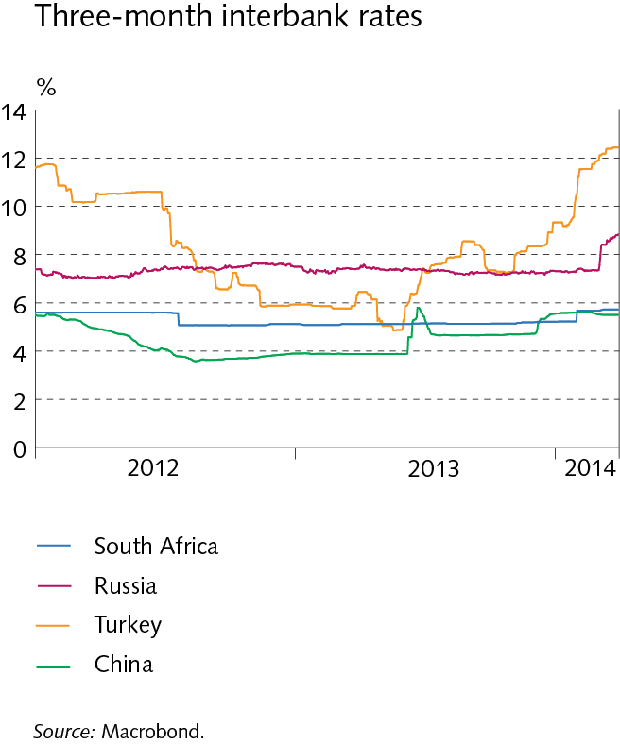
I Economic environment

Slide 14
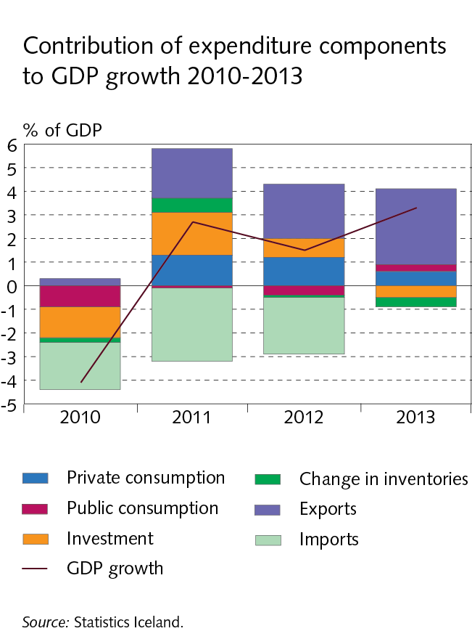
I Economic environment

Slide 15
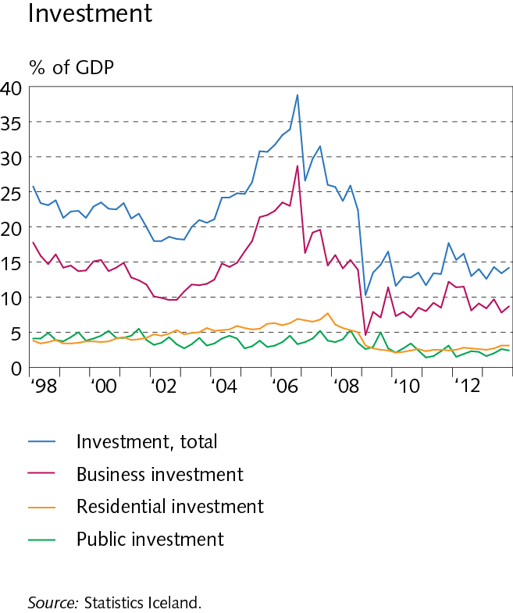
I Economic environment

Slide 16
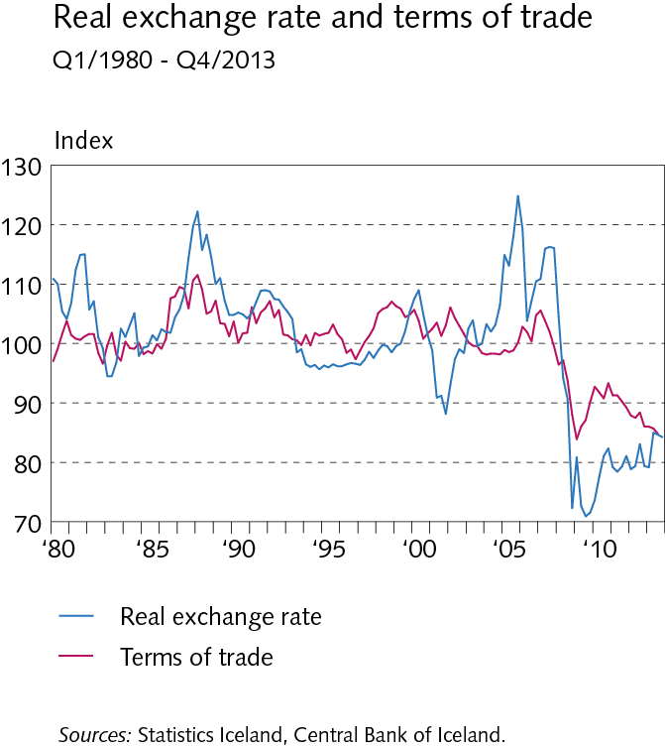
I Economic environment

Slide 17
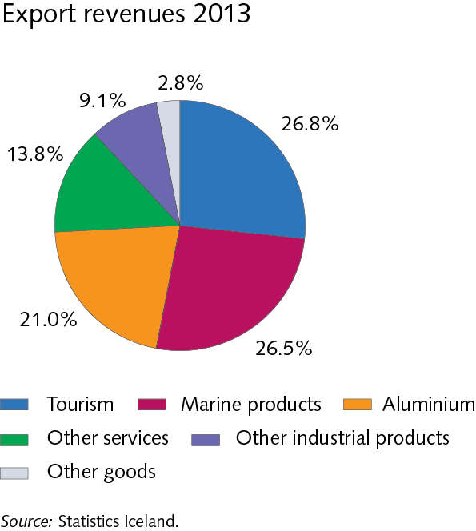
I Economic environment

Slide 18
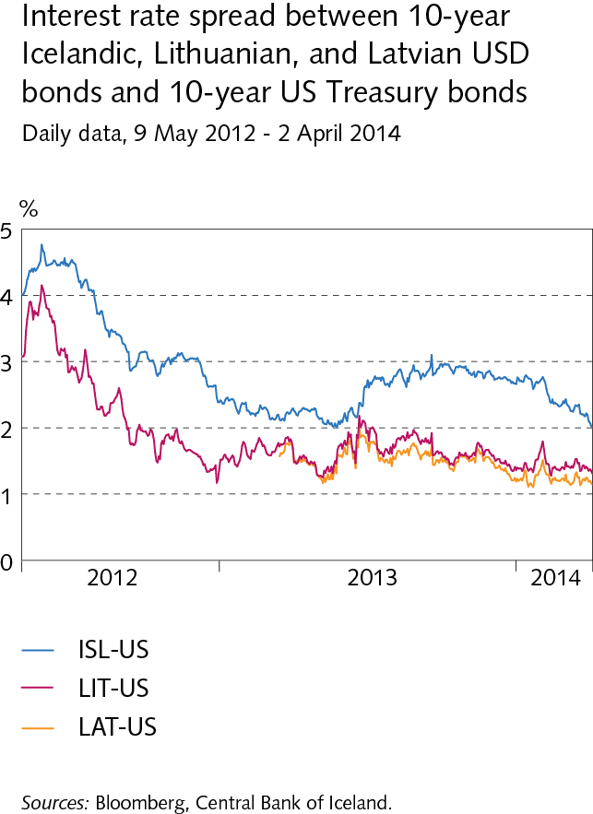
I Economic environment

Slide 19
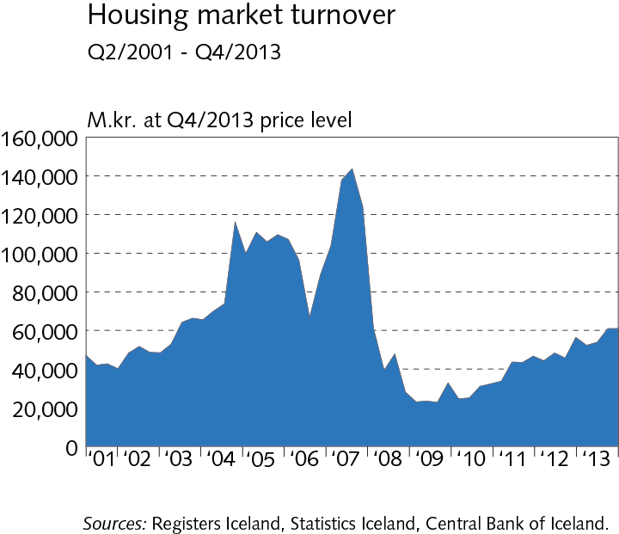
I Economic environment

Slide 20
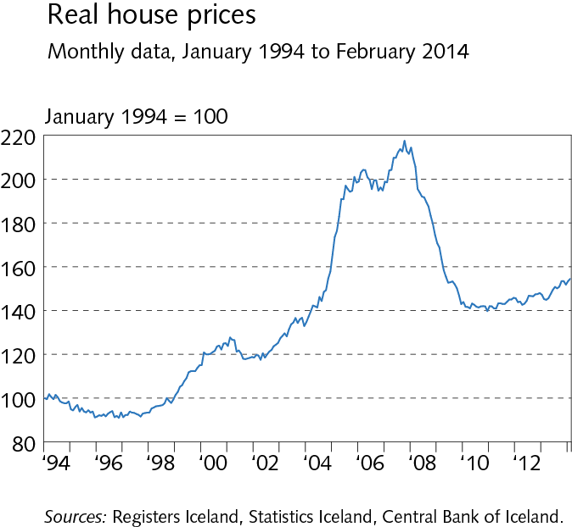
I Economic environment

Slide 21
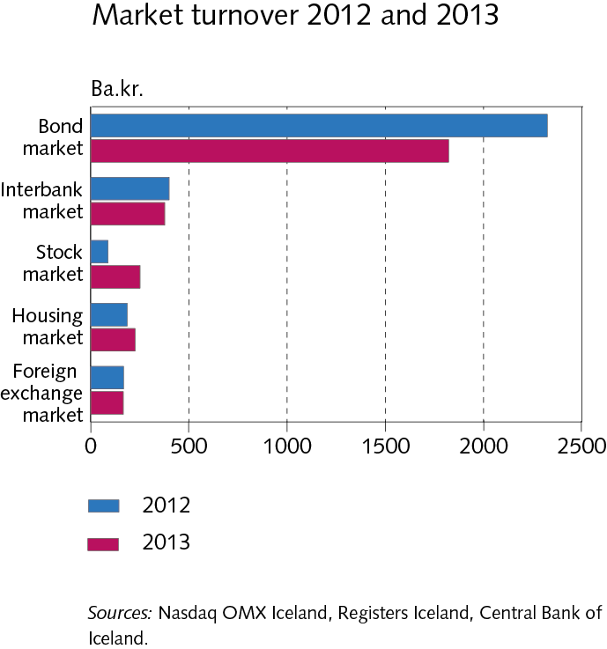
I Economic environment

Slide 22
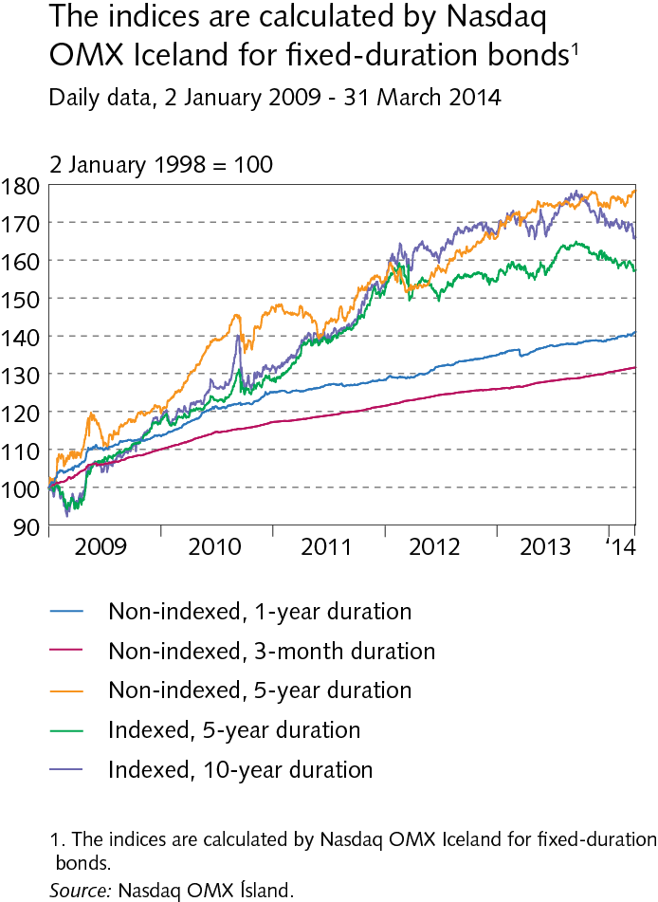
I Economic environment

Slide 23
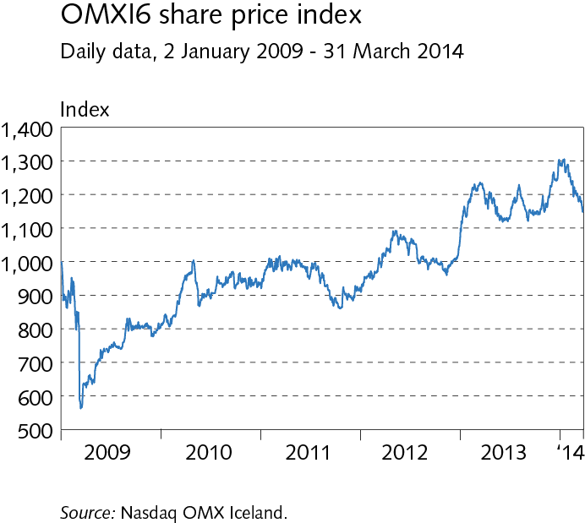
I Economic environment

Slide 24
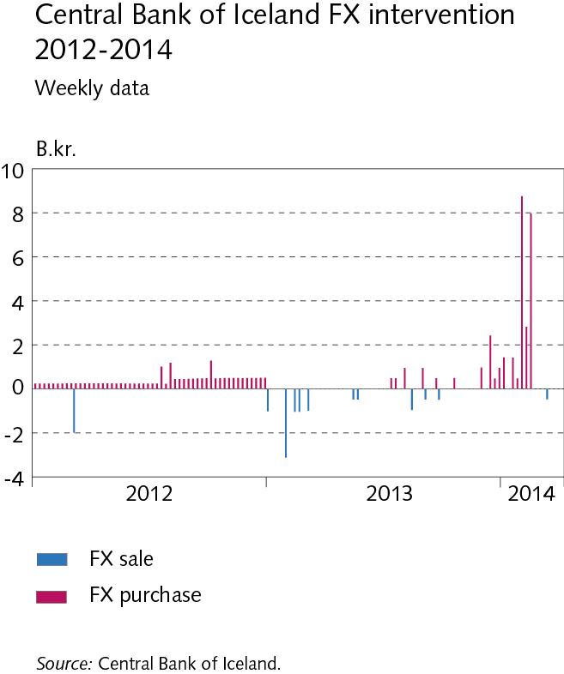
I Economic environment

Slide 25
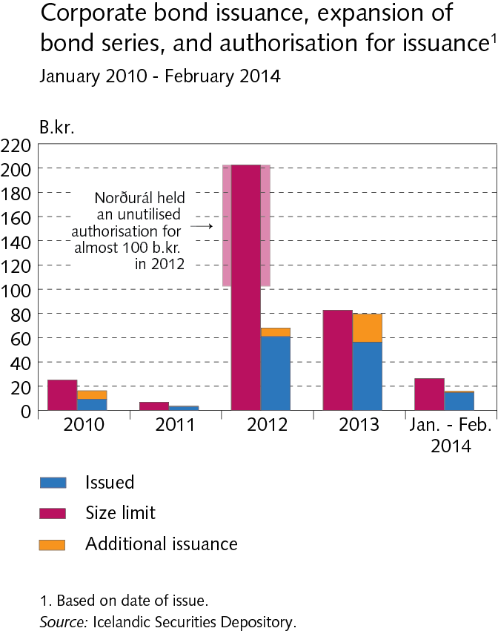
Box I-2

Slide 26
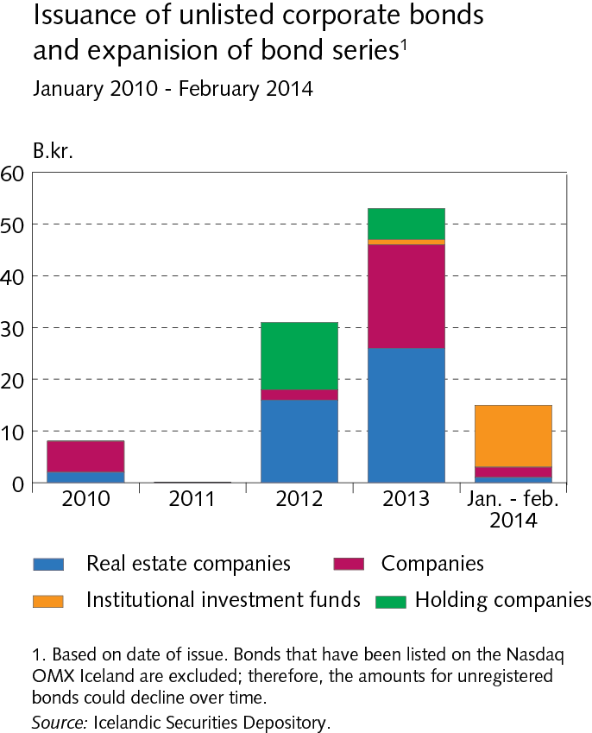
Box I-2

Slide 27
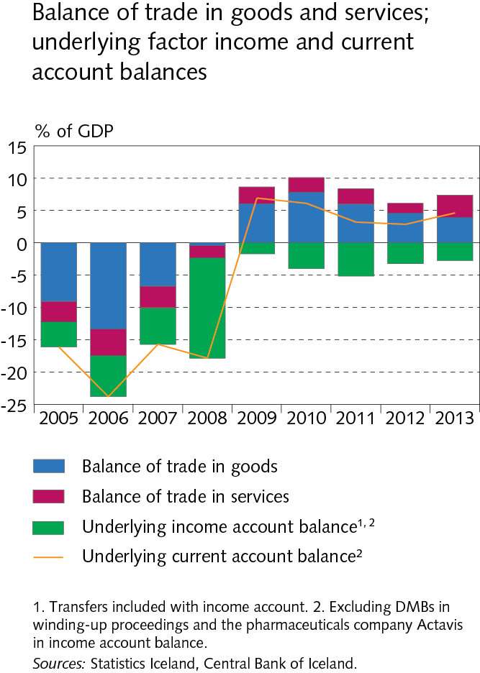
II External postition

Slide 28
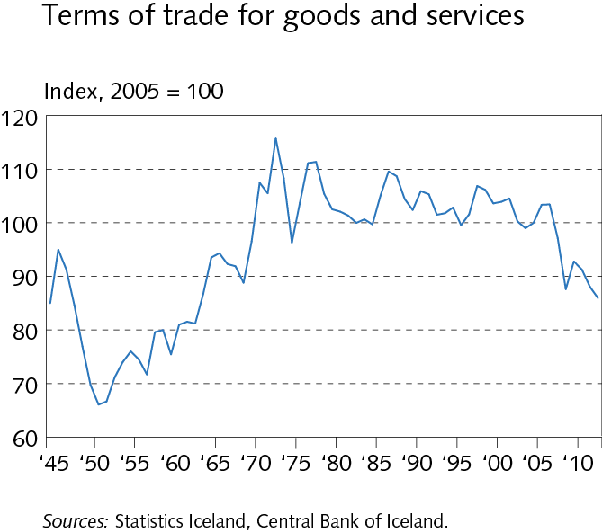
II External postition

Slide 29
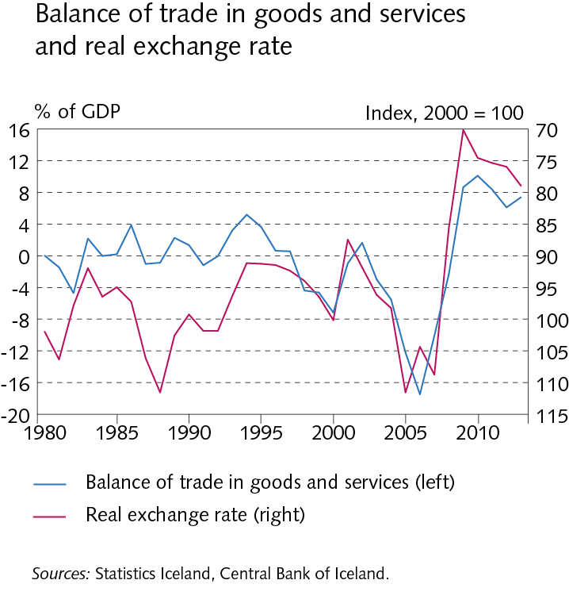
II External postition

Slide 30
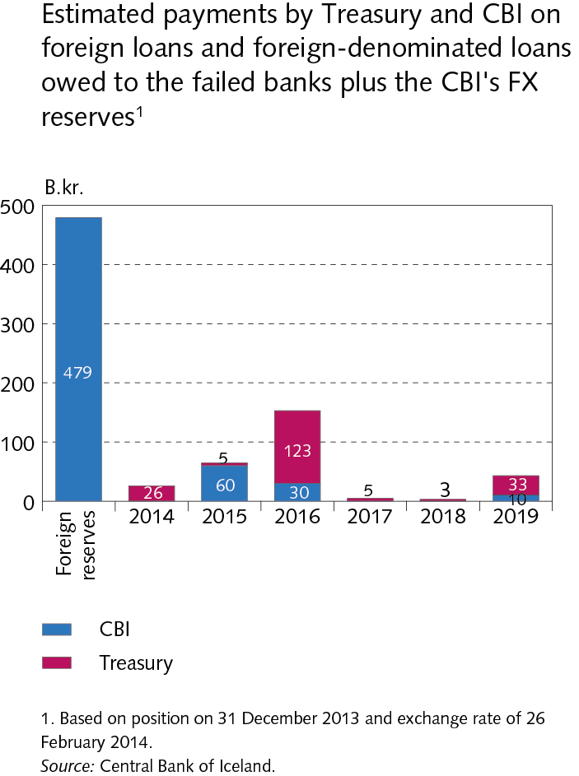
II External postition

Slide 31
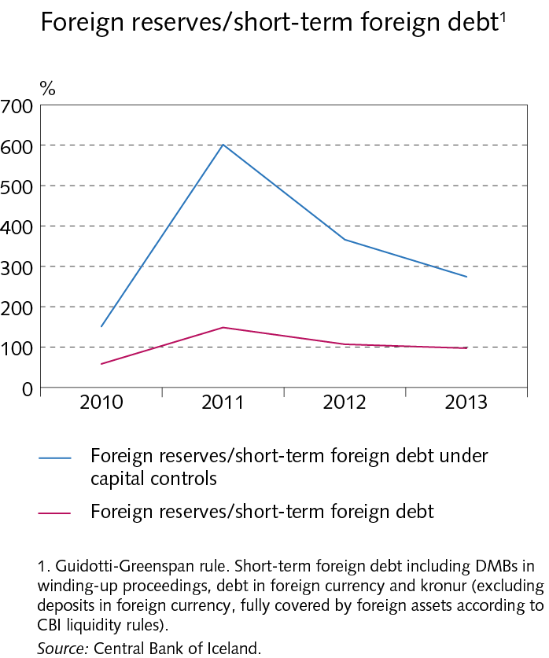
II External postition

Slide 32
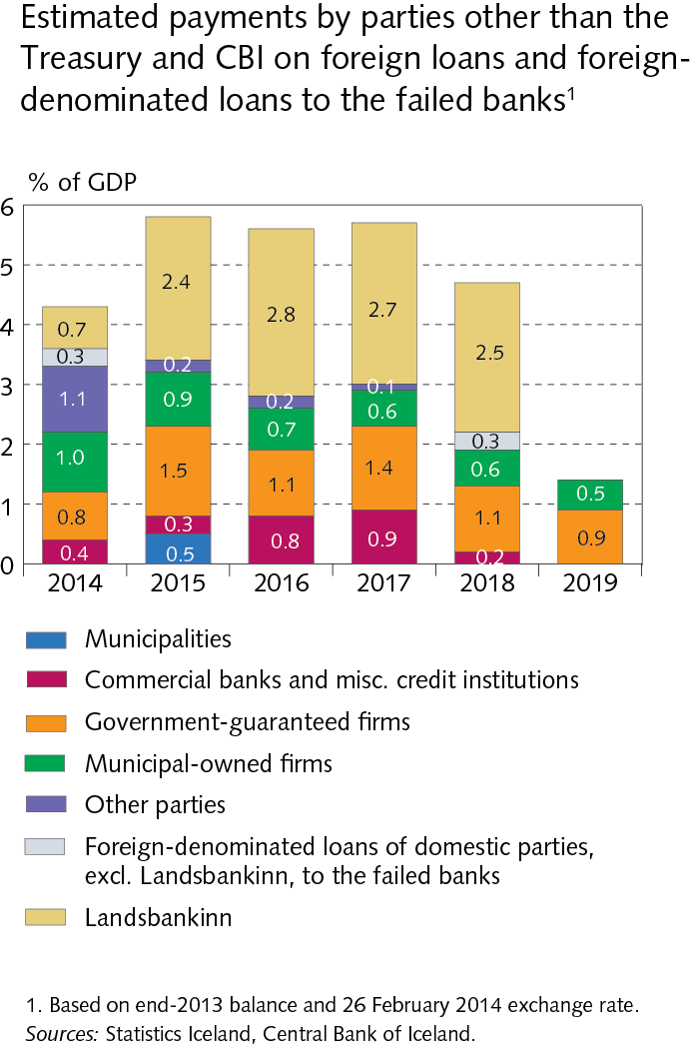
II External postition

Slide 33
II External postition

Slide 34
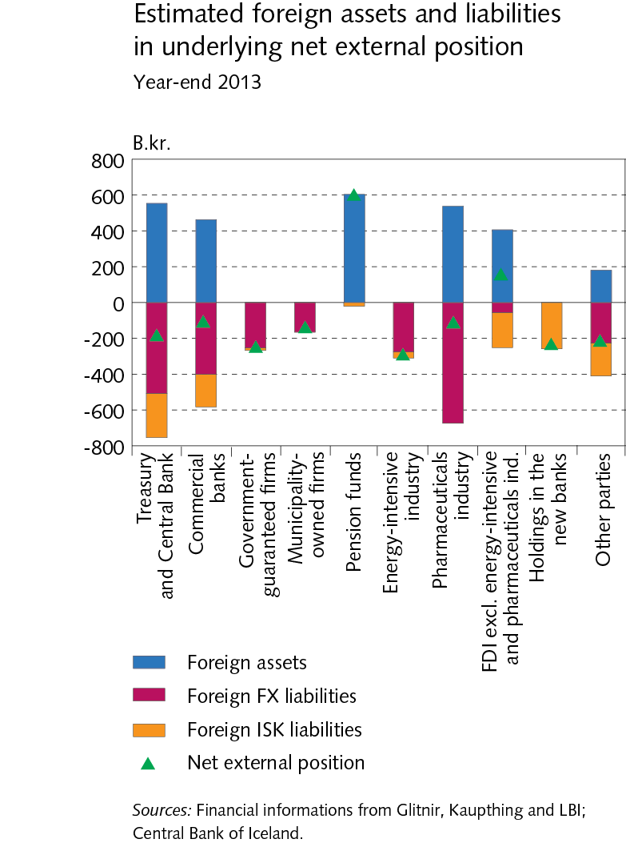
II External postition

Slide 35
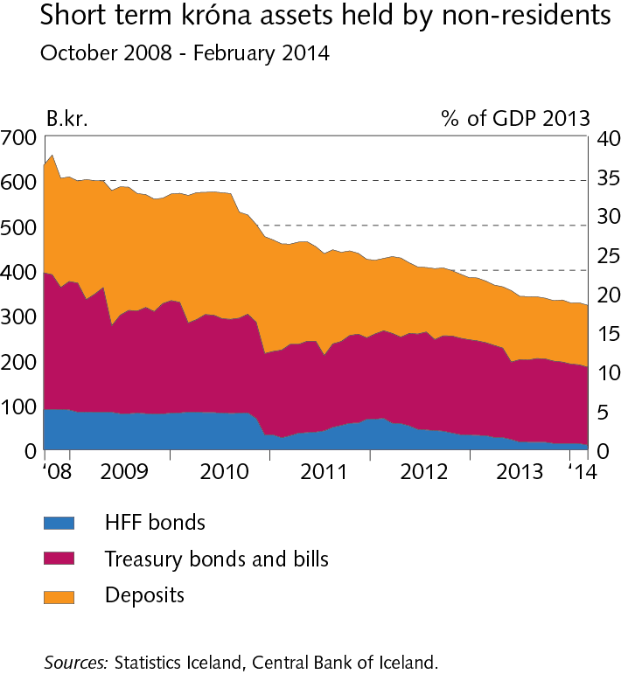
II External postition

Slide 36
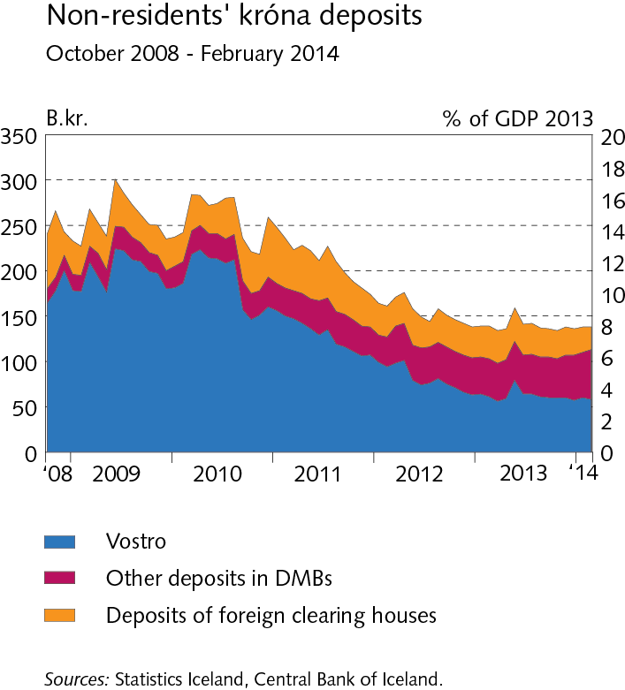
II External postition

Slide 37
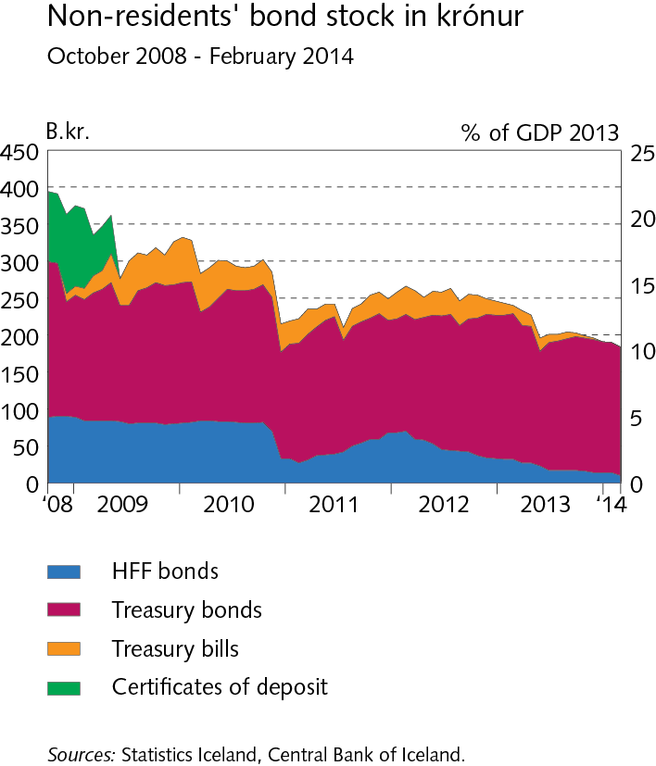
II External postition

Slide 38
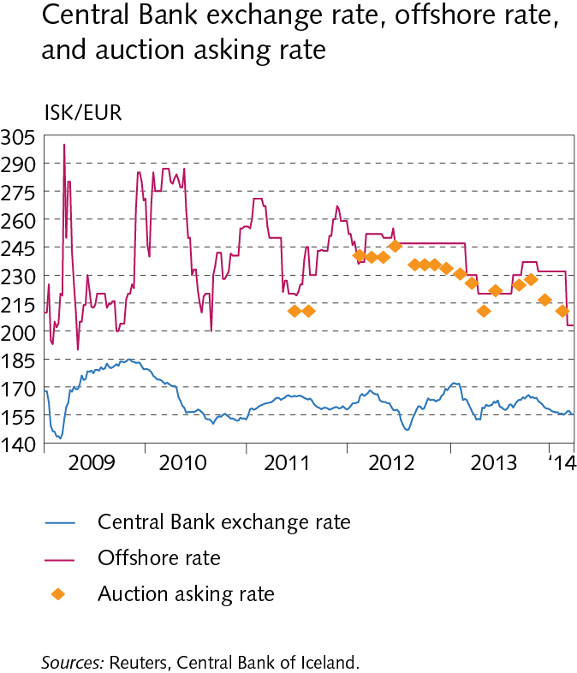
II External postition

Slide 39
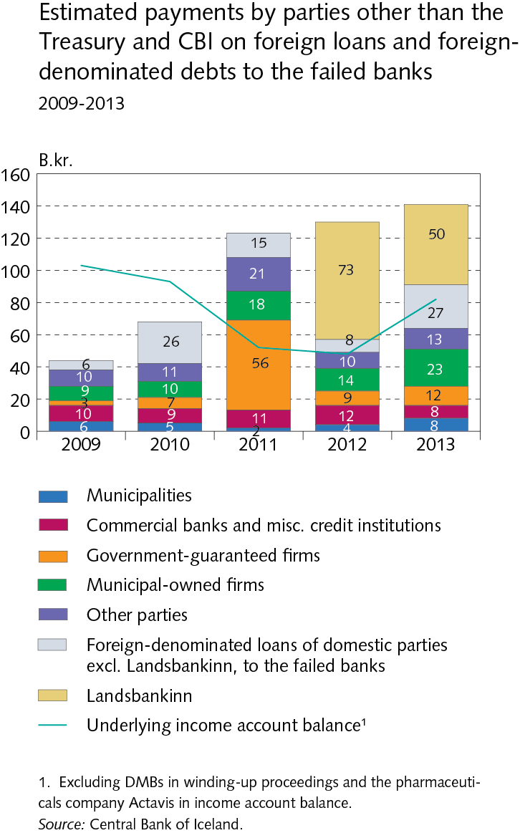
Box II-1

Slide 40
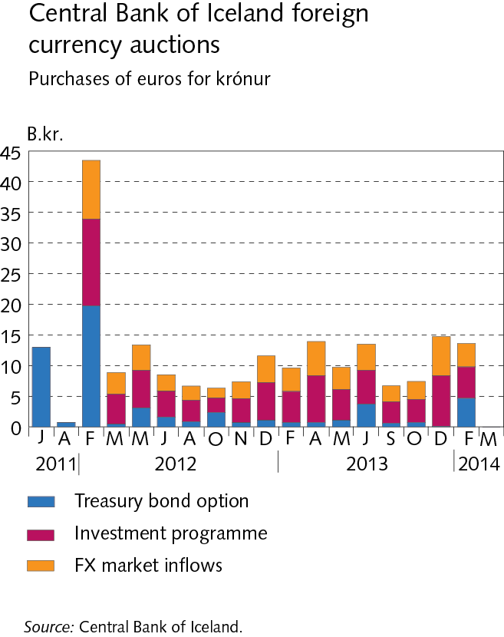
Box II-2

Slide 41
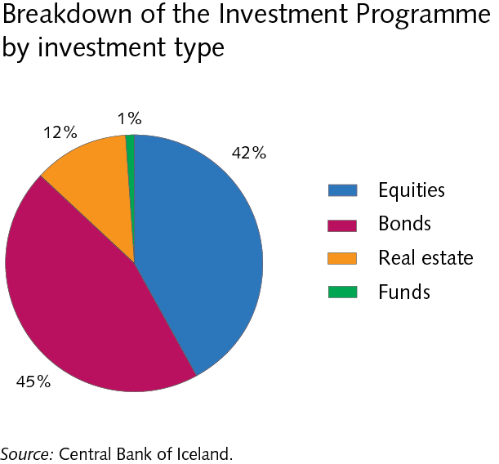
Box II-2

Slide 42
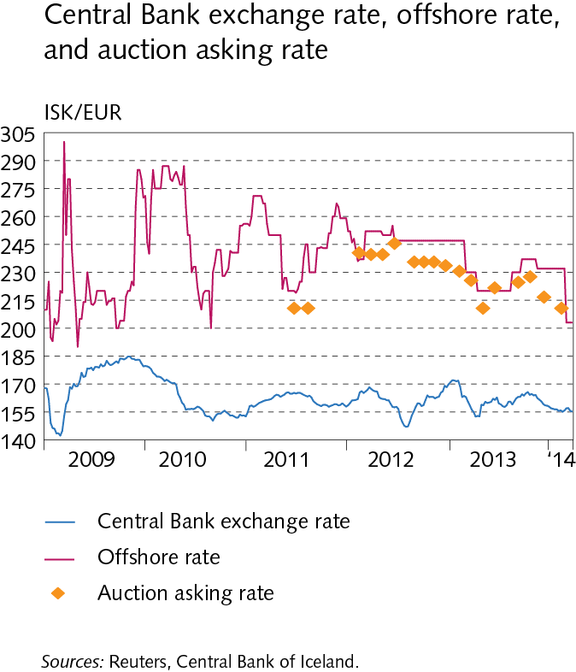
Box II-2

Slide 43
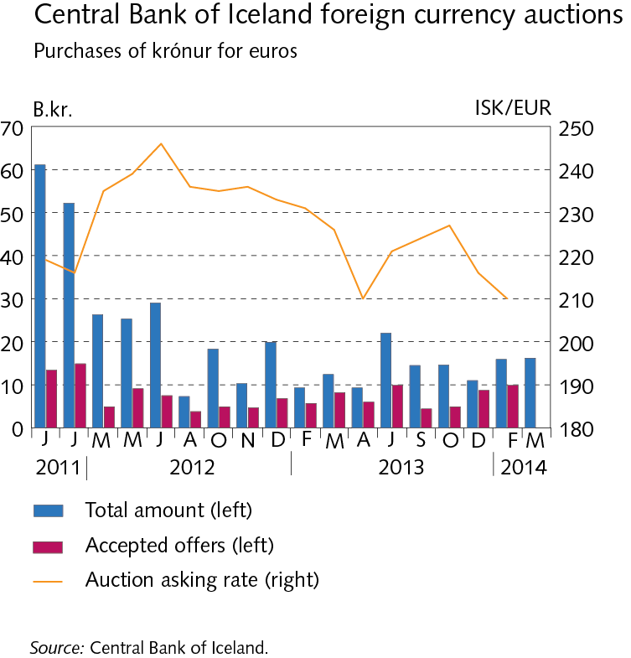
Box II-2

Slide 44
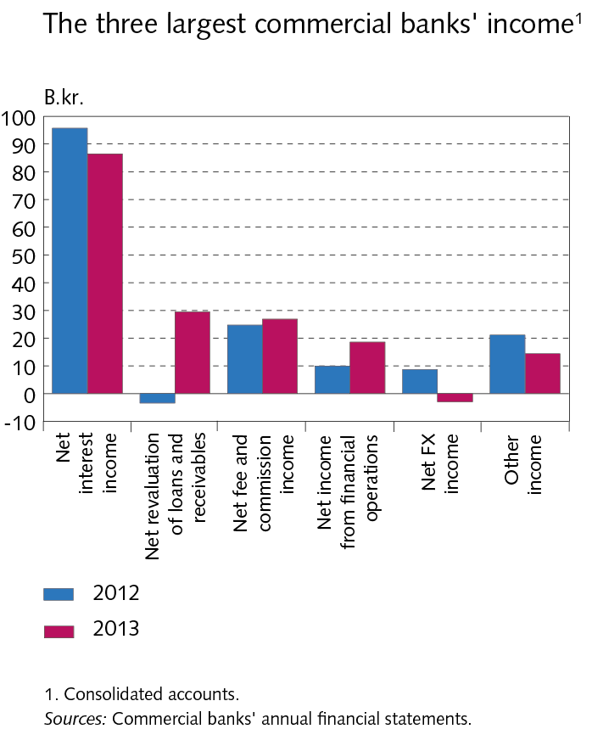
III Operations and equity

Slide 45
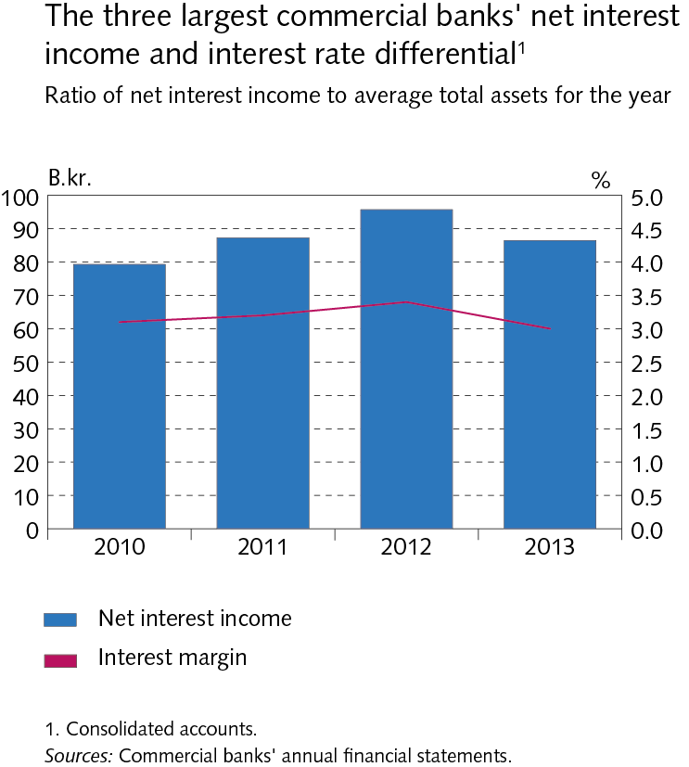
III Operations and equity

Slide 46
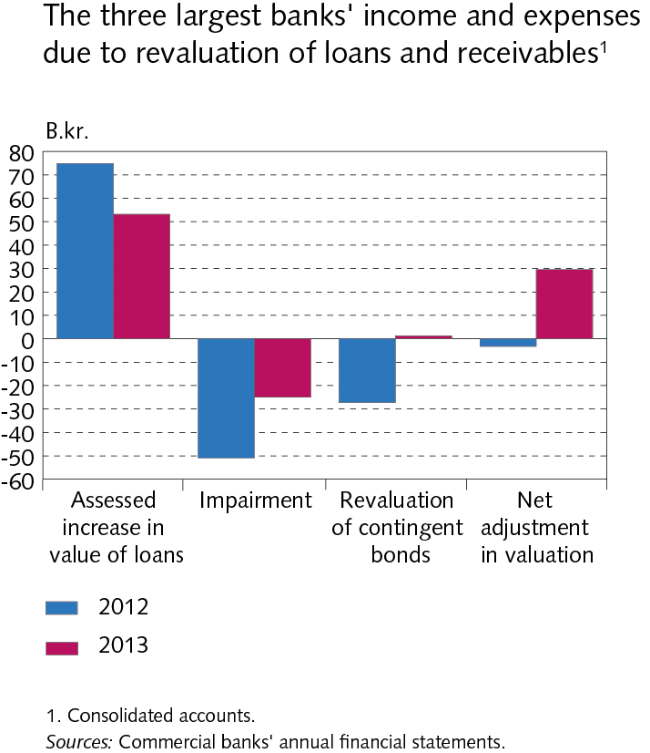
III Operations and equity

Slide 47
III Operations and equity

Slide 48
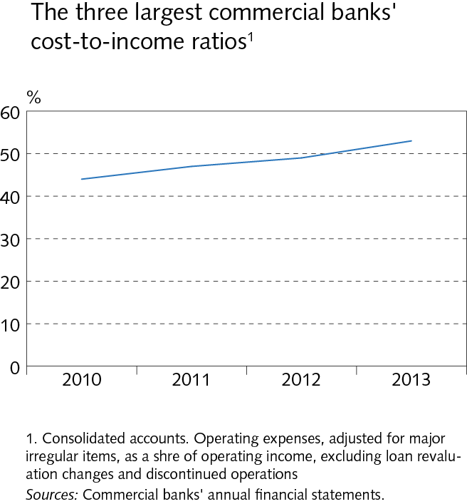
III Operations and equity

Slide 49
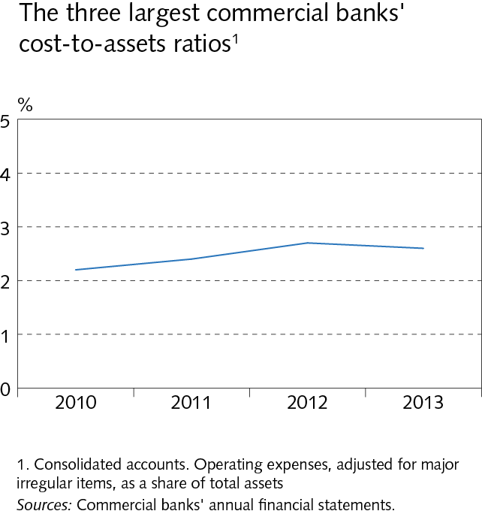
III Operations and equity

Slide 50
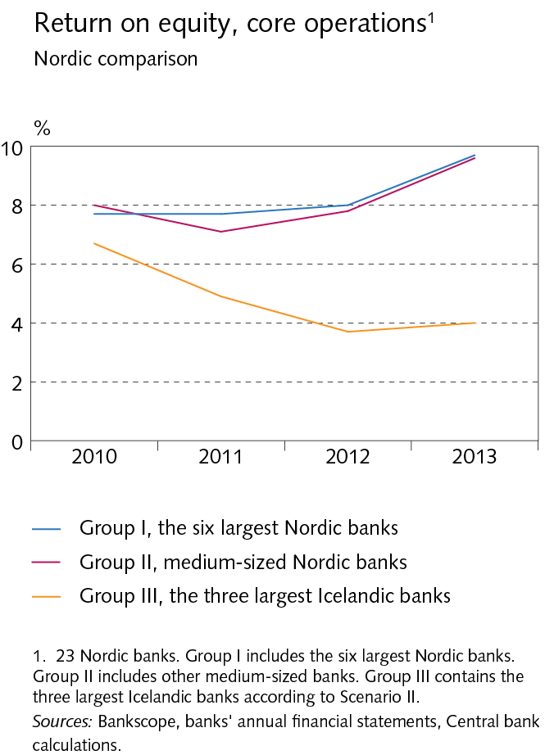
III Operations and equity

Slide 51
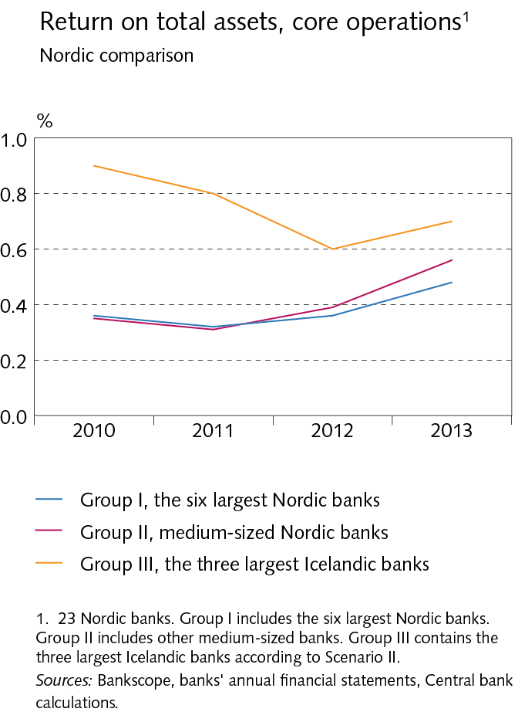
III Operations and equity

Slide 52
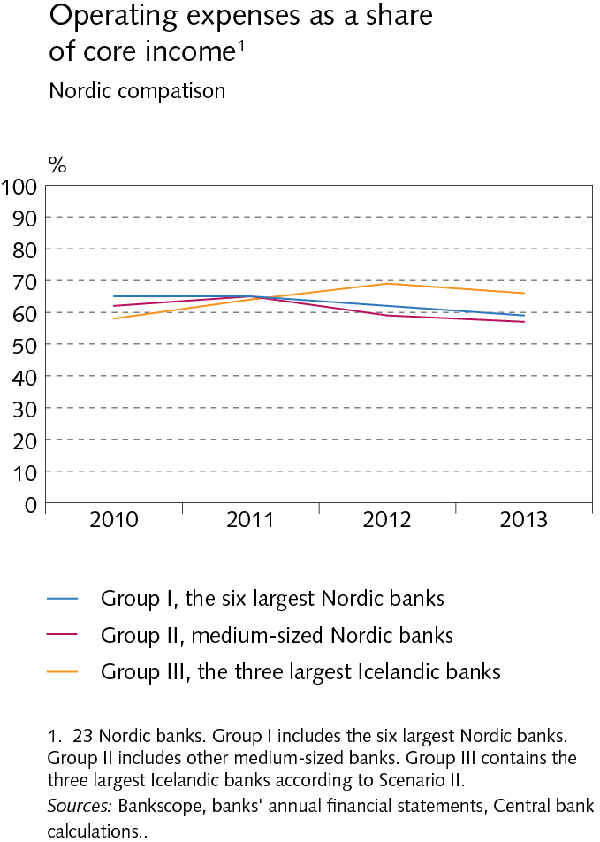
III Operations and equity

Slide 53
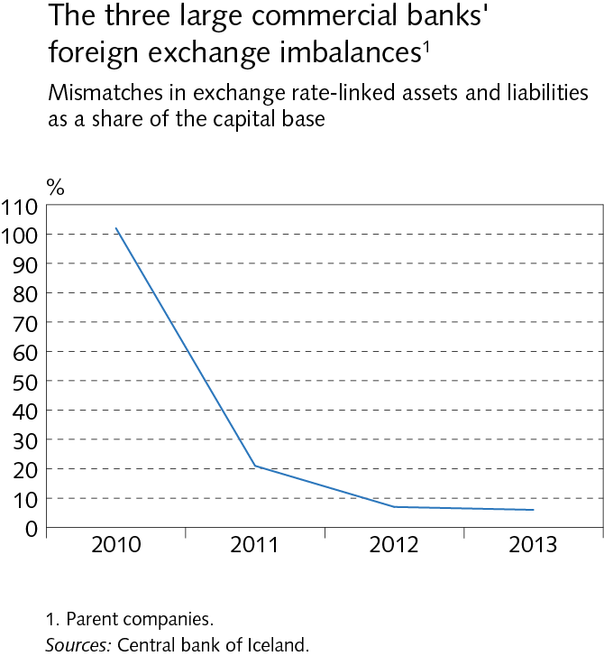
III Operations and equity

Slide 54
III Operations and equity

Slide 55
III Operations and equity

Slide 56
III Operations and equity

Slide 57
Box III-2

Slide 58
Box III-2

Slide 59
IV Funding and liquid funds

Slide 60
IV Funding and liquid funds

Slide 61
IV Funding and liquid funds

Slide 62
IV Funding and liquid funds

Slide 63
IV Funding and liquid funds

Slide 64
IV Funding and liquid funds

Slide 65
IV Funding and liquid funds

Slide 66
IV Funding and liquid funds

Slide 67
IV Funding and liquid funds

Slide 68
IV Funding and liquid funds

Slide 69
IV Funding and liquid funds

Slide 70
V Assets of DMBs and borrowers´ situation

Slide 71
V Assets of DMBs and borrowers´ situation

Slide 72
V Assets of DMBs and borrowers´ situation

Slide 73
V Assets of DMBs and borrowers´ situation

Slide 74
V Assets of DMBs and borrowers´ situation

Slide 75
V Assets of DMBs and borrowers´ situation

Slide 76
V Assets of DMBs and borrowers´ situation

Slide 77
V Assets of DMBs and borrowers´ situation

Slide 78
V Assets of DMBs and borrowers´ situation

Slide 79
V Assets of DMBs and borrowers´ situation

Slide 80
V Assets of DMBs and borrowers´ situation

Slide 81
V Assets of DMBs and borrowers´ situation

Slide 82
V Assets of DMBs and borrowers´ situation

Slide 83
V Assets of DMBs and borrowers´ situation

Slide 84
V Assets of DMBs and borrowers´ situation

Slide 85
V Assets of DMBs and borrowers´ situation

Slide 86
V Assets of DMBs and borrowers´ situation

Slide 87
V Assets of DMBs and borrowers´ situation

Slide 88
V Assets of DMBs and borrowers´ situation

Slide 89
V Assets of DMBs and borrowers´ situation

Slide 90
V Assets of DMBs and borrowers´ situation

Slide 91
V Assets of DMBs and borrowers´ situation

Slide 92
V Assets of DMBs and borrowers´ situation

Slide 93
V Assets of DMBs and borrowers´ situation

Slide 94
V Assets of DMBs and borrowers´ situation

Slide 95
V Assets of DMBs and borrowers´ situation

Slide 96
V Assets of DMBs and borrowers´ situation

Slide 97
V Assets of DMBs and borrowers´ situation

Slide 98
V Assets of DMBs and borrowers´ situation

Slide 99
V Assets of DMBs and borrowers´ situation

Slide 100
V Assets of DMBs and borrowers´ situation

Slide 101
V Assets of DMBs and borrowers´ situation

Slide 102
V Assets of DMBs and borrowers´ situation

Slide 103
V Assets of DMBs and borrowers´ situation

Slide 104
V Assets of DMBs and borrowers´ situation

Slide 105
V Assets of DMBs and borrowers´ situation

Slide 106
V Assets of DMBs and borrowers´ situation

Slide 107
Box V-1

Slide 108
Box V-1

Slide 109
Box V-1

Slide 110
Box V-1

Slide 111
Box V-1

Slide 112
VI Financial market entities

Slide 113
VI Financial market entities

Slide 114
VI Financial market entities

Slide 115
VI Financial market entities

Slide 116
VI Financial market entities

Slide 117
VI Financial market entities

Slide 118
VI Financial market entities

Slide 119
VI Financial market entities

Slide 120
VI Financial market entities

Slide 121
VI Financial market entities

Slide 122
VI Financial market entities

Slide 123
VI Financial market entities

Slide 124
VII Settlement of the failed banks´ estates

Slide 125
VII Settlement of the failed banks´ estates

Slide 126
VII Settlement of the failed banks´ estates

Slide 127
VII Settlement of the failed banks´ estates

Slide 128
VII Settlement of the failed banks´ estates

Slide 129
VII Settlement of the failed banks´ estates

Slide 130
VII Settlement of the failed banks´ estates

Slide 131
Appendix I

Slide 132
Appendix I

Slide 133
Appendix I

Slide 134
Appendix I

Slide 135
Appendix I

Slide 136
Appendix I

Slide 137
Appendix I

Slide 138
Appendix I

Slide 139
Appendix I

Slide 140
Appendix I

Slide 141
Appendix I

Slide 142
Appendix I

Slide 143
Appendix I

Slide 144
Appendix I

Slide 145
Appendix I

Slide 146
Appendix I

Slide 147
Appendix I

Slide 148
Appendix I

Slide 149
Appendix I

Slide 150
Appendix I

Slide 151
Appendix I

Slide 152
Appendix I

Slide 153
Appendix I

Slide 154
Appendix I

Slide 155
Appendix I

Slide 156
Appendix I

Slide 157
Appendix I

Slide 158
Appendix II

Slide 159
Appendix II

Slide 160
Appendix II

Slide 161
Appendix II

Slide 162
Appendix IV

Slide 163
Appendix IV

Slide 164
Appendix IV

Slide 165
Appendix IV

Slide 166
Appendix IV

Slide 167
Appendix IV

