Slide 1
Economy of Iceland 2014
Powerpoint charts

Slide 2
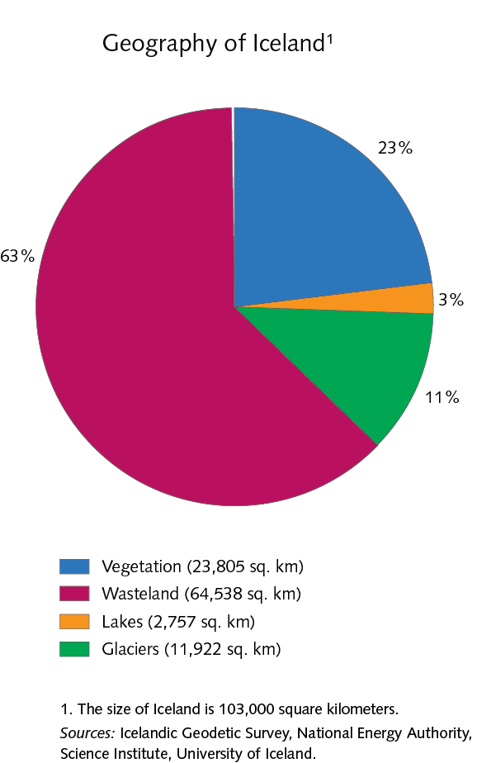
1 Country and people

Slide 3
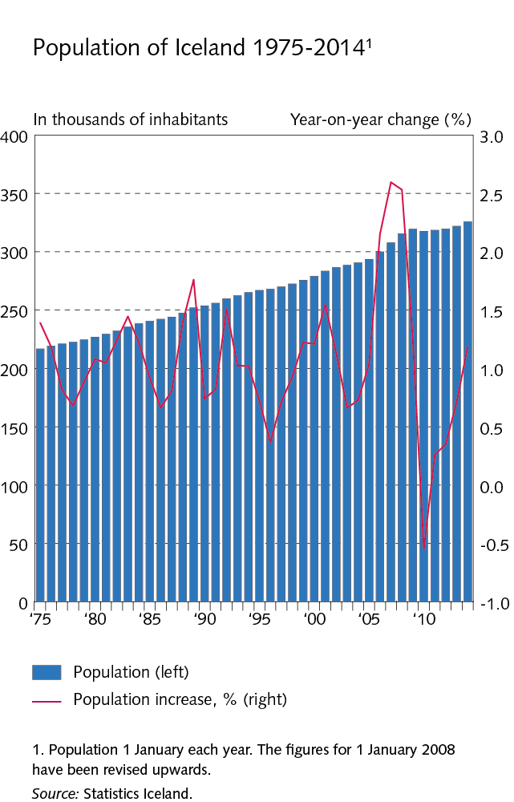
1 Country and people

Slide 4
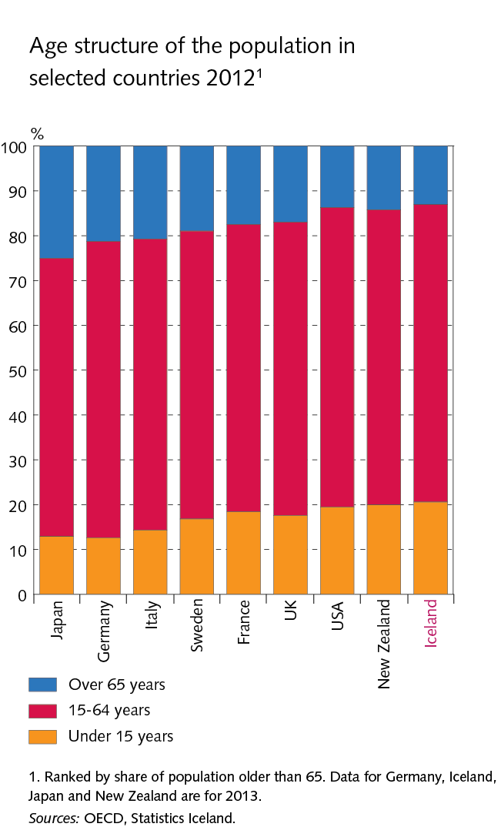
1 Country and people

Slide 5
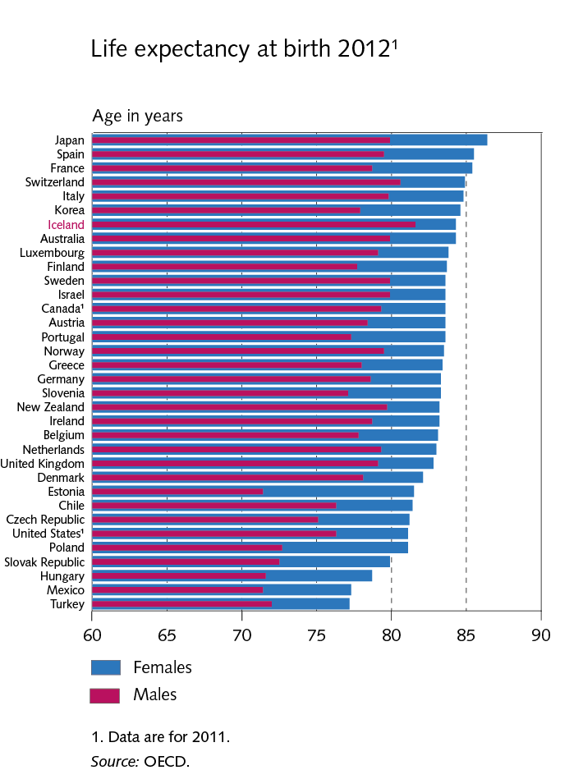
1 Country and people

Slide 6
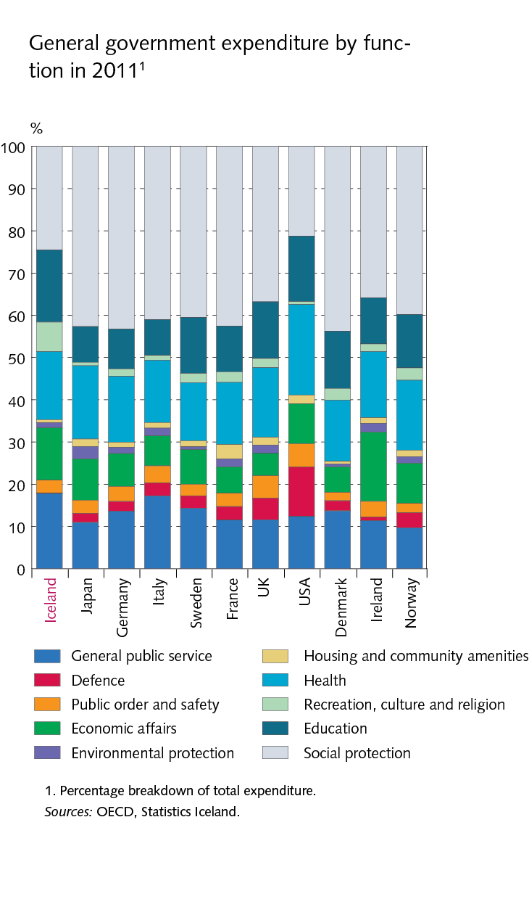
1 Country and people

Slide 7
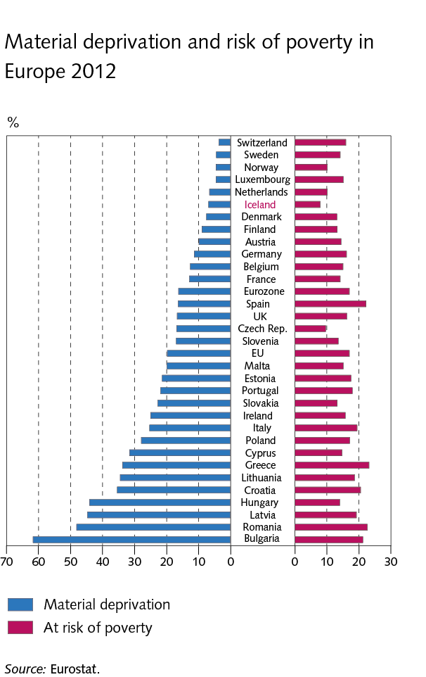
1 Country and people

Slide 8
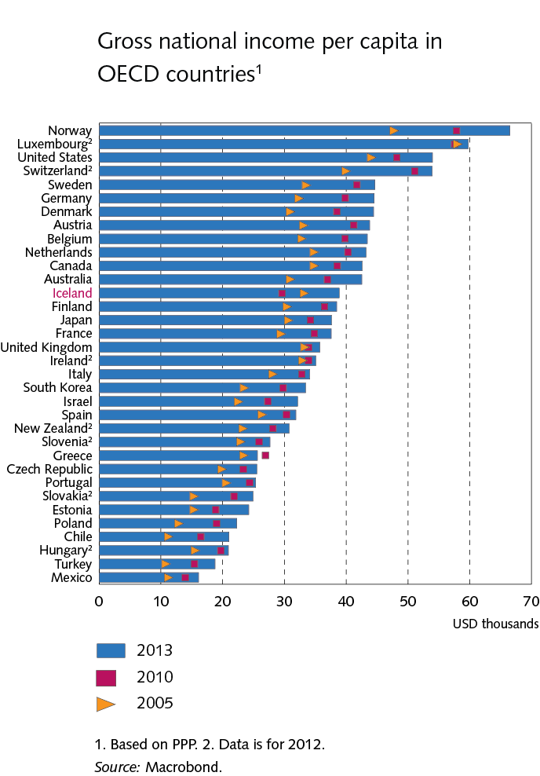
2 Structure of the economy

Slide 9
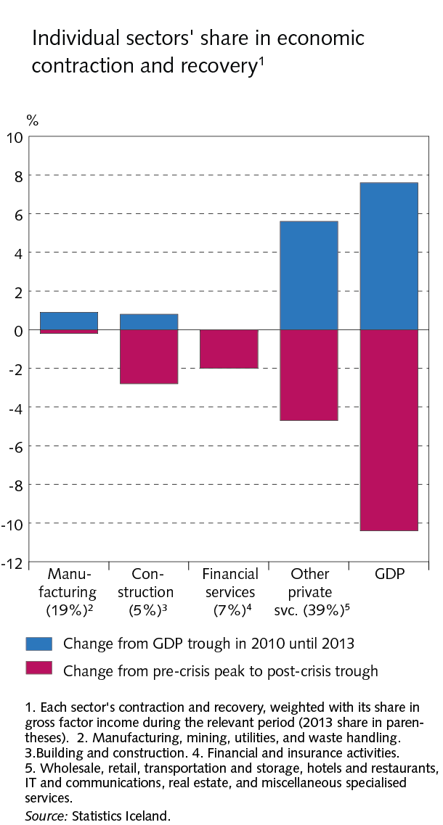
2 Structure of the economy

Slide 10
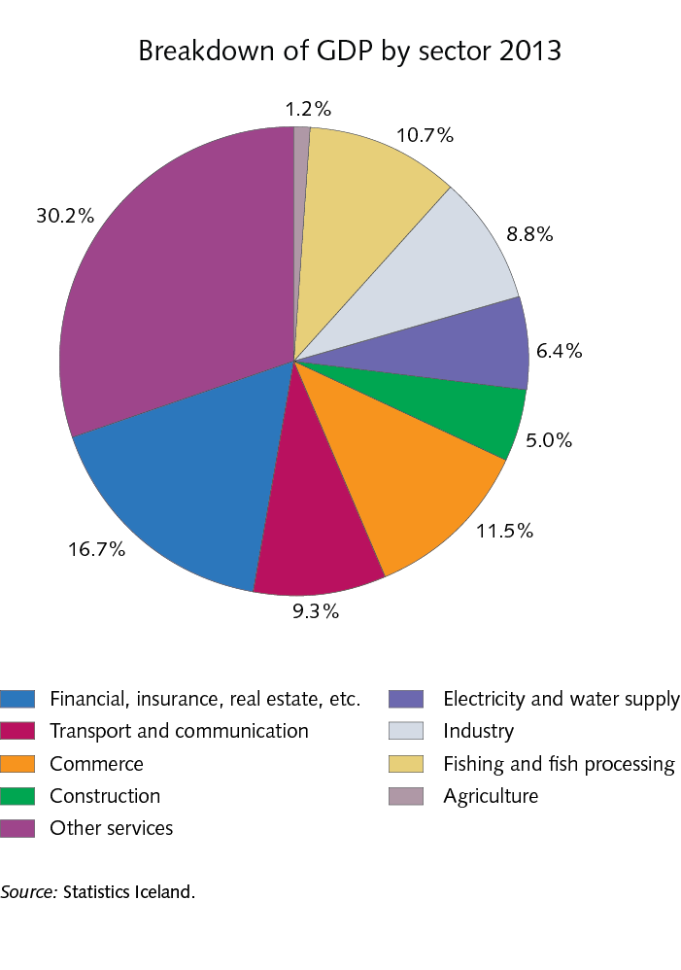
2 Structure of the economy

Slide 11
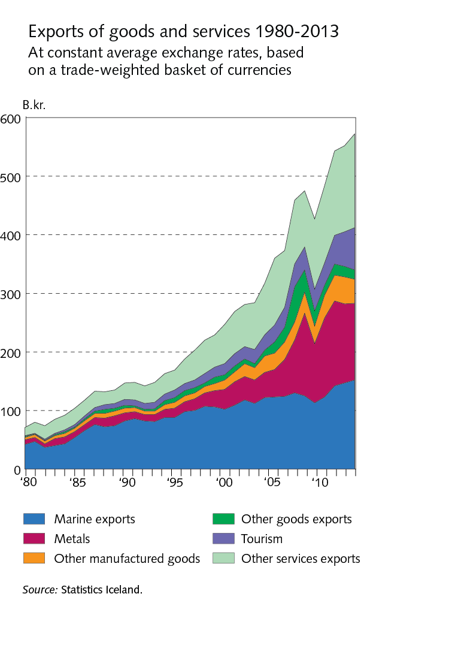
2 Structure of the economy

Slide 12
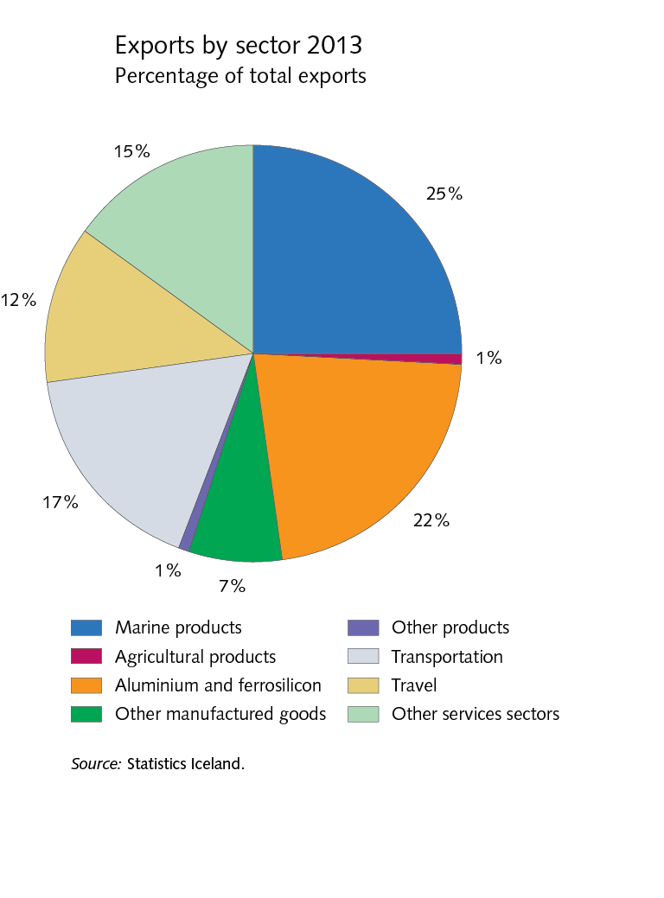
2 Structure of the economy

Slide 13
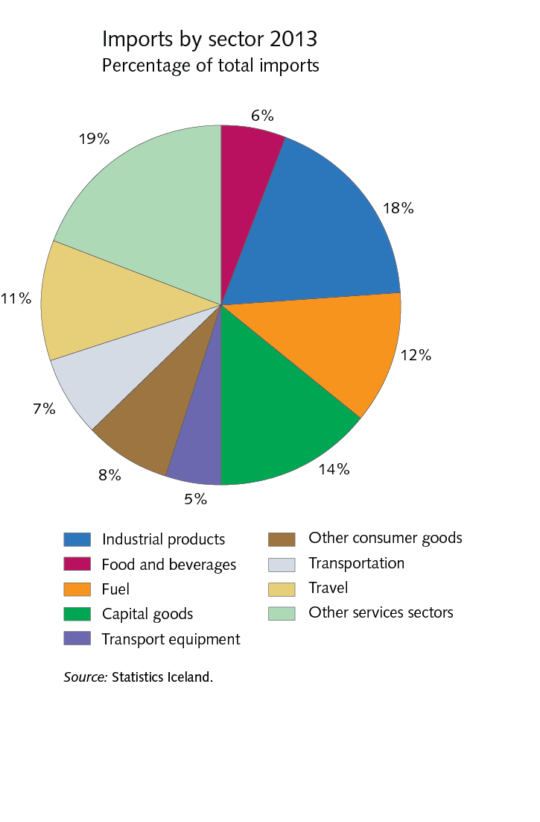
2 Structure of the economy

Slide 14
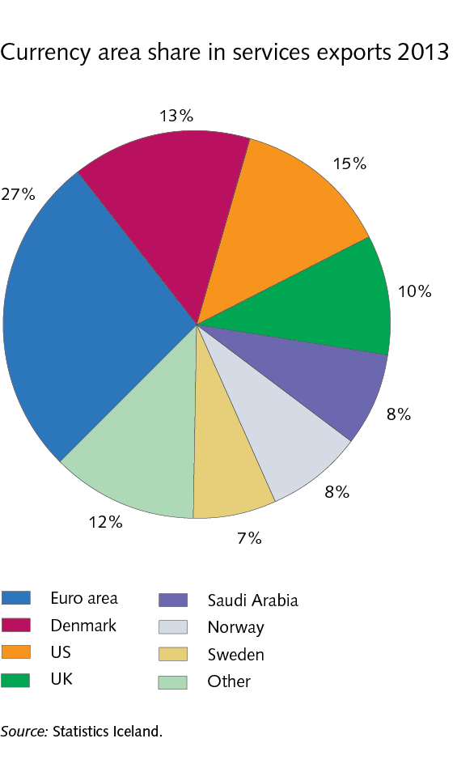
2 Structure of the economy

Slide 15
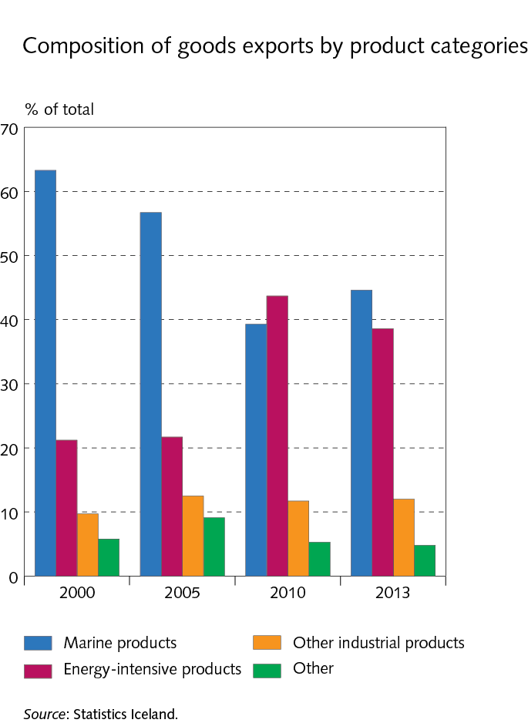
2 Structure of the economy

Slide 16
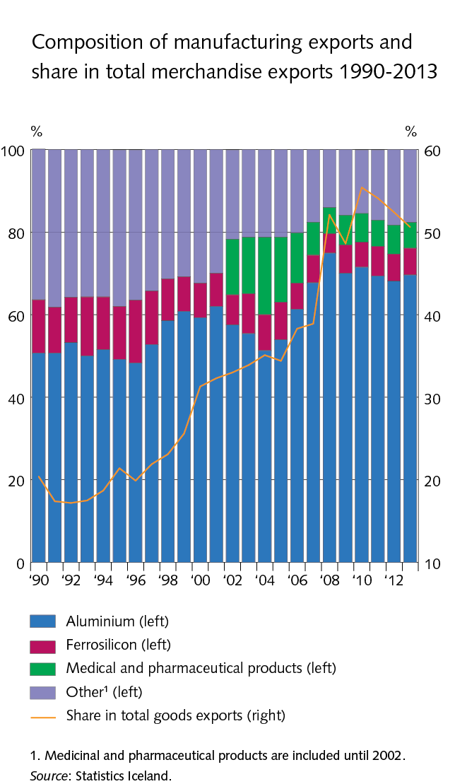
2 Structure of the economy

Slide 17
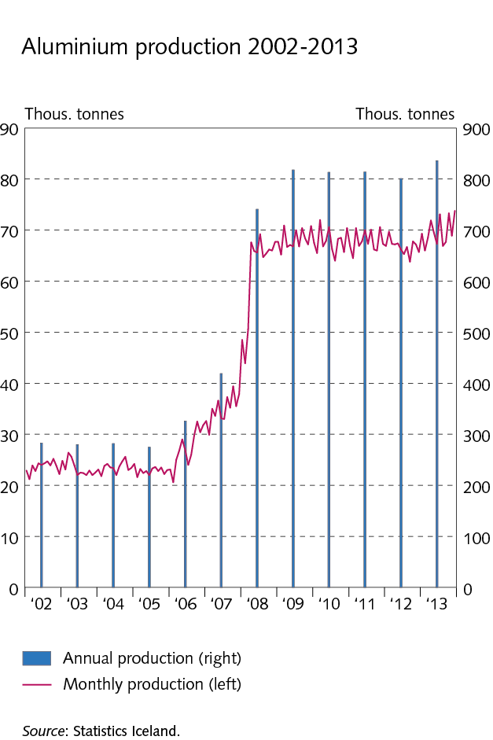
2 Structure of the economy

Slide 18
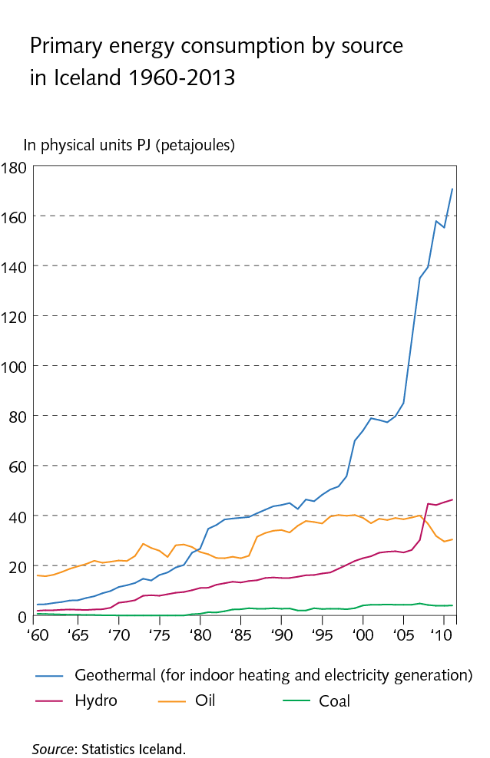
2 Structure of the economy

Slide 19
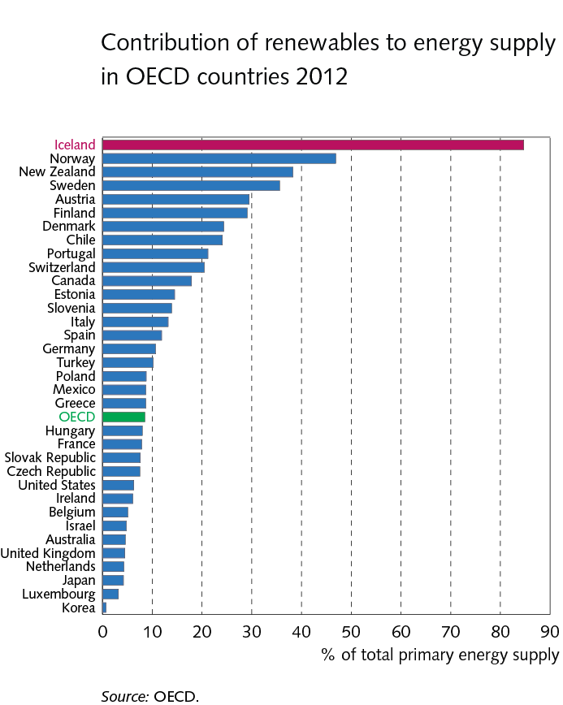
2 Structure of the economy

Slide 20
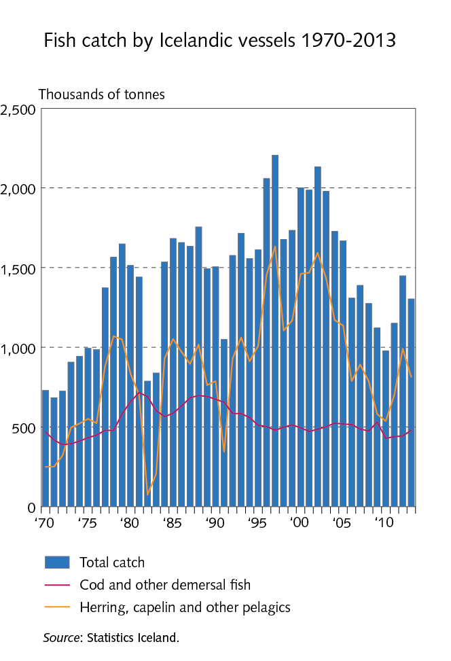
2 Structure of the economy

Slide 21
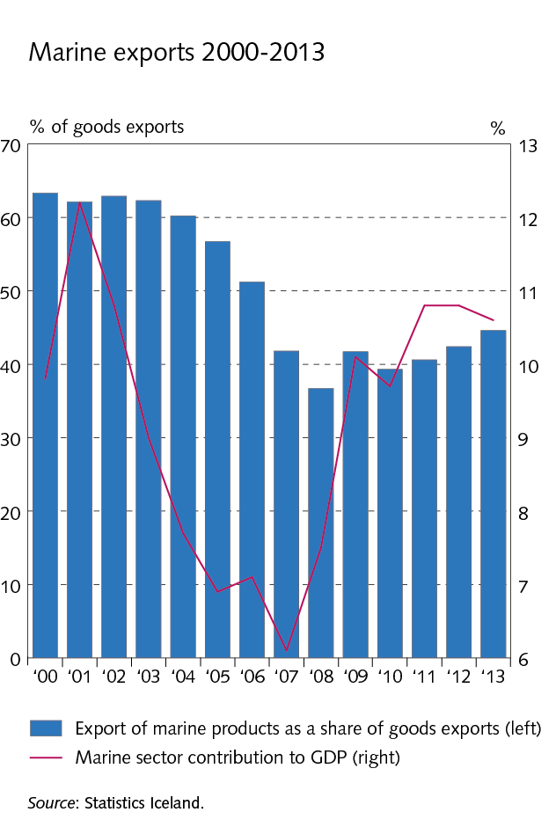
2 Structure of the economy

Slide 22
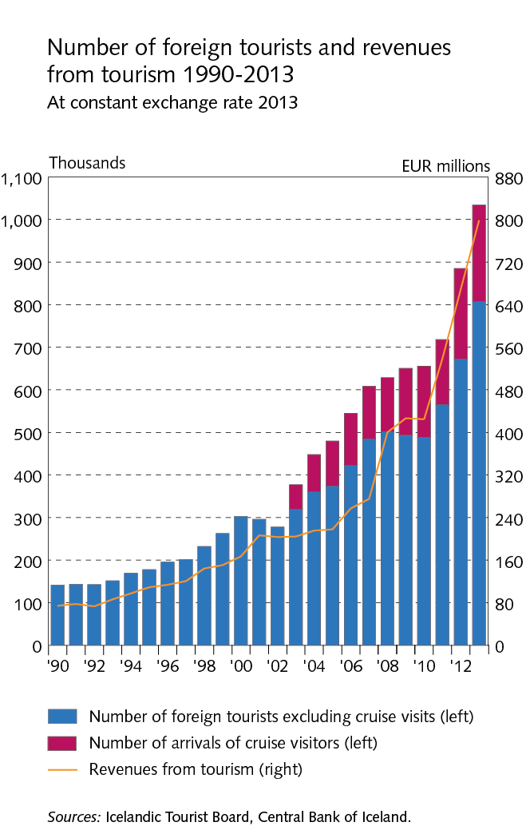
2 Structure of the economy

Slide 23
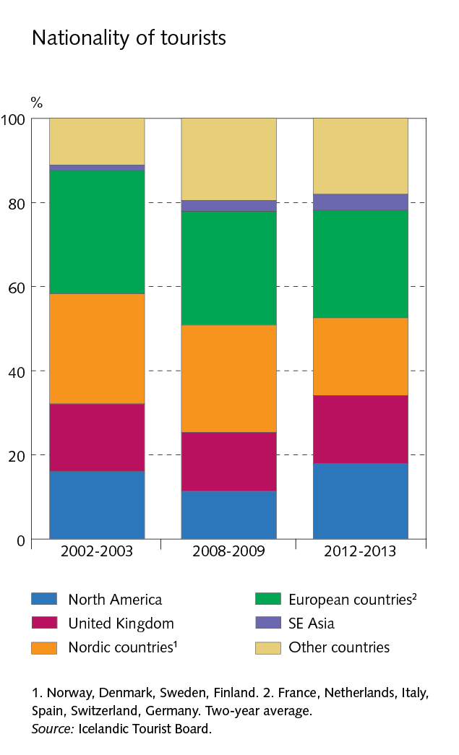
2 Structure of the economy

Slide 24
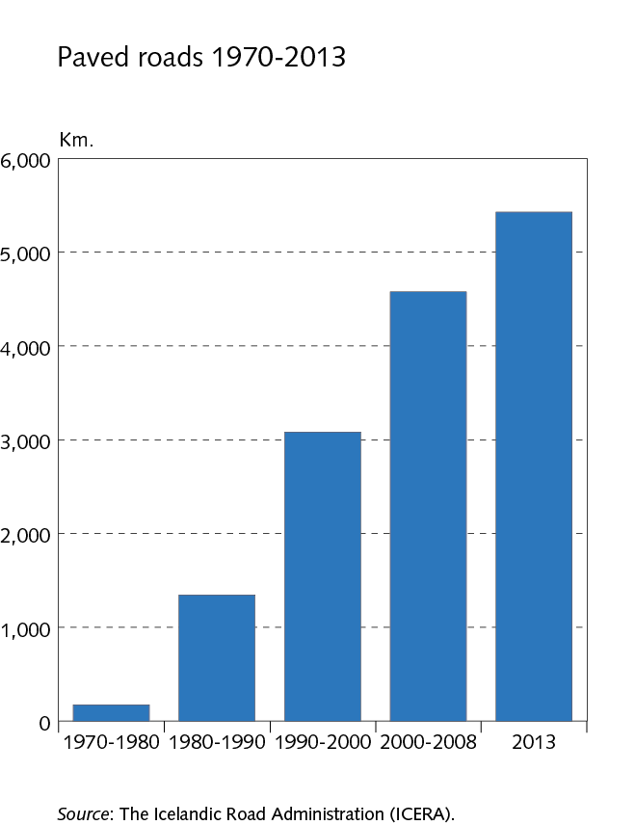
2 Structure of the economy

Slide 25
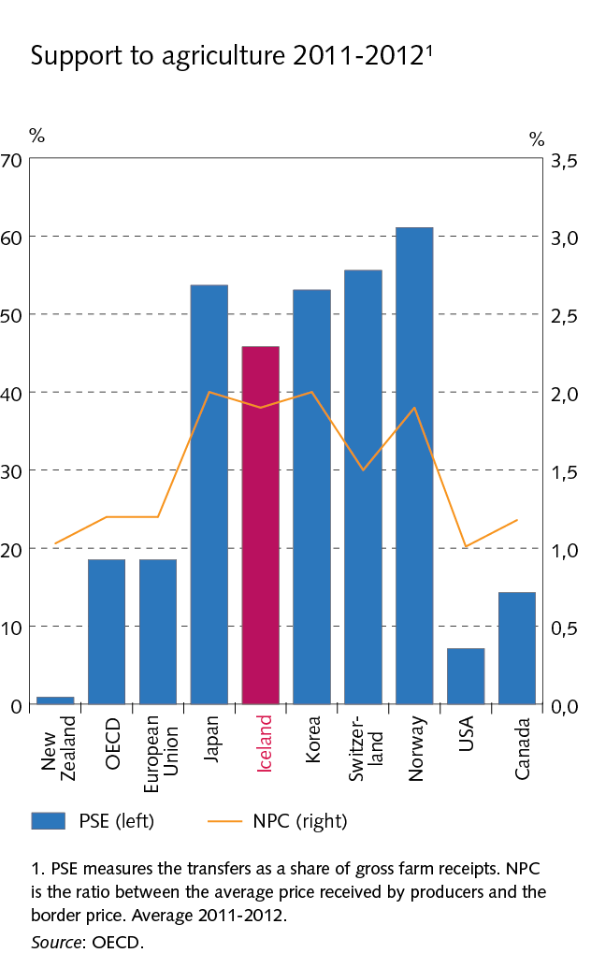
2 Structure of the economy

Slide 26
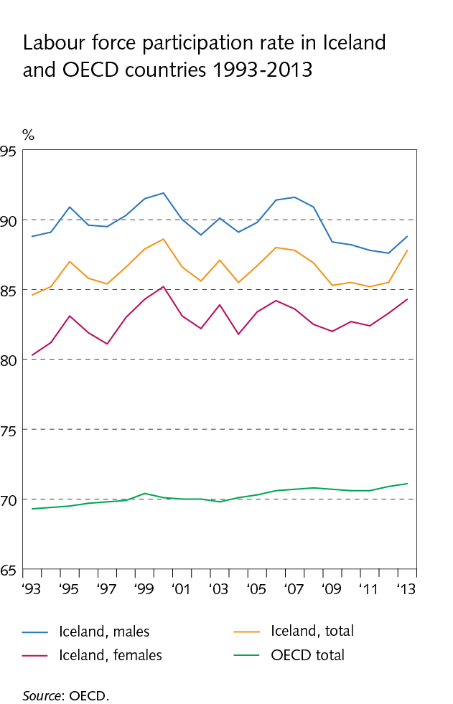
2 Structure of the economy

Slide 27
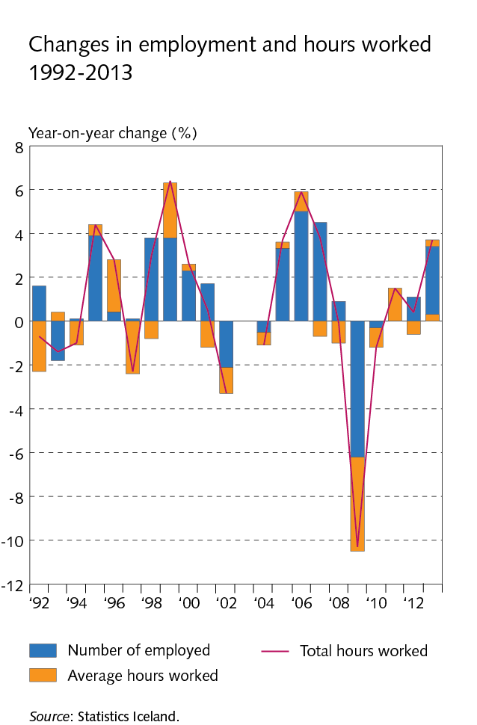
2 Structure of the economy

Slide 28
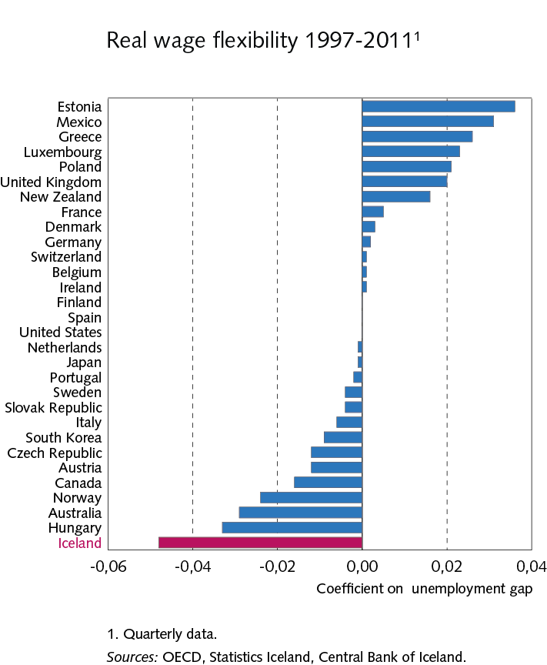
2 Structure of the economy

Slide 29
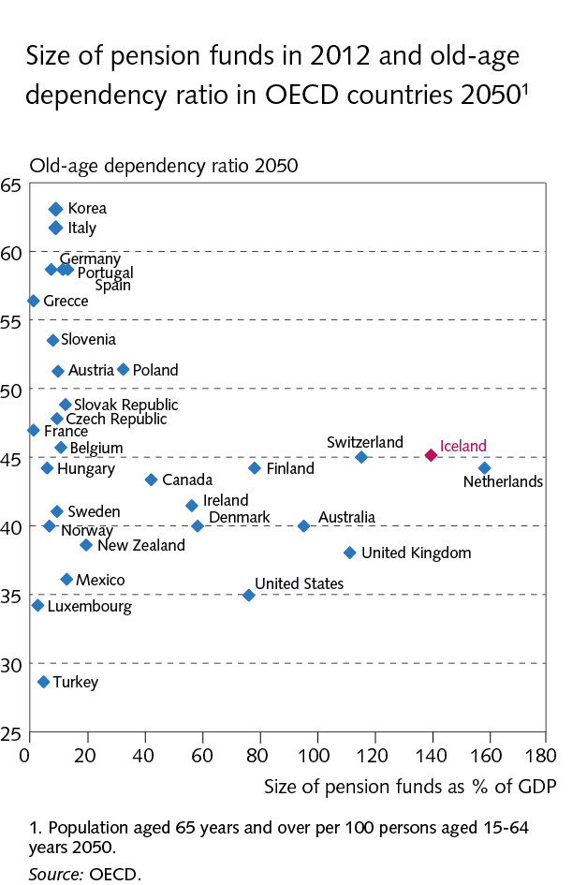
2 Structure of the economy

Slide 30
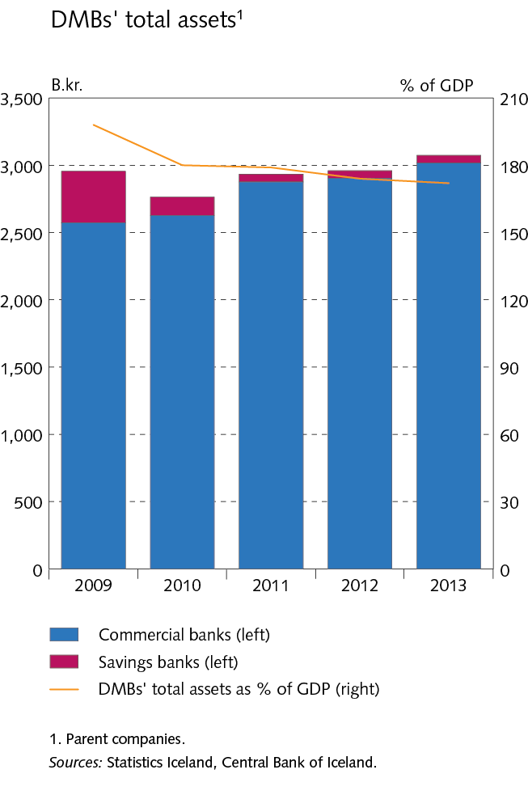
3 Financial system

Slide 31
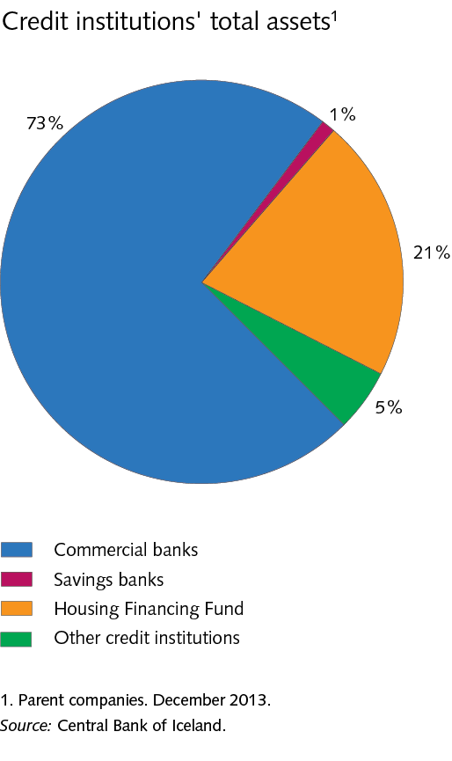
3 Financial system

Slide 32
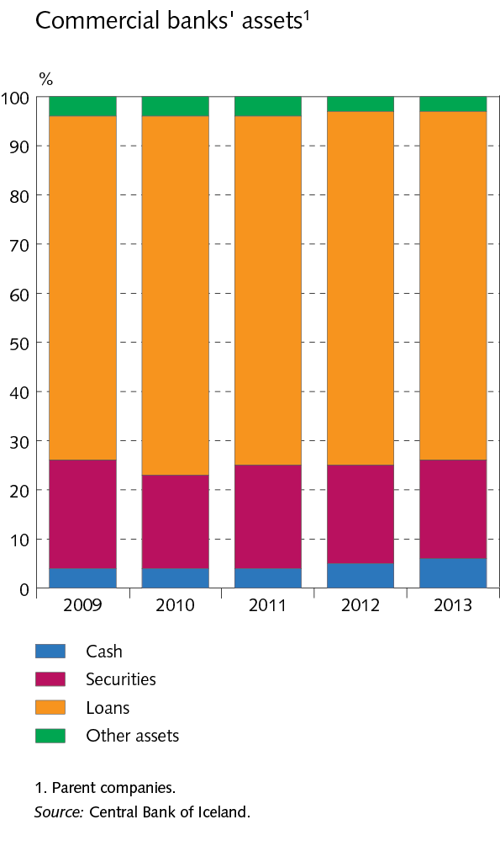
3 Financial system

Slide 33
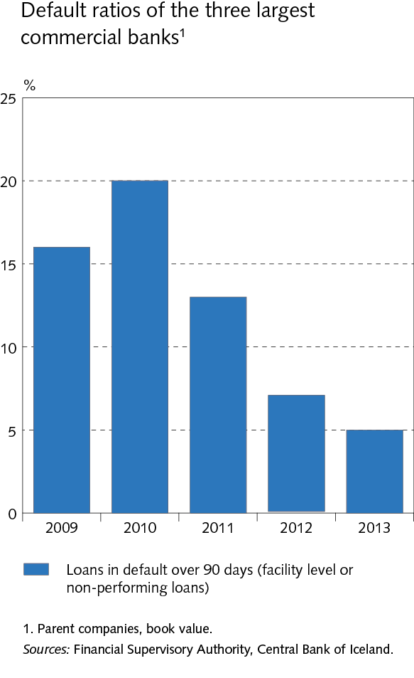
3 Financial system

Slide 34
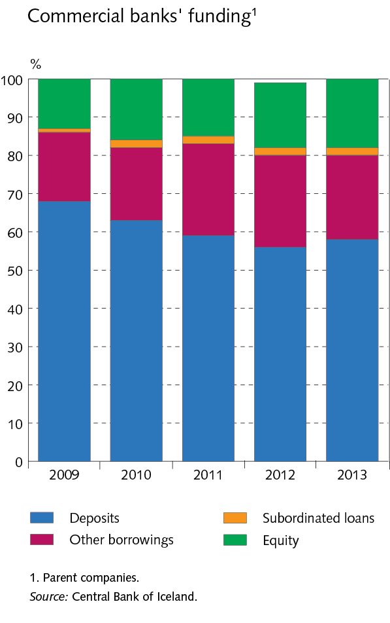
3 Financial system

Slide 35
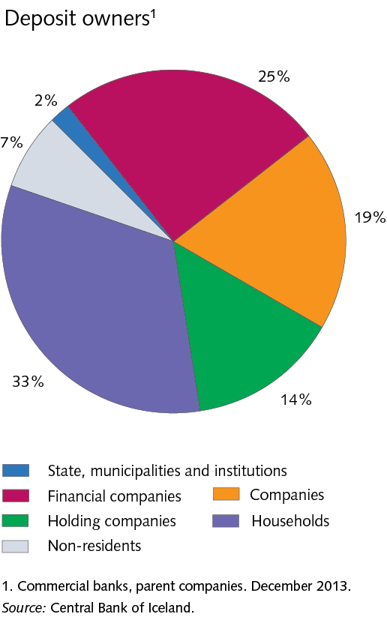
3 Financial system

Slide 36
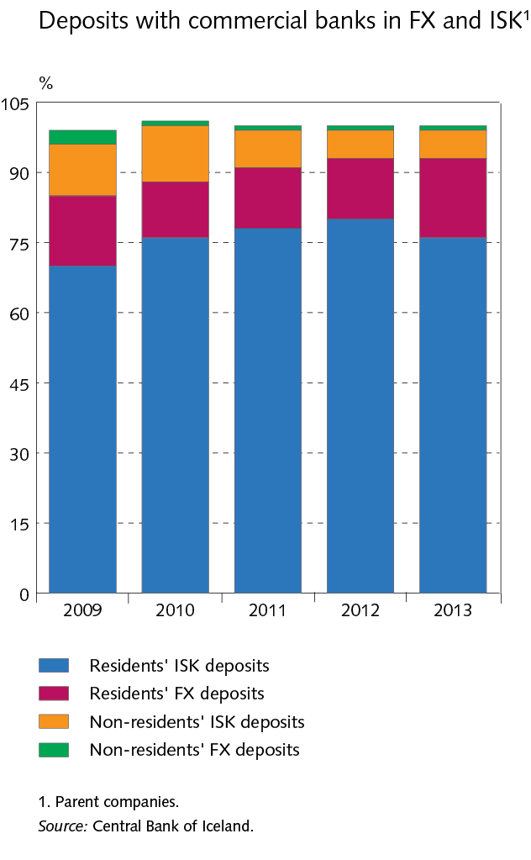
3 Financial system

Slide 37
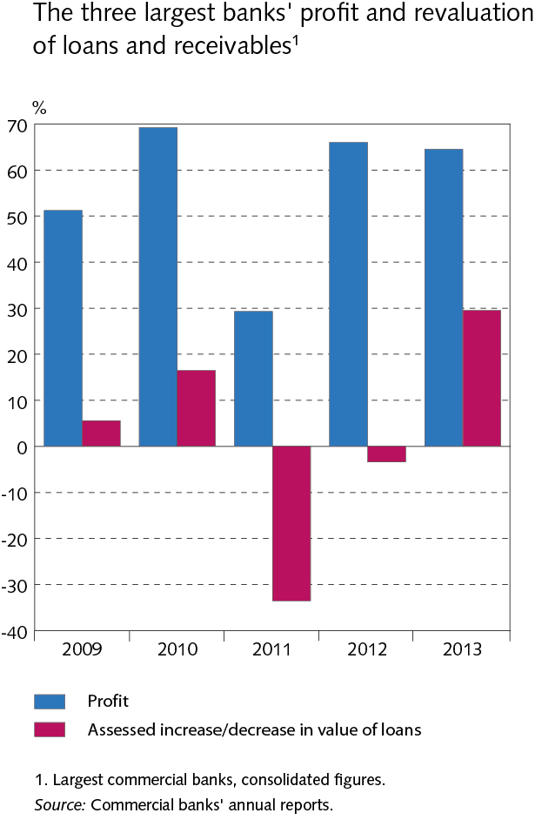
3 Financial system

Slide 38
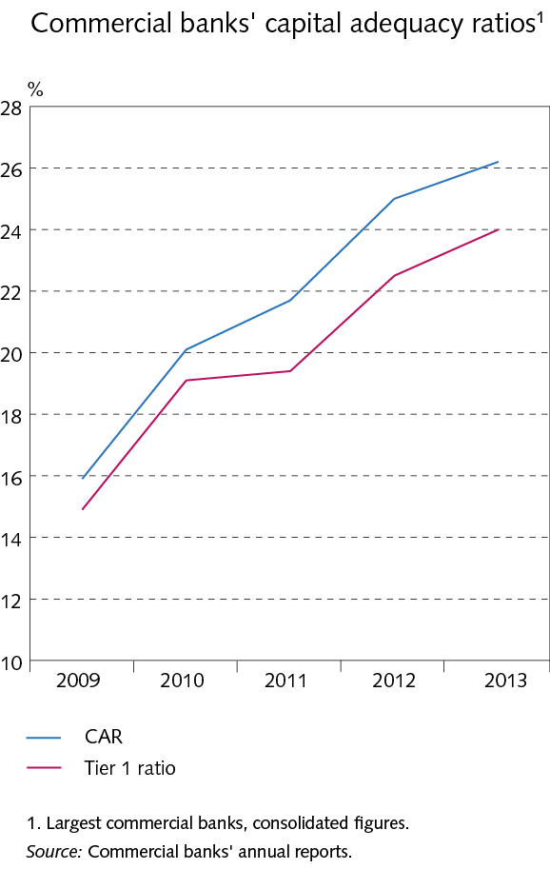
3 Financial system

Slide 39
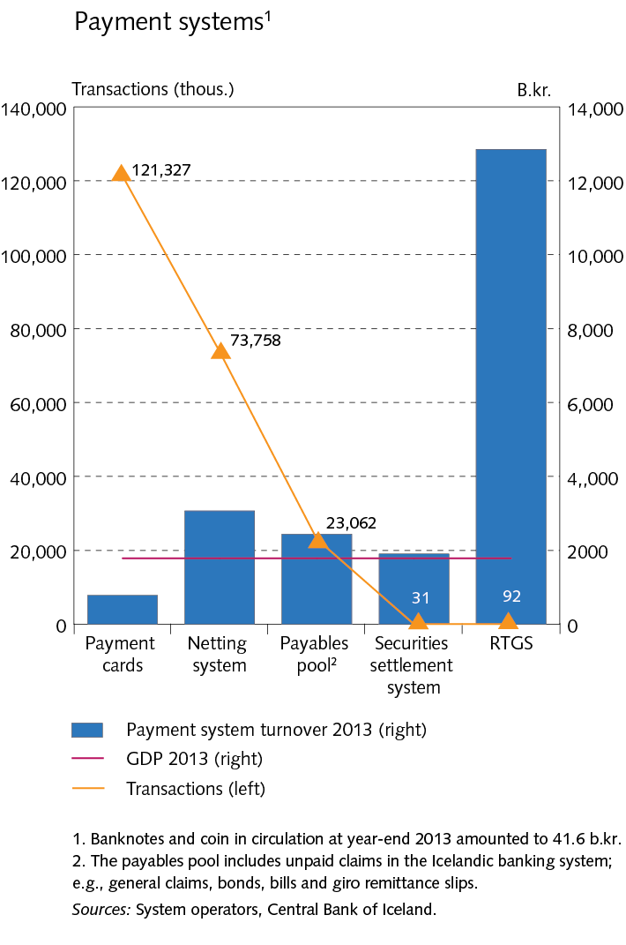
3 Financial system

Slide 40
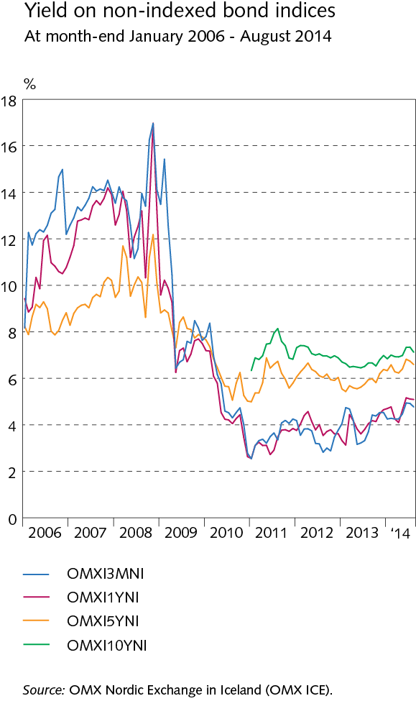
3 Financial system

Slide 41
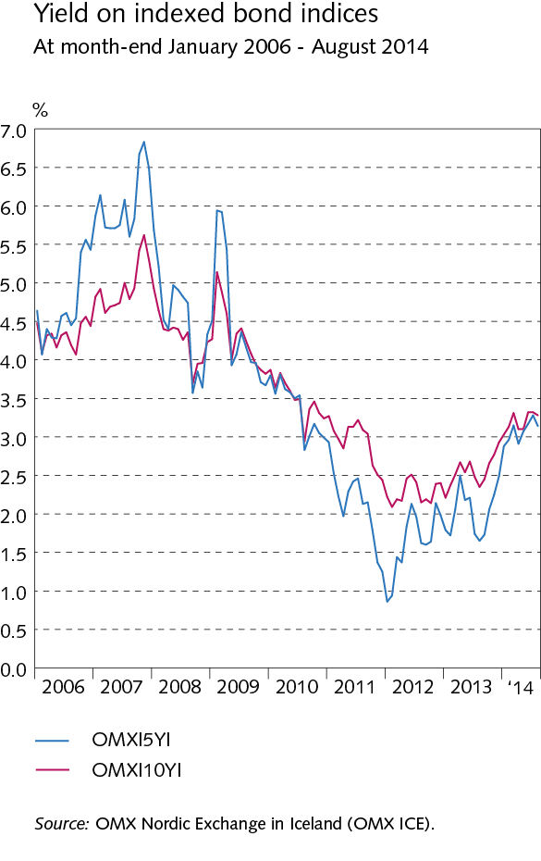
3 Financial system

Slide 42
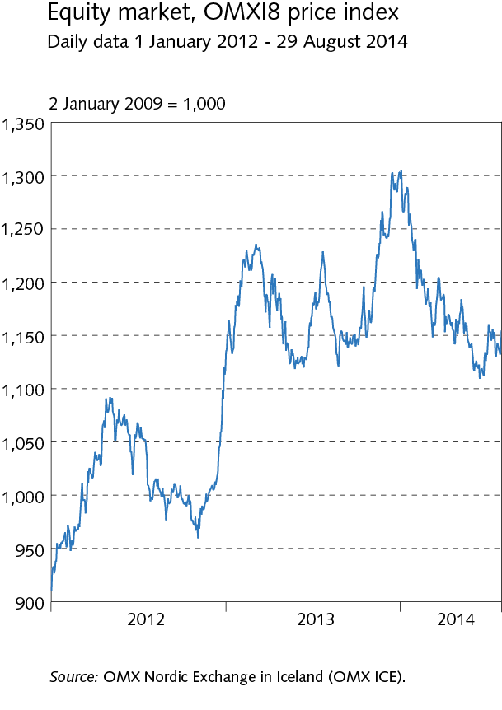
3 Financial system

Slide 43
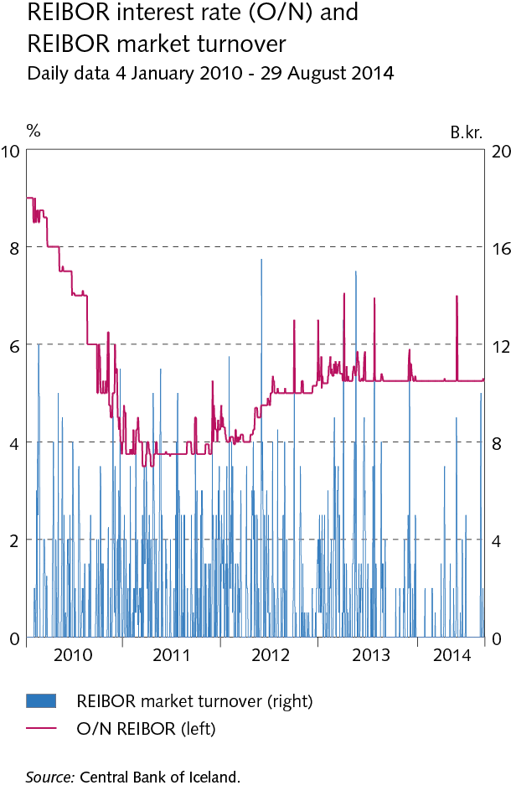
3 Financial system

Slide 44
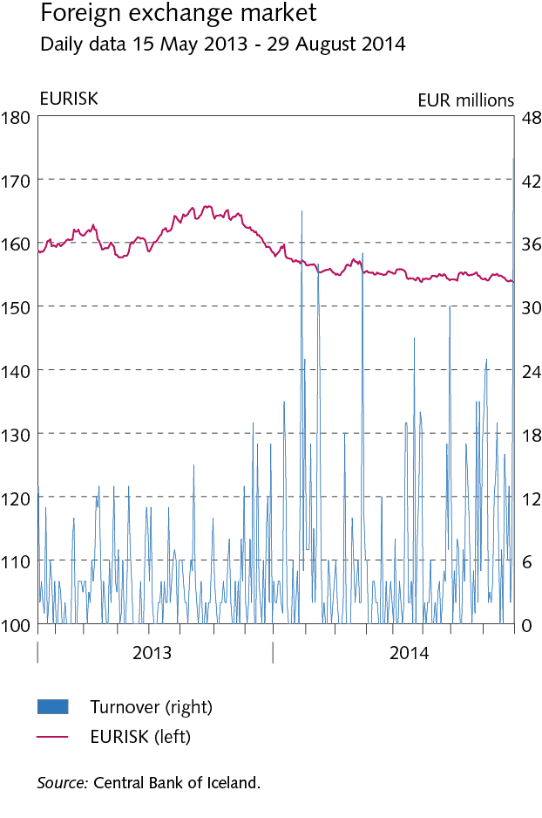
3 Financial system

Slide 45
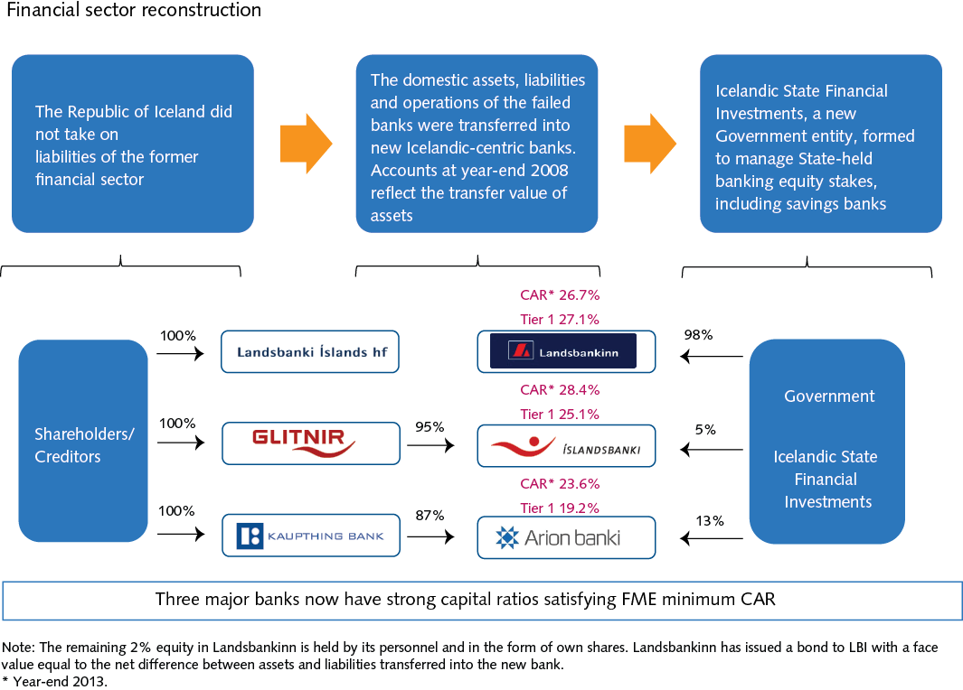
3 Financial system Box 3.1

Slide 46
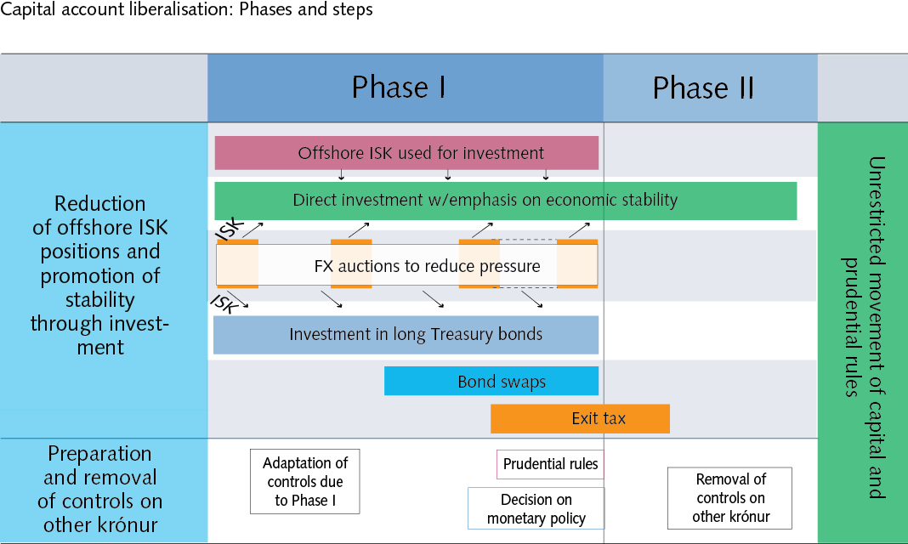
3 Financial system Box 3.2

Slide 47
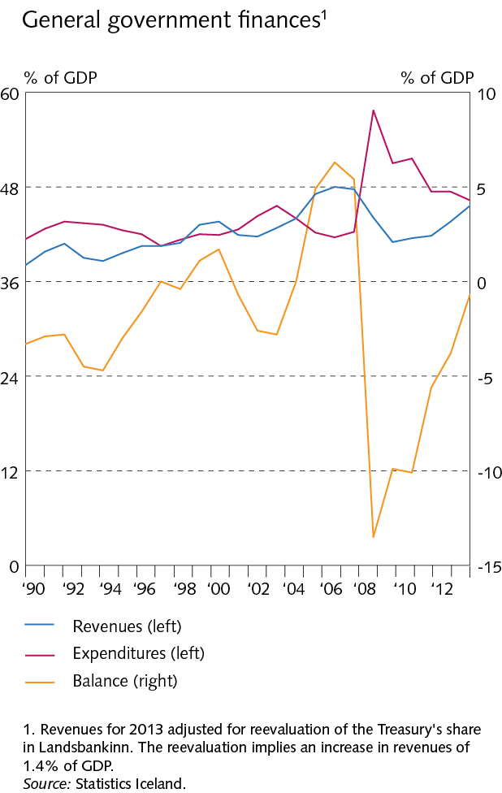
4 Public sector

Slide 48
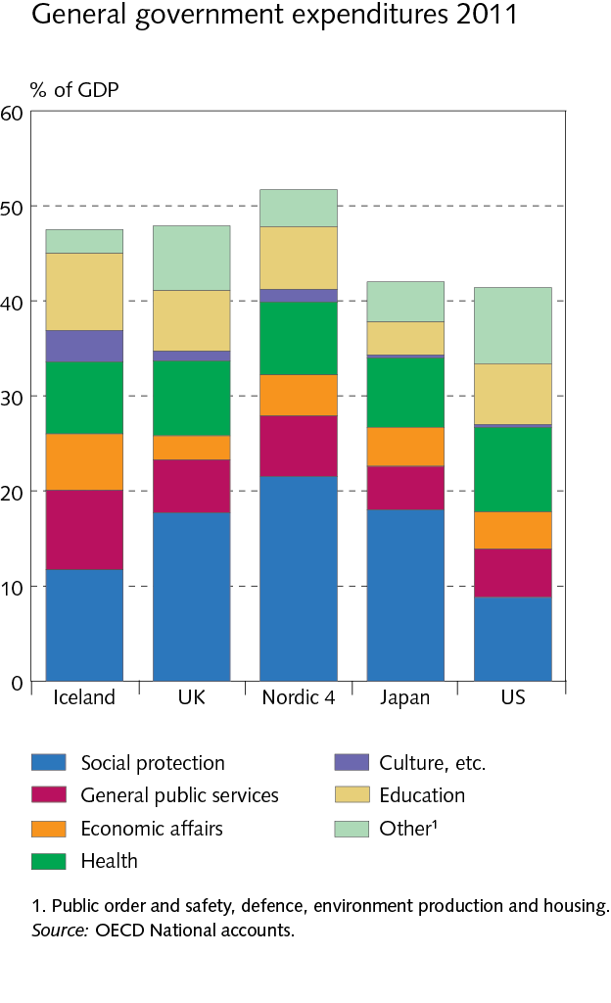
4 Public sector

Slide 49
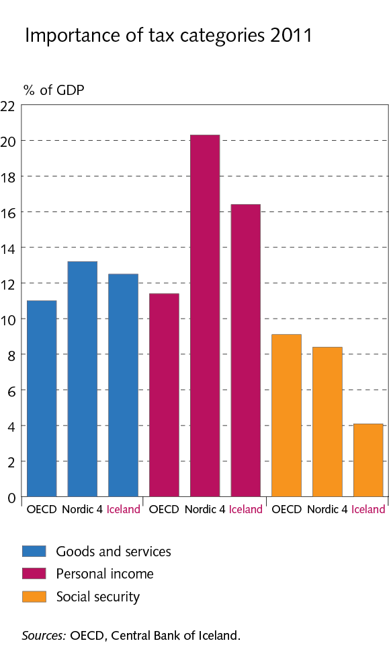
4 Public sector

Slide 50
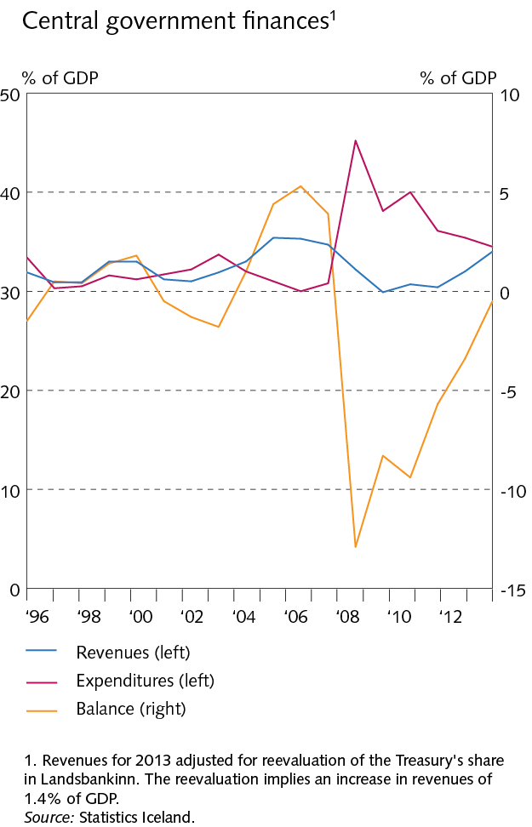
4 Public sector

Slide 51
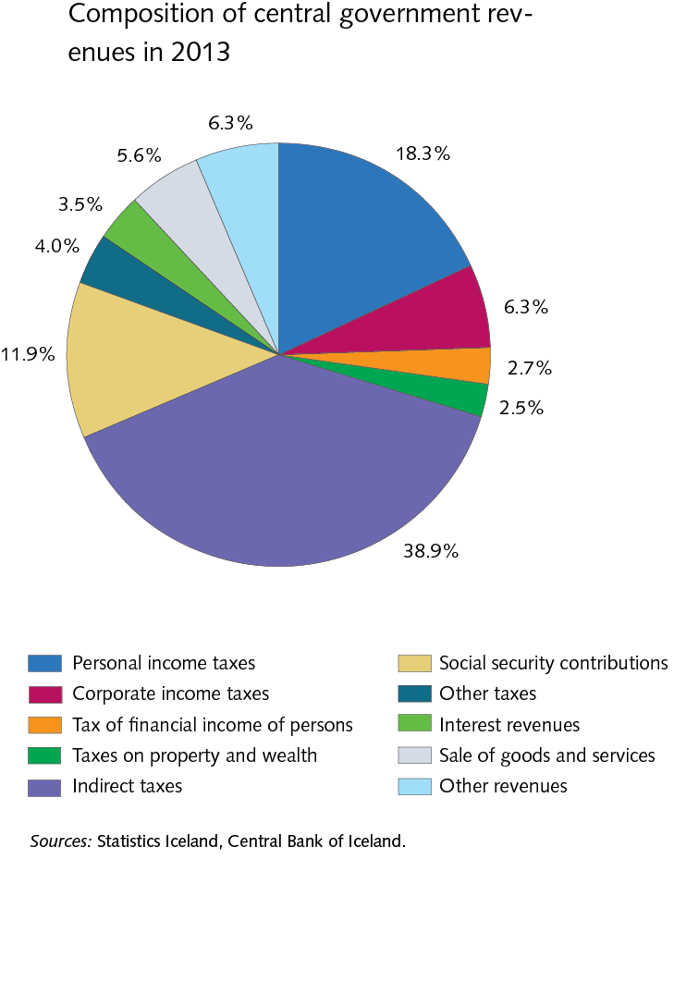
4 Public sector

Slide 52

4 Public sector

Slide 53

4 Public sector

Slide 54

4 Public sector

Slide 55

4 Public sector

Slide 56

4 Public sector

Slide 57

4 Public sector

Slide 58

4 Public sector

Slide 59

5 Monetary and financial stability policies

Slide 60

5 Monetary and financial stability policies

Slide 61

6 External position

Slide 62

6 External position

Slide 63

6 External position

Slide 64

6 External position

Slide 65

6 External position

Slide 66

6 Foreign debt position Box 6.1

Slide 67

7 Government, corporate, and household balance

Slide 68

7 Government, corporate, and household balance

Slide 69

7 Government, corporate, and household balance

Slide 70

7 Government, corporate, and household balance

Slide 71

7 Government, corporate, and household balance

Slide 72

7 Government, corporate, and household balance

Slide 73

7 Government, corporate, and household balance

Slide 74

7 Government, corporate, and household balance

Slide 75

7 Government, corporate, and household balance

