Slide 1
Economy of Iceland 2010
Powerpoint charts

Slide 2
Chapter 1: Recent economic and financial developments

Slide 3
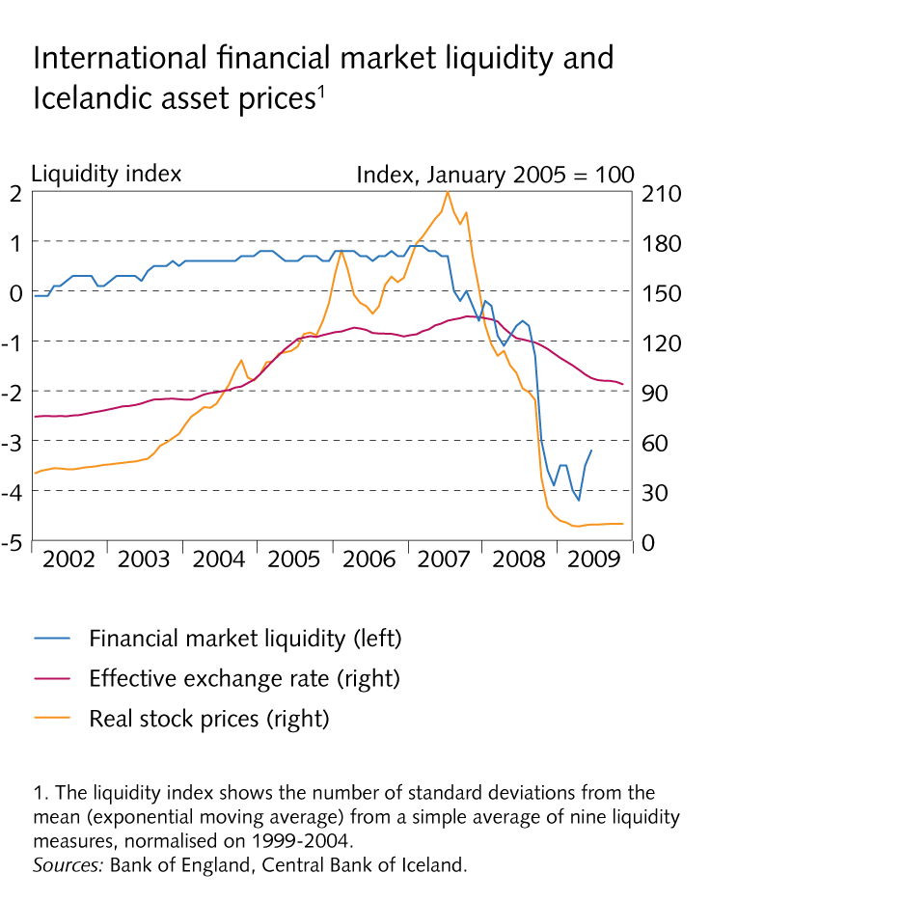
Chapter 1: Recent economic and financial developments

Slide 4
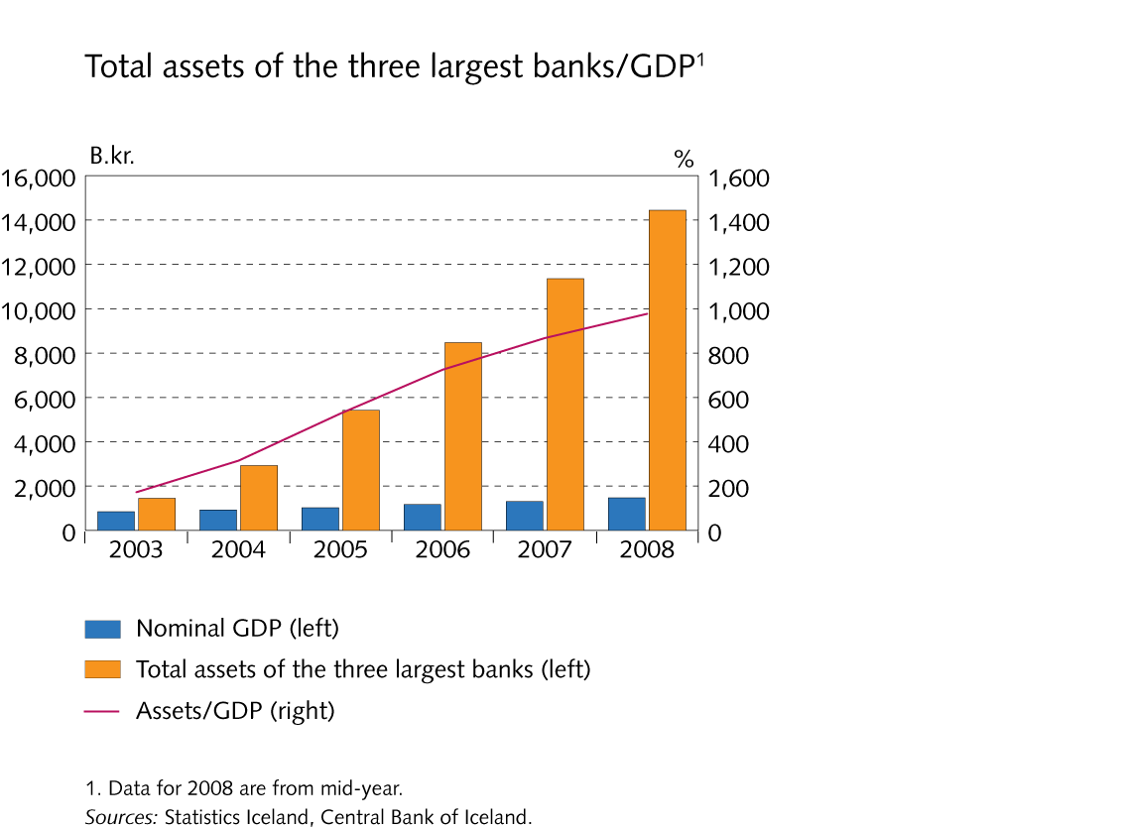
Chapter 1: Recent economic and financial developments

Slide 5
Chapter 1: Recent economic and financial developments

Slide 6
Chapter 1: Recent economic and financial developments

Slide 7
Chapter 1: Recent economic and financial developments

Slide 8
Chapter 1: Recent economic and financial developments

Slide 9
Chapter 1: Recent economic and financial developments

Slide 10
Chapter 1: Recent economic and financial developments

Slide 11
Chapter 1: Recent economic and financial developments

Slide 12
Chapter 1: Recent economic and financial developments

Slide 13
Chapter 1: Recent economic and financial developments

Slide 14
Chapter 2: Country and people

Slide 15
Chapter 2: Country and people

Slide 16
Chapter 2: Country and people

Slide 17
Chapter 2: Country and people

Slide 18
Chapter 2: Country and people

Slide 19
Chapter 2: Country and people

Slide 20
Chapter 2: Country and people

Slide 21
Chapter 3: Structury of the economy

Slide 22
Chapter 3: Structury of the economy

Slide 23
Chapter 3: Structury of the economy

Slide 24
Chapter 3: Structury of the economy

Slide 25
Chapter 3: Structury of the economy

Slide 26
Chapter 3: Structury of the economy

Slide 27
Chapter 3: Structury of the economy

Slide 28
Chapter 3: Structury of the economy

Slide 29
Chapter 3: Structury of the economy

Slide 30
Chapter 3: Structury of the economy

Slide 31
Chapter 3: Structury of the economy

Slide 32
Chapter 3: Structury of the economy

Slide 33
Chapter 3: Structury of the economy

Slide 34
Chapter 3: Structury of the economy

Slide 35
Chapter 3: Structury of the economy

Slide 36
Chapter 3: Structury of the economy

Slide 37
Chapter 3: Structury of the economy

Slide 38
Chapter 3: Structury of the economy

Slide 39
Chapter 4 : The financial system

Slide 40
Chapter 4 : The financial system

Slide 41
Chapter 4 : The financial system

Slide 42
Chapter 4 : The financial system

Slide 43
Chapter 4 : The financial system

Slide 44
Chapter 4 : The financial system

Slide 45
Chapter 4 : The financial system

Slide 46
Chapter 4 : The financial system

Slide 47
Chapter 4 : The financial system

Slide 48
Chapter 4 : The financial system

Slide 49
Chapter 4 : The financial system

Slide 50
Chapter 4 : The financial system

Slide 51
Chapter 4 : The financial system

Slide 52
Chapter 4 : The financial system

Slide 53
Chapter 5 : Public sector

Slide 54
Chapter 5 : Public sector

Slide 55
Chapter 5 : Public sector

Slide 56
Chapter 5 : Public sector

Slide 57
Chapter 5 : Public sector

Slide 58
Chapter 5 : Public sector

Slide 59
Chapter 5 : Public sector

Slide 60
Chapter 5 : Public sector

Slide 61
Chapter 5 : Public sector

Slide 62
Chapter 5 : Public sector

Slide 63
Chapter 5 : Public sector

Slide 64
Chapter 5 : Public sector

Slide 65
Chapter 5 : Public sector

Slide 66
Chapter 5 : Public sector

Slide 67
Chapter 6 : Monetary and financial stability policies

Slide 68
Chapter 6 : Monetary and financial stability policies

Slide 69
Chapter 7 : Foreign debt position

Slide 70
Chapter 7 : Foreign debt position

Slide 71
Chapter 7 : Foreign debt position

Slide 72
Chapter 7 : Foreign debt position

Slide 73
Chapter 7 : Foreign debt position

Slide 74
Chapter 7 : Foreign debt position

Slide 75
Chapter 8 : Government, corporate, and household balance sheets

Slide 76
Chapter 8 : Government, corporate, and household balance sheets

Slide 77
Chapter 8 : Government, corporate, and household balance sheets

Slide 78
Chapter 8 : Government, corporate, and household balance sheets

Slide 79
Chapter 8 : Government, corporate, and household balance sheets

Slide 80
Chapter 8 : Government, corporate, and household balance sheets

Slide 81
Chapter 8 : Government, corporate, and household balance sheets

Slide 82
Chapter 8 : Government, corporate, and household balance sheets

Slide 83
Chapter 8 : Government, corporate, and household balance sheets

Slide 84
Chapter 8 : Government, corporate, and household balance sheets

Slide 85
Chapter 8 : Government, corporate, and household balance sheets

Slide 86
Chapter 8 : Government, corporate, and household balance sheets

